Slide 1
Solar Thermal Energy Generation
Group 7
Andy Bryan (EE), Beau Eason (EE), Rob Giffin (EE), Sean Rauchfuss (EE)
Funded by Progress Energy

Slide 2
Motivation
The world needs new reliable sources of energy
Current energy supply is based mainly on fossil fuels and natural gas which have a limited supply
Finding a new energy source which is renewable, such as solar, would be best
Because of this need a lot of money can potentially made

Slide 3
Project Goals & Objectives
Utilize an energy source which is free and abundant
Be able to store the generated energy as electric potential
Prove that the concept can work with a functioning prototype

Slide 4
Specifications
Accurately track the sun for an entire day
System to weigh no more than 50lbs and require only two people to move
Safely use concentrated solar energy to power a heat engine
Use the output of the heat engine to safely charge battery system

Slide 5
General Overview

Slide 6
Critical Components

Slide 7
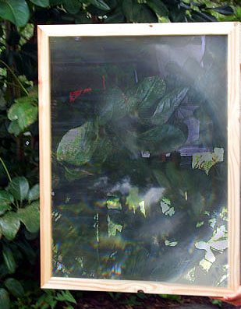
Fresnel Lens
Reach temperature of up to 2000 °F
Requires precise alignment of focal point
Chose a 40”x28” spot lens

Slide 8
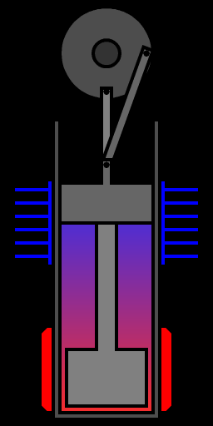
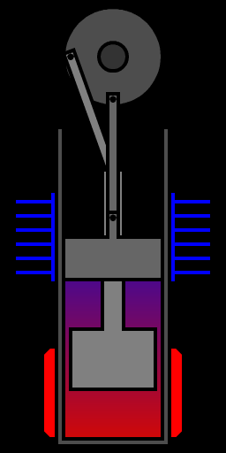
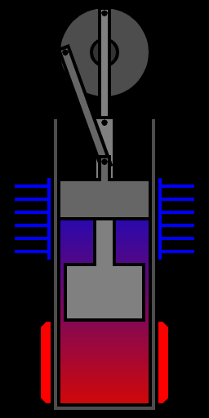
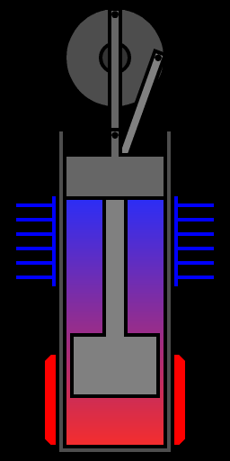
Stirling Engine .
Based on Carnot cycle of
thermodynamics

Slide 9
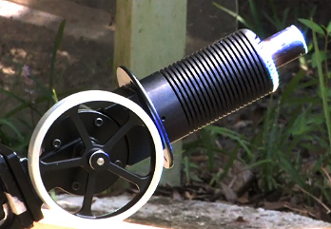
Stirling Engine Choice

Slide 10
Charging Subsytem

Slide 11
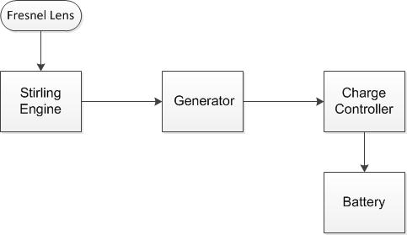
Charging Block Diagram

Slide 12
Criteria for Viable Generator
Permanent Magnet vs Inductive
At least 12v DC output
Low starting torque
Low running torque
Long run time
Withstand heat

Slide 13
Generator Choice
Part number : | 443540 | 130ZYT55CPX144A3 | WBB236691 | 443541
Voltage | 24VDC | 24VDC | 12-24VDC | 24VDC
Current | 1.5A | 45A | 14A | 3A
RPM | 0-5,000 | 21RPM | 1800-3900 | 0-5,000
Width | 150mm | 110mm | 3.16inch | 150mm
Height | 150mm | n/a | 3.16inch | 150mm
Length | 300mm | n/a | 7.38inch | 300mm
Total volume | 6.75mm³ | small | 73.69inch³ | 6.75mm³
Weight | 3.3lb | light | 9lb | 9.2lb
Price | $149.00 | Waiting Reply | $193.95 | $249.00

Slide 14
The Generator We Will Use
Rated up to 24 VDC
Low starting / running torque
Brush permanent magnet
Cost effective

Slide 15
Criteria for Viable Charge Controller
12v charge controller
Max output voltage 13.8
Low input current
Constant current output
High Efficiency
Safety

Slide 16
Charge Controller Choice
Part number : | 461400 | AD2016 | PST-DC/2812-8
Input Voltage | 80VDC Max | 16-40VDC | 10-15VDC
Output Voltage | 13.8V | 1-12VDC | 12V
Input Current | low | <1.8A | low
Output Current | 10A DC max | 6A max | 7.5A
Width | 90mm | 68mm | 200mm
Height | 48mm | 43mm | 164mm
Length | 152mm | 22mm | 67mm
Total volume | 0.655mm³ | 0.064mm³ | 2.1mm³
Weight | 380g | light | 1.5kg
Price | $125.00 | $19.00 | $154.00

Slide 17
AD4012
Input range: 3.5~28VDC (< 1.5Amp)
Output: 1.5~26VDC adjustable, can be higher or lower than input.
Rated 0.8 Amp, max can achieve 3 Amp for a short time.
Size: 5.3 * 3.8 * 1.5cm
Non-load current: 10mA (this number will be different according to different input and output)
Typical Effeciency: 90% (this number will be different according to different input and output)
Working Ambient Temperature: -20 ~ +60℃
Typical Ripple: 100mV p-p (this number will be different according to different input and output)
Overload protect point: 125~180% of rated power
Short circuit protection: No

Slide 18
Batteries
12 volt batteries
Capable of withstanding hot temperatures
At least 5Ah
Deep Cycle for increased usage time
Non explosive
Can be oriented any way we want
low internal Resistance
High Depth of Discharge

Slide 19
Battery Choice
Part number : | LP12-6-F1 | AP-1250F2 | UB1250-D5777
Make: | Leoch | Amstron | Universal Power
Voltage | 12VDC | 12VDC | 12VDC
Max Charge Current | 1.25 A | 1.25 A | 1.25 A
Capacity | 7.2 Ah | 5 Ah | 5 Ah
Power Rating | 72 Whr | 60 Whr | 60 Whr
Terminal Type | F1 | F2 | F2
Op. Temperature | (-)4°to140°F | (-)4°to140°F | (-)4°to140°F
Ambient Temperature | (-)4°to122°F | (-)4°to122°F | (-)4°to122°F
Class | AGM | AGM | AGM
Width | 2.76inch | 3.56inch | 2.76inch
Height | 3.98inch | 2.77inch | 3.98inch
Length | 3.54inch | 3.94inch | 3.54inch
Total volume | 38.8inch³ | 38.8inch³ | 38.8inch³
Weight | 4lb | 4lb | 4.4lb
Price | $19.79 | $17.99 | $15.10

Slide 20
LP12-6-F1
Chemistry Lead Acid
Voltage 12
Capacity 7000 mAh / 7.00 Ah
Rating 84 Whr
Cell 6 cells
Connector F1
Length 5.94 inch / 15.09 cm
Width 2.56 inch / 6.50 cm
Height 3.72 inch / 9.45 cm
Color Gray
Weight 5 lb / 2.27 Kg
Warranty 1 Year

Slide 21
Dual Axis Solar Tracking
Meets accuracy need of lens and engine
Maintains central point where focal will always be
Altitude
Azimuth

Slide 22
Hardware Design

Slide 23
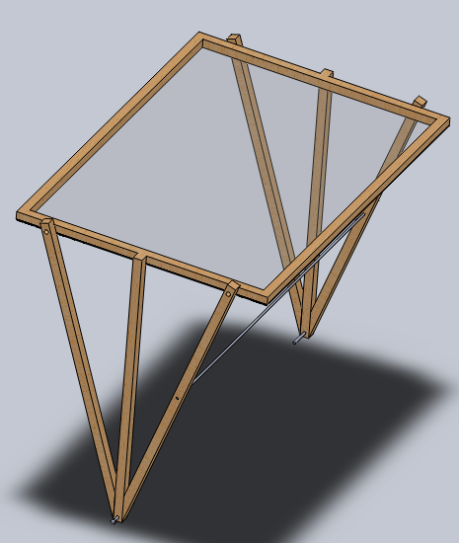
Lens Support Assembly
Contains Lens and Sensor Array
Rotates about Lens focal point (0° - 90°)
Interfaces with an actuator
Pins to Revolving Frame Assembly

Slide 24
Revolving Frame Assembly
Contains Actuator bracket, LSA support arms, and wheels
Rotates about central axis (0° - 360°)
Interfaces with a geared stepping motor on base platform

Slide 25
Base Platform Assembly
Contains Stirling Cycle Heat Engine, Generator, Stepper Motor, Batteries, Control Box
Dual concentric grooves keep wheels on RFA aligned properly

Slide 26
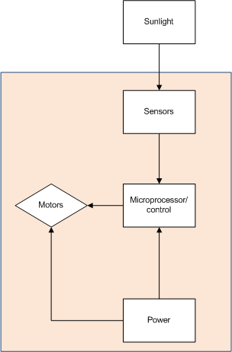
Control Subsystem

Slide 27
Solar Sensing
Sunlight
Photo detector
To control system
Block diagram of how sunlight is communicated to the control system
Altitude Up
Sensor A
Sensor B
Azimuth Left
Azimuth Right
Sensor C
Sensor D
Altitude Down
The finalized design of the solar tracking sensor array.

Slide 28
Light Detectors Choice
 | Cost | Key Advantage | Major disadvantage
LED | $.50 | No supply voltage needed
LDR | $1.50 | No supply voltage needed | Inaccurate
Photodiode | $.75-$3.00 | Purpose built for light detection | Most require supply voltage
Small PV cell | $5.65 | No supply voltage needed | Size and cost

Slide 29
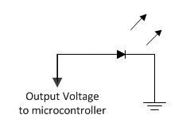
Using LEDs as Light Detectors
No input voltage required
Output
Direct sunlight=1.5V
Partial sunlight=0.6V
Ambient Light=.02V

Slide 30
Control System Overview

Slide 31
Microcontroller Choice
Microcontroller | Cost | Input Voltage | I/O Pins | Footprint | Communicates with computer | Greatest advantage
Arduino Nano | $47.19 | 7-12 | 14 | 0.73”x1.70” | USB mini | Common with lots of online support
TI MSP430 | $4.30 | 1.8-3.6 | variable | 0.25”x0.3” | USB | Cheap, low input voltage
68HC11 | unavailable | 4.5-5.5 | 38 | 2.4”x0.5” | USB | Not applicable
Circuitry | $50 | ~5 | Any | 2.4”x2.4” | n/a | Meets technical objective

Slide 32
Software
During most of the operation cycle no control will be needed
This allows us to utilize the MSP430’s low power modes (LMPX)
An internal clock will be used for the delay between sensor reads

Slide 33
Low Power Modes
Mode | CPU | Mclock | SMclock | Aux. Clock | Oscillators
Active | Active | Active | Active | Active | Active
LMP0 | Off | Off | Active | Active | Active
LMP1 | Off | Off | Active | Active | Active (for LF oscillator and CLKIN as source, HF oscillator is mapped to LF oscillator as source)
LMP2 | Off | Off | Off | Active | Active
LMP3 | Off | Off | Off | Active | Active (for LF oscillator and CLKIN as source, HF oscillator is mapped to LF oscillator as source)
LMP4 | Off | Off | Off | Off | Off

Slide 34
Stepper Motors
Stepper motors | Torque oz-in | Current amps | Price $ | Weight lbs | Torque/ Price | Torque/ Weight | Shaft radius
HT23-180-8 | 180 | 2 | 29.95 | 1.54 | 6.010 | 116.883 | .125
HT23-260-4 | 260 | 2.5 | 39.95 | 2.31 | 6.508 | 112.554 | .125
HT23-280-8 | 280 | 4.2 | 49.95 | 2.2 | 5.606 | 127.272 | .125
85BYGH450A-08 | 582 | 3 | 48.95 | 3.2 | 11.887 | 181.835 | .1888
57BYGH405A | 277 | 3 | 22.5 | 2.926 | 12.311 | 94.668 | .1575
57BYGH303 | 208 | 2.3 | 19.95 | 1.43 | 10.426 | 145.454 | .125
11YPG102S-LW4 | 705 | 0.67 | 93 | 0.213 | 7.581 | 3300 | .0625
TGM25-075-26 | 55.5 | 0.467 | 35 | 0.045 | 1.586 | 1221 | .58

Slide 35
HT23-260-4
260 Oz In. Hybrid
1.8° /200 Steps Per Rev.
2.5 Amps Current Per Phase
4-wire Bi-polar

Slide 36
Stepper motor control
This is shows TI’s DRV8412 configured to run a stepper motor
Utilizing one of these ICs will make controlling our stepper motor much easier
Lots of application documentation available

Slide 37
Actuators
Linear Actuators | stroke in | closed in | open in | push lbs | static lbs | price $ | max I amps
FA-240-S-12-6 | 6 | 10.5 | 16.5 | 200 | 200 | 119 | 5
FA-200-L-12-8 | 8 | 14.88 | 22.88 | 200 | 200 | 119 | 3
FA-PO-150-12-8 | 8 | 13.9 | 21.9 | 150 | 300 | 138 | 3
FA-240-S-12-9 | 9 | 13.5 | 22.5 | 200 | 200 | 119 | 5
PA-02-9-400 | 9 | 15.89 | 24.89 | 200 | 400 | 129 | 4.5
FA-05-12-9 | 9 | 17.5 | 26.5 | 150 | 150 | 129 | 3
FA-240-S-12-12 | 12 | 16.5 | 28.5 | 200 | 200 | 119 | 5
FA-PO-150-12-12 | 12 | 17.9 | 29.9 | 150 | 300 | 140 | 4

Slide 38
FA-PO-150-12-12
Built in limit switches (non moveable)
Aluminum case
Two clevis mount points, one on each end (uses our MB1 brackets)
10K ohm potentiometer built in

Slide 39
PCB choice
Website | Solder mask and silkscreen? | Dimensions | Free CAD software? | Lead time | Min quantity | Price ($)
Batchpcb | Yes | Up to 10”x15” | No | 3-4 weeks | 1 | 10 +2.50/in²
Expresspcb | Yes | 3.8”x2.5” | Yes | 1 week | 3 | 75
Custompcb | Yes | Up to 6.3”x4” | No | 1 week | 4 | 105
Pcbexpress | Yes | Up to 9in² | Yes | 2 days | 2 | 139
4pcb | Yes | Up to 60in² | Yes, and free design check | 5 days | 1 | 33

Slide 40
Simple PCB Layout

Slide 41
Approved Budget
Item | Function | Price | Quantity | Total
PCB | Connecting subsystems | $ 33.00 | 1 | $ 33.00
Bright red LED | Solar Tracking | $ 1.60 | 4 | $ 6.40
½” Balsa wood | Solar Tracking | $ 2.00 | 1 | $ 2.00
¼” Balsa wood | Solar Tracking | $ 4.00 | 1 | $ 4.00
Hot glue | Solar Tracking | $ 2.90 | 1 | $ 2.90
Electrical Wire | Solar Tracking | $ 10.00 | 3 | $ 30.00
MSP 430 | Microcontroller | $ 4.30 | 2 | $ 8.60
Fresnel Lens | Concentrating Ligh Energy | $ 189.00 | 1 | $ 189.00
WBB236691 generator | Converting Engine output | $ 193.95 | 1 | $ 193.95
85BYGH450A-08 Stepper motor | Rotational Motion | $ 49.98 | 1 | $ 49.98
FA-PO-150-12-8 Linear Actuator | Lens Angle Adjustment | $ 138.00 | 1 | $ 138.00
LP12-6-F1 Leoch Battery | Energy Storage | $ 19.79 | 2 | $ 39.58
PST-DC/2812-8 Voltage Regulator | Energy Storage | $ 154.00 | 1 | $ 154.00
TAF10810N10G Coupler | Energy Storage | $ 18.95 | 1 | $ 18.95
SB1524iX Charger controller | Energy Storage | $ 249.00 | 1 | $ 249.00
Auto Darkening Helmet Powerweld PWH9843 | Eye Protection | $ 59.90 | 4 | $ 239.60
Aluminized Carbon Kevlar® Wool-Lined Gloves | Heat safety | $ 48.00 | 2 | $ 96.00
Kidde 1-A:10-B:C Fire Extinguisher | Fire safety | $ 17.97 | 2 | $ 35.94
misc hardware |  | $ 200.00 | 1 | $ 200.00
misc electronics |  | $ 200.00 | 1 | $ 200.00
 |  |  | Total | $ 1,890.90

Slide 42
Budget So Far
Component | Cost
Fresnel Lens | 200
Stirling Engine | 316
Welding Goggles, Fire Extinguisher | 91.78
Wooden Lens Frame | 9.5
Kinkos Printing | 20.54
Generator and Stepper Gears | 41.48
Stepper Motor | 54.65
Actuator | 160
12V Batteries | 49.58
LEDs | 11
Aluminum Framing | 40.13
Total Spent | 994.66
Budget Remaining | 896.24

Slide 43
Project Progress

Slide 44
Work Distribution

Slide 45
Potential Issues
Weak Stirling Cycle
Overly expensive welding
Motor control
Charging control

Slide 46
Questions?

