Slide 1
Photovoltaic MPPT Charge Controller (PMC²)
Group 10
Amber Scheurer, EE
Eric Ago, EE
Sebastian Hidalgo, EE
Steven Kobosko, EE
Funded by Workforce Central Florida
Mentor: Alan Shaffer - Lakeland Electric

Slide 2
System Overview
MPPT Charge Controller
Inverter
Solar Array
Battery
LCD
Wireless
Wireless
We intend on designing a charge controller that will implement MPPT and demonstrate it in a fully functional stand-alone photovoltaic system.

Slide 3
Motivation and Value of Project
Maximize the cost return on investment for solar panels by using Maximum Power Point Tracking (MPPT) algorithms
LCD screen and wireless data transfer
Useful for testing, research, and maintenance
Potential for industrial scaling
Incorporate a charge controller system with one controller per panel
Notes:
- Save (as much) money on electricity (as possible) - Typical charge controllers just have LED lights Consulting with research engineer at the Florida Solar Energy Center (FSEC)

Slide 4
Goals
Charge controller has to be inherently low power
Utilize Maximum Power Point Tracking to increase efficiency
User/Researcher Friendly Design
LCD Screen
Wireless Data Transfer to Computer Station
Inexpensive

Slide 5
Specifications
Solar Panel delivers > 14 V
Total System Power Output > 200 W
12 V Battery with > 30 Ah
Wireless range > 20 m
Approximately 90% Efficient
Charge Controller ~ $200

Slide 6
The microcontroller interprets the current and voltage from the solar panel to determine maximum power point
IV sensors on the battery determine the charging mode
This information is used to control the DC-DC converter and efficiently charge the battery

Slide 7
Light
Sensor
PV Panel
Temp. Sensor
Charge Controller
LCD Screen
Current Sensor
Voltage Sensor
Micro Controller
XBee
XBee
Boost
Buck
MCU
Current Sensor
Voltage Sensor
Temp. Sensor
Battery
Inverter

Slide 8
Solar Panel
Parameter | SunWize SW120
Rated Power | 120 W
Type | Monocrystalline
Peak Power Voltage | 16.7 V
Peak Power Current | 7.18 A
Open Circuit Voltage | 21.0 V
Short Circuit Current | 8.0 A
Dimensions | ~ 2 x 5 ft.

Slide 9
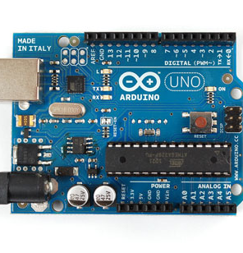
Microcontroller
ATmega328P
Parameter | Arduino UNO
Chip | ATmega328P
Digital I/O | 14 Pins
Analog Input | 6 Pins
PWM Output | 6 Pins
Communication Protocols | I2C, Serial
2.1 in
Arduino Bootloader
Open Source
2.7 in

Slide 10
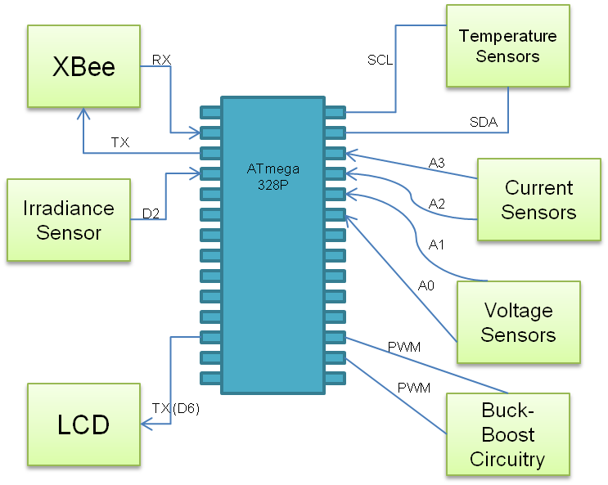
Microcontroller Peripherals

Slide 11
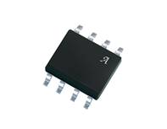
Current Sensor
ACS711ELCTR-12AB-T
Parameter | ACS711
Sensor Type | Hall Effect
Operating Voltage | 3 – 5.5 V
Current Sensing | -12 – +12 A
Operating Temp. | -40 – 85 °C
6 mm
4.9 mm

Slide 12
Voltage Sensor
Voltage Divider
Parameter | Voltage Divider
Source | PV panel
Sensor Type | Voltage Divider
Voltage Sense | 0 – 21 V
R1 | 3.2 KΩ
R2 | 1 KΩ
Output Voltage | 0 – 5 V
R1
Vo
R2

Slide 13
Voltage Sensor
Voltage Divider
R1=2.7kΩ
R2=10kΩ
Vo
Notes:
13

Slide 14
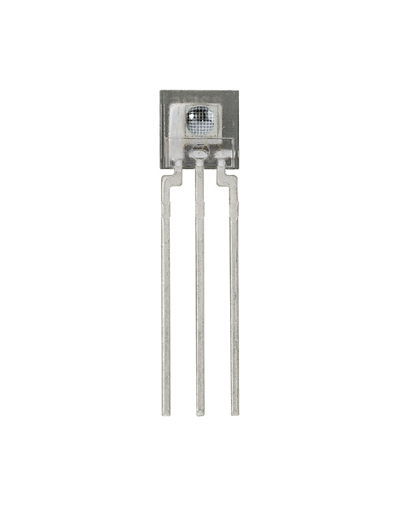
Irradiance Sensor
TSL235R-LF
Parameter | TSL235R-LF
Operating Voltage | 5 V
Output | Square wave 50% Duty Cycle
Operating Temp. | -25 – 70 °C
Light Wavelength Range | 320 – 1050 nm
Output Frequency | 200 – 300 KHz
19.46 mm
4.6 mm

Slide 15
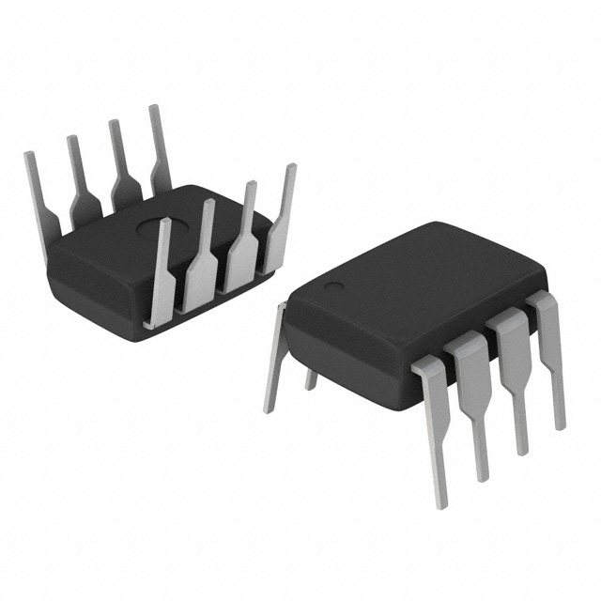
Temp Sensor
DS1624
Parameter | DS1624
Operating Voltage | 3 – 5V
Temp. Range | -55 – 125° C
Internal Memory E² | 256 Bytes
Protocol | I2C
8.5 mm
9 mm

Slide 16
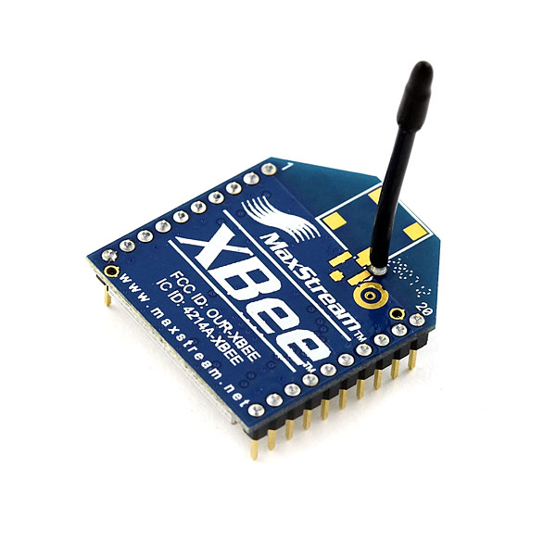
Wireless Module
Parameter | Xbee Series 1
Protocol | 802.15.4
Communication | Serial
Transmitting Power | 1 mW
Outdoor Range | 90 m
Frequency Band | 2.4 GHz
Operating Voltage | 3.3 V
24.3 mm
27.6 mm

Slide 17
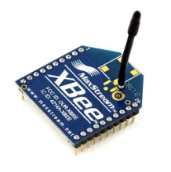
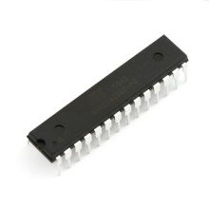
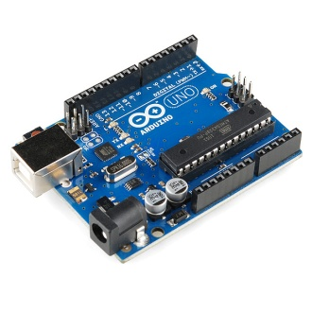
Wireless Subsystem
Sensor Data

Slide 18
Battery Comparisons
Deep-Cycle Lead Acid vs. Li-ion
AGM vs. Gel vs. Flooded
Key Parameters
Cost
Overcharge Tolerance
Charge Cycles

Slide 19
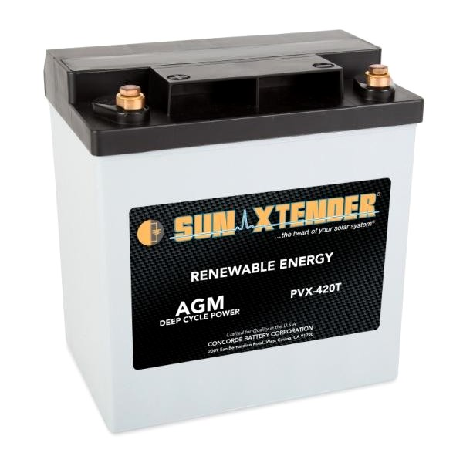
Battery
Sun Xtender PVX-420T
Parameter | Sun Xtender
Chemistry | AGM
Nominal Voltage | 12 V
Capacity | 42 Ah
CCA | 40 A
Number of Charges | 1000
8.05 in
5.18 in
7.71 in

Slide 20
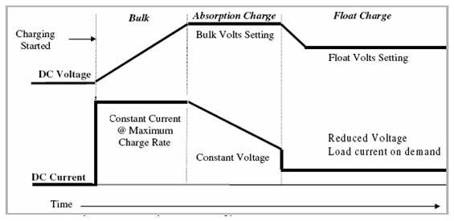
Battery Charging Stages
Bulk
Absorption
Float

Slide 21
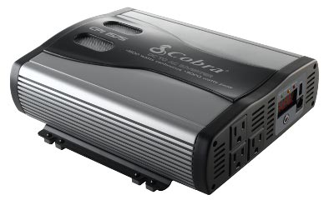
Inverter
Scobra CPI 1575
Parameter | Scobra/1575
Max Power | 1500 W
Surge | 3000 W
Wave output | Moderate Sine
Input Voltage | 12 V
Output Voltage | 110 – 120 VAC
AC Outlets | 3
USB | 1
83.82 mm
238.8 mm
223.5 mm

Slide 22
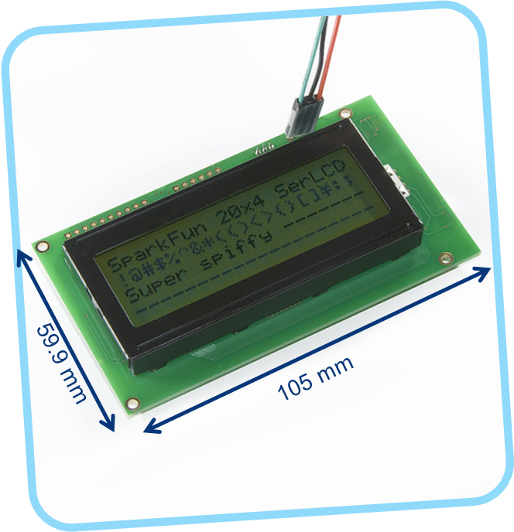
LCD Screen
Parameter | 20 x 4 LCD
Communication | Serial
Color | Black on Green
Operating Voltage | 5 V
Max Current | 60 mA
Notes:
105 x 59.9 mm

Slide 23
MPPT Algorithms
 | Efficiency | Programming Difficulty | Potential for “error”
Incremental Conductance Method | Highest | Complex | Yes
Perturb and Observe Method | High | Average | Yes
Constant Voltage Method | Low | Low | No

Slide 24
Perturb and Observe Method
MPP
P_{max}
Power
Voltage
V_{mp}
V_{OC}

Slide 25
Perturb and Observe Method
Start/System On
Increase
Operating Voltage
Decrease
Operating Voltage
Yes
No
No
Yes
Is current power greater than previous power?
Is current power greater than previous power?

Slide 26
LCD: LCD.print Xbee: Serial.write
Sensor Read: Battery Voltage
Bulk
Sensor Read: Battery Current & Voltage
Start
Float or Absorption
I x V > P₀
I x V < P₀
Increase Voltage
Decrease Voltage
Adjust PWM
Regulated Power Delivered to Battery
Notes:
Software Diagram & User Interface

Slide 27
LCD: LCD.print Xbee: Serial.write
Sensor Read: Battery Voltage
Bulk
Sensor Read: Battery Current & Voltage
Start
Float or Absorption
I x V > P₀
I x V < P₀
Increase Voltage
Decrease Voltage
Adjust PWM
Regulated Power Delivered to Battery
Notes:
Software Diagram & User Interface
27

Slide 28
H-Bridge Topology Buck-Boost DC/DC Regulator
Single Inductor Buck/Boost Architecture
Separate Buck and Boost Operating Modes
Synchronous 4-Switch Operation for Higher Efficiency
Wide Input Voltage Range: 4.5V to 40V
Wide Output Voltage Range: 12V to 15V

Slide 29
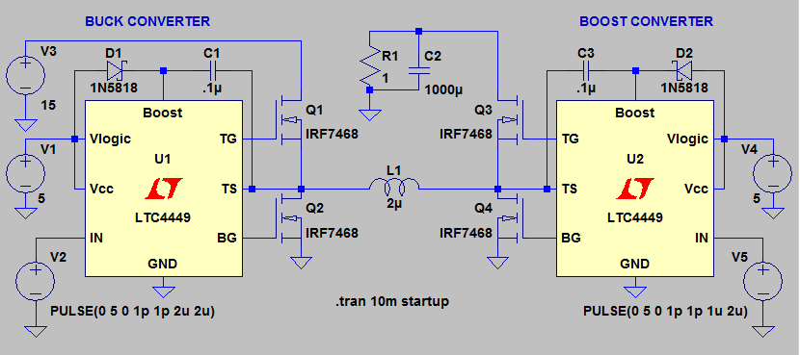
Boost Operation

Slide 30
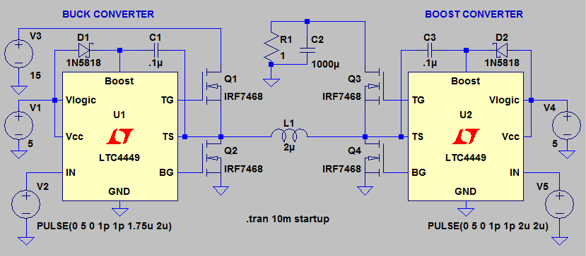
Buck Operation

Slide 31
Distribution of Responsibilities
Eric
Solar
Panel
Power Electronics
Amber
Algorithms
Sebastian
Inverter
Sensors
LCD Screen
User Interface
Steve
Micro- processor
Battery
Wireless
Simulation
PCB Design

Slide 32
Progress

Slide 33
Budget
Notes:
Cost of Charge Controller vs. Whole System

Slide 34
Remaining Milestones
Critical Design Review Feb 14
All Parts Ordered Feb 20
Order PCB Feb 29
Meet with Mentor Mar 15
Done Building/Begin Testing Mar 30
Testing Complete Apr 9
Progress Energy Symposium Apr 13

Slide 35
Remaining Work
Order solar panel, battery, and inverter
Design and order PCB
Complete software
System Integration
Testing

Slide 36
Anticipated Problems
Designing circuit to handle high power
Heat dissipation
Buck-Boost Circuitry

Slide 37
Questions?

Slide 38
Maximum Power Point Tracking
V_{in}
V_{out}
Solar Array
I_{in}
MPPT
I_{out}
Battery
Sensing PV current and voltage
Sensing battery current and voltage
Adjusting based on MPPT Algorithm

Slide 39
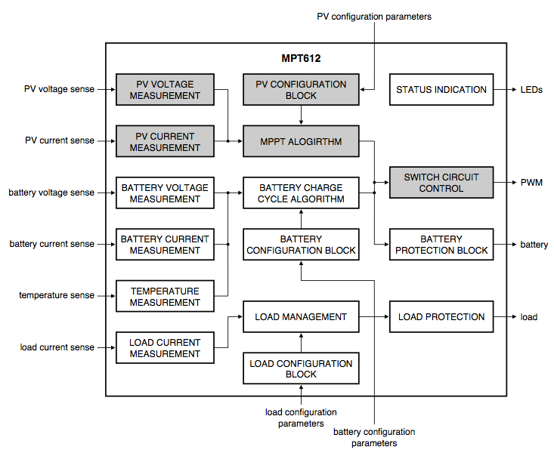
Example Block Diagram from NXP Semiconductors

Slide 41
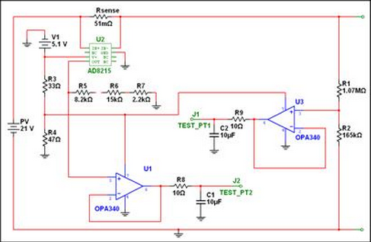
Reference Circuit

