Slide 1
SQVID Simplified Quad-Vitals Integration Device Sponsored by Philips
Group 1 Connor Hogan, EE Jonathan Lamones, EE
Lauren Martinez, CpE William Michelin, EE
Fall 2013 – Spring 2014

Slide 2
Project Motivation and Overview
Hospital patients facing an MRI scan are monitored for various vital signs during the scan and hospital stay.
Cables are unnecessarily large and not only complicate transportation of the patient, but contribute to patient discomfort.
Philips seeks a more streamlined cabling solution for their healthcare customers to increase the comfort of their patients.

Slide 3
SQVID and the Existing System
Four vital signs are typically monitored in a patient: ECG, SpO2, CO2, and NiBP.
ECG and SpO2 already transmit wirelessly to Philips’ software for analysis, but each go to a battery powered handheld.
The SQVID Project aims to transmit the remaining two vitals wirelessly and incorporate all four into a central box located at the foot of a patient’s bed.

Slide 4
Goals and Objectives
Transmit the CO2 and NiBP signals wirelessly.
Incorporate all four vital signals into a central connection box located at the bottom of the patients’ bed.
Guarantee all materials used are MRI safe.
Ensure the central connection box is light weight with a small footprint for mobility and patient comfort.
All hardware development must adhere to Philips’ proprietary standards and approval as the sponsor and customer.

Slide 5
Specifications and Requirements
Hardware Requirement | Description |  | Software Requirement | Description
HRS-001 | Cabling materials will be MRI safe. |  | SRS-001 | The system will be standalone.
HRS-002 | Connector materials will be MRI safe. |  | SRS-002 | Vital signs connected will be recognized automatically.
HRS-003 | Connection box manufacturing materials will be MRI safe. |  | SRS-003 | The software system will attain the wireless data sent from the central connection box.
HRS-004 | All power sources will be an approved DC supply. |  | SRS-004 | Embedded software will convert A/D and D/A.
HRS-005 | The central connection box will not exceed 10 lbs. |  | SRS-005 | Embedded software will convert and transmit wireless signals.
HRS-006 | The central connection box will not exceed 1’x1’x1’ in size.
HRS-007 | Each connector will not exceed a 2”x3” footprint.
HRS-008 | Total cable length will be 8 ft. long.
HRS-009 | The central connection box will allow up to four connections, and operate with at little as one.
HRS-010 | All cabling will resist bending or looping.

Slide 6
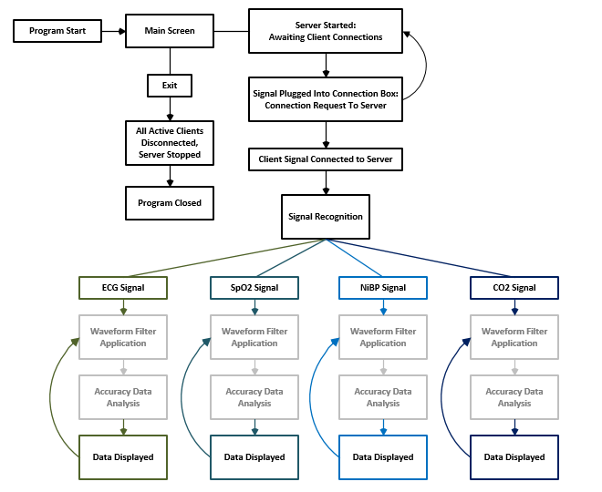
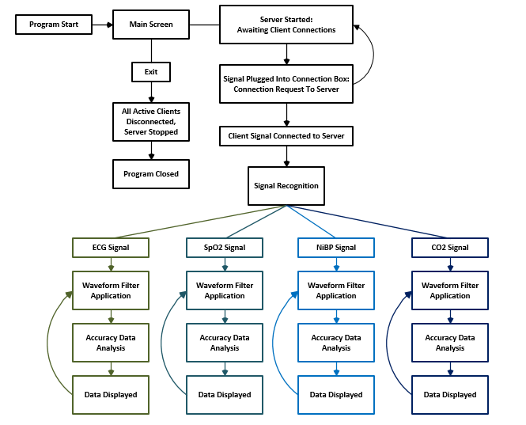
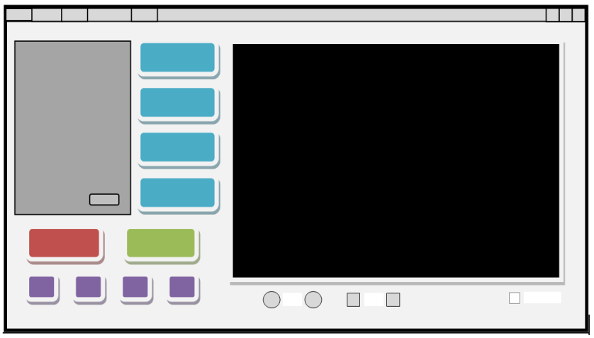
Software: Overall Program Flow
ECG
SpO2
NiBP
Data Display
CO2
Philips’ Magic!

Slide 7
Design Tree

Slide 8
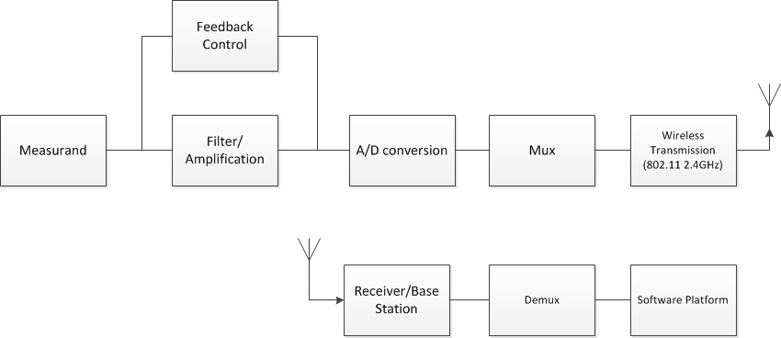
Overall Project Block Diagram

Slide 9
Hardware
Microcontroller
Wireless
CO2 Sensor
NiBP Sensor
SPO2 & ECG Sensors
Power System

Slide 10
Microcontroller Selection
µController | Description
TI MSP430 | Well suited to low power and bioinstrumentation solutions. Familiarity with the architecture from embedded systems laboratory. Low cost and easy prototyping.
ST ARM | More powerful and ubiquitous platform. Newer microcontrollers from this family have increased performance with decreased power consumption.
Atmel AVR | High availability of resources and open source support. Low-power and wireless capabilities in the zigbee wireless standard.
Microchip PIC | 8-bit microprocessors available for very small low power applications. Robust third-party support and development kits. Larger and more powerful units available as well.

Slide 11
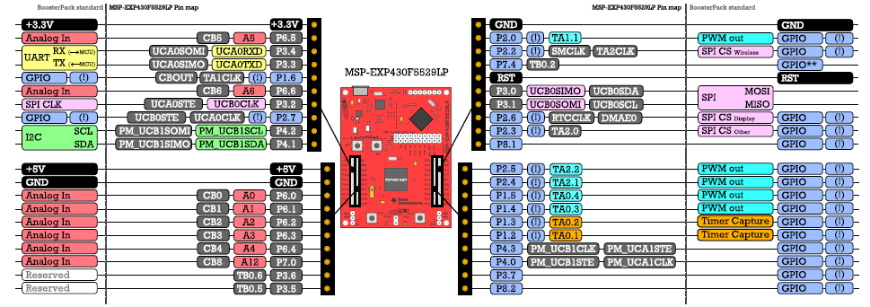
MSP430F5529

Slide 12
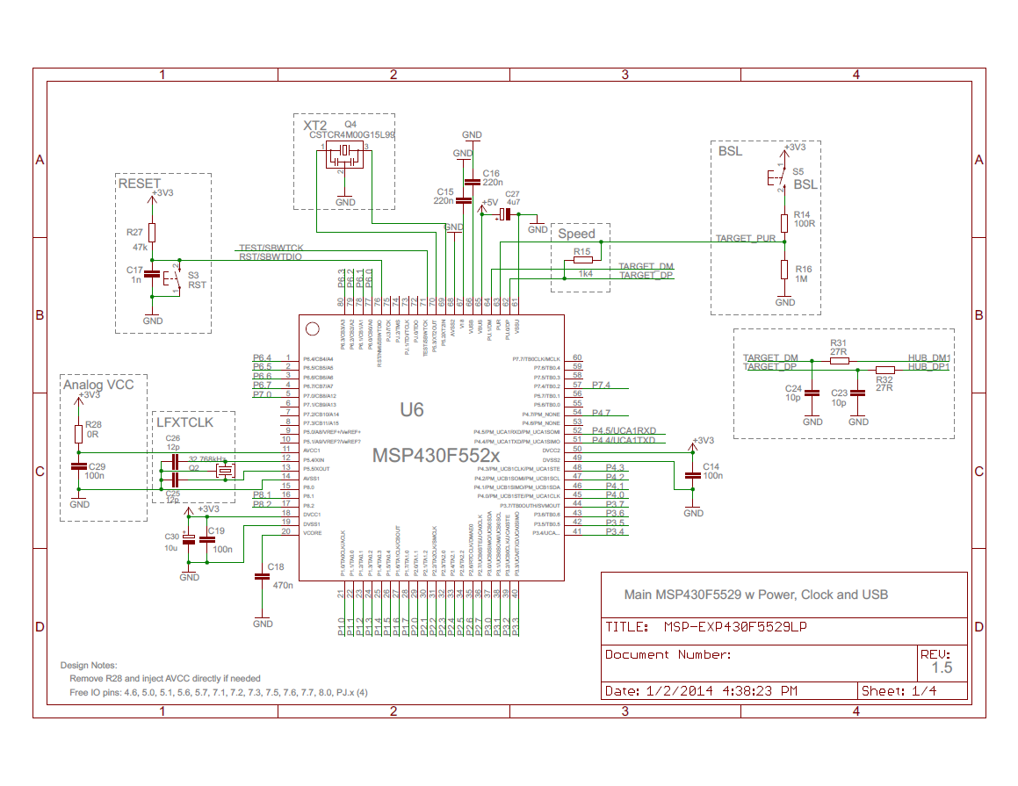

Slide 13
Wireless
Name | Features
TiWi-uB2 Bluetooth Module | Bluetooth 2.1+EDR and BLE 4.0 Integrated Band-Pass Filter Miniature Footprint: 7 mm x 7 mm
XBee Pro 60mW Wire Antenna - Series 1 (802.15.4) | 250kbps Max data rate 6 10-bit ADC input pins 128-bit encryption Built-in antenna 1 mile (1500m) range
XBee Pro 900 XSC RPSMA | Up to 2000 ft Indoor range with high-gain antenna 10 Kbps data rate Up to 24 dBm (250 mW) Transmit Power
TI CC3000 | IEEE 802.11 b/g Embedded IPv4 TCP/IP stack Works with low MIPS and low-cost MCUs with compact memory footprint

Slide 14
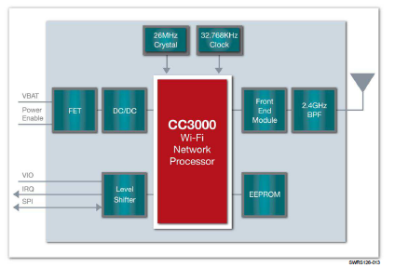
CC3000

Slide 15
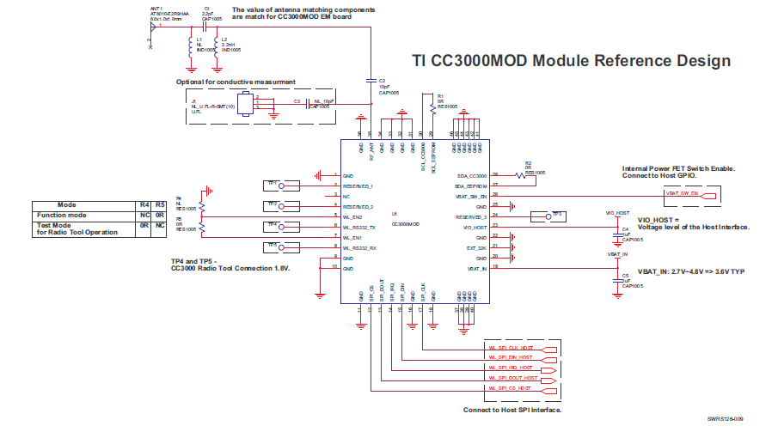

Slide 16
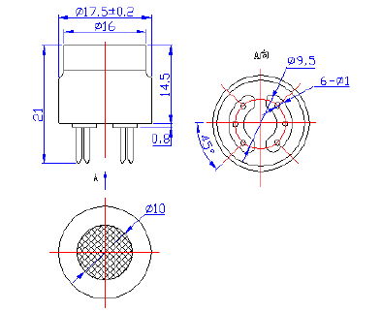
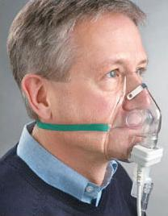
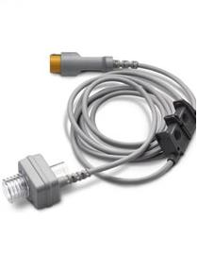
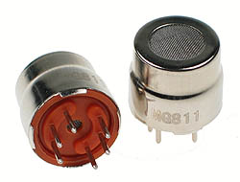
CO2 Sensor

Slide 17
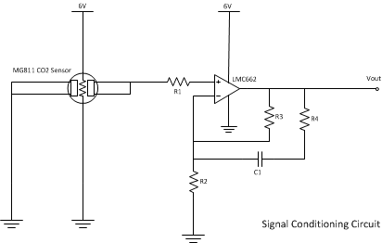
CO2 Sensor Initial Circuit

Slide 18
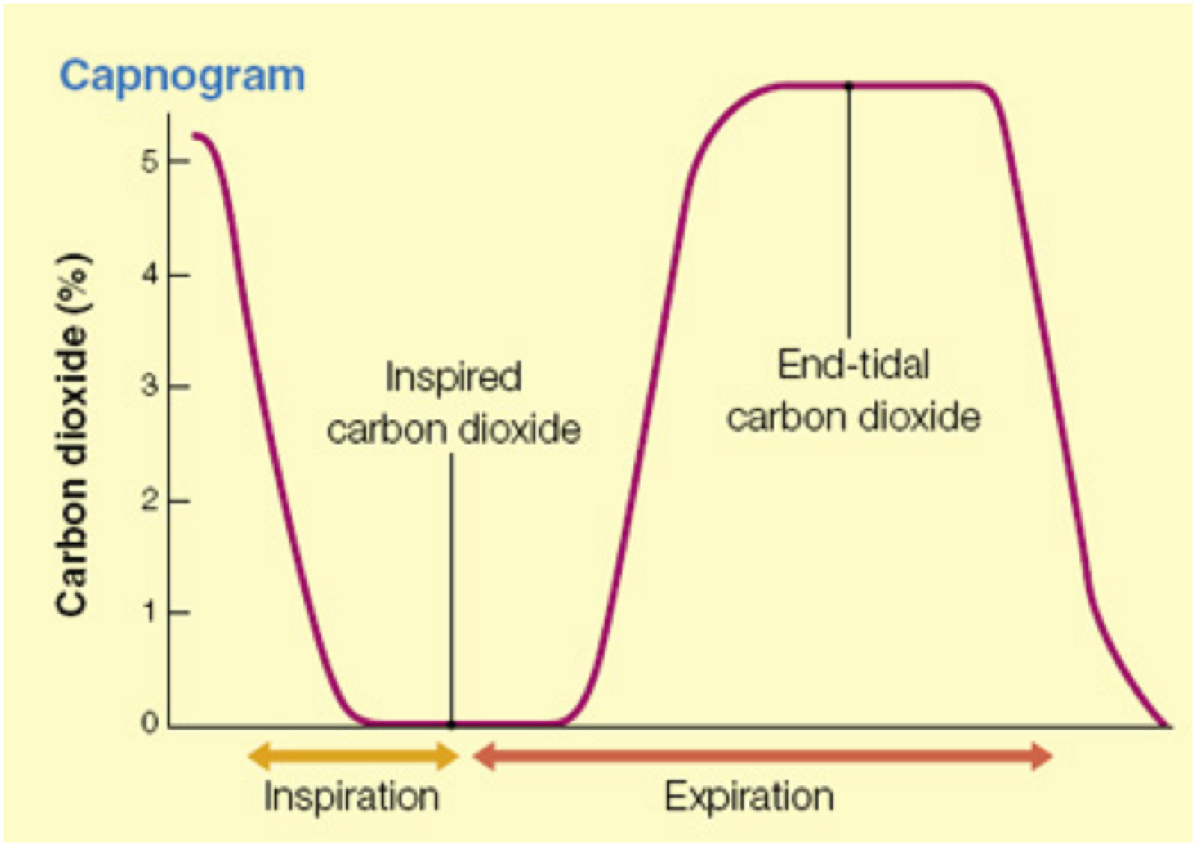

Slide 19
NiBP Sensor
Transducer → Amplifier → Filter → Microcontroller

Slide 20
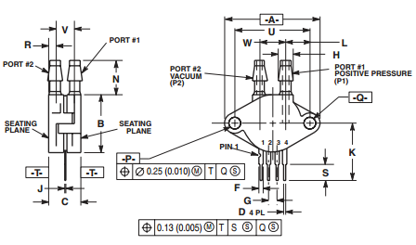
NiBP Sensor
Transducer: Motorola MPX2050DP (344C case)
Port orientation allows for structural longevity
Dual-transducer acts as filter (reference to ambient pressure/temp)

Slide 21
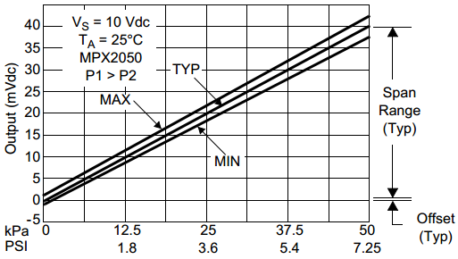
NiBP Sensor
What outputs should we expect to see from our transducer?
Patient State | Systolic (mmHg) | Diastolic (mmHg)
Hypotension | < 90 | < 60
Desired | 90 - 119 | 60 - 79
Hypertensive Emergency | ≥ 180 | ≥ 110
Max. Output (mV) | 40
Max. Target Output (mV) | 21.36
Min. Target Output (mV) | 4.26
Min. Output (mV) | 0

Slide 22
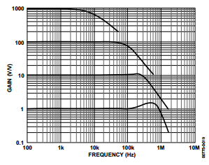
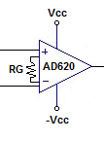
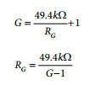
NiBP Sensor
Instrumental Amplifier: Analog Devices AD620

Slide 23
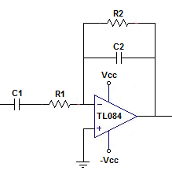
NiBP Sensor
Bandpass Filter: TL084 Operational Amplifier
$$C_{1}=C_{3}$$
$$R_{1}=R_{3}$$
$$f_{low}=\frac{1}{2πC_{1}R_{1}}=\frac{1}{2π\left(47 μF\right)\left(10 kΩ\right)}=0.339 Hz$$
$$f_{high1}=\frac{1}{2πC_{2}R_{2}}=\frac{1}{2π\left(2.2 μF\right)\left(30 kΩ\right)}=2.41Hz$$
$$f_{high2}=\frac{1}{2πC_{4}R_{4}}=\frac{1}{2π\left(2.2 μF\right)\left(20 kΩ\right)}=3.62Hz$$
$$A_{v1}=\frac{−R_{2}}{R_{1}}=\frac{−30 kΩ}{10 kΩ}=−3$$
$$A_{v2}=−\frac{R_{4}}{R_{3}}=\frac{−20 kΩ}{10 kΩ}=−2$$
$$A_{v1}∗A_{v2}=\left(−3\right)\left(−2\right)=6$$
$$A_{inst}(ideal)=\frac{A_{total}(ideal)}{A_{v1}∗A_{v2}}=\frac{200}{6}=33.3$$
$A_{inst}=\frac{49.4 kΩ}{R_{G}}+1$ (from AD620 datasheet)
$$R_{G}(ideal)=\frac{49.4 kΩ}{A_{inst}(ideal)−1}=\frac{49.4 kΩ}{33.3−1}=1.53kΩ$$
Common low cutoff

Slide 24
Battery Requirements
Initial Specifications
Rechargeable
5 Volts – 6 Volts
≤ 2 cubic inches (including battery compartment)
Non-ferromagnetic or tested for up to 3 Teslas
≤ 0.3 lbs or <≅ 140 grams

Slide 25
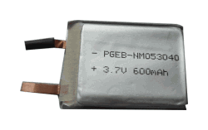
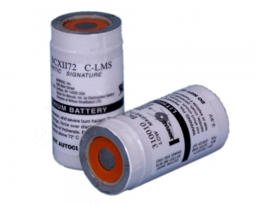
Battery Selection
Power Stream Battery Vs. Magmedix Battery
$20 per battery (max) | $335 for two C batteries
3.7 volts | 3.9 volts
No ferromagnetic materials | Tested for up to 3T
Available specifications | Obscure specifications
Notes:
Source: https://www.magmedix.com/store/mri-anesthesia/low-magnetic-field-laryngoscope-batteries-c-2-pk/

Slide 26
Power Stream Non-magnetic Lithium Polymer Battery
Specifications
Voltage (V) | 3.7
Milli-ampere-hours (mAH) | 600
Thickness x Width x Height (size in mm) | 5x30x40
Weight (grams) | 11
 | Non-ferromagnetic
Notes:
Source: http://www.powerstream.com/non-magnetic-lipo.htm

Slide 27
Charger and Requirements
Ideal Charger
7.2 Volt Charger output
1200 mAh output
Non-magnetic or 3T resistant
120 V at 50/60 Hz input

Slide 28
Budget
 | Part | Qty. | Unit Price (USD)
ECG | Expression MRI Monitoring System - ECG component | 1 | (Provided)
SpO2 | Expression MRI Monitoring System – SpO2 component | 1 | (Provided)
NiBP | Pressure cuff | 1 | (Provided)
 | MPX2050 Pressure Transducer | 1 | 12.20
 | AD620 Instrumentation Amplifier | 1 | 9.43
 | TL084 Operational Amplifier | 2 | 0.68
CO2 | CAPNO2 mask | 1 | (Provided)
 | CAPNOSTAT CO₂ Sensor | 1 | (Provided)
Microcontroller | MSP430F5529 | 1 | 12.99
Wireless | SimpleLink Wi-Fi CC3000 | 1 | 9.99
Power Supply | 7.2V Lithium-Polymer Non-ferromagnetic Battery | 2 | 20.00
 | 7.2V AC/DC adapter | 1 | 12.00 – 30.00
Total | 13 parts | 14 | 77.97 – 95.97

Slide 29
Action Items
Finalize a parts and budget list
Get the cables and schematics for sensors
Strengthen relationship with Philips
Acquire parts and begin testing

Slide 30
Current Progress

Slide 31
Questions?

