Slide 1
SQVID Simplified Quad-Vitals Integration Device Sponsored by Philips
Group 1 Connor Hogan, EE Jonathan Lamones, EE
Lauren Martinez, CpE William Michelin, EE
Fall 2013 – Spring 2014
Notes:
-Lauren

Slide 2
Project Motivation and Overview
Hospital patients facing an MRI scan are monitored for various vital signs during their scan and hospital stay.
Cables are unnecessarily large and not only complicate transportation of the patient, but contribute to patient discomfort.
Philips seeks a more streamlined cabling solution for their healthcare customers to increase patient comfort.
Notes:
-Lauren

Slide 3
SQVID and the Existing System
Four vital signs are typically monitored in a patient: ECG, SpO2, CO2, and NiBP.
ECG and SpO2 already transmit wirelessly to Philips’ software for analysis, but each go to a battery powered handheld.
The SQVID Project aims to prove that wireless transmission of the remaining signals is possible and to design a central connection box to house all components.
Notes:
-Lauren

Slide 4
Goals and Objectives
Transmit the CO2 and NiBP signals wirelessly.
Design and construct a central connection box to house electronic components.
Ensure the connection box is light weight with a small footprint for mobility and patient comfort.
Design SQVID with customization in mind for future development purposes.
All hardware development must adhere to Philips’ proprietary standards and approval as the sponsor and customer.
Notes:
-Lauren

Slide 5
Specifications and Requirements
Software Requirement | Description
SRS-001 | The software system (GUI) will be standalone.
SRS-002 | The software system will attain the wireless data sent from the central connection box.
SRS-003 | Data exchange between the embedded controller and the software system will be reliable and consistent.
SRS-004 | The receiving software system will display the data in an easy to read fashion.
SRS-005 | Embedded software will convert and transmit wireless signals.
Hardware Requirement | Description
HRS-001 | Connection box manufacturing materials will be MRI safe.
HRS-002 | The central connection box will not exceed 10 lbs.
HRS-003 | The central connection box will not exceed 1’x1’x1’ in size.
HRS-004 | Each connector will not exceed a 2”x3” footprint.
HRS-005 | Total cable length will be <8 ft. long.
HRS-006 | The central connection box will allow up to four connections, and operate with at little as one.
Notes:
-Lauren for Software Requirements: Reliable and consistent meaning no drop outs, no false readings (or very few false readings), if a packet is lost the next is right behind it and there is no gap between data packets seen by the user.
-Will : Hardware requirements updated?

Slide 6
Design Tree
MRI Patient Monitoring System
Cable Consolidation
Sensor Instrumentation
Wireless Design
Enclosure Design
Signal Amplification and Filtering
802.11 Wi-Fi Processor Implementation
Base Station GUI
Sensor Integration
A/D Conversion
Notes:
Will: Redesign the Design Tree

Slide 7
Overall Project Block Diagram
Measurand
Instrumentation / Amplification
Band Pass Filter
A/D Conversion
Wireless Transmission (802.11 2.4GHz)
Router
Software Platform
Notes:
Will: Redesign the block diagram

Slide 8
Hardware
NiBP Sensor Electronics
Microcontroller Selection
Wireless Processor Configuration
SPO2 & ECG Sensor Integration
Future: CO2 Sensor Integration
Notes:
Will: Edit hardware presentation flow, content

Slide 9
NiBP Sensor
Signal Flow:
Transducer
Instr. Amp
MCU
Filter
Non-Inv. Amp
DC Offset
Rg=5.6k
Notes:
-Connor

Slide 10
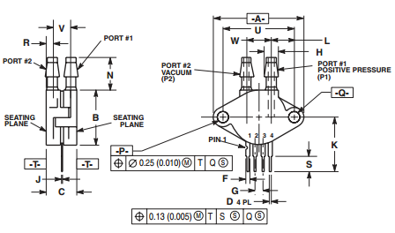
NiBP Sensor
Transducer: Motorola MPX2050DP (344C case)
Port orientation allows for structural longevity
Dual-transducer acts as filter (reference to ambient pressure/temp)
Notes:
-Connor

Slide 11
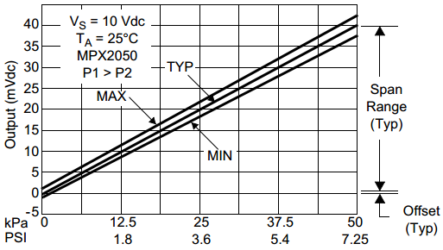
NiBP Sensor
Input Pressure Range
Minimum: 40mmHg = 5.33kPa
Maximum: 200mmHg = 26.7kPa
Patient State | Systolic (mmHg) | Diastolic (mmHg)
Hypotension | < 90 | < 60
Desired | 90 - 119 | 60 - 79
Hypertensive Emergency | ≥ 180 | ≥ 110
Max. Output (mV) | 40
Max. Target Output (mV) | 21.36
Min. Target Output (mV) | 4.26
Min. Output (mV) | 0
Notes:
-Connor

Slide 12
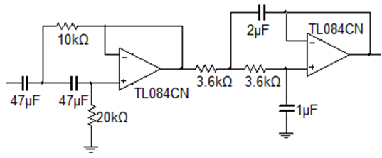
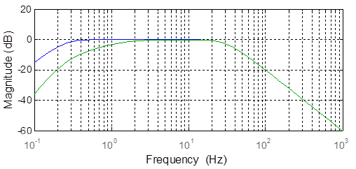
NiBP Sensor
Bandpass Filter:
2nd-Order Butterworth
TL084CN Op. Amp
Sallen-Key used for simplicity
Human heartrate varies from ~1-6Hz
Notes:
-Connor

Slide 13
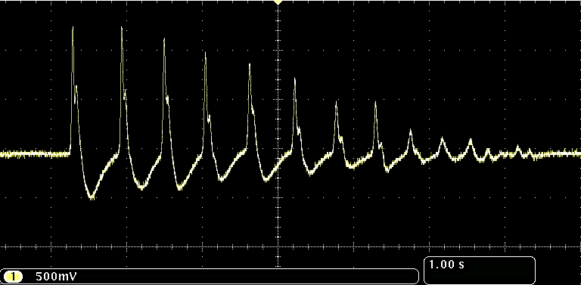
NiBP Sensor
Output:
0-2.5V constraint for MCU
Distinct peaks for systolic and diastolic indication
2.5V-
~1V-
0V-
Notes:
-Connor

Slide 14
TI MSP430G2553
Notes:
-Will

Slide 15
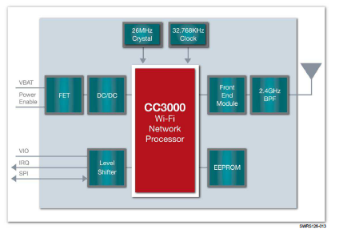
TI CC3000 Wireless Module
IEEE 802.11 b/g Embedded IPv4 TCP/IP stack
Works with low MIPS and low-cost MCUs with compact memory footprint.
Notes:
-Will

Slide 16
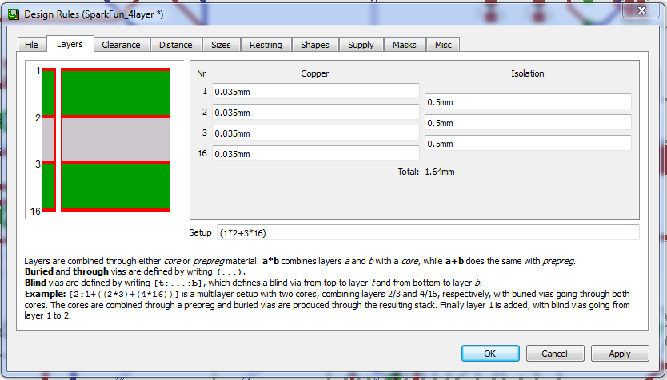
PCB Design
Four Layer board design
Special attention to RF trace; Impedance Matched 50Ω
Notes:
Will

Slide 17
Software: Overview
Software consists of both the embedded programming for the MCU and the GUI control.
The CC3000 and MSP430 were programmed using TI’s Code Composer Studio.
The GUI control was written in C# using Visual Studio 2012.
Data transmission between the wireless module and the control utilizes UDP Communication.
Notes:
-Lauren

Slide 18
Software: MCU Programming
Configuration of the host controller follows the process below:
Host driver initializes GPIO pins and clock source/frequency.
SPI communication is established with CC3000 wireless processor.
UART communication is enabled to aid in debugging the processor.
The CC3000 Basic WiFi Example was used as a base for communication with the wireless module.
Notes:
-Jonathan

Slide 19
ADC: ADC10CTL0
SREF_1 was chosen for using Vref+, the built in reference voltage and Vss, ground
REFOUT was left to 0 because no external reference source was used.
REFBURST was set for optimization purposes, by only referencing the voltage when sampling and converting.
REF2_5V was set to 1 for 2.5V for a higher voltage resolution
ADC10ON is set to 1 in order for everything to work, it turns the ADC10 on.
ENC and ADC10SC will oscillate between set because they are the starting and stopping of the converting process.
Notes:
Speaker: Jonathan
Anything that is open is I’m waiting for final code revisions

Slide 20
ADC: ADC10CTL1
INCH0 was set to 0 that’s where the signal is coming through.
ADC10DF was set to 0 because no negative values were taken in.
CONSEQ0 was set to 00 for single channel single conversion
ADC10BUSY is toggled for whenever the ADC10 is busy converting.
All signal input is taken directly into ADC10MEM.
Notes:
Speaker: Jonathan
Anything that is open is I’m waiting for final code revisions

Slide 21
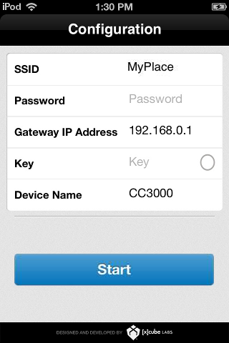
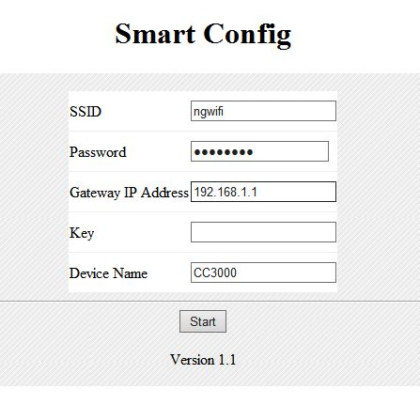
Software: UDP Communication
Configuration Process for the CC3000
Smart Config to connect to designated AP
IP automatically assigned; can be user-assigned if needed.
Opening and Binding the UDP Socket
Port Number must be assigned.
IP Address of host computer being sent data must be programmed.
Create and bind the socket; Ready for data transfer.
ulSocket = socket(AF_INET, SOCK_DGRAM, IPPROTO_UDP);
bind(ulSocket, &tSocketAddr, sizeof(sockaddr));
Notes:
-Lauren
SmartConfig: This is part of the initial configuration process – once done does not have to be done again. Potential to be more automated for future development. TI has Apps for Andriod, Apple, and a Java one – iOS and Java both tested during this project. Command “01” into the hyperterminal tells the device to attempt connection to the designated AP. Once done, IP Address of device automatically assigned and displayed via hyperterminal window.

Slide 22
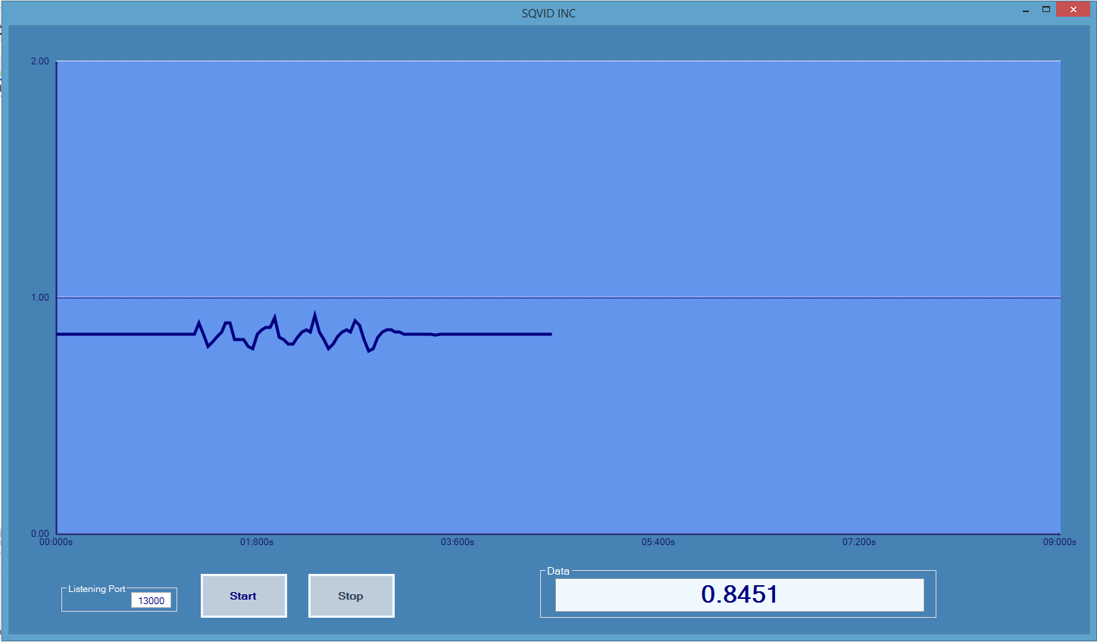
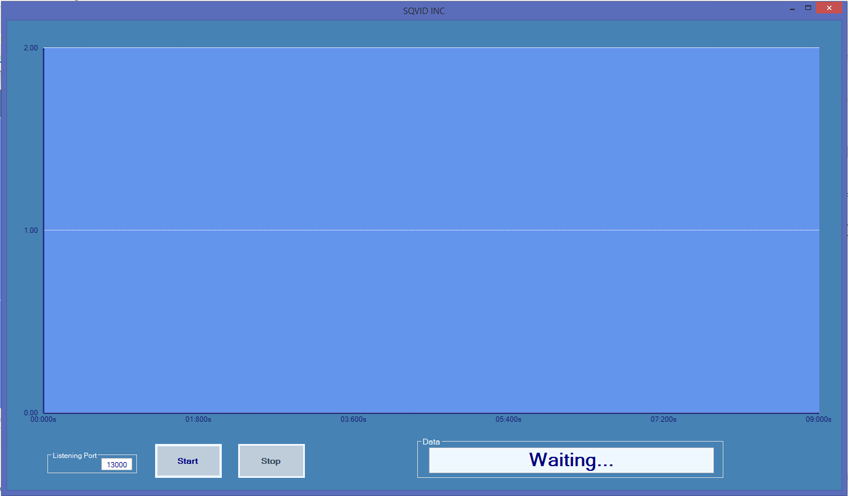
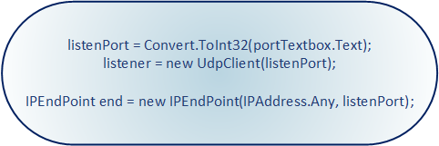
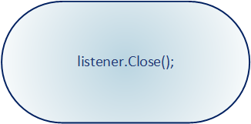
SQVID Intelligent Navigation Controller
UDP Protocol:
No handshaking necessary
Quick and Easy data transmission
Listening for any IP Address – configurable!
Notes:
-Lauren (please don’t edit, lots of animations!!!)

Slide 23
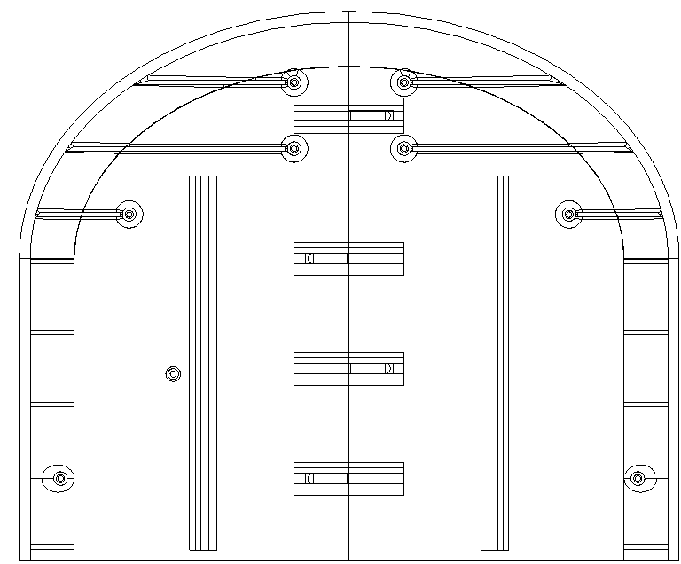
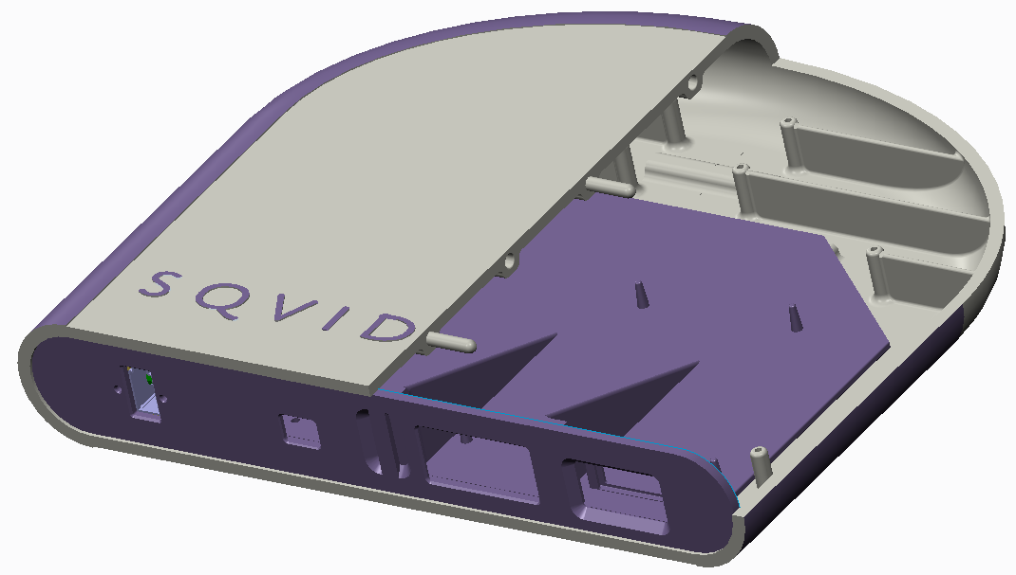
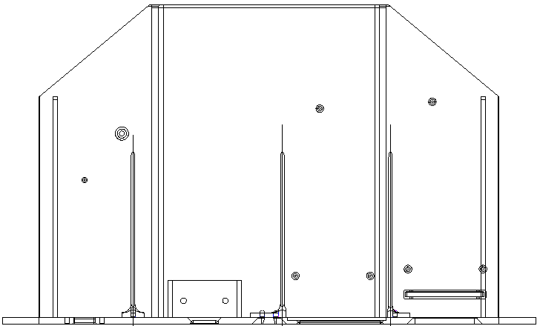
Connection Box Design
3D Printed at Philips’ lab
Designed using PTC Creo 2.0 (and a lot of paper.)
Notes:
-Connor

Slide 24
Demo Time!
… Any Questions?

Slide 25
BOM
 | Part | Qty. | Unit Price (USD)
ECG | Expression MRI Monitoring System - ECG component | 1 | (Provided)
SpO2 | Expression MRI Monitoring System – SpO2 component | 1 | (Provided)
NiBP | Pressure cuff | 1 | (Provided)
 | MPX2050 Pressure Transducer | 1 | 12.20
 | AD620 Instrumentation Amplifier | 1 | 9.43
 | TL084 Operational Amplifier | 2 | 0.68
CO2 | CAPNO2 mask | 1 | (Provided)
 | CAPNOSTAT CO₂ Sensor | 1 | (Provided)
Microcontroller | MSP430G2553
Wireless | SimpleLink Wi-Fi CC3000 | 1 | 9.99
Power
Total

Slide 26
Future Concepts

