Slide 1
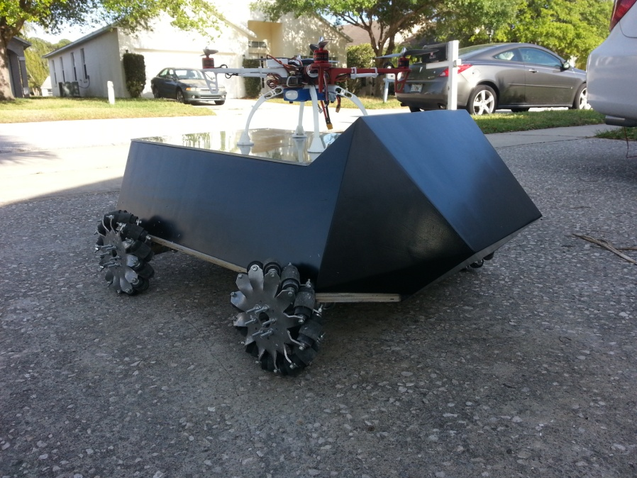
Raymond Lueg
DRONENET: The Quad Chronicles
Brandon Frazer
Raymond Lueg
Joe Howard
Ryan Borden
Notes:
Joe

Slide 2
DRONENET:THE QUAD CHRONICLES Design & System Integration
Raymond Lueg
What system did we design & integrate?
Four major subsystems that are integrated with one another
Quadcopter
Quadcopter Control Terminal (QCT)
Mobile Landing Platform (MLP)
MLP Control Terminal (MLPCT)
Notes:
Joe

Slide 3
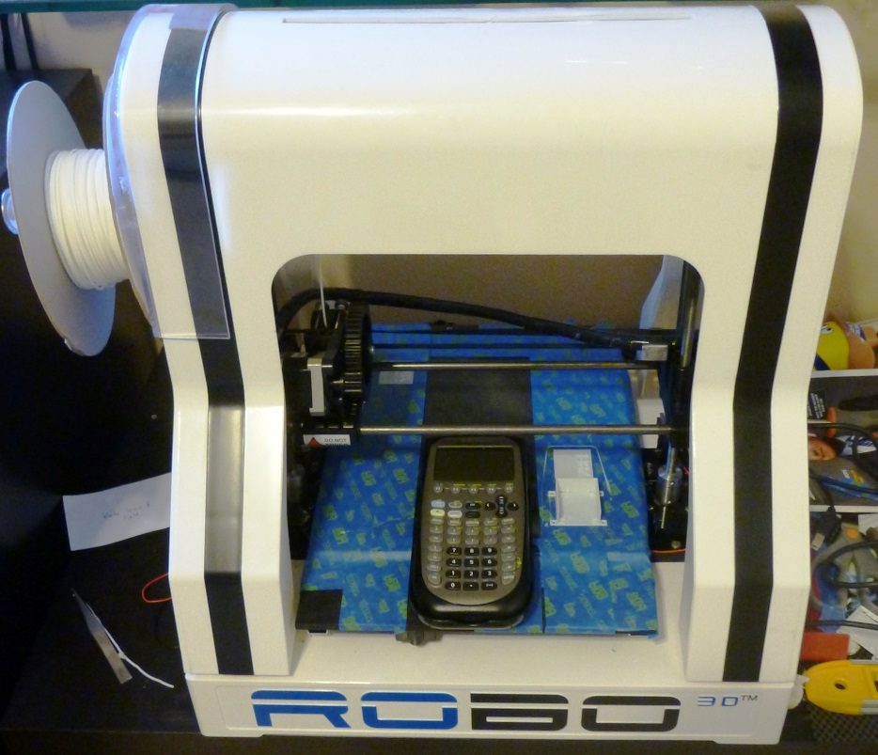
DRONENET:THE QUAD CHRONICLES Design & System Integration Motivation
Raymond Lueg
Design something fun, potential real-world applications, and challenging
Wireless communication, real-time navigation, (GUI), and power sustainability
Build a flying-air-vehicle
Build a ground vehicle
Utilize 3D printers
Notes:
Joe

Slide 4
DRONENET:THE QUAD CHRONICLES Design & System Integration Goals & Objectives
Brandon Frazer
Quadcopter or Quad
Autonomous Flight Modes (Landing/Take-off)
Record telemetry
Stream live video back to ground
Stream real-time flight data on-screen over video
Flight-time of at least 12 minutes
Quad Control Terminal (QCT)
Plan missions and waypoints and upload OTA
Control Quadcopter in real-time
View telemetry from Quad in real-time
Notes:
Joe

Slide 5
DRONENET:THE QUAD CHRONICLES Design & System Integration Goals & Objectives
Brandon Frazer
Mobile Landing Platform (MLP) or Platform
Extend mission time of Quadcopter
Successful implementation of a Bedini Motor
Ability to traverse challenging terrain
Highly maneuverable and easy to drive
Locking system for Quadcopter
MLP Control Terminal (MLPCT)
Multiple control modes
Touch screen interface
Joystick-based control
Secure control of MLP
Notes:
Joe

Slide 6
DRONENET:THE QUAD CHRONICLES Design & System Integration Specifications
Brandon Frazer
Quadcopter
Flight time up to 15 minutes
Payload of up to 5 lbs.
Travel up to 100 meters above sea level
Travel up to 300 meters radially from the control terminal
Quadcopter Control Terminal
Map out at least 5 waypoints for a single mission
Be able to program at least 3 flight modes
Notes:
Joe

Slide 7
DRONENET:THE QUAD CHRONICLES Design & System Integration Specifications
Brandon Frazer
Mobile Landing Platform
Travel up to 100 meters from the control terminal
Charge up to 4 batteries using the regenerative
Ability to navigate through rough terrain
Ability to lock down the quadcopter while not in flight
Ability to charge the quadcopter
MLP Control Terminal
Wirelessly Control the mobile platform
View all of the real time data streaming from the mobile platform
Communicate with the Quadcopter control terminal
Utilize both hardware and software based control systems
Have a touchscreen LCD display for control and monitoring
Secure User authentication
Notes:
Joe

Slide 8
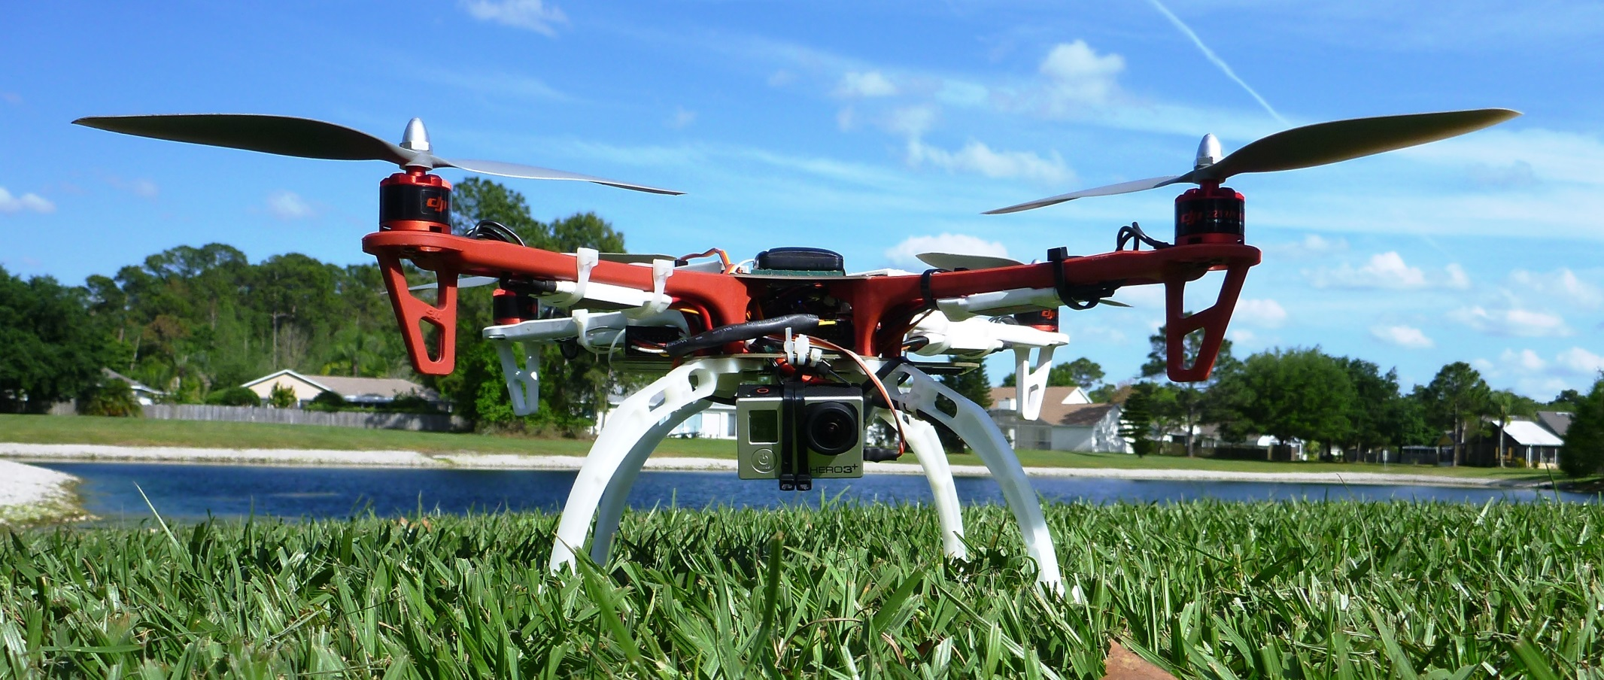
THE QUAD CHRONICLES: Quadcopter Design & System Integration
Joe Howard
Quadcopter
Notes:
Joe

Slide 9
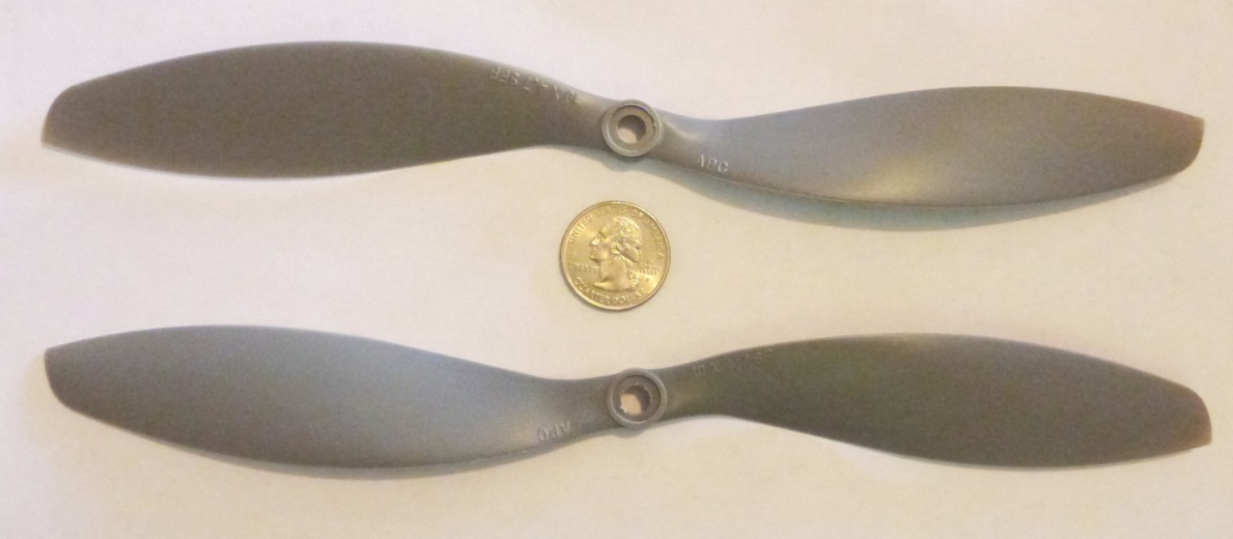
Joe Howard
THE QUAD CHRONICLES: Quadcopter Propellers
APC 1047 Slow Fly Props
10” diameter
4.7” pitch
6500 RPM limit
Estimated Max Thrust: approx. 1.5 – 1.8 lbs. each
Notes:
Joe

Slide 10
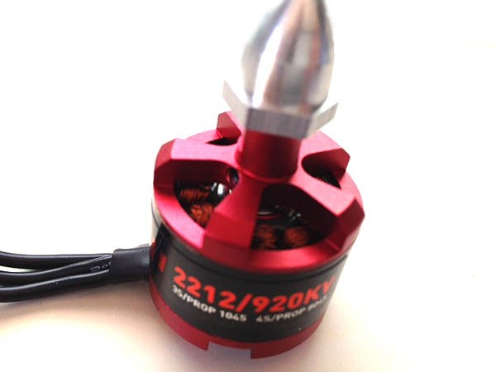
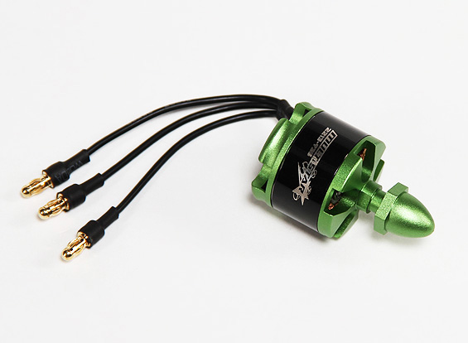
Joe Howard
THE QUAD CHRONICLES: Quadcopter Motors
DJI 2212-920
Stator Size: 22 x 12mm
KV: 920 rpm/V
Max Current: 15A (Given)
Coil Resistance: 0.171 Ω (Calc)
Idle Current: 0.5 Amps (Measured)
Weight: 56g
Multistar 2213-935
Stator Size: 22 x 13mm
KV: 935 rpm/V
Max Current: 15A
Weight: 55g
Notes:
Joe

Slide 11
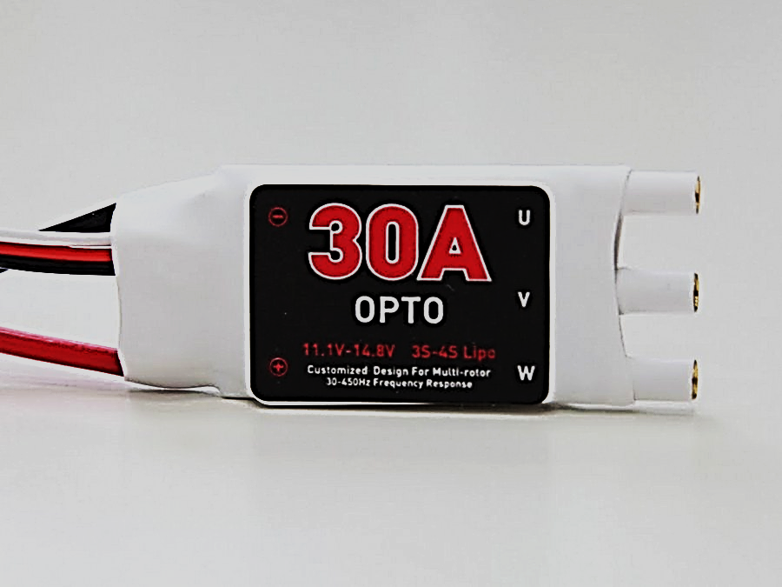
Joe Howard
THE QUAD CHRONICLES: Quadcopter Electronic Speed Controls
ESC 30A OPTO
Max Current: 30A
OPTO-coupled for noise isolation
No calibration required
Compatible Signal Frequency: 30Hz - 450Hz
Notes:
Joe

Slide 12
Joe Howard
THE QUAD CHRONICLES: Quadcopter Power Distribution
Power Distribution Flow Chart
Notes:
Joe

Slide 13
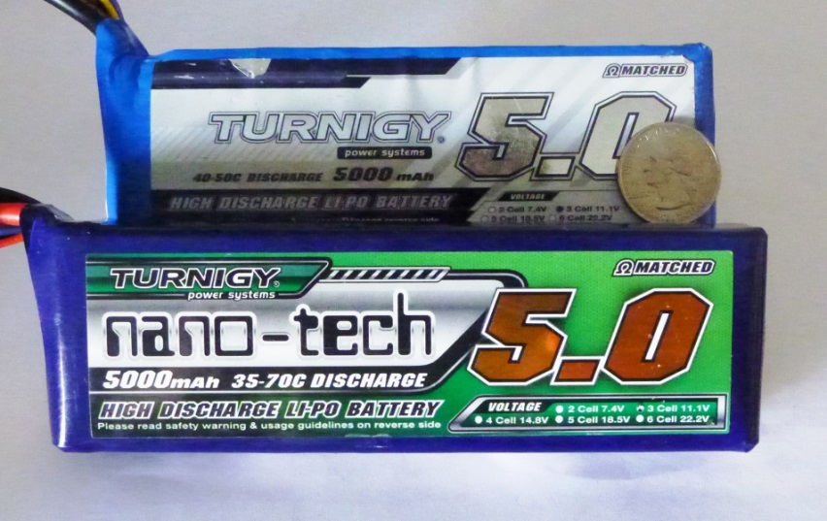
Joe Howard
THE QUAD CHRONICLES: Quadcopter Batteries
Turnigy 5000 mAh 3S
3 Cells
Nom Voltage: 11.1V
Const. Discharge: 200A
Peak Discharge (10sec): 250A
Weight: 443g
Const. Charge Rate: 25A
Internal impedance: .003 Ω
Turnigy nano-tech 5000 mAh 3S
3 Cells
Nom Voltage: 11.1V
Const. Discharge: 175A
Peak Discharge (10sec): 350A
Weight: 409g
Const. Charge Rate: 40A
Internal impedance: .0012 Ω
Notes:
Joe

Slide 14
Joe Howard
THE QUAD CHRONICLES: Quadcopter Battery Benchmarks
Battery Testing Data
Battery | Voltage | Capacity (mAh) | Const. Discharge Rate | Avg Flight Time | Max Flight Time | Weight | Flight Time to Weight Ratio (sec/g)
Turnigy Nano-Tech 5000 | 11.1 V | 5000 | 175 A | 15:56 | 16:03 | 400g | 2.41
Turnigy 5.0 | 11.1 V | 5000 | 200 A | 12:53 | 14:26 | 451g | 1.92
Turnigy 2650 | 11.1 V | 2650 | 53 A | 8:35 | 8:49 | 244g | 2.17
Notes:
Joe

Slide 15
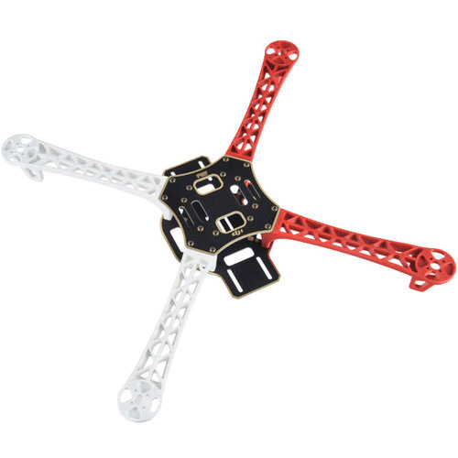
Joe Howard
THE QUAD CHRONICLES: Quadcopter
Frame
DJI Flame Wheel F450
Fiberglass
Weighs 282g
Diagonal Wheelbase of 450mm
VERY STRONG
Built-in PCB for power distribution
Notes:
Joe

Slide 16
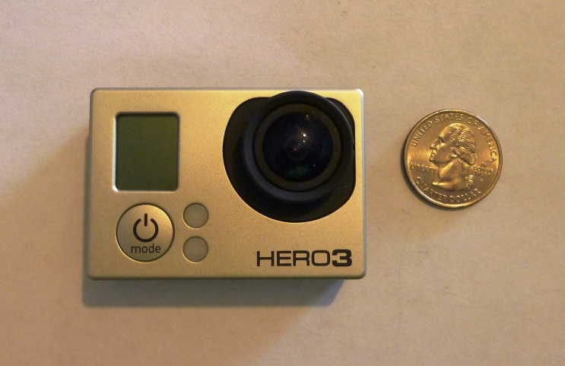
Joe Howard
THE QUAD CHRONICLES: Quadcopter Camera System
GoPro HERO3 Camera
Medium Range FPV
Weight < .2 pounds
1080P @ 60 FPS
1280 MHz Transmitter
200 mW 1280 MHz transmitter/receiver with standard antenna
Onscreen Display (OSD) for the camera to stream back to the ground station
Tested at 700ft range with clear picture
Decided against a servo controlled camera system
Notes:
Joe
*BRANDON

Slide 17
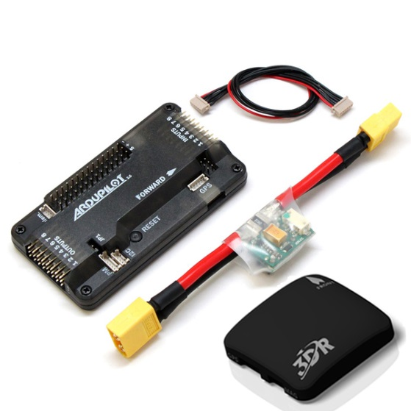
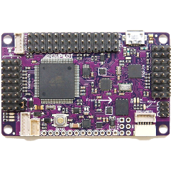
Ryan Borden
THE QUAD CHRONICLES: Quadcopter Flight Controller Requirements
For a working flight controller we need several components
Processor, accelerometer, gyroscope, on board programming, GPS, compass, and data logging
Controls motor speed
Allows for autonomous features
Notes:
Ryan

Slide 18
Ryan Borden
THE QUAD CHRONICLES: Quadcopter Flight Controller Selection
APM 2.6
Specs work for our application
Mission Planner software
Previous experience
Stability
Controller | Processor | Clock Speed | GPIO | UART | RAM | PWM Channels | Retail Price
APM 2.6 | Atmega 2560 | 16 MHz | 86 | 4 | 8KB | 12 | $240
Pixhawk | Cortex M4 | 168 MHz | 168 | 5 | 256 KB | 14 | $280
Notes:
Ryan

Slide 19
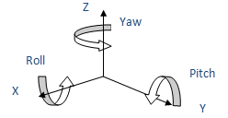
Ryan Borden
THE QUAD CHRONICLES: Quadcopter Flight Controller Details
Accelerometer and Gryoscope
MPU-6000
2.4 Volts
3.9mA’s
On-board programming
ATmega 32U
Altimeter
MS5661
3.6V
1μA
Compass
HMC5883L
3V
100μA
Notes:
Ryan
CHANGE THE DAMN GRID

Slide 20
Ryan Borden
THE QUAD CHRONICLES: Quadcopter
Wireless Telemetry
Xbee Pro Telemetry
S3B
900 MHz
Up to 215mW transmit power
Up to 9 miles line of sight
Gives us :
GPS
Battery monitoring
Wireless programming
FPV
1280 MHz
200 mW transmit power
1 mile range
Gives us:
Live video stream
Notes:
Brandon or Ray
3DR TELEMTRY PIC

Slide 21
THE QUAD CHRONICLES: Quadcopter Control Terminal Design & System Integration
Ryan Borden
Quadcopter Control Terminal
Plan out waypoints for autonomous missions
Display and record real-time telemetry data
Battery life
GPS
Altitude
Calibrate the flight controller
Customize all parameters for the flight controller
Limits on speed, fail-safes, and almost anything you could imagine controlling with the Quadcopter
Verbal warnings are given if there are major issues
Notes:
Ryan

Slide 22
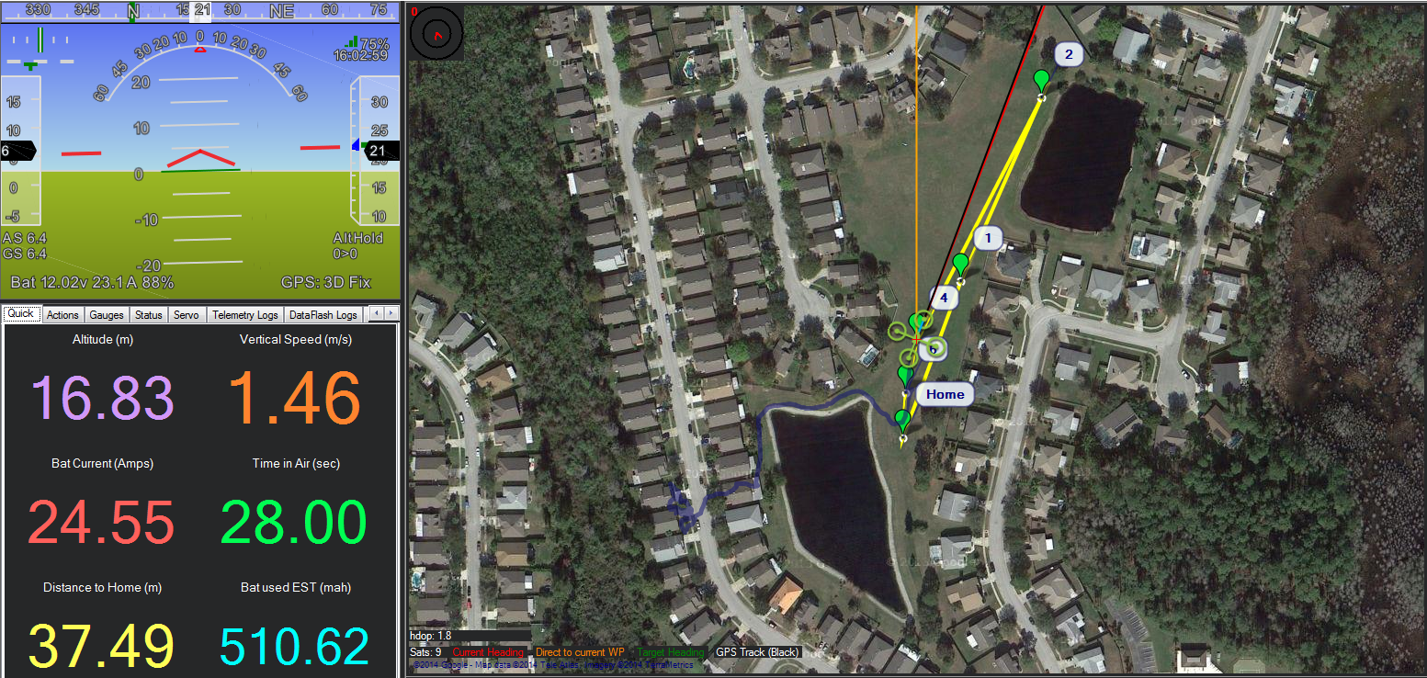
THE QUAD CHRONICLES: Quadcopter Control Terminal Mission Planner
Ryan Borden
Notes:
Ryan

Slide 23
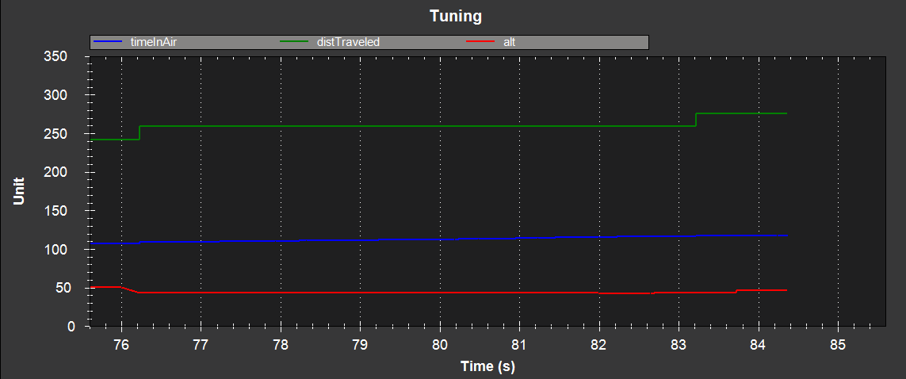
THE QUAD CHRONICLES: Quadcopter Control Terminal Mission Planner: Post Flight Data Analysis
Ryan Borden
Notes:
Ryan

Slide 24
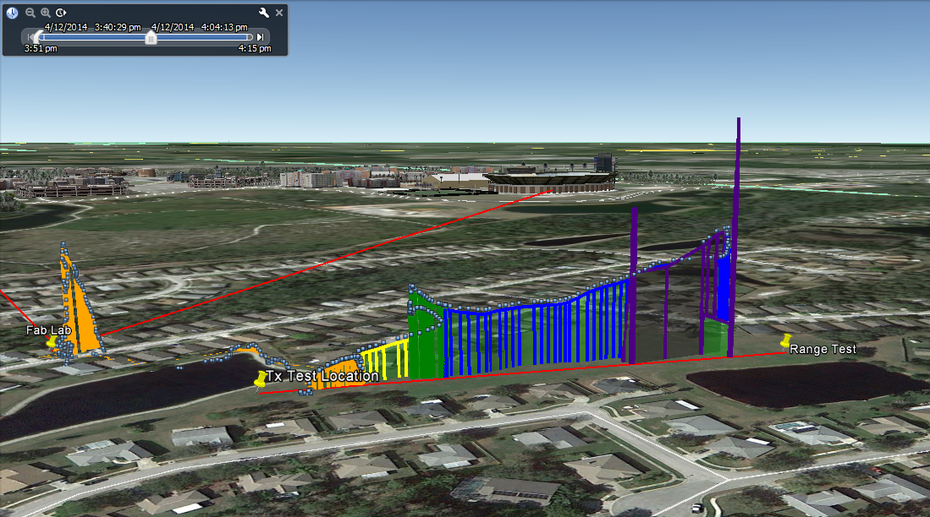
THE QUAD CHRONICLES: Quadcopter Control Terminal Mission Planner: Exported GPS Data
Ryan Borden
Notes:
Ryan

Slide 25
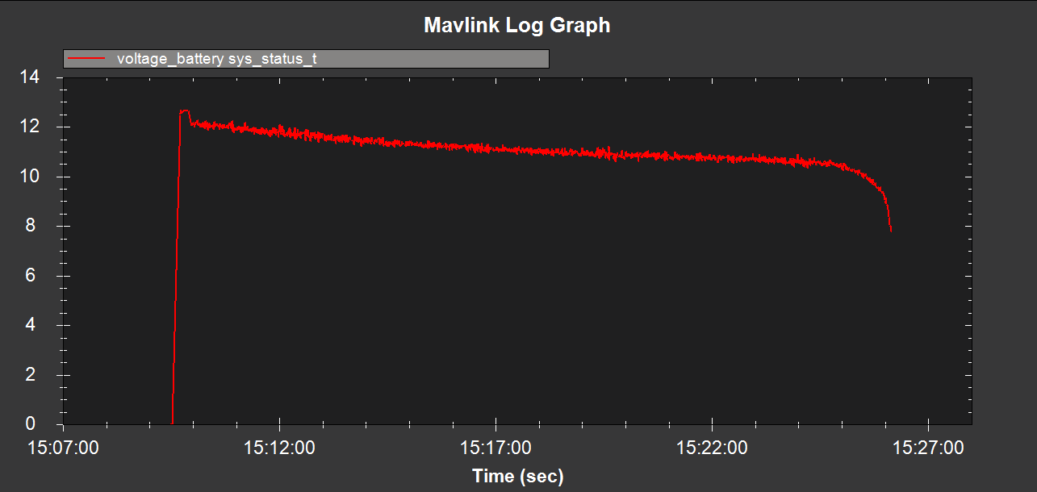
THE QUAD CHRONICLES: Quadcopter Control Terminal Mission Planner: Parameter Customization
Ryan Borden
Notes:
Ryan

Slide 26
Brandon Frazer
THE QUAD CHRONICLES: Mobile Landing Platform
Platform
Mobile Landing Platform
Features
Mecanum Wheel based drive-train
Renewable power system
Quadcopter locking system
Wireless communications
Active NeoPixel Lighting
Notes:
Brandon or Ray

Slide 27
THE QUAD CHRONICLES: Mobile Landing Platform
Electronic Device Architecture
Brandon Frazer
Six total 8-bit microcontrollers
Real-Time Wireless Navigation System with GPS
Ability to communicate with each other and the Platform controller
Wireless Controls for Servos, Mecanum Motors, and Bedini Motor Switching.
Ability to monitor Mecanum Motor Current and Faults, Sonar, and Motion Sensing.

Slide 28
THE QUAD CHRONICLES: Mobile Landing Platform
Electronic Device Architecture Flowchart
Brandon Frazer

Slide 29
Brandon Frazer
THE QUAD CHRONICLES: Mobile Landing Platform
Wireless Communication
Xbee Pro Controls
900 MHz
63 mW transmit power
1 mile range
$65
FPV
1263 MHz
100 mW transmit power
1 mile range
$100
Xbee S1 Navigation
2.4GHz
100 mW transmit power
1 mile range
$100
Notes:
Brandon or Ray
3DR TELEMTRY PIC

Slide 30
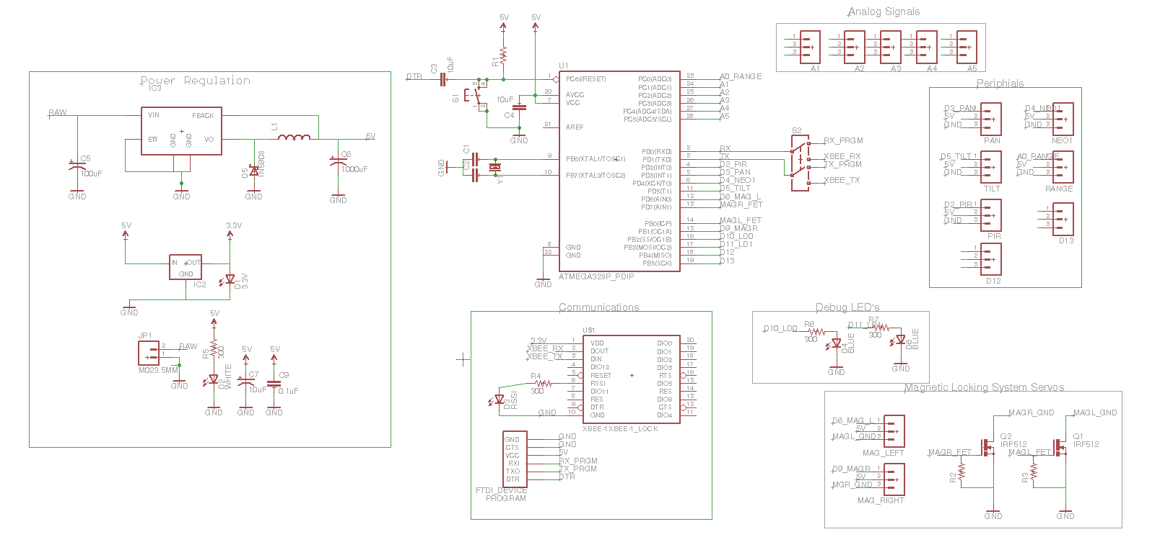
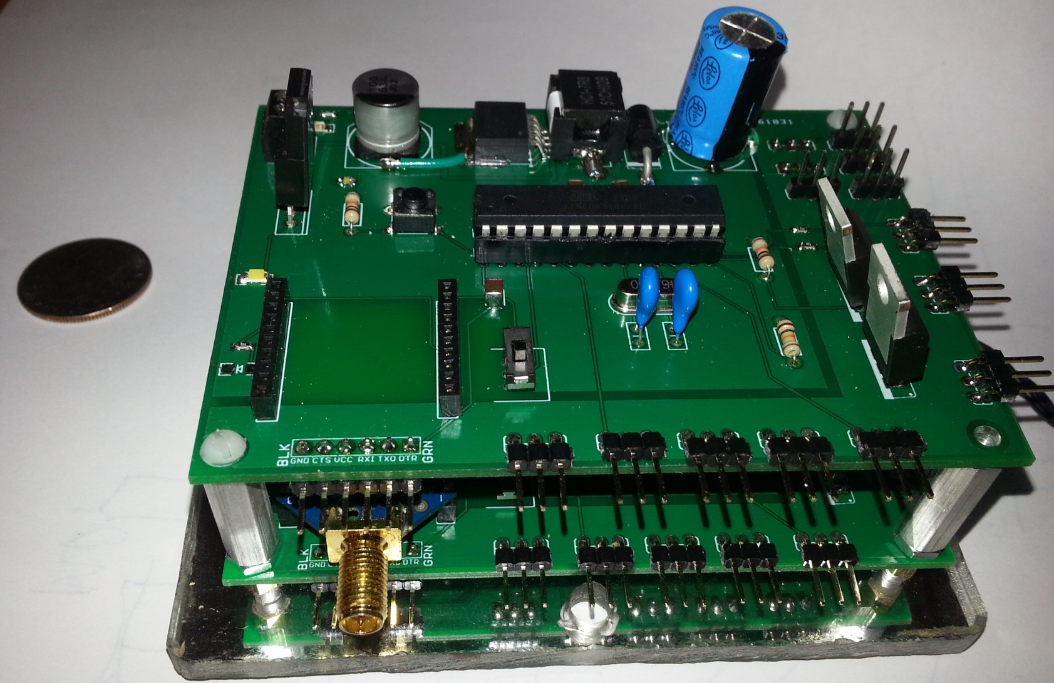
Brandon Frazer
THE QUAD CHRONICLES: Mobile Landing Platform
Platform Master and Slave Controllers
Notes:
Brandon or Ray

Slide 31
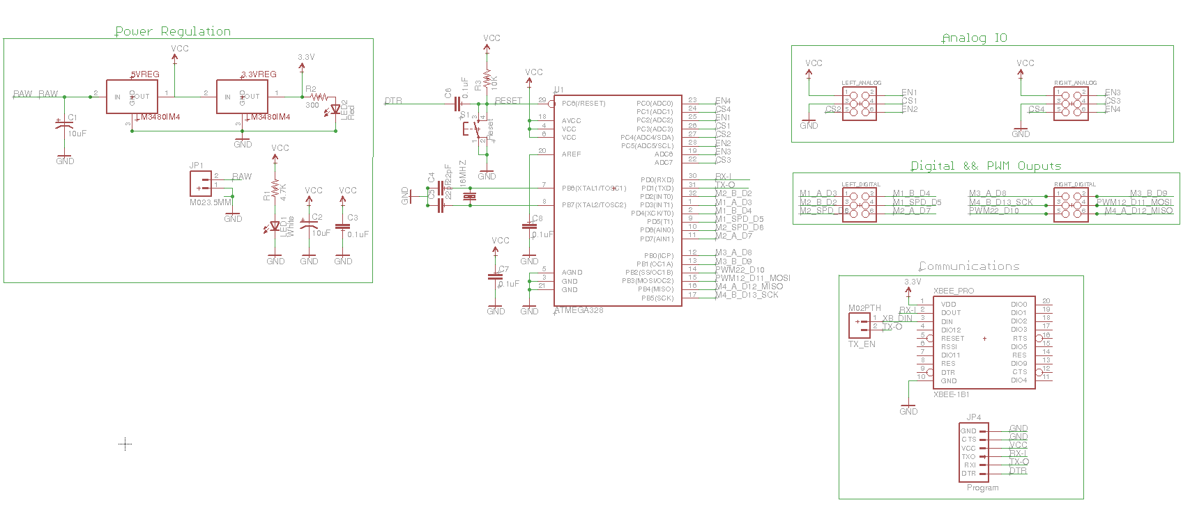
Brandon Frazer
THE QUAD CHRONICLES: Mobile Landing Platform
Mecanum Motor Driver Controller

Slide 32
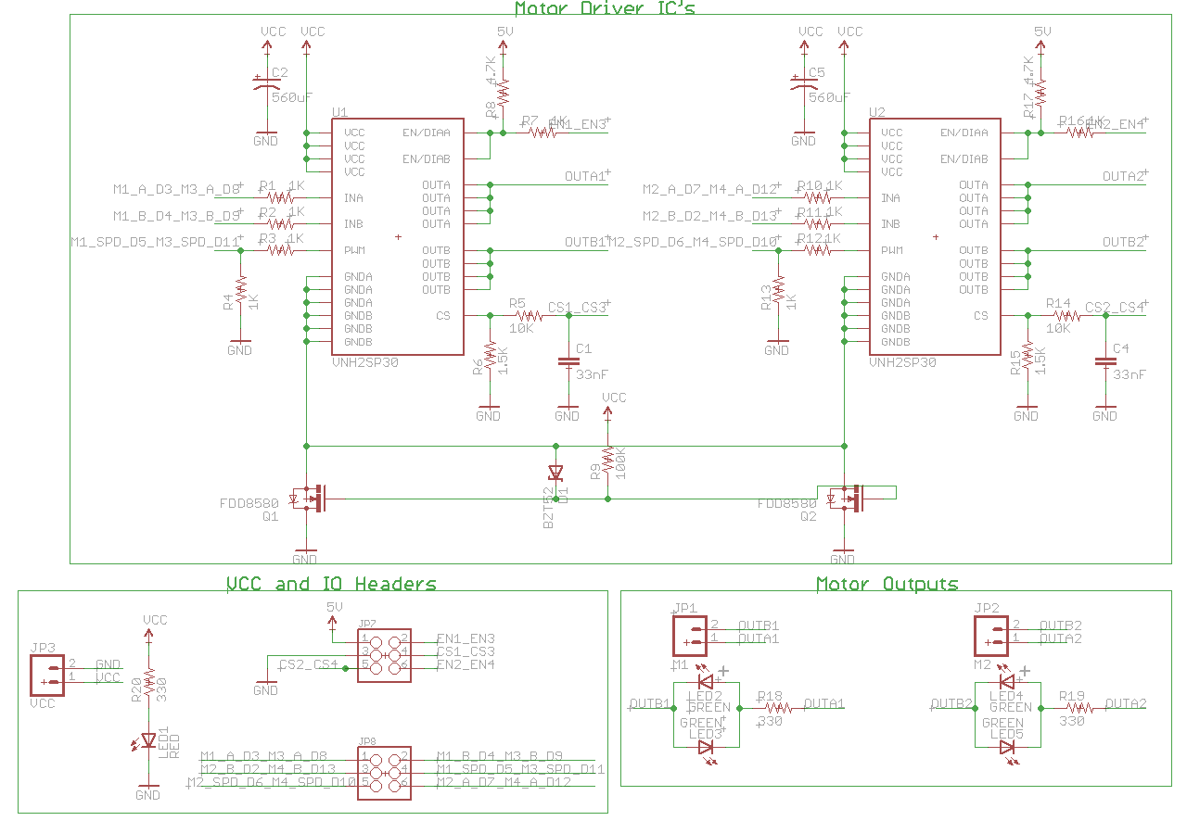
Brandon Frazer
THE QUAD CHRONICLES: Mobile Landing Platform
Motor Drivers
Notes:
Brandon or Ray

Slide 33
Ryan Borden
THE QUAD CHRONICLES: Mobile Landing Platform
Platform Peripherals
Active NeoPixel lighting
Based on WS2812 LED drivers
RGB LEDs
Controlled using a single data line
Individually addressed pixels
Arduino Mini
5 V, 2-3A
Low brightness
Programmed two mode
Runway and Cylon
Maintenance
Notes:
Brandon or Ray

Slide 34
Brandon Frazer
THE QUAD CHRONICLES: Mobile Landing Platform
Mecanum Wheel Drive-Train

Slide 35
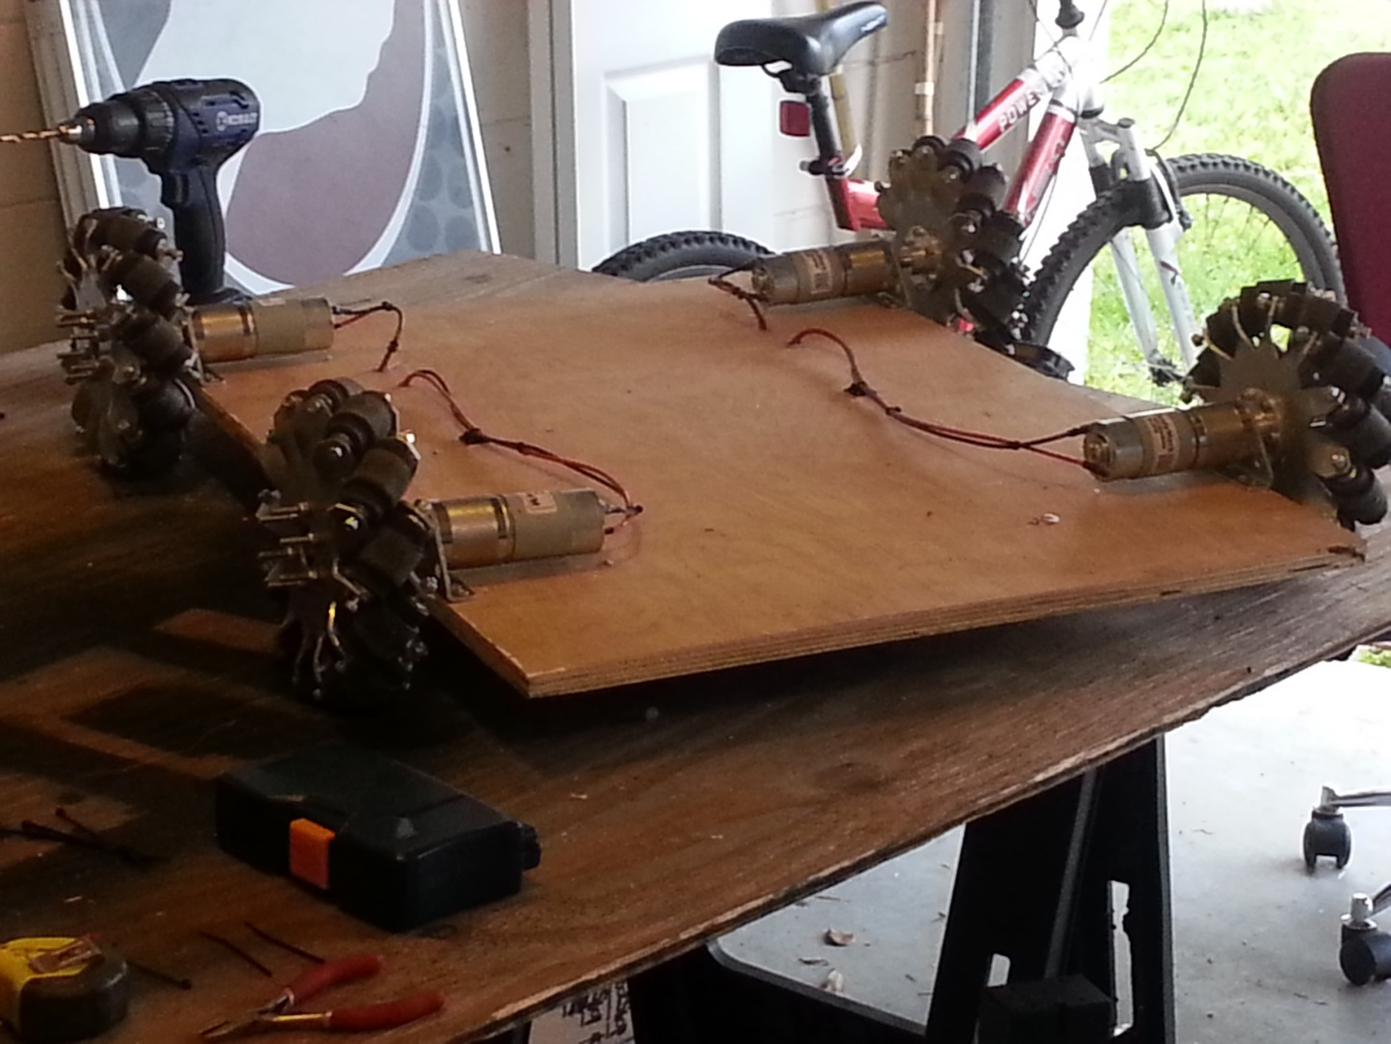
Brandon Frazer
THE QUAD CHRONICLES: Mobile Landing Platform
Mecanum Wheel Drive-Train
2-Stage Planetary Gearbox
198 RPM
Stall Current of 22 Amps
Tested Nominal Current ~5 Amps
1210 oz-in (6.3 ft-lb) Torque

Slide 36
Raymond Lueg
THE QUAD CHRONICLES: Mobile Landing Platform
Mobile Platform Power Distribution
Total Current Draw ~30 Amps Nominal
Designed to handle up to 120 Amps Peak (Stall)
Current monitoring of the left and ride side
Current monitoring of the Bedini charging circuit
System voltage and current monitoring
Notes:
Brandon or Ray
No more GRID….snow…aka cocaine.

Slide 37
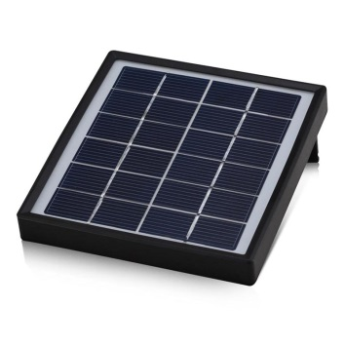
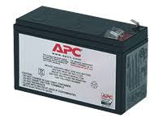
THE QUAD CHRONICLES: Mobile Landing Platform Power
Raymond Lueg
Solar Panel for supplemental power
Bedini Motor with sensing circuit
Extends life of battery system
12V battery supply
Notes:
Ray

Slide 38
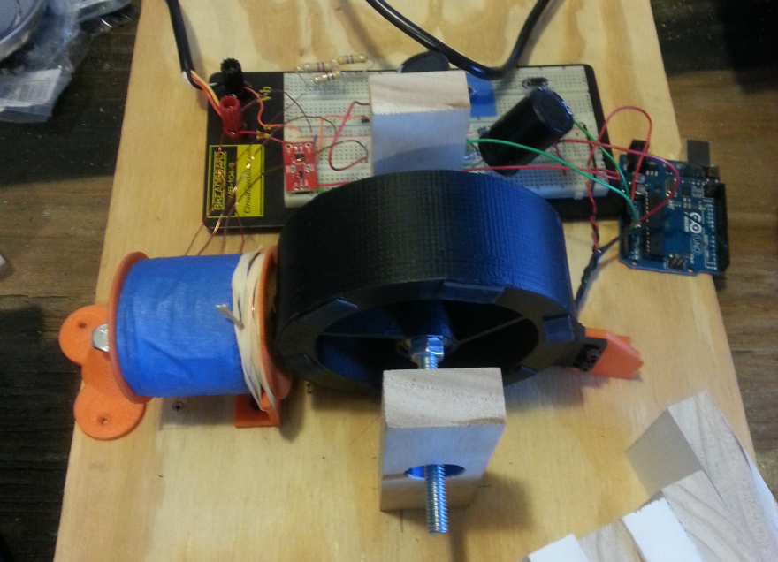
Raymond Lueg
THE QUAD CHRONICLES: Mobile Landing Platform
Bedini Motor
Regenerative power supply
Referenced design
Added sensing and switching circuitry
Mounted on mobile platform
Notes:
Ray

Slide 39
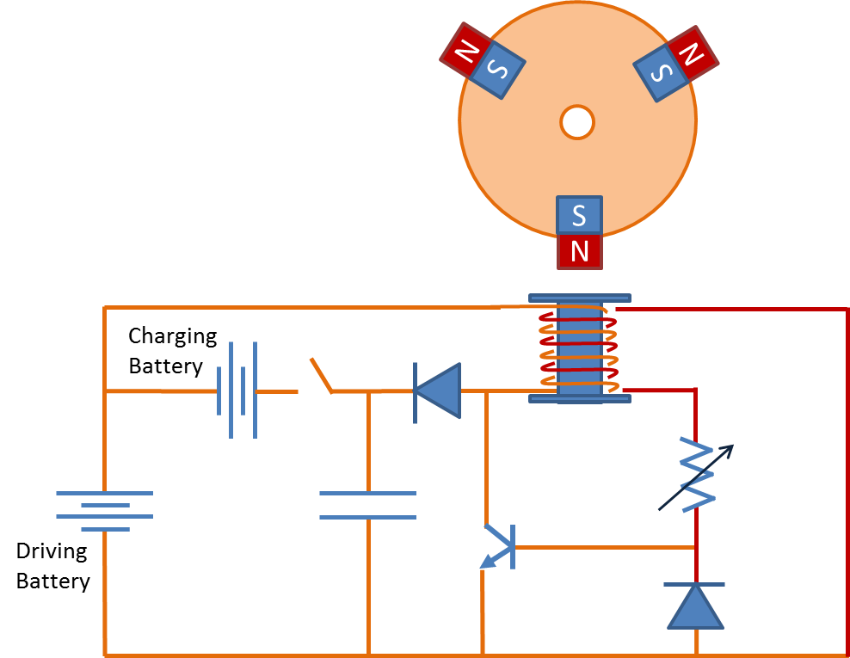
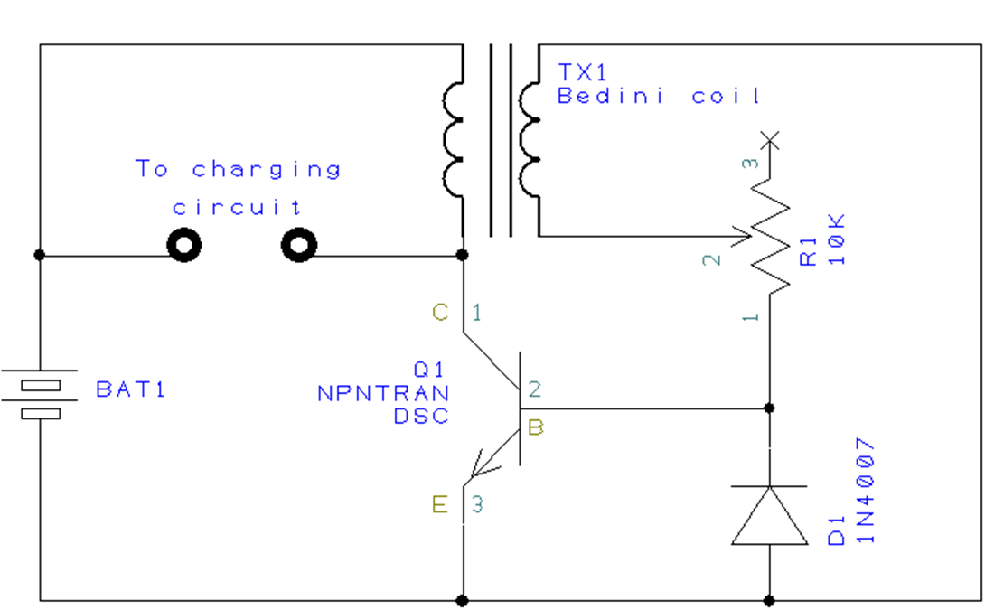
Raymond Lueg
THE QUAD CHRONICLES: Mobile Landing Platform
Bedini Motor
Notes:
Ray

Slide 40
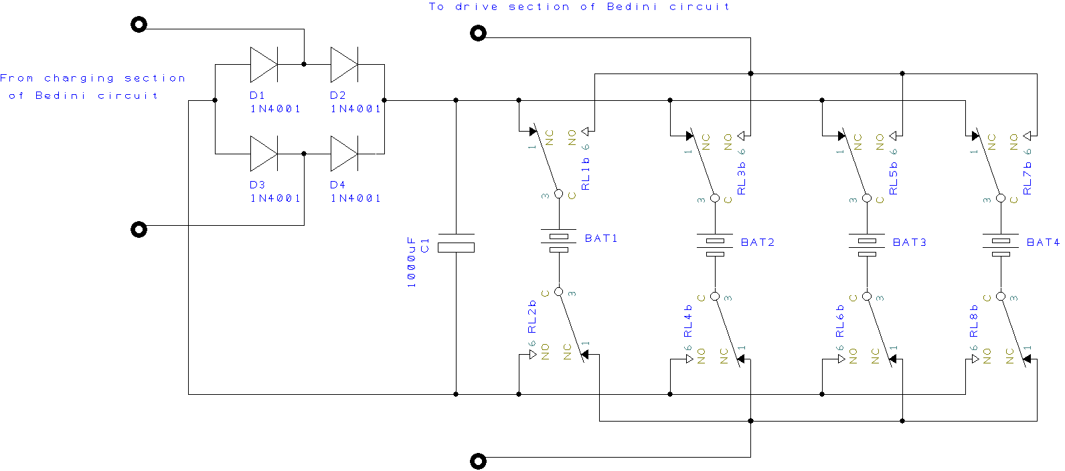
Raymond Lueg
THE QUAD CHRONICLES: Mobile Landing Platform
Bedini Motor
Bedini Circuit Diagram
Notes:
Ray

Slide 41
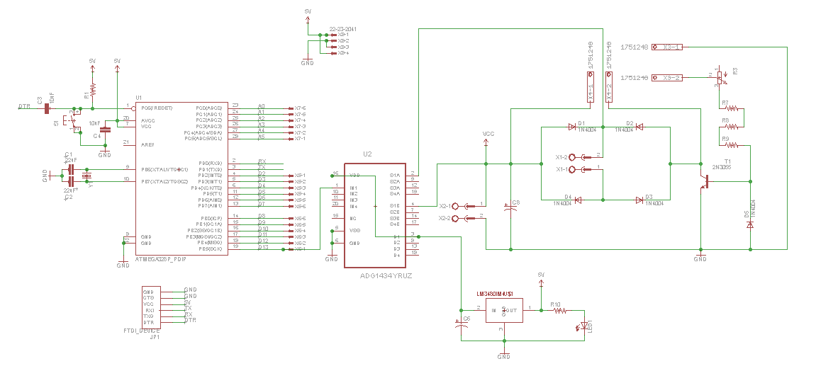
Raymond Lueg
THE QUAD CHRONICLES: Mobile Landing Platform
Bedini Motor
Bedini Schematic
Notes:
Ray

Slide 42
Brandon Frazer
THE QUAD CHRONICLES: Mobile Landing Platform
Quad Locking System
Purpose
To transport the quad copters safely while on the mobile platform.
Parameters
Easily controlled by the MLPCT
Minimal power consumption (Ability to turn off when locked/not in use)
Stability
Components
Neodymium magnets
¼ Scale Hitech Servos (183 oz-in Torque)
Notes:
Brandon or Ray

Slide 43
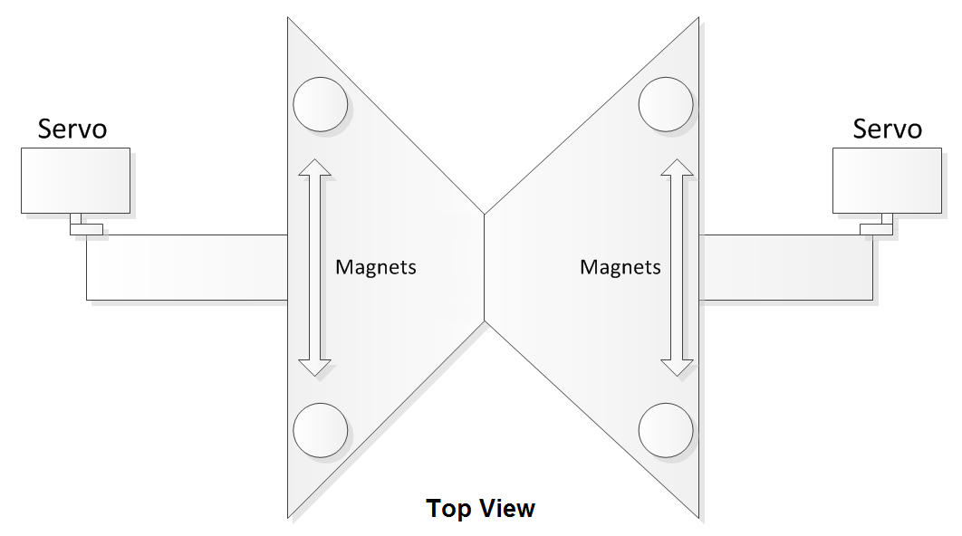
Brandon Frazer
THE QUAD CHRONICLES: Mobile Landing Platform
Quad Locking System
Notes:
Brandon or Ray

Slide 44
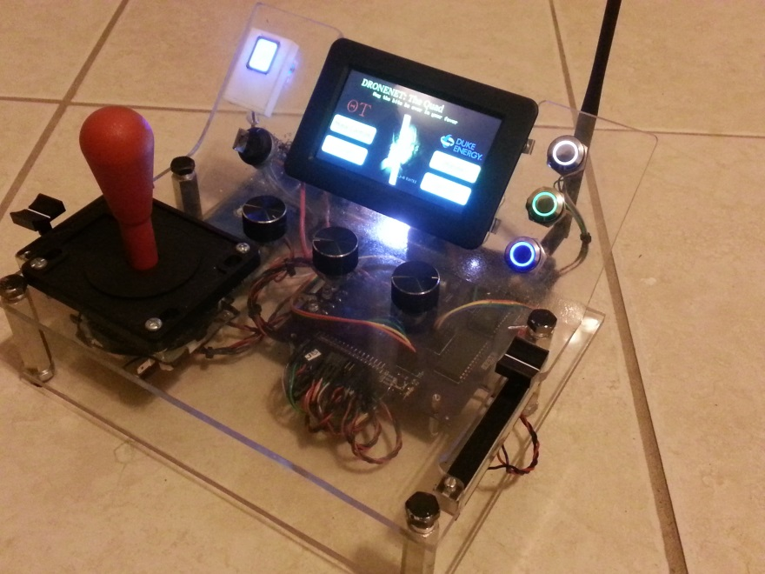
THE QUAD CHRONICLES: Platform Carrier Control Terminal Design & System Integration
Brandon Frazer
Mobile Landing Platform Control Terminal
Mobile Platform Brains
Real time monitoring and controls
Touchscreen graphical LCD
Slide potentiometers and push buttons
8-Way Joystick for motor controls
Fingerprint Scanner
Notes:
Brandon or Ray

Slide 45
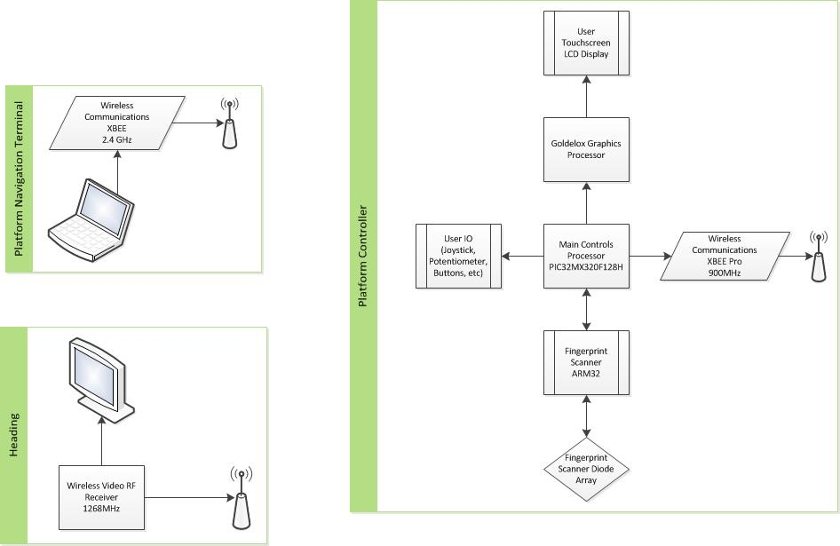
THE QUAD CHRONICLES: Platform Carrier Control Terminal Electronic Device Architecture
Brandon Frazer
Notes:
Fix the visio “heading”

Slide 46
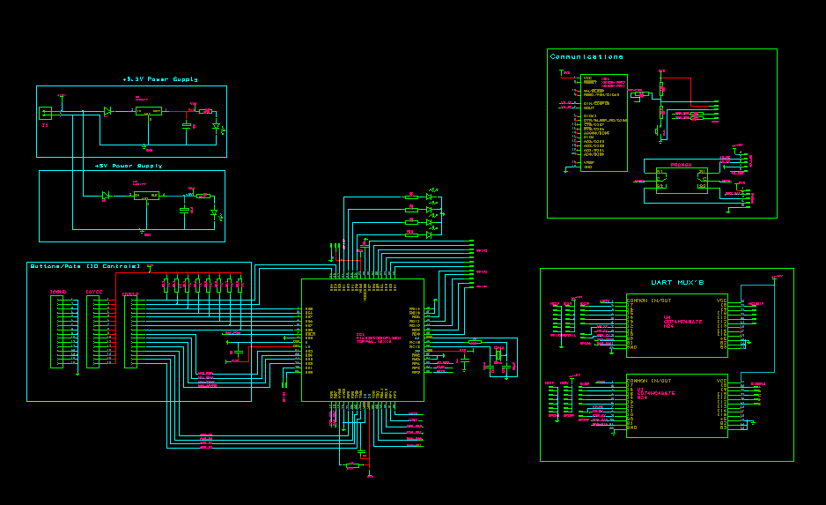
THE QUAD CHRONICLES: Platform Carrier Control Terminal MLPCT Schematic
Brandon Frazer
Notes:
Brandon

Slide 47
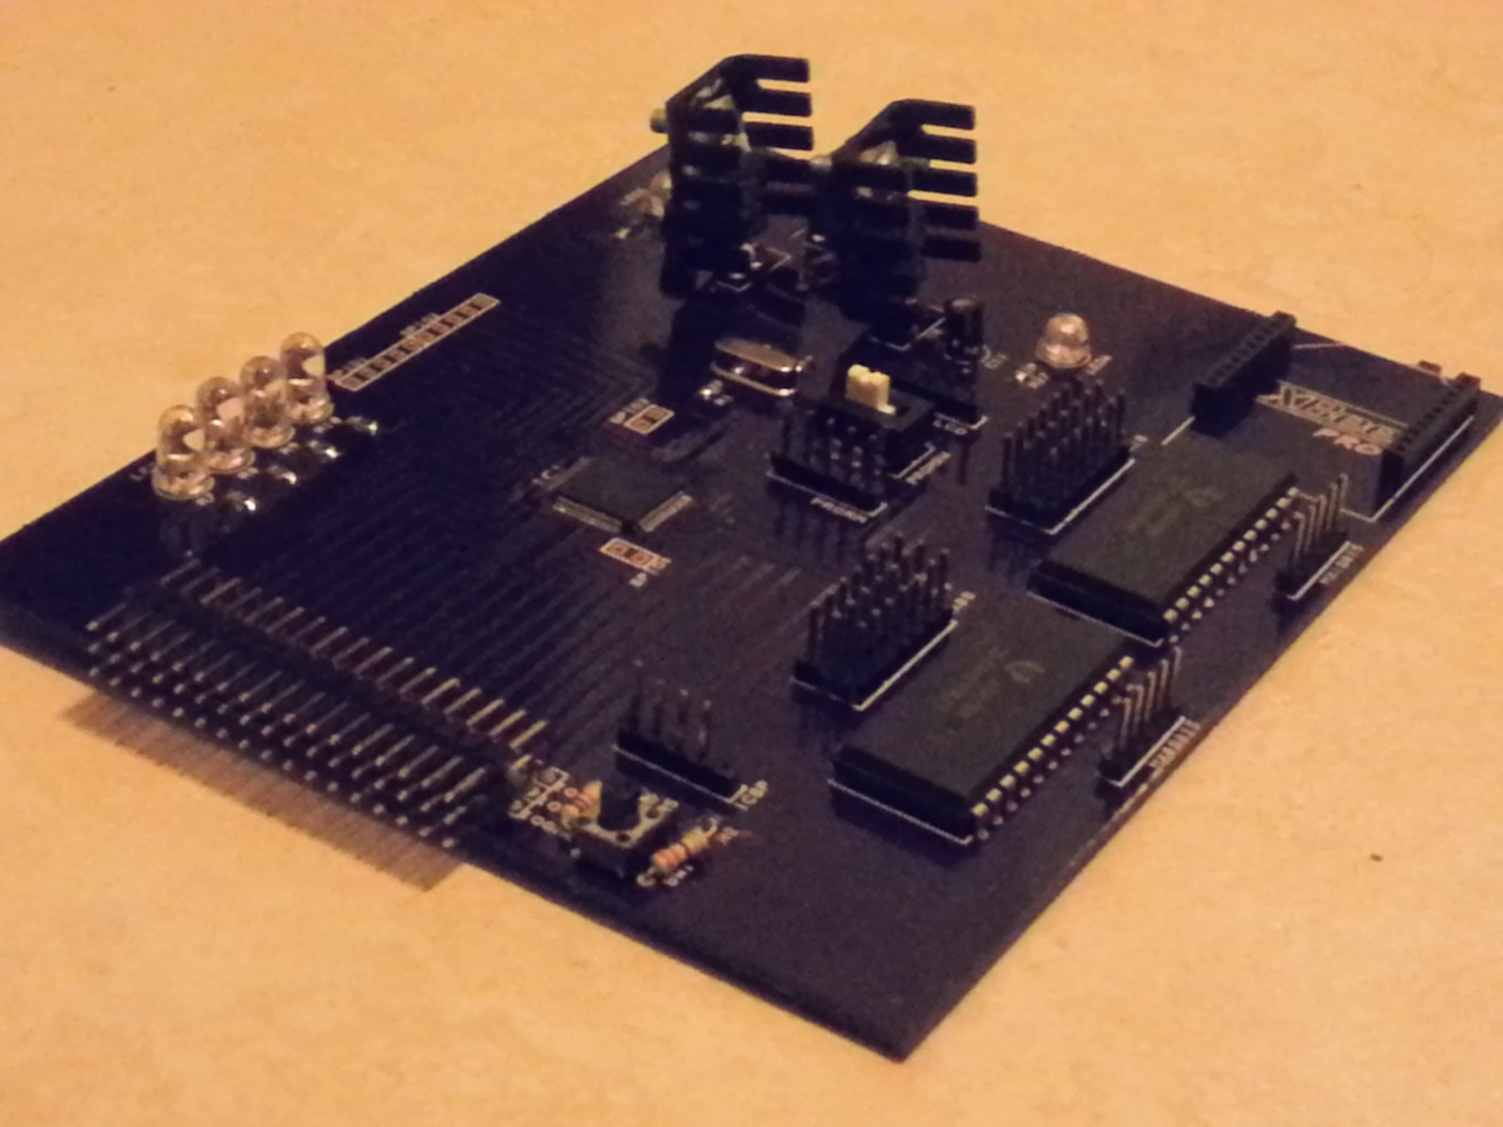
THE QUAD CHRONICLES: Platform Carrier Control Terminal MLPCT PCB
Brandon Frazer
Notes:
Brandon

Slide 48
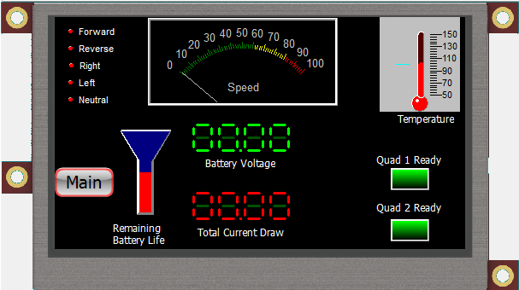
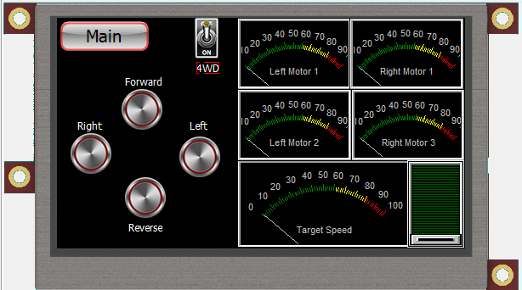
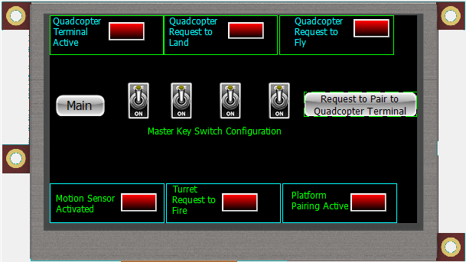
THE QUAD CHRONICLES: Platform Carrier Control Terminal MLPCT Menu System
Brandon Frazer
Notes:
Brandon

Slide 49
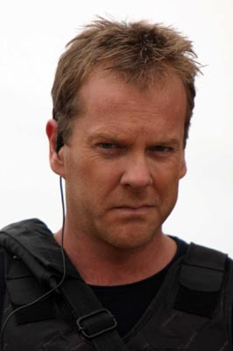
THE QUAD CHRONICLES UAV Carrier Control Terminal MLPCT Security System
Brandon Frazer
Security System
Secured across Sub-Systems I-IV
Fingerprint scanner for user authentication
Certain actions (such as arming the turret or unlocking/landing a Quadcopter) require authentication codes
Notes:
Brandon

Slide 50
Brandon Frazer
THE QUAD CHRONICLES: Mobile Landing Platform
Camera System
200 mW RF Transmitter(TX)-Receiver(RX)
1268MHz operating frequency
GoPro HERO3 mounted on a user-controlled Pan and Tilt Servo System
Mounted with an Ultrasonic Sonar for range
Ability to be viewed through any LCD with RCA inputs
Tested TX range ~700 feet (line of site)

Slide 51
Brandon Frazer
THE QUAD CHRONICLES: Mobile Landing Platform
Budget
Quadcopter
$760
Quadcopter Control Terminal
$95
Platform
$2100
Platform Control Terminal
$280
Misc. Materials
$350

Slide 52
Raymond Lueg
THE QUAD CHRONICLES: Mobile Landing Platform
Division of Labor
 | Platform | Regenerative Power System | Platform Control Terminal | Quadcopter | Quadcopter Control Terminal | Administrative
Brandon | X |  | X | X | X | X
Ray | X | X |  |  |  | X
Ryan |  |  |  | X | X | X
Joe |  |  |  | X | X | X

Slide 53
Brandon Frazer
THE QUAD CHRONICLES: Mobile Landing Platform
Acknowledgments
Dr. Richie – Encouragement and Advice
Duke Energy – Funding
Theta Tau Rho Gamma
Monica Bertram, M.E.
Sean Delvecchio, M.E.
Matthew Harrison, M.E.
Steven Darrow, A.E.
UCF Alumni
Stephen Sheldon, E.E.

Slide 54
THE QUAD CHRONICLES: Mobile Landing Platform
Questions
Notes:
WEEEEEEEEEEEEEEEEEEEE

Slide 55
Appendices
Mobile Platform Control Terminal

Slide 56
Appendices
Platform Master and Slave Controllers

Slide 57
Appendices
Mecanum Motor Driver Controller

Slide 58
Appendices
Motor Drivers

Slide 59
Appendices
Bedini Motor

