Slide 1
Game Qube
UCF Senior Design Group 33
Stephen Monn (CpE)
Omar Alami (CpE)
Matthew Dworkin (CpE)

Slide 2
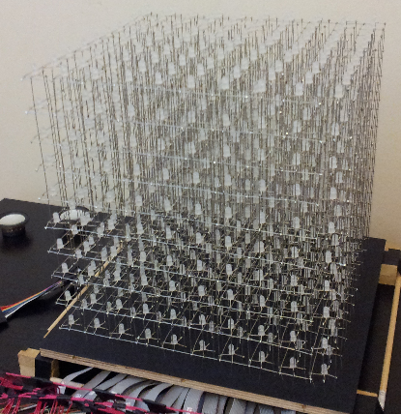
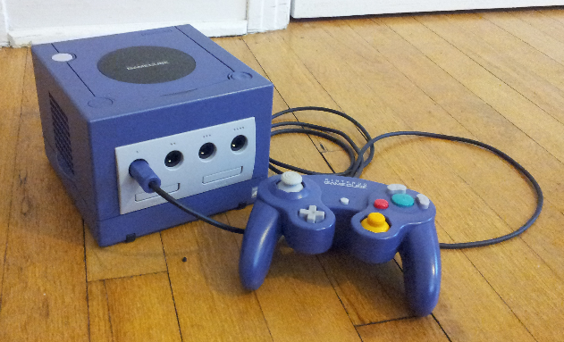
Project Description
Game Qube is a video game unit, inspired by the Nintendo Gamecube, that includes games and applications highlighting it’s unique LED cube display.
Game Qube

Slide 3
Project Specifications
Pixel Resolution: 10 x 10 x 10 = 1000 LEDs
LED Volume Dimension: 10’’x10’’x10’’
Base Dimension: 12’’x12’’x4’’
Visible Sides of Cube: Top, All Sides (not Bottom)
LED Color: Multiple colors supported
Color Depth: 8bit = 256 colors per LED
LED Refresh Rate: at least 60Hz
Input Voltage: 120V AC at 60Hz (Standard Wall Outlet)
Input: Gamecube Controllers
Low Cost

Slide 4
Modular Design Overview
Handles LED display driving
Volume Based Rendering Software
LED Volumetric Display Control
Central Processing
Handles all graphics and input processing
Data transferred through custom display interface

Slide 5
Modular Design Overview
Volume Based Rendering Software
LED Volumetric Display Control
Central Processing

Slide 6
LED Display Goals
Multiplex the LEDs so that they are not all on at once (drive LEDs in smaller chunks)
Low power consumption
Highly responsive interface

Slide 7
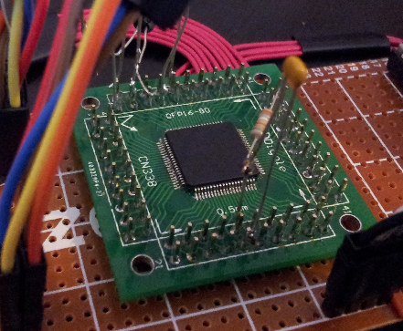
Micro Controller
MSP430s
Model | RAM (kB) | Flash (kB) | Clock (MHz) | Max SPI | I/O Pins
g2553 | 0.5 | 16 | 16 | 2 | 24
g2203 | 0.25 | 2 | 16 | 2 | 24
g2303 | 0.25 | 4 | 16 | 2 | 24
f5529 | 8 | 128 | 25 | 4 | 63

Slide 8
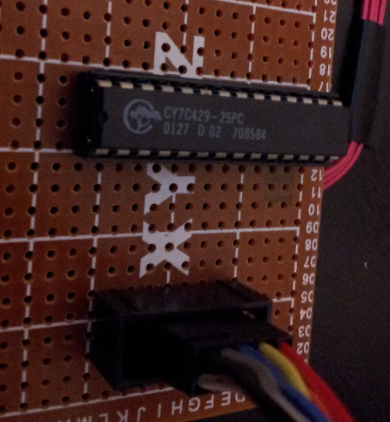
Memory IC
FIFO Memory
Generally less expensive
Fewer I/O pins
Easy buffer like interface
Asynchronous and simultaneous read and write
CYPRESS CY7C429-25PC
2kx9 memory size
28.5MHz R/W rate
Can be swapped for higher memory capacities

Slide 9
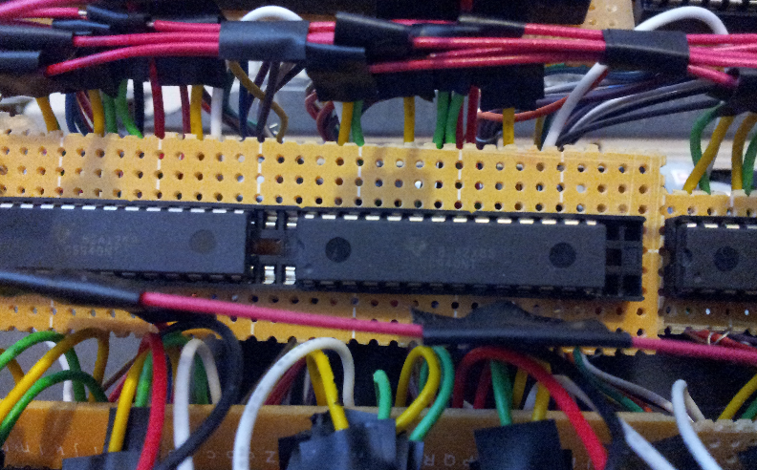
LED Drivers
Driver | Channels | Transfer Speed | PWM (Brightness) | Dot Correction
STP16CP05 | 16 | 30MHz | No | No
TLC5940 | 16 | 30MHz | Yes | Yes

Slide 10
LEDs
Specifications
Diffused for better color mixing
Common anode for LED driver compatibility
8mm for low visual obstruction
Layout
Anodes of layers are tied together (10)
Cathodes are common across all layers (300)
10x300 addressable matrix

Slide 11
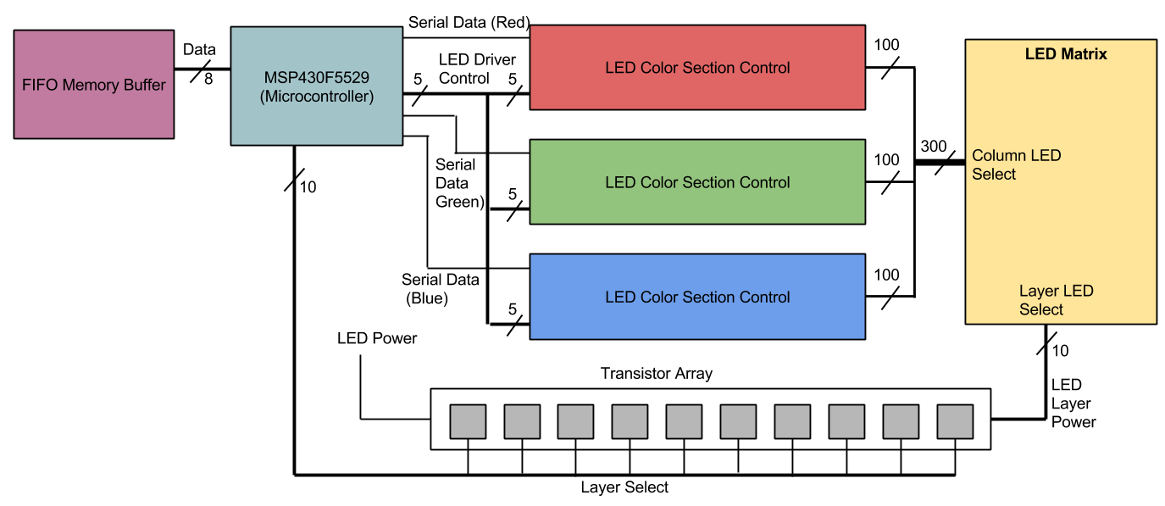
LED Control Overview

Slide 12
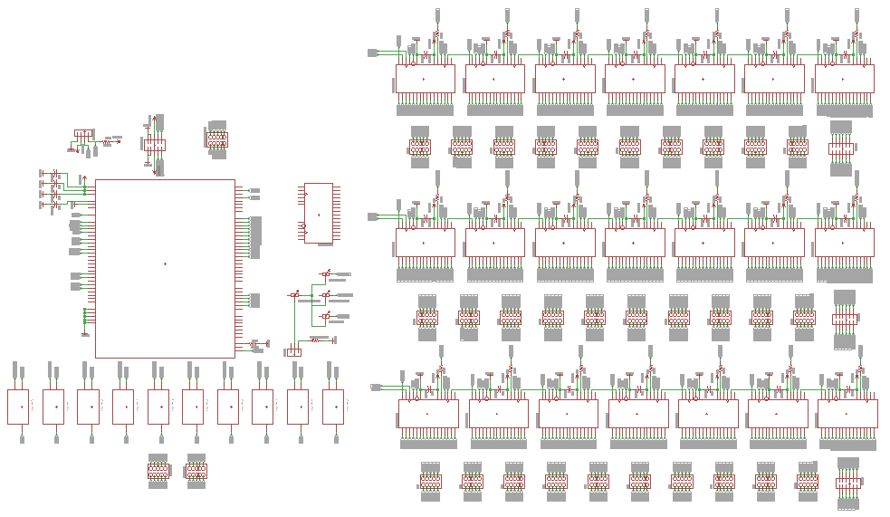
Schematic

Slide 13
Software/Interface
10 Pin Connector
Clock
LED control software is interrupt based running on a timer
LED cube refreshes at around 300Hz, but is an overkill frequency for rendering frames
Software then only checks for new data after 5 cube refreshes (60Hz)
Cube still refreshes at 300Hz, however, and is then capable of checking after refresh 6, 7, 8, etc.
Gives a supported frame rates of 60Hz, 50.8Hz, 43.6Hz, 38Hz, 33.9Hz
Data
Sync
Pins | Function
Data | Pins to write a byte of data
Clock | Clock in the byte of data
Sync | Goes low when all data has been processed. Can be used to keep a constant 60Hz frame rate

Slide 14
Timing Diagram
3.34ms (300Hz)
Clock
Sync
16.7ms (60Hz)
16.7ms (60Hz)
16.7ms (60Hz)
23.38ms (42.8Hz)

Slide 15
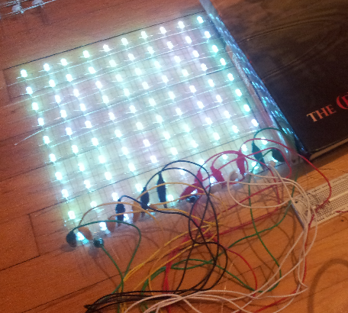
Testing
LED Stress Testing
All LEDs were individually tested to ensure all colors were appropriately lighting
LEDs were left on for 3hrs. at a constant current of 5mA to ensure reliability over time
Results
Only one bad LED was found out of 1000
All LEDs maintained consistent brightness over long period of time

Slide 16
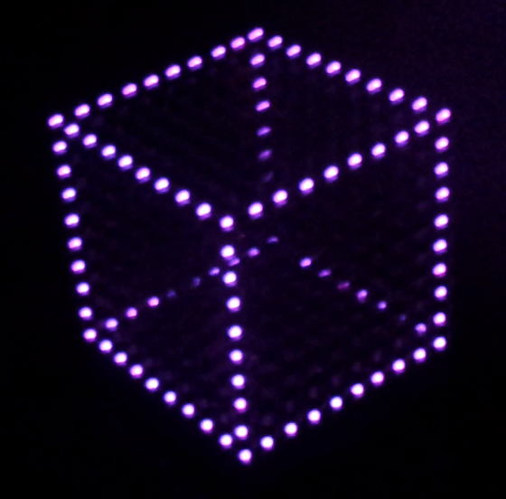
Testing
Cube Refresh Rates
Display was tested to ensure a refresh rate of 300 Hz was being achieved
Results
Lights blinked at a noticeable 1 Hz when programmed to blink once every 300 refreshes

Slide 17
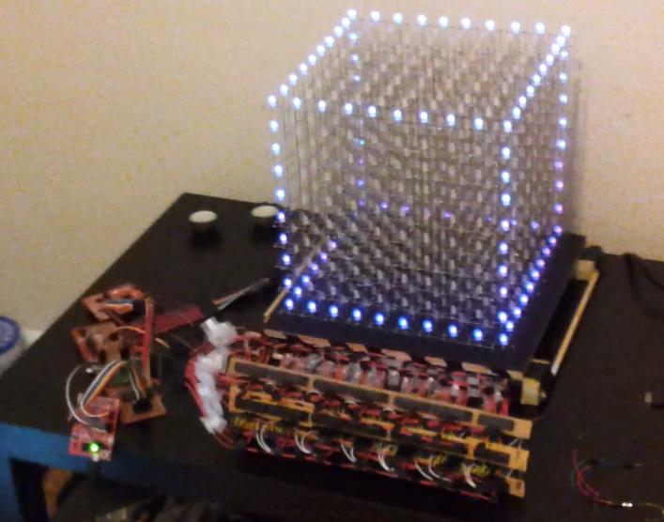
Testing
Interface
Interface was tested to ensure a reliable and consistent data transfer
Results
Successful transfer of byte encoded LED data with little to no display artifacts
Have not yet stressed the interface to determine highest possible refresh rates

Slide 18
Central Processing
Volume Based Rendering Software
LED Volumetric Display Control
Central Processing

Slide 19
Central Processing Goals
Supply data to LED cube
Communicate with Gamecube Controller
Control the power
Control any additional features

Slide 20
Microcontroller Requirements
Enough memory for games and animations: 256kB+
Enough IO pins for 1+ controllers, LED data, and future features: 20+
Easy to program

Slide 21
Microcontroller Choices
Model | Family | Architecture | Flash (kB) | Clock (MHz) | I/O Pins
Atmel UC3: AT32UC3B0512 | AVR UC3 | 32-bit AVR | 512 | 64 | 60
TI Tiva: TM4C123GH6PM | Cortex-M4 | ARMv7-M (Thumb2) | 256 | 80 | 43
Atmel SAM3S: ATSAM3S8B | Cortex-M3 | ARMv7-M (Thumb2) | 512 | 64 | 64

Slide 22
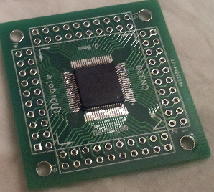
Microcontroller Choice
TI Tiva: TM4C123GH6PM
Meets minimum requirements
Easier programming
Launchpad allows for quick testing and as a reference design

Slide 23
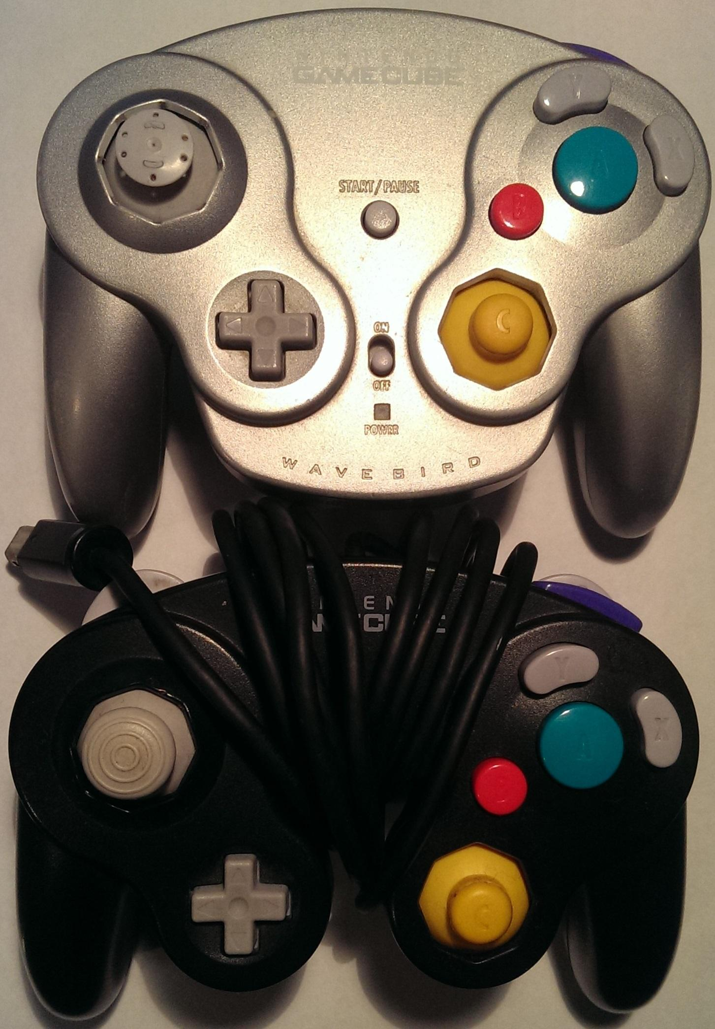
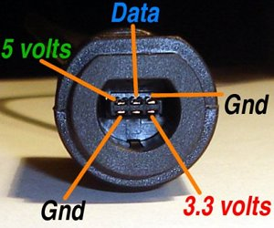
Gamecube Controller
Fits theme
Plenty of buttons
Wired and wireless options
Four pins per controller

Slide 24
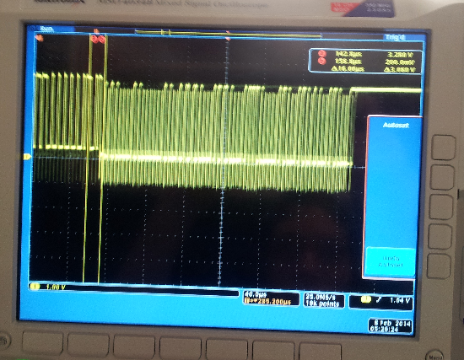
Testing
Gamecube controller timings
Oscilloscope was used to verify that the main microcontroller was able to produce a signal precisely timed so that the Gamecube controller would understand and respond with button data
Results
Successfully sent timed signal and were able to retrieve button data from the controller

Slide 25
Power
Requirements:
LED Display: 3.3V, 1A
TI Tiva: 3.3V
Gamecube controller: 5V, 3.3V
Options:
12V Gamecube AC Adapter
9V AC Adapter
Design:
12V Gamecube AC Adapter
DC/DC Converter: 3.3V, 5V

Slide 26
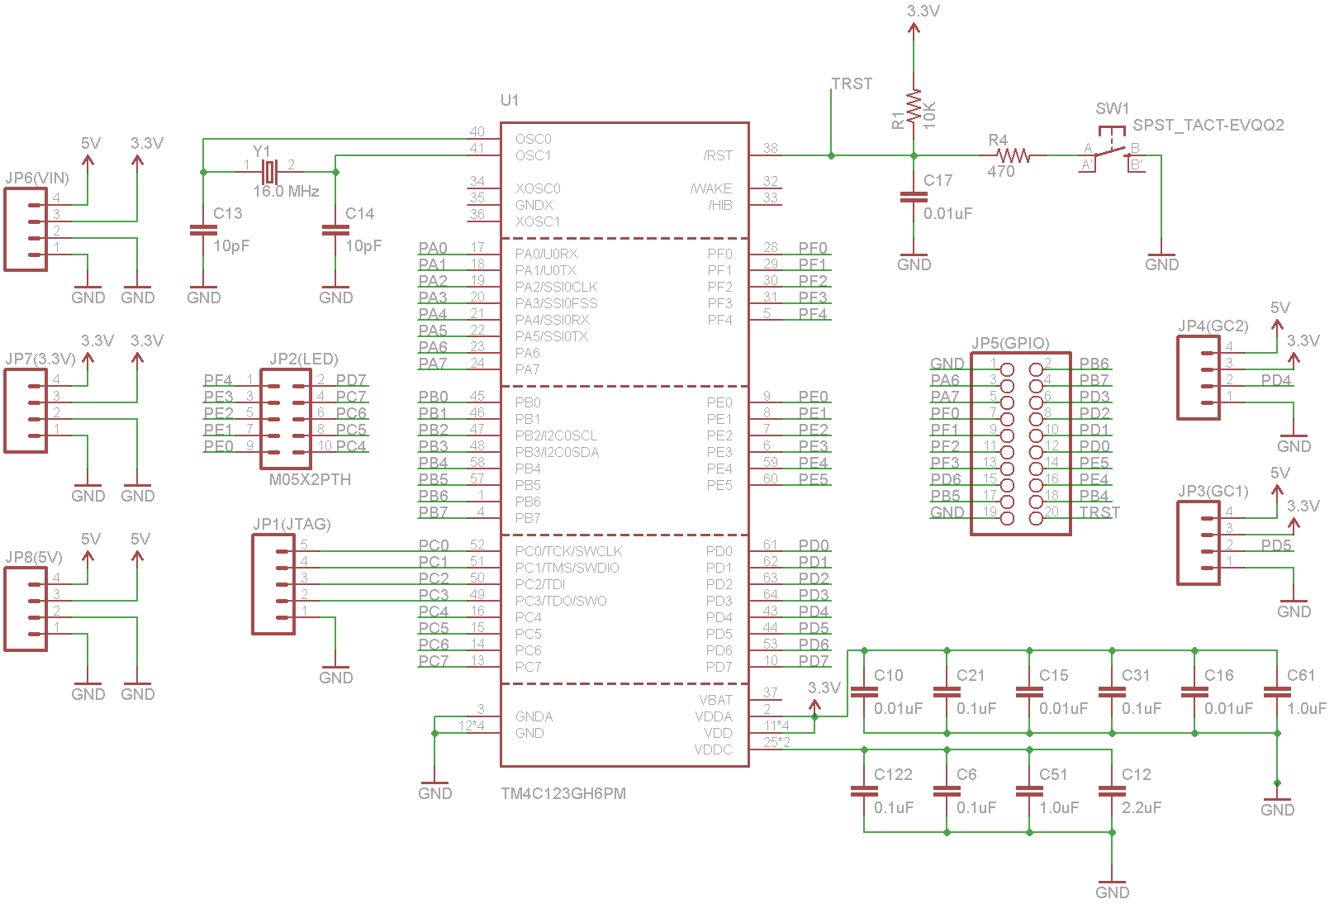
Board Design

Slide 27
Software
Volume Based Rendering Software
LED Volumetric Display Control
Central Processing

Slide 28
Software Goals
Animations
Games
Simple user interface

Slide 29
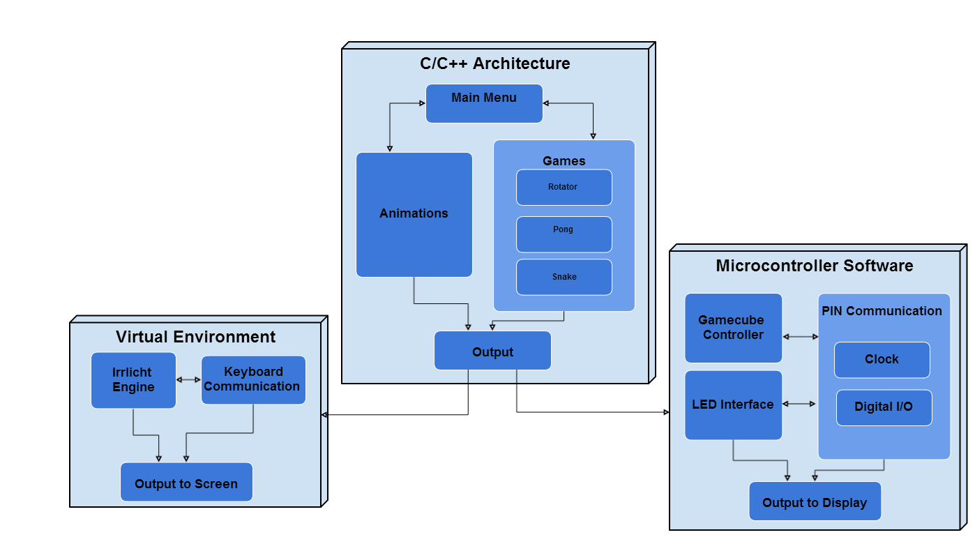
Software Block Diagram
Low level microcontroller interface
Virtual environment testing interface
Core rendering and program flow

Slide 30
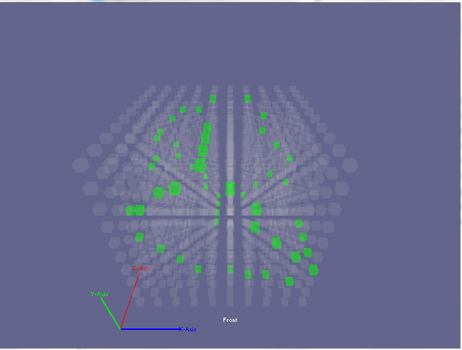
Virtual Environment
Virtual representation of our LED Cube
Easy input mapping to keyboard or any convenient PC peripherals
Allows for immediate testing of animations and games
Acts as a quick prototyping environment for testing new ideas before embedded design

Slide 31
Rendering Engine
Runnable
Handles logic loop for anything that can be run from the main menu
Scene Manager
Keeps track of all items to be rendered in a scene
Main
- Creates a Video Driver, Scene Manager and Controller - Creates all runnables - Handles transitioning between different runnables
Scene Nodes
Individual items drawn in a scene
1
*
1
1
Video Driver
Handles rendering primitives to a buffer array
Controller
Handles all things related to input

Slide 32
User Interface
Main Menu
(Home)
Snake
Animations
Rotator
Other Games

Slide 33
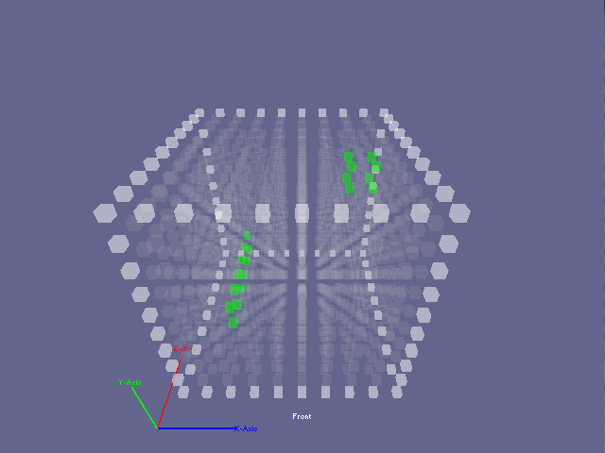
Snake
Control a snake’s movement in order to collect dots and make the snake grow longer
Snake can move in x, y, and z directions

Slide 34
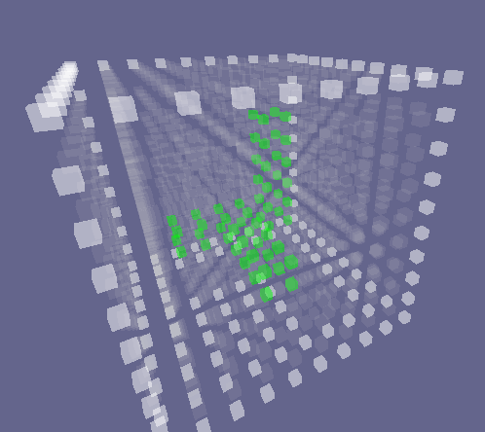
Rotator
Rotate a block so that it can fit through a hole on one side of the cube
The block can rotate left, right, forwards and backwards

Slide 35
Animation Testing
3D Rendered Wireframes
Display a wireframe mesh of a cube on LED display for possible game applications
Results
Wireframe objects look too distorted on such a low resolution display, especially when not moving

Slide 36
Administrative Info

Slide 37
Budget
Item | Price | Qty | Total
10pin Ribbon Cable x1 | $0.99 | 16 | $15.84
Ribbon Cable Sockets x20 | $4.99 | 2 | $9.98
Ribbon Cable Sockets x4 | $1.01 | 1 | $1.01
28pin DIP IC Sockets x5 | $0.99 | 5 | $4.95
TLC5940NT x20 | $17.50 | 1 | $17.50
5mm RGB LEDs x1000 | $60.60 | 1 | $60.60
MSP430F5529 | $0.00 | 1 | $0.00
Resistors/Capacitors | $0.00 | 0 | $0.00
Wire (price/ft) | $0.03 | 500 | $15.00
2kx9 FIFO CY7C429-25PC x5 | $4.99 | 1 | $4.99
Item | Price | Qty | Total
P-Channel MOSFET x20 | $3.19 | 1 | $3.19
LED Matrix Wood Base | $4.99 | 1 | $4.99
LED Matrix Black Paper | $0.33 | 1 | $0.33
LED Matrix Nails | $1.30 | 1 | $1.30
0.1uF Ceramic Capacitors x100 | $0.99 | 1 | $0.99
Broken Gamecube | $0.99 | 1 | $0.99
Sub Total: | $140.67
Shipping: | $31.81
Grand Total: | $172.48

Slide 38
Work Distribution
 | Omar Alami | Matthew Dworkin | Stephen Monn
Main Controller (Processor/ Power/ Controls)
Main Software (Rendering Engine/ Games)
LED Cube Control (LED Driving/ Display Interface)

Slide 39
Progress
Research
Design
Prototype
Testing
Final Package
Stretch Goals
Main Controller (Processor/ Power/ Controls)
Overall: 70%
Main Software (Rendering Engine/ Games)
LED Cube Control (LED Driving/ Display Interface)
10% 20% 30% 40% 50% 60% 70% 80% 90% 100%

Slide 40
Overall Difficulties
Housing Design
Very tricky timings!
IC Coupling
Race conditions
Heap size allocation

Slide 41
Questions?

