Slide 1
GameQube
UCF Senior Design Group 33
Stephen Monn (CpE)
Omar Alami (CpE)
Matthew Dworkin (CpE)

Slide 2
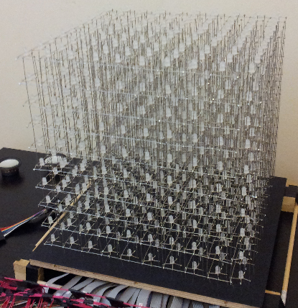
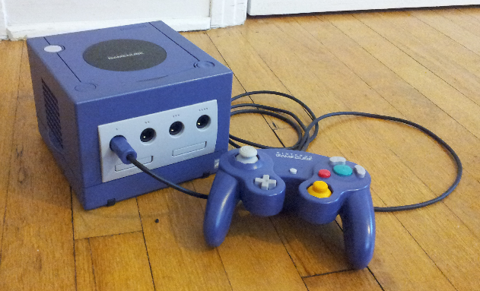
Project Description
Game Qube is a video game unit, inspired by the Nintendo Gamecube, that includes games and applications highlighting it’s unique LED cube display.
Game Qube

Slide 3
Project Specifications
Pixel Resolution: 10 x 10 x 10 = 1000 LEDs
LED Volume Dimension: 10’’x10’’x10’’
Base Dimension: 14’’x14’’x5’’
LED Color: Multiple colors supported
Color Depth: 8bit
Frame Rate: 60Hz
Input Voltage: 120V AC at 60Hz (Standard Wall Outlet)
Input: Gamecube Controllers
Low Cost

Slide 4
Modular Design Overview
Handles LED display driving
Volume Based Rendering Software
LED Volumetric Display Control
Central Processing
Handles all graphics and input processing
Data transferred through custom display interface

Slide 5
Modular Design Overview
Volume Based Rendering Software
LED Volumetric Display Control
Central Processing

Slide 6
LED Display Goals
Multiplex the LEDs so that they are not all on at once (drive LEDs in smaller chunks)
Low power consumption
Highly responsive interface

Slide 7
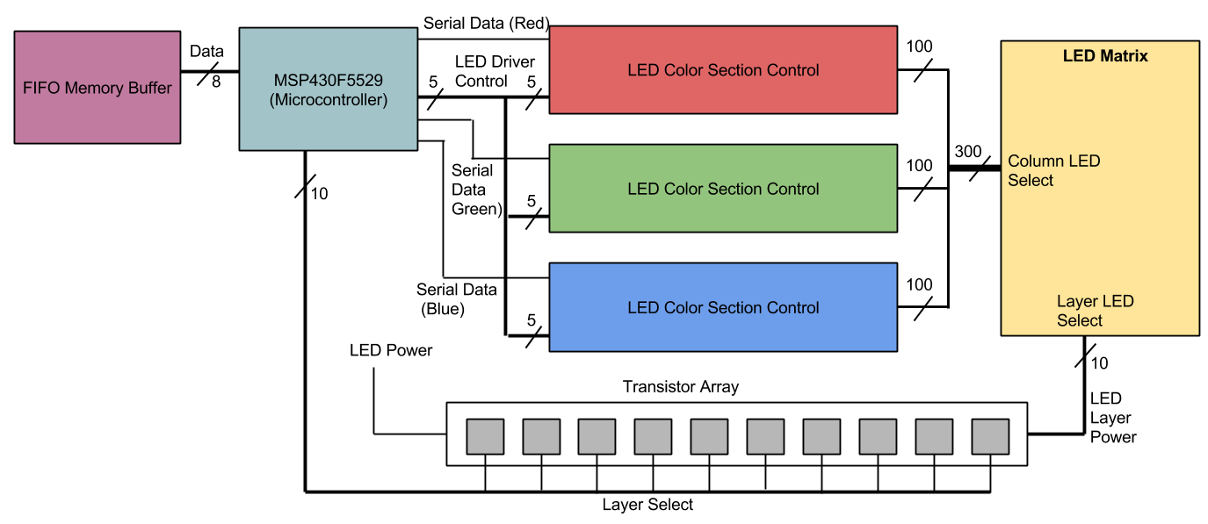
LED Control Overview

Slide 8
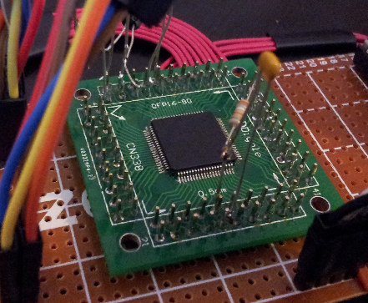
Micro Controller
MSP430s
Model | RAM (kB) | Flash (kB) | Clock (MHz) | Max SPI | I/O Pins
g2553 | 0.5 | 16 | 16 | 2 | 24
g2203 | 0.25 | 2 | 16 | 2 | 24
g2303 | 0.25 | 4 | 16 | 2 | 24
f5529 | 8 | 128 | 25 | 4 | 63

Slide 9
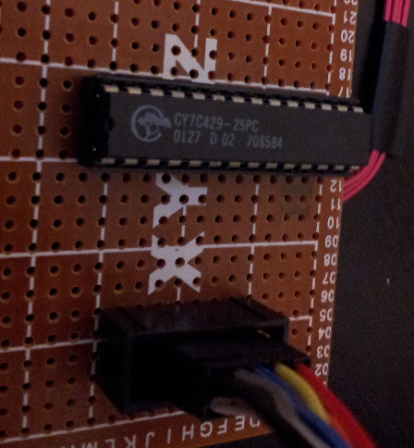
Memory IC
FIFO Memory
Generally less expensive
Fewer I/O pins
Easy buffer like interface
Asynchronous and simultaneous read and write
CYPRESS CY7C429-25PC
2kx9 memory size
28.5MHz R/W rate
Can be swapped for higher memory capacities

Slide 10
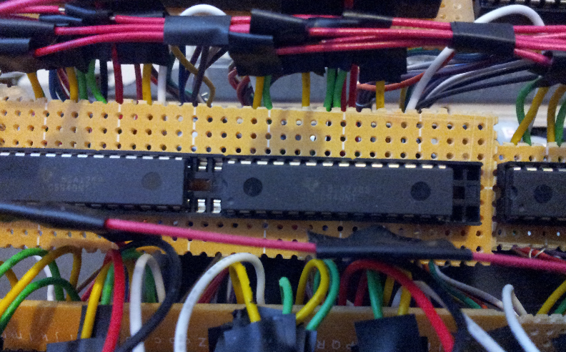
LED Drivers
Driver | Channels | Transfer Speed | PWM (Brightness) | Dot Correction
STP16CP05 | 16 | 30MHz | No | No
TLC5940 | 16 | 30MHz | Yes | Yes

Slide 11
LEDs
Specifications
Diffused for better color mixing
Common anode for LED driver compatibility
8mm for low visual obstruction

Slide 12
LEDs
Specifications
Diffused for better color mixing
Common anode for LED driver compatibility
8mm for low visual obstruction
Layout
Anodes of layers are tied together (10)
Cathodes are common across all layers (300)
10x300 addressable matrix

Slide 13
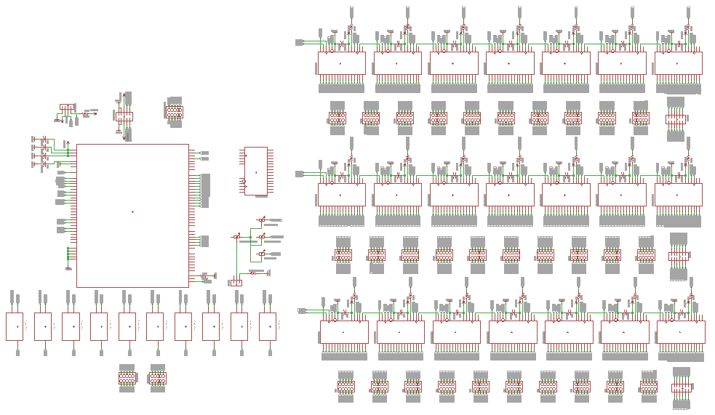
Schematic

Slide 14
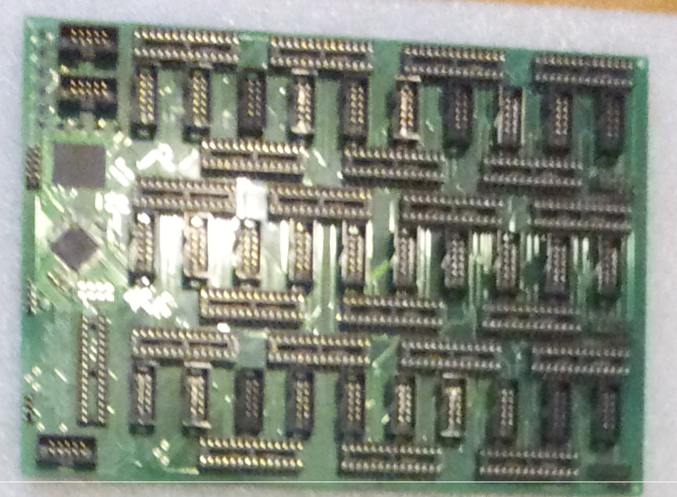
PCB

Slide 15
Software/Interface
10 Pin Connector
Clock
LED control software is interrupt based running on a timer
LED cube refreshes at around 300Hz, but is an overkill frequency for rendering frames
Software then only checks for new data after 5 cube refreshes (60Hz)
Cube still refreshes at 300Hz, however, and is then capable of checking after refresh 6, 7, 8, etc.
Gives a supported frame rates of 60Hz, 50.8Hz, 43.6Hz, 38Hz, 33.9Hz
Data
Sync
Pins | Function
Data | Pins to write a byte of data
Clock | Clock in the byte of data
Sync | Goes low when all data has been processed. Can be used to keep a constant 60Hz frame rate

Slide 16
Timing Diagram
3.34ms (300Hz)
Clock
Sync
16.7ms (60Hz)
16.7ms (60Hz)
16.7ms (60Hz)
23.38ms (42.8Hz)

Slide 17
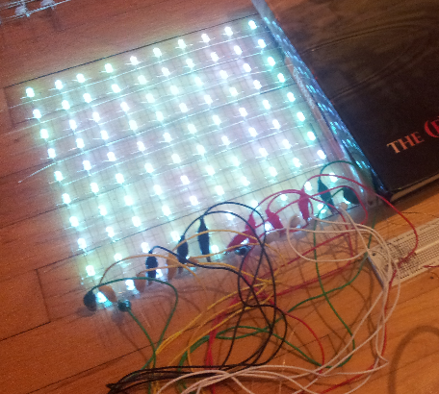
Testing
LED Stress Testing
All LEDs were individually tested to ensure all colors were appropriately lighting
LEDs were left on for 3hrs. at a constant current of 5mA to ensure reliability over time
Results
Only one bad LED was found out of 1000
All LEDs maintained consistent brightness over long period of time

Slide 18
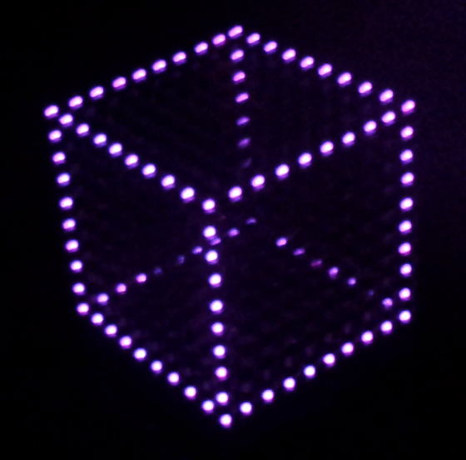
Testing
Cube Refresh Rates
Display was tested to ensure a refresh rate of 300 Hz was being achieved
Results
Lights blinked at a noticeable 1 Hz when programmed to blink once every 300 refreshes

Slide 19
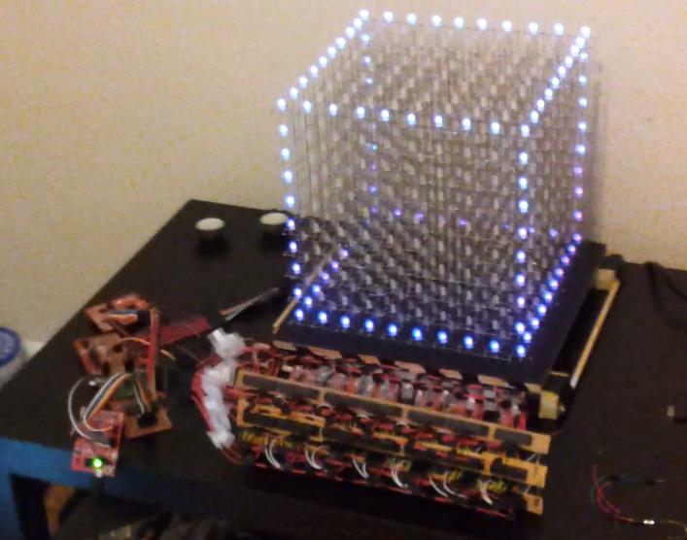
Testing
Interface
Interface was tested to ensure a reliable and consistent data transfer
Results
Successful transfer of byte encoded LED data with little to no display artifacts
Have not yet stressed the interface to determine highest possible refresh rates

Slide 20
Central Processing
Volume Based Rendering Software
LED Volumetric Display Control
Central Processing

Slide 21
Central Processing Goals
Supply data to LED cube
Communicate with Gamecube Controller
Control the power
Control any additional features

Slide 22
Microcontroller Requirements
Enough memory for games and animations: 256kB+
Enough IO pins for 1+ controllers, LED data, and future features: 20+
Easy to program

Slide 23
Microcontroller Choices
Model | Family | Architecture | Flash (kB) | Clock | I/O Pins
Atmel UC3: AT32UC3B0512 | AVR UC3 | 32-bit AVR | 512 | 64 | 60
TI Tiva: TM4C123GH6PM | Cortex-M4 | ARMv7-M (Thumb2) | 256 | 80 | 43
Atmel SAM3S: ATSAM3S8B | Cortex-M3 | ARMv7-M (Thumb2) | 512 | 64 | 64

Slide 24
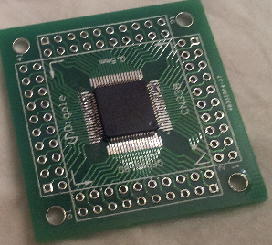
Microcontroller Choice
TI Tiva: TM4C123GH6PM
Meets minimum requirements
Easier programming
Launchpad allows for quick testing and as a reference design

Slide 25
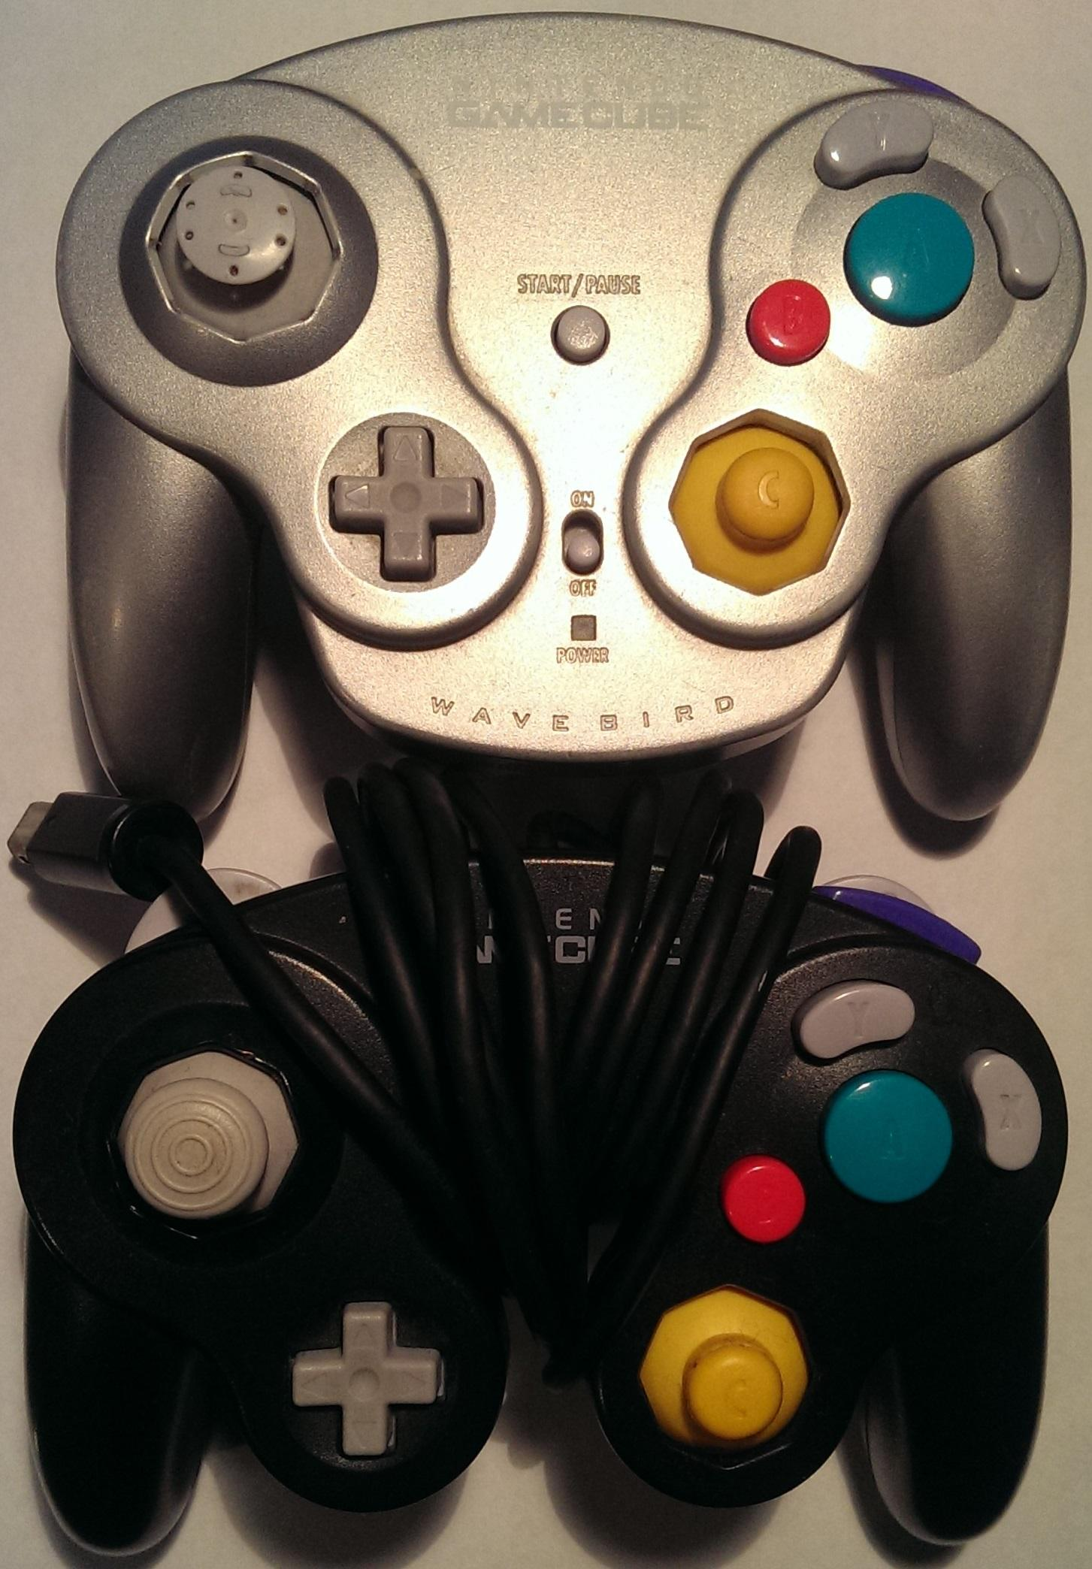
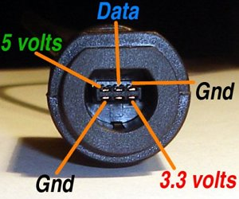
Gamecube Controller
Fits theme
Plenty of buttons
Wired and wireless options
Four pins per controller

Slide 26
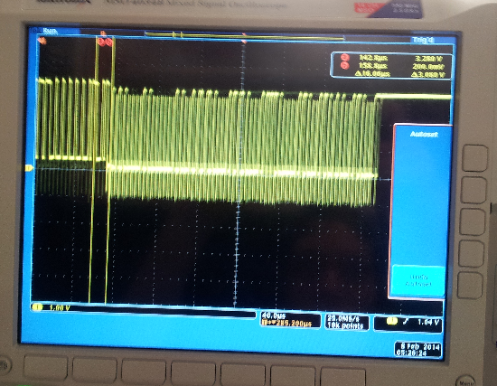
Testing
Gamecube controller timings
Oscilloscope was used to verify that the main microcontroller was able to produce a signal precisely timed so that the Gamecube controller would understand and respond with button data
Results
Successfully sent timed signal and were able to retrieve button data from the controller

Slide 27
Power
Requirements:
LED Display: 3.3V, 1-2A
TI Tiva: 3.3V
Gamecube controller: 5V, 3.3V
Options:
12V Gamecube AC Adapter
9V AC Adapter
Design:
12V Gamecube AC Adapter
DC/DC Converter: 3.3V, 5V

Slide 28
Sound Design
Requirements:
Stereo Input/Output
Play both music and sound effects simultaneously
Allow for user to input their own music
Design:
MSP430g2553
SD Card for extra ROM
Op Amp to amplify signal for ADC

Slide 29
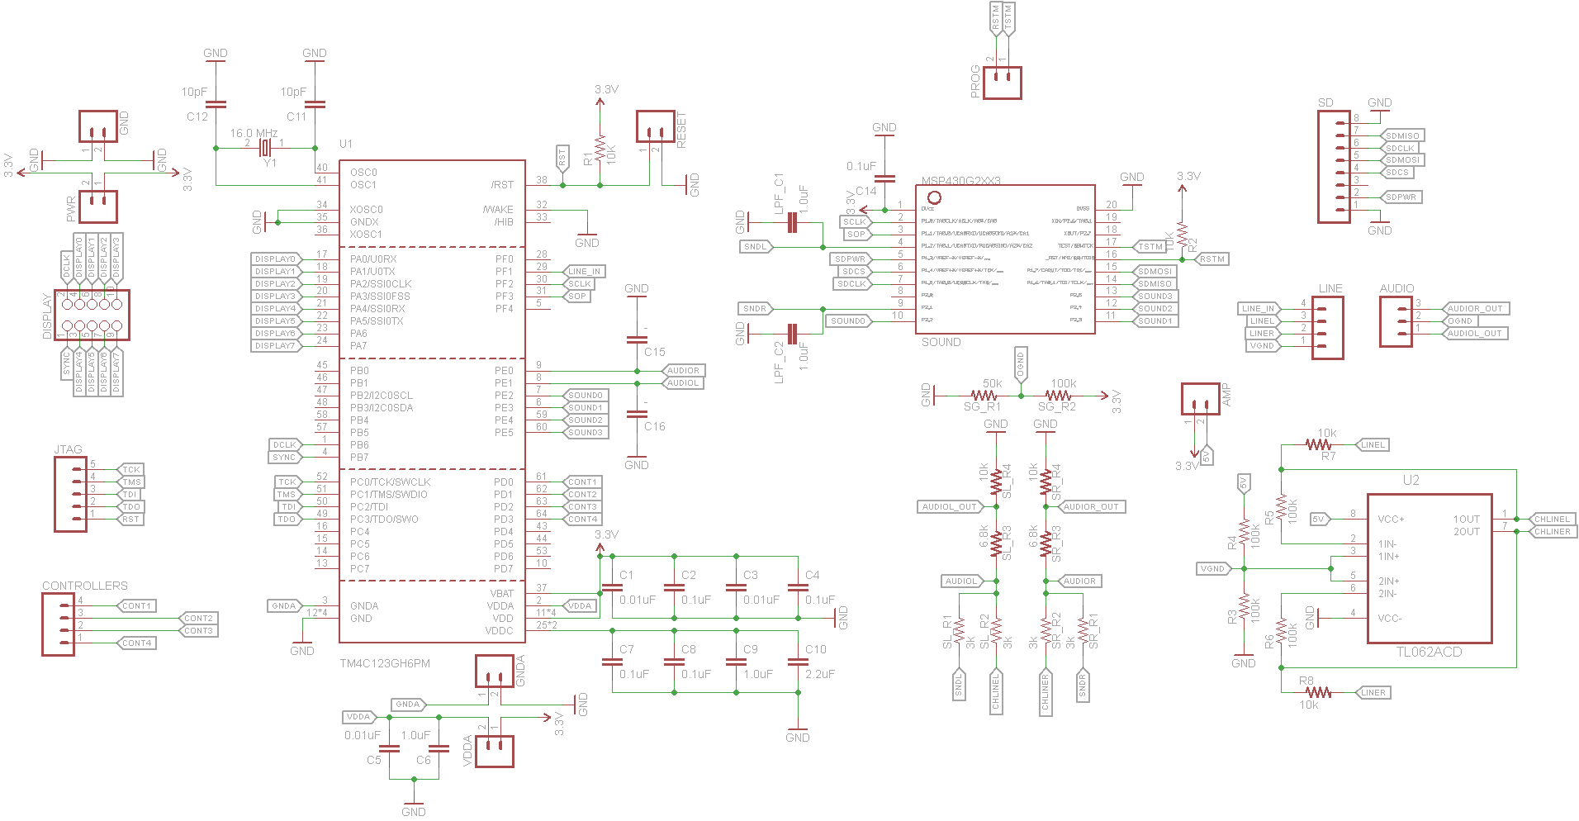
Board Design

Slide 30
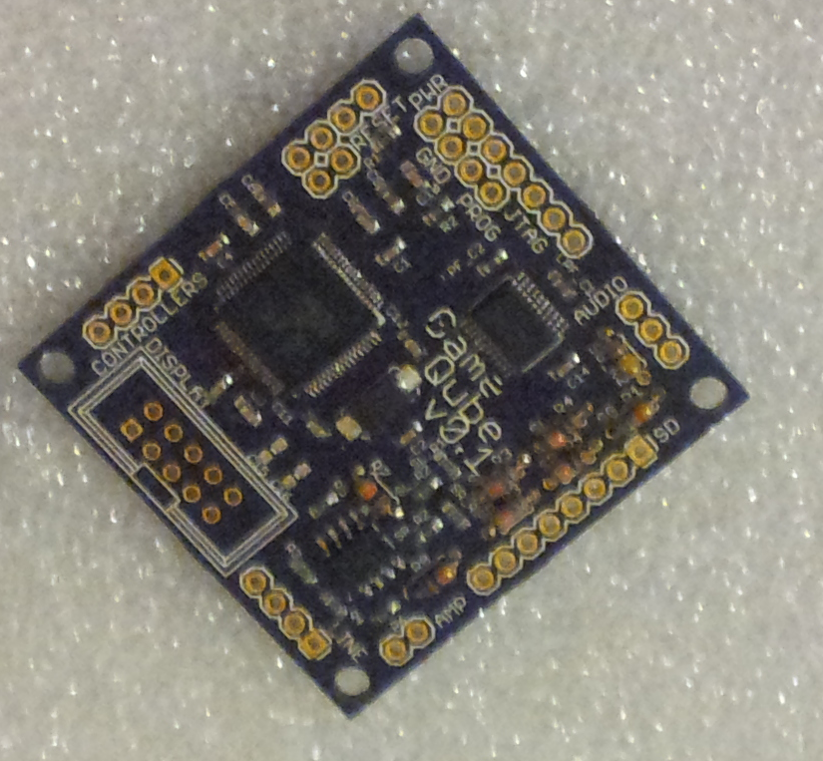
PCB

Slide 31
Software
Volume Based Rendering Software
LED Volumetric Display Control
Central Processing

Slide 32
Software Goals
Simple user interface
Games
Snake
Pong
Brick
Block
Animations
Music Visualizer

Slide 33
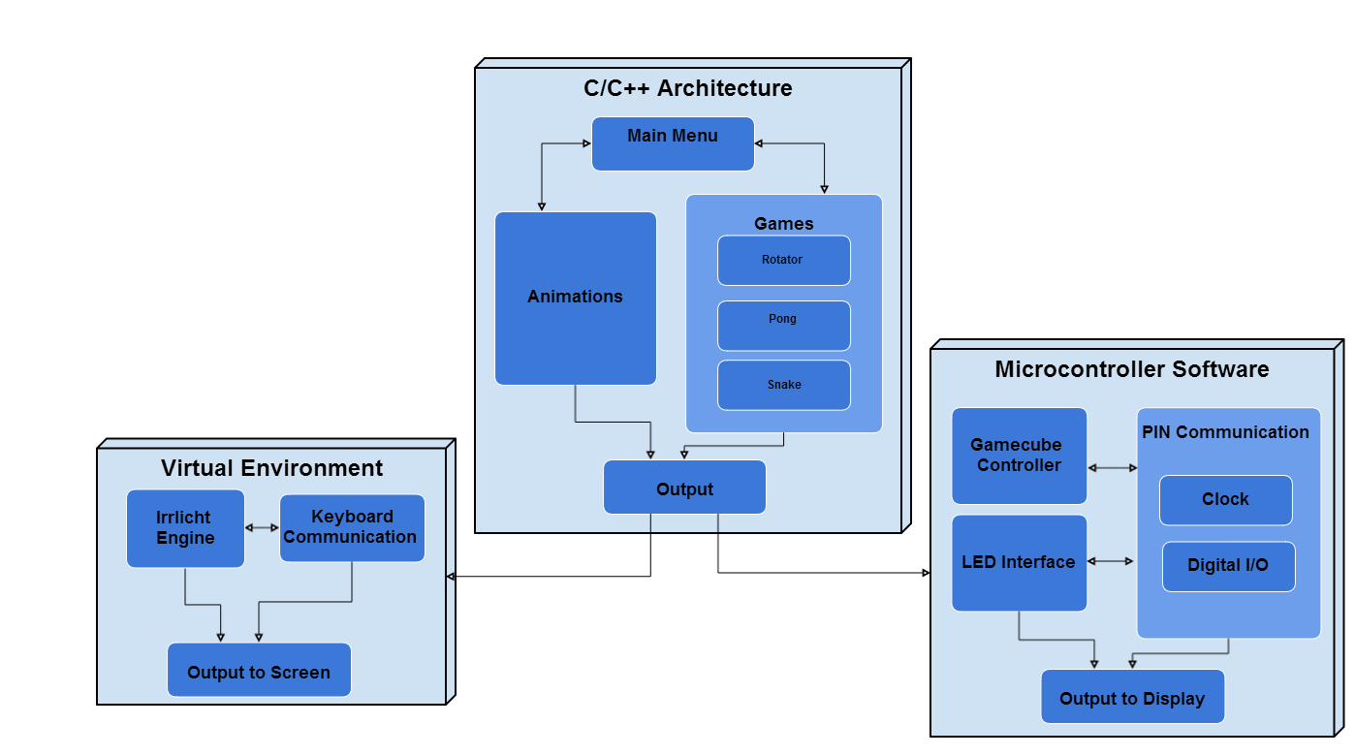
Software Block Diagram
Low level microcontroller interface
Virtual environment testing interface
Core rendering and program flow

Slide 34
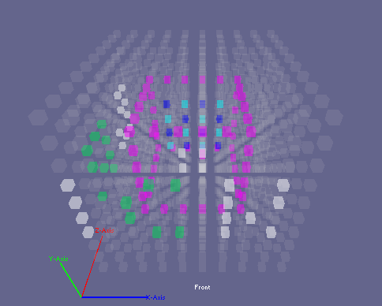
Virtual Environment
Virtual representation of our LED Cube
Programmed using Microsoft Visual C++ 2010 and the Irrlicht Engine
Easy input mapping to keyboard or any convenient PC peripherals
Allows for immediate testing of animations and games
Acts as a quick prototyping environment for testing new ideas before embedded design

Slide 35
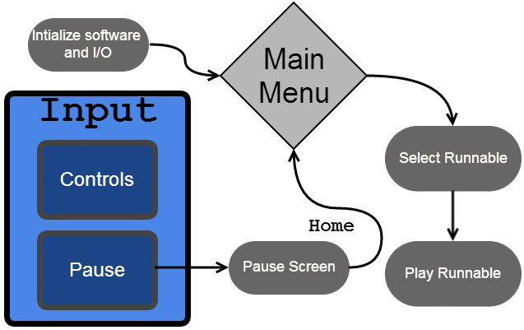
User Interface

Slide 36
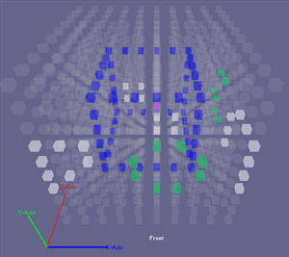
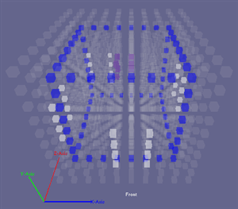
User Interface
Menu
Pause

Slide 37
Rendering Engine
Runnable
Handles logic loop for anything that can be run from the main menu
Scene Manager
Keeps track of all items to be rendered in a scene
Main
- Creates a Video Driver, Scene Manager and Controller - Creates all runnables - Handles transitioning between different runnables
Scene Nodes
Individual items drawn in a scene
1
*
1
1
Video Driver
Handles rendering primitives to a buffer array
Controller
Handles all things related to input

Slide 38
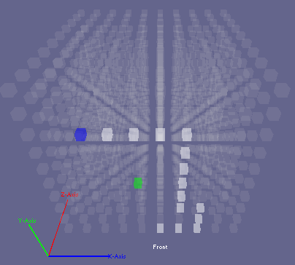
Snake
Control a snake’s movement in order to collect dots and make the snake grow longer
Snake can move in x, y, and z directions
Game ends if:
Snake hits any of the six sides of the cube
Snake runs into itself

Slide 39
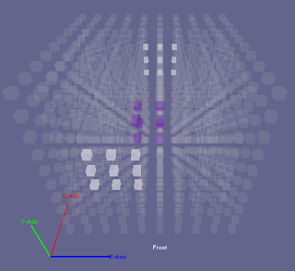
Pong
Two players move paddles on opposite sides of the cube, bouncing a ball in between
The ball speed will get faster and faster over time
Game ends if:
A player reaches winning score

Slide 40
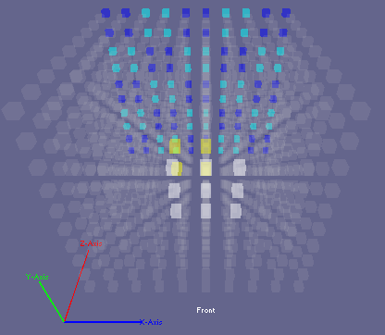
Brick
Based on Atari “Breakout”
One player pong
Player has to destroy all bricks before losing all lives

Slide 41
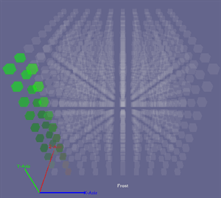
Animations
Animations runnable loops through several animations
User can skip any animation using A

Slide 42
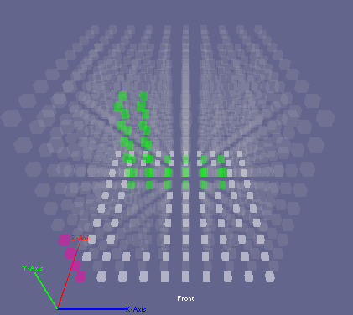
Block
Rotate a block so that it can fit through a hole on one side of the cube
The block can rotate left, right, forwards and backwards
Game ends if:
Time runs out and block does not fit through hole

Slide 43
Music Visualizer
Animations controlled by music
View raw waveform of the sound signal
View the presence of frequencies in the sound signal
Input your own music through auxillary

Slide 44
Administrative Info

Slide 45
Budget
10pin Ribbon Cable x1 | $0.99 | 16 | $15.84 | $1.00
Ribbon Cable Sockets x20 | $4.99 | 2 | $9.98 | $0.00
Ribbon Cable Sockets x4 | $1.01 | 1 | $1.01 | $0.00
28pin DIP IC Sockets x5 | $0.99 | 5 | $4.95 | $2.51
TLC5940NT x20 | $17.50 | 1 | $17.50 | $2.00
5mm RGB LEDs x1000 | $60.60 | 1 | $60.60 | $22.00
MSP430F5529 | $0.00 | 1 | $0.00 | -
Resistors/Capacitors | $0.00 | 0 | $0.00 | -
Wire (price/ft) | $0.03 | 500 | $15.00 | -
2kx9 FIFO CY7C429-25PC x5 | $4.99 | 1 | $4.99 | $2.00
P-Channel MOSFET x20 | $3.19 | 1 | $3.19 | $0.00
LED Matrix Wood Base | $4.99 | 1 | $4.99 | -
LED Matrix Black Paper | $0.33 | 1 | $0.33 | -
LED Matrix Nails | $1.30 | 1 | $1.30 | -
LED Display PCB | $25.00 | 1 | $25.00 | $0.00
Main Processor PCB | $15.00 | 1 | $15.00 | $0.00
PAM8403 Audio Amplifier | $2.49 | 1 | $2.49 | $0.00
SD Card Pinout | $0.89 | 1 | $0.89 | $0.00
Acrylic | $26.40 | 1 | $26.40 | -
Wood Filler | $6.48 | 1 | $6.48 | -
Wood | $21.24 | 1 | $21.24 | -
Super Glue | $1.97 | 1 | $1.97 | -
LED Display Components | $7.85 | 1 | $7.85 | $2.86
Main Processor Components | 7.14 | 1 | $7.14 | $3.4
MSP430G2553 | $0.00 | 1 | $0.00 | -
TL 792 | $0.00 | 1 | $0.00 | -
TM4C123GH6PM | $0.00 | 1 | $0.00 | -
Paint | $0.69 | 2 | $1.38 | -

Slide 46
Budget
Sub Total: | $255.52
Shipping: | $35.77
Grand Total: | $291.29

Slide 47
Work Distribution
Stephen Monn - LED Display Design, Central Processor Design, PCB Design, Sound Processing Design, Rendering Engine Design, Software Design
Omar Alami - Central Processor Design, PCB Design, Power Design, Software Design
Matthew Dworkin - Software Design

Slide 48
Progress
Research
Design
Prototype
Testing
Final Package
Stretch Goals (Sound)
Main Controller (Processor/ Power/ Controls)
Overall: 100%
Main Software (Rendering Engine/ Games)
LED Cube Control (LED Driving/ Display Interface)
10% 20% 30% 40% 50% 60% 70% 80% 90% 100%

Slide 49
Overall Difficulties
Very tricky timings!!
IC Coupling
Race conditions
Limited RAM
Heap size allocation
Noise/Cable Shielding

Slide 50
Questions?

