Slide 1
Project Alfred
Group 6
Alec Seketa EE
Ben Bush EE
Brandon Becker EE
The building Master

Slide 2
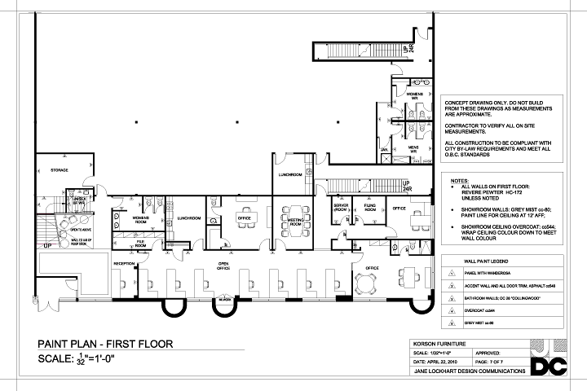
Can I get anything for you Sir?
It all started with a project management internship.
There has to be a better way!
NANANANANANA Batman!
Our goal: to create a better and smarter building Management system for companies everywhere.

Slide 3
objective, specification, and requirements.
Objectives:
Divide and conquer: Design a device to keep track of a room in a building.
Unite the forces: Design a system to tie the rooms together.
Specifications and Requirements:
Easy to use easy to read.
Convenient and not bulky.
Multi purpose and robust.
Organized and well informed
Final note: Remember that this is an aid, and you are the master!

Slide 4
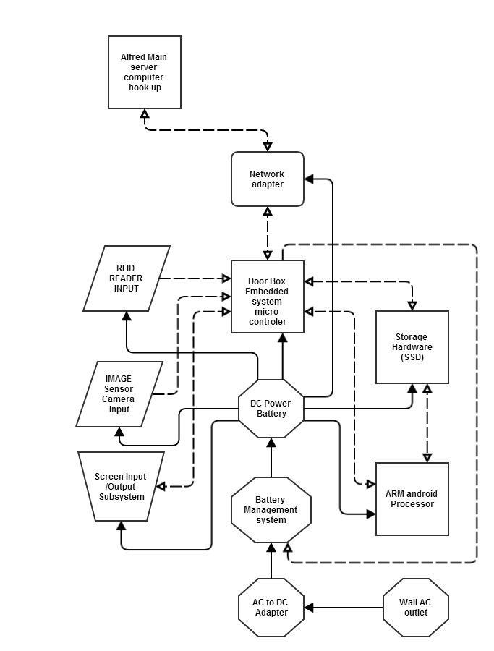
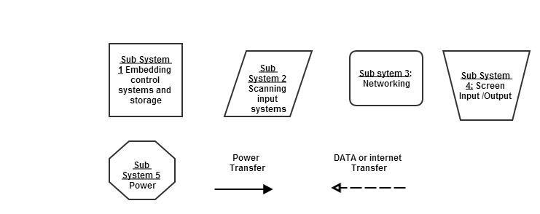
Hardware Design

Slide 5
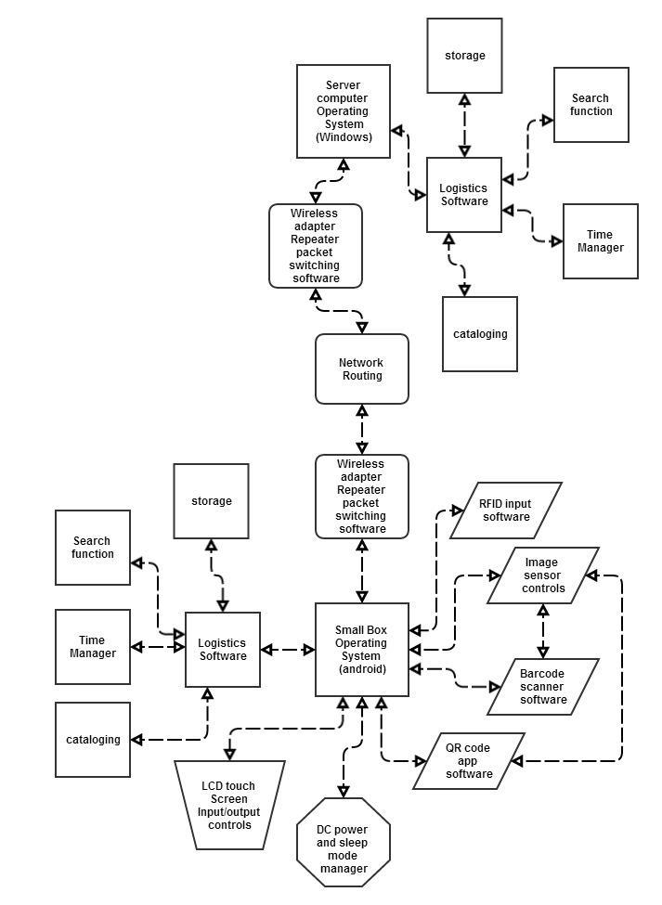
Software Design

Slide 6
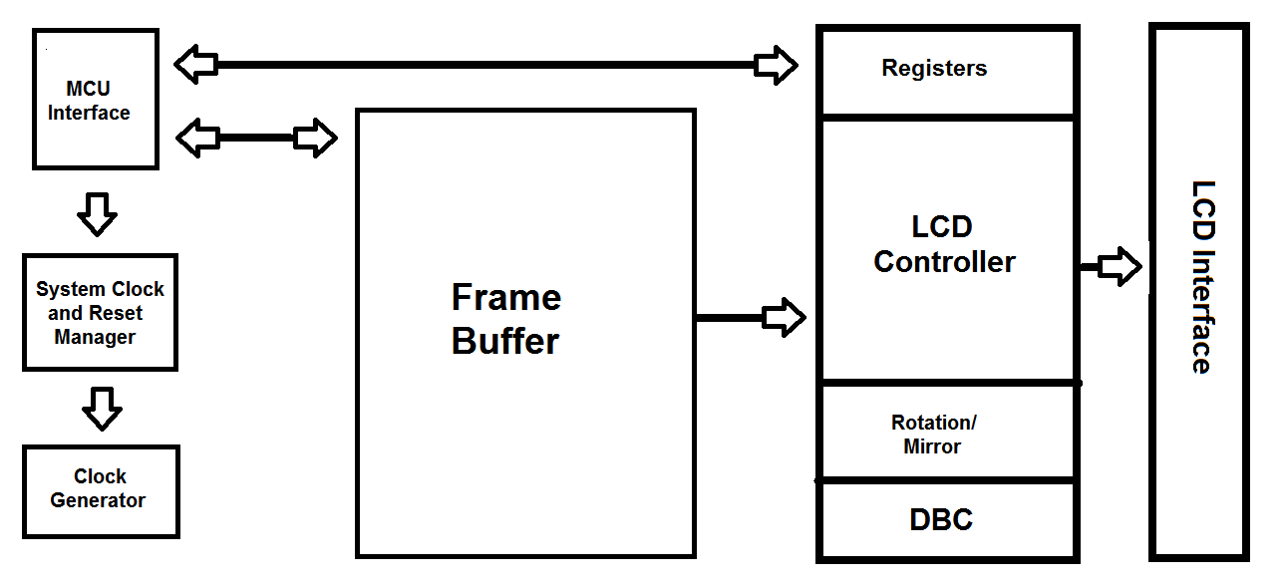
SSD1963 Controller
Selection Criteria:
Display features
Built-in 1215k byte frame buffer
Support TFT 18/24-bit generic RGB interface
Hardware rotation 0, 90, 180, 270
Programmable brightness, contrast and saturation
Backlight Control
8/9/16/18/24-bit MCU interface
4 GPIO pins
Built-in clock generator
Deep sleep mode

Slide 7
Msp430 g2553
Selection Criteria:
24 Capacitive-Touch Enabled I/O Pins
Low power consumption
Fully supports peripherals
Easily mounted to custom PCB
Prior experience with controller and launchpad

Slide 8
Development Environments
Language – C
Testing – Code::Blocks
Implementation – Code Composer Studio 5.3.0
PCB Schematic – Cadsoft EAGLE 7.2.0

Slide 9
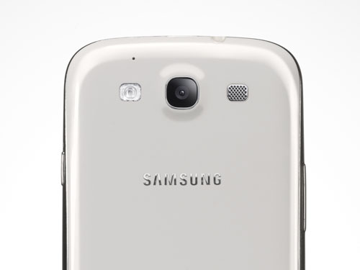
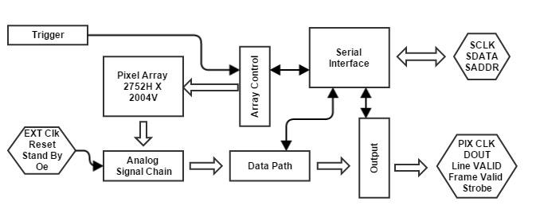
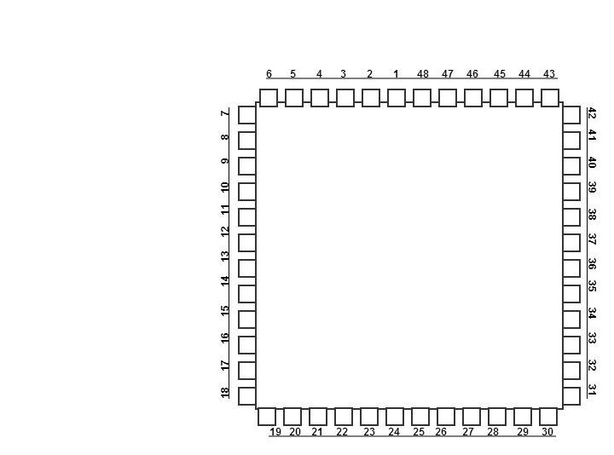
A Picture is worth 1000 Words
Image Sensor
A Picture is worth 1000 words
MT9P031 Block Diagram

Slide 10
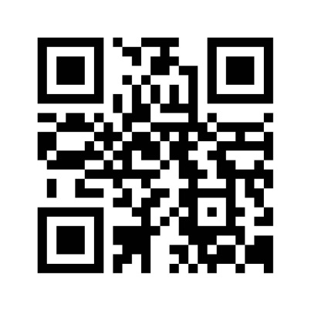
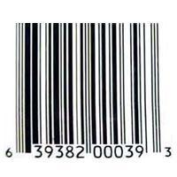
Camera Subsystem Software
Camera Tracking system: Open CV: Free!
The major ways of item tracking.
ZXing (Zebra Crossing)
QR Pal
ZXing

Slide 11
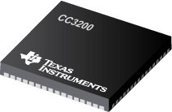
Networking Subsystem
Hardware: CC3200
-Texas Instrument’s WIFI internet on a chip
-Dedicated ARM MCU
-WIFI and internet Protocols in ROMi
-802.11 b/g/n radio, baseband, medium access control, WIFI driver, and supplicant
Permission: to use pictures by Texas Instruments

Slide 12
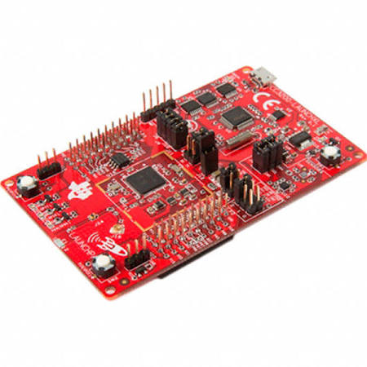
Networking Subsystem
Why the CC3200?
WIFI capable
Already familiar with TI products
Easy to code using C
Affordable
TI support
Permission: to use pictures by Texas Instruments

Slide 13
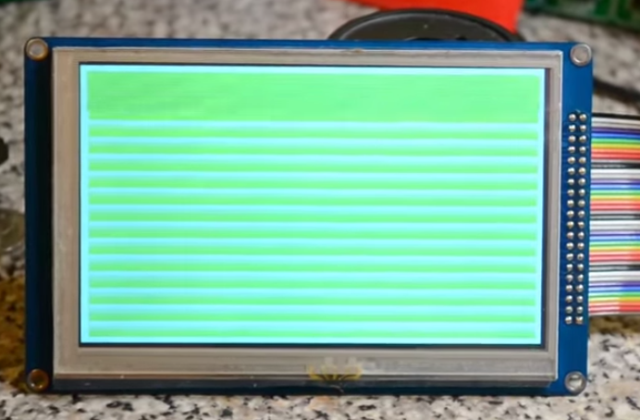
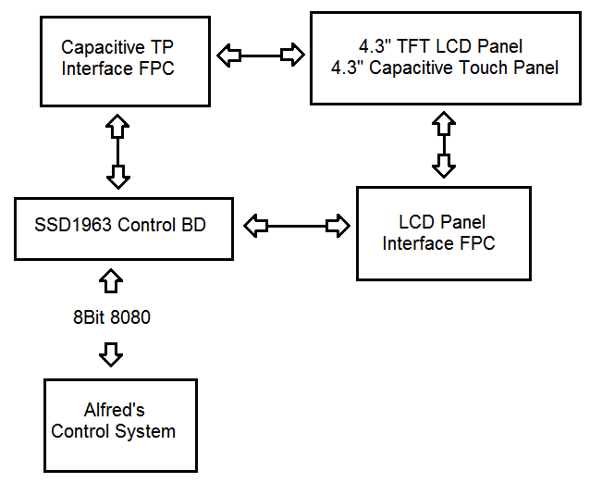
Screen I/O Subsystem Hardware
LCD –TFT Display
Capacitive touch
SSD1963 Controller Built-in
8-bit Parallel Interface

Slide 14
Screen Selection
Touch Method
Display Type
Resistive | Capacitive
Low Cost | High Cost
High Durability | Low Durability
Single Touch | Multi-tough
Low Contrast | High Contrast
LED | TFT - LCD
Emits own light | Back light needed
High Cost | Mid-Low Cost
Low Power | Low Power

Slide 15
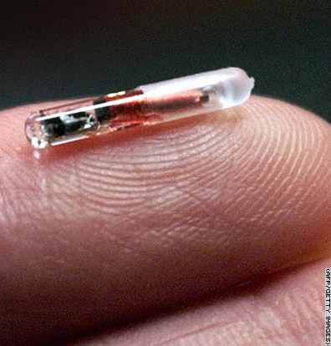
Tracking at an instant
RFID Technology
A Radio-Frequency Identification system has three parts:
A scanning antenna
A transceiver with a decoder to interpret the data
A transponder - the RFID tag - that has been programmed with information.

Slide 16
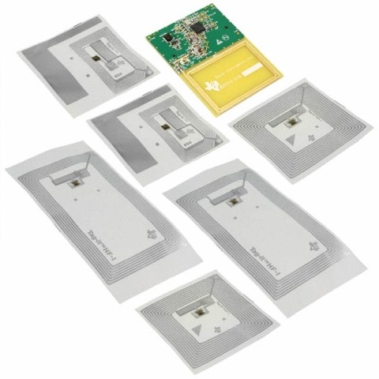
Rfid from texas instraments
The chip itself
Permission: to use pictures by Texas Instruments

Slide 17
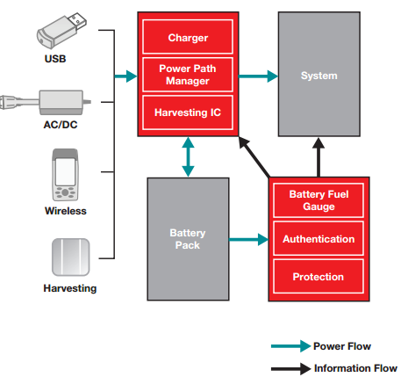
Power
Wireless Power Management system
Lipo Battery Cells
AC/DC Converter
Permission: to use pictures by Texas Instruments

Slide 18
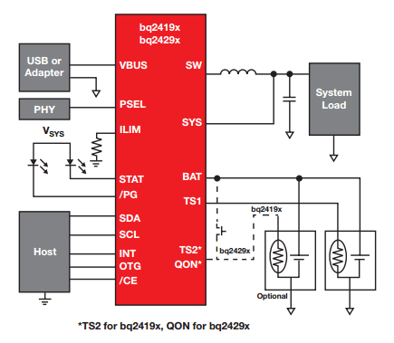
Power management system Schematic
Permission: to use pictures by Texas Instruments

Slide 19
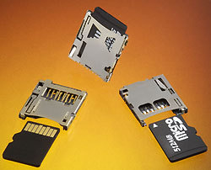
Storage – SD CArds
Selection Criteria:
32 GB Micro SD
Upgrade option up to 128 GB
Easy data recovery
Connection mounts to custom PCB

Slide 20
Work distribution
 | Power | Input Devices | Wireless | Screen | Storage
Alec | P | P | S
Ben |  | S |  | P | P
Brandon |  |  | P |  | S
P = Primary Responsible
S = Secondary Responsible

Slide 21
Subsystem | Part | Projected Price
Network Adapter | cc3200 | $18.08
Micro Controller | msp430 | $4.30
Touch Screen | TFT LCD display | $62.08
SSD | SSD NOW S100 | $50.00
Processor | ARM Core A9 | $70.00
RFID reader | TIDM RFID | $49.99
Main Box | Plastic box | $50.00
AC to DC converter | PMP 4390 | $6.00
Camera | Micron mt90p001 | $15.20
Battery Power System | Lithium Ion Polymer | $6.90
PCB Manufacturing |  | $60.00
Product Software |  | $120.00
Miscellaneous Equipment |  | $100.00
Total |  | $612.55
Budget and Financing
Total funding by Boeing: $650

Slide 22
Progress
90%
80%
60%
35%
15%
55%

Slide 23
Remains to be done
Objective | Timeframe
Finalize PCB Design | 2/20/15
Order remaining parts | 2/20/15
Finish coding subsystems | 3/20/15
Test subsystems | Ongoing throughout
Final build | 3/27/15

Slide 24
Copyrights

Slide 25
Any Questions?
People who are organized are just to lazy to look for things.

