Slide 1
Project Alfred
Group 6
Alec Seketa - EE
Ben Bush - EE
Brandon Becker - EE
The building Master

Slide 2
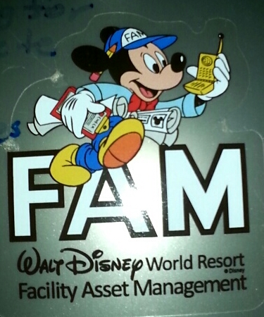
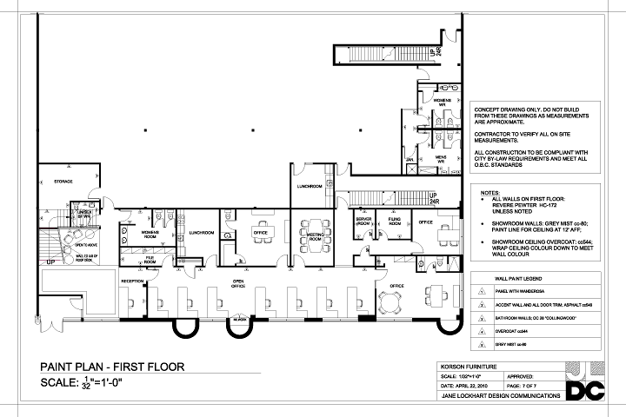
Can I get anything for you Sir?
It all started with a project management internship.
There has to be a better way!
NANANANANANA Batman!
Our goal: to create a better and smarter building Management system for companies everywhere.

Slide 3
objective, specification, and requirements.
Objectives:
Divide and conquer: Design a device to keep track of a room in a building.
Unite the forces: Design a system to tie the rooms together.
Specifications and Requirements:
Easy to use easy to read.
Convenient and not bulky.
Multi purpose and robust.
Organized and well informed
Final note: remember that this is an aid and you are the master!

Slide 4
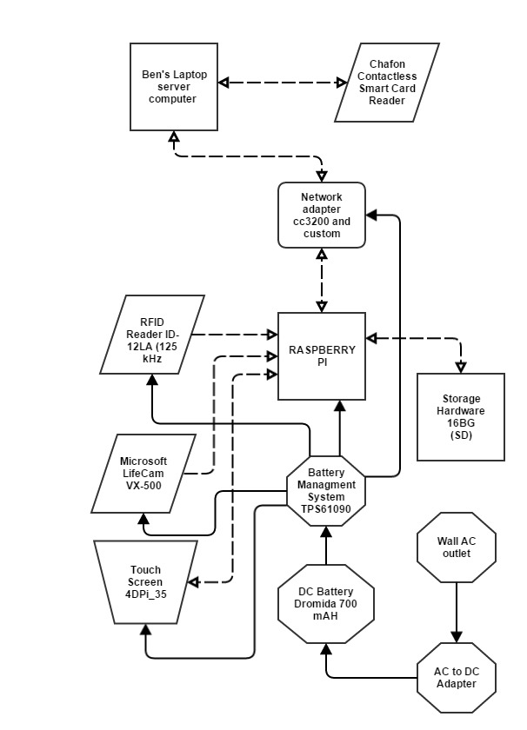
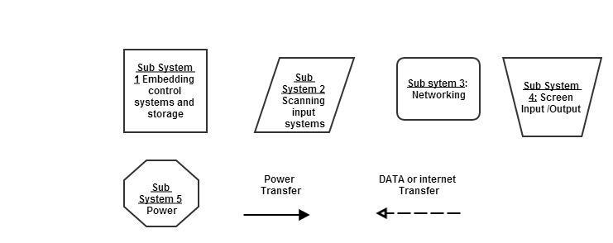
Hardware Design

Slide 5
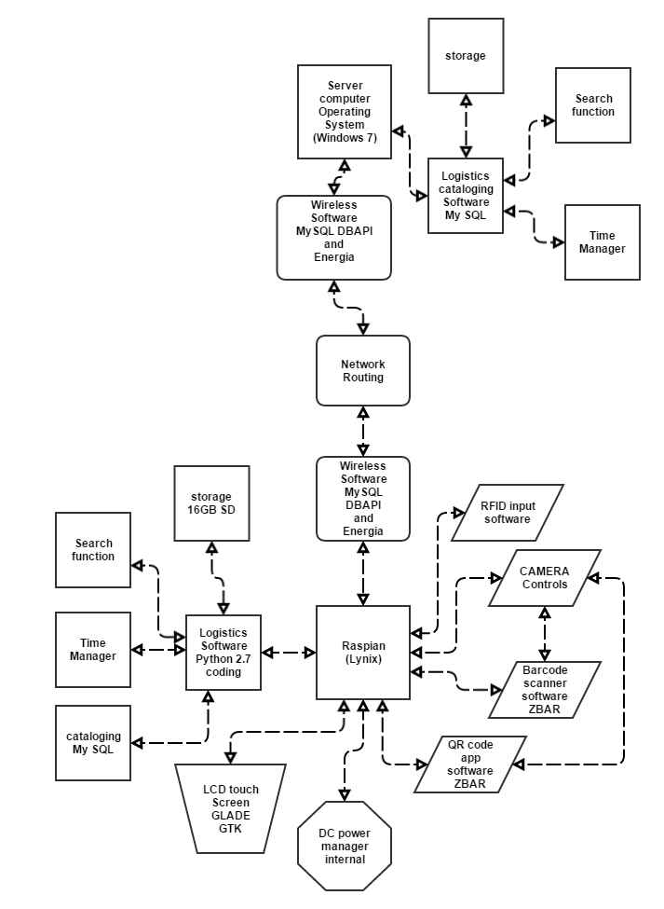
Software Design

Slide 6
RASPBERRY PI
Selection Criteria:
Display features
Dimensions: 86 x 56 x 20mm
Broadcom BCM2835 700MHz ARM1176JZFS processor with FPU and VideoCore IV dual-core GPU
GPU provides Open GL ES 2.0, hardware-accelerated OpenVG, and 1080p30 H.264 high-profile decode
GPU is capable of 1Gpixel/s, 1.5Gtexel/s or 24GFLOPs
512MB SDRAM
HD 1080p video
Raspian Operating system
Python 2.7 coding
16 GB SD card Storage

Slide 7
SERVER COMPUTER
Selection Criteria:
Lenovo Laptop
MySQL Lite
MySQLdb API

Slide 8
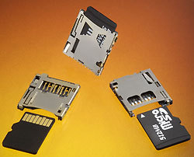
Storage – SD CArds
Selection Criteria:
16 GB Micro SD
Upgrade option up to 128 GB
Easy data recovery
Connection mounts to custom PCB

Slide 9
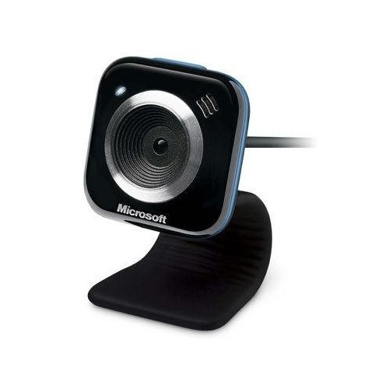
Microsoft Lifecam vx-5000 webcam
Optical sensor type: CMOS
Manufacture: Microsoft
Max digital video resolution: 640 x 480
Digital Zoom: X4
Min focus Range: 19.7
3x Magnified Glass

Slide 10
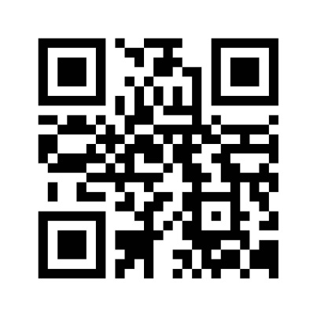
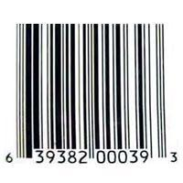
Camera Subsystem Software
Camera Tracking system:
The major ways of item tracking.
ZBAR Software
ZBAR Software

Slide 11
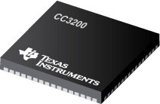
Networking Subsystem
Hardware: CC3200
-Texas Instrument’s WIFI internet on a chip
-Dedicated ARM MCU
-WIFI and internet Protocols in ROMi
-802.11 b/g/n radio, baseband, medium access control, WIFI driver, and supplicant

Slide 12
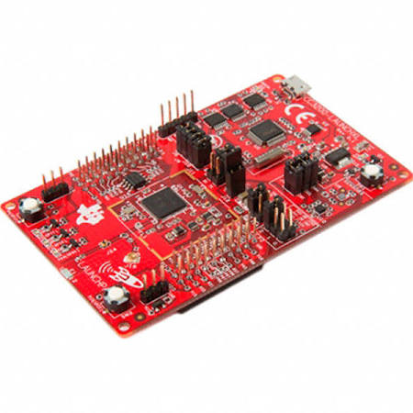
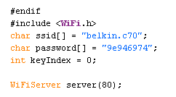
Networking Subsystem Software
ENERGIA
SQL DBAPI

Slide 13
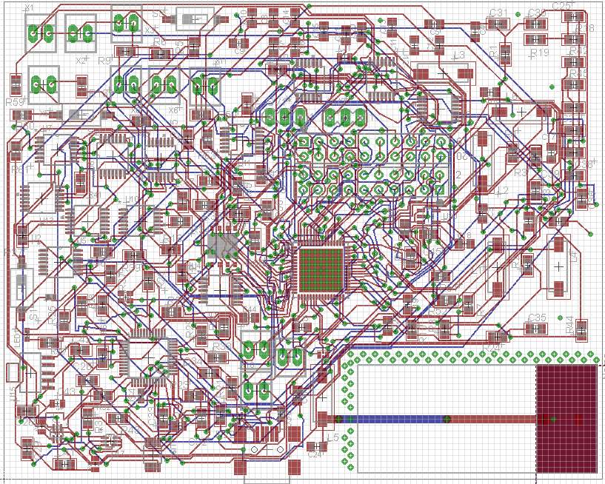
Networking PCB Design

Slide 14
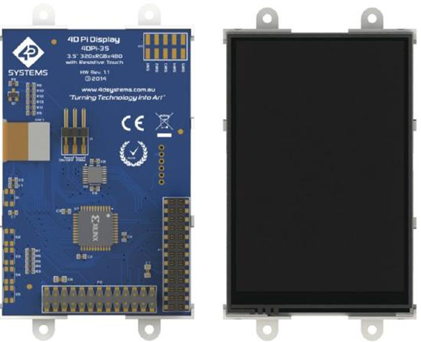
LCD TOUCH SCREEN
LCD –4DPi-35
Resistive touch
480x320 QVGA Resolution, RGB 65K true to life colors
8-bit Parallel Interface

Slide 15
SCREEN Software
Glade and GTK
GTK+, or the GIMP Toolkit, is a multi-platform toolkit for creating graphical user interfaces
Glade is a RAD (Rapid application development) tool
GTKpy Library

Slide 16
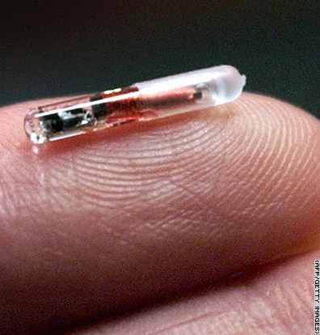
Tracking at an instant
RFID Technology
A Radio-Frequency Identification system has three parts:
A scanning antenna
A transceiver with a decoder to interpret the data
A transponder - the RFID tag - that has been programmed with information.

Slide 17
The Reader and the writer

Slide 18
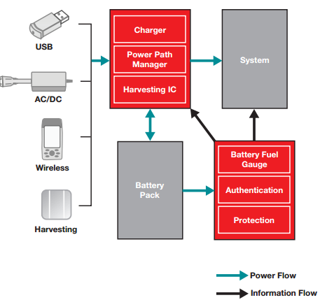
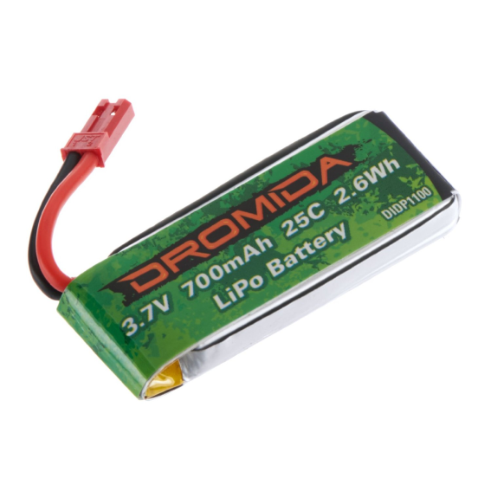
Power
Wireless Power Management system
Lipo Battery Cell Dromida
AC/DC Converter

Slide 19
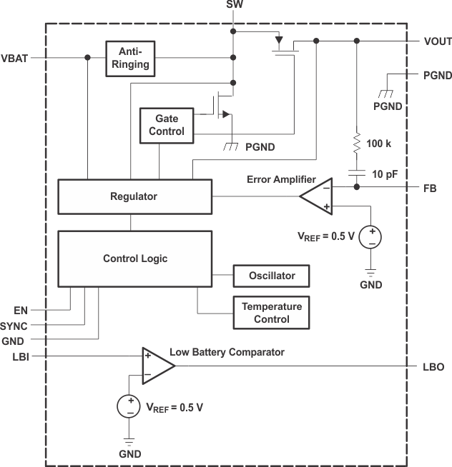
Power management system Schematic

Slide 20
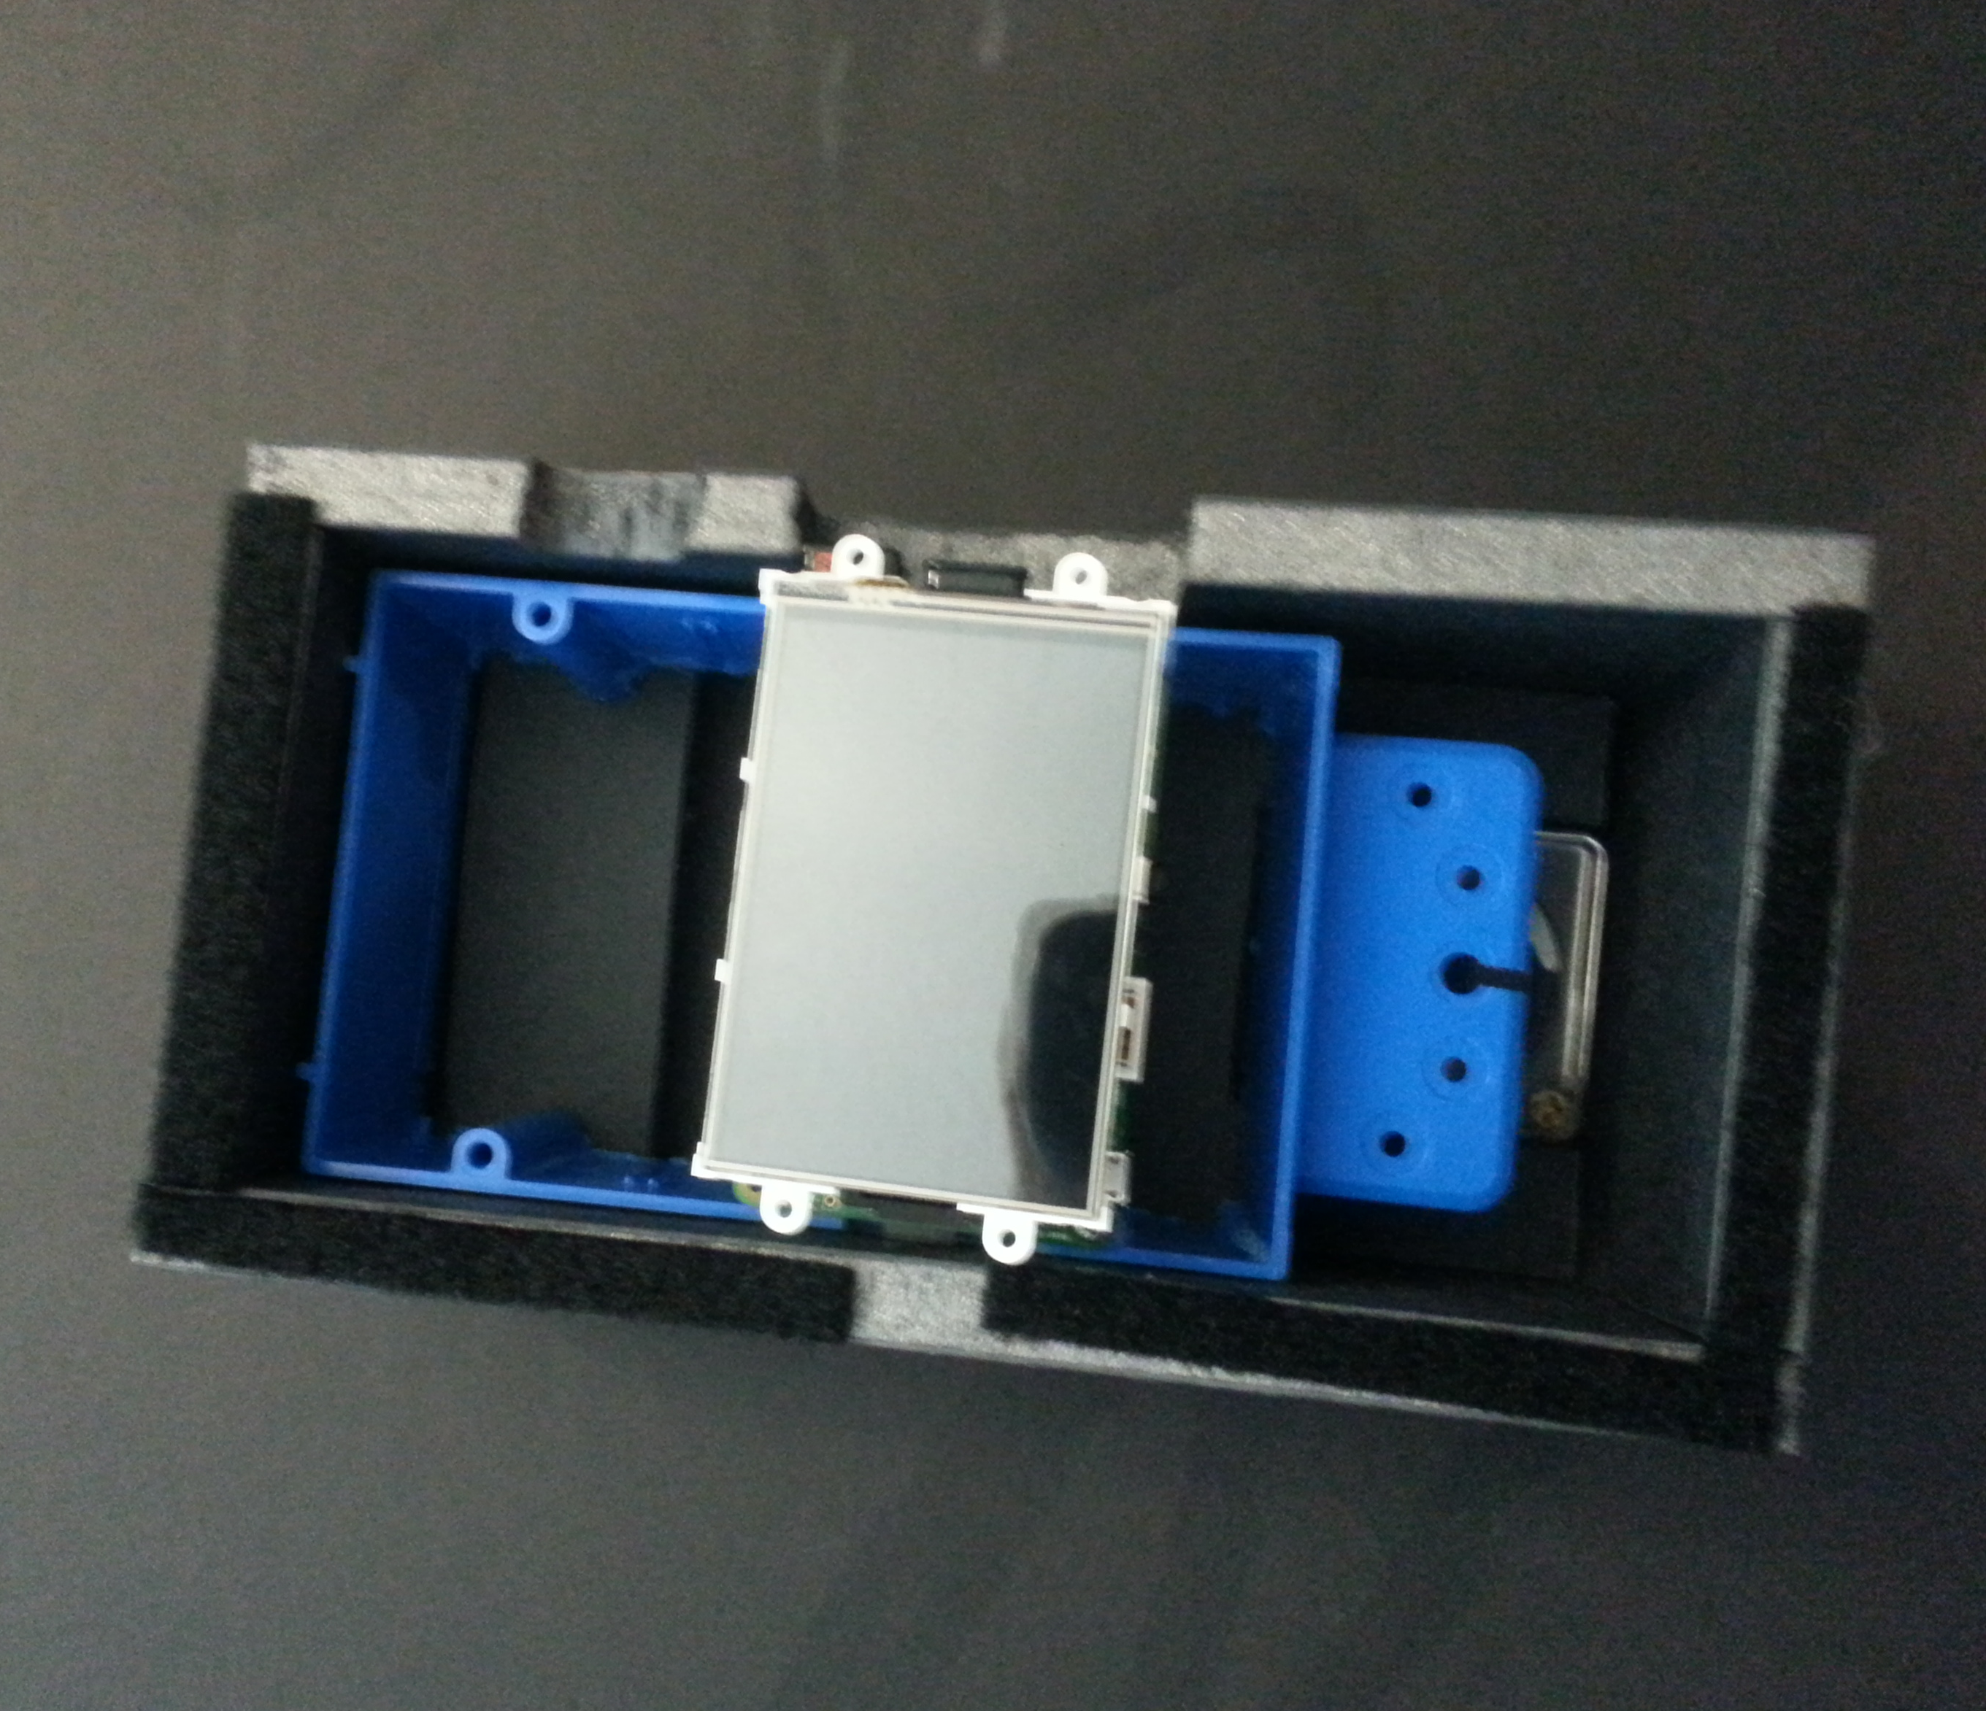
Appliance Materials
Foam Core Board
Electrical Box plastic
Velcro
Electrical Tape

Slide 21
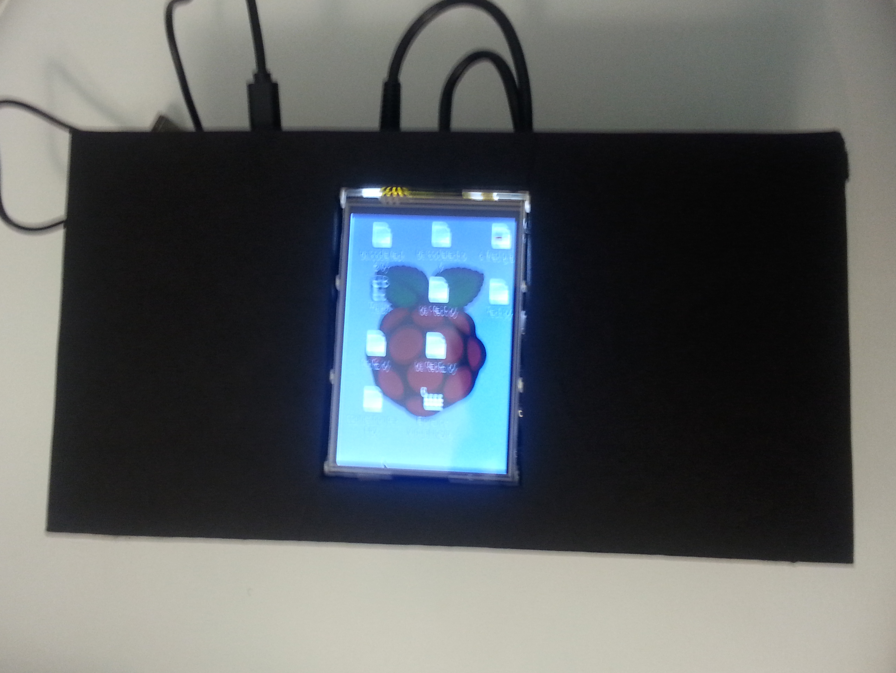
The appliance As a whole

Slide 22
Work distribution
 | Power | Input Devices | Wireless | Screen | Software Development
Alec | P | P | S
Ben |  | S |  | P | P
Brandon |  |  | P |  | S
P = Primary Responsible
S = Secondary Responsible

Slide 23
Devices | Part | Price
network board (3) and parts | cc3200 and custom | $60
Microcomputer | Raspberry Pi B+ | $35
touch screen | 4DPi_35 | $69.99
SD Card | 16 GB SD | free
Server computer | Ben’s Laptop | free
RFID | Chafon Contactless Smart Card Reader And Sparkfun RFID reader | $80
Main Box | Box And Foam Cordboard | free
AC to DC converter | Provided by team | $free
Camera | Microsoft LifeCam VX-500 | $free
battery | Dromida 700mAH | $10.99
Power board(3) and parts | TPS61090 and other parts | $60.00
product software | Python Glade GTK MY SQL | $Free
miscellaneous equipment and contingency and shipping |  | $100.00
Total |  | $415.99
Budget and Financing
Total funding by Boeing: $650

Slide 24
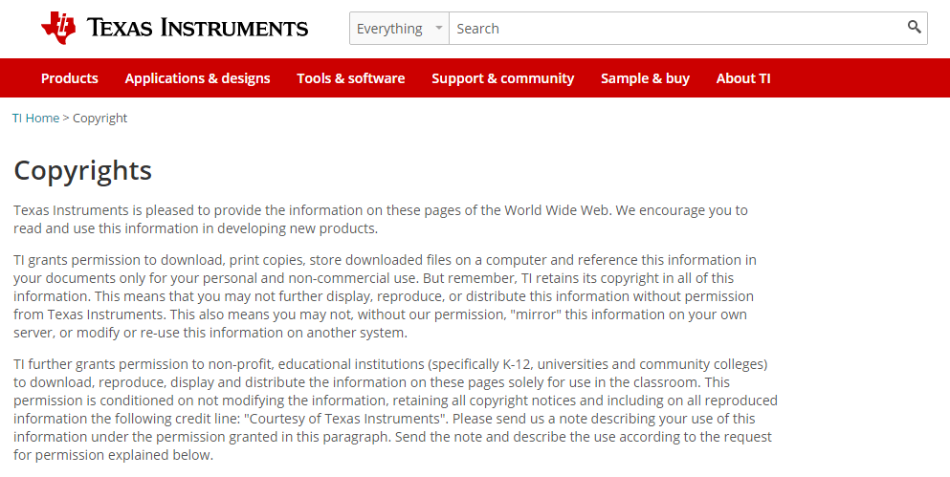
Copyrights

Slide 25
Any Questions?
People who are organized are just to lazy to look for things.

