Slide 1
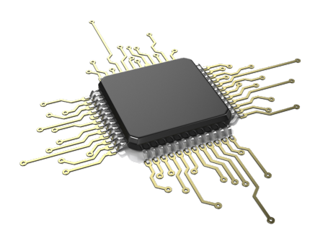
Group 34
Akash Patel (CpE)
Ayoub Soud (CpE)
Nishit Dave (EE)
Younes Enouiti (EE)

Slide 2
Wi-Fi Controlled Quadcopter

Slide 3
Goals and Objectives
Use of Wi-Fi control of copter in place of traditional RF control
Feed data to Autopilot through UDP protocol
Use of “RTL” mode for the flight safety
Use of “Follow Me” mode for autonomous flight using GPS coordinates
Mobile application interface for flight control

Slide 4
Specification
Component | Parameter | Design Specification
Battery | Charge Time Discharge Time | 2.5 hours (Full) 30C Constant/ 40C Burst
Mobile Wi-Fi | Wi-Fi range | 100 Ft
GPS(Android) | Accuracy | Less than 10 Ft
Quadcopter | Flight time | 10 Minutes
360Fly camera | Capacity | 32GB

Slide 5
FAA Rules and Guiedline
Effective December 21, 2015, anyone who owns a small unmanned aircraft of a certain weight must register with the Federal Aviation Administration's Unmanned Aircraft System (UAS) registry before they fly outdoors.

Slide 6
FAA Guideline

Slide 7
Related Standards
Wi-Fi Standard: The 802.11 standard has several specifications of WLANs. This standard defines the air interface between two wireless devices, client and a base station
Android App standard: App follows Android Design guidelines and uses common UI patterns and icons
Battery standards: We found many battery standards related to our project. The LiPo battery pack we are using is rechargeable and some of the standards include rules and guidelines on how to install, operate, maintain, and recharge the batteries.

Slide 8
Design Constraints
Economic: Along with many consumers, there are many states and regulators that believe the usage of UAV to be harmful and damaging.
Health and safety: The UAV has obvious limitations when it comes to safety. Drones are often causing of innocent lives lost. When it causes collateral damage it kills civilian and furthermore damages properties.
Sustainability: It’s no secret that wireless signals can be lost, hacked, or hijacked, in these cases the drone must be able to return home.
Manufacturability: 17 states have already some kind of legislation passed to restrict drone usage. This legislation has prevented manufacturers to build drones for public use.

Slide 9
Overall Block Diagram

Slide 10
MSP430 Block Diagram
Interfaces
2 USCIs
2 GPIOs
Ez-FET Lit Emulator
USB HUB

Slide 11
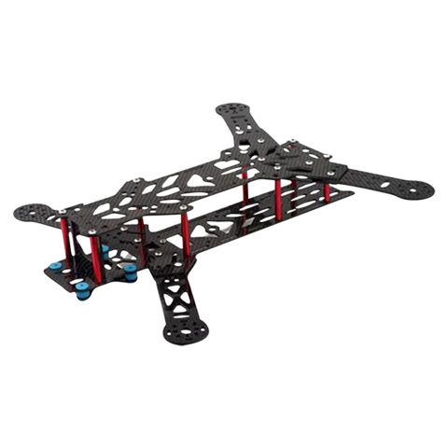
Drone’s Frame
Frame Model 3K-QAV250 - $30
Carbon Fiber Material for Durability
Dimensions: 25X20cm
Light Weight & Strong: 170g
Flexible Device Mounting Options
Easy to Obtain Replacement Parts

Slide 12
Batteries
Battery Type | Price | Available Platform | Charging | Battery Capacity
Alkaline | About $1.00 for each AA | AA, AAA, C, D configurations are available | 100 mA to 1A depending on the price | 700mAh-1300mAh in AA or AAA form
Nickel Metal-Hydride (NiMH) | Somewhat expensive, about $2.00 for each AA | AA, AAA, C, D configurations are available | 100 mA to 1A depending on the price | 100mAh-2500mah in AA or AAA form
Nickel Cadmium (NiCad) | Cheapest of All | AA, AAA, C, D configurations are available | 100 mA to 1A depending on the price | 100mAh-1500mah in AA or AAA form
Nickel Zinc (NiZn) | About $2.00 for each AA | AA, AAA, C, D configurations are available | 100 mA to 1A depending on the price | 1000mAh-4500mAh in
Lithium Polymer(LiPo) | Between $20.00 to $55.00 based on Capacity | Most common ones are 3S and 4S | 100 mA to 3A depending on the battery | 1000mAh and over based on the number of cells

Slide 13
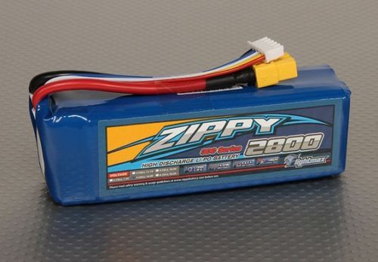
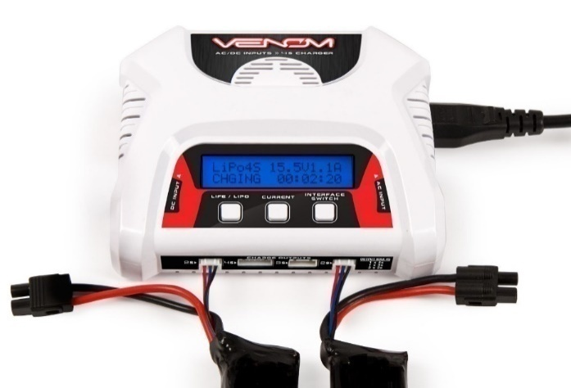
Battery
Battery Charger
ZIPPY Flightmax 2800mAh 11.1v 3S LiPo battery
Voltage: 3S1P / 3 Cell / 11.1V
Discharge: 30C Constant / 40C Burst
Weight: 231g (including wire, plug & case)
Dimensions: 116x37x27mm
Balance Plug: JST-XH
Discharge Plug: XT60
LiPO/LiFE/Li-Ion Cell Count: 2-4 Cell
Charge Current: 0.1 - 3.0A
Circuit Power: 40W
Input: DC 10.0-18.0 Volts - AC 100v-240v
Display Type: LCD
Dimensions: 130x48.25x5.6mm
Weight: 306g

Slide 14
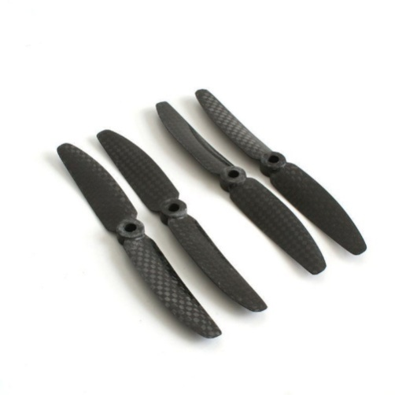
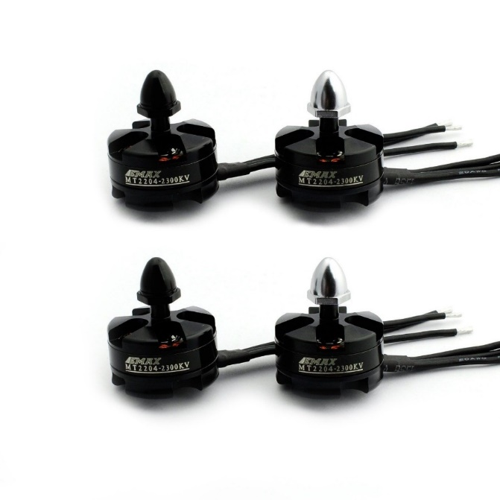
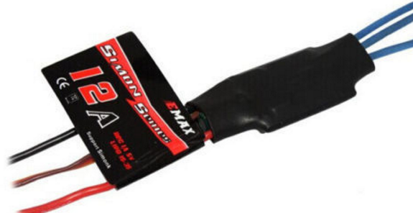
Propellers
Motors
Size: 5.0" x 3.0“
Hole Diameter: 5.1mm
Material: Carbon Fiber
KV: 2300
Max Trust: 440g
No. of cell: 2-3S
Framework: 12N14P
Propeller: 5" - 6“
Length: 32.2mm
Shaft: 3mm
Diameter: 27.9mm
Weight: 25g
ESC’s
Separate power supply for MCU and BEC
Low-voltage protection, over-heat protection and self-check functions
Equipped with built-in linear BEC or switch BEC
Continuous/Burst Current: 12A/15A
Input: 2S-3S Lipo
Dimension (L*W*H): 25mm x 20mm x 7mm
Weight : 9g (Including Wires)
BEC Mode: Linear
BEC Output: 1A/5V

Slide 15
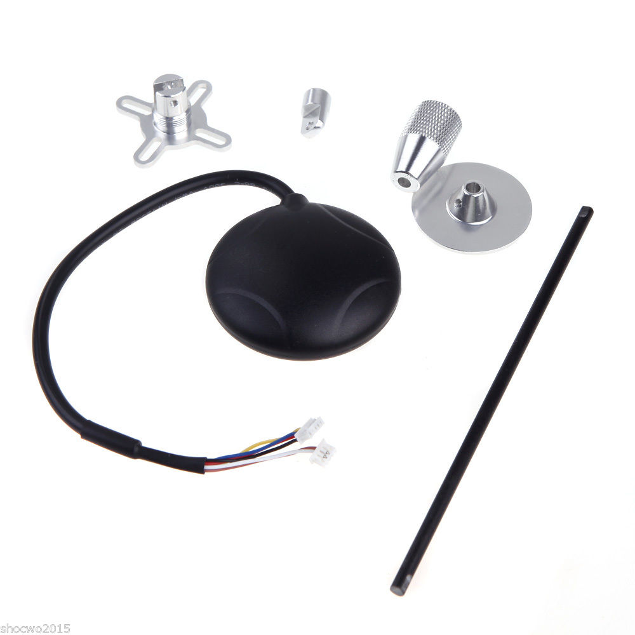
GPS
NEO-6M GPS module
10Hz update rate
Build in 25 x 25 x 4mm ceramic patch antenna
UART (TTL) port with EMI protection
3V Rechargeable Backup Capacitors
Fix indicator LEDs
Reverse polarity protection for input power
Default parameter
NMEA protocol
Baud rate : 9600
Nav rate : 1Hz
TIMEPULSE (fix LED) rate : 1Hz

Slide 16
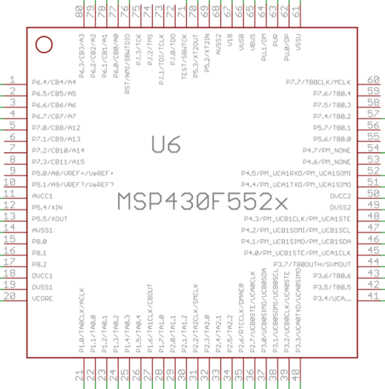
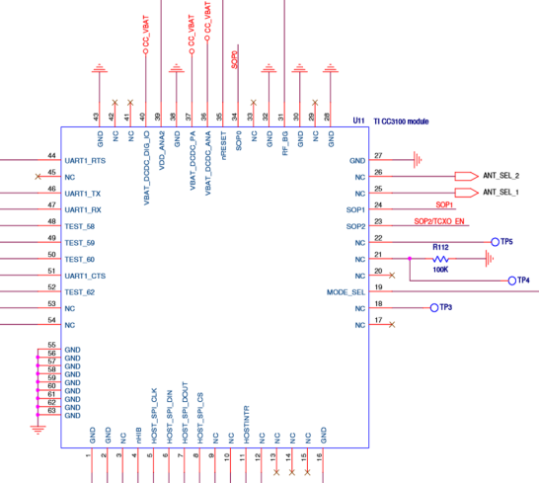
Wireless Communication
Microcontroller Choice
MSP430F5529
Low Supply Voltage Range: 3.6 V Down to 1.8 V
Ultra-Low Power Consumption
Two Universal Serial Communication Interfaces
Hardware Multiplier Supports 32-Bit Operations
Compatible with Wi-Fi Module Chosen
Affordable: $12.99
Wi-Fi Module Choice
CC3100
Wi-Fi CERTIFIED Chip
Wide-Voltage Mode: 2.1 to 3.6 V
Interfaces with 8-, 16-, and 32-Bit MCU or ASICs Over SPI or UART Interface
8 Simultaneous TCP or UDP Sockets
Affordable: $24.99

Slide 17
Functional Diagram of the MSP430F5529 & CC3100
SPI

Slide 18
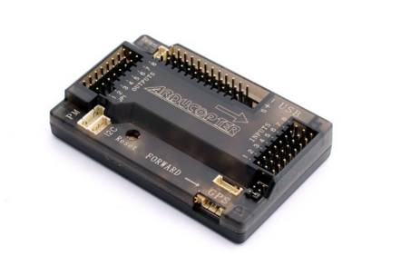
Flight Controller (APM 2.8)-Nerve center of Drone
Why APM?
Open source project from 3DRobotics
“cinema flying” and “autonomous flying”
Better for exploring and learning
Meets specification: Loiter, Circle, and follow me modes
Low power Consumption: 4.6V(min) – 5.25V(max), 200mA draw
Light weight: 31g
Affordable Cost: $40

Slide 19
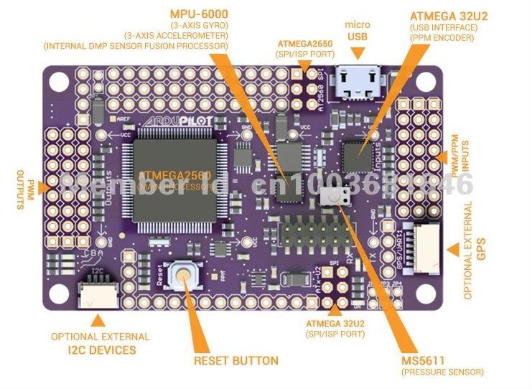
APM Specifications
ATmega2560 main processor: 8bit atmel processor running at 16 Mhz
ATmega32u4: handles USB functionality
InvenSense MPU-6000: handles gyro & accelerometer duties
Onboard barometer sensor and IMU(GPS receiver helper): allows GPS receiver to work when in tunnel or building
Interfaces: off-board GPS/compass/magnetometer module

Slide 20
Signal sharing fromMSP430 to APM to ESCs

Slide 21
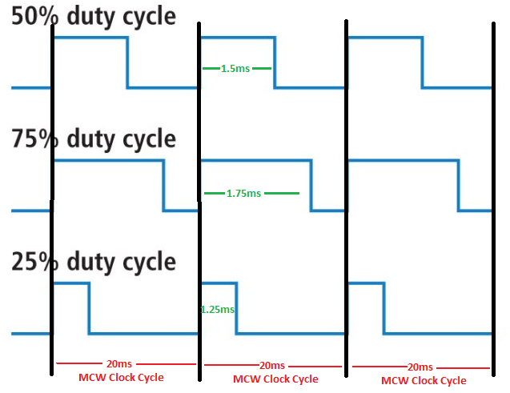
APM 2.8 PWM
APM Clock cycle: 20,000 µs (50hz)
APM 2.8 R/C PWM range: 1000-2000 µs (50%-100% duty cycle)

Slide 22
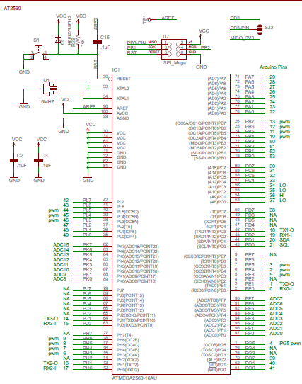
APM 2.8 schematics

Slide 23
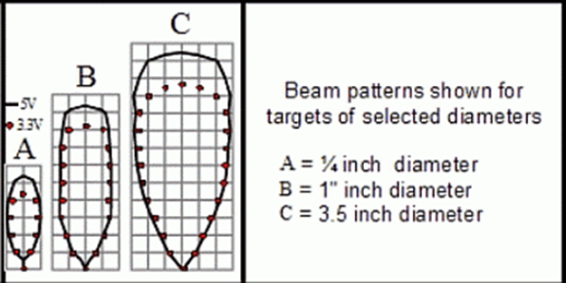
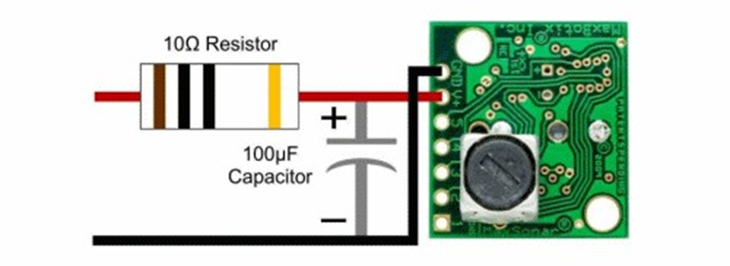
UltraSonic Sensors
MaxSonar EZ02 beam pattern diagram
Easy to implement with the drone on hand
Offer a good combination between small object detection and narrow beam width
The MaxSonar EZ2 sensors utilize a frequency of 42 kHz and have an effective range from 6 to 254 inches
Operate between 2.5 and 5.5 volts at a ballpark 2 mA
Offer an output choice of analog, serial, and PWM signals
The beam patterns differ between a 3.3V and 5V supply
Single forward oriented Sensor and it would be effective in alerting the quad-copter to obstacles in its path when flying in an autonomous mode
Elimination of Noise using a low-pass filter

Slide 24
Live video streaming
Possiblities
Raspberry Pie: far more difficult to implement
MSP430 PCB: not enough power for video streaming through Wi-Fi
360Fly Camera
Wi-Fi built in camera
Panoramic 360 degree HD video
Accelerometer sensor
Light weight- only 4.9oz
32Gb storage
Built in 1600mah Lippo battery
Resistant to rain, liquid, sweat, sand and dust
Supports mobile OS- IOS8+ and Android 4.3+
Supports PC OS- Mac OS x, Windows
Price- $400

Slide 25
Drone Flight System Components
Part | Model
Quadcopter’s Battery | ZIPPY Flightmax 2800mAh
Quadcopter’s Motors | EMAX MT 2204-2300KV
Electronic Speed Controller | EMAX 12A SimonK Firmware
Flight Controller | APM 2.8
Propellers | Carbon Fiber 5x3 inch
Ultrasonic Sensors | Max-Sonar EZ02
GPS/Compass | NEO-7M GPS & Compass Module

Slide 26
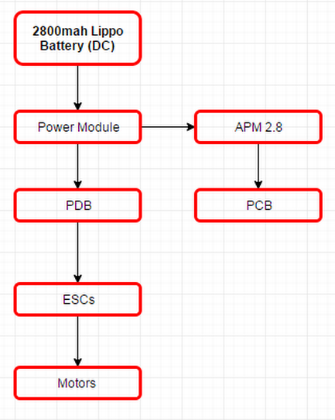
Power Distribution

Slide 27
3DRPower Module (Voltage regulator)

Slide 28
Powering APM board
Two separate circuits connected by jumper (JP1)
Two ways to provide power to APM
1. Through ESC’s BEC (JP1 needed)
2. Through Power Module (JP1 not needed)
Powering APM through 3DR PM
1. APM has PM 6-pin power port
2. Its voltage regulated, provides
consistence 5V power supply with
200mA current.

Slide 29
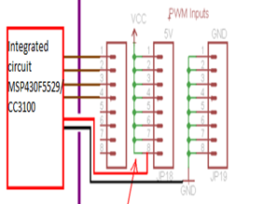
Powering PCB
MSP430F5529 MCU powering
DVCC = 3.3V
APM powering to PCB

Slide 30
Powering Motors
3s Lippo battery power: 11.1V, 2800mah, 31.08W
Motor power consumption: 8V-12V, 7.5A, 90W
Power Modulate regulates power
PDB shares common power to all ESCs
Approximate flight time = $\frac{31.08W}{90W∗4}∗60min$=5.18min

Slide 31
Mobile Wi-Fi Approach
CC3100 & MSP430
IP | Port Number
UDP Packet
Initiate: sends an Throttle value of 1500 will start the motor and stabilize the drone at5ft
Follow Me mode: Sends the GPS (longitude and latitude) every 2 second in a loop
Manual Mode: Sends Throttle, Yaw, Roll, and Pitch values in an array when button pressed

Slide 32
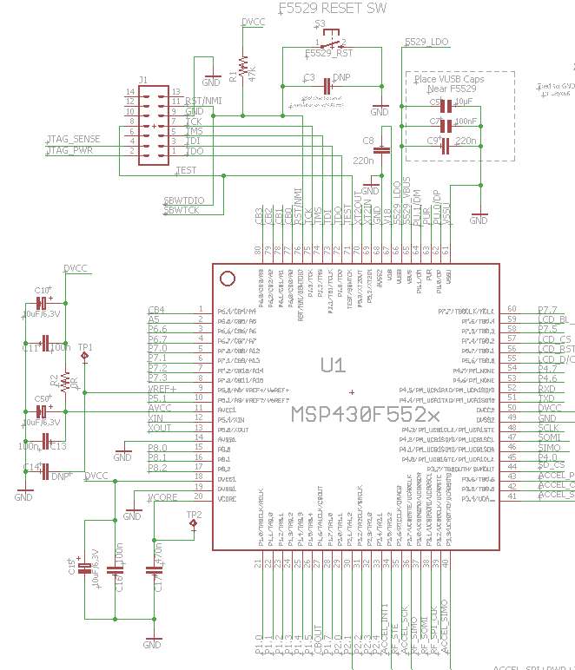
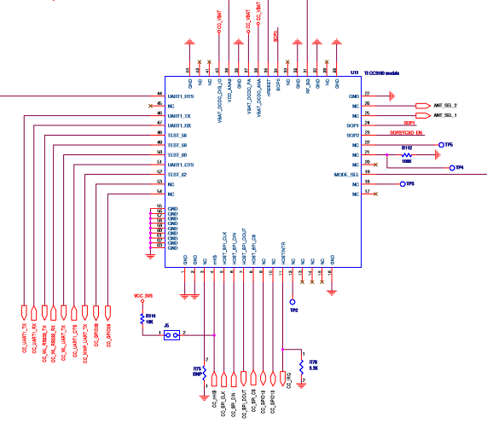
PCB Design
MSP430F5529/CC3100 Schematic Eagle CAD Design
CadSoft Eagle PCB Design Software is being utilized to create schematics of the PCB
OSH Park is the online vendor that will be used to print PCB
A 2 layer board will cost $5.00 per square inch or a 4 layer board will cost $10.00 per square inch
OSH Park offers 3 copies of the PCB at no charge

Slide 33
Work Distribution
Name | APM | Android | CC3100 (Wi-Fi Module) | MSP430F5529 | PCB Design
Akash
Ayoub
Younes
Nishit

Slide 34
Budget and Finance
No Sponsors
Dragon Bee is a self funded project
All teammates agreed to divide the total expense equally
Mostly all part are bought and paid for

Slide 35
Budget
Item | Quantity | Price | Supplier | Bought
1. Drone Kit | 1 | $100 | ebay | Yes
2. Battery | 1 | $45 | ebay | Yes
3. Battery Charger | 1 | $49 | ebay | Yes
4. Sensors (IR and Proximity) | 2 to 3 | $125 | ebay | Yes
5. 360 FLY Camera | 1 | $400 | BestBuy | Yes
6. ArduPilot Kit 2.8 | 1 | $95 | ebay | Yes
7. MSP430 | 2 | $30 | TI | Yes
8. PCB | 1 | $75 | OSH PARK | No
9. CC3100 Wi-Fi Module | 1 | $30 | ebay | Yes
10. Miscellaneous |  | $50
Total |  | $999

Slide 36
Project Completion

Slide 37
Issues
Communication between APM (autopilot) and MSP430
Battery weight
Copter cant lift our battery
Tuning the ESCs

Slide 38
Immediate Plan
Build APM firmware from scratch using ArduPilot libraries
To solve the communication problem
Reliable UART connection
Finalize the Android app and test the UDP connection
Finding the library for CC3100 module and MSP430 for PCB design
Finalize PCB layout

Slide 39
Questions

