Slide 1
Reconnaissance and Demolition Super Attack Tank A.K.A RADSAT
Jeff Hildebrandt
Dylan Lambe
Mick Muzac
Bradley Raley
Notes:
<number>

Slide 2
About RADSAT
RADSAT is a semi-autonomous tank designed to find, lock onto, and shoot a target specified by its color.
The base is an RC tank and mounted on top of it is a camera and air-soft gun aimed with servos.
RADSAT can be controlled by a laptop as well as voice commands delivered over WiFi.
The user has the option to have the tank autonomously or manually search for a target.
The user will also be able to view the video stream from the camera within a GUI.
Notes:
Dylan
<number>

Slide 3
Project Requirements
One battery to drive all systems for a least 10 minutes
Ability to quickly move in a straight line and turn while moving or while still
Sufficient sensors to avoid real-world obstacles
Equipped with a camera able to relay video information
Ability to aim and fire an airsoft gun
Shoot rapidly and accurately
Appropriately sized
Operate in various types of terrain
Notes:
Dylan
<number>

Slide 4
Block Diagram
Notes:
Dylan
<number>

Slide 5
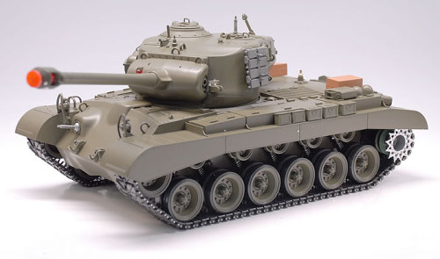
Notes:
<number>

Slide 6
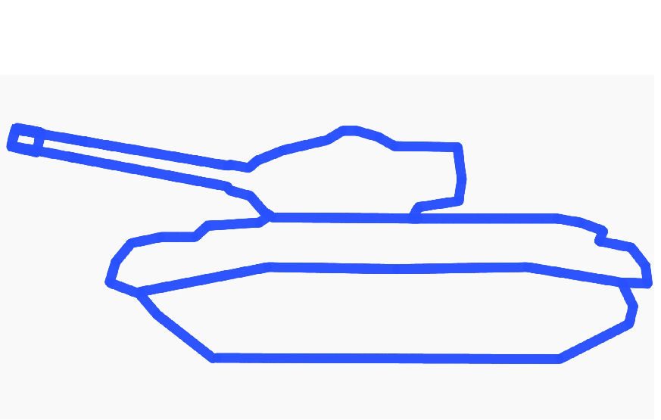

Slide 7
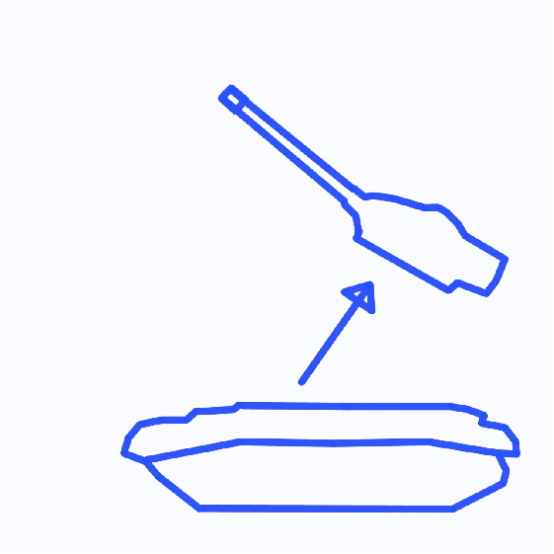

Slide 8
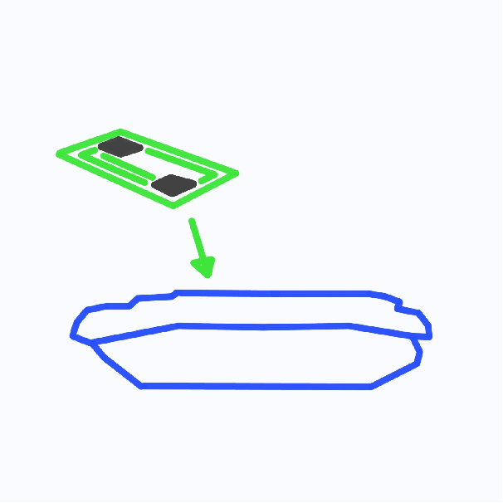

Slide 9
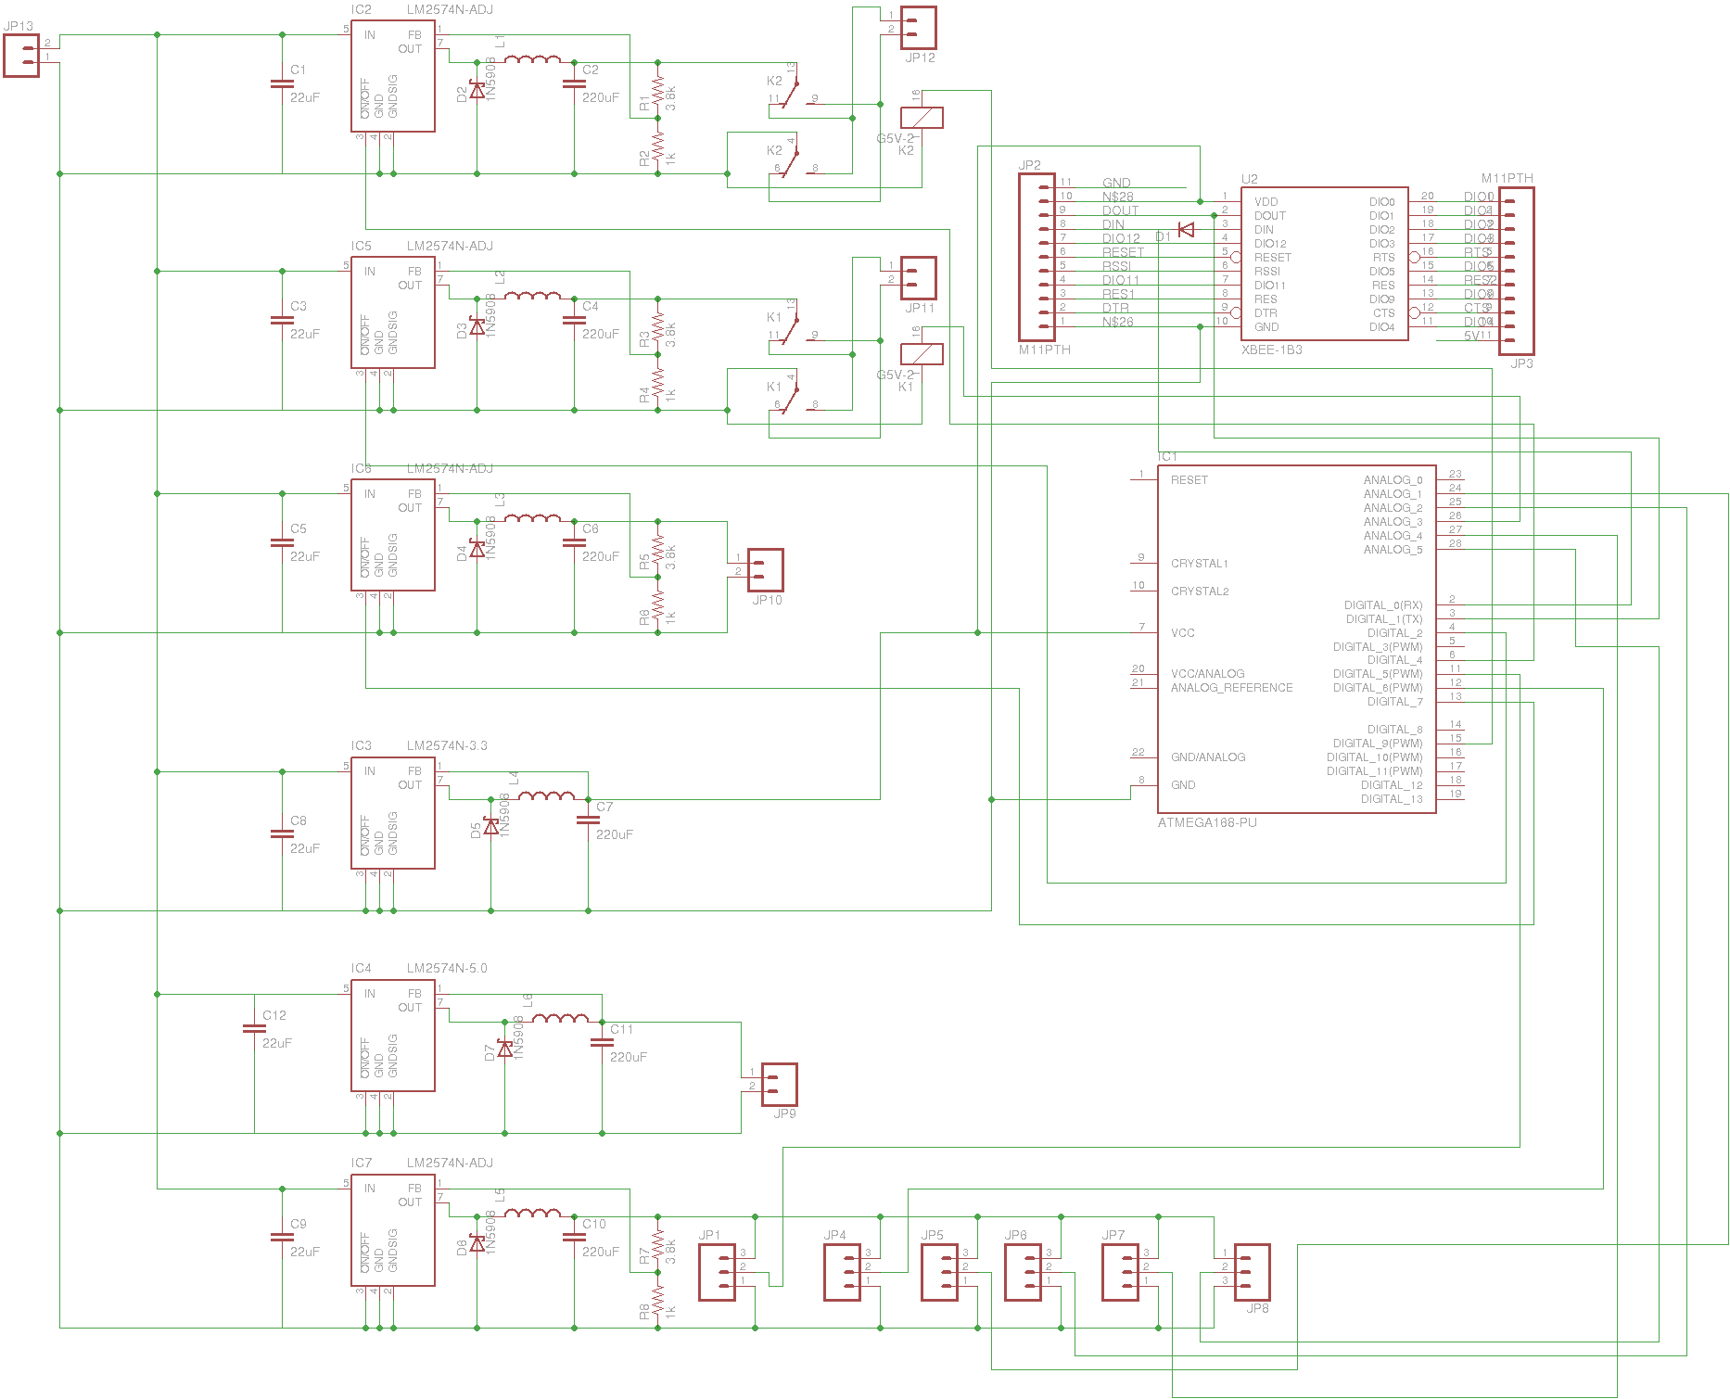
Power & Control Signal Diagram

Slide 10
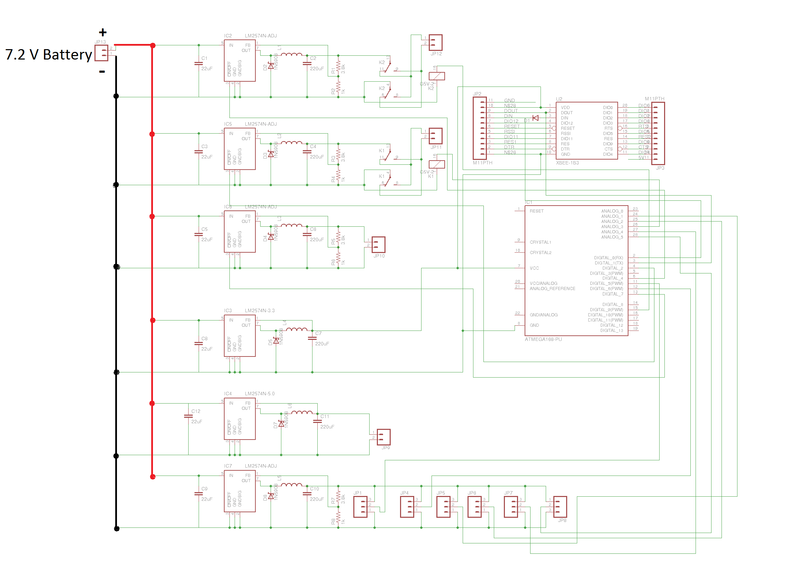
Power & Control Signal Diagram
Notes:
<number>
<number>

Slide 11
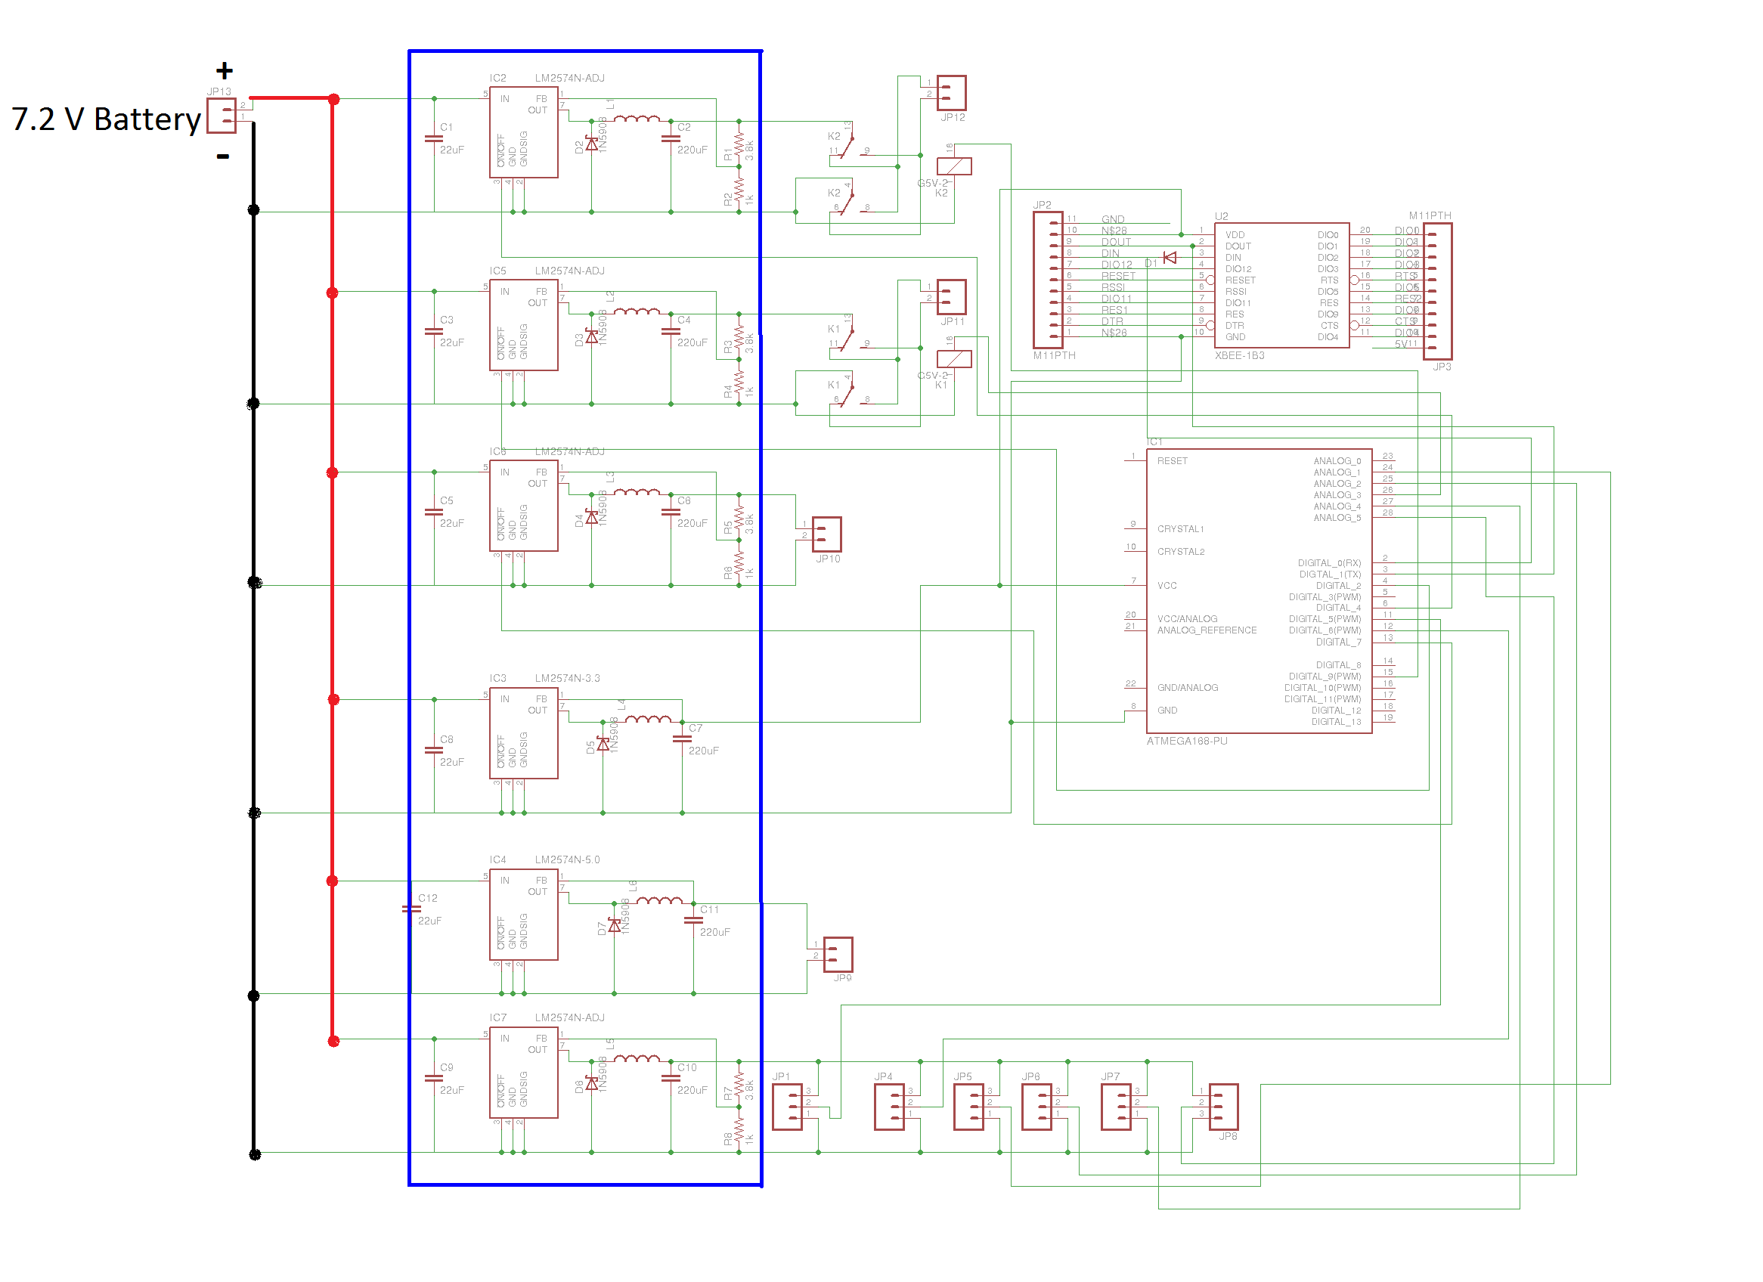
Power & Control Signal Diagram
Notes:
<number>
<number>

Slide 12
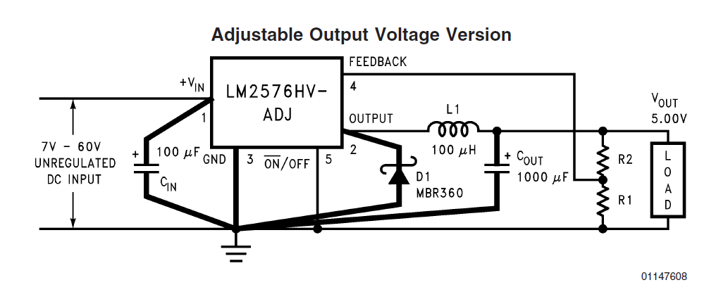
LM 2574
Notes:
<number>
<number>

Slide 13
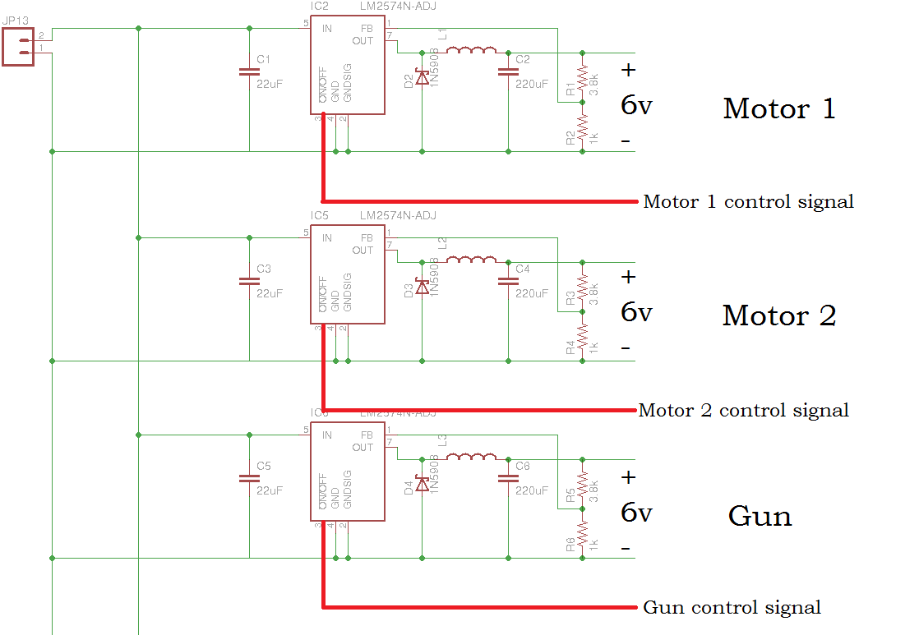
Notes:
<number>
<number>

Slide 14
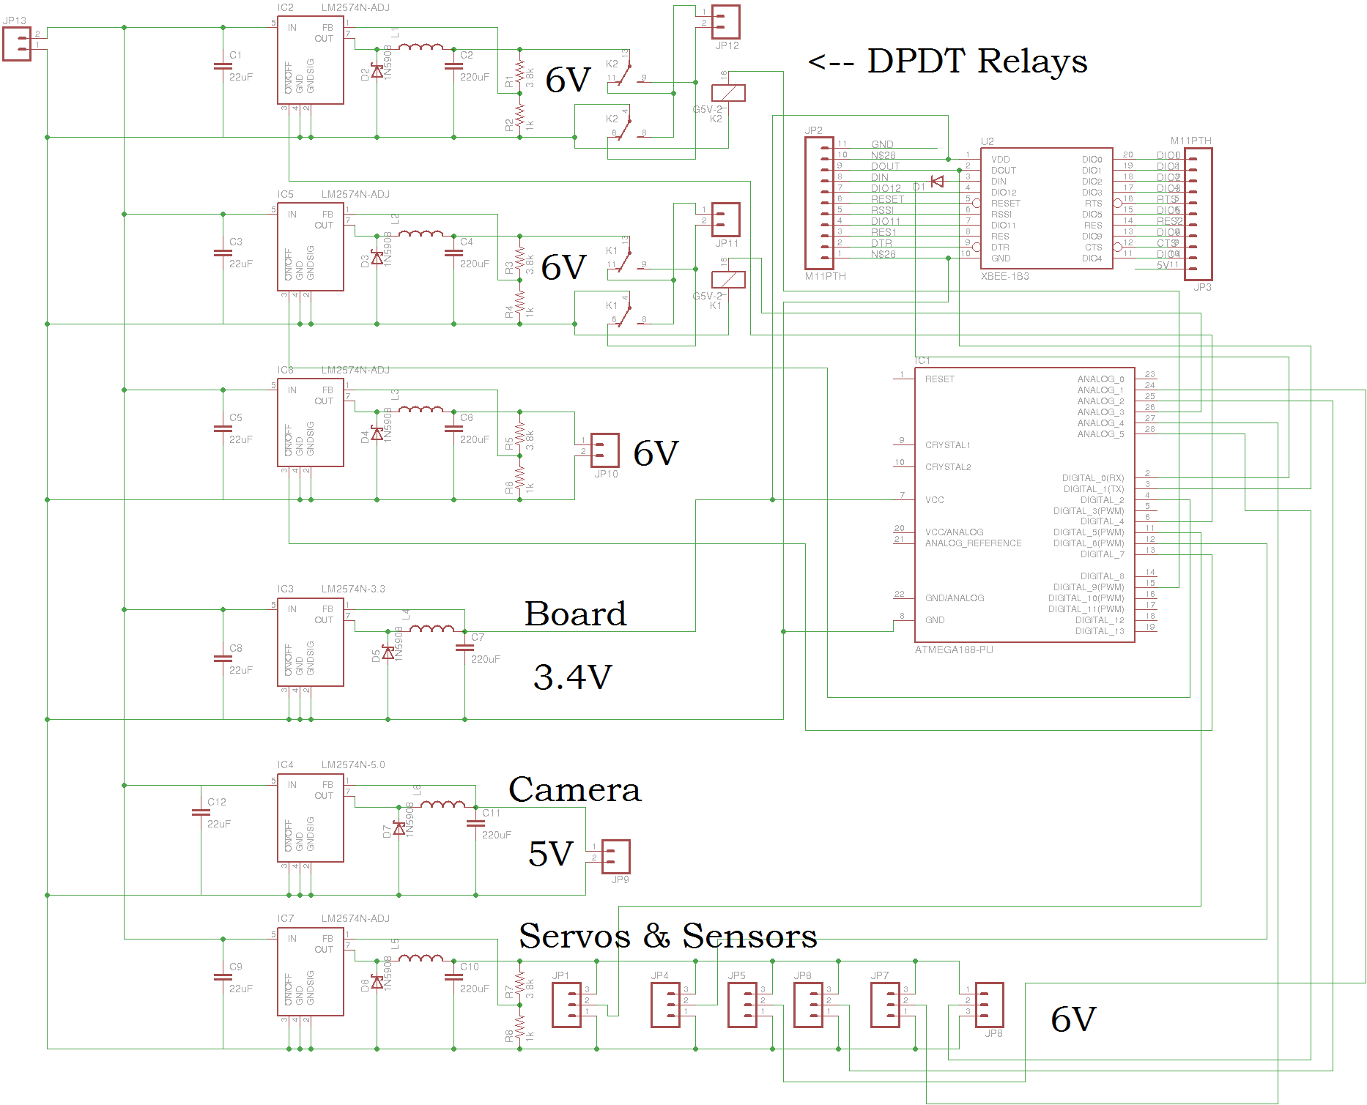
Notes:
<number>
<number>

Slide 15
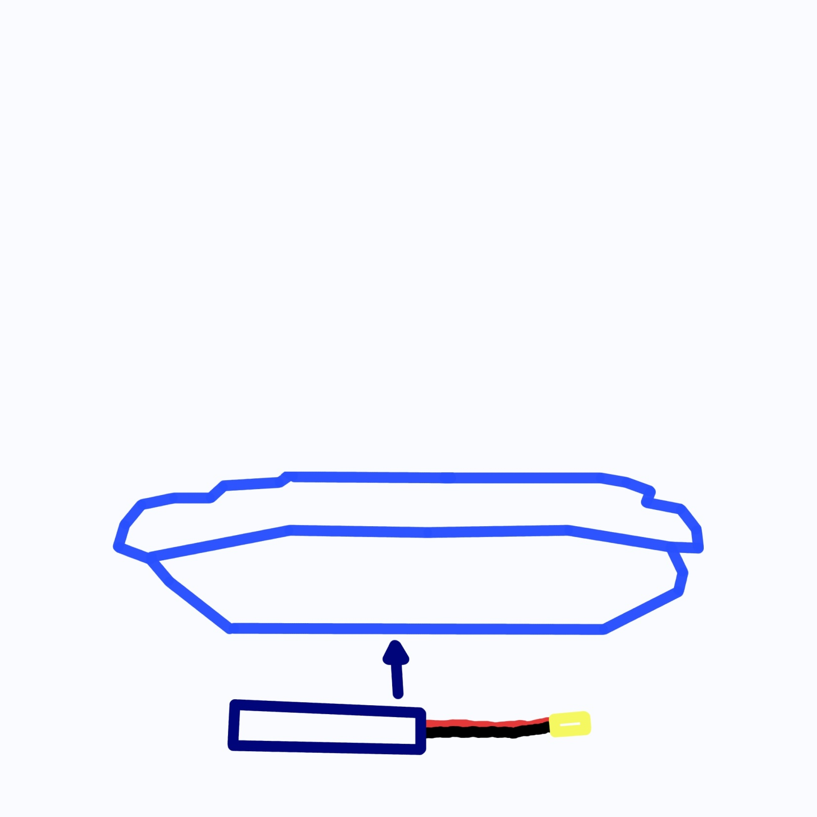
Notes:
<number>

Slide 16
7.2 V 3800Mah NiMH Battery
Equation: 3800mAh * 1A/1000mA * 60 min./1h * 1/3A = 76 minutes
This figure assumes a constant draw of 3 amps. Therefore it is useful for estimation only. The requirement of a 10 minute battery life will probably be met.
Notes:
<number>
<number>

Slide 17
Sensor Selection

Slide 18
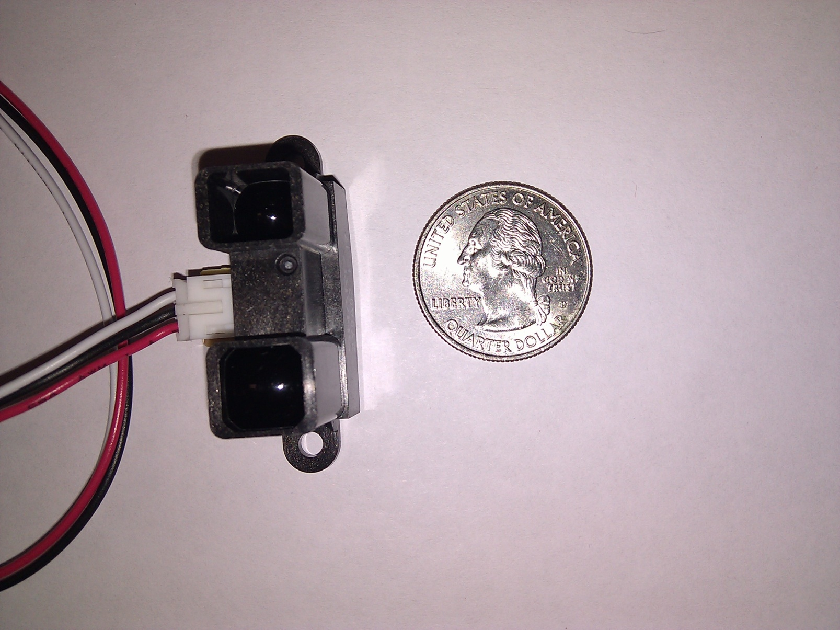
Sony GP2Y0A02YK

Slide 19
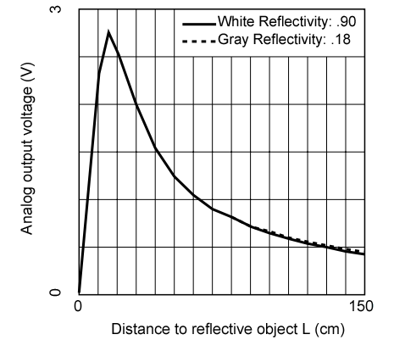
Infrared Advantages
Sony GP2Y0A02YK infrared is very inexpensive
Not susceptible to interference
Easy to mount and comes with JST connector
Will be used as side sensors to detect side obstructions
Notes:
<number>

Slide 20
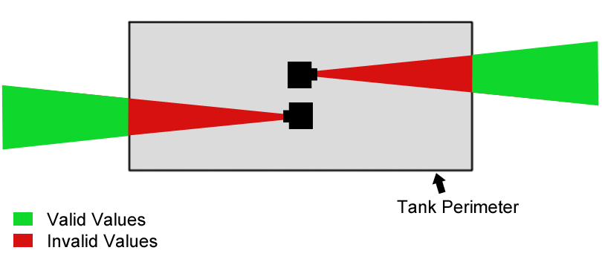
Infrared Placement
20 cm invalid range means sensor needs 20 cm buffer
Duplicate Vo values are impossible

Slide 21
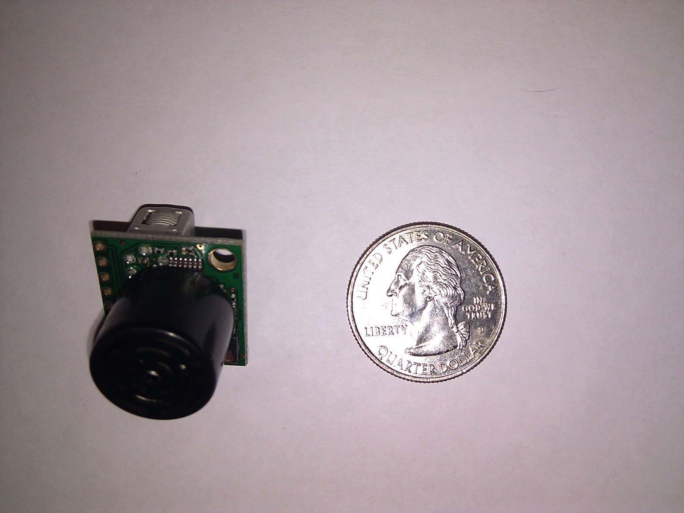
Maxbotix MB1210

Slide 22
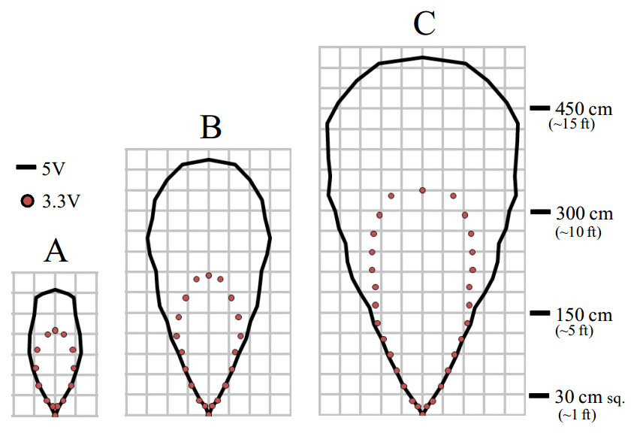
Ultrasonic Advantages
Doesn’t suffer from duplicate Vo problem
Used as front sensor due to range (25ft)
Different modes of operation: 5V > 3.3V
Single speaker Multiple interfaces for measurements
Analog, Serial, Pulse Width

Slide 23
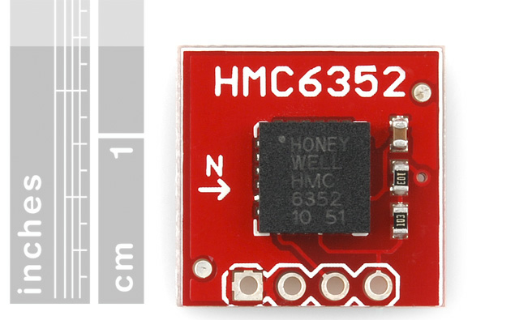
Compass Module
Honeywell HMC6352
0.5 degree heading resolution
I2C interface allows for easy integration
Used to facilitate accurate turning
Biggest drawback: prone to magnetic field interference

Slide 24
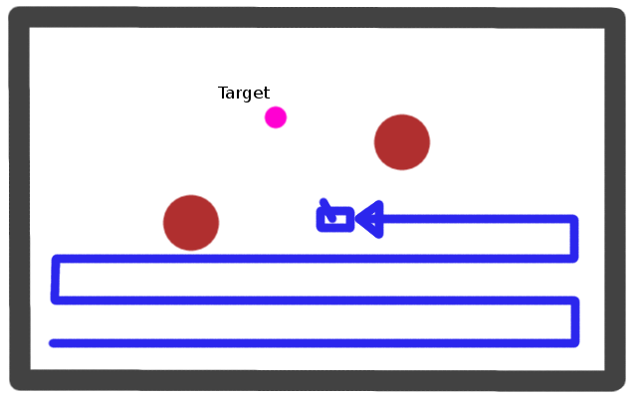
Example Path

Slide 25
Sound Library

Slide 26
Camera Selection
Needs to stream a live video feed from RADSAT to the computer screen.
Needs to be in color.

Slide 27
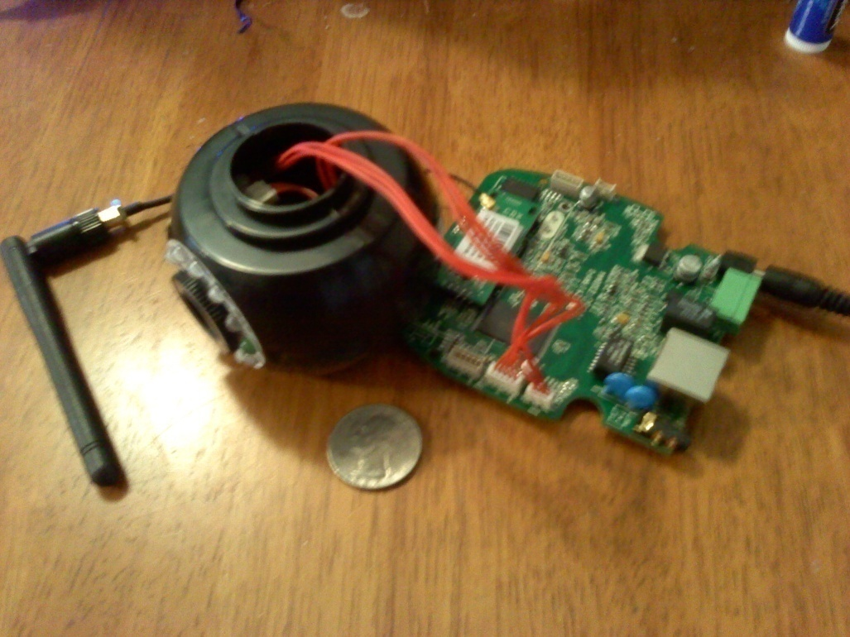
Video Processing
The WiFi camera automatically
puts a video stream onto a
server.
Using AForge.net video libraries
for C# - going to retrieve an
MJPEG video stream from the
server.
Parse the MJPEG frames into
individual JPEG images then
convert them to Bitmap.
Each time a new frame is loaded, an event occurs and the program receives a new Bitmap image.
Once the Bitmap image is received the targeting system can occur.

Slide 28
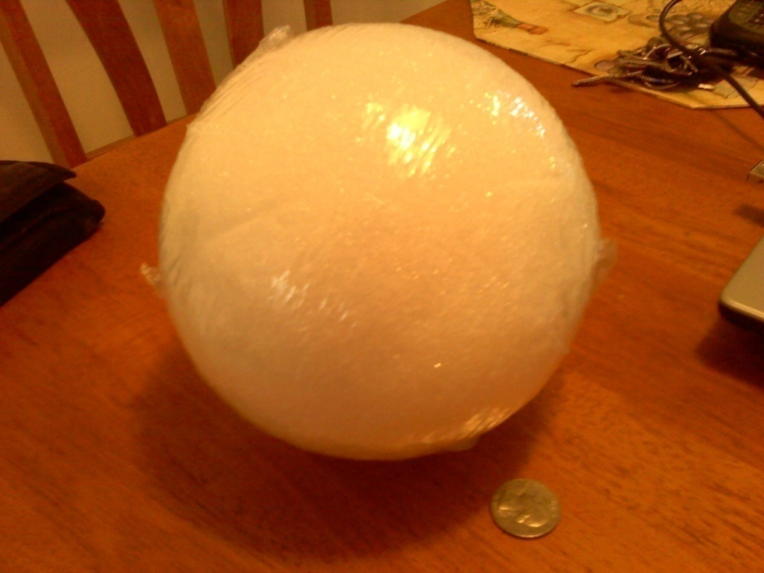
Targeting
The target which RADSAT will
be shooting at will be a 6”
Styrofoam ball which will be
painted either red, blue, or
green.
The program will identify the
target using the Bitmap
image of the camera’s view.
It can differentiate the target
from different objects using color recognition as well as shape recognition.

Slide 29
Class Diagram
Notes:
Mention how all the classes implement each other so the image doesn’t have to be passed around
<number>

Slide 30
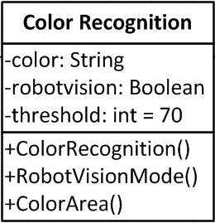
Color Recognition
A variation of this equation will be applied
to every pixel, starting at the top left and
moving right until the target is found.
D = sqrt((R - 0)^2 + (G - 255)^2 +
(B - 0)^2), where R represents red within
the RGB color scheme, G represents
green, and B represents blue. The result
D will be compared against a variable.
The larger “D” is then the farther the pixel
is from the desired color.
Depending on which color is desired the 255 will replace the zero for either red or blue.
Any pixel that does not meet the specifications will be colored grey, making it easier for the user to see exactly what the robot is seeing. There will be a button to turn this feature on or off.
The equation for grayscale is N = (R + G + B) / 3 where R, G, and B will be reassigned to the value of N.

Slide 31
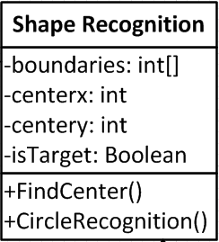
Shape Recognition
The target that has been chosen is spherical
in shape, which means no matter what
angle it is being viewed at it will appear as
a circle to the camera.
Thus the target must be the specified color as
well as circular in shape.
When the program finds the correct color, it will
start saving the pixels to an array. While it is
saving it will simultaneously be checking to
here the leftmost pixel begins.
The pixel that is farthest left can be thought of as a line which cuts through the circle’s center point. So by taking that line and finding the center point. Every pixel located on the perimeter of the circle should have about the same distance to the center point.
This will be calculated using the distance equation:
sqrt((x2-x1)^2+(y2-y1)^2)

Slide 32
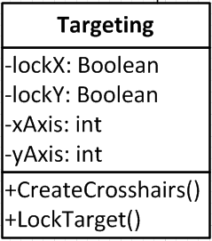
Targeting
This is called after the target
has been found.
It will first draw crosshairs
at the center point of the
target. As well at the location
where RADSAT is currently
targeted.
The program will check
whether the target is in
relation to the firing point.
It will first move the turret into the correct horizontal position, then when that has been achieved it will move into the correct vertical position both in relation to the firing point.
Notes:
Explain what the firing point is.
<number>

Slide 33
Robot Motion
Commands delivered to RADSAT over WiFi connection
Executed in the order they are received
Continuously listening while the autonomous Boolean is not set
Autonomous function will tell RADSAT to become autonomous
Notes:
Dylan
<number>

Slide 34
GUI Design
Written in C#
Allows for wireless connection and complete control of the tank
Provides video feedback from the tank
Can set the tank to autonomous mode
Notes:
Dylan
<number>

Slide 35
Wireless Communication
Arduino Diamondback used for prototyping
WIFI Shield included on the board
XBee Adapter will be used in the final design for wireless communication
Video stream sent over a separate server
Notes:
Dylan
<number>

Slide 36
XBee Adapter
XBee adapter will be used for delivering commands wirelessly to the ATMega microcontroller with the Arduino boot loader
Provides wireless communication for transmitting code to our microcontroller

Slide 37
Financing
Original budget: $800
Notes:
Dylan
<number>

Slide 38
Progress Chart
Notes:
Dylan
<number>

Slide 39
Next Steps and Concerns
Create PCB and power allocation circuit
Finish Hardware and software development
Develop final product
Decide if voice will be custom designed, or Android based.
Depending on sensor performance, an accelerometer might be implemented.
Test, test, test
Notes:
Dylan
<number>

Slide 40
Questions?
Notes:
Dylan
<number>

