Slide 1
ManScaper
Autonomous Lawnmower
Group 2
Andrew Cochrum
Joseph Corteo
Jason Oppel
Matthew Seth

Slide 2
Project Goals & Motivation
Remove the chore of mowing your lawn
Create a lawnmower that runs with little to no user interaction
Eliminate the need to detect boundaries using buried cable lines
Create a safe system that avoids obstacles that may be in the path of the mower

Slide 3
ManScaper Features
Fully electric, rechargeable lawnmower
Boundary detection using computer vision
Object detection to avoid obstacles
Autonomous operation with little to no user interaction required

Slide 4
ManScaper Design Specifications
Project Design Specs
Lawnmower size | 26”x35”x12.5”
Mower location accuracy | ≤ 12”
Forward speed | 1-2 mph
Obstacle detection distance | 2 cm to 3 m
Battery life | ≥ 30 min

Slide 5
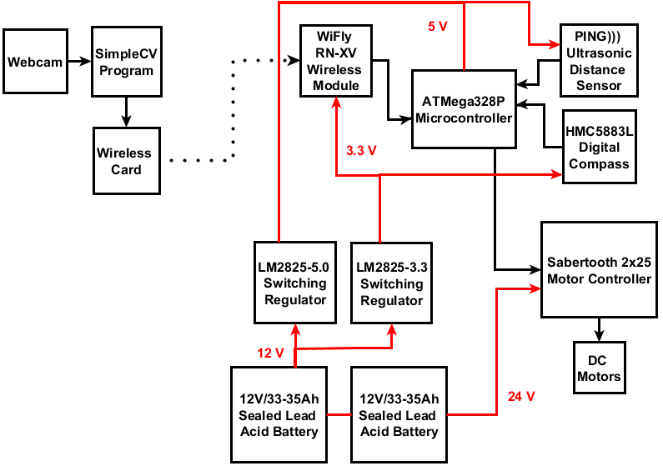
Overall Block Diagram

Slide 6
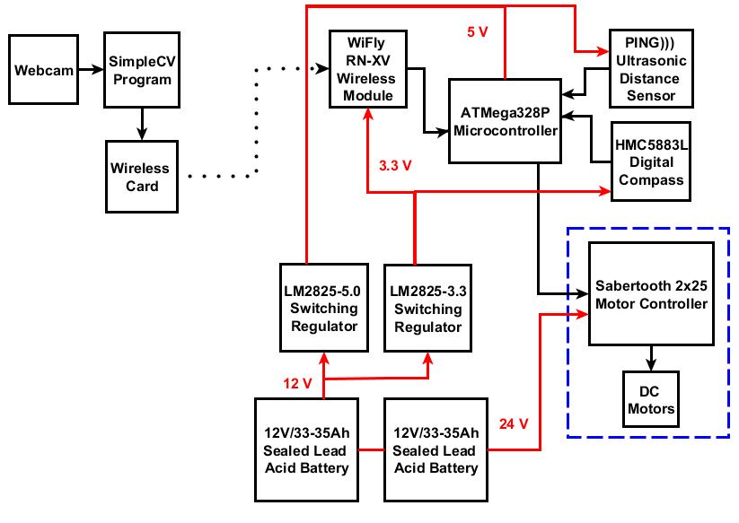
Drive Subsystem & Chassis Integration

Slide 7
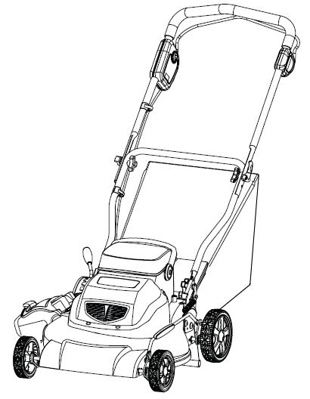
Lawnmower Integration onto Existing Chassis
We started with a Greenworks 24 Volt 3-in-1 Cordless Mower

Slide 8
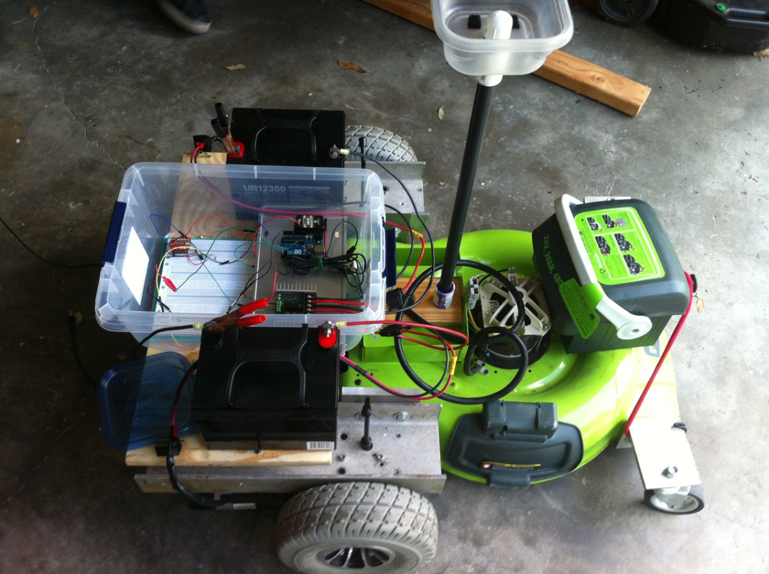
Lawnmower Integration onto Existing Chassis
Our 1st design had CG issues and was too low to the ground to travel over taller grass

Slide 9
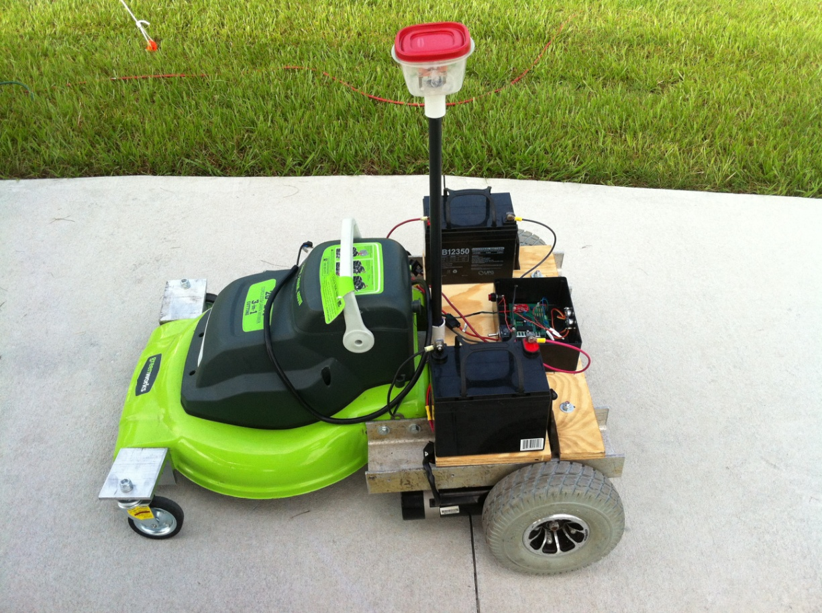
Lawnmower Integration onto Existing Chassis
Our 2nd design fixed our CG issues and put the mower at an optimal ride height

Slide 10
Lawnmower Integration onto Existing Chassis
The mower turns and navigates via differential steering achieved by using each motor independently as well as free castoring wheels on the front of the chassis
The mower blade is turned on and off by a simple 25 amp relay via the microcontroller

Slide 11
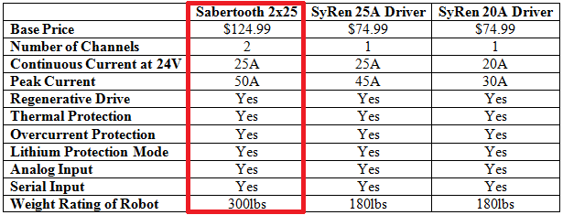
Drive Motors/Motor Controller Selection
Since the electric motors were loaned to us by the UCF Robotics Club, motor selection was simple and the motors that were loaned to us provide more than enough power for our application
According to the UCF robotics club the motors each require 25 amps so we needed a motor controller that could handle the current

Slide 12
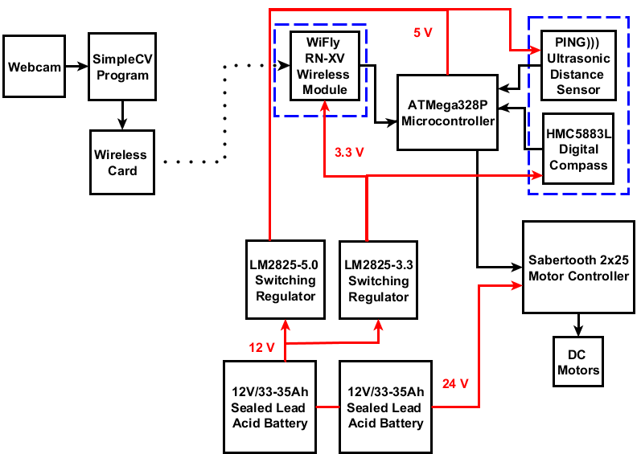
Peripheral Sensors

Slide 13
Infrared vs. Ultrasonic Sensors
 | Infrared sensors | Ultrasonic sensors
Detection range | 2cm – 1m | 2cm – 7m
Beam width | Narrow width | Wide width
Detection issues | Problems in direct sunlight | Poor detection of absorbent materials
Average price | $10-$15 | $30-$40

Slide 14
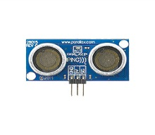
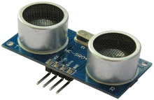
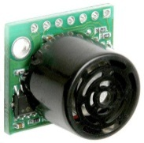
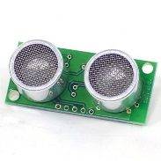
Ultrasonic Sensor Comparison
Sensor | Parallax PING))) Ultrasonic Sensor | HC-SR04 | Maxbotix LV-EZ1 | SRF04
Supply Voltage | 5 V | 5 V | 2.5-5 V | 5 V
Supply Current | 30 mA | 2 mA | 3 mA | 30 mA
Range | 2cm-3m | 2cm-0.5m | 0cm-6.45m | 3cm-3m
Frequency | 40 kHz | 40 kHz | 42 kHz | 40 kHz
Size (mm) | 22x46x16 | 20x43x15 | 20x22x16 | 20x43x17
Price | $29.99 | $5.99 | $29.95 | $29.50

Slide 15
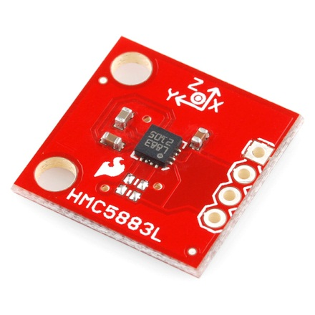
HMC5883L Triple Axis Magnetometer
Used to measure the heading of the lawnmower during operation
Internal measurement scale can be modified via software in case local interference saturates the magnetometer
Disadvantages:
  Inaccuracies when tilted by more than a few degrees from the horizontal
  Sensitive to ferrous materials – must be either shielded or placed at a suitable distance

Slide 16
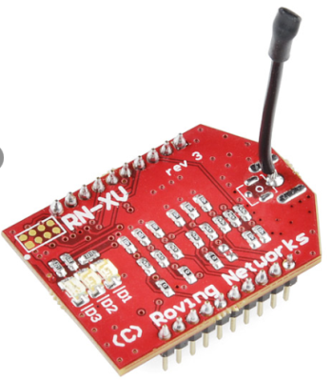
RN-XV WiFly Wireless Module
Onboard TCP/IP stack includes DHCP, UDP, DNS, ARP, ICMP, HTTP client, FTP client and TCP
Requires only two pins to communicate with the ATMega328P (RX and TX)
Both the laptop and WiFly module connect to a wireless access point
Once on the same network, a Telnet session will allow for the transfer of location data to the WiFly module

Slide 17
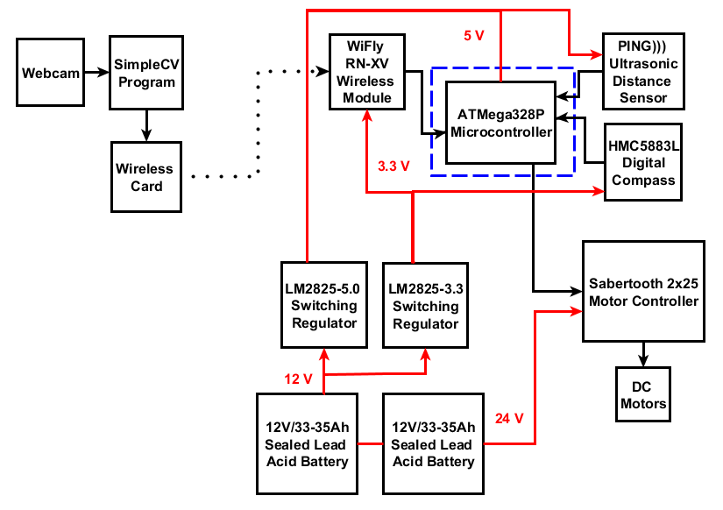
Microcontroller

Slide 18
Microcontroller Selection
Specifications taken into consideration for microcontroller selection:
    I/O lines for each component (at least 13 lines total)
      2 lines – HMC5883L Digital Compass
      1 line – PING ))) Ultrasonic Distance Sensor
      2 lines – WiFly RN-XV Wireless Module
      1 line – Sabertooth 2x25 Motor Controller
      4 lines – Quadrature Encoders (2 per encoder)
      2 lines – ADXL345 Accelerometer
      1 line – 25 Amp Solid State Relay
    Widely supported platform
    Reasonable cost

Slide 19
Microcontroller Selection
Microcontroller choices
 | MINI-MAX/51-C2 | ATMega328P
Memory | 2 Kbyte of EEPROM memory | 1 Kbyte EEPROM memory
I/O Ports | 32 general purpose I/O pins | 23 programmable I/O lines
Additional Advantages | Analog/Digital Converter | Analog/Digital Converter
Programming | In-circuit programming/ debugging | Program is flashed through UART (IC programming is possible through burned boot loader)
Cost | $53.00 | $29.99

Slide 20
Microcontroller Selection
ATMega328P chosen for this design
  Wide selection of libraries available for each component
    Reduces time spent programming
  23 ports available for components (I/O lines)
  Arduino IDE allowed for C/C++ programming
  Reasonable cost
  Readily available at local vendors

Slide 21
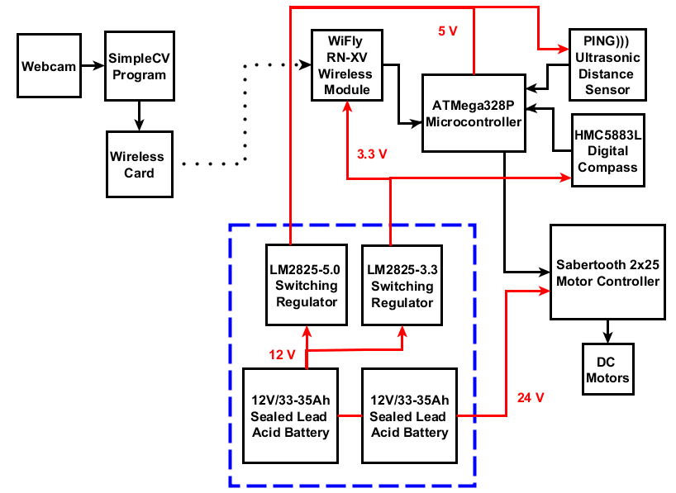
Power Subsystem

Slide 22
Component Power Requirements
Component | Voltage | Max Current Draw
Drive motors | 24 V | 3 A (each)
Microcontroller | 5 V | 12 mA
Ultrasonic sensor | 5 V | 35 mA
Wi-Fly module | 3.3 V | 38 mA
Digital compass | 3.3 V | 100 μA
Total maximum current draw of ≈ 6.09 A

Slide 23
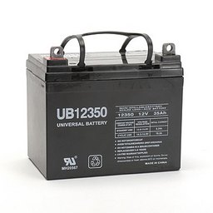
Battery Selection
Existing battery used for blades
  Maximizes blade run time
Desired a ½ hour of minimum run time
Low cost
Two UB12350 12V / 33Ah sealed lead-acid batteries in series
  Same battery is used to drive the commercial electric wheelchair that uses our DC motors

Slide 24
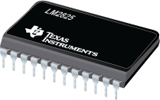
Linear vs. Switching Regulators
85 mA regulated current draw
P_{out} = 5V * 85mA = 425mW
  LM2825 1A switching regulator
  (24 pin DIP package)
 | Linear regulator | Switching regulator
Efficiency (η) | ≈ 41.7% | ≈ 80%
Power dissipation P_{d} = P_{out} / η - P_{out} | 425/0.417 – 425 = 0.59 W | 425/0.8 – 425 = 0.11 W

Slide 25
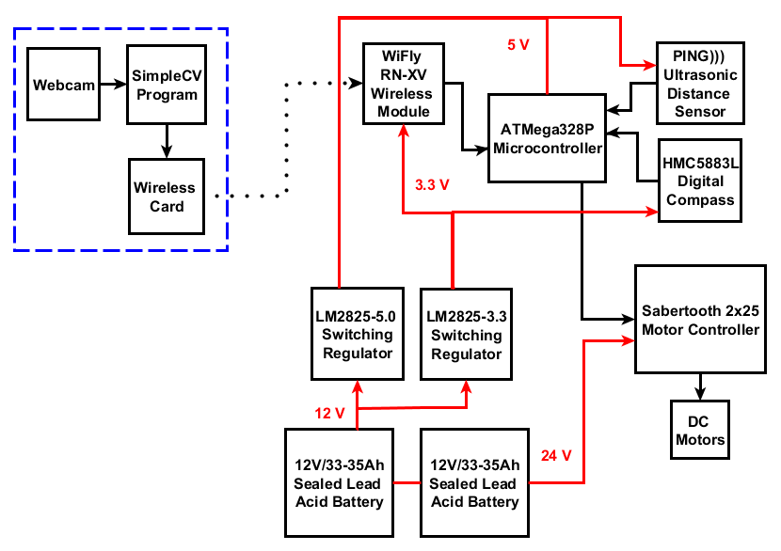
Location Subsystem

Slide 26
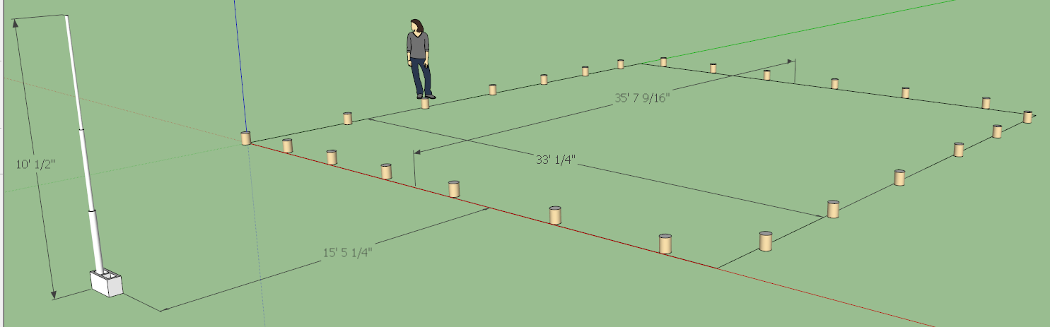
Computer Vision: General Setup
Webcam will be mounted on top of support structure to provide a high enough elevation to survey the entire area

Slide 27
Computer Vision Software: Running Segmentation in SimpleCV
Camera takes a raw image
Previous images are averaged and then subtracted from the current image
  This results in a binarized image that only shows pixels that have changed
  The binarized image is dilated to make the blobs more pronounced
Program then stores blobs into a feature set
  Blobs are filtered based on pixel distance from the previous blob
  Ensures that the program is tracking the mower and not another moving object

Slide 28
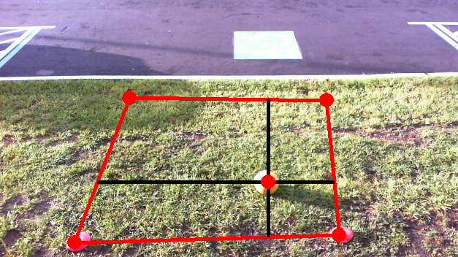
Computer Vision: Computing Boundaries

Slide 29
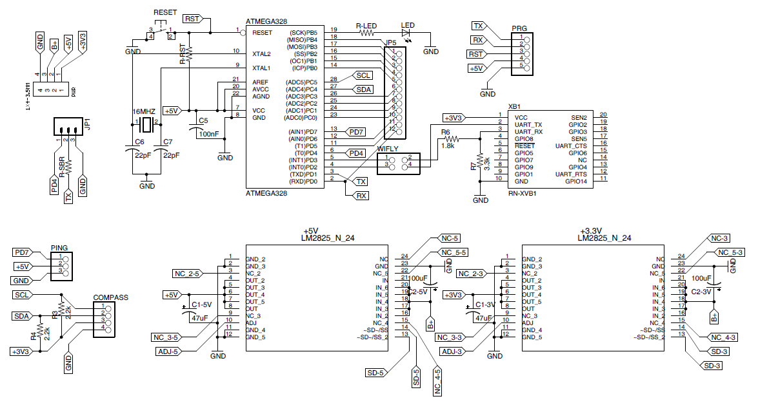
Overall Schematic

Slide 30
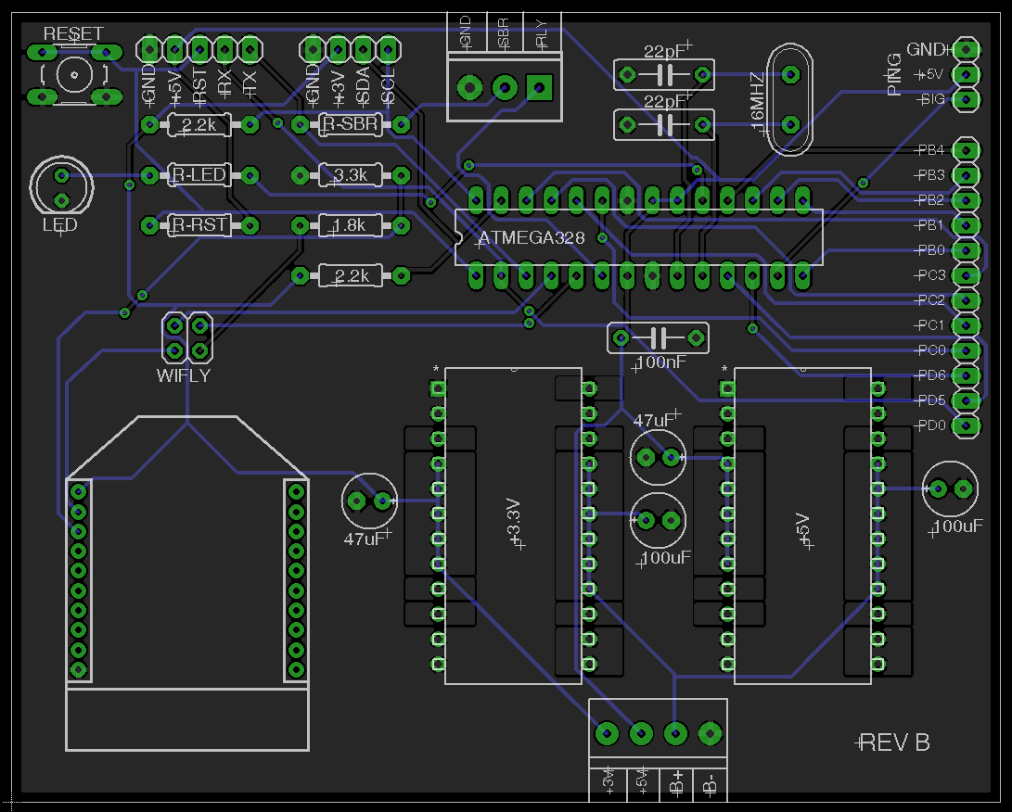
PCB Design

Slide 31
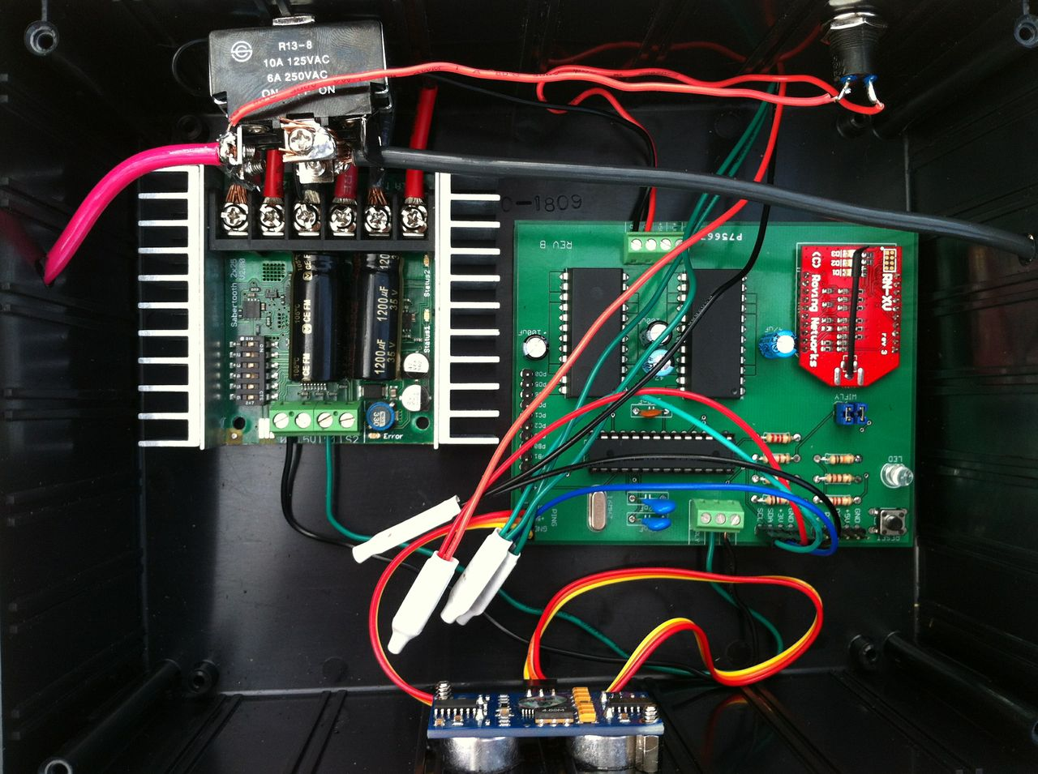
PCB Design

Slide 32
Responsibility Distribution
 | Andrew | Jason | Joe | Matt
Chassis fabrication | X
Drive subsystem | X
Computer vision |  | X | X
Obstacle avoidance |  | X | X
Power subsystem | X | X
Mower navigation |  | X | X
PCB design | X
Administrative | X | X | X | X

Slide 33
Budget
Part | Manufacturer | Quantity | Unit Price | Net Price
25222 20-Inch 24-Volt Cordless Lawn Mower | Greenworks | 1 | $369.00 | $150.00 (used)
Ideapad Z560 Laptop | Lenovo | 1 | $597.00 | $0.00 (used)
DC brushed motor with gearbox and wheel | X | 2 | $181.64 | $0.00 (donated)
ATMega328 with development board for testing | Atmel | 4 | $29.99 | $119.96
PING))) Ultrasonic Distance Sensor | Parallax Inc. | 1 | $29.99 | $29.99
Sabertooth 2x25 V2 motor controller | Sabertooth | 1 | $124.99 | $124.99
HMC5883L Triple Axis Magnetometer | Sparkfun | 1 | $14.95 | $14.95
Lifecam HD-5000 Webcam and USB extension | Microsoft | 1 | $34.99 | $34.99
12V Sealed Lead Acid Battery 33-35Ah | Batteries.com | 2 | $59.99 | $119.98
LM2825-5.0 fixed output switching regulator | TI | 1 | Free sample | $0.00
LM2825-3.3 fixed output switching regulator | TI | 1 | Free sample | $0.00
Breakout board for XBee module | Sparkfun | 1 | $2.95 | $2.95
RN-XV WiFly Wireless Module | Roving Netwks | 1 | $34.95 | $34.95
PCB 2 Layer Full Spec | Adv Circuits | 1 | $77.00 | $77.00
Various PCB Components | X | X | $60.00 | $60.00
DIR-655 Wireless-N Router | D-Link | 1 | $94.99 | $0.00 (donated)
25A Solid State Relay | Shenlan | 1 | $25.00 | $25.00
Drive subsystem fabrication supplies | Home Depot | X | $30.00 | $30.00
Webcam telescopic platform building supplies | Home Depot | X | $100.00 | $100.00
 |  |  | Total Price | $924.76

Slide 34
Issues
DC motor specs were unknown
Fabrication issues
  Original angle iron was not strong enough
  CG issues
  Platform was too low for taller grass
Compass needed offset for calibration
Dead reckoning mapping in combination with computer vision
PING))) sensor false positives
Color/hue segmentation in computer vision

Slide 35
Questions

