Slide 1
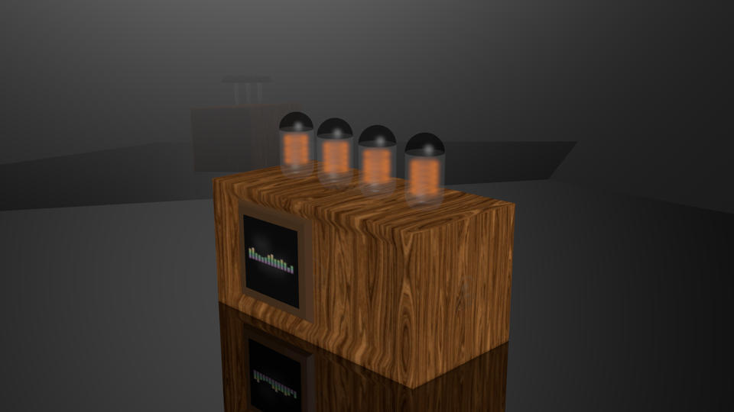
Vacuum Tube amplifier
Group IV
Stephen Nichols
Jason Lambert
Rafael Enriquez

Slide 2
description
Stephen
A Vacuum tube audio amplifier for which the entire signal path is analog but the audio parameters are digitally controlled via a digital touch interface which controls a graphical user interface and also displays visualizations of the amplitude, frequency and phase characteristics of the audio signals.

Slide 3
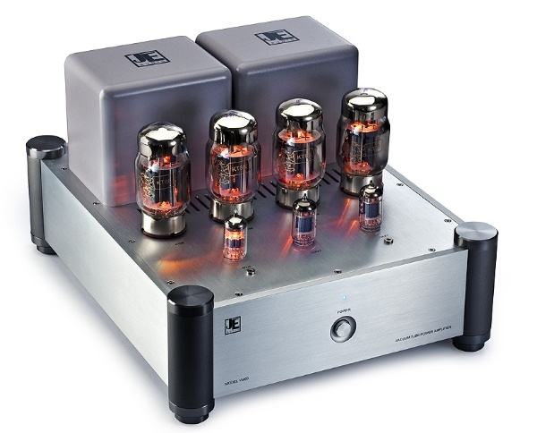
motivation
Stephen
JE-Audio, model VM60
This unit is about 5” x 13” x 16” weighs about 45 pounds
and costs about $6300 per pair.
Image reprinted with permission from John Lam of JE-Audio
Our project will be embody the analog aspects of modern commercial VTAs such as this one.
The unique feature of our project is digital controlled source switching, volume, and graphic equalizer with a digital touch interface and an LCD to display music visualizations.
  As far as we can determine, no other modern VTA has this feature.

Slide 4
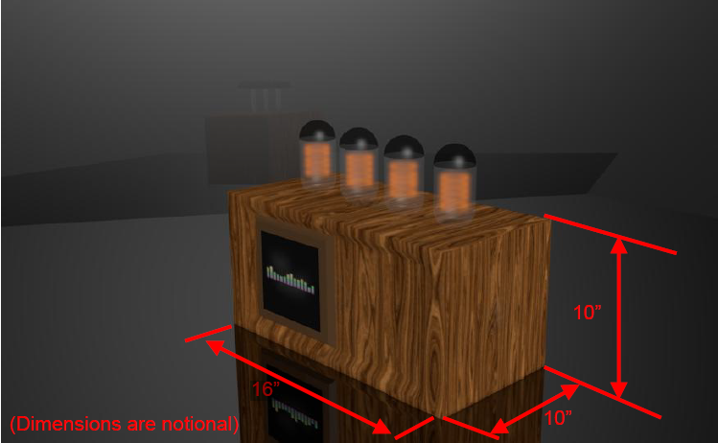
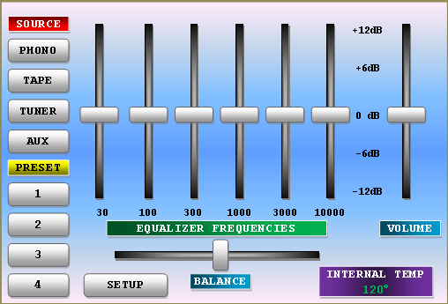
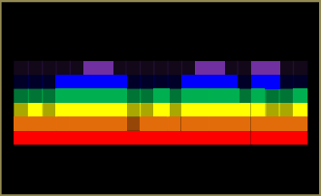
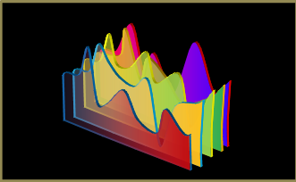
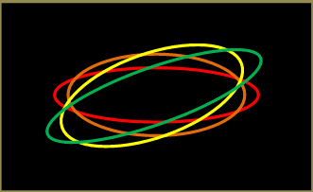
goals
Jason
CONTROL PANEL
POSSIBLE MUSIC VISUALIZATIONS

Slide 5
Project Goals
Stephen
The goal is to design, document, and fabricate an all-analog vacuum-tube pre-amplifier and power amplifier, yet be all digitally controlled. The finished product must incorporate a modern Graphical User Interface (GUI) control for all functions except power. The LCD should produce an entertaining display that reacts to the audio signal in a similar manner to Microsoft Windows Media Center when not being used for control.

Slide 6
Hardware requirements
Stephen
Requirement | Value | Condition
Number of audio channels | 2 (stereo)
Output power rating | 10 Watts Root Mean Square (RMS) | Per channel at 1000 Hz without clipping
Input impedance | 10K ohms | Per channel
Output impedance | 8 ohms | Per channel
Bandwidth | 20 Hz to 20 KHz flat ±3dB | As measured at a moderate output level relative to the input signal level
Total Harmonic Distortion, low signal level | 0.5% | When measured at a number of frequencies 100 Hz to 5 KHz 12dB below maximum output
Total Harmonic Distortion, high signal level | 2.5% | When measured at the onset of clipping at a selection of audio midrange frequencies

Slide 7
INTERNAL DETAIL (TOP VIEW)
Stephen
IO Jacks
Fan
Fuse
AC Power
Terminal Strip
Filament
Transformer
High Voltage Power Supply
Low Voltage Transformer
High Voltage Transformer
Filament Power Supply
Left
Audio
Processor
Right
Audio
Processor
Microcontroller,
Low Voltage Power Supply,
Optocouplers
LCD
Power Switch
Digital Touch Panel

Slide 8
Overall BLOCK DIAGRAM
Stephen
SOURCES
B
LOCAL
VOLT
REG
SPEAKER
TO ALL AUDIO STAGES
PHONO
RIAA
EQU
INPUT
SOURCE
SELECT
GRAPHIC
EQUAL-IZER
TUBE
PREAMP
AND
PHASE
SPLITTER
TUBE
PUSH-
PULL
AMP
Z-
MATCH
XFMR
TAPE
PRE-EQU
GAIN
ADJ
INPUTS
BUFF
BUFF
VOL
ADJ
TUNER
AUX
GAIN
SEL IN
VR1
BUFFER
HIGH
VOLT
SUPPLY
VR2
A
VR3
VR4
VR5
VR6
DIGITAL POTENTIOMETERS
FILAMENT
SUPPLY
A
B
VR7
A
TO ALL TUBES
VR8
110
VOLTS
AC
MICROCONTROLLER
OPTO
COUPLERS
LOW
VOLT
SUPPLY
16 MILLION COLOR
800 x 480
LIQUID CRYSTAL
DISPLAY
CLOCK
OSC
TOUCHSCREEN
EXTERNAL
USB
PROGRAM
INTERFACE
AUDIO PATH FOR ONE CHANNEL SHOWN ONLY – THE OTHER IS SIMILAR

Slide 9
AUDIO INPUT BLOCK DIAGRAM
Stephen
SOURCES
B
LOCAL
VOLT
REG
SPEAKER
TO ALL AUDIO STAGES
PHONO
RIAA
EQU
INPUT
SOURCE
SELECT
GRAPHIC
EQUAL-IZER
TUBE
PREAMP
AND
PHASE
SPLITTER
TUBE
PUSH-
PULL
AMP
Z-
MATCH
XFMR
TAPE
PRE-EQU
GAIN
ADJ
INPUTS
BUFF
BUFF
VOL
ADJ
TUNER
AUX
GAIN
SEL IN
VR1
BUFFER
HIGH
VOLT
SUPPLY
VR2
A
VR3
VR4
VR5
VR6
DIGITAL POTENTIOMETERS
FILAMENT
SUPPLY
A
B
VR7
A
TO ALL TUBES
VR8
110
VOLTS
AC
MICROCONTROLLER
OPTO
COUPLERS
LOW
VOLT
SUPPLY
16 MILLION COLOR
800 x 480
LIQUID CRYSTAL
DISPLAY
CLOCK
OSC
TOUCHSCREEN
EXTERNAL
USB
PROGRAM
INTERFACE
AUDIO PATH FOR ONE CHANNEL SHOWN ONLY – THE OTHER IS SIMILAR

Slide 10
AUDIO INPUT PROCESSING
Stephen
The analog multiplexer, driven by two GPIOs from the MCU, selects one of four input sources. The output of the multiplexer is buffered by a unity-gain stage to provide a constant-impedance drive for the equalizer stage.
One VR channel is used to equalize the levels of the various signals (see chart) and is set to a pre-determined value by the MCU as the sources are selected.
Source Name | Processing | Input Signal required to get 1 volt peak at mux output at 1KHz
Phono | Two-pole low-pass filter to compensate for the Recording Industry Association of America (RIAA) specification equalization applied to vinyl records when they are made | 17 mV
Tape | None | 1 Volt
Tuner | None | 1 Volt
Aux | Constant voltage gain of 10 | 100 mV

Slide 11
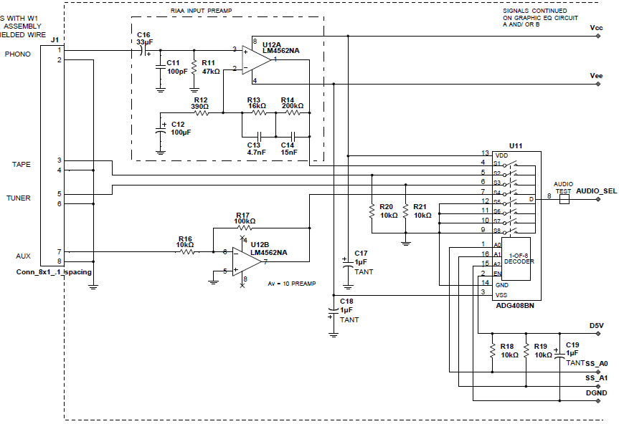
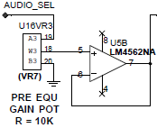
AUDIO INPUT SCHEMATIC
Stephen
From low-voltage power supply
To graphic equalizer
From back panel input jacks (not shown)
From MCU

Slide 12
AUDIO INPUT DESIGN DECISIONS
Stephen
Op-amps:
  The Texas Instruments’ LM4562
Analog Multiplexer:
  The Analog Devices’ ADG408
Parameter | Texas Instruments SN74LV4051 | Analog Devices AD8184ANZ | Analog Devices ADG408BN | Maxim DG508
Supply range | –0.5 V to 7 V | ±4V to ±6V | ±5V to ±15V | ±4.5V to ±18V
Crosstalk | -45dB | -98dB | -85dB | -68dB
Noise Voltage | Not rated | 4.5 nV / √Hz | Not rated | Not rated
THD | Not rated | -74dBc | Not rated | Not rated
Cost, each | $0.17 | $5.75 | $6.15 | $6.31
The ADG408BN was chosen due to excellent crosstalk, compatibility with the power supply voltages and performance during simulation

Slide 13
GRAPHIC EQUALIZER
Jason
SOURCES
B
LOCAL
VOLT
REG
SPEAKER
TO ALL AUDIO STAGES
PHONO
RIAA
EQU
INPUT
SOURCE
SELECT
GRAPHIC
EQUAL-IZER
TUBE
PREAMP
AND
PHASE
SPLITTER
TUBE
PUSH-
PULL
AMP
Z-
MATCH
XFMR
TAPE
PRE-EQU
GAIN
ADJ
INPUTS
BUFF
BUFF
VOL
ADJ
TUNER
AUX
GAIN
SEL IN
VR1
BUFFER
HIGH
VOLT
SUPPLY
VR2
A
VR3
VR4
VR5
VR6
DIGITAL POTENTIOMETERS
FILAMENT
SUPPLY
A
B
VR7
A
TO ALL TUBES
VR8
110
VOLTS
AC
MICROCONTROLLER
OPTO
COUPLERS
LOW
VOLT
SUPPLY
16 MILLION COLOR
800 x 480
LIQUID CRYSTAL
DISPLAY
CLOCK
OSC
TOUCHSCREEN
EXTERNAL
USB
PROGRAM
INTERFACE
AUDIO PATH FOR ONE CHANNEL SHOWN ONLY – THE OTHER IS SIMILAR

Slide 14
Graphic equalizer
Jason
DESIGN DECISIONS
Equalizer topology | Sallen-key | Gyrator
Order | 2nd | 2nd
Constant Q | Yes | No
Adjustable center frequency | No | No
Number of op-amps per band | 2 | 1
Complexity 10 being high | 7 | 4
Familiarity 10 being high | 8 | 3

Slide 15
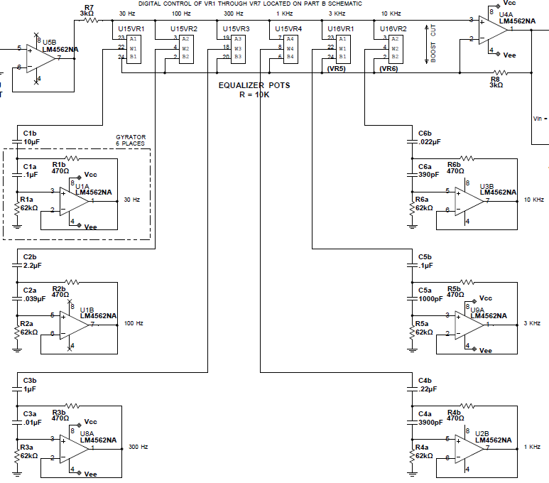
GRAPHIC EQUALIZER
Jason

Slide 16
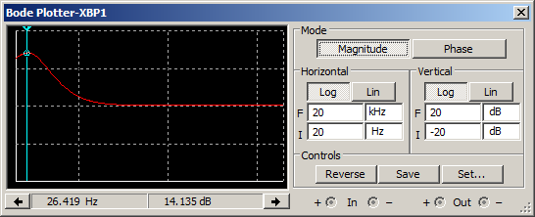
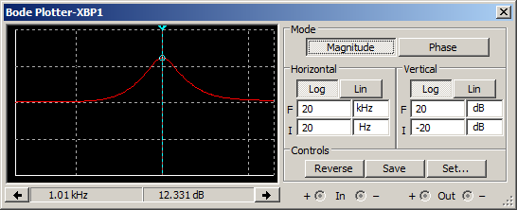
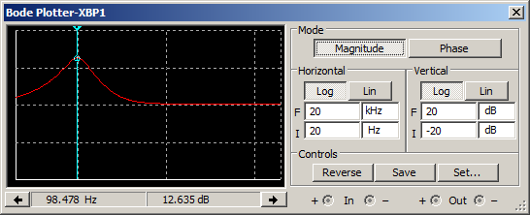
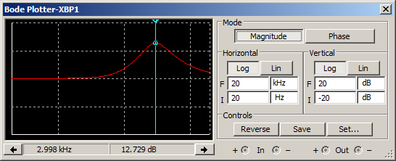
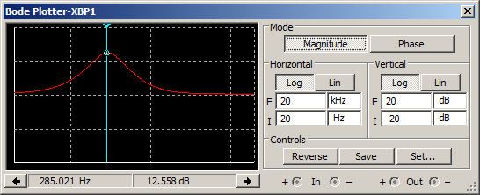
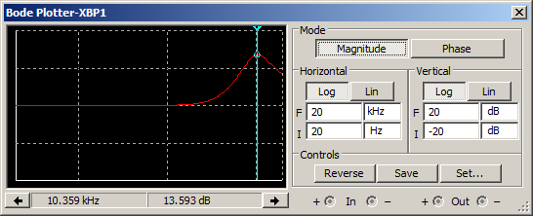
GRAPHIC EQUALIZER SIMULATION
Boost graphs are shown; cut graphs are mirror-image
30 Hz
1000 Hz
100 Hz
3000 Hz
300 Hz
10000 Hz

Slide 17
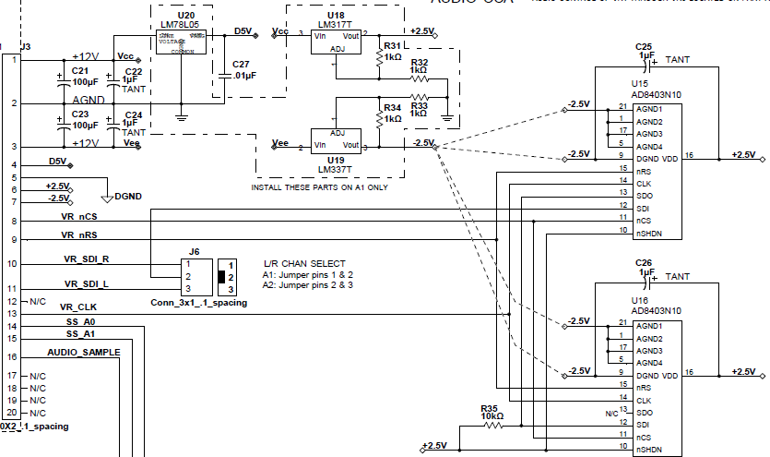
GRAPHIC EQUALIZER
Jason

Slide 18
Digital Potentiometers
Jason
DESIGN DECISIONs
key parameters | AD8403
Number of channels | 4 per chip
Number of positions | 256
Serial interface | 3 pin min
Availability in a DIP | Yes
Min cross talk VA = VDD, VB = 0 V | −65 dB
Min THD VA = 1 V rms + 2 V dc, VB = 2 V dc, f = 1 kHz | 0.003 %
Daisy chainable | Yes

Slide 19
Digital potentiometers
Jason
difficulties
The AD8403 is extremely sensitive to ESD and improper voltages. We had numerous mishaps that rendered the chips useless.
  As resolution we are following ESD precautions and double checking connections before applying power.

Slide 20
VTA BLOCK DIAGRAM
Stephen
SOURCES
B
LOCAL
VOLT
REG
SPEAKER
TO ALL AUDIO STAGES
PHONO
RIAA
EQU
INPUT
SOURCE
SELECT
GRAPHIC
EQUAL-IZER
TUBE
PREAMP
AND
PHASE
SPLITTER
TUBE
PUSH-
PULL
AMP
Z-
MATCH
XFMR
TAPE
PRE-EQU
GAIN
ADJ
INPUTS
BUFF
BUFF
VOL
ADJ
TUNER
AUX
GAIN
SEL IN
VR1
BUFFER
HIGH
VOLT
SUPPLY
VR2
A
VR3
VR4
VR5
VR6
DIGITAL POTENTIOMETERS
FILAMENT
SUPPLY
A
B
VR7
A
TO ALL TUBES
VR8
110
VOLTS
AC
MICROCONTROLLER
OPTO
COUPLERS
LOW
VOLT
SUPPLY
16 MILLION COLOR
800 x 480
LIQUID CRYSTAL
DISPLAY
CLOCK
OSC
TOUCHSCREEN
EXTERNAL
USB
PROGRAM
INTERFACE
AUDIO PATH FOR ONE CHANNEL SHOWN ONLY – THE OTHER IS SIMILAR

Slide 21
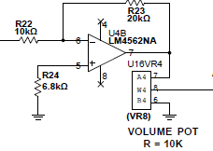
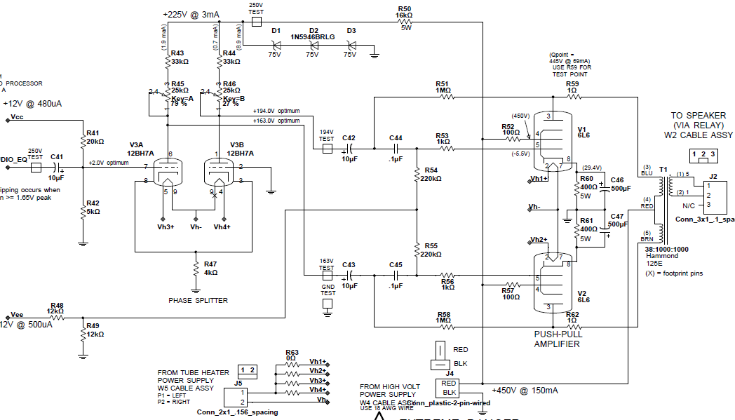
VTA SCHEMATIC
Stephen
From graphic equalizer
To speaker
5.75 Volts DC for tube heaters
From High Voltage Power Supply
420V @ 120mA

Slide 22
VTA ARCHITECTURE
Stephen
selection
Four candidate architectures were investigated early in the project to select the design approach of the power amplifier. Design 1 was chosen as offering the best frequency response and highest power at the lowest distortion.
Design | Topology | Max Vout (Vpk) | Max Power (Wrms) | THD at 1KHz | THD at -6dB | THD at -12dB | THD at -18dB | THD at -24dB | Freq Response
1 | Phase splitter, no feedback | 18 | 20.24 | 2.95 | 1.3 | 0.61 | 0.293 | 0.165 | 18.3 dB, 20Hz-100KHz down <1dB at ends
2 | Phase splitter, with feedback | 15.3 | 14.63 | 3.8 | 0.96 | 0.42 | 0.27 | 0.16 | 18.3dB 500Hz-100KHz down 3dB @ 92Hz
3 | Single end, no feedback | 9.2 | 5.29 | 3.7 | 1.98 | 0.4 | 0.17 | 0.09 | -1.2dB, 20Hz-100KHz down <1dB at ends
4 | Single end, with feedback | 9.1 | 5.17 | 1.9 | 1.2 | 0.04 | 0.017 | 0.08 | -0.5dB, 90Hz-100KHz down 3dB @ 20Hz

Slide 23
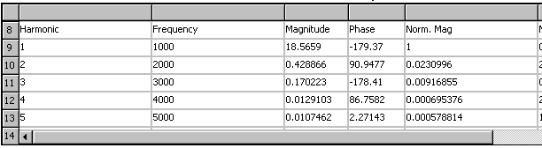
VTA DISTORTION
Stephen
VTAs are favored by many musicians and high-end audio enthusiasts for their mellower sound and low-distortion characteristics. This effect, known as “tube sound”, is believed to come from the “soft clipping” characteristics of vacuum tube amplifiers which emphasize even-order harmonics, as opposed to solid-state designs that tend to produce odd-order harmonics when they sharply clip during musical peaks.
During the architecture selection, the distortion characteristics of the various configurations were analyzed with NI Multisim. In general, the even-order harmonics tended to be of higher amplitude than the next odd-order harmonic (see Table 1).
Note that even-order harmonics are simply the same musical note at a higher octave (see Table 2)
Table 1
Frequency | Harmonic Number | Musical Note
440 Hz | 1 (fundamental) | A in 4th octave
880 Hz | 2nd | A in 5th octave
1320 Hz | 3rd | Approx. E in 6th octave
1760 Hz | 4th | A in 6th octave
2200 Hz | 5th | Approx. C in 7th octave
Table 2
(Music notes are per the Equal Tempered Chromatic Scale)

Slide 24
VTA DESIGN
Stephen
decisions
V3 is a dual-triode tube configured as a phase splitter. Various reference designs used type 12xx7 tubes so several were analyzed in NI Multisim. The type 12BH7A was chosen due to slightly lower THD characteristics
V2 and V1 are beam power pentode tubes configured as a push-pull amplifier with a center-tapped transformer as their plate load. Type 6L6 tubes were chosen due to almost universal use in reference designs.
Impedance Transformer: The model 125E was chosen due to being specifically designed for this application, flexible impedance ratio and availability. It provides six taps on the secondary ranging from 3KΩ to 22.5KΩ. A value of 5.6KΩ ohms was chosen because it provided the best combination of maximum output power and THD.

Slide 25
Audio processor
Stephen
difficulties
The optimal configuration of the push-pull amplifier was challenging due to several conflicting factors:
  Maximum output power occurs with the highest plate voltage. High plate voltages unfortunately run the risk of exceeding the 6L6 maximum plate voltage rating of 500 volts.
  Lowest distortion was achieved with lower values of cathode resistor, however this resulted in higher plate voltages.
Notes:
What it

Slide 26
Audio processor
Stephen
successes
The entire audio processor circuit worked very well when prototyped.
A few minor schematic issues were discovered during this process, which have been resolved.

Slide 27
HV POWER SUPPLY BLOCK DIAGRAM
Stephen
SOURCES
B
LOCAL
VOLT
REG
SPEAKER
TO ALL AUDIO STAGES
PHONO
RIAA
EQU
INPUT
SOURCE
SELECT
GRAPHIC
EQUAL-IZER
TUBE
PREAMP
AND
PHASE
SPLITTER
TUBE
PUSH-
PULL
AMP
Z-
MATCH
XFMR
TAPE
PRE-EQU
GAIN
ADJ
INPUTS
BUFF
BUFF
VOL
ADJ
TUNER
AUX
GAIN
SEL IN
VR1
BUFFER
HIGH
VOLT
SUPPLY
VR2
A
VR3
VR4
VR5
VR6
DIGITAL POTENTIOMETERS
FILAMENT
SUPPLY
A
B
VR7
A
TO ALL TUBES
VR8
110
VOLTS
AC
MICROCONTROLLER
OPTO
COUPLERS
LOW
VOLT
SUPPLY
16 MILLION COLOR
800 x 480
LIQUID CRYSTAL
DISPLAY
CLOCK
OSC
TOUCHSCREEN
EXTERNAL
USB
PROGRAM
INTERFACE
AUDIO PATH FOR ONE CHANNEL SHOWN ONLY – THE OTHER IS SIMILAR

Slide 28
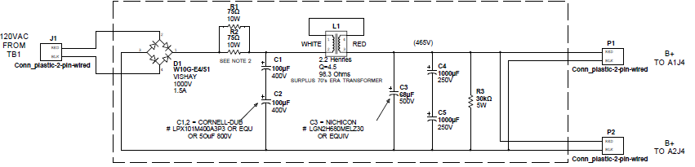
TUBE POWER SUPPLIES
Stephen
HIGH VOLTAGE FOR TUBE PLATE CIRCUITS “B+”
Nominal 420 Volts DC to the VTA
360 Volts AC
HIGH CURRENT FOR TUBE FILAMENTS

Slide 29
Low voltage power supply
Rafa
Item | Symbol | Volt (V)
Display | DV_{DD} | +3.3
 | V_{high_power} | +3.3
Amplifier + | Vah | +12
Amplifier - | Val | -12
MCU 5 | Vdd | +3.0
MCU 3 | Vddref | +3.3

Slide 30
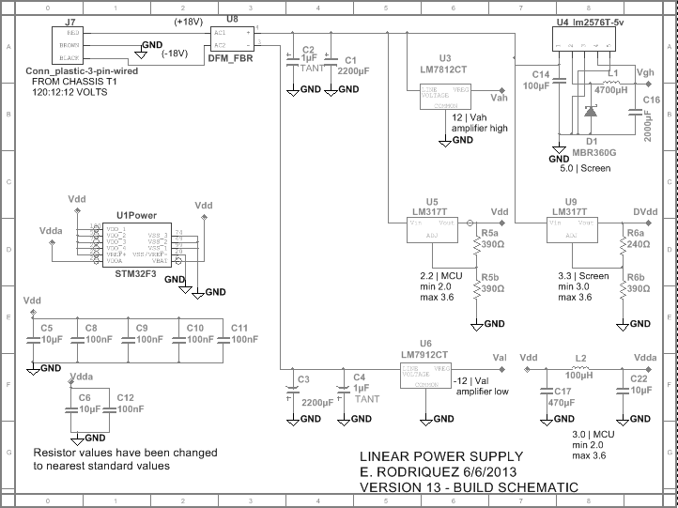
Low voltage power supply
Rafa

Slide 31
Low voltage power supply
Rafa
Difficulties
Incorrect display documentation caused an incorrect initial design.
The schematic for the panel and the physical panel had discrepancies
Incorrect labeling of the panel caused a malfunction of the DC to DC converters

Slide 32
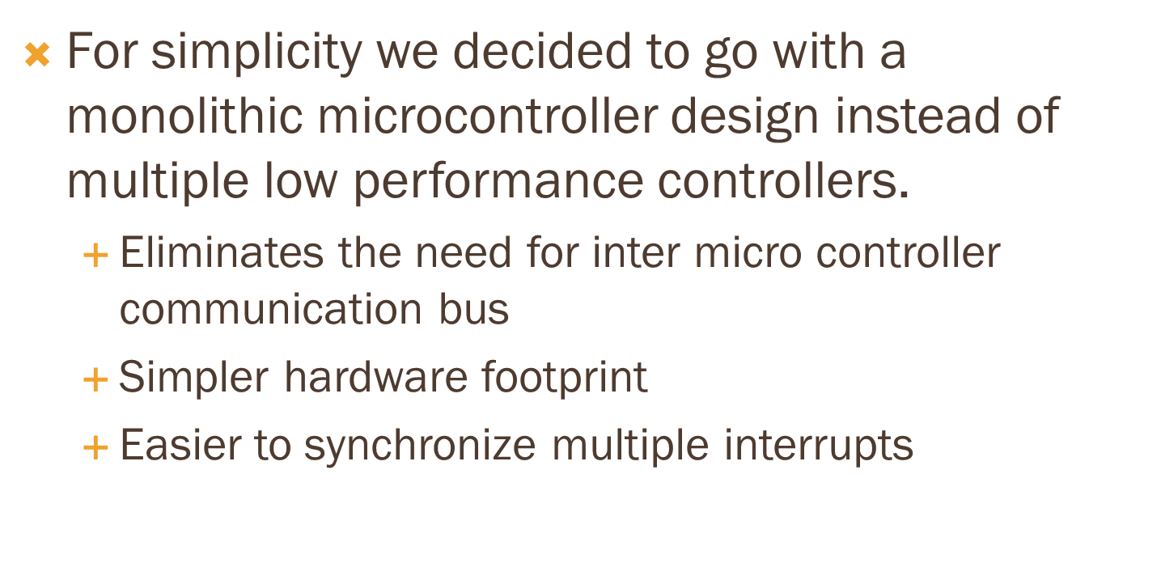
Microcontroller topology
Jason
Design decisions

Slide 33
Microcontroller selection
Jason
Design decisions
Microcontroller | Stellaris | STM32F3
GPIO Min 63 | 100 | 100
Clock frequency Min 50 MHz | 60MHz | 72MHz
ADC Min 12 bit res | 12 | 12
FPU | Yes | Yes
Well supported | Yes | Yes
Dev board available | Yes | Yes
Peripheral library | Yes | Yes
Availability | No | Yes

Slide 34
display
Rafa
requirements
Item | Requirement
Screen Dimension | 6” to 7” diagonal
Refresh rate | at least 50ms
Cost | $100 max.
Interface | digital
Documentation | sufficient documentation must be available
Availability | Ability to receive product within 30 days of purchase

Slide 35
display
Rafa
options
Item | Option 1 | Option 2
Cost | $57 | $86
Screen dimension | 7” diagonal | 6.2” diagonal
Panel dimension (width x height x depth) | 6.4” x 3.8” x 0.7” | 6.1” x 3.5” x 0.2”
Resolution | 800 x 480 | 800 x 480
Colors | 16 million | 16 million
LCD Controller | SSD1963 (integrated) | Not documented
LCD Controller documentation | available | Not documented
Touch Screen controller | XPT2046 (integrated) | Not documented
Touch Screen controller documentation | available | Not documented
Availability | within 20 days | Within 20 days

Slide 36
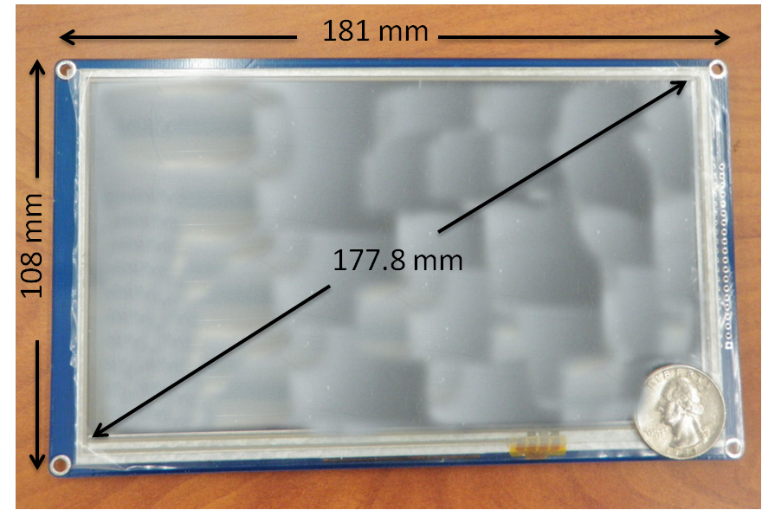
display
Rafa
decision
Item | Option 1
Cost | $57
Screen dimension | 7” diagonal
Panel dimension (width x height x depth) | 6.4” x 3.8” x 0.7”
Resolution | 800 x 480
Colors | 16 million
LCD Controller | SSD1963 (integrated)
LCD Controller documentation | available
Touch Screen controller | XPT2046 (integrated)
Touch Screen controller documentation | available
Availability | within 20 days

Slide 37
display
Rafa
difficulties
Difficulty | Overcome
Can not display the color white | Did not use the color white
Achieving a high refresh rate | Refresh portions of the screen instead of the entire screen
Touch screen did not work | Replaced with the MSP430 digital touch interface

Slide 38
display
Rafa
successes
Success | Description
LCD communication | Communication between MCU and LCD screen.
GUI fully functional | The interface that was created displays all the desired features
Visualization | Displays desired graphics

Slide 39
Software diagram
Rafa
Visualization
State Detector
EQ
Sound Analyzer
Values Updater
Graphics Generator I
Graphics Generator II
Graphics Update
Display

Slide 40
OVERALL Budget & financing details
Stephen
This project is self-funded by the group, with Stephen providing 90% of the funds
The original budget of this project was $500
As of now, approximately $700 has been spent
Item | Cost | Comments
Audio processor PC board | $180 X 2 | 2 boards with all the components
MCU PC board | $150 | 1 board with all the components
Chassis components | $115 | Estimated

Slide 41
questions

