Slide 1
Hydroponics with Automated Reporting and Monitoring
Sponsored by Duke Energy
Group 15
David Mascenik (Electrical Engineer)
Jon Spychalsky (Electrical Engineer)
James Tooles (Electrical Engineer)

Slide 2
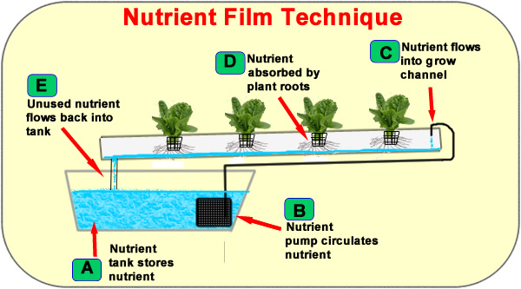
What is Hydroponics?
"Growing plants in the absence of soil."
Nutrients and air dissolved in the water, directly absorbed by the plant roots
Sensitive to:
pH
Dissolved Oxygen
Temperature (water and air)
Contamination (fungi and molds)
Design Choice: Implement the Nutrient Film Technique to cultivate the test plant (tomatoes) for the project.
Figure 1

Slide 3
Project Motivations And Goal
Motivation 1: Investigate hydroponic science, which has the potential to be:
Resource Efficient (Nutrients)
Space efficient (Vertical Growing)
More Controllable
Motivation 2: Develop skills that will be desirable in the job market:
Embedded Programming
PCB Layout Design
Project Goal: Interface with sensors and relays to control a hydroponic system.
Design boards for the MCU, Voltage Regulators, and Power Board Switching Control.
Analyze sensor data to on/off control automation subsystems
Put data in a readable format on an LCD Touchscreen

Slide 4
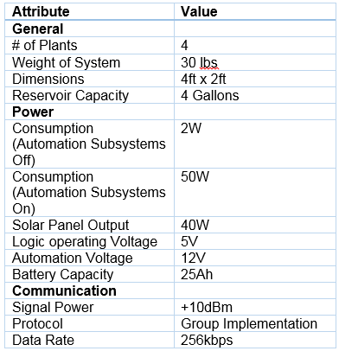
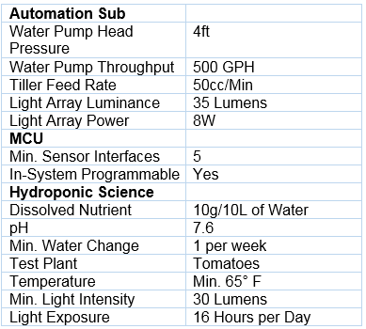
Specifications and Requirements

Slide 5
Standards and Specifications
RS232 UART
Inter-Integrated Circuit (I2C)
JTAG Interface (IEEE 1149.1)
C Programming Language (ISO 9899)
Chip Package Types

Slide 6
Hardware Block Diagram

Slide 7
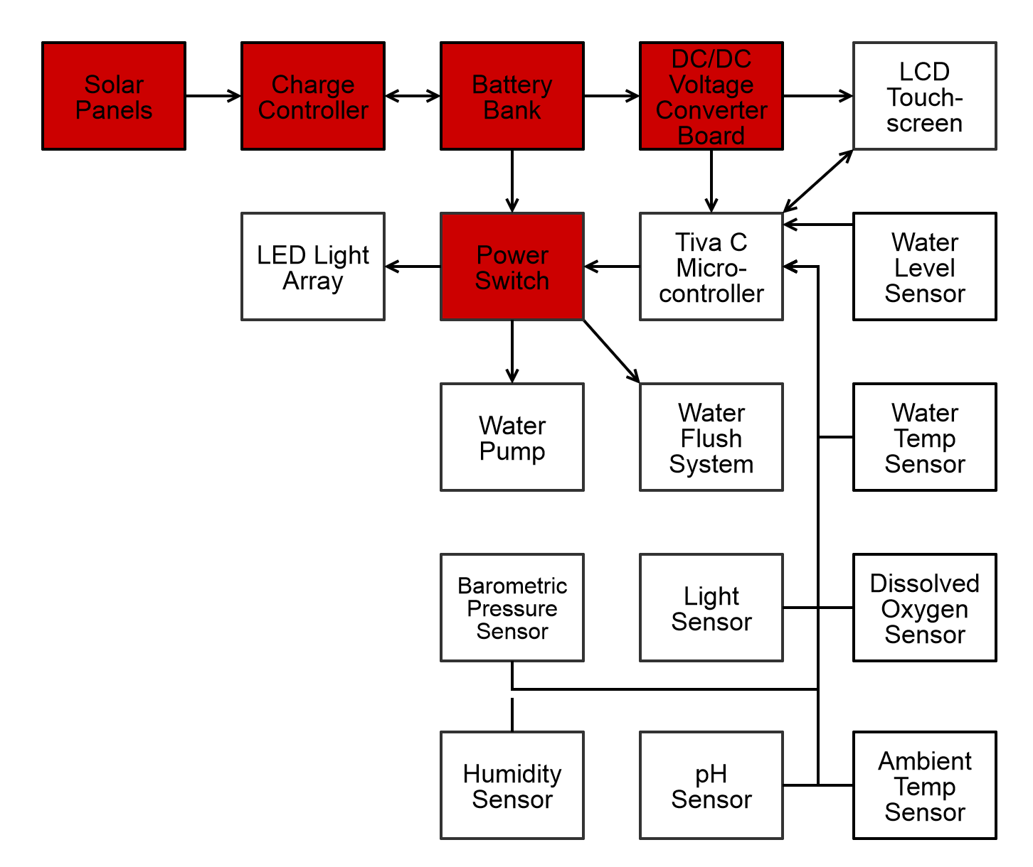
Power Distribution

Slide 8
Solar Panel
HQRP Mono-Crystalline Solar Panel
50 Watt Power Rating
12V Operating Voltage
Mono-Crystalline Solar Panel
6.07kg (13.4lb) Weight
53.3cm x 73.66cm x 3.81cm (21in x 29in x 1.5in) Dimensions
Figure 2

Slide 9
Solar Charge Controller
Thunderbolt Magnum Solar
100W - Max Solar Panel Input
22V - Max Input Voltage
14V - Overcharge Protection
10.5V – Discharge Protection
7A Maximum Current
Charging of Sealed Lead Acid
Internal Separation of Battery, Load, and Solar Panel
Figure 3

Slide 10
Selecting Battery Chemistery
Sealed Lead Acid
(SLA)
Lithium Iron Phosphate
(LiFePO4)
20% The Cost of LiFePO4
Low Charging and Discharging Complexity
Wide Operation Temperature Range -40C - 45C
No Battery Memory
Minimal Self Discharge
75% The Weight of SLA
Higher Charge Density
65% The Volume of SLA
7 Times The Life Cycle of SLA
No Harmful Elements
Minimal Voltage Sag

Slide 11
Sealed Lead Acid Battery
Trojan 27-AGM
12V Nominal Voltage
89Ah Capacity
29kg (64lb) Weight
Stud and Bolt Terminal Options
Power Consumption of System:
5.325Ah per 24 Hours
39.9W - Peak Power Consumption
Figure 4

Slide 12
Voltage Regulation Goals
Need to Reduce the Voltage from the Battery.
Need to Output Multiple Voltages.
Since linear regulators are inefficient, and efficiency is important for our project, we decided to use switching voltage regulators.
An efficiency of 85% or greater for the regulators is a minimum, but a >90% efficiency is ideal.

Slide 13
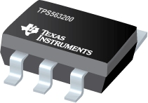
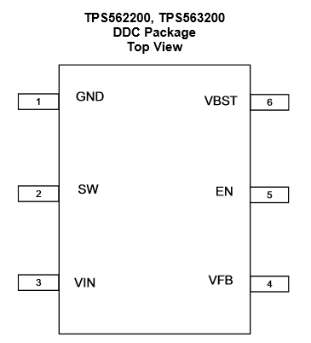
TPS563200 Switching Voltage Regulator Overview
Description | Value
Input Voltage Range | 4.5V – 17V
Output Voltage Range | 0.76V – 7V
Feedback Voltage Accuracy | 1%
Operating Temperature | -40°C – 85°C
Efficiency | Varies (graph on next slide)
Figure 5

Slide 14
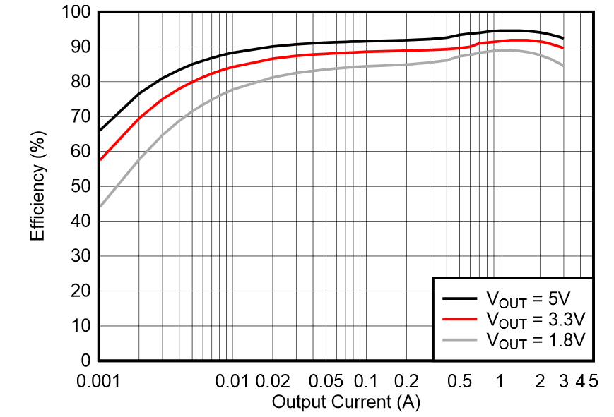
TPS563200 Switching Voltage Regulator Efficiency Graph
For 5V Output, Greater than 85% Efficiency at ~5mA, Greater than 90% Efficiency at ~20mA.
For 3.3V Output, Greater than 85% Efficiency at ~15mA, Greater than 90% Efficiency at ~600mA.
Figure 6

Slide 15
12V Input to 5V Output Schematic Design
Figure 7
Based on Reference Design: Texas Instruments

Slide 16
12V Input to 3.3V Output Schematic Design
Figure 8
Based on Reference Design: Texas Instruments

Slide 17
Complete Voltage Regulator PCB Design
Figure 9

Slide 18
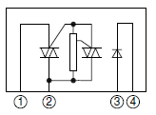
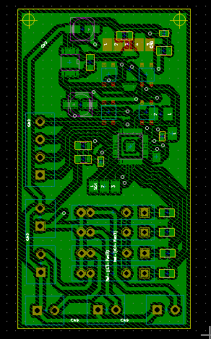
Power Switch
Receive TTL Commands to Selectively Engage Hydroponic Automation Subsystems.
Multiplexor to Solid State Relays
Hold Circuit to Hold MUX Output
MUX = ATMega328p
SSR = ODC-5 38595
Modulate
Water Pump
LED Light Array
Solenoid Valves
Solid State Relay - SHARP Datasheet
Figure 10a
Figure 10b

Slide 19
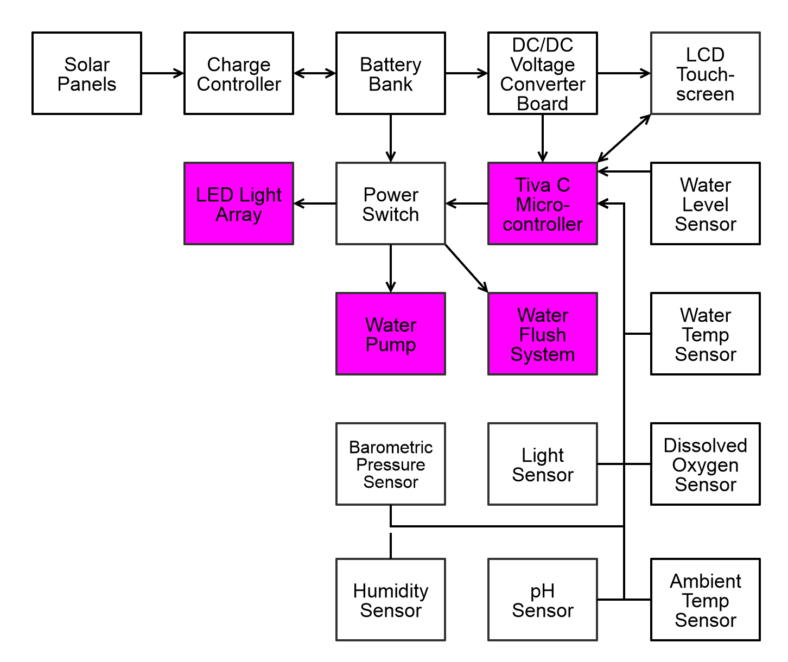
Power Switch Control

Slide 20
The Microcontroller
Project Requirements:
Take Sensor Readings From 5 Separate Devices
At Least 4 GPIO Necessary For Control Subsystems
Display Sensor Readings Locally on an LCD Display
Summary:
At Least 2 I2C And 2 ADC Modules
At Least 1 UART For Debugging Over Serial
Min. 32kB of Space For User Code

Slide 21
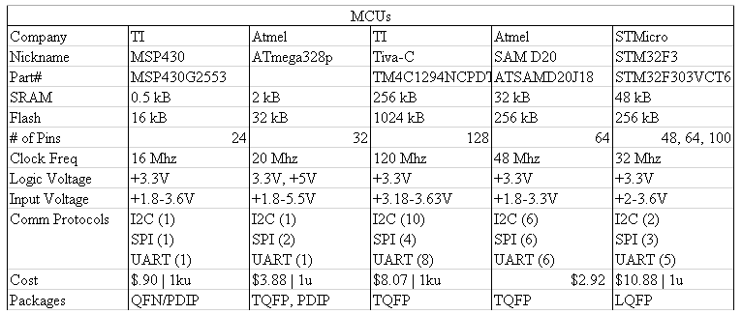
Microcontroller - Comparisons

Slide 22
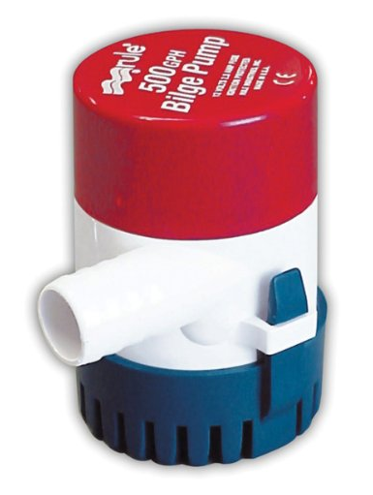
Control Subsystem - Water Pump
Boat Bilge Pump
500 Gallons per Hour
12VDC @ 2Amps
Submersible
MSRP $30 - Donated to Project
Figure 11

Slide 23
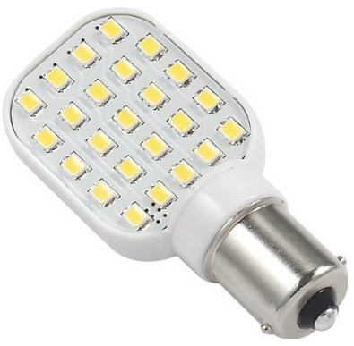
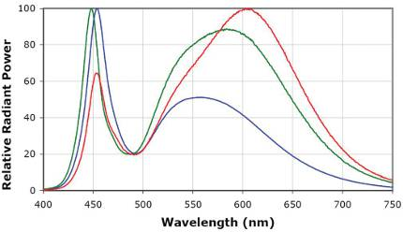
Control Subsystem - LED Array
RV LED Lights
250 Lumens
12VDC @ 200mA
Sufficient Spectrum for Plants
Array of 4 LED Bulbs
Figure 12
Figure 13

Slide 24
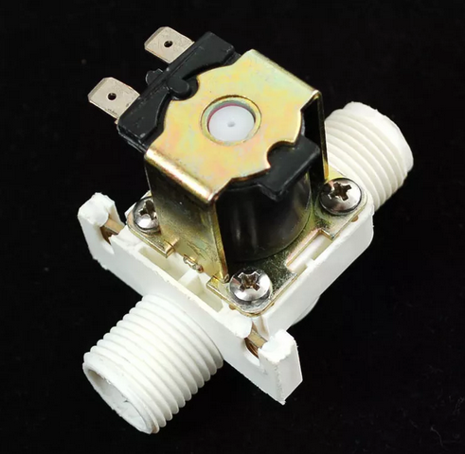
Control Subsystem - Water Flush
Solenoid Valves Between Water Pump and Hydroponic System Intake
Flush Water Reservoir
Solenoid Valves
12V @ 400mA
Off-State = Valve Closed
One Valve Active At A Time
2 Solenoids for Bi-Directional Water Flow
Figure 14

Slide 25
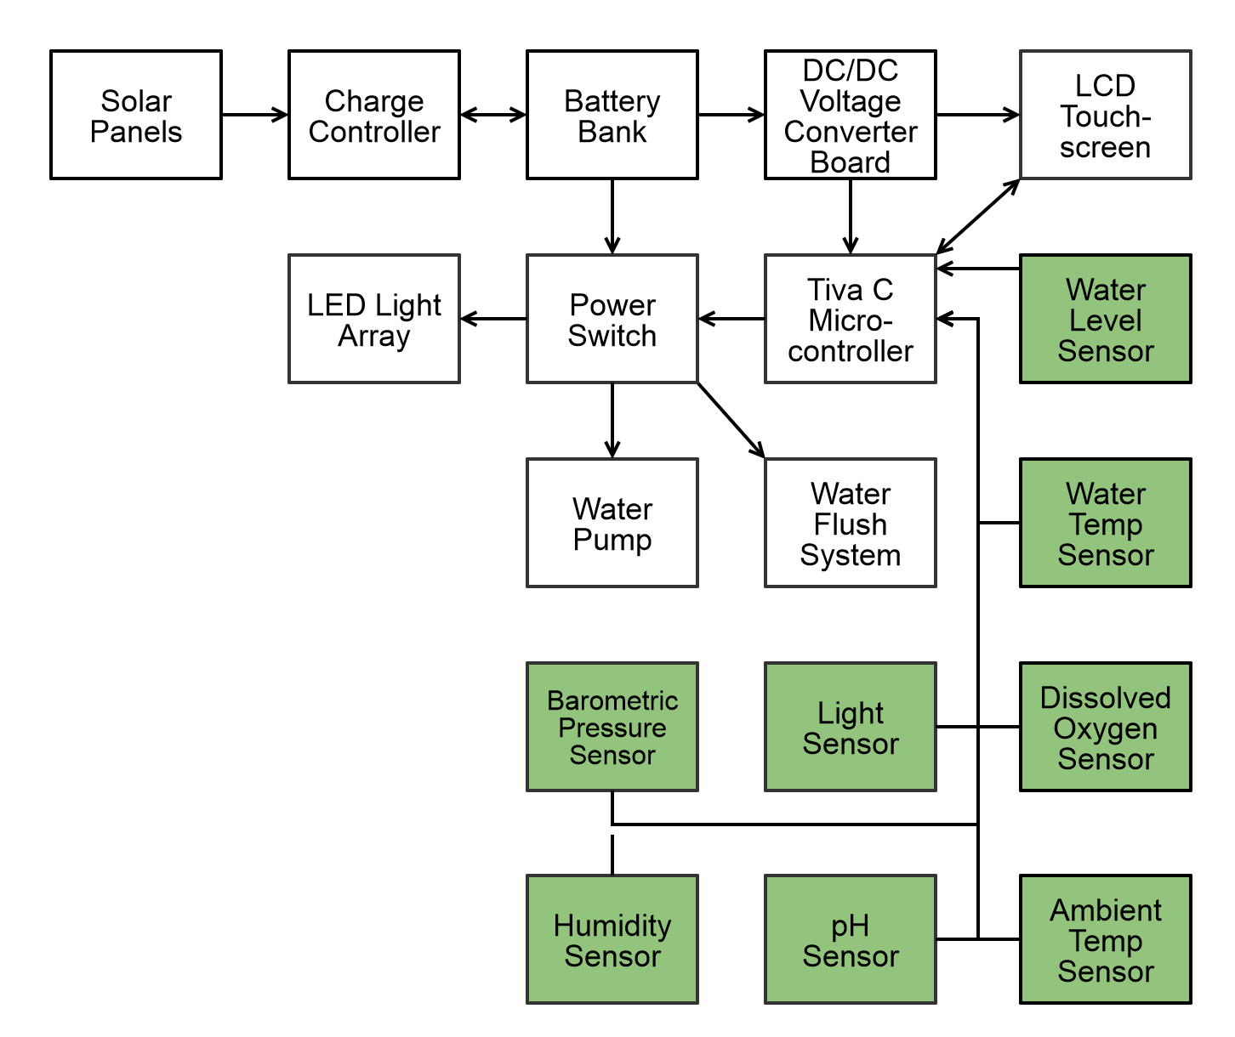
Sensors

Slide 26
Types of Sensors
Ambient Light Sensor
Ambient Temperature Sensor
Ambient Humidity Sensor
Barometric Pressure Sensor
Water Level Sensor
Water Temperature Sensor
pH Sensor
Dissolved Oxygen Sensor

Slide 27
Texas Instruments Sensor Hub
All Sensors Use I²C
Sensirion SHT21
Humidity Sensor
Intersil ISL29023
Ambient Light Sensor
TMP006
Ambient Temperature Sensor
Bosh Sensortec BMP180
Barometric Pressure Sensor
Figure 15

Slide 28
Water Level Sensor
eTape Continuous Fluid Level Sensor PN-12
Uses Analog to Digital Interface
12" Long
Resistive Output
0.25mm (0.01") Resolution
1500Ω (Empty) - 300Ω (Full)
0.5W Power Rating
-9C - 65C Temperature Range
Figure 16

Slide 29
Water Temperature Sensor
Waterproof DS18B20
One-Wire Interface
Digital Water Temperature Sensor
3V - 5V Operating Voltage
9 - 12 bit Selectable Resolution
0.5C Accuracy
-10C - 85C Temperature Range
Figure 17

Slide 30
pH Sensor
Atlas Scientific EZO Embedded pH Sensor
UART or I²C Protocol
3.3V - 5V Operating Voltage
0.001 - 14 pH Range Readings
0.02pH Resolution
Waterproof Probe
0.995mA at 3.3V Sleep Mode
Figure 18

Slide 31
Dissolved Oxygen Sensor
Atlas Scientific EZO Embedded Dissolved Oxygen Sensor
UART or I²C Protocol
3.3V - 5V Operating Voltage
0 – 36 mg/L Readings
0.1 mg/L Resolution
Waterproof Probe
0.995mA at 3.3V Sleep Mode
Figure 19

Slide 32
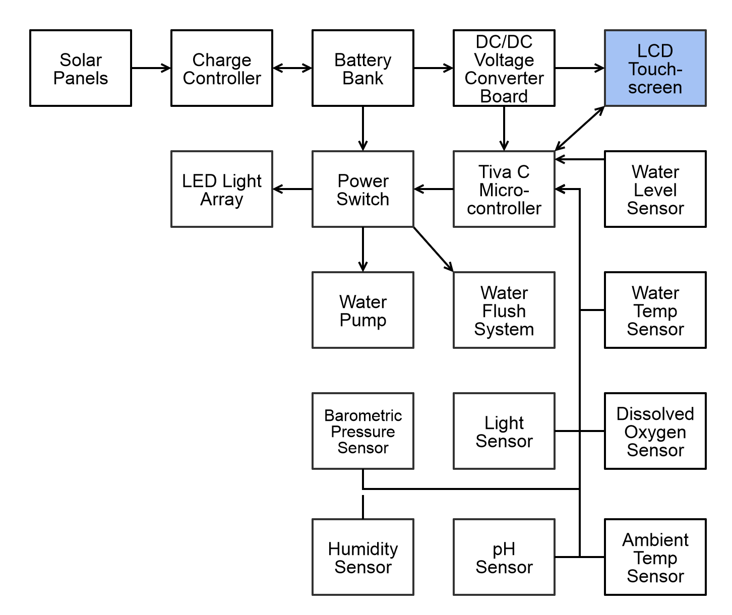
User Interface

Slide 33
User Interface Specifications
An LCD Touchscreen Based Interface.
View Current Sensor Readings and Threshold Warnings.
Ability to Manipulate Warning Thresholds.
Manually Activate Numerous Parts of the System.
A Resistive Touch LCD Screen for Control at the Site.
Ability to Manually Refresh Sensors.
Straightforward and Simple to Use UI.

Slide 34
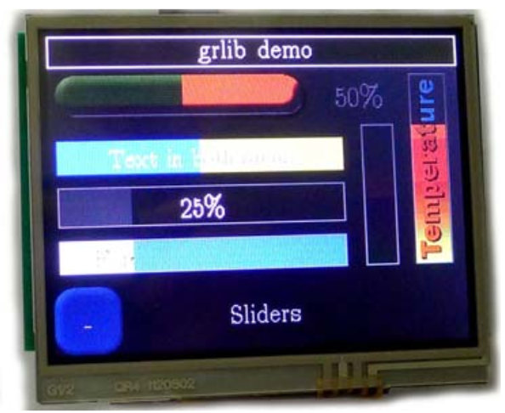
Kentec 3.5” LCD Touchscreen Overview
Decent Size.
Can Fit Multiple Elements on Screen Easily.
Touchscreen Allows Ease of Use of Control of the System.
Supported by Texas Instruments TivaWare Graphics Library.
Parallel Data Connection.
Figure 20

Slide 35
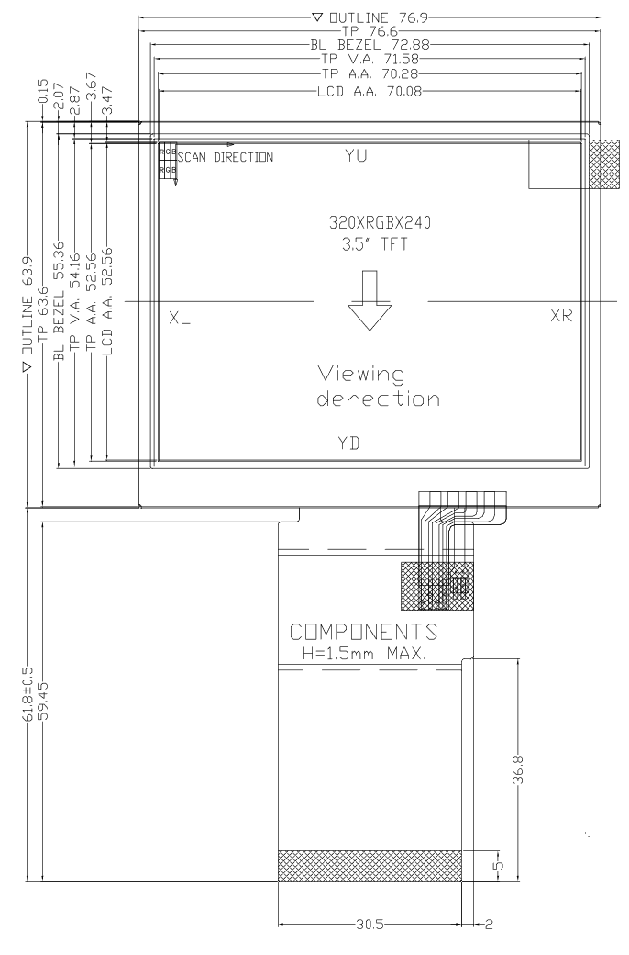
Kentec 3.5” LCD Touchscreen Specifications
 | Value
Operating Voltage | 3.3V & 5V
Resolution | 320 x 240
Interface | 16-bit parallel
Operating Temp. | -20 – 70°C
Figure 21

Slide 36
LCD Touchscreen Flowchart

Slide 37
Main Board Schematic

Slide 38
Main Board Schematic

Slide 39
Main Board Layout

Slide 40
Administrative Content Work Distribution
 | David | James | Jon
PCB Design | X |  | X
Sensor Integration | X | X
Control Signals Integration | X |  | X
LCD Screen | X
Power Distribution | X | X
Pump, Tiller, Hydroponics System |  | X | X

Slide 41
Administrative Content Budget
Device | Device Type | # of Units | Vendor | Price per Unit
Solar Panel | Power Distribution | 1 | Senior Design Lab | Free
Battery | Power Distribution | 1 | Senior Design Lab | Free
Sensor Hub | Sensor | 1 | TI Innovation Lab | Free
Water Level Sensor | Sensor | 1 | Adafruit | $47.91
Water Temperature Sensor | Sensor | 1 | Adafruit | $9.95
pH Sensor | Sensor | 1 | Atlas Scientific | $135.54
Dissolved Oxygen Sensor | Sensor | 1 | Atlas Scientific | $231.99
LCD Touch Screen | User Interface | 1 | Newark | $41.19

Slide 42
Administrative Content Budget (cont)
Device | Device Type | # of Units | Vendor | Price per Unit
Tiva C TM4C1294 | Microcontroller | 1 | Texas Instruments | Free (Sample)
TPS563200 | Voltage Regulator | 2 | Texas Instruments | Free (Sample)
Various main board and VR board devices | Multiple | Multiple | Digikey | $52.22
Wires | Wires | 1 set of 120 | Amazon | $9.99
Bilge Pump | Pump | 1 | N/A | Free
Solid-State Relays | Active Device | 4 | Sparkfun | $4.99
LED Bulbs | Light | 4 | Amazon | $8.00
Auger Bit | Hardware | 1 | N/A | Free
Solenoids | Active Devices | 2 | eBay | $12.99

Slide 43
Administrative Content Budget (cont)
Device | Device Type | # of Units | Vendor | Price per Unit
3/4” Hosing | Hardware | 1 | Home Depot | Free (Sample)
Main Board PCB | Circuit Board | 3 | OSH Park | $64.60
Voltage Regulator PCB | Circuit Board | 3 | OSH Park | $3.27
Battery Terminal Connectors | Hardware | 1 set of 2 | Skycraft | $24.29
Fuses | Hardware | Multiple | Skycraft | $9.20
Heat Shrink | Hardware | 1 | Skycraft | $8.69
Exterior 3M Tape | Mounting Hardware | 1 | Skycraft | $8.88
 |  | Total |  | $861.40
 |  | Duke Funding |  | $1250.00
 |  | Remaining Funds |  | $388.60

Slide 44
Constraints
Time (Shorter Semester)
Money (Cost vs Performance)
Practical Experience
Mechanical Design Knowledge
Manufacturing
No Low Cost Pick and Place
No Low Cost Reflow Station
No Low Cost and High Quality PCB Design Software Package

Slide 45
Difficulties and Successes
Difficulties
Software Development With Only Electrical Engineers
Manufacturing Failures
Things Not Working the Way you Expect
Successes
Completed Hydroponic System Frame and Tubing
Sensor Integration with 8 Different Sensors
Interfacing with Relays to Activate Pump and Lights
Learning a Large Amount of Practical Design Applications

Slide 46
Future Upgrades and Modifications
Modular System allows for Upgrades Including:
Automated Tiller Subsystem
Webserver Interface
Webcam
Wireless RF Interface

Slide 47
Upgrade - Web-based Interface Possibilities
In Addition, a Similar Featured Web Interface to the LCD Interface.
Adds a Database for History.
Manipulate Alert Thresholds and Control Subsystems.
Can Access the System Remotely, No Need to Be at the Location.

Slide 48
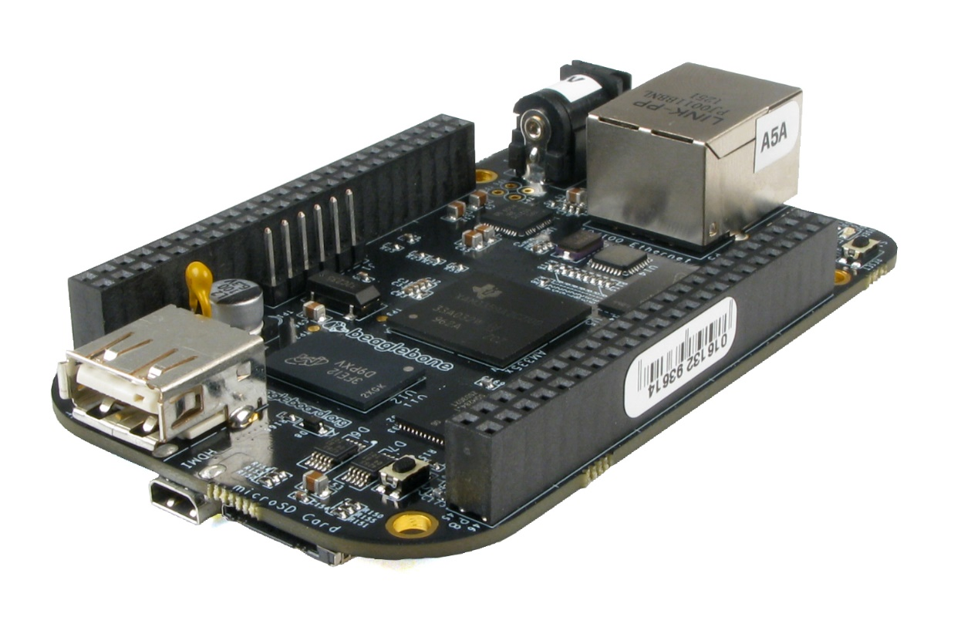
Upgrade - BeagleBone Black Overview
Open Source Hardware and Tons of Documentation.
69 GPIO Pins, Easy to Interface With.
4GB On-Board eMMC, No Need for a microSD Card.
Low Power Consumption (between 1-2W).
Free from the Innovation Lab.
Large Community.
Built-in Simple to Use Node.js Web Server.
Figure 22

Slide 49
Upgrade - Wireless Module Possibilities
Need a Longer Range Communication Device Between MCU and BeagleBone Black.
Wires Not Practical, a Wireless Approach is Needed.
Should Use Low Power
Should Have 10-15 Meter Range
Should Be Easy to Implement

Slide 50
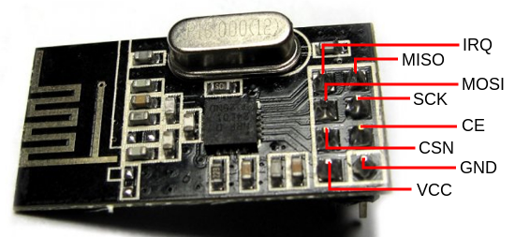
Upgrade- NRF24L01+ Wireless Transceiver PossibilityOverview
Uses 2.4 – 2.525 GHz RF
Can Use up to 126 Channels
Range of About 30 Meters
Powered by 3.3V (Same as MCU and Beaglebone Pins)
Uses SPI for Communication
Has an Interrupt Pin
Has an Ultra Low Power Mode
Figure 23

Slide 51
Upgrade - NRF24L01+ Wireless Transceiver Possibility Specifications & Block Diagram
 | Value
Operating Voltage | 1.9 – 3.6V
Maximum Current Draw | 13.5mA
Standby Current Draw | 26µA
Data Rates | 250kbps, 1Mbps, 2Mbps
Operating Temp. | -40 – 125 °C
Figure 24

Slide 52
Upgrade - Camera
TMEZON Outdoor IP Camera
1.0 Mega Pixels
720p
24 IR LEDs
Night Vision
Power Over Ethernet (POE)
Weatherproof
IP66 Water Resistance
Self Hosting IP Camera Stream
WiFi 802.11 b/g/n Compliant
Figure 25

Slide 53
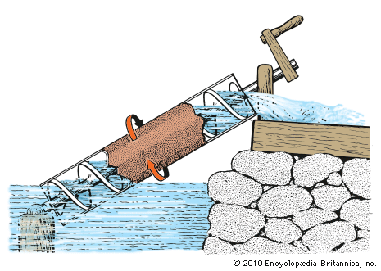
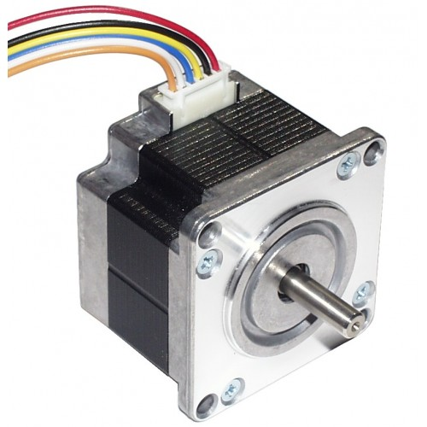
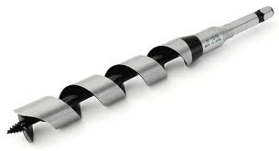
Upgrade - Control Subsystem - Nutrient Tiller
"Archimedes Water Screw" Design
Stepper Motor
Step Angle = 3.6 deg
12VDC @ 150mA per Phase
Auger Bit Mounted to Till Nutrient Solute
Figure 28
Figure 27
Figure 26

Slide 54
Figure Sources
Figure 1 - http://hydroponie.fr/mendota-hydroponie-production-local-solution-global/
Figure 2 - http://www.amazon.com/HQRP-Mono-crystalline-Anodized-Aluminum-Warranty/dp/B002OSAB28
Figure 3 - http://www.electroschematics.com/6899/12v-ldo-solar-charge-control/
Figure 4 - http://www.amazon.com/Odyssey-PC925-Automotive-LTV-Battery/dp/B0002ILK72
Figure 5 - http://www.ti.com/product/TPS563200/datasheet
Figure 6 - http://www.ti.com/product/TPS563200/datasheet
Figure 10a - http://cdn.sparkfun.com/datasheets/Components/General%20IC/S108,208T02%20Series.pdf
Figure 11 - www.amazon.com
Figure 12 - www.amazon.com
Figure 13 - http://www.electronicsweekly.com/
Figure 14 - www.adafruit.com
Figure 15 - http://www.ti.com/tool/boostxl-senshub
Figure 16 - http://www.adafruit.com/products/464
Figure 17 - https://www.sparkfun.com/products/11050
Figure 18 - http://atlas-scientific.com/product_pages/kits/ph-kit.html
Figure 19 - http://atlas-scientific.com/product_pages/kits/do_kit.html
Figure 20 - http://www.kentecdisplay.com/uploads/soft/Products_spec/EB-LM4F120-L35_UserGuide_04.pdf
Figure 21 - http://www.kentec.com.hk/images/UploadFile/20111115190922-7.pdf
Figure 22 - http://www.logicsupply.com/blog/2013/05/23/beaglebone/
Figure 23 - http://web.uvic.ca/~andpol/project5.html
Figure 24 - https://www.nordicsemi.com/eng/content/download/2726/34069/file/nRF24L01P_Product_Specification_1_0.pdf
Figure 25 - www.amazon.com
Figure 26 - http://www.robosoftsystems.co
Figure 27 - www.fine-tools.com

Slide 55
QUESTIONS?

