Slide 1
Rubik’s Cube Solving Robot
Daniel Truesdell - EE
Corey Holsey - CpE
Tony Verbano - CpE
Group 12

Slide 2
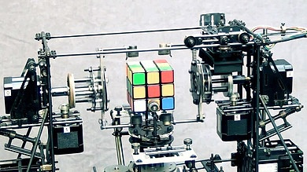
Motivation
Build a robot that can solve a scrambled Rubik’s Cube
Combination of hardware and software systems
Rubik’s Cube is a fascinating puzzle
blog.zok.pw

Slide 3
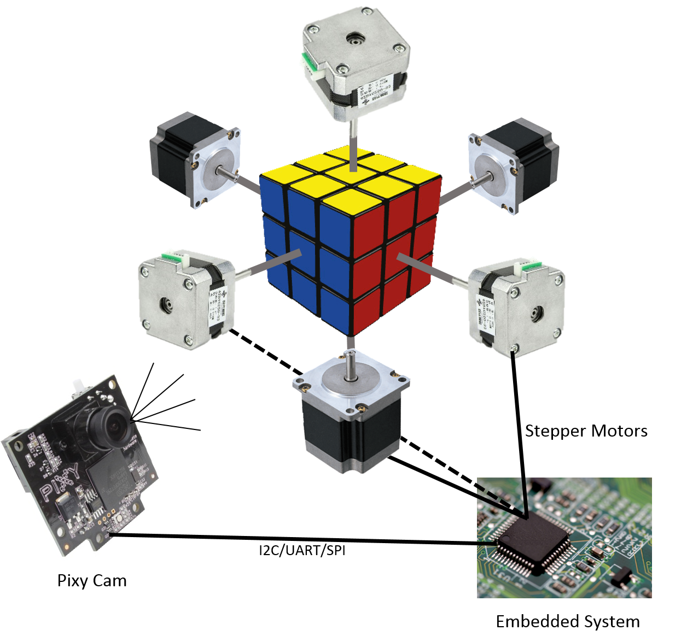
General
Three main parts of the project
Hardware design
Structural Frame, Motor control,
PCB Design Cube
Visualization
CMUcam5 Pixy, Visualization implementation,
Matrix Input
Rubik’s cube algorithm
Mathematics, CFOP method Vs Kociemba, Randomization of the cube

Slide 4
Specifications & Functions
Solve a Rubik’s cube correctly 90 % of the time
Fully visualize and map the cube 90% of the time
Solve the cube in at least 15 minutes
Rotate each face of the cube 90 degrees
Displays a timer that corresponds with the amount of time it takes to solve the cube

Slide 5
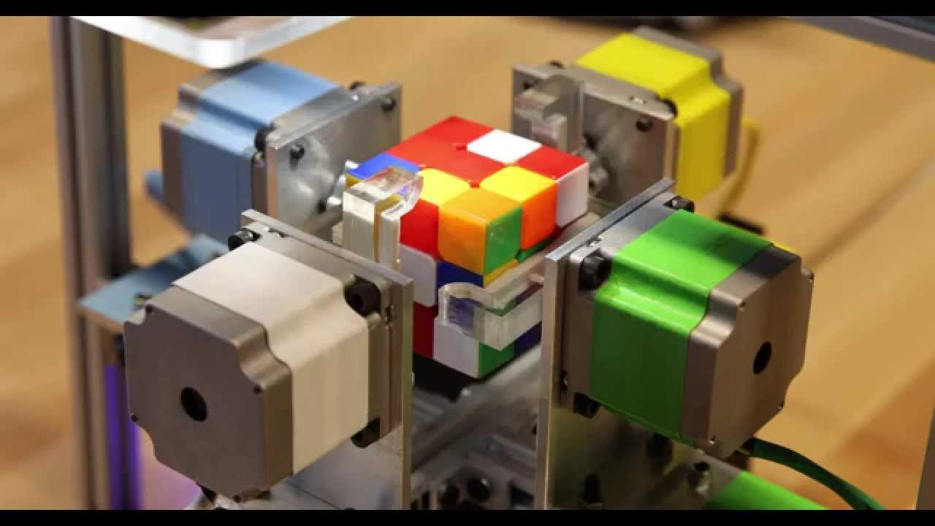
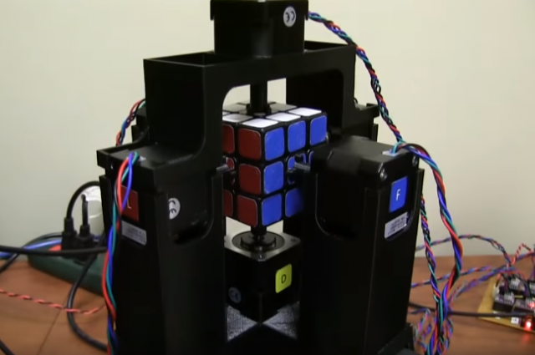
Mechanical Design - Structural Platform
Prototype
3D-Print
YouTube - Calit2ube (Raspberry Pi - based)
YouTube - Jay Flatland (PC-based)

Slide 6
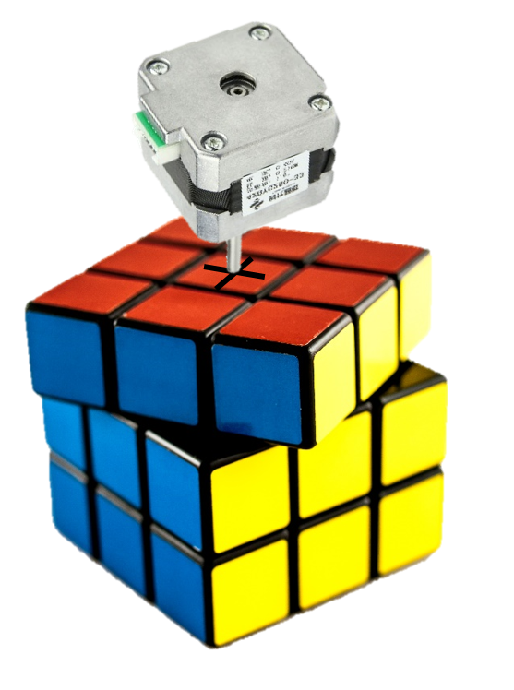
Mechanical Design - Cube Control
One motor per side of the cube
No repositioning necessary
No claw/gripper necessary
Fastest cube manipulation

Slide 7
Mechanical Design - Motors
 | DC | Servo | Stepper
Pros | High RPM Easy to operate | Easy to operate - Single PWM input | Predetermined, reliable positioning
Cons | Lack of position control | Require feedback or precise tuning for accurate positioning | Usually require driver IC

Slide 8
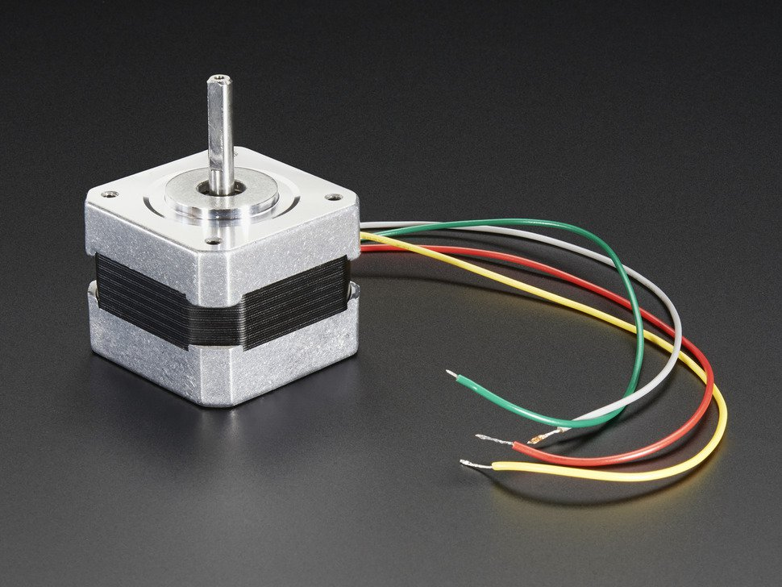
Mechanical Design - Motors
Adafruit NEMA-17 Stepper Motor
$14 per motor
1.8° Step size = 200 steps per revolution
Rated for 350mA at 12V
Small, robust
Adafruit.com

Slide 9
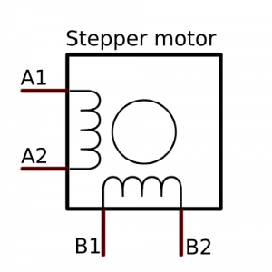
Electrical Design - Motor Control
Motor Control Requirements:
Bidirectional motion requires bidirectional current (source/sink) ability on all 4 wires
Smooth operation requires precise coil actuation and current control
42bots.com

Slide 10
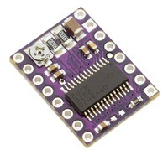
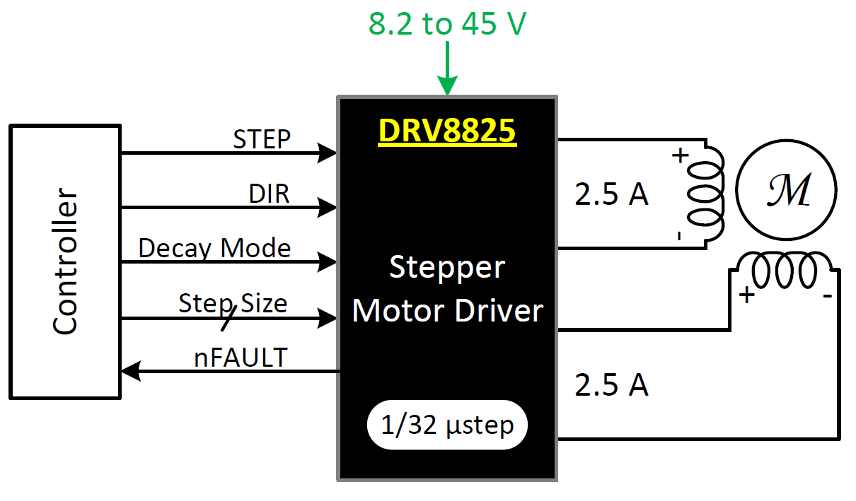
Electrical Design - Motor Control
Solution: TI DRV8825 Stepper Motor Driver
2.5A max current output
Integrated H-bridge circuit for bidirectional motion
Isolates processor from harmful back-EMF
Allows separate (12V) motor supply voltage
Simple control scheme (enable, step, direction)
Pololu.com

Slide 11
Electrical Design - Processor
 | MSP430G2553 | MSP430F5529 | MSP430f6659
ROM | 16kB | 128kB | 512kB
RAM | 500B | 10kB | 66kB
Serial | 1 I2C, 1 UART | 2 I2C, 2 UART | 3 I2C, 6 UART
Extras | Temp Sensor | LCD & USB support | LCD & USB support
Power | 230 μA/MHz | 370 μA/MHz | 404 μA/MHz
Price | $3 | $8 | $12

Slide 12
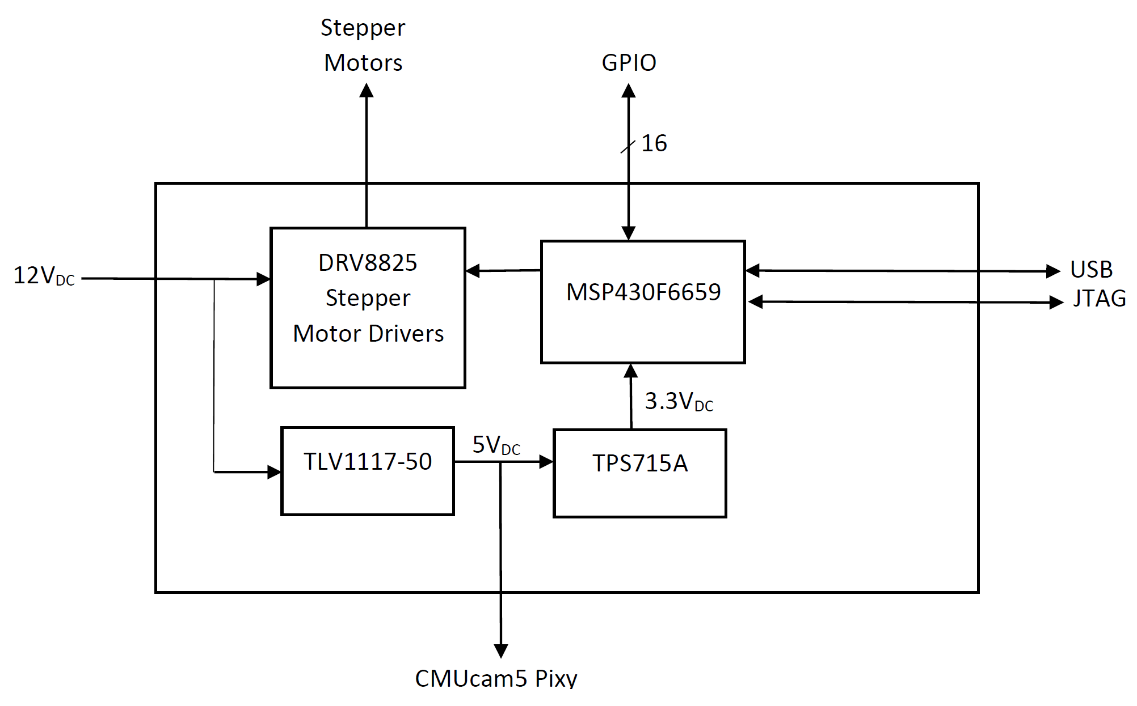
Electrical Design - Embedded System
MSP430
6 Stepper Driver ICs
Mini USB
12V DC input
16 GPIO (can be internally mapped for serial communication)
JTAG pins
2 user switches & LEDs
5V and 3.3V Headers

Slide 13
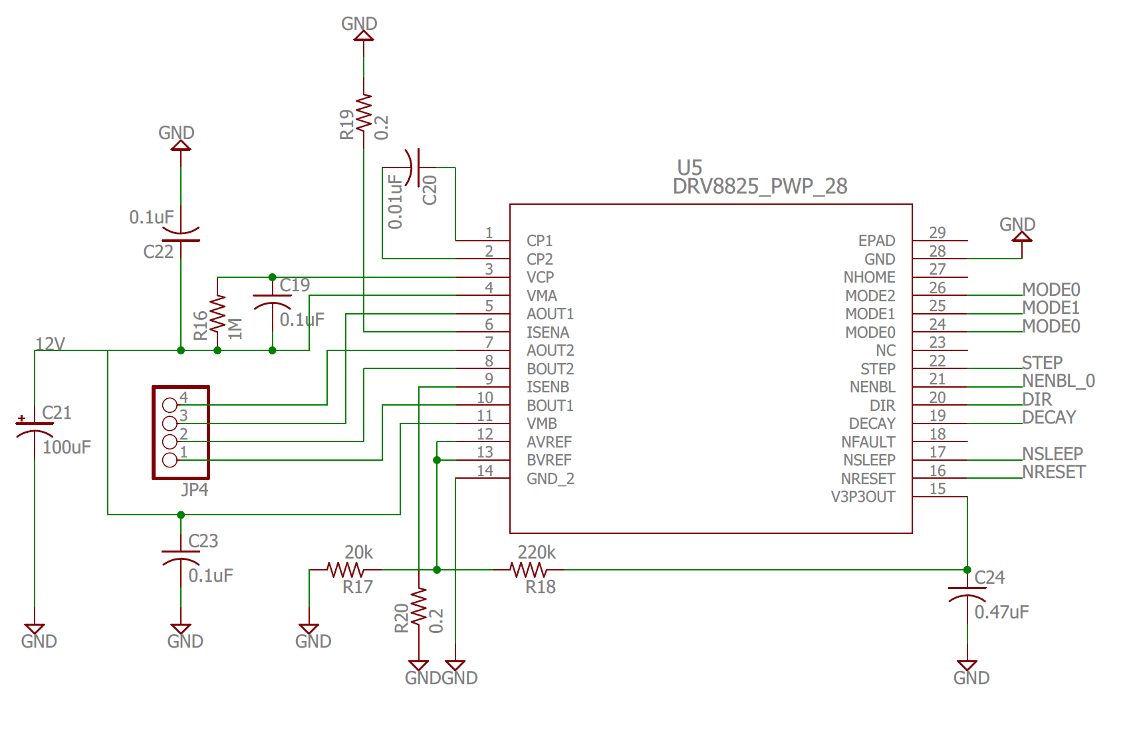
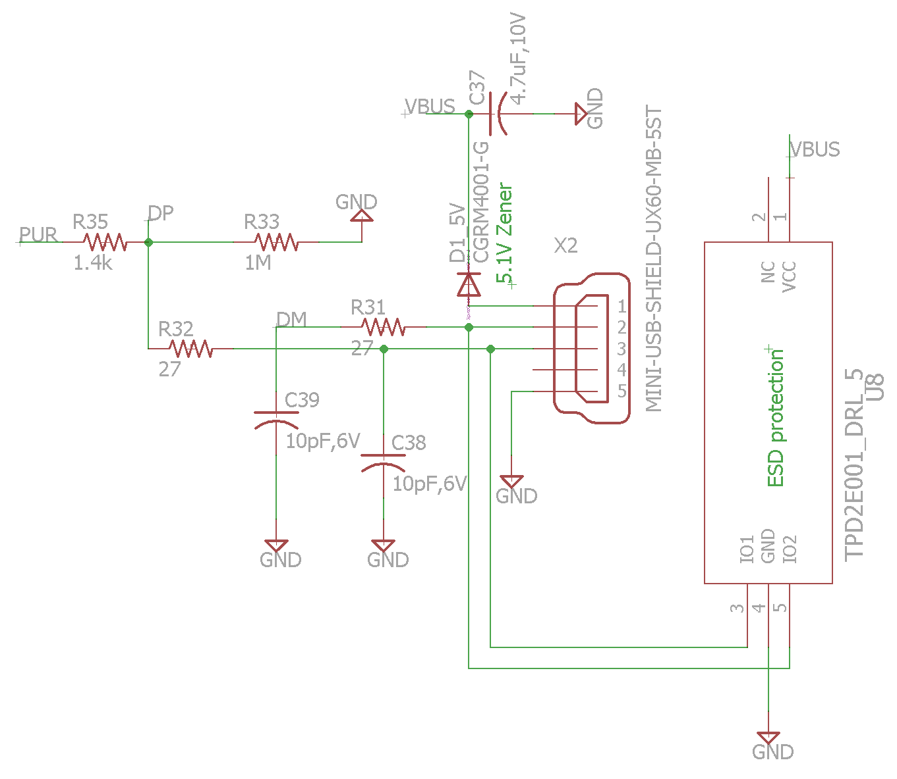
Electrical Design - Embedded System
Stepper Motor Driver
USB Mini

Slide 14
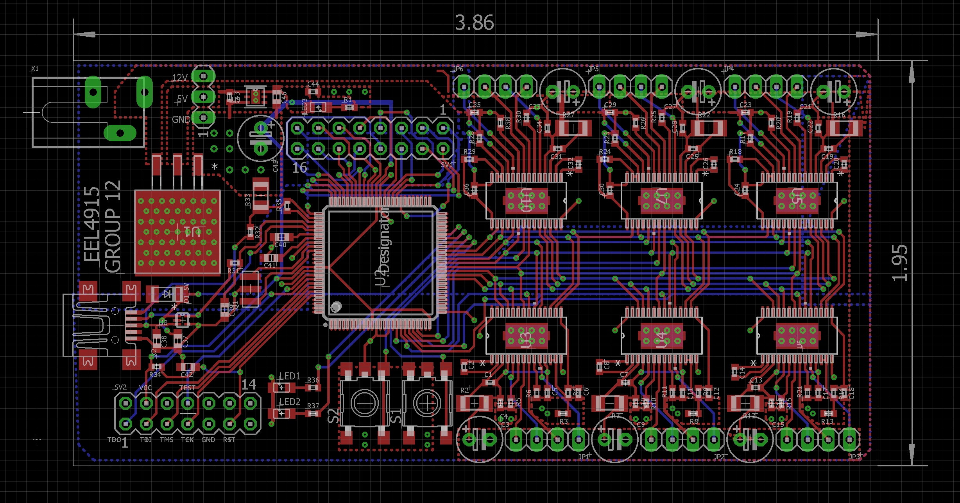
Electrical Design - PCB

Slide 15
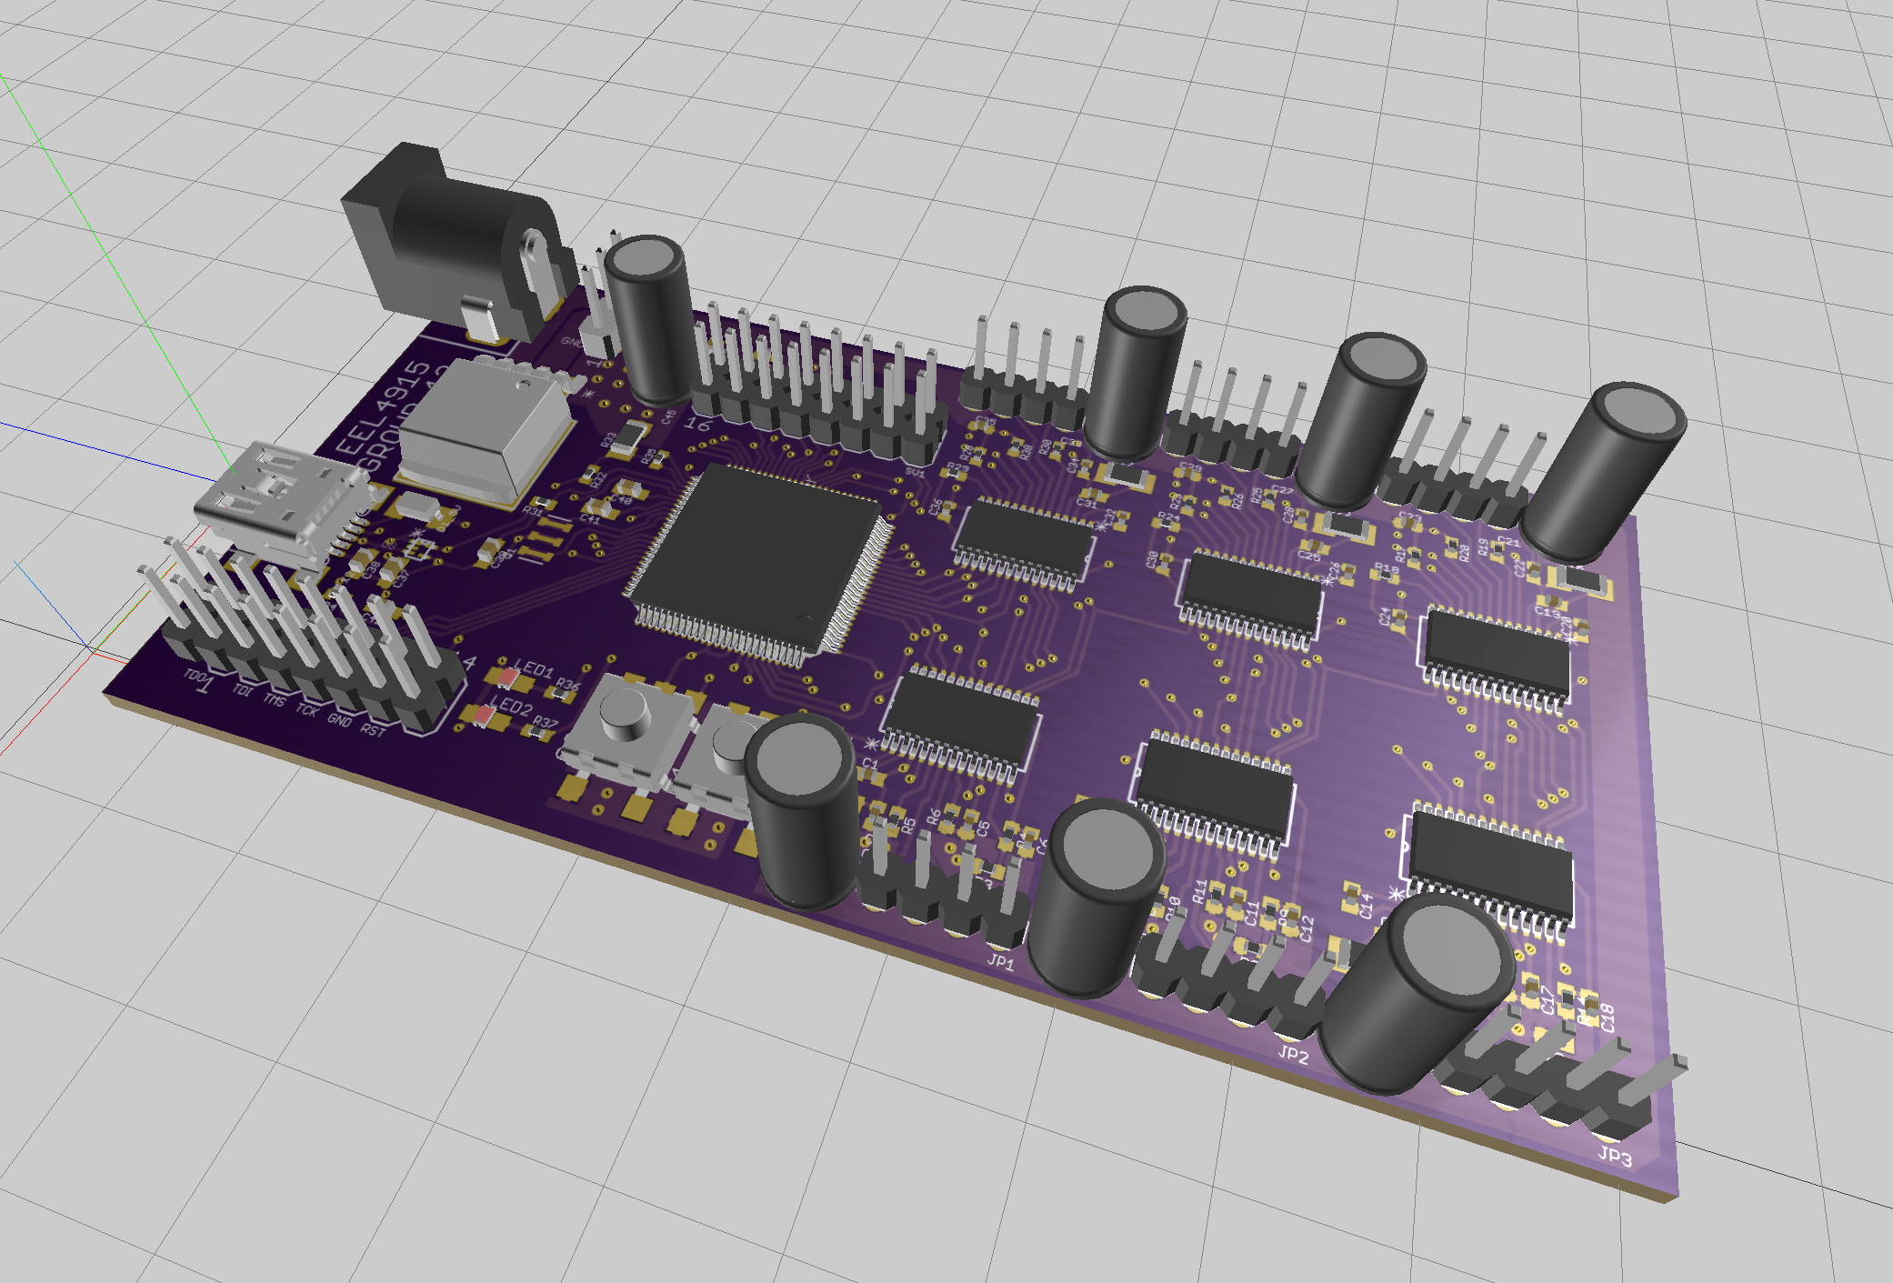
Electrical Design - PCB Render

Slide 16
Camera options
CMUcam5 Pixy
•Open CV library's
•Lots of documentation and source information
•Has its own processor
•Easily transfers data over to our embedded computer
•Expensive
Webcam
•Cheap
•Lots of useless bits and information sent to embedded computer
•Uses tons of memory and processing speed

Slide 17
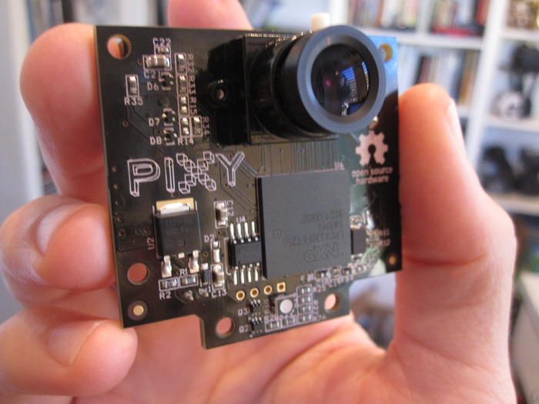
Electrical Design - Image Sensing
CMUcam5 Pixy
Integrated image sensing solution
Performs all image processing on-board
Serial communication for data transfer to processing platform
Cmucam.org

Slide 18
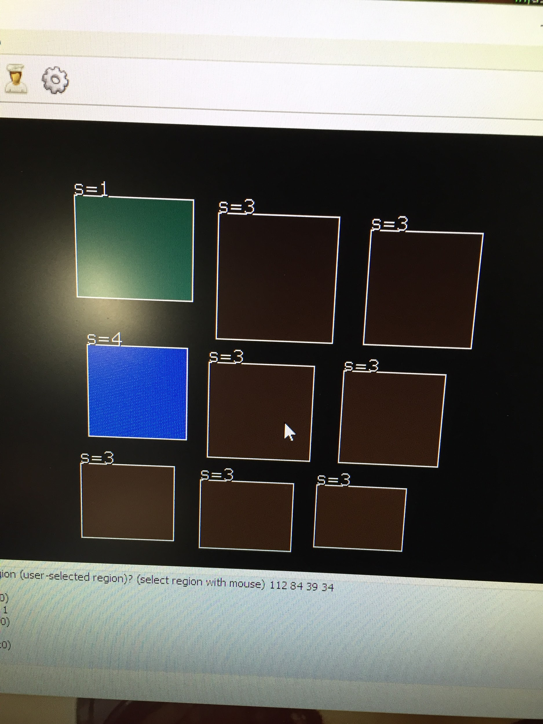
Sample Pixy Camera Image
Each color is assigned a signature with Pixymon
The signature is determined by position in
(x,y) coordinate to handle miscellaneous colors
Camera is fixed and still

Slide 19
CMUcam5 Pixy Arrangement
•Option 1 camera
•Slower
•Needs an algorithm to decode the whole cube
•Cheap
•Easy to implement
•Option 6 cameras
•More efficient
•Easier to determine color positions on cube
•Very expensive

Slide 20
Vision Algorithm
•Designed to visualize the entire from a single location
•With this algorithm we assume the center locations of each side of the cube
•The algorithm to visualize the cube has a total of 11 move sets
•After each move a picture is taken and the output of the image is deciphered to put into the matrix

Slide 21
CMUcam5 Output
Bytes 16-bit word Description
•0, 1 0 sync: 0xaa55=normal object,
0xaa56=color code object
•2, 3 1 checksum (sum of all 16-bit words 2-6)
•4, 5 2 signature number
•6, 7 3 x center of object
•8, 9 4 y center of object
•10, 11 5 width of object
•12, 13 6 height of object

Slide 22
Matrix Output
•The output of the camera will tell us the color of the square and its position to put into a matrix
•6 Significant colors each given their own number 1-6
•Area will be input as face value and then position on that face
•Each face will have a center color already determined

Slide 23
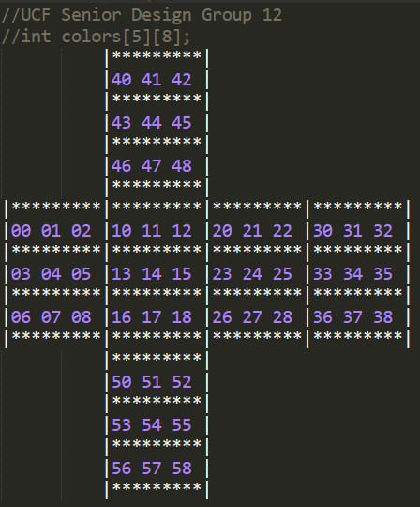
Mapping the Cube
The 2D array will map each position of the cube
The first value of the array will hold the signature value of the color from the camera
The second value of the array will hold the position on the cube
int colors[5][8];

Slide 24
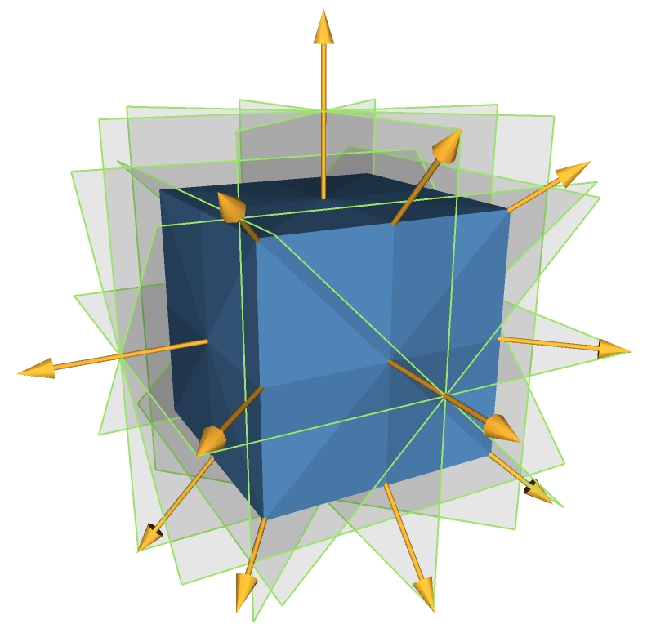
Math - Symmetries
Over 43 quintillion possibilities of the Rubik’s Cube!
8 corners with 8! ways they can be arranged and seven corners that can be arranged independently with the eighth being dependent on the preceding seven
12 edges with 12!/2 ways they can be arranged. Divided by two because of its dependency to be even exactly when the corners are. And eleven of the edges can be moved independently. These together make the equation below:
8! x 3^7 x 12!/2 x 2^11 = 43,252,003,274,489,856,000

Slide 25
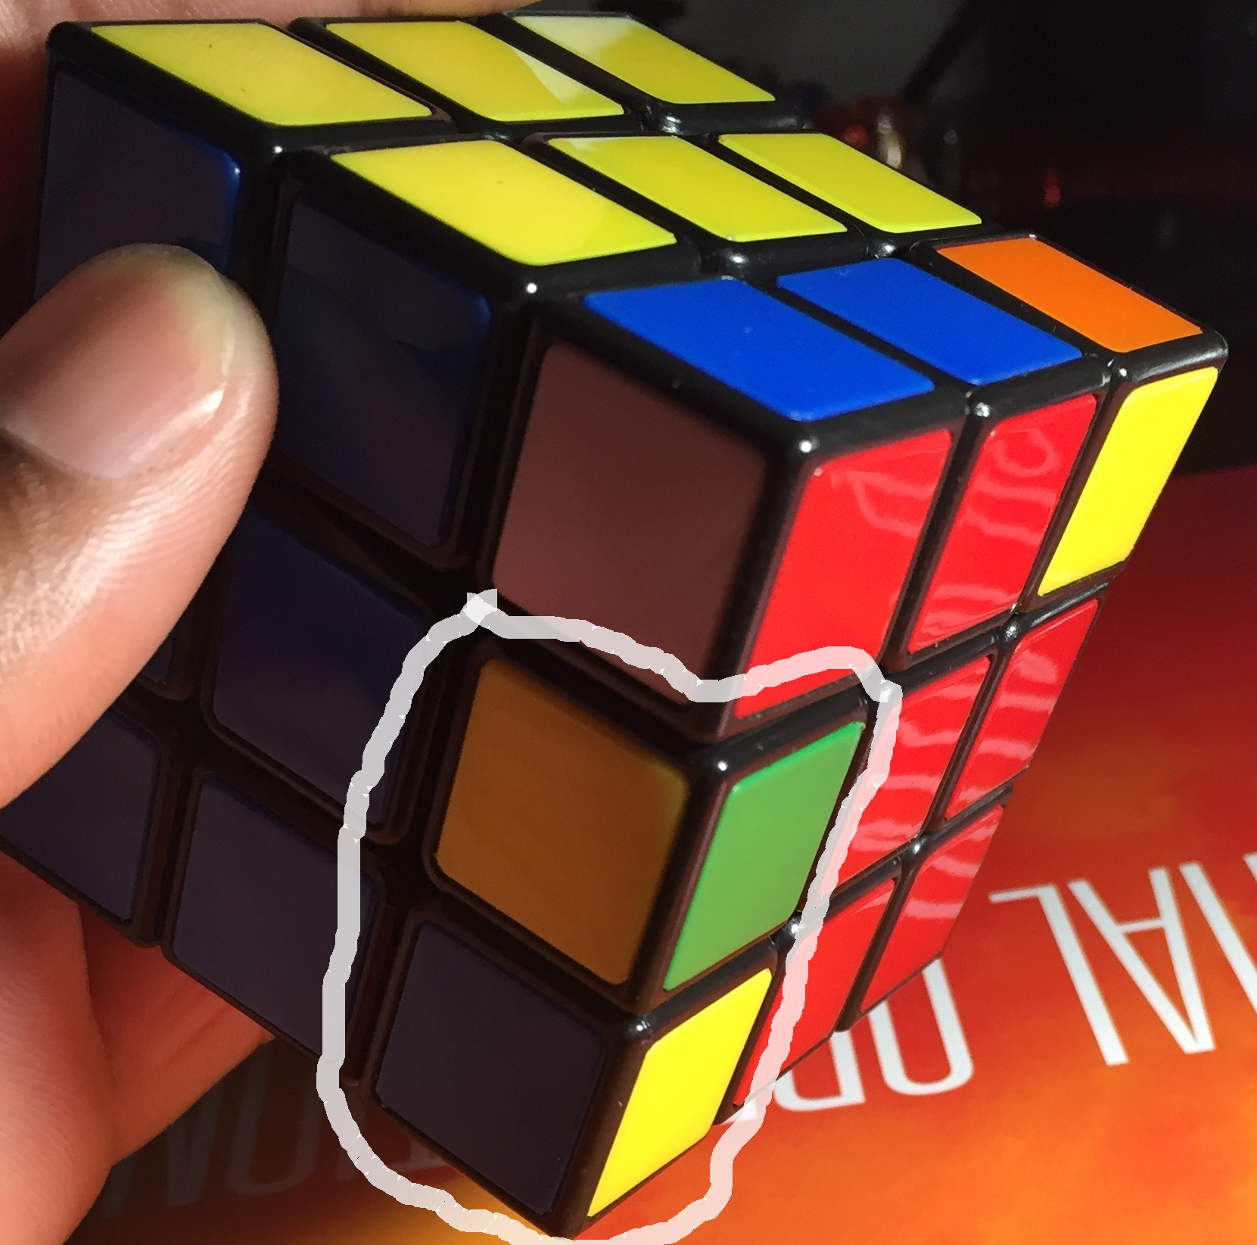
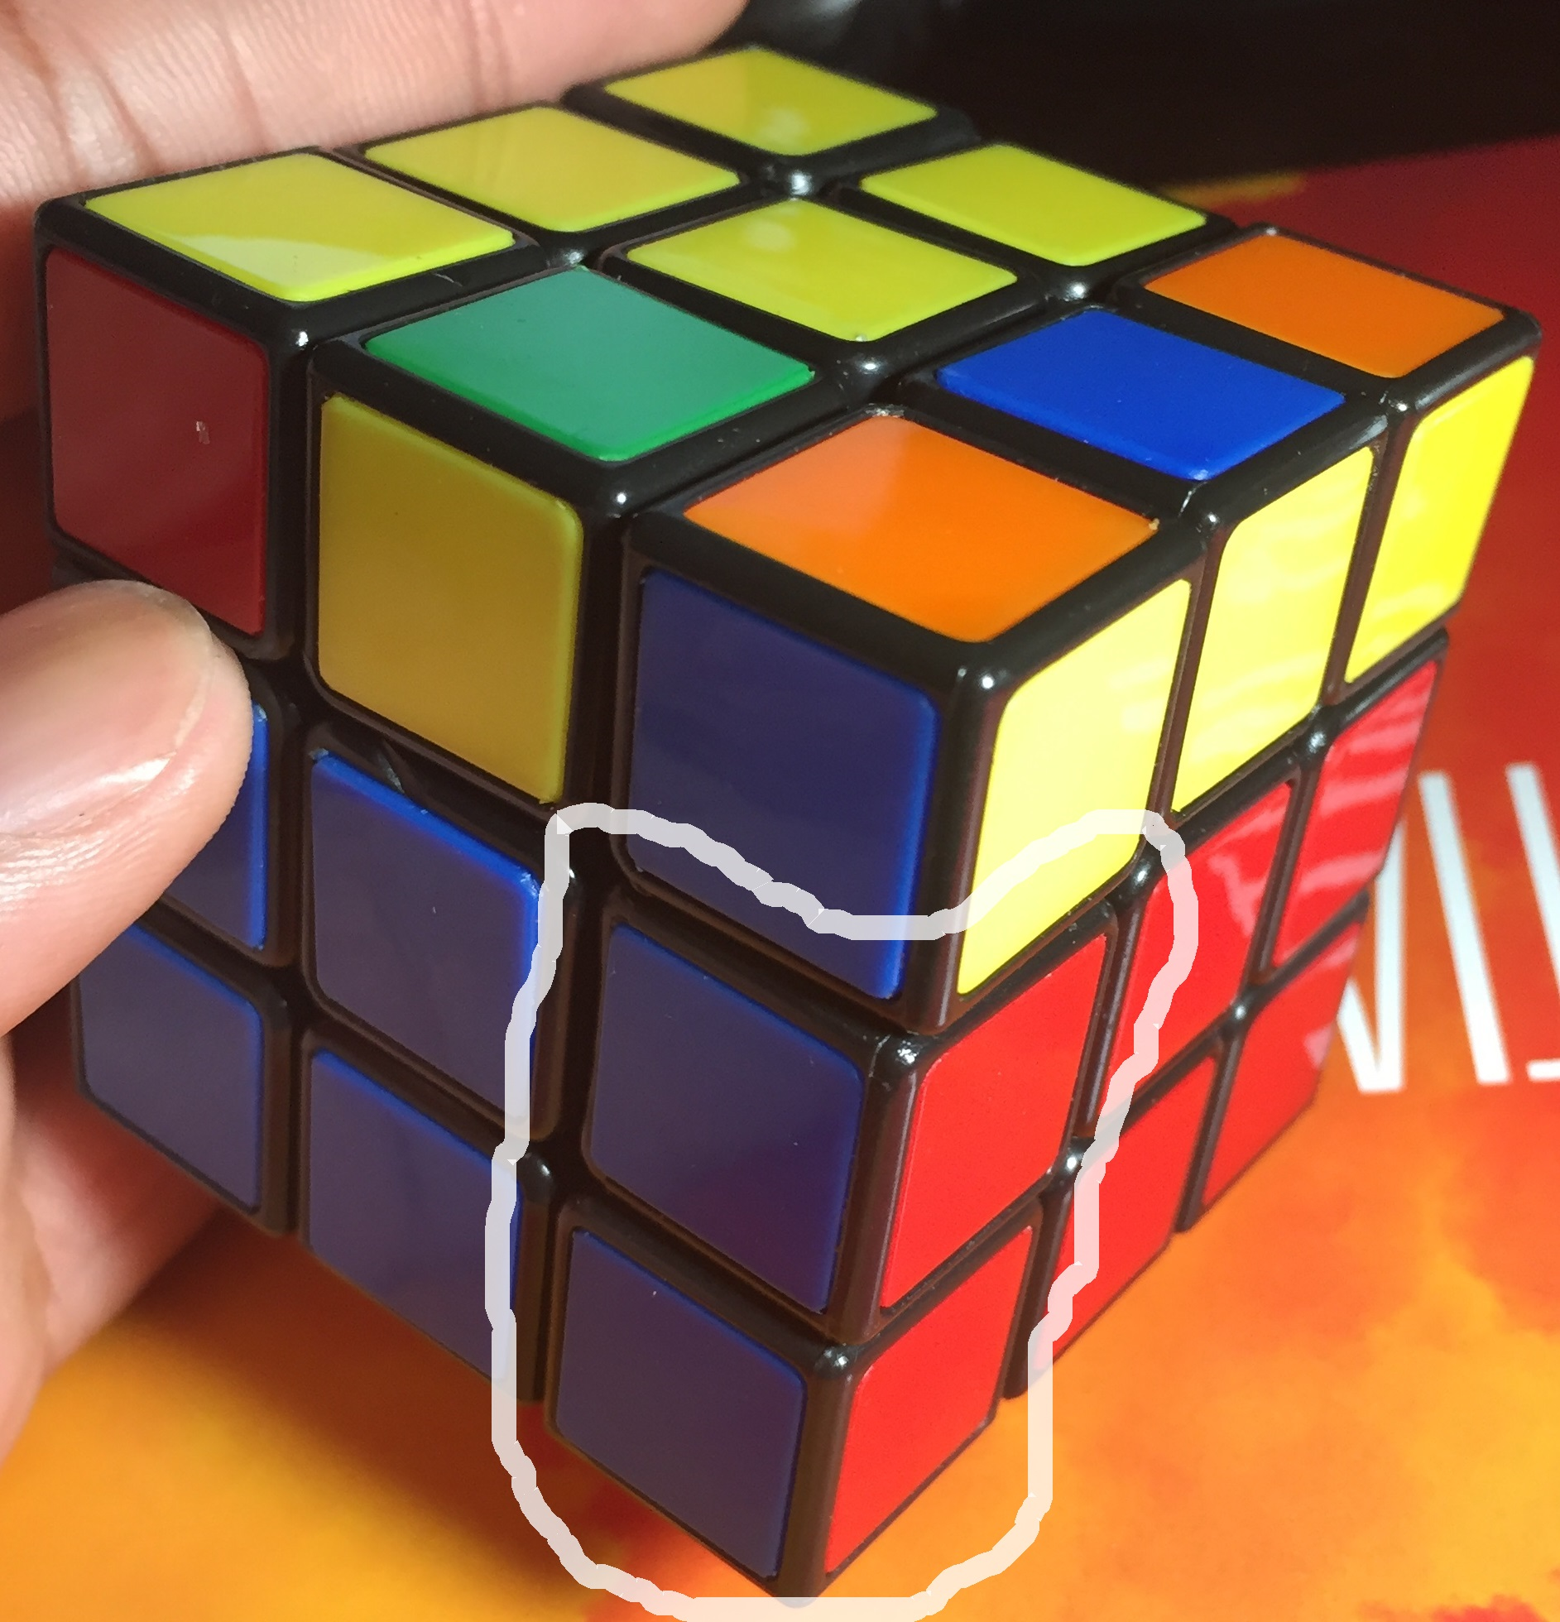
Math - Conjugations
Conjugate - binomial form by negating the second term of the binomial (conjugate of x+y is x-y)
Many of the algorithms of Rubik’s Cube are derived from conjugates
Using David Singmaster Notation for the faces (Front - F, Left - L, Right - R, Up - U, Down - D, Back - B) and add prime symbol ‘ to a letter to denote CCW move
Example: Attempting to only change the U face of a solved cube R U R’ U’ will change 2 cubes that are not on the U face as displayed in Figure 1
Therefor a move F is added before it to orient those two cubes first then F’ added to the end making only the U layer changed as displayed in Figure 2
Figure 1
Figure 2

Slide 26
Algorithm Options
CFOP (Speed Cubing)
Minimum memory requirements
Simple to develop
Less efficient with time
Solves the cube in hundreds of moves
Kociemba (God’s Algorithm)
Abuses RAM
Complex development (need bluetooth and mobile app)
More efficient with time
Solves the cube in at most 20 moves

Slide 27
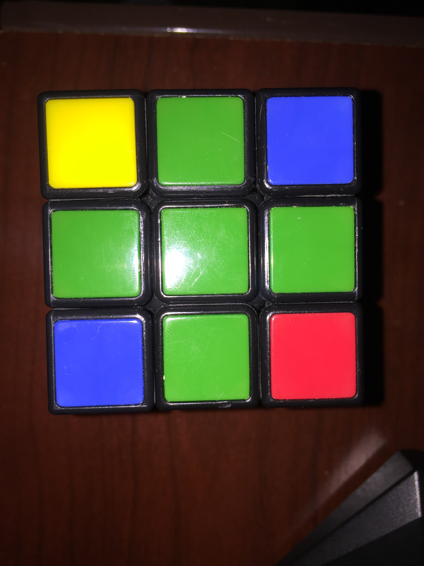
CFOP (Cross - F2L - OLL - PLL)
Also known as the Jessica Friedrich method
Solves the Rubik’s Cube by layers from Bottom, Middle, then Top
This algorithm only works from what I like to call the Base State
Most commonly called the Cross

Slide 28
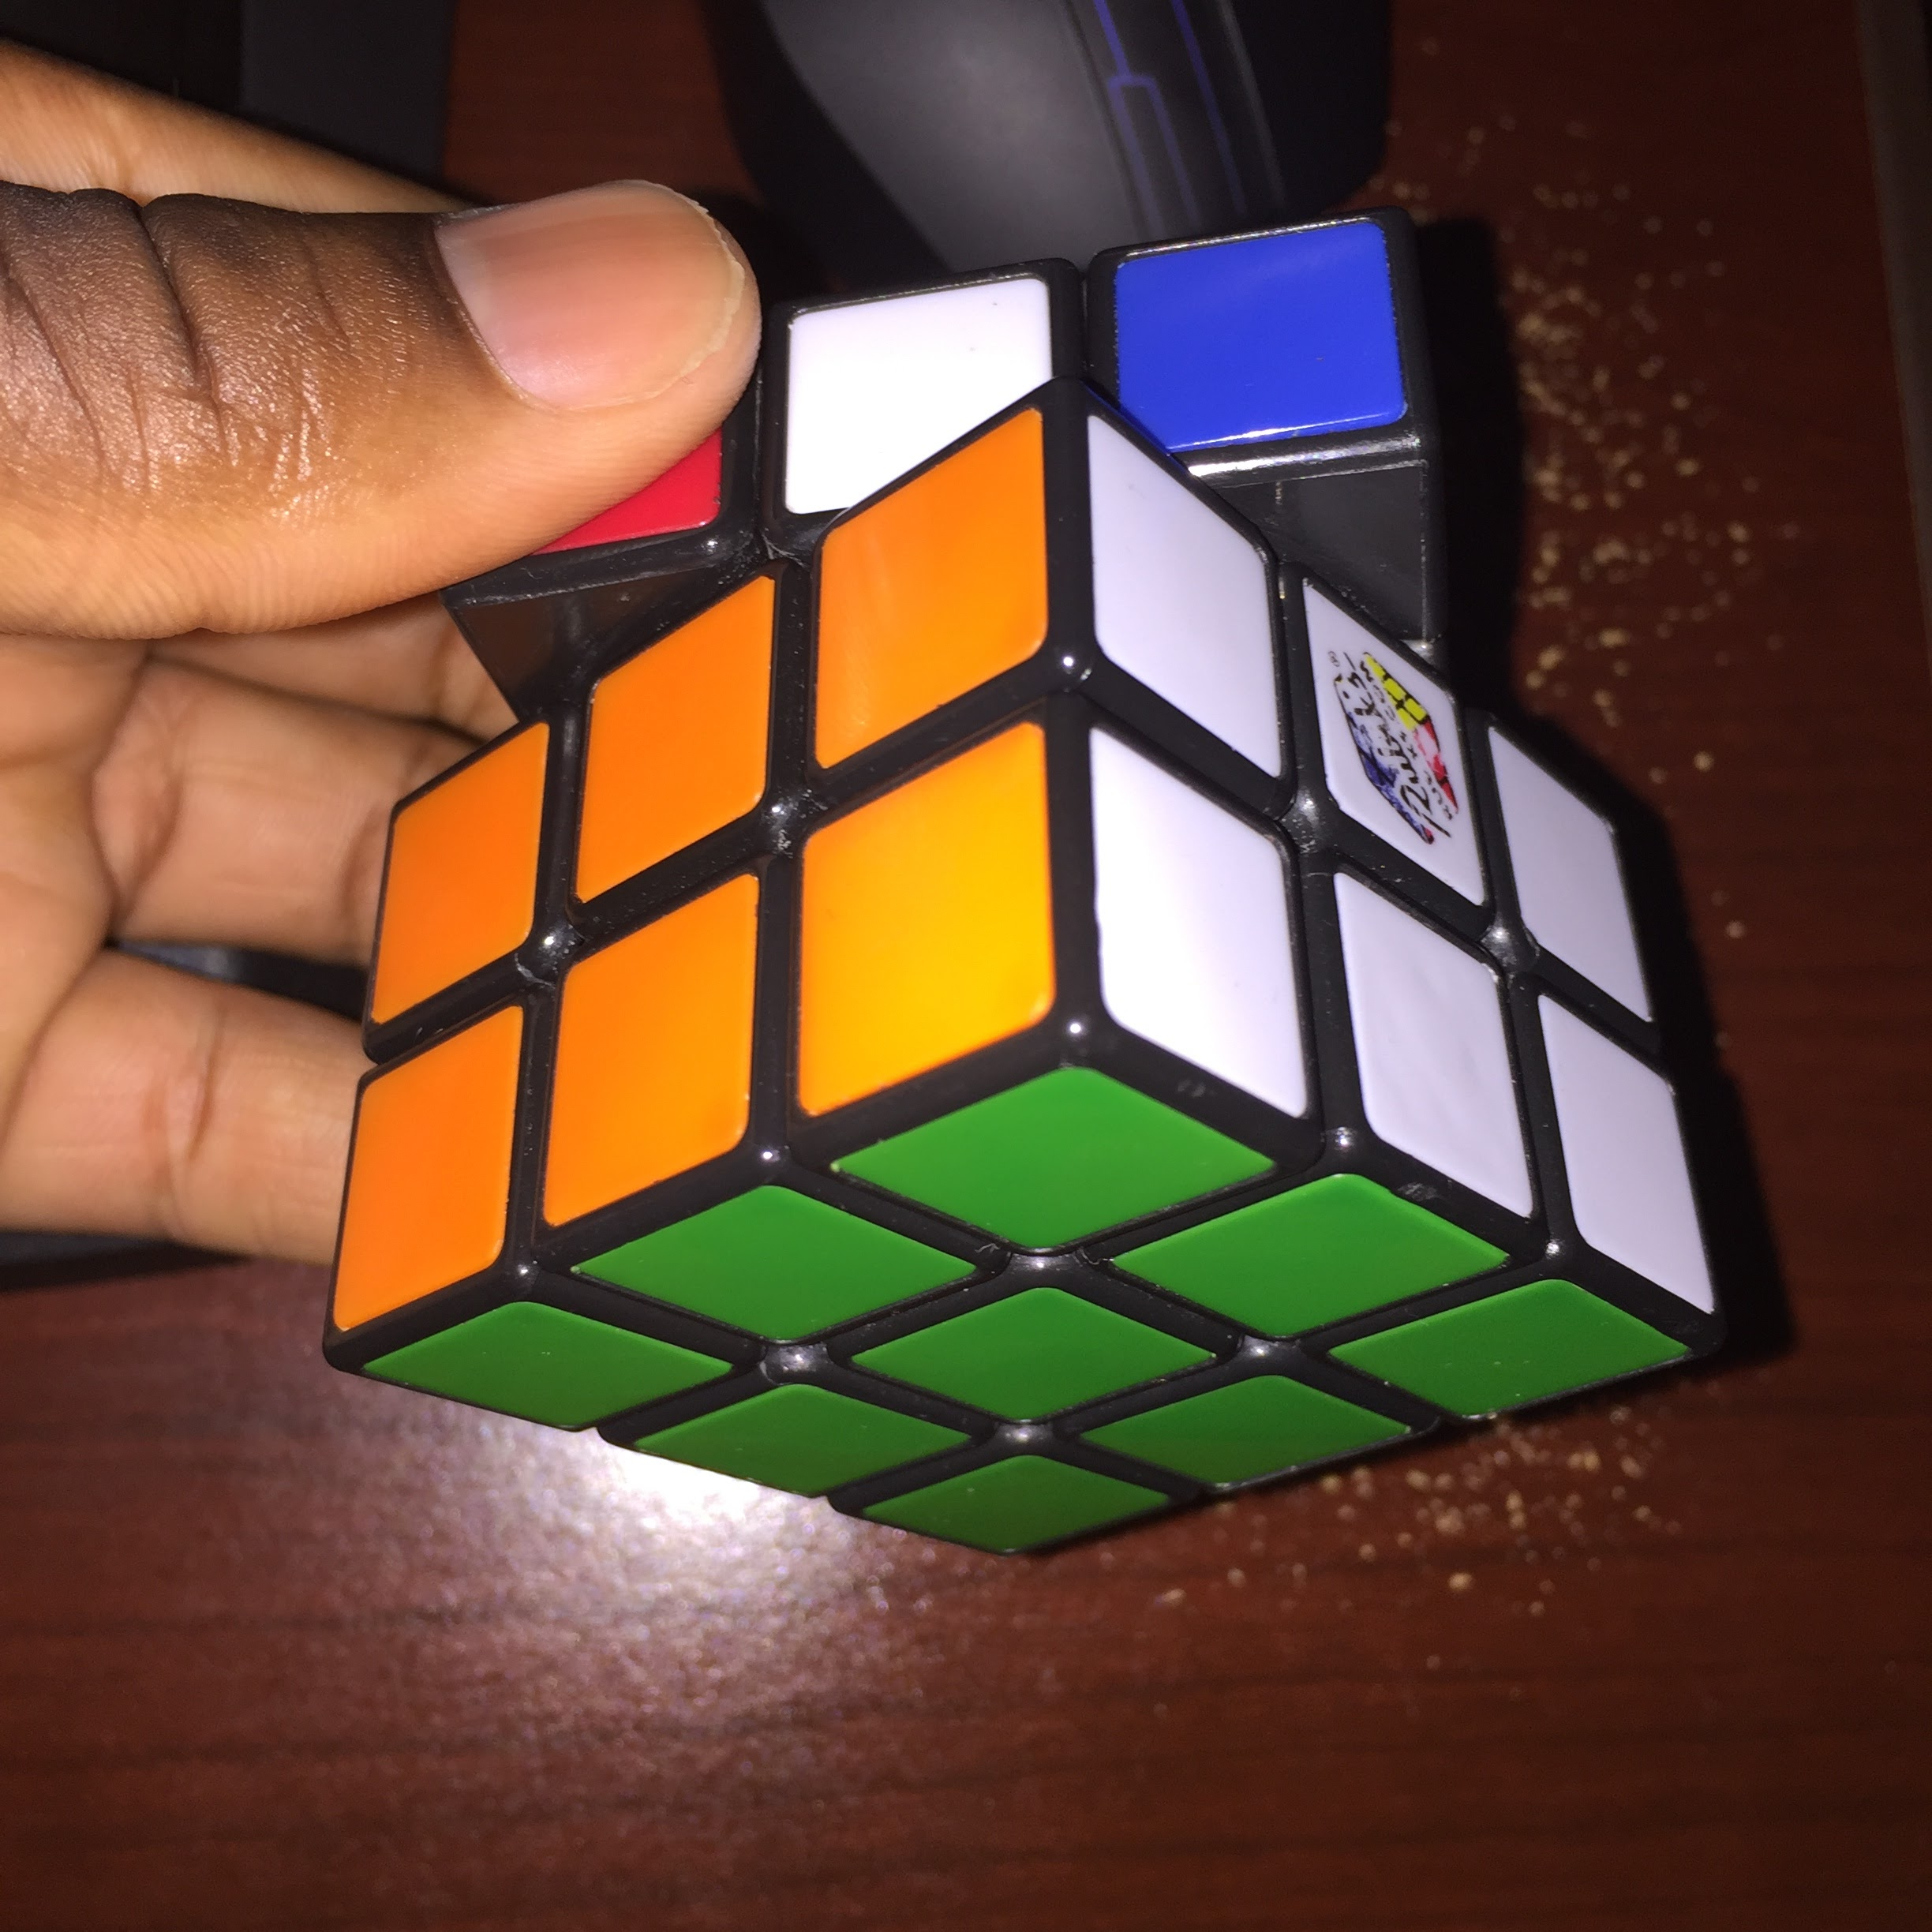
F2L (First Two Layers)
In this phase the First Two Layers are solved
First the Bottom layer corners are solved from the Base State, or Cross
Then the Middle Layer is solved, there will be at most 4 cubes to solve in the middle layer

Slide 29
OLL (Orientation of Last Layer)
Solves the Top Face of the cube without worrying about each cube being in the correct position
This is a standard step of this method, but is inefficient and unnecessary so it will be skipped for our project
The next step will be the final one

Slide 30
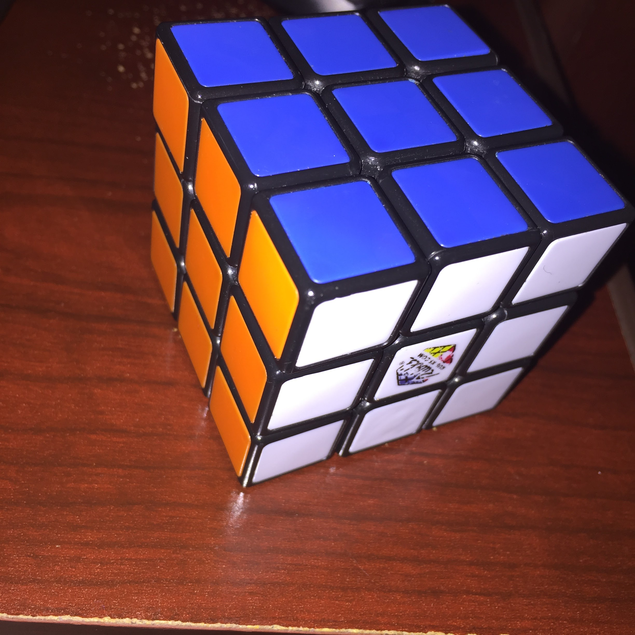
PLL (Permutation of Last Layer)
The edges of the Top Layer will be solved
Followed by the corners
The cube will then be completely solved

Slide 31
Development
The CFOP method will be implemented in C on MSP430 development board
The MSP430 has a RTOS that allows development directly on the board
Once the state of the cube has been properly mapped from the Camera values it will be implemented
The 3D Rubik’s Cube will be read as a 2D array of matrices
The cube will be solved by the program first and make a queue for each move that must be implemented to solve the cube
That queue will then be sent to robot servos to physically solve the cube

Slide 32
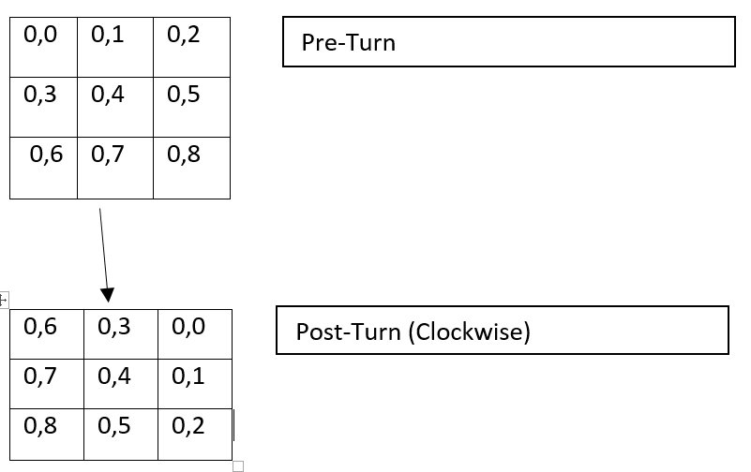
Turning the Cube
Each face of the cube must be able to turn both Clockwise and CounterClockwise 90 degrees
It has to be done physically by the robot and logically by the code
For the code the position in the 2D array will be saved and then replaced according to rather the Clockwise function or CounterClockwise function is called

Slide 33
Solving String
•After we found the algorithm to solve the cube we determined we are going to save the rotations of the cube into a matrix of strings
•The string will be sent to be parsed and determine the move set

Slide 34
Randomization
•Can’t take out the cube when it’s in our robot
•Need to randomize the cube after its solved
•Easier to just make a program that randomizes the cube
•We plan on using a random number generator to randomize the cube
•There will be two sets of random numbers:
•Face that needs to be turned
•How much to turn the face
•40 random moves

Slide 35
Random Numbers
Selecting the side that needs to be Rotated
Front Face 1 - 166
Top Face 167 - 333
Bottom Face 334 - 500
Right Face 501 - 666
Left Face 667 - 833
Back Face 834 - 1000
Determining how much it will be rotated
90 degrees right 1 - 33
90 degrees left 34 - 66
180 degrees 67 - 99

Slide 36
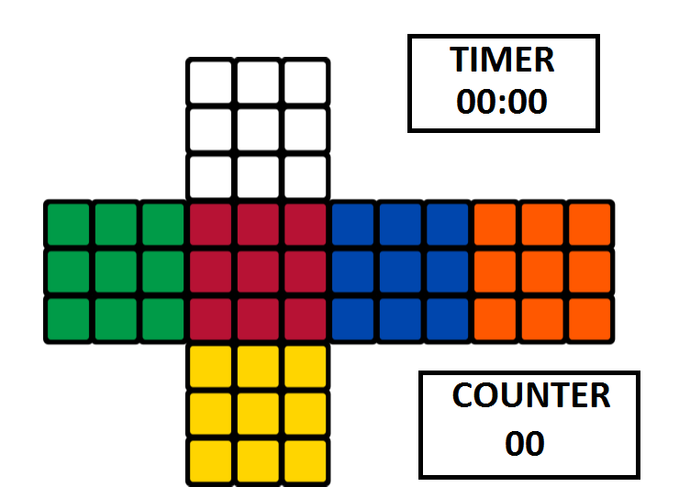
GUI/Display
Timer (for solving cube)
Move Counter
2D display of the cube
Possible mobile App

Slide 37
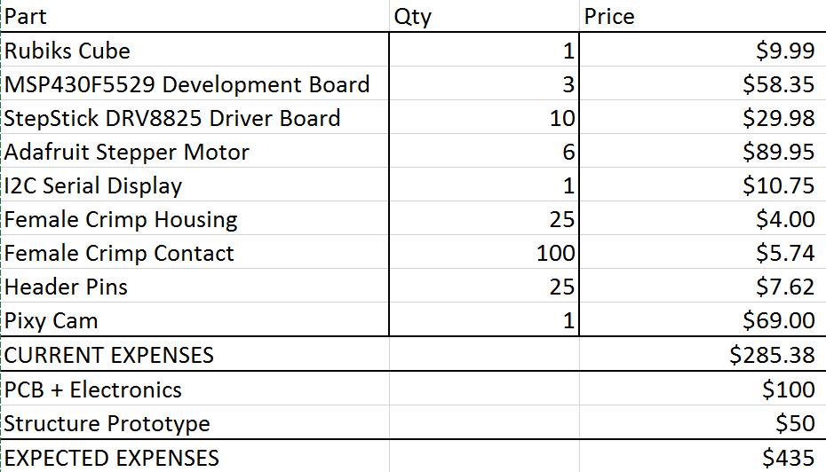
Budget

Slide 38
Group Distribution
 | Structure | Vision Control | Algorithm | GUI | Electronics
Daniel
Corey
Tony
Primary Job Secondary Job

Slide 39
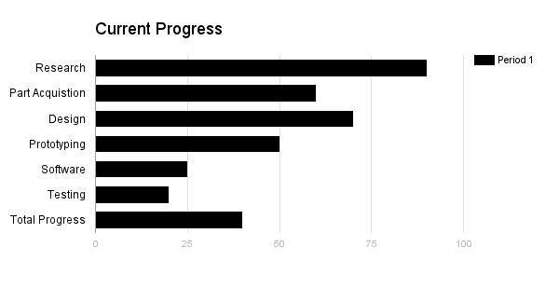
Current Progress

Slide 40
Immediately Plans to Success
PCB ordered
Finish software algorithm
Image Processing
Test Final Prototype

Slide 41
Questions?

