Slide 1
Portable Solar Power Supply
Group V:
David Carvajal
Amos Nortilien
Peter Obeng
November 20, 2012

Slide 2

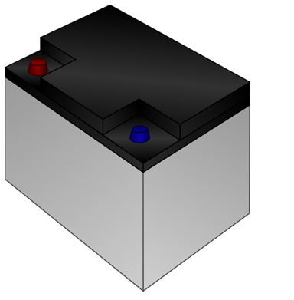

Project Definition
Mobile harnessing of solar energy
Store this energy into a battery
Supply the stored energy when desired

Slide 3
Project Overview
Solar Panel
Solar Tracking
Maximum Power Point Tracking (MPPT)
Charge Controller
DC/DC Converter
DC/AC Inverter

Slide 4
Goals and Objectives
Harvest solar energy
Convenient mobile power
Lightweight
Provide Power for broad range AC and DC devices

Slide 5
Portable Solar Power Supply
Block Diagram
Power from Solar Panel
Microcontroller (MPPT)
LCD Display
Charge Regulator
12 V Lead Acid Battery
Provision of AC and DC Power
Microcontroller and Motor (Solar Tracking)
Solar Panel Mount

Slide 6
Specifications and Requirements
Convert 12 V DC to 120 V AC at 60Hz
Capable of supplying 5 V DC at 500mA for USB outputs
The efficiency (Input power from solar panel to output power from outlet devices) should be at least 90 percent
An MPPT algorithm that works very well to keep the solar panel operating at its maximum power point (MPP)
Horizontal rotation for solar panel mount (solar tracking)

Slide 7
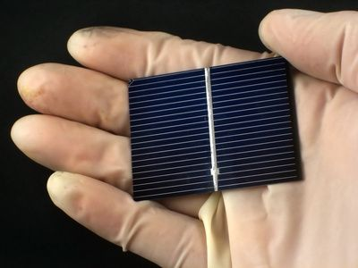
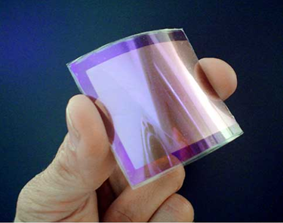
Solar Panel Types
Crystalline PV Panels | Thin Film PV Panels
Higher Efficiency | Low Priced
High power per area | Suited for large areas
Ease of fabrication | Better tolerance in the shade
High stability | Less susceptible to damage
Higher liability | Flexible and easier to handle

Slide 8
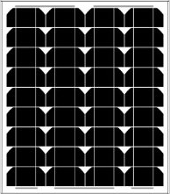
Monocrystalline Solar Panel
50 Watt Solar Panel
Monocrystalline Photovoltaic Solar Panel
Up to 50 Watts (power)
Up to 2.92 Amps (current)
24 in.
21in.
Specifications | Monocrystalline | Polycrystalline
Efficiency | 17% | 12%
Weight | 8.8lbs | 12.6lbs
Dimensions | 24.6x1.2x21 in. | 30.6x1.9x27.2 in.
Price | $169.99 | $149.99
Voltage | 12V nominal output | 12V nominal out put

Slide 9
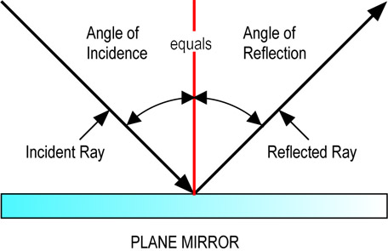
Solar Angle of Incidence
Depends on the geographic location and time of year.
The fixed angles are dependent of the seasons.
Multiple solar angle calculators can be found online.

Slide 10
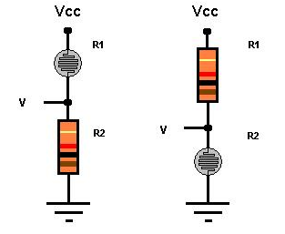
Photoresistor
The absolute maximum temperature range for operating and storage of these photoresistors are -40 to +75 degrees Celsius.
The continuous power dissipation is 80mW and derate above 25 ˚C is 1.6mW/ ˚C.
The active surface of these photoresistors are plastic coated for protection.
These photoresistors have a maximum peak voltage of 100 volts.

Slide 11
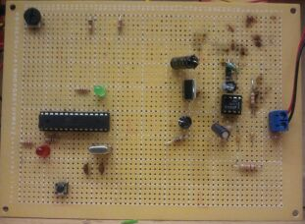
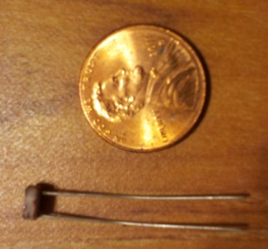
Solar Tracker
Simple and Effective Design
2 photocells
Arduino Microcontroller
Resistors
Single Axis Tracker
4.8 – 6 V Servo Motor
Solar panel mount
Dimensions: 4.5 inches*6.625 inches

Slide 12
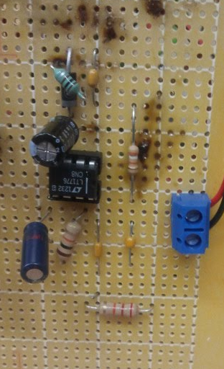
DC to DC Converter
LT1776
Input Voltage from 7.4 V to 40V
Outputs 5V, 500 mA
85% efficiency
Switching frequency:
200kHz

Slide 13
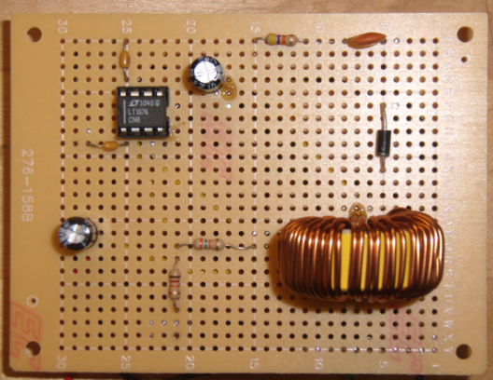
DC to DC converter
LT1676
Input Voltage from 8V to 40V
Outputs 5V, 500 mA
87% efficiency
Switching frequency: 100kHz

Slide 14
Battery
Specification
Convenience
Manufacture: Battery Mart
Type: Sealed Lead Acid Battery
Voltage Output: 12 Volt
Capacity: 35 Ah
Size: 7.65 L x 5.25 w x 7.18 h in.
Cost : Donated
Weight: 29.00 Pounds
Battery Life: 100,000 hours
Deep Cycle Sealed
Long Service Life
Long Shelf Life
Wide Operating Temperature Ranges (-40°C to +60°C )
No Memory Effect
Recyclable

Slide 15
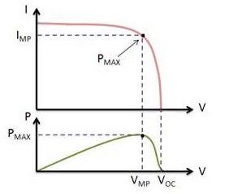
Maximum Power Point Tracking (MPPT)
The current and voltage at which a solar module generates the maximum power
Location of maximum power point is not known in advance
Modifies the electrical operating point of a solar energy system to ensure it generates the maximum amount of power.
Finding the current or voltage of the solar panel at which maximum power can be generated
Improves electrical efficiency of a solar energy system

Slide 16
Maximum Power Point Tracking (MPPT)
Algorithms
Perturb and Observe:
Most commonly used because of its ease of implementation
Modifies the operating voltage or current of the photovoltaic panel until maximum power can be obtained
Incremental Conductance:
Take advantage of the fact that the slope of the power-voltage curve is zero at the maximum power point
- The slope of the power voltage curve is positive at the left of the MPP and negative at the right
of the MPP
MPP is found by comparing the instantaneous conductance (I/V) to the incremental conductance (ΔI/ΔV)
When MPP is obtained, the solar module maintains this power unless a change in ΔI occurs.

Slide 17
Maximum Power Point Tracking (MPPT)
Algorithms
Increase the conversion ratio of the DC/DC/converter.
Measure the solar panel Watt.
If the solar panel watts are greater than the last measurement, then it is climbing the front of the hill, loop back and do it again.
Else if Watts are less than the last time measurement, then it is on the back side of the hill, decrease the conversion ratio and loop back to try again.

Slide 18
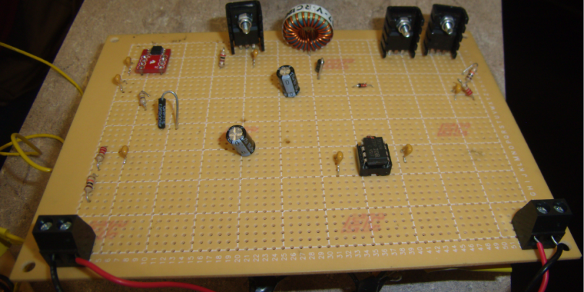
Charge Controller
DC/DC Converter (Buck)
Changes the solar panel’s higher voltage and lower current to the lower voltage and higher current needed to charge the battery.
Controlled by PWM signal that switches the MOSFETS at 50kHz
Prevents battery from discharging at night
Measures battery and solar panel’s voltage
Dimensions: 4.5 inches*6.625 inches

Slide 19
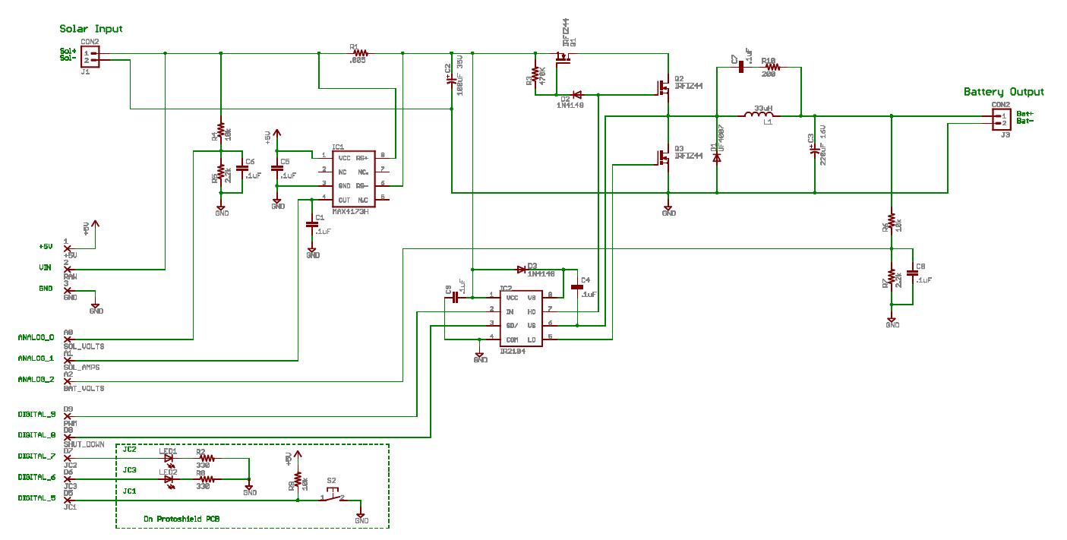
Charge Controller
Schematic Diagram

Slide 20
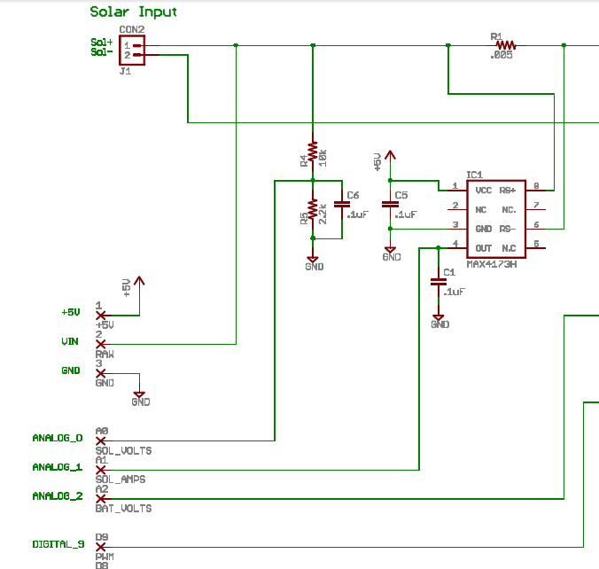
Charge Controller
Current Sense Resistor and High Side Current Sense Amplifier

Slide 21
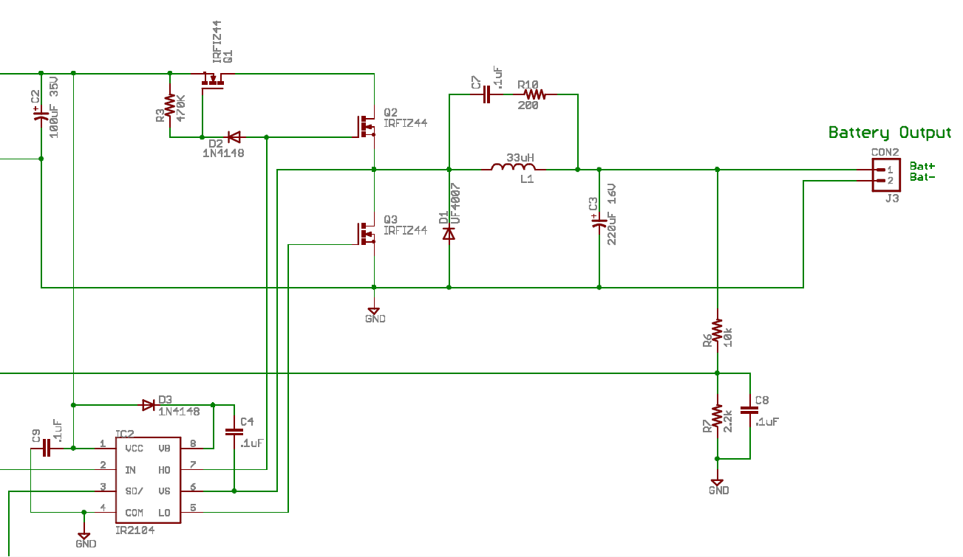
Charge Controller
Switching MOSFETS and Blocking MOSFET, and MOSFET Driver

Slide 22
Microcontroller
Arduino Uno
Specification:
Function:
Processor: ATmega328
Operating Voltage: 5 V
Digital I/O Pins: 14 (6 provides PWM output)
Analog Input Pins: 6
DC Current per I/O Pin 40mA
Flash Memory: 32KB (2KB is used by bootloader)
SRAM: 1 KB
EEPROM: 512 bytes
Clock Speed: 16MHz
Controls Charge Controller to Optimize battery charging
Displays status of the portable solar power supply on LCD display

Slide 23
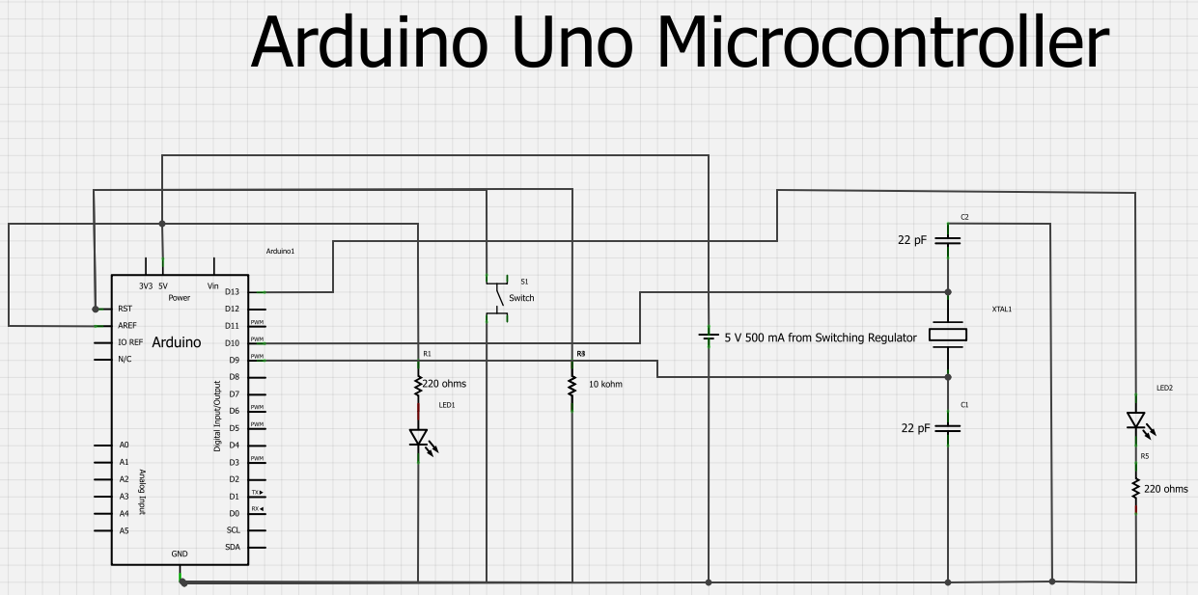
Microcontroller
Arduino Uno Schematic

Slide 24


LCD Display
Pin connections
Pin | Symbol | Level | Functions
1 | VSS | ---- | GND (0V)
2 | VDD | ---- | Supply Voltage for Logic (+5V)
3 | V0 | ---- | Power supply for LCD
4 | RS | H/L | H: Data; L: instruction Code
5 | R/W | H/L | H: Read; L: Write
6 | E | H/L | Enable Signal
7 | DB0 | H/L | Data Bus Line
8 | DB1 | H/L
9 | DB2 | H/L
10 | DB3 | H/L
11 | DB4 | H/L
12 | DB5 | H/L
13 | DB6 | H/L
14 | DB7 | H/L
15 | LEDA | ---- | Backlight Power (+5V)
16 | LEDB | ---- | Backlight Power (0V)

Slide 25
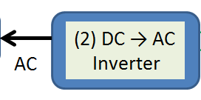
Pure sine wave Inverter
Specifications
90% of Efficiency
Output voltage of 120V AC at 60 Hz
Power rating of 300 W

Slide 26
Inverter
Inversion Process
Stepping up the low DC voltage to a much higher voltage using boost converter
Transforming the high DC voltage into AC signal using Pulse Width Modulation
Inverter

Slide 27
High Voltage DC/DC Converter
Specification
Feed the high side of the H-bridge
Efficiency of 90%
Isolated voltage feedback
Cooling passively

Slide 28
Block Diagram
Voltage Regulator
MCU
Signal Generation
MOSFETs Drivers
H-bridge
AC Output Signal
DC Input

Slide 29
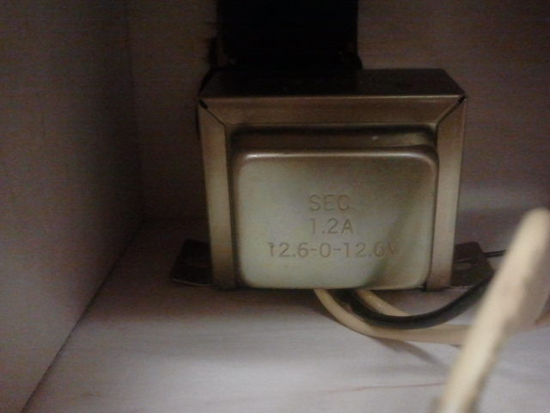
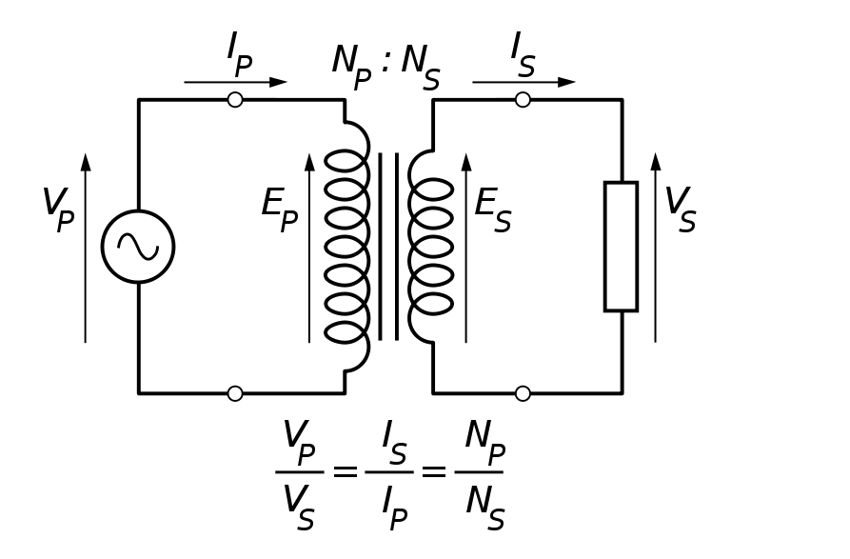
Transformer
Specifications
12 – 0 – 12 volts input at 2 A.
120 volts output at 60 Hz

Slide 30
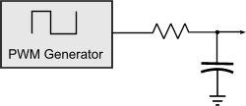
Pulse Width Modulation
Method of generating AC Power in Electronic Power Conversion through:
Simple Analog Components
Digital Microcontroller
Specific PWM Integrated Circuits

Slide 31
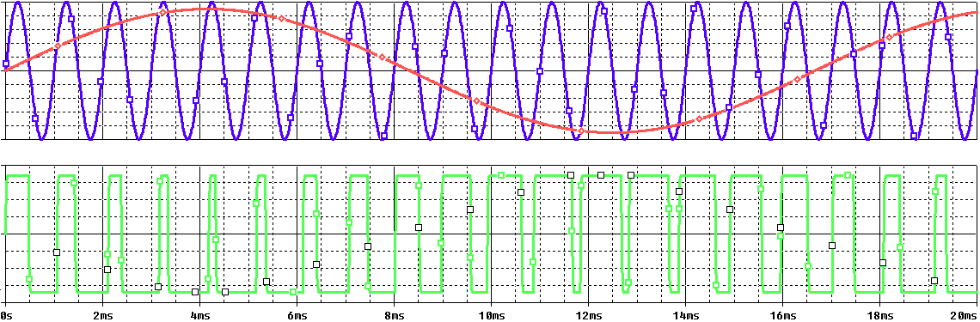
Pulse Width Modulation
2 Level PWM Signal

Slide 32
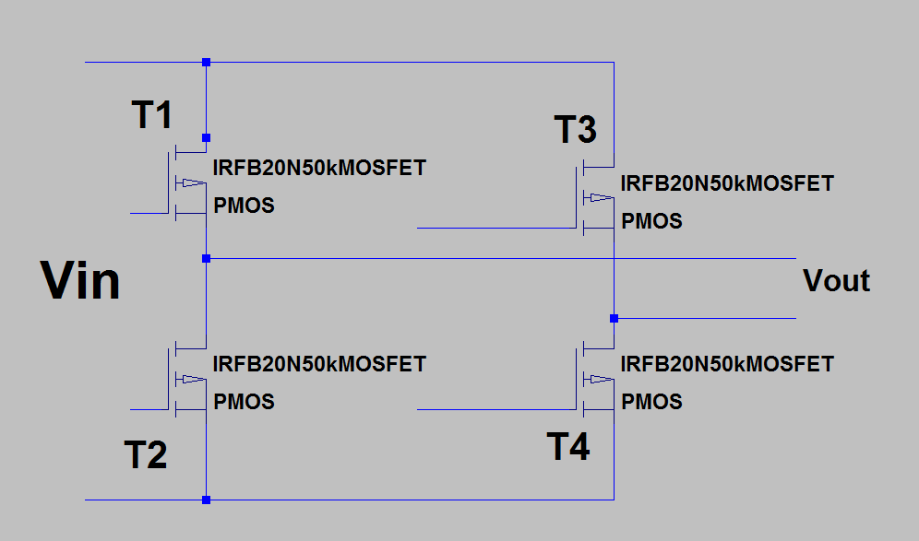
H-Bridge Circuit
Circuit that enables a voltage to be across a load
Consists of 4 switches, MOSFETS

Slide 33
H-Bridge Circuit
Control of the Switches
High side left | High side right | Low side left | Low side right | Voltage load
On | Off | Off | On | Positive
Off | On | On | Off | Negative
On | On | Off | Off | Zero
Off | Off | On | On | Zero
Table 4.4.4-1: Switches Position and Load Sign

Slide 34
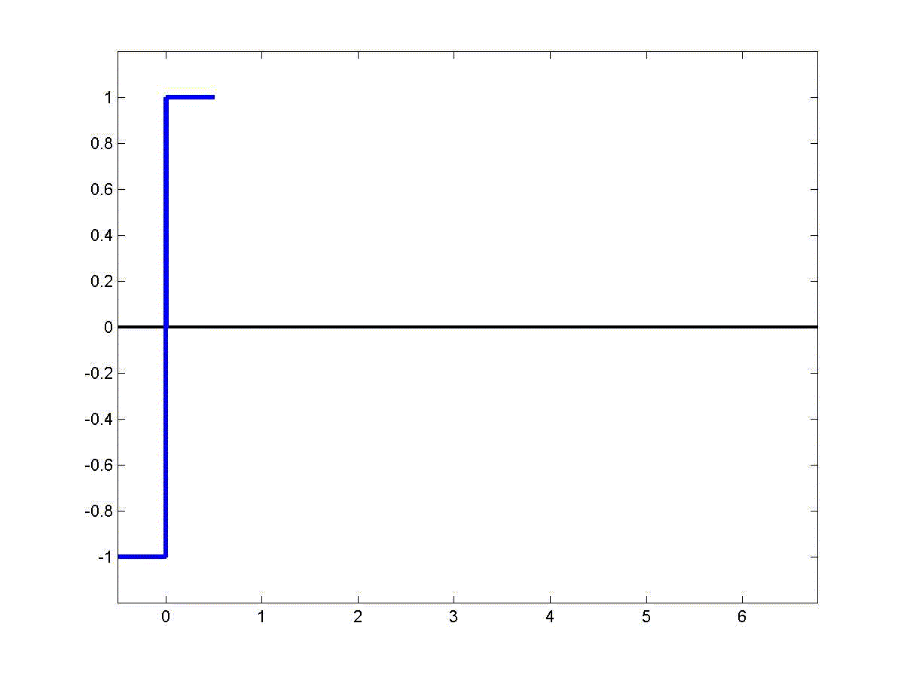
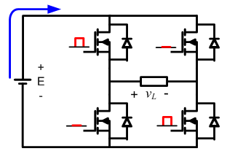
H-Bridge Circuit
Control and Operation

Slide 35
Microcontroller
PIC16F628A
Specification
Functionality
Frequency: 4 MHz
Pin: 18
Memory: 3.5 KB
Comparator: Yes
Generate signals for the MOSFET drivers
Control the PWM
Provides easier feedback to control power

Slide 36
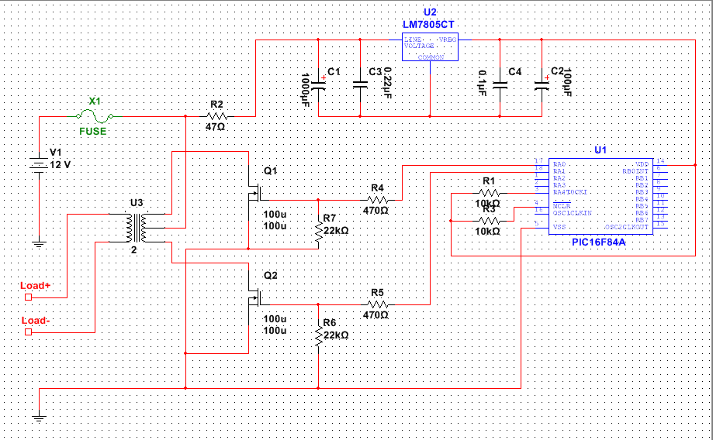
Inverter Circuit Diagram

Slide 37
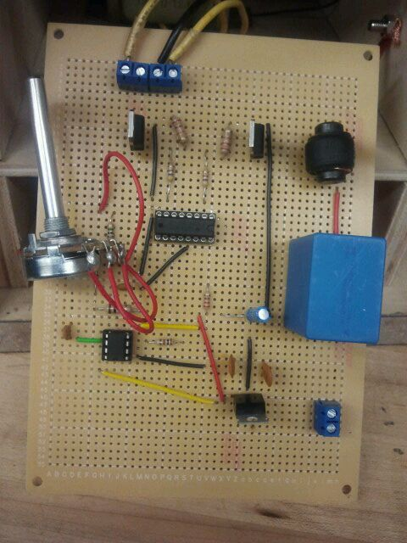
Inverter

Slide 38
Testing MPPT
Power Supply |  |  | Electronic DC Load
18.4 | 2.19 |  | 14 |  | 2.71
16 | 2.52 |  | 13.9 |  | 2.71
14 | 1.66 |  | 7.9 |  | 2.71
12 | 1.65 |  | 6.4 |  | 2.791
17.25 | 2.25 |  | 13 |  | 2.791
18.75 | 2.1 |  | 12.8 |  | 2.971
Power | 40.296 |  | 37.94 |  | 94.15%
 | 40.32 |  | 37.669 |  | 93.43%
 | 23.24 |  | 21.409 |  | 92.12%
 | 19.8 |  | 17.8624 |  | 90.21%
 | 38.8125 |  | 36.283 |  | 93.48%
 | 39.375 |  | 38.0288 |  | 96.58%
MPPT Average | 93.33%

Slide 39
Progress

Slide 40
Budget

Slide 41
Total Spent
$500.00

Slide 42
Questions??

