Slide 1
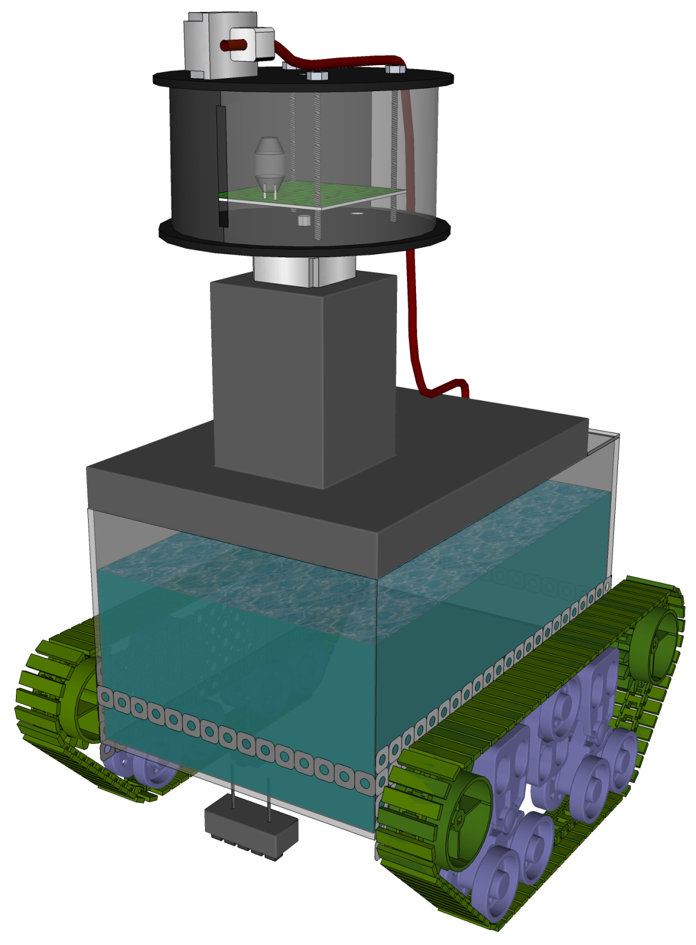
Fire Detection and Eradication
Group 13 (formerly known as Group A)
Bernadeau Charles
Matt Erdelac
Erik Ferreira
Armin Sadri

Slide 2
Project Overview
HeatSeekr addresses issues plaguing the current fire extinguishing methodology.
Minimizes the amount of additional damage caused by traditional fire systems.
Efficient and accurate without human interaction

Slide 3
Primary Goals and Objectives
Be able to detect the beginning stages of a fire.
Extinguish flames with concentrated water.
Be fully independent and autonomous.

Slide 4
Design Specifications
Criteria | Specification
Fire Detection Range | Up to 20 feet
Fire Detection Response Time | Under 30 seconds
Navigational Response Time | Travel 40 feet under 1 minute
Water Extinguisher Range | Distance of 5 feet
Standby Response Time | Operate after sleeping for 2 hours
Weight | Under 30 lbs
Total Size | Under 2ft x 2ft x 2ft

Slide 5
Data Flow
LCD Screen
Bluetooth
Bluetooth
Fire Detector
UART
UART
Master
µC
Wireless
µC
I²C
I²C
Extinguishing
µC
Navigation
µC
Fire Detector
Aiming Motors
Line Follower
Drive Motors
Extinguisher
Water Level Sensor

Slide 6
Fire Detection
Extinguishing
µC
Aiming Motors
Fire Detector
Extinguisher
Water Level Sensor

Slide 7
Fire Detection
Three initial choices: IR Camera, IR Thermometer, and Hamamatsu UVTron
Main specification: feasible and efficient to incorporate on rover and wireless probe

Slide 8
Fire Detection - Methods
 | IR Camera | IR Thermometer | UVTron
Functional Essence | IR sensitive image | IR value for a point | UV sensitive transistor
Interface | UART | SPI | µC Pin
FOV Control | Medium – Software | None – point source | Shroud – Naturally Omni
Processing | OpenCV Contour Match | Array Max Value Search | Frequency Counter
Processing Requirement | Very High | Low | Low
Scanning Requirement | X plane servo | X-Y plane servo | X plane servo/omni
Detection Speed | Slow – 1 minute per degree | Slow – 1 minute per x-parallel | Fast – 1 degree per second
Detection Range | ~15 feet | Less than 7 feet | 20+ feet
Voltage Requirement | 5V | 5V | 12V
Current Consumption | 90mA | 5mA | 4mA
Cost | $49.95 | $99.50 | $84.90*

Slide 9
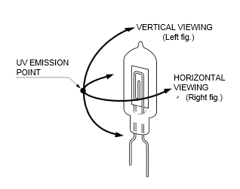
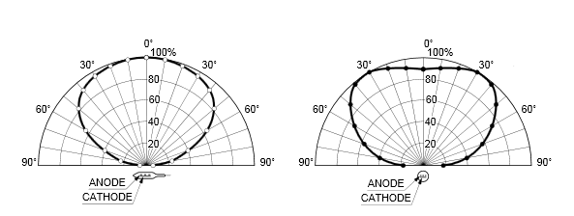
Fire Detection - UVTron
 | UVTron
Functional Essence | UV sensitive transistor
Interface | µC Pin
FOV Control | Shroud – Naturally Omni
Processing | Frequency Counter
Processing Requirement | Low
Scanning Requirement | X plane servo/omni
Detection Speed | Fast – 1 degree per second
Detection Range | 20+ feet
Voltage Requirement | 12V
Current Consumption | 4mA
Cost | $84.90*

Slide 10
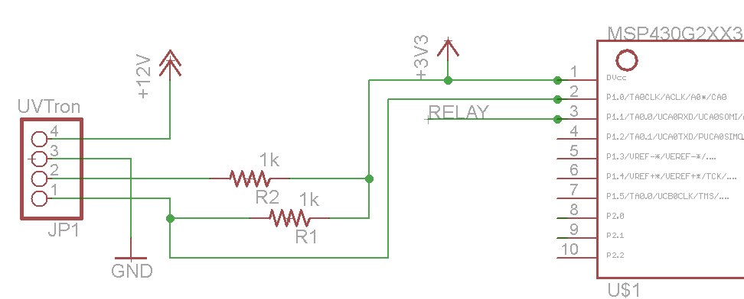
Fire Detection - UVTron

Slide 11
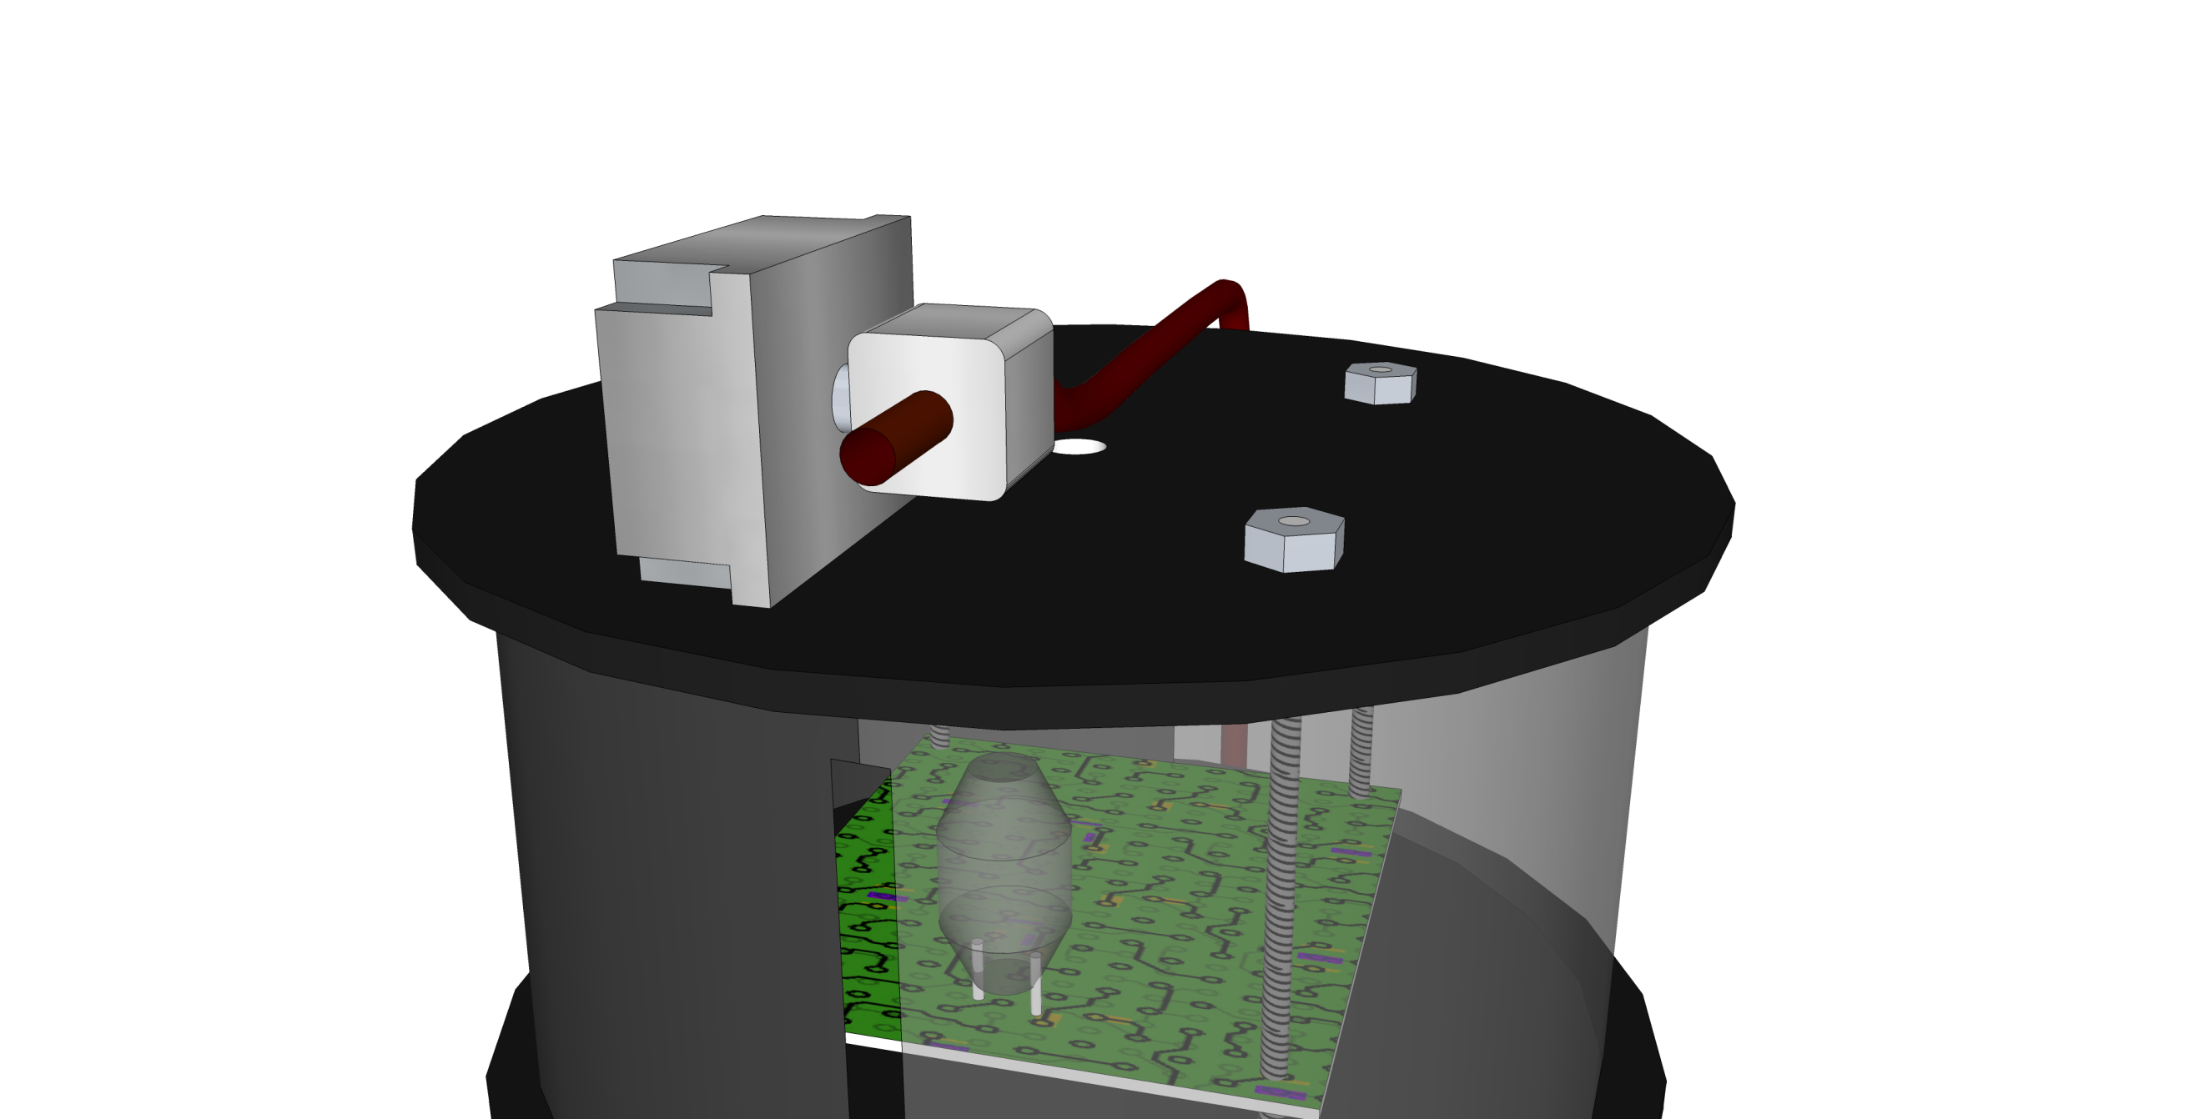
Fire Detection - Render

Slide 12
Fire Extinguisher
Extinguishing
µC
Aiming Motors
Fire Detector
Water Level Sensor
Extinguisher

Slide 13
Fire Extinguisher
Two considered methods: ABC dry chemical and water cannon
Main specification: Ease of testing and implementation

Slide 14
Fire Extinguisher – Water Cannon
Comprised of water tank, pump, and hose
Appropriate for Class A fires
Advantages: Ease of activation and testing - $83.95
Disadvantages: Cannot handle B and C fires, cumbersome aiming

Slide 15
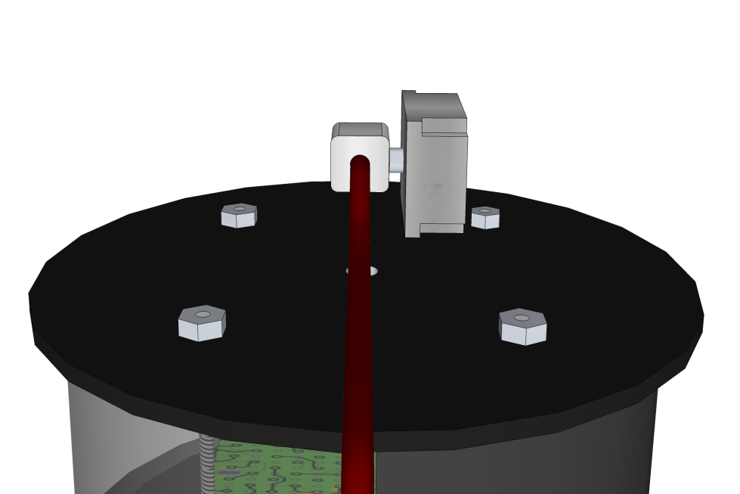
Fire Extinguisher – Water Cannon
Proposed firing
pattern
For-loop controlled
alternation of motors

Slide 16
Line Follower
Navigation
µC
Line Follower
Drive Motors

Slide 17
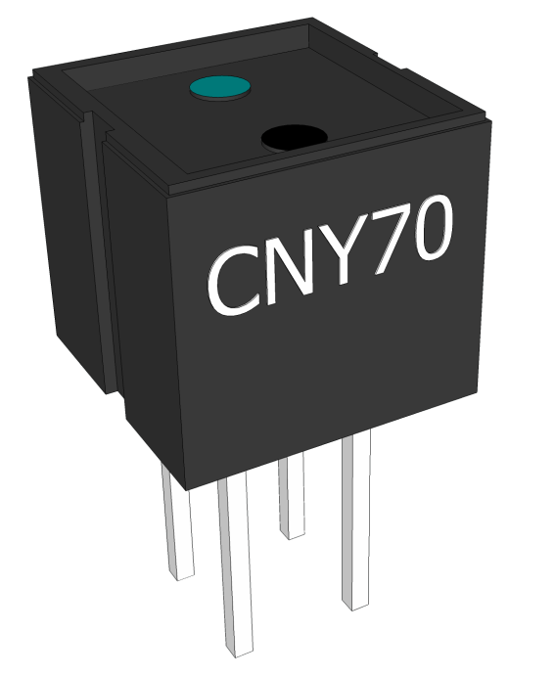
Line Follower
Based on CNY70 Optical Transistor
Output depends on reflection of IR light
Array of CNY70s feeds into comparator
Comparator outputs logic level Boolean response

Slide 18
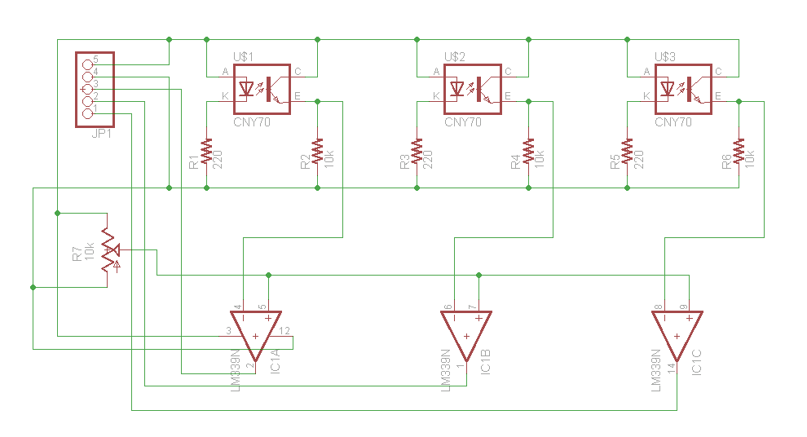
Line Follower - Schematic

Slide 19
Line Follower - Navigation
010
Both motors on
011
Left motor on, right motor off

Slide 20
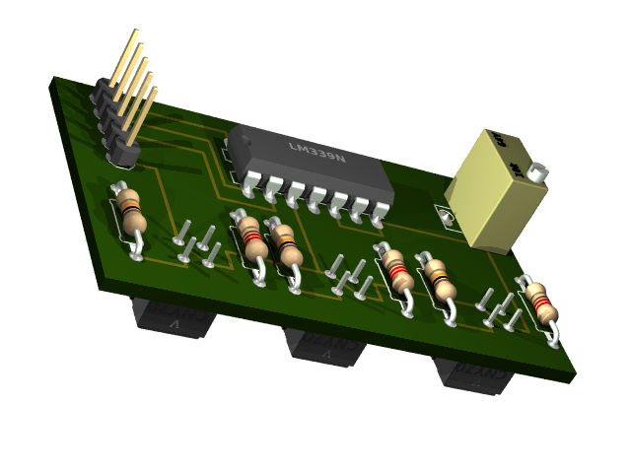
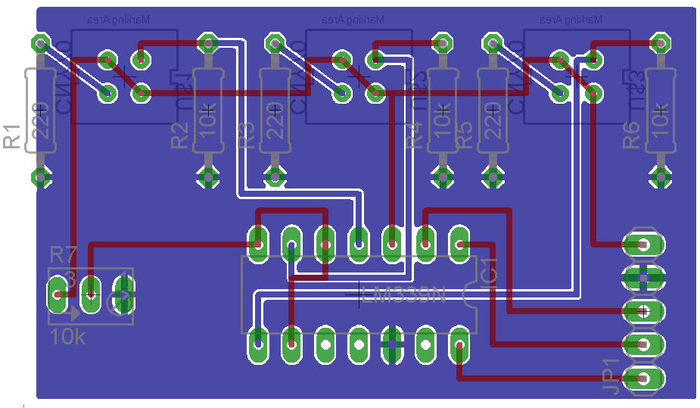
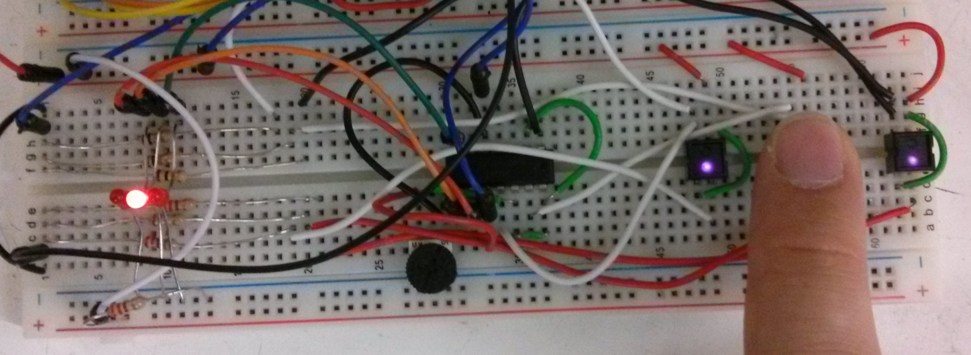
Line Follower – PCB Representation

Slide 21
Drive Motors
LCD Screen
Bluetooth
Bluetooth
Fire Detector
UART
UART
Master
µC
Wireless
µC
I²C
I²C
Extinguishing
µC
Navigation
µC
Fire Detector
Aiming Motors
Line Follower
Drive Motors
Extinguisher
Water Level Sensor

Slide 22
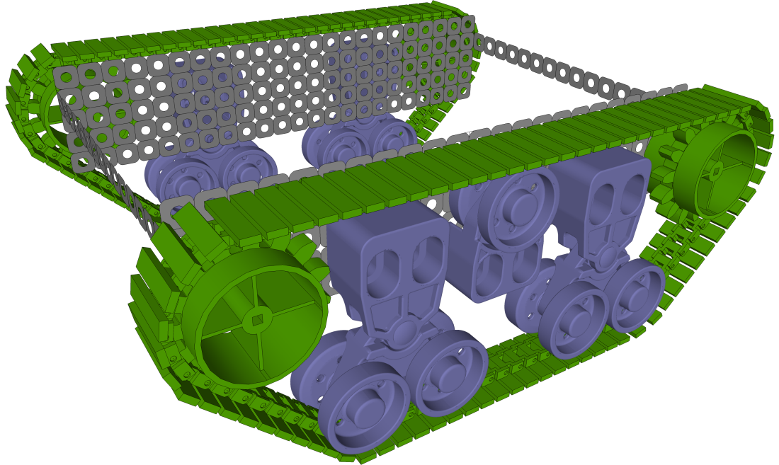
Tread Kit
VEX Robotics Tank Tread Kit
Criteria | Specification
Length | 2 chains of up to 32.75 in
Tread Width | 1.5 in
Tread Weight | 12 inches weights 0.532 lbs.
Tread Drive Diameter | Approx. 2.375 in
Material | Delrin Plasitc

Slide 23
Drive Motor
 | GHM-13 | PGHM-02
Reduction Ratio | 50 : 1 | 91: 1
Voltage | 12 Vdc | 12 Vdc
RPM | 152 | 65
Outside Diameter | 37 mm | 35 mm
Stall Torque | 231.5 oz/in | 388.85 oz/in
Weight | 7.28 oz | 8.90 oz
Cost | $29.95 | $37.95

Slide 24
MOSFET
 | HIP4020IBZ-ND
Configuration | NMOS
Logic Voltage | 3.3 V
Delay Time | 2.5µs
Current - Peak | 625mA
Supply Voltage | 3 V ~ 12 V
Operating Temperature | -40°C ~ 85°C
Cost | $6.83

Slide 25
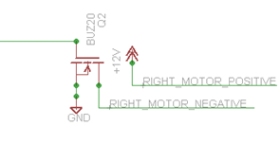
Drive Motors – Schematic

Slide 26
Aiming Motors
LCD Screen
Bluetooth
Bluetooth
Fire Detector
UART
UART
Master
µC
Wireless
µC
I²C
I²C
Extinguishing
µC
Navigation
µC
Fire Detector
Aiming Motors
Line Follower
Drive Motors
Extinguisher
Water Level Sensor

Slide 27
Aiming
Extinguishing
µC
Fire Detector
Aiming Motors
Extinguisher
Water Level Sensor

Slide 28
Stepper Motors
 | PM42M | HT23-180-8 | 39BYG302
Step Angle | 7.5 ° | 1.8 ° | 1.8 °
Drive Voltage | 24 V | 12 V | 12 V
Current / Phase | 0.5 A | 2.5 A | 0.32 A
Coil Resistance | 80 Ωs unipolor or 6 Ωs bipolar | 1.23 Ωs unipolor or 0.62 Ωs parallel | 15.0 Ωs
Torque | 4 N/cm | 13 N/cm | 1 N/cm
Cost | $7.95 | $33.95 | $12.95

Slide 29
Bipolar Stepper Motor Driver
 | DRV8811
Vs (Min) (V) | 5
Vs (Max) (V) | 38
RMS Output Current (A) | 1.4
Peak Output Current (A) | 1.9
# of Full Bridges | 2
Operating Temperature Range (C) | -40 to 85
RDS(ON) (HS + LS) (mOhms) | 1000
Current Regulation Levels | 8
Additional Features | 1/8 Microstepping P2P w/ DRV8818
# of half-bridges | 4
Cost | Free

Slide 30
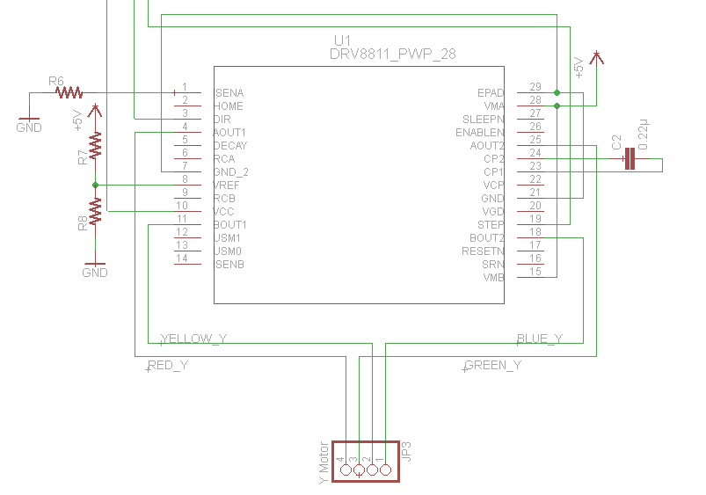
Stepper Motor - Schematic

Slide 31
Microcontrollers
LCD Screen
Bluetooth
Bluetooth
Fire Detector
UART
UART
Master
µC
Wireless
µC
I²C
I²C
Extinguishing
µC
Navigation
µC
Fire Detector
Aiming Motors
Line Follower
Drive Motors
Extinguisher
Water Level Sensor

Slide 32
Microcontrollers
 | MSP430G2553 | ATmega328
Voltage Range | 1.8 V to 3.6 V | 1.8 V to 5.5 V
Max. Operating Frequency | 16 MHz | 20 MHz
Power Consumption | Active: 230μA at 1MHz, 2.2V Standby: 0.5 μA | Active: 0.2mA Standby: 0.75 μA
Timer | Two 16-bit timers | Two 8-bit, One 16-bit
I/O pins | 20 | 23
Memory | 16 kB | 32 kB
RAM | 512 Bytes | 512 Bytes
Cost | Free | $2.88

Slide 33
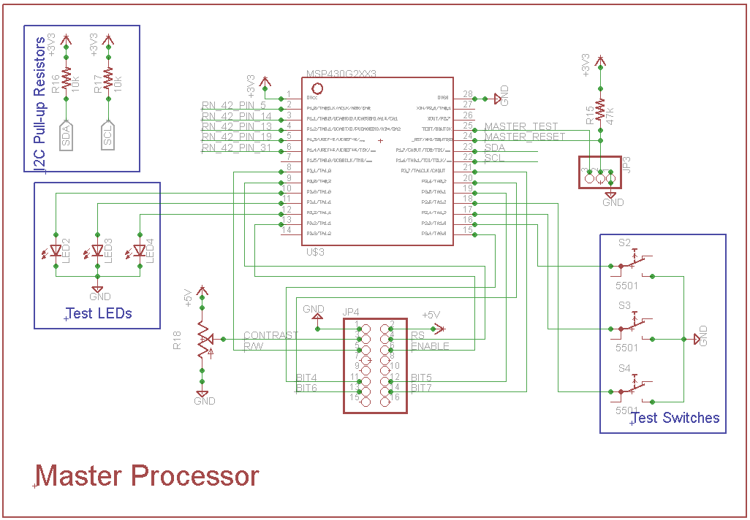
Master Schematic

Slide 34
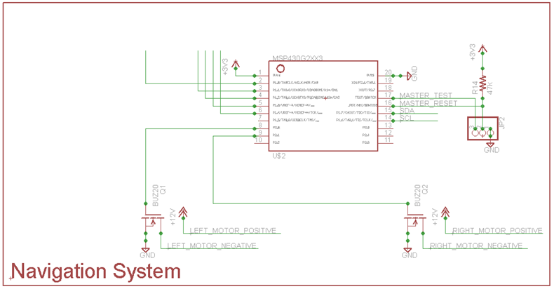
Navigation Schematic

Slide 35
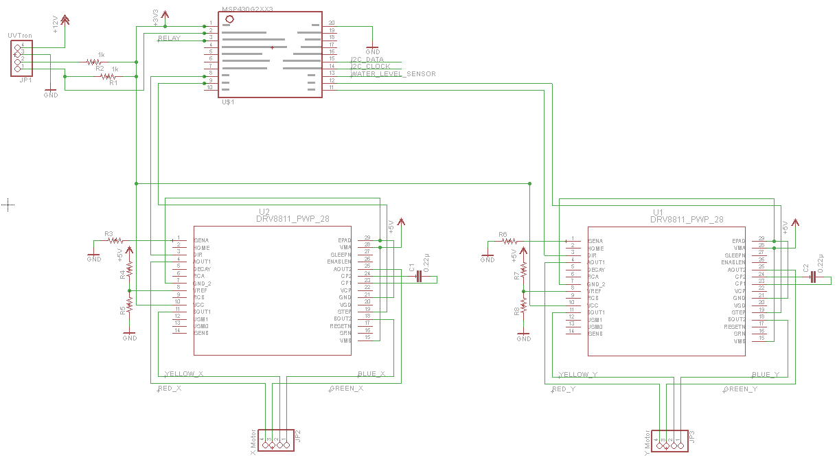
Extinguisher Schematic

Slide 36
Mainboard IC Communication
LCD Screen
Bluetooth
Bluetooth
Fire Detector
UART
UART
Master
µC
Wireless
µC
I²C
I²C
Extinguishing
µC
Navigation
µC
Fire Detector
Aiming Motors
Line Follower
Drive Motors
Extinguisher
Water Level Sensor

Slide 37
Mainboard IC Communication
I²C
UART is chip-to-chip
SPI required too many GPIO pins
Master processor will handle all communication of the rover
Fire?
Moving?

Slide 38
Wireless
LCD Screen
Bluetooth
Bluetooth
Fire Detector
UART
UART
Master
µC
Wireless
µC
I²C
I²C
Extinguishing
µC
Navigation
µC
Fire Detector
Aiming Motors
Line Follower
Drive Motors
Extinguisher
Water Level Sensor

Slide 39
Wireless
 | RN-171 | RN-42 | CC2520
Specification | 802.11 b/g | 802.15.1 V2.1 | 802.15.4
Common name | Wi-Fi | Bluetooth | Zigbee
Operating voltage | 3.3 V | 3.3 V | 3.3 V
Current Consumption (Tx) | 120 mA | 30 mA | 25.8 mA
Current Consumption (Sleep) | 4 µA | 26 µA | <1 µA
Interface | UART, SPI | UART, SPI | SPI
Antenna | External | On-board trace | External
Cost | $26.25 | $19.14 | $6.05

Slide 40
RN-42
UART - ‘invisible wire’
Commands vs Data
Device always assumes data
Sending the ‘connect’ command:
Send three ASCII ‘$’ – Enter command mode
Send ASCII ‘C, ’ – ‘connect’ command
Send three ASCII ‘-’ – Leave command mode
$
-
$
C,
-
$
-

Slide 41
Remote Probe
LCD Screen
Bluetooth
Bluetooth
Fire Detector
UART
UART
Master
µC
Wireless
µC
I²C
I²C
Extinguishing
µC
Navigation
µC
Fire Detector
Aiming Motors
Line Follower
Drive Motors
Extinguisher
Water Level Sensor

Slide 42
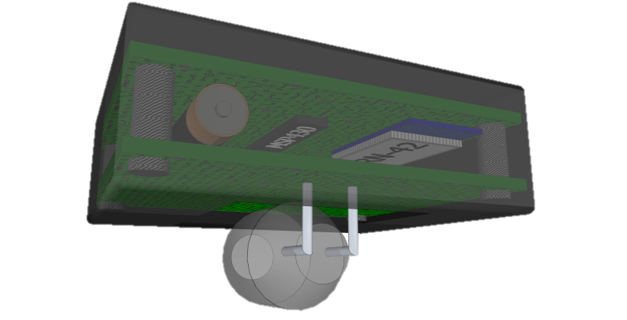
Remote Probe
Detect fires away from the rover
UVTron, MSP430G2553, RN-42
Bluetooth Master
Rover has the Bluetooth slave module
Ultra low power
µC sleeps in LPM4 – 0.1 µA @ 25°C
RN-42 not connected
4.5 mA
A23 alkaline battery

Slide 43
Remote Probe Logic Flowchart
µC enters LPM4
Pulse from UVTron
µC enters Active Mode
Determine if fire is present
Fire?
No
Yes
RN-42 connects
‘Fire present’ sent
RN-42 disconnects

Slide 44
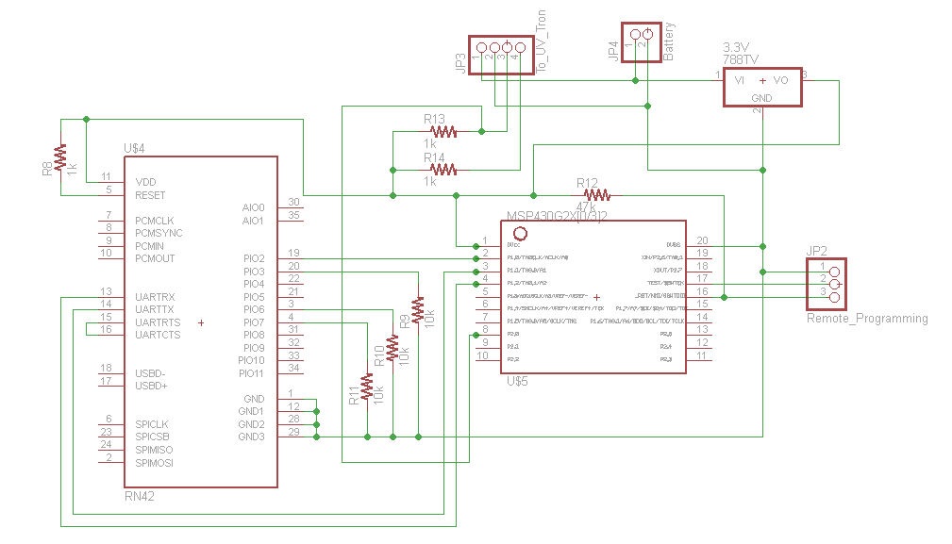
Remote Probe Schematic

Slide 45
Data Flow
LCD Screen
Bluetooth
Bluetooth
Fire Detector
UART
UART
Master
µC
Wireless
µC
I²C
I²C
Extinguishing
µC
Navigation
µC
Fire Detector
Aiming Motors
Line Follower
Drive Motors
Extinguisher
Water Level Sensor

Slide 46
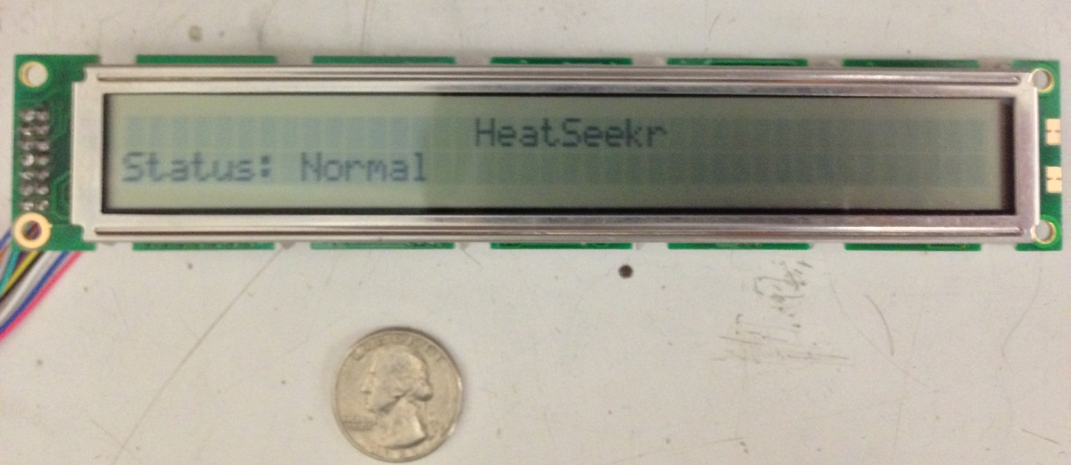
LCD screen
Hitachi MED100-DSPL
40 characters per line, 2 lines
Using Nikosapi’s HD44780 Library for the MSP430
Displays status messages

Slide 47
Water Tank
12”x 7”x 6” water tank.
Ultraviolet-Resistant Clear Extruded Acrylic Sheets
6 sheets with dimensions 12” x 12” with 1/4” thickness
Able to support a maximum of 2.18 gallons with a maximum weight of 16.68 lbs
Sheets attached with Weld-On #4 Acrylic Adhesive

Slide 48
Water Level Sensor
LCD Screen
Bluetooth
Bluetooth
Fire Detector
UART
UART
Master
µC
Wireless
µC
I²C
I²C
Extinguishing
µC
Navigation
µC
Fire Detector
Aiming Motors
Line Follower
Drive Motors
Extinguisher
Water Level Sensor

Slide 49
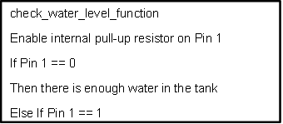
Water Level Sensor
Used to determine water level
Essentially a “ground detection” sensor
Pseudo-code for the water level sensor

Slide 50
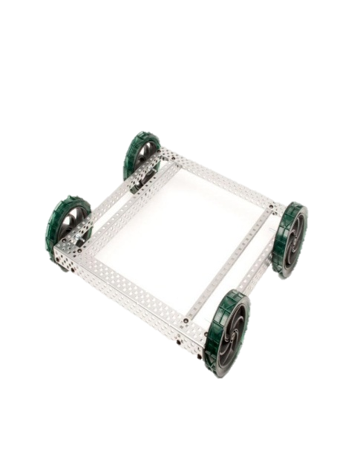
Chassis
25 holes long x 25 holes wide
Size is Adjustable

Slide 51
Power Requirements
 | Operating Voltage | Current Consumption
Microcontroller | 3.3 V | 0.5 mA
Water level Sensor | 3.3 V | 0.3 mA
Line Following Sensor | 3.3 V | 3 mA
Wireless Module | 3.3 V | 30 mA (Tx)
Servos | 5 V | 32 mA
Drive Motor | 12 V | 80 mA
UVTron | 12 V | 4 mA
Water pump | 12 V | 40 mA

Slide 52
Power Components
Tenergy 22.2V 7800mAh li-po battery pack
Physical switch to turn HeatSeekr on and off.
3.3 volt switching regulator (Murata Power Solutions 78SR-3.3/2)
5 volt switching regulator (Murata Power Solutions 78SR-5/2)
12 volt switching regulator (Innoline R-78C12-1.0)

Slide 53
Power Flow Chart
Tenergy 22.2V
3.3 V Switching VR
5 V Switching VR
12 V Switching VR
WIFI module
MSP430
Servos
Drive motors
UVTron
Water Pump

Slide 54
Power Supply Schematic

Slide 55
Battery Specifications Summary
Specifications | Ni-MH | Ni-Cd | Li-Po | Li-ion
Energy density (W-hr/kg) | 70-90 | 40-60 | 130-200 | 100-160
Capacity (Amp-hr) | 2.4 | 1 | 12.6 | 2.8
Internal resistance (mΩ) | 200-300 | 100-200 | 200-300 | 100-200
Nominal voltage (V) | 1.2 | 1.2 | 3.7 | 3.6
Discharge Rate | Flat | Flat | Flat | Flat
Recharge cycle | 600-1000 | 500-700 | >1000 | > 600
Disposal | Recyclable | Non-degradable | Recyclable | Recyclable
Charge/discharge efficiency | 66% | 70-90% | 99.80% | 80%-90%
Cost ($/Whr) | 2.75 | 2 | 2.8-5 | 2.5

Slide 56
Budget and Finance
Part | Cost per unit | Required | Acquired Thus Far | Total Spent Thus Far | Projected Cost
Hamamatsu UVTRON Flame Sensor R2868 | $35.95 | 2 | 1 | $0.00 | $71.90
C3704 Hamamatsu UVTRON Board | $49.94 | 2 | 1 | $0.00 | $99.88
MCP355 Swifttech PC Liquid Cooling Pump | $83.95 | 1 | 0 | $0.00 | $83.95
1.0 kg/cm Nema 16 Step Motor- 39BYG302 | $12.95 | 2 | 2 | $25.90 | $25.90
Bipolar Stepper Motor DriverDRV8811 | $4.67 | 2 | 2 | Free* | $9.34
Vex Robotics Tank Tread Kit | $29.99 | 1 | 1 | $29.99 | $29.99
Planetary Gear Motor PGHM-02 | $37.95 | 2 | 2 | $75.90 | $75.90
Reflective Optical Phototransistor | $0.76 | 4 | 4 | $3.04 | $3.04
3.3V / 5V Switching Regulator | $13.18 | 2 | 2 | $26.36 | $26.36
2-layer PCB board | $33 | 1 | 0 | $0.00 | $33.00
Plexiglas | $9.03 | 6 | 6 | $54.18 | $54.18
MSP430G2553 | $2.50 | 4 | 4 | Free* | $10.00
Chassis | $25.00 | 1 | 1 | $25.00 | $25.00
 |  | Total: |  | $240.37 | $548.44

Slide 57
Labor Distribution
 | Power | Chassis | Sensors | Servos | Microcontroller | Wireless | Navigation
Bernadeau Charles | X | X
Matt Erdelac |  |  |  |  | X | X
Erik Ferreira |  | X |  | X | X
Armin Sadri |  | X | X |  |  |  | X

Slide 58
Progress

Slide 59
Issues
Shipping Delays
Speed of Heatseekr with current motors
Money

Slide 60
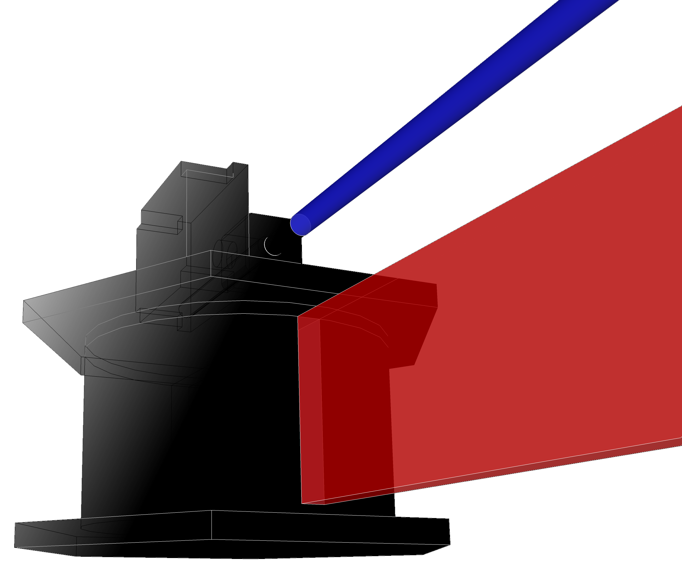
QUESTIONS?

