Slide 1
 | Malware and Software Vulnerability Analysis
CAP 6135
Spring 2013
to
Analysis of the Spam Value Chain
END
END
Kirill Levchenko
Andreas Pitsillidis
Neha Chachra
Brandon Enright
Tristan Halvorson
Chris Kanich
He Liu
Damon McCoy
Geoffrey M. Voelker
Stefan Savage
11. Mark Felegyhazi
Laboratory of Cryptography and System Security University of Technology and Economics
IEEE Symposium on Security and Privacy
Oakland, California
May 24, 2011
12. Chris Grier
Computer Science Division
University of California, Berkeley
Department of Computer Science and Engineering
University of California, San Diego
13. Nicholas Weaver
14. Vern Paxson
International Computer Science Institute, Berkeley
Apr. 3, 2013
Fawaz Al Fahmi

Slide 2
Acknowledgement and Work Cited
Paper:
Levchenko, Kirill, et al. "Click trajectories: End-to-end analysis
of the spam value chain." Computer Science Journal (2010): 1-14.
Wiki Site:
Spam (electronic)
http://en.wikipedia.org/wiki/Spam_(electronic)
Presentation:
Show me the money…
In search of a meaningful research agenda
for addressing cybercrime
Stefan Savage & Geoff Voelker

Slide 3
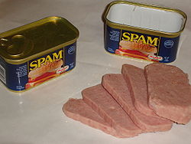
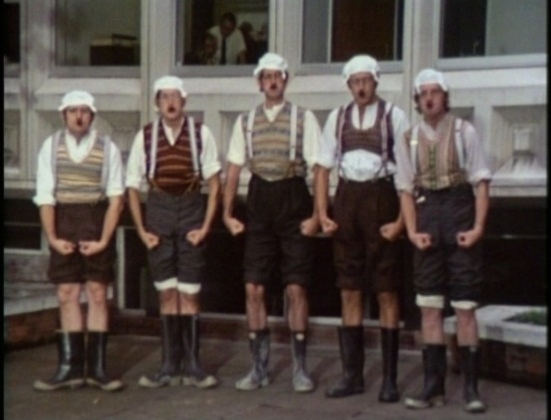
SPAM
SPICED
HAM
Definition:
Disruptive messages, especially commercial messages posted on a computer network or sent as e-email.
Use of electronic messaging systems to send unsolicited bulk messages indiscriminately.
Etymology (origin of word ‘Spam’)
Spam (spiced ham) is canned meat made by the Hormel Foods Corporation, first introduced in 1937.
In 1970 the BBC television comedy series Monty Python's Flying Circus ran a sketch based on a café which could supply no other food than Spam.
Pre-Internet:
In the late 19th Century Western Union allowed telegraphic messages on its network to be sent to multiple destinations.
Notes:
According to the Internet Society and other sources, the term spam for Internet abuses came into use in reference to this sketch

Slide 4
Motivation
There are many basic characteristics of SPAM activity that still lack insight like:
  How many organizations are complicit in the spam ecosystem?
  Which points in their value chains do they share and which operate independently?
  How “wide” is the bottleneck at each stage of the value chain—do spammers find alternatives plentiful and cheap?
Notes:
There are many basic characteristics of SPAM activity that still lack insight like:

Slide 5
Outline
Introduction
Spam Value Chain
How Modern Spam Works
Pharmacy Express: An Example
Data Collection Methodology
Analysis
Contribution
Weakness
Improvement
Conclusion
Notes:
Cited

Slide 6




Introduction
Many spam email have been seen to be a nuisance by the receivers.
It is an advertising channel to most of the perpetrators.
The study of the elements that make up the spam-advertising value chain have been studied in isolation.
There is a need to study the relationships that exist between spam value chain elements.
Most anti-spam interventions lack a framework and focus on one area alone.
Every click on an email which has been sent on a spam email is the start of a long trajectory of a complex path.
Notes:
Most spam email receivers hate spam email as they think it is a nuisance to their communication and to their inboxes.
This is not the case with the spammers of these emails. This is a channel that can be used to market various products and services to the masses.
In many circumstances, the attention is focused on the delivery of the email itself. Less is given and channeled to the whole multi-faceted business empire that exists with the eemail itself.
There is still a lack of solid understanding of this enterprise’s full structure, and thus most anti-spam interventions focus on only one facet of the overall spam value chain like, spam filtering, URL blacklisting, site takedown.
Every click on a email which has been sent on a spam email is the start of a long trajectory of a complex path that leads to a large business empire.

Slide 7
Spam Value Chain
Name Server
Hosting
Registrar
Affilait Program
Fullfilment
Payement
Notes:
Each distinct path through this ‘Spam chain’ comprised of the showing different components

Slide 8
How Modern Spam Works
Click support
Realization
Advertising
Notes:
The Spam value chain can be classified into three distinct stages:

Slide 9
How Modern Spam Works
Click support
Realization
Advertising

Slide 10
How Modern Spam Works
Click support
Realization
Advertising
Click support
Realization
Advertising
Effort of reaching to potential clients and striving to entice them to click a given URL.
    Countermeasures:
  Shut down open SMTP proxies
  Introduction of well-distributed IP blacklisting of spam senders
Spammers reactions:
Botnets : A collection of internet-connected programs communicating with other similar programs in order to perform tasks.
Webemail spam
IP prefix hijacking.
Notes:
Includes all activities focused on attracting potential customers to pay attention to what the spammers want to sell

Slide 11
How Modern Spam Works
Click support
Realization
Advertising
Click support
Realization
Advertising
The spam sender will depend on a fraction of the receivers to click on an embedded link.
Redirection sites
Domains
Name servers
Webs servers
Affiliate Programs
Redirection sites
Affiliate Programs
Domains
Webs servers
Name servers
Notes:
This process seems simple, but in practice a spammer must orchestrate many moving parts and maintain them against pressure from Spam defenders. These parts include:

Slide 12
How Modern Spam Works
Click support
Realization
Advertising
Click support
Realization
Advertising
The spam sender will depend on a fraction of the receivers to click on an embedded link.
Redirection sites
Domains
Name servers
Redirect to additional URLs.
Redirection strategies:
To a legitimate 3rd party controls the DNS name resource for the redirection site.
To a DNS resource managed by spammers
Affiliate Programs
Web
Servers

Slide 13
How Modern Spam Works
Click support
Realization
Advertising
Click support
Realization
Advertising
The spam sender will depend on a fraction of the receivers to click on an embedded link.
Redirection sites
Domains
Name servers
A spammer may purchase domains directly from a registrar.
Frequently purchase instead from a domain reseller.
Affiliate Programs
Web
Servers

Slide 14
How Modern Spam Works
Click support
Realization
Advertising
Click support
Realization
Advertising
The spam sender will depend on a fraction of the receivers to click on an embedded link.
Redirection sites
Domains
Name servers
Registered domain must in turn have supporting name server infrastructure.
A “bulletproof” market hosting services that resist takedown requests in exchange for a payment premium.
Affiliate Programs
Web
Servers

Slide 15
How Modern Spam Works
Click support
Realization
Advertising
Click support
Realization
Advertising
The spam sender will depend on a fraction of the receivers to click on an embedded link.
Redirection sites
Domains
Name servers
Spammers work as affiliates of an online store, earning commission.
The affiliate program provides the storefront templates, shopping cart management, analytics support, and even advertising materials.
In addition, the affiliate programs even take responsibility for payment and fulfillment services.
Affiliate Programs
Web
Servers

Slide 16
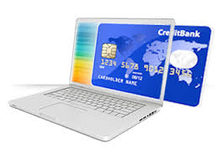

How Modern Spam Works
Click support
Realization
Advertising
Click support
Realization
Advertising
After the customer has been directed to a site and purchases a product, the spammer realizes the value of the advertisement.
There should be support of universal credit cards in order to serve many customers with different payment methods.
Two processes:
  Payment service
  Fulfillment service

Slide 17
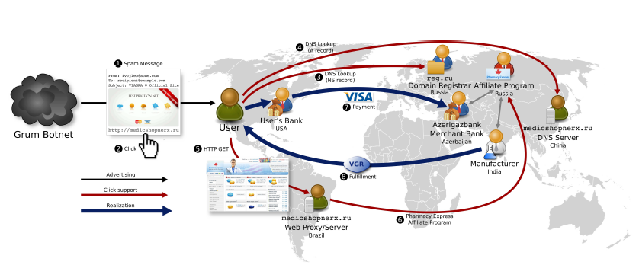
Pharmacy Express: An Example
(1) On October 27th, the Grum botnet delivered an eemail titled VIAGRA Official Site. The body of the message includes an image of male enhancement pharmaceutical tablets and their associated prices.
(2) The image provides a URL tag and thus when clicked directs the user’s browser to resolve the associated domain name, medicshopnerx.ru
(3) This domain was registered by REGRU-REG-RIPN (a.k.a. reg.ru ) on October 18th and was active even after this writing complaint.
(4) The machine providing name service resides in China, while hosting resolves to a machine in Brazil.

Slide 18
Pharmacy Express: An Example
(5) The user’s browser initiates an HTTP request to the machine, and receives content that renders the storefront for “Pharmacy Express,” a brand associated with the emailien pharmaceutical affiliate program based in Russia (6).
(8)Ten days later the product arrives, blister-packaged, in a cushioned white envelope with postal markings indicating a supplier named PPW based in Chennai, India as its originator.
(7) After purchase selection the storefront redirects the user to a payment portal served from payquickonline.com (IP address in Turkey), which accepts the user’s details, confirms the order, provides an EMS tracking number, and includes a contact eemail for customer questions.
The bank that issued the user’s credit card transfers money to the acquiring bank, in this case the Azerigazbank Joint-Stock Investment Bank in Baku, Azerbaijan

Slide 19
Data Collection Methodology
Collecting Spam-Advertised URLs
Crawler data
Content Clustering
Tagging
Purchasing

Slide 20
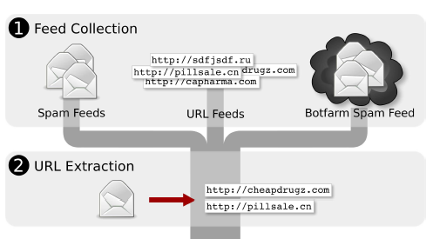
Data Collection Methodology
Feed parsers extract embedded URLs from the raw feed data for further processing.

Slide 21
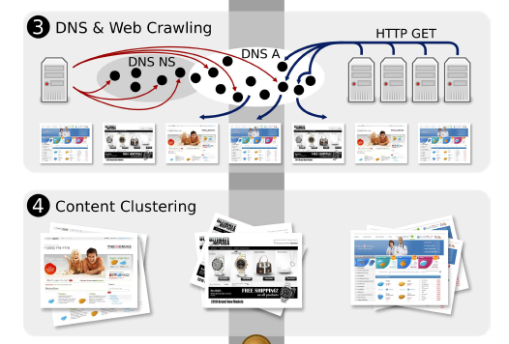
Data Collection Methodology
(3) Use of DNS Crawler to identify the name server infrastructure used to support spam Advertised domains.
Use of Web Crawler to replicate User Clicking experience by having crawler replica over
cluster of machines. Each replica running 100 instances of Firefox.
(4) A clustering tool clusters pages by content similarity

Slide 22
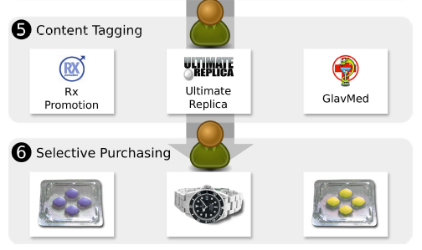
Data Collection Methodology
(5). A content tagger labels the content clusters according to the category of goods sold, and the associated affiliate programs
(6) Place purchases from each affiliate program, and store the feed data and distilled and derived metadata in a database

Slide 23
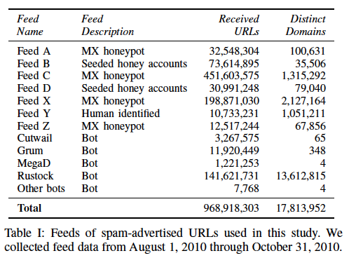
Collecting Spam-Advertised URLs
Data Collection Methodology
“bot” feeds tend to be focused spam sources, while the other feeds are spam sinks comprised of a blend of spam from a variety of sources.
Example, Rustock bot - 13M distinct domains is an artifacts of a “blacklist-poisoning” campaign undertaken by the bot operators that comprised millions of “garbage” domains

Slide 24
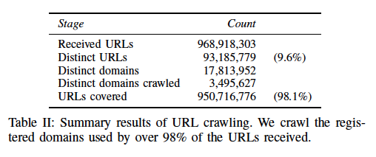
Data Collection Methodology
Crawler Data

Slide 25
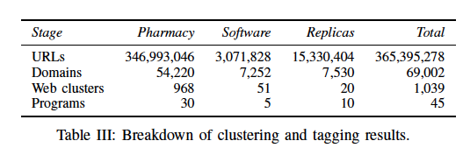
Content Clustering and Tagging
Data Collection Methodology
  To classify each Web site:
  content clustering is used to match sites with lexically similar content structure
  category tagging to label clustered sites with the category of goods they sell
  program tagging to label clusters with their specific affiliate program and/or storefront brand.

Slide 26
Data Collection Methodology
Purchasing
For a subset of the sites with program tags, some goods being offered for sale were purchased.

Slide 27
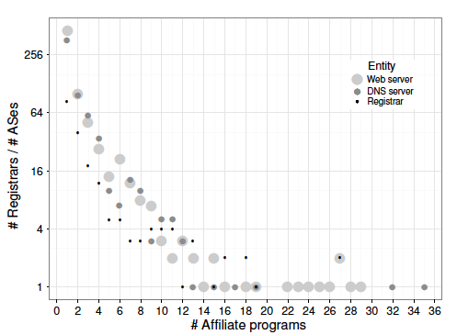
Analysis
Sharing of network infrastructure among affiliate programs.
80 registrars serve a single affiliate program.
2 registrars (NauNet and China Springboard) serve domains for 20 programs.
Notes:
Only a small number of registrars host domains for many affiliate programs, and similarly only a small number of Ases (Autonomous Systems) host name and Web servers for many programs

Slide 28
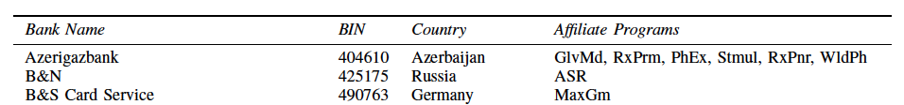
How much realization infrastructure is being shared across programs?
Analysis
Payment: Of 76 purchases for which transaction information was received , there were only 13 distinct banks acting as Visa acquirers.

Slide 29
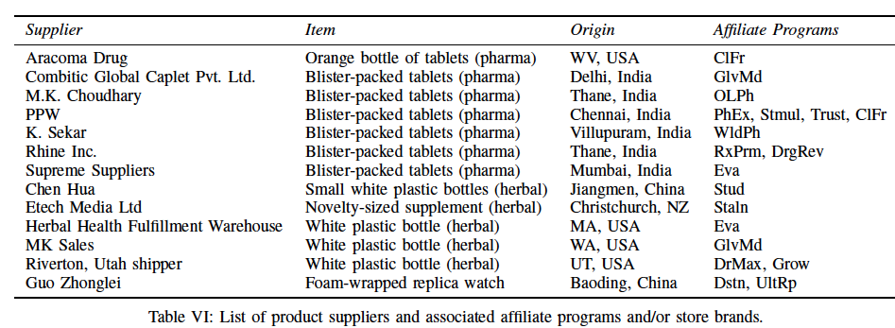
Fullfillment
Analysis
Fulfillment for physical goods was sourced from 13 different suppliers (as determined by declared shipper and packaging), of which eight were again seen more than once.

Slide 30
Intervention analysis
Analysis
Intervention Analysis
Anti-spam interventions need to be evaluated in terms of two factors:
  Overhead to implement
  Business impact on the spam value chain. This business impact is the sum
      The replacement cost (to acquire new resources equivalent to the ones disrupted)
      The opportunity cost (revenue forgone while the resource is being replaced).
For any given registered domain used in spam, the defender may choose to intervene by:
  Blocking its advertising (e.g., filtering spam),
  Disrupting its click support (e.g., takedowns for name servers of hosting sites),
  Interfering with the realization step (e.g., shutting down merchant accounts).

Slide 31
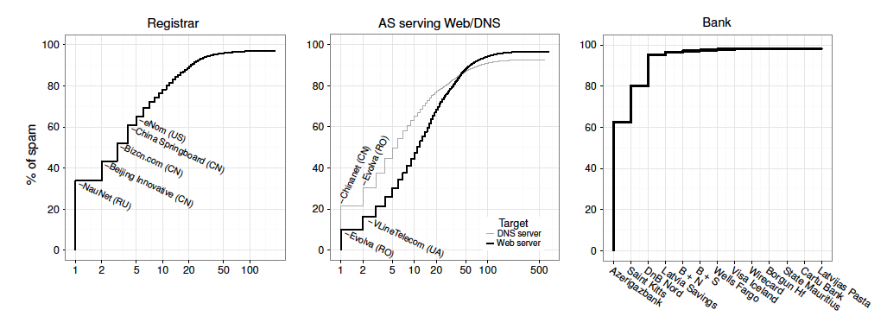
Analysis
38% of spam-advertised domains were registered by NauNet

Slide 32
Analysis
Evolva Telecom, (Romanian) hosts 9% of name servers for spam-advertised domains

Slide 33
Analysis
60% of payments handled via a single acquirer, Azerigazbank.

Slide 34
Contribution
A better analysis and assessment of the whole process of spam advertisement is looked.
Better methods of undertaking spam analysis was used.
Provides information about the number of organizations who have been involved and their relationships in the spam business.

Slide 35
Weakness
Absence of legal and ethical dimensions.
Sole environment, focusing on email spam.
The tagging and clustering components lack the capability to distinguish those criminal related spam advertisement.

Slide 36
Improvement
  Extend the scope to consider other media spam.
  There is a need to have better analysis and tools that will be used in the methodology section.
  Highlight legal and ethics issues caused by criminal supplier.

Slide 37
Conclusion
This paper has analyzed the spam value chain using end-to-end method.
A relatively small number of registrars are used to register and host spam domains.
A small number of banks are involved in the financial transactions.
The payment tier is the most effective stage where intervention can be undertaken.
The banking component of the spam value chain that is both the least studied the most critical.

Slide 38
Q & A

