Slide 1
Penetration Testing− Scanning
CIS 6395, Incident Response Technologies
Fall 2016, Dr. Cliff Zou
czou@cs.ucf.edu

Slide 2
Acknowledgement
Content from the book:
“The Basics of Hacking and Penetration Testing: Ethical Hacking and Penetration Testing Made Easy”, Second Edition

Slide 3
Checking Machine Online Status?
root@kali: ping IPaddress
Windows with firewall enabled blocks PING by default for not home network (subnet)
Enable PING response in Windows:
Search “firewall”, click “Windows Firewall” in control panel
Click “Advanced settings” on the left
From the left panel, click “Inbound Rules”
Find the rules titled “File and Printer Sharing (Echo Request - ICMPv4-In)”
Right-click each rule and choose “Enable Rule”.

Slide 4
Ping and Ping Sweep
Ping Sweep: series of pings sent to a range of IP addresses
Tool: fping (preinstalled in Kali Linux)
fping -a -r 0 -g 192.168.0.1 192.168.0.254
-a: only show live
-r 0: retry ping number (0 means only 1 ping per IP)
-g: the IP range
Con: only can find computers that respond to ICMP echo request message

Slide 5
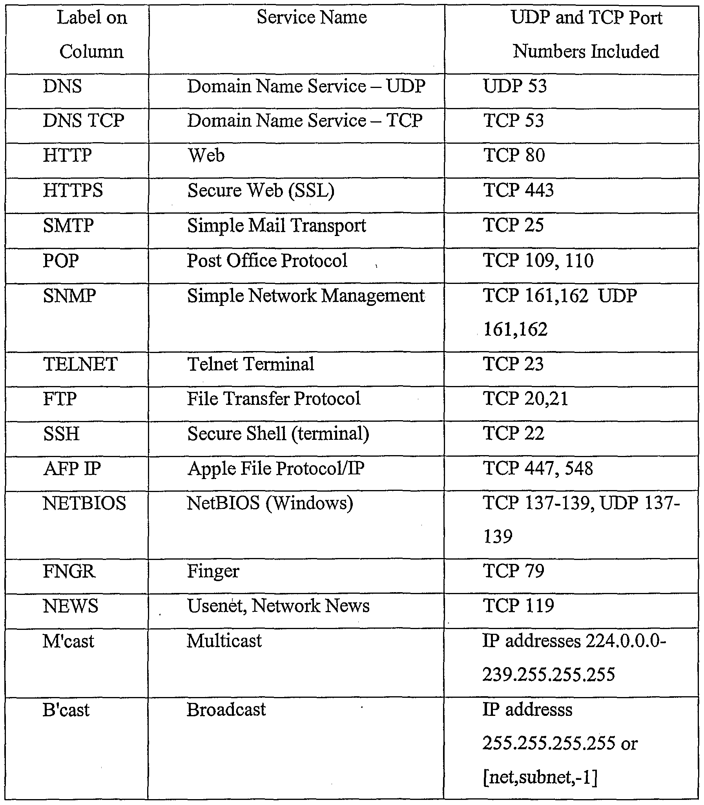
Port Scanning
Discover what services are running on a target computer
See the “common port number” sheet: http://packetlife.net/media/library/23/common_ports.pdf

Slide 6
TCP based Scan
TCP connect scan
Open port: syn/ack response
Closed port: rst/ack response
TCP syn scan (half-open scan)
TCP fin scan
TCP null scan (no flag is set)
TCP ack scan
TCP XMAS tree scan (all flags are set)

Slide 7
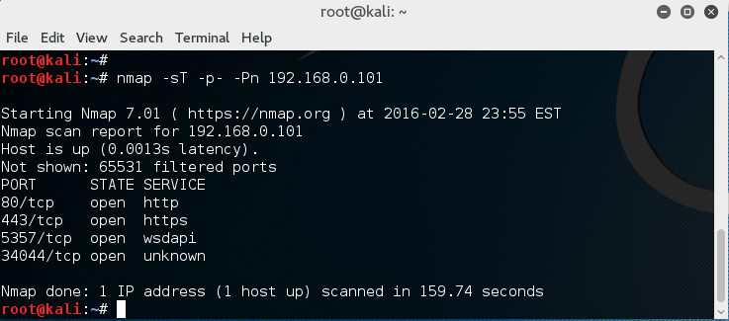
Port Scanning Tool: Nmap
Included in Kali Linux
nmap –sT 192.168.0.101
Default scan will scan 1000 TCP ports
For safety, try nmap on your own VMs in the same LAN, such as the Metasploitable VM

Slide 8
Nmap Command Options
-sT: TCP connect scan
-sS: TCP SYN scan
-sA: TCP ACK scan
-sF: TCP FIN scan
-sX: XMAS tree scan
-sN: NULL scan
-sP: Ping scan
-sU: UDP scan
-sO: protocol scan
A good online tutorial:
https://hackertarget.com/nmap-cheatsheet-a-quick-reference-guide/

Slide 9
Nmap Target Selection
Scan a single IP
nmap 192.168.1.1
Scan a host
nmap www.testhostname.com
Scan a range of IPs
nmap 192.168.1.1-20
Scan a subnet
nmap 192.168.1.0/24
Scan targets from a text file
nmap -iL list-of-ips.txt (one IP per line)

Slide 10
Nmap Port Selection
Scan a single Port
nmap -p 22 192.168.1.1
Scan a range of ports
nmap -p 1-100 192.168.1.1
Scan 100 most common ports (Fast)
nmap -F 192.168.1.1
Scan all 65535 ports
nmap -p- 192.168.1.1
Be careful with this. Generate large amount of scanning traffic!

Slide 11
Nmap Port Scan Types
Scan using TCP connect
nmap -sT 192.168.1.1
Scan using TCP SYN scan (default)
nmap -sS 192.168.1.1
Scan UDP ports
nmap -sU -p 123,161,162 192.168.1.1
Scan selected ports - ignore discovery
nmap -Pn -F 192.168.1.1

Slide 12
Service and OS Detection
Detect OS and Services
nmap -A 192.168.1.1
Will setup connection successfully and get the first data packet from the server
Standard service detection
nmap -sV 192.168.1.1
More aggressive Service Detection
nmap -sV --version-intensity 5 192.168.1.1
Lighter banner grabbing detection
nmap -sV --version-intensity 0 192.168.1.1

Slide 13
Service and OS Detection
The more aggressive service detection is often helpful if there are services running on unusual ports.
The lighter version of the service will be much faster as it does not really attempt to detect the service by simply grabbing the banner of the open service.

Slide 14
Nmap Script Engine (NSE)
Nmap --script banner 192.168.0.101
Setup TCP connection, get the first response text from the target
Nmap --script vuln 192.168.0.101
Run a series of scripts looking for known vulnerabilities

Slide 15
GUI-based Nmap: Zenmap
Included in Kali Linux
Where?
Application menu → “Information Gathering…” → Zenmap
You can download Zenmap for Windows and Mac OS as well
https://nmap.org/zenmap/

Slide 16
Nessus: a GUI-based Power Network Scanner
Nessus is a proprietary vulnerability scanner which is developed by Tenable Network Security. It is free of charge for personal use in a non-enterprise environment ----wikipiedia.com
Download home-only FREE version: http://www.tenable.com/products/nessus/select-your-operating-system
Request a home-only registration key: http://www.tenable.com/products/nessus-home
Tutorial on installing nessus on Kali Linux
http://www.tenable.com/blog/installing-and-using-nessus-on-kali-linux

Slide 17
Install Nessus on Kali Linux
Download the free home version of nessus for Linux:
Debian 6 and 7 / Kali Linux 1 AMD64 (64bit VM)
File: Nessus-6.5.6-debian6_amd64.deb
Debian 6 and 7 / Kali Linux 1 i386 (32-bit VM)
File: Nessus-6.5.6-debian6_i386.deb

Slide 18
Install Nessus on Kali Linux
#dpkg –i Nessus-6.5.6-debian6_amd64.deb
For programs existed in Kali’s App store, use “apt-get install …” to install them
Enable nessus service first:
#/etc/init.d/nessusd start
Then the nessus demon will start to run
Nessus relies on Web Browser for GUI and remote access
Local access: https://localhost:8834/
Remote access: https://192.168.0.3:8834/ (if the machine running nessusd has IP of 192.168.0.3)

Slide 19
Web Browser-based GUI and Remote Access
Many recent software use this way for implementation
Pros:
A user can remote access and use the software
Remote user does not need any client-side software installation
Cons:
Rely on the graphic and interaction functions provided by Browsers, may not be beautiful
Could suffer the same Web-based attacks

Slide 20
Use of Nessus
Why Nessus runs as a webserver (on port 8834)?
It enables other computers to do nessus scanning, too, by remote login to the Nessus server machine
You can install Nessus server on Linux, or Windows
Nice video tutorial on using Nessus:
https://www.youtube.com/watch?v=r_pDVhNoYr0

Slide 21
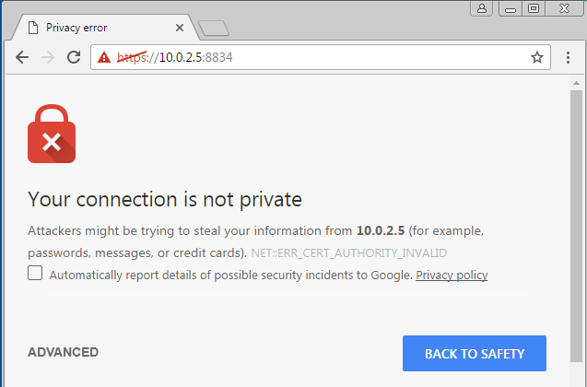
Use of Nessus
Assume the Nessus is installed in Kali VM
We run Nessus on the Win7 VM in the same LAN
The warning is normal
Due to the Nessus
Server has no valid
Digital certificate

Slide 22
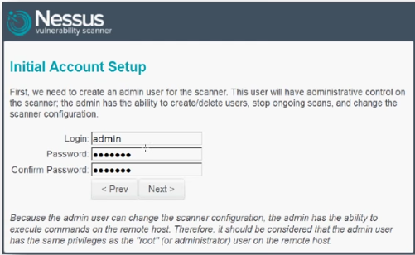
Use of Nessus
First run, set up an account as you choose the username and password

Slide 23
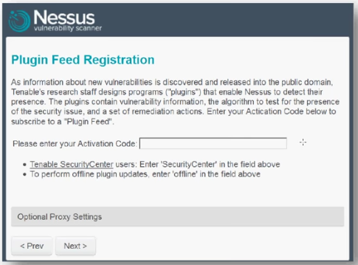
Use of Nessus
First run, after account set up, you need to input your activation code:

Slide 24
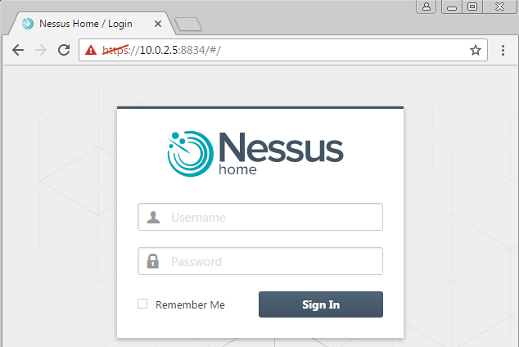
Use of Nessus

Slide 25
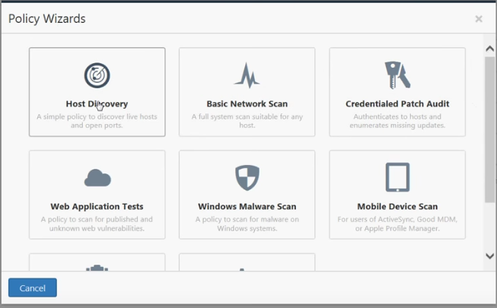
Use of Nessus
The free version comes with a few predefined types of scans
The gray entries are only available in commercial version

Slide 26
Use of Nessus
Test of Basic Network Scan:
You can test to scan your Kali VM, Win7 VM,
The best target is the Metasploitable VM since it has many vulnerabilities that can be discovered by Nessus

Slide 27
Metasploitable 2 VM
Metasploitable is a vulnerable Linux set up for penetration testing purpose
Download this VM at: http://sourceforge.net/projects/metasploitable/files/Metasploitable2/
Setup is slightly different from Kali VM and Win VM
Set up instruction: http://hackercool.com/2013/09/how-to-install-metasploitable-in-virtualbox/

Slide 28
Metasploitable 2 Virtual Machine
Notice from Producer: Never expose this VM to an untrusted network, use NAT or Host-only mode!
Don’t use bridged adapter mode in a hotspot!
If your VirtualBox host machine is within your home WiFi, as long as your home machines are not malicious, this Metasploitable is safe
Because outside computers cannot scan and see this vulnerable Linux
But, do not use browser to browse webserver from this computer, your computer may get infected by “drive-by download”
This Linux is a command-based Linux
The default login and password is msfadmin
You can change the password by: $passwd
Change to root:
$sudo su
Then you can change root password by #passwd

Slide 29
Metasploitable 2 Virtual Machine
Use nmap to see what services are running on this Linux
Use Nessus installed on your Kali Linux to check any known vulnerabilities on this Linux

