Slide 1
Chapter 11: File System Implementation

Slide 2
Chapter 11: File System Implementation
File-System Structure
File-System Implementation
Directory Implementation
Allocation Methods
Free-Space Management
Efficiency and Performance
Recovery
Log-Structured File Systems
NFS
Example: WAFL File System

Slide 3
Objectives
To describe the details of implementing local file systems and directory structures
To describe the implementation of remote file systems
To discuss block allocation and free-block algorithms and trade-offs

Slide 4
File-System Structure
File structure
Logical storage unit
Collection of related information
File system resides on secondary storage (disks)
File system organized into layers
File control block – storage structure consisting of information about a file

Slide 5
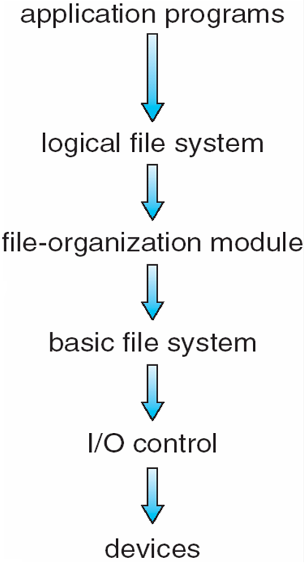
Layered File System

Slide 6
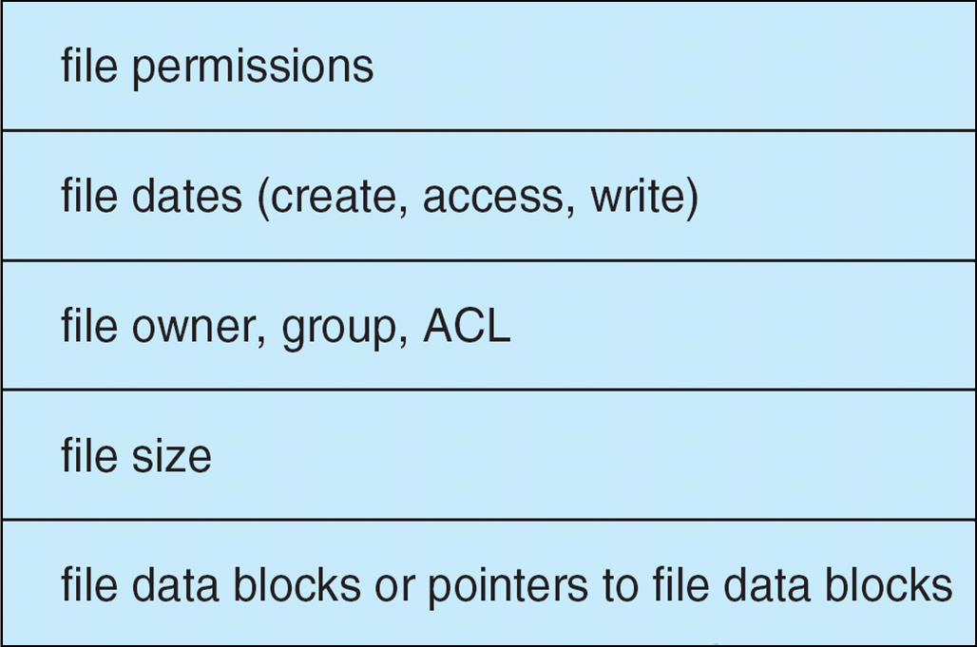
A Typical File Control Block

Slide 7
In-Memory File System Structures
The following figure illustrates the necessary file system structures provided by the operating systems.
Figure 12-3(a) refers to opening a file.
Figure 12-3(b) refers to reading a file.

Slide 8
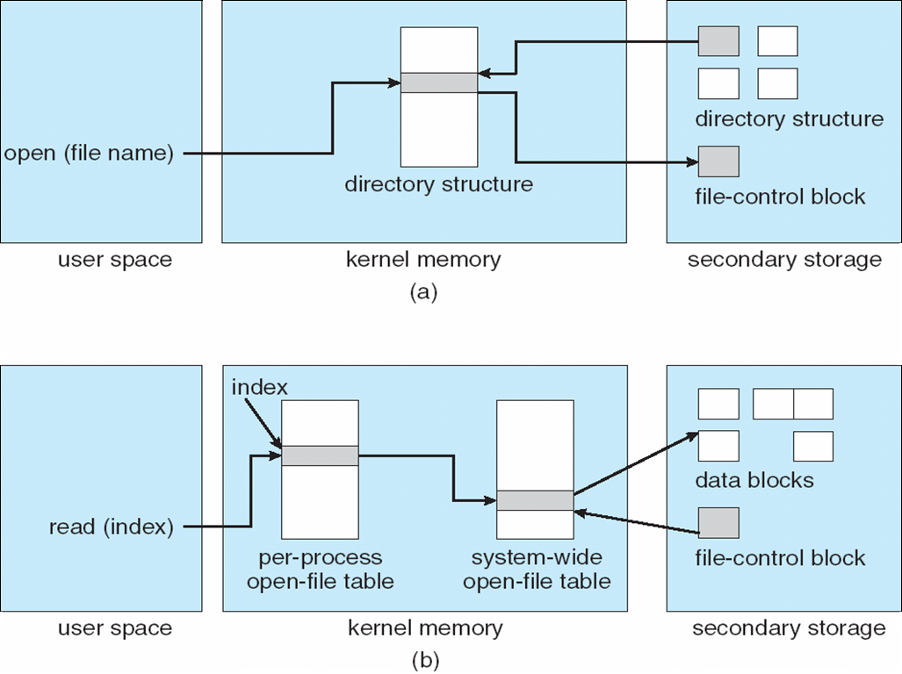
In-Memory File System Structures

Slide 9
Virtual File Systems
Virtual File Systems (VFS) provide an object-oriented way of implementing file systems.
VFS allows the same system call interface (the API) to be used for different types of file systems.
The API is to the VFS interface, rather than any specific type of file system.

Slide 10
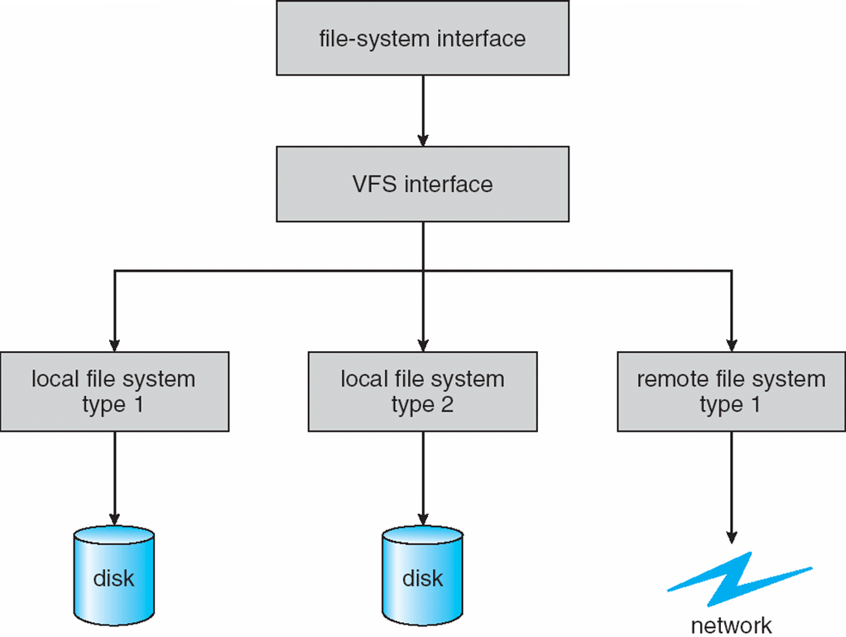
Schematic View of Virtual File System

Slide 11
Directory Implementation
Linear list of file names with pointer to the data blocks.
simple to program
time-consuming to execute
Hash Table – linear list with hash data structure.
decreases directory search time
collisions – situations where two file names hash to the same location
fixed size

Slide 12
Allocation methods

Slide 13
Allocation Methods
An allocation method refers to how disk blocks are allocated for files:
Contiguous allocation
Linked allocation
Indexed allocation

Slide 14
Contiguous Allocation
Each file occupies a set of contiguous blocks on the disk
Simple – only starting location (block #) and length (number of blocks) are required
Random access
Wasteful of space (dynamic storage-allocation problem)
Files cannot grow

Slide 15
Contiguous Allocation
Mapping from logical to physical
Q
LA/512
R
Block to be accessed = ! + starting address
Displacement into block = R

Slide 16
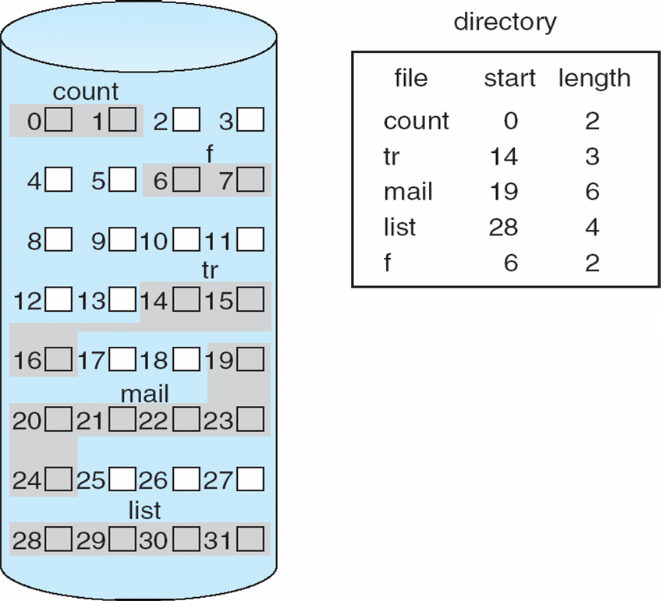
Contiguous Allocation of Disk Space

Slide 17
Extent-Based Systems
Many newer file systems use a modified contiguous allocation scheme
Extent-based file systems allocate disk blocks in extents
An extent is a contiguous block of disk
Extents are allocated for file allocation
A file consists of one or more extents.
Most modern file systems support it:
Linux: Ext4, Reiser4
Windows: NTFS
Apple: HFS Plus

Slide 18
Linked Allocation
Each file is a linked list of disk blocks: blocks may be scattered anywhere on the disk.
block =
pointer

Slide 19
Linked Allocation (Cont.)
Simple – need only starting address
Free-space management system – no waste of space
No random access
Mapping
Q
LA/511
R
Block to be accessed is the Qth block in the linked chain of blocks representing the file.
Displacement into block = R + 1
File-allocation table (FAT) – disk-space allocation used by MS-DOS and OS/2.

Slide 20
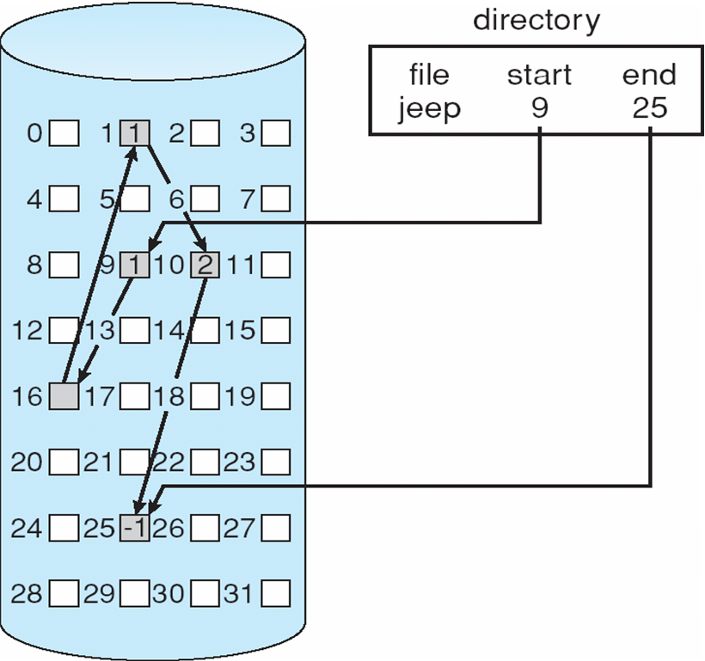
Linked Allocation

Slide 21
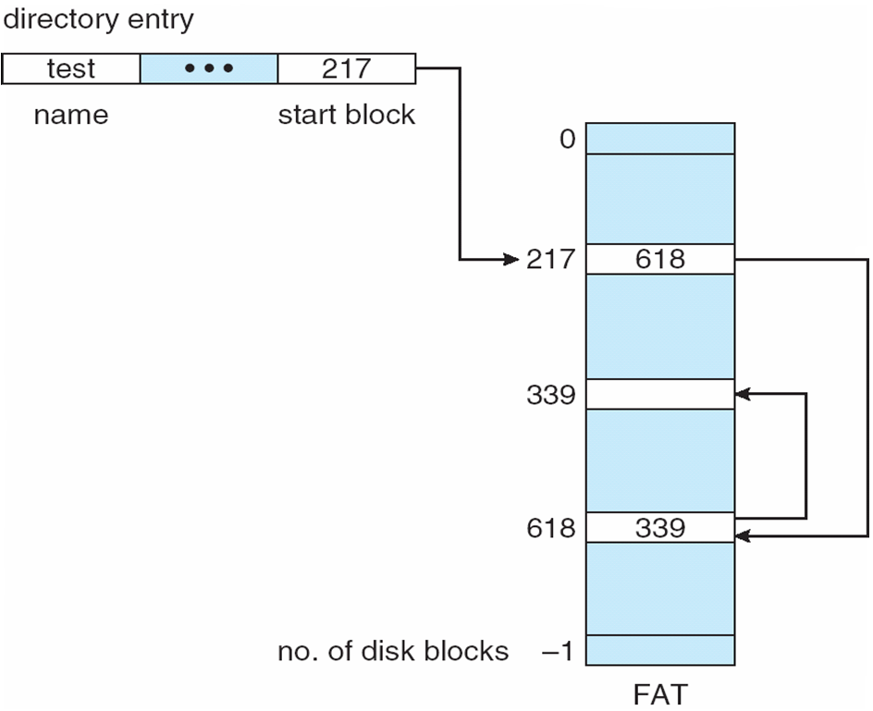
File-Allocation Table

Slide 22
Indexed Allocation
Brings all pointers together into the index block.
Logical view.
index table

Slide 23
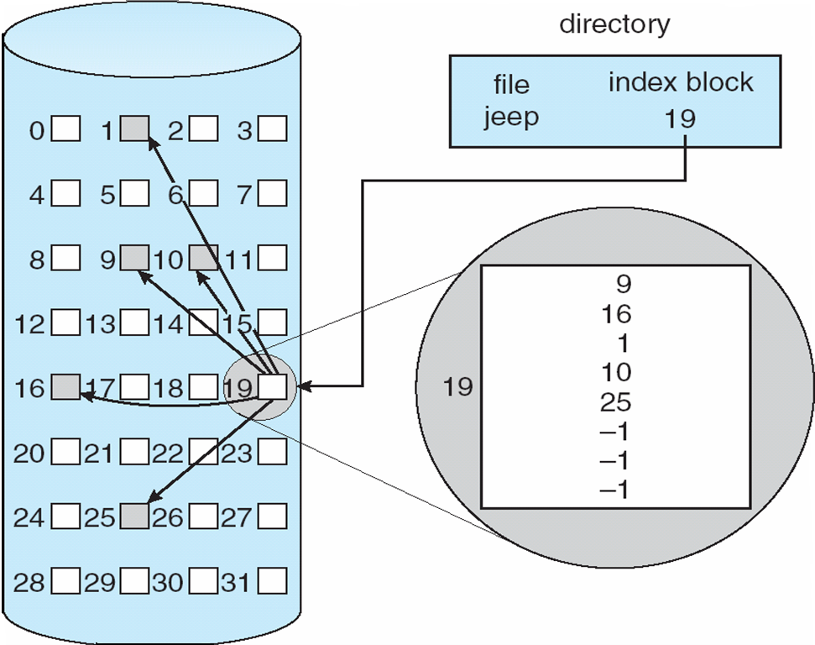
Example of Indexed Allocation

Slide 24
Indexed Allocation (Cont.)
Need index table
Random access
Dynamic access without external fragmentation, but have overhead of index block.
Mapping from logical to physical in a file of maximum size of 256K words and block size of 512 words. We need only 1 block for index table.
Q
LA/512
R
Q = displacement into index table
R = displacement into block

Slide 25
Indexed Allocation – Mapping (Cont.)
Mapping from logical to physical in a file of unbounded length (block size of 512 words).
Linked scheme – Link blocks of index table (no limit on size).
Q₁
LA / (512 x 511)
R₁
Q₁ = block of index table
R₁ is used as follows:
Q₂
R₁ / 512
R₂
Q₂ = displacement into block of index table
R₂ displacement into block of file:

Slide 26
Indexed Allocation – Mapping (Cont.)
Two-level index (maximum file size is 512³)
Q₁
LA / (512 x 512)
R₁
Q₁ = displacement into outer-index
R₁ is used as follows:
Q₂
R₁ / 512
R₂
Q₂ = displacement into block of index table
R₂ displacement into block of file:

Slide 27
Indexed Allocation – Mapping (Cont.)

outer-index
index table
file

Slide 28
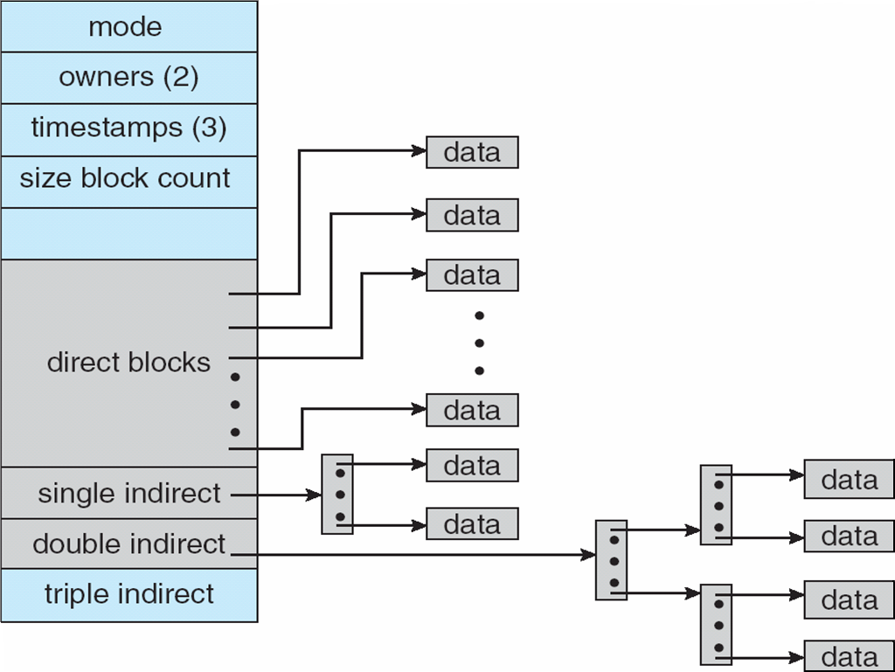
Combined Scheme: UNIX (4K bytes per block)

Slide 29
Free-Space Management
Bit vector (n blocks)
0
1
2
n-1
…
0 ⇒ block[i] free
1 ⇒ block[i] occupied
bit[i] =

Block number calculation
(number of bits per word) *
(number of 0-value words) +
offset of first 1 bit

Slide 30
Free-Space Management (Cont.)
Bit map requires extra space
Example:
block size = 2¹² bytes
disk size = 2³⁰ bytes (1 gigabyte)
n = 2³⁰/2¹² = 2¹⁸ bits (or 32K bytes)
Easy to get contiguous files
Linked list (free list)
Cannot get contiguous space easily
No waste of space
Grouping
Counting

Slide 31
Free-Space Management (Cont.)
Need to protect:
Pointer to free list
Bit map
Must be kept on disk
Copy in memory and disk may differ
Cannot allow for block[i] to have a situation where bit[i] = 1 in memory and bit[i] = 0 on disk
Solution:
Set bit[i] = 1 in disk
Allocate block[i]
Set bit[i] = 1 in memory

Slide 32
Directory Implementation
Linear list of file names with pointer to the data blocks
simple to program
time-consuming to execute
Hash Table – linear list with hash data structure
decreases directory search time
collisions – situations where two file names hash to the same location
fixed size

Slide 33
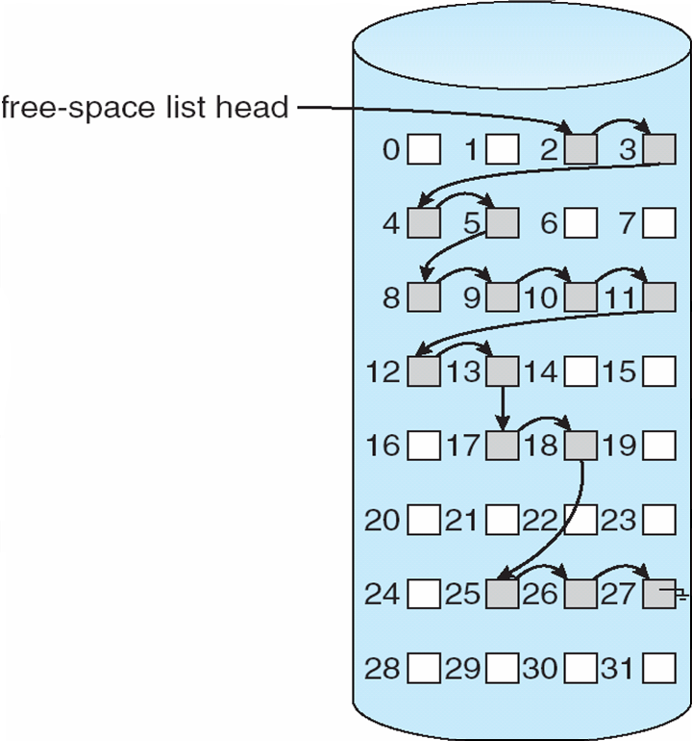
Linked Free Space List on Disk

Slide 34
Recovery
Consistency checking – compares data in directory structure with data blocks on disk, and tries to fix inconsistencies
Use system programs to back up data from disk to another storage device (floppy disk, magnetic tape, other magnetic disk, optical)
Recover lost file or disk by restoring data from backup

Slide 35
Crash consistency
To write a piece of data, you need to update in three places on the disk
Data, Inode, Bitmap
What happens if the system crash:
Data only: no consistency problem (but lost data)
Inode only: garbage readings…
Bitmap only: space leak
Inode and bitmap only: garbage in the file
Inode and data only: inconsistency, data not mapped as occupied…
Bitmap and data only: we don’t know where it belongs, data only
One solution: file system consistency check (fsck)

Slide 36
Log Structured File Systems
Log structured (or journaling) file systems record each update to the file system as a transaction
All transactions are written to a log
A transaction is considered committed once it is written to the log
However, the file system may not yet be updated
The transactions in the log are asynchronously written to the file system
When the file system is modified, the transaction is removed from the log
If the file system crashes, all remaining transactions in the log must still be performed

