Slide 1

Automatic Collection of Fuel Prices from a Network of Mobile Cameras
A. Dong, S. S. Kanhere, C. T. Chou and N. Bulusu, Automatic Collection of Fuel Prices from a Network of Mobile Cameras, in Proceedings of the 4th IEEE International Conference on Distributed Computing in Sensor Systems (DCOSS), June 2008
James Pittman
February 9, 2011
EEL 6788

Slide 2
Outline
Introduction
Background
System Design
Computer Vision Algorithm
Evaluation
Related Work
Conclusions

Slide 3
Introduction
Wireless sensor network (WSN) technology has been applied to many different domains
  This paper presents a concept where WSNs are used for collecting consumer pricing information
  The specific target for this paper’s effort is in gathering pricing from fuel (gasoline) stations

Slide 4
Introduction
Two stations on the same corner of an intersection can have greatly different prices for fuel
Currently websites such as Gaswatch, GasBuddy, and others either:
  Send workers out every day multiple times to collect and track fuel pricing data.
  Rely on input from volunteer site users
This is highly labor intensive and inaccurate since stations often update prices at different times of the day

Slide 5
Background - SenseMart
The authors are re-using the Sensing Data Market (SenseMart) framework they proposed in an earlier paper
The SenseMart concept is similar to participatory sensing.
  It leverages existing infrastructure (WSNs) for data collection and encourages the users to share their data to accomplish some high level task.

Slide 6
Background - SenseMart
The SenseMart framework facilitates the data exchange using a “BitTorrent” style concept
  They incentivize the system by giving a return to the users proportionate to their contributions to encourages data sharing.
  They did not detail what the ‘return’ was other than access to accurate data on gas prices.

Slide 7
System Design
The proposed system has 2 methods of operation
  Fuel price collection
  User query
The first is the focus of this paper.
  Automatic triggering of users phones
  Use of computer vision algorithms + GPS/GIS contextual information to extract the pricing info

Slide 8
System Design

Slide 9
System Design – Camera Sensor
Primary function – automatic capture of images of fuel price boards
  Assumed that participating users have cameras mounted in car on dashboard on passenger side (in Australia)
  System could also interface with built in car camera vision systems and transfer data via Wi-Fi or Bluetooth to mobile phones

Slide 10
System Design – Camera Sensor
A control unit in the mobile phone oversees the capturing operations.
  It periodically polls the GPS receiver to obtain the current location
  A GIS (geographic information system) app such as Google maps or TomTom is required on the phone
  The GIS on the phone is then queried (using GPS location) to gather local contextual information
Notes:
Mention that this also can work with an external GPS set up to connect to the phone via Bluetooth.

Slide 11
System Design – Camera Sensor
  If a gas station is known to be close, the control unit estimates viability for image capture (camera facing, distance to target)
  If the situation is deemed viable the camera is activated, images are captured and the camera is deactivated
  The resulting images along with the associated meta-data (location, time of capture, and any GIS data such as station brand) are passed to the “data-upload unit” for upload to the central server
Notes:
Mention that this also can work with an external GPS set up to connect to the phone via Bluetooth.

Slide 12
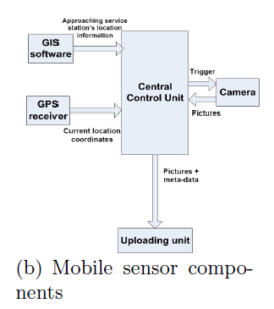
System Design – Camera Sensor

Slide 13
System Design – Data Transport
Any data captured by the camera along with the meta-data is transferred to the data upload unit
  This “unit” is generally the ability of the mobile phone to access the internet via 3G or Wi-Fi.
  The device establishes a TCP connection with the server and uploads the data.
  The backup/alternative method is to use multimedia SMS for the data transfer

Slide 14
System Design – Central Server
The central server stores all of the data and runs the computer vision algorithms.
  Processes the images
  Extracts the fuel prices
The server also handles the reception of the images, and processing / storing of the associated meta data

Slide 15
System Design – Central Server
The server processes all of the data in steps
  Detect a fuel board
  Detect the section with the numbers
  Crop the image to the numbers and normalize to a standard size & resolution
  Extract the numbers
  Classify the values
  Report fuel prices

Slide 16
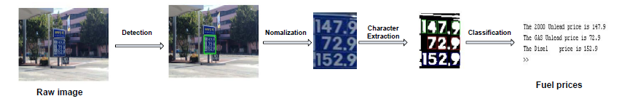
Computer Vision Algorithm
Pictorial overview of the algorithm

Slide 17
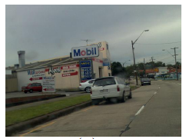
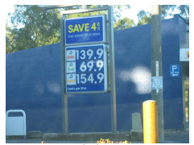
Computer Vision Algorithm
Challenges to overcome
  Objects obscuring the fuel price boards
  Background color similar / identical to the price board

Slide 18
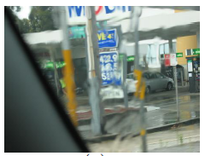
Computer Vision Algorithm
  Blurred or unfocused image captures (often due to capturing while sensor in motion)
  Sections of the board that share characteristics with the prices (adds, borders)

Slide 19
Fuel Price Board Detection
Detecting an fuel board and identifying its location in any given image is challenging
  Authors use GPS and GIS information to reduce the difficulty of the problem
  Each fuel brand has a generally unique color scheme
  Meta – data from GPS/GIS can be used to tag incoming images with fuel brands to guide the system in identifying color information

Slide 20
Fuel Price Board Detection
There are 2 prominent color schemes for representing images: RGB and HIS (Red-Green-Blue and Hue-Intensity-Saturation)
  HIS is illumination independent but computationally complex
  RGB is illumination sensitive, but computationally efficient
  Authors work with RGB due to targeting mobile applications

Slide 21
Fuel Price Board Detection
RGB is an additive color space, making it easy to extract a single color component
  Each pixel is represented by red, green and blue color components
  They extract a single color by boosting that channel and subtracting the other components
To extract the blue color:

Slide 22
Fuel Price Board Detection
The first step used by the authors is color thresholding
  The objective is to classify all pixels as either
    Object pixels (in areas potentially containing an object)
    Background pixels (everything else)
  This produces a binary image
  The difficulty in this is selecting the correct threshold to separate Object and Background pixels.

Slide 23
Fuel Price Board Detection
They were unable to design a single color threshold to work with all images
  To resolve this they took all of the images and classified them into groups based on lighting conditions
  Each group was then analyzed and a threshold was derived based on the average intensity

Slide 24
Fuel Price Board Detection
The next step merges adjacent regions together to form a complete price board
Finally connected component labeling is employed to connect pixels into components (all pixels in a component share a physical connection and an intensity range)

Slide 25
Fuel Price Board Detection

Slide 26
Dimension Comparison
Using a priori knowledge about general fuel board dimensions, overly large and overly small regions are excluded
Ratios were devised to take in account differences in angles, and distance to sensor
Variables correspond with:
W – width, H – height
Of the region in the image

Slide 27
Color Histogram Comparison
The second part of the post processing is a histogram comparison algorithm
  Compares histogram distribution of candidate region to a template of the price board.
  Compute a χ squared distance between the candidate histogram (h_{i}) and the reference histogram (h_{j}). K = number of histogram bins.

Slide 28
Color Histogram Comparison
Since χ turns out to be a large number they normalize it against the number of bins (K) and the width of the image (W_{i})
Based on test results they have come up with a threshold of D_{norm} ≤ 2.5
  If the value of D_{norm} is under this threshold, the region is very likely a price board

Slide 29
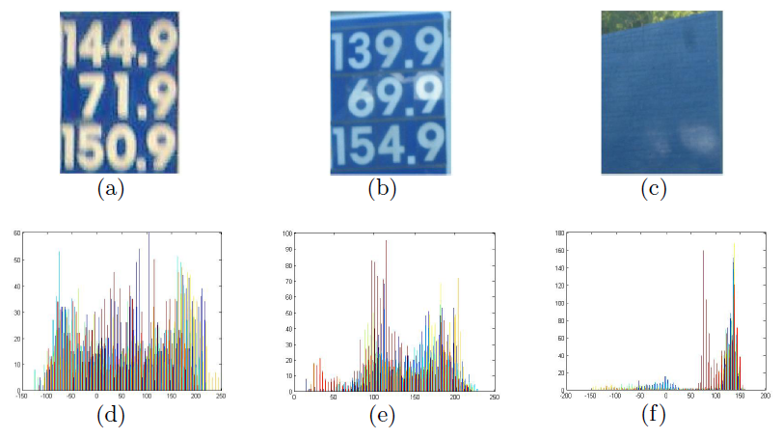
Color Histogram Comparison
Template (a)
Histogram(d)
Example (b)
Histogram(e)
Other Region in Image (c)
Histogram(f)

Slide 30
Fuel Price Classification
Character Extraction
  Once the fuel board has been detected and located in the image the price must be extracted
  Due to the nature of the board (color choice, low noise) it can be converted to a binary image.
  This significantly reduces the complexity of character extraction

Slide 31
Character Extraction
A bounding box algorithm is applied to the image to crop each character
The cropped characters are normalized to a 50x70 pixel standard size image
Each character is broken up into 35 10x10 pixel images that are used to create a 35x1 feature vector of the average intensity

Slide 32
Character Recognition
Feed-forward Back-propagation Neural Networks (FFBPNN) are used in the character recognition
Trained on characters from 20 sample fuel boards
A priori knowledge of price placement is used as a base to know what price corresponds to what fuel type.

Slide 33
Evaluation
Data Set
  52 images from 5 Mobil and 3 BP stations
  Captured with a 5-megapixel Nokia N95 phone or 4-megapixel Canon IXUS 400 camera
  Cameras held by passenger in front seat
  Images captured in a range of distances, weather and lighting conditions
  Each image has 1 fuel price board with 3 prices, and 11 numerals are expected (Australian stations)

Slide 34
Evaluation - Detection
Range Definitions
  Board is “close” if it occupies > 1/8 of the image
  Otherwise it is “far away”
Results metric
  “hit” if board correctly detected
  “miss” otherwise

Slide 35
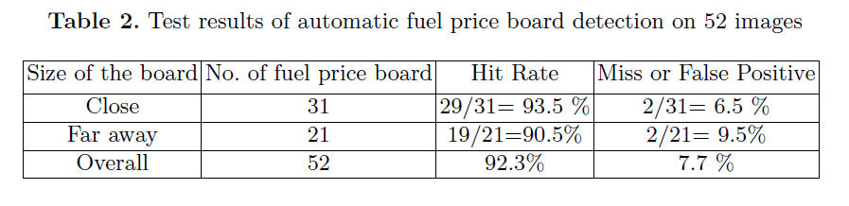
Evaluation - Detection
Detection Results

Slide 36
Evaluation - Classification
Data Set
  48 successfully classified images from detection phase
  15 contain board to blurry even for humans to ID
  33 images (15 Mobil, 18 BP) with 330 total characters and 99 fuel prices
  Issue with Mobil is always lower than BP as classification algo counted a white border as a “1”

Slide 37
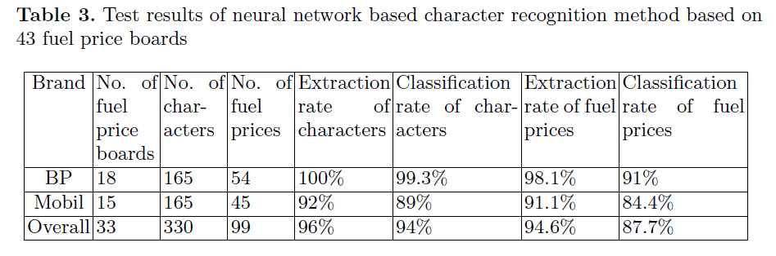
Evaluation - Classification
Results
Nearly 90% combined correct classification!

Slide 38
Related Work
The authors mention related work in both WSNs and detection/recognition of objects in images
Point out that many WSN researchers are starting to look to a variety of tools (beyond traditional WSNs) such as mobile phones, vehicles, GPS, cameras etc. as everyday data collection devices

Slide 39
Related Work
They also mention the difficulty (or near impossibility) of using commercial OCR (optical character recognition) software to do the task they have presented
  Issues include
    lack of standard layout
    lack of standard fonts
    Other unstructured variables (lighting, weather, distance)

Slide 40
Conclusions
3 Key factors to the authors work
  Offering a “BitTorrent” style platform for sensing data, encouraging users to contribute
  Proposed system leverages existing sensing and communication infrastructure (lowering the barrier for a volunteer to participate)
  Use of computer vision algorithms for the extraction of data

Slide 41
References
www.Gassbuddy.com
Chou, C.T., Bulusu, N., Kanhere, S.: Sensing data market. In: Proceedings of Poster Papers of 3rd IEEE International Conference on Distributed Computing in Sensor Systems (DCOSS 2007). (June 2007)
Yuan, B., Kwoh, L.K., Tan, C.L.: Finding the best-fit bounding-boxes. Document Analysis Systems VII 3872/2006 (2006) 268-279

Slide 42
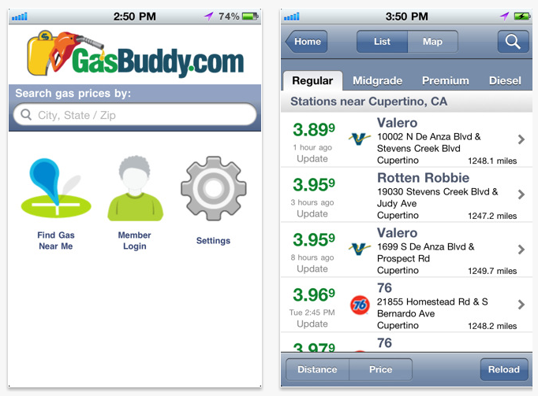
Example GasBuddy.com App

