Slide 1
BikeNet: A Mobile Sensing System for Cyclist Experience Mapping
SHANE B. EISENMAN
GAHNG-SEOP AHN
Columbia University
EMILIANO MILUZZO, NICHOLAS D. LANE, and RONALD A. PETERSON
ANDREW T. CAMPBELL
Dartmouth College
From ACM Transactions on Sensor Networks (TOSN), vol. 6, no. 1, December 2009
Presented by:
Travis Cossairt
February 21, 2011
EEL 6788

Slide 2
Outline
Introduction
Hardware Design
Software Design
Incentivizing Usage
System Evaluation
Conclusions & Significance

Slide 3
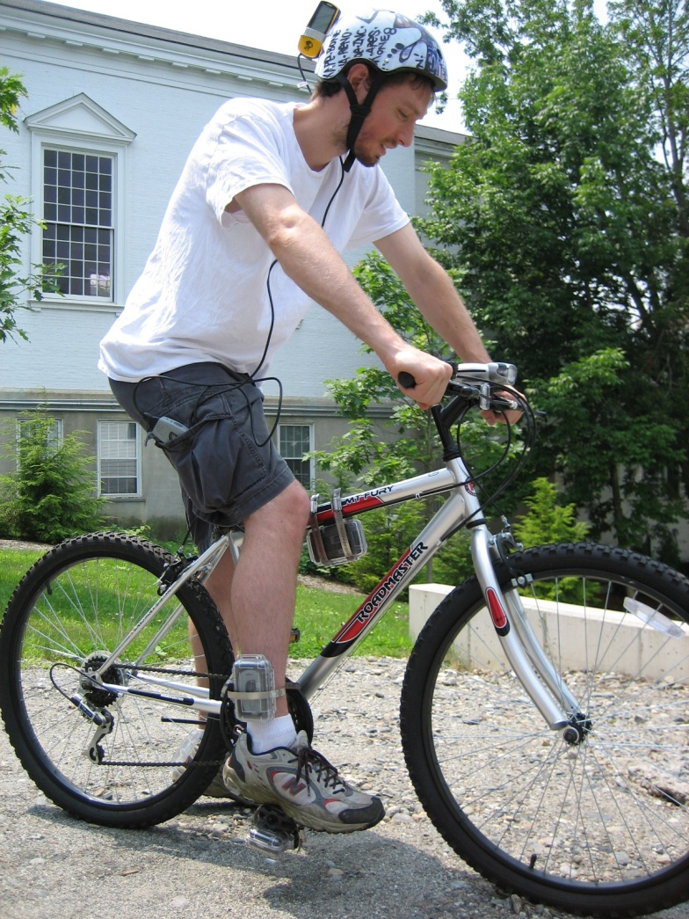
Introduction
“BikeNet is a mobile sensing system for mapping the cyclist experience”
Leverages the MetroSense Architecture[2]
Project embeds multiple hardware sensors onto a bicycle
Dual mode operation for data collection to handle areas without network connectivity
Web-based portal created for community sharing and data viewing

Slide 4
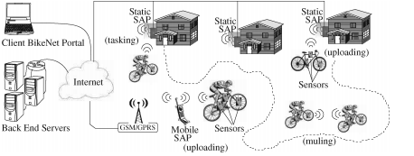
Hardware Design
Organized into 3 tiers:
Mobile Sensor Tier
Sensor Access Point (SAP) Tier
Backend Server Tier

Slide 5
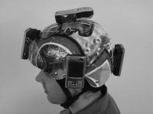
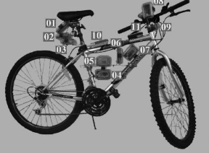
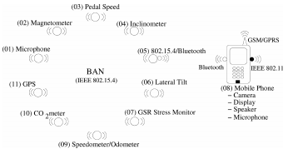
Mobile Sensor Tier
# of sensors that are bicycle and human-mounted to create a BAN (Bicycle Area Network)
Gathers data on cycling performance, cyclist heath/fitness, and environment on route
Includes: 2-axis accelerometer, thermistor, photodiode, microphone, camera, multiple radios, GPS, C0₂, Biofeedback, magnetometer (car detection),
etc.

Slide 6
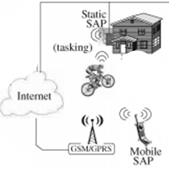
Sensor Access Point (SAP) Tier
Offers high performance/reliability and secure gateway access from sensor tier to backend servers
Point of command to task available sensors with user application requests/queries
Can also be fitted with sensors to provide context/validation for any uploaded data
Authors experimented with both static
(wired directly to internet e.g. Tmote
Invent plugged into IEEE 802.11 access
point) or mobile (e.g. radio access via
phone GSM/GPRS)

Slide 7
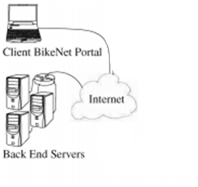
Backend Server Tier
Backend members are Ethernet-connected servers that have “practically unbounded storage and computational power”
Provides number of services to architecture that will be described in more detail in Software Design (application request/queries in sensor tier, and to retrieve/visualize sensed data)

Slide 8
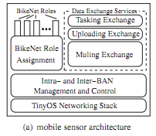
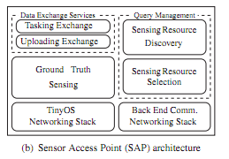
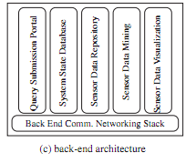
Software Design
The software system provides a number of services to the 3 hardware tiers including:
BikeNetRoleAssignment
Intra and Inter-BAN Mangement
Data Exchange Services
Ground Truth Sensing
Query Management
Route Checkpoints
Query Submission Portal
Sensor Data Storage/Processing/Visualization
System State Database

Slide 9
BikeNet Role Assignment
BAN divides functionality into logical roles:
Pedal Sensor/Wheel Sensor
Tilt Sensor/LateralTiltSensor: can measure slope/terrain
CompassSensor
MetalDetector: Detect passing cars
SyncSprinkler: common absolute notion of time/location to all members
LocalDisplay: means to locally display data
CO₂Sensor
SoundSensor: ambient noise + voice triggered sensing
CameraSensor

Slide 10
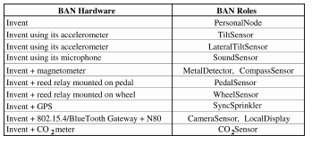
BikeNet Role Assignment Cont.
PersonalNode provides control of short-range radio over other sensing roles
Signals start/stop of trip
Only REQUIRED role, all other optional, as well as storage of user profile preferences
PersonalNode communicates with all local sensors in the BAN via a “hello”/”ack” type of protocol
Sensors respond back with what role they can/are willing to fulfill

Slide 11
Intra-BAN & Inter-BAN Management
Localization & Synchronization managed by SyncSprinkler role that does periodic broadcasts to update time/location to all BAN members
When PersonalNode establishes all roles fulfilled in BAN, “Ready” state occurs. When ride starts, a button click broadcasts to all members to start recording data
System supports both event-based and continous sensing, as setup by the profile stored in PersonalNode
LocalDisplay communicates to BAN members to provide real-time display of sensor data communicating via Bluetooth

Slide 12
Data Exchange Services
3 types of data exchange occur in system:
Tasking exchange (mobile sensing<->SAP): handles bootstrapping the sensors as well as requests from backend to particular BAN
Mulling exchange (between members of mobile sensing tier i.e. other cyclists): allows other BAN’s outside of SAP range to be exchanged and uploaded for real-time requests from back end
Uploading exchange (mobile sensing<->SAP): uploads data when in range of a SAP

Slide 13
Ground Truth Sensing
SAPs equipped with special sensors to provide “ground-truth” measurements
Refers to trusted, high-fidelity, always accessible stream of data
Used to validate or invalidate uploaded data for samples expected to have high expected correlation
E.g. temperature sampled at same time
Can also be used to self-calibrate a BAN within radio range of a SAP

Slide 14
Query Management
SAP handles queries from both backend user and PersonalNode of a BAN
Invokes sensing resource discovery to find sensing resources available to meet the request
Checks both ground-truth sensors on SAP as well as any BAN’s within radio range
If sensor resource available, invokes the task
E.g. If phone used as SAP, could be invoked to take photo

Slide 15
Route Checkpoints
Location-specific entities to allow storage/retrieval of location-specific data e.g. average speed up a particular hill
Could be used to display other cyclists performance at that location (competition), or your previous performance
Can be created by the cyclist through UI on LocalDisplay or via web interface before the ride (w/ privacy indicator)

Slide 16
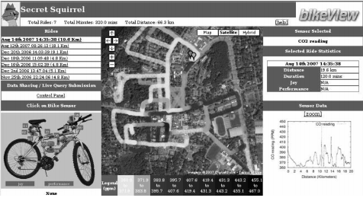
Query Submission Portal
Web portal containing graphical presentation of cyclist data
Allows real time querying of BANs if cyclist using a GPRS connection device
Includes ability to query BAN’s location, capture camera image, sample microphone
Communicates by sending an SMS to the BAN’s phone over GPRS

Slide 17
Sensor Data Storage, Processing, Visualization
Repository provides location for long-term storage of cyclist experience data on a per-cyclist basis
Also provides location for aggregation of communal cyclist data
System uses a number of data interpretation and inference tools to look for trends, averages, etc. and then filter/smooth those results for visualization
Future goal is to provide full back end sharing and dynamic visualizers to share among community, groups, etc.

Slide 18
System State Database
Contains both static and dynamic state information about elements in the network
Tracks which BAN’s currently in radio range of mobile and static SAP’s
Facilitates proper query routing from any back end query
Also useful for debugging and management of network

Slide 19
Incentivizing Usage
Using BikeNet consumes battery energy and storage space of personal device, thus must incentive user to help contribute to community
As a PersonalNode role, system provides direct usefulness to cyclist, so no additional incentive needed at this phase
During upload however, muling may be used to get data to servers which consumes energy, storage, and radio bandwidth
BikeNet thus allows user to indicate amount of resources he is willing to share for others

Slide 20
Privacy and Trust
All sensed data originates from cyclist and surroundings
Privacy threat comes from mulling process of the other biker’s data, which can be addressed using standard encryption technologies
For sharing data (once in secure BikeNet repository), authors assume that data is shared via secure internet channels such as SSL or IKE
Identifies tension between user privacy and trust of data on internet, which is outside scope of project

Slide 21
System Evaluation
5 fully equipped BikeNet bicycles built
Number of static and mobile SAP’s deployed over Dartmouth College & adjacent area in Hanover, NH
Fully functional backend Web portal offering query submission and data retrieval services
Number of experiments ran using this test setup

Slide 22
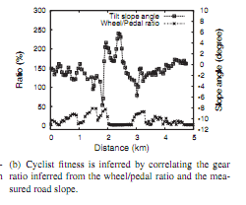
Cyclist Experience Mapping Experiments
Inference and Cyclist Fitness Sensing
By tracking wheel gear, & pedal speed vs. slope, they were able to derive a level of fitness

Slide 23
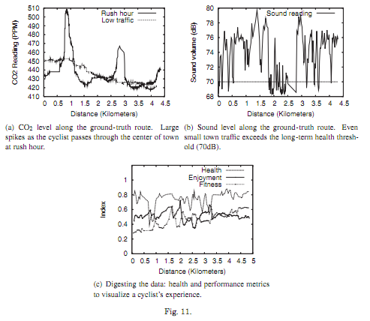
Cyclist Experience Mapping Experiments
Cyclist Experience:
Measured levels of air pollution, noise pollution, and “Health index”over routes
Health index is a measure overall index comparing CarDensity, CO₂ level, and SoundLevel

Slide 24
Social Cycling Experiment
Bicycling is very social, and many ride in groups
Could this be used to do data correlation for a group, and take advantage of auto calibration, anomaly detection, and noise reduction?
In this experiement, cyclists travelled in tandem within 10m of each other (w/ as much as 50m separation at times)
Found good correlation in some sensors such as CO₂ and GPS, w/ ability to “patch” e.g. compass sensor
Bad/difficult to correlate some data such as sound, lateral tilt, GSR bio-feedback etc.

Slide 25
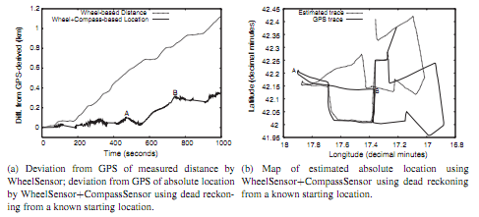
Services Performance Experiments
Cyclist Localization
Alternative to GPS for SyncSprinkler role, as GPS might not work in tall building areas, expensive, high energy consumption etc.
Combine WheelSensor and CompassSensor to determine position (i.e. dead reckoning) w/ known starting location
Determined not accurate enough, due to wheel size flucations etc., but makes good complement solution for when GPS signal may be lost

Slide 26
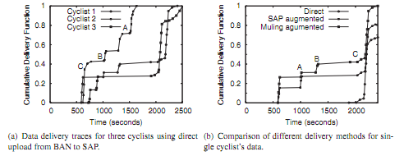
Town-Scale System Scenario Experiment
3 BikeNet bikes and small scale BikeNet testbed with 7 static SAP’s across Dartmouth College and Hanover collected on morning of November 20, 2006
Cyclists 1&2 live near each other, rendezvous with cyclist 3, then 1 & 3 depart to library and cyclist 2 heads to CS building

Slide 27
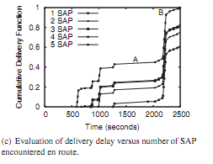
Town-Scale System Scenario Experiment
Evalulated impact of incremental addition of SAP’s to system on average delay of delay deliverred from 3 cyclists to backend
Discovered that addition of new SAP yields nonuniform improvement to data delivery performance, thus highly dependent on factors like deployment density and location in relation to routes

Slide 28
Conclusions & Significance
BikeNet represents the “first comprehensive mobile sensing system quantifying the cyclist experience”
Collects and analyzes personal cyclist performance and communal environment data
Supports two modes of operation to support both delay-tolerant and real-time sensing
Data can be displayed locally to cyclist or to others via backend services
Web portal provides social networking among other cyclists

Slide 29
My Own Thoughts
Sensors mounted on cyclist (e.g. the helmet) seem unwieldly and could be improved
Could BikeNet system be used to trigger events such as if cyclist crashes/or falls down? (auto call 911 or other nearby bikers? ☺)

Slide 30
References
[1] Shane B. Eisenman, Emiliano Miluzzo, Nicholas D. Lane, Ronald A. Peterson, Gahng-Seop Ahn, and Andrew T. Campbell, "BikeNet: A Mobile Sensing System for Cyclist Experience Mapping", ACM Transactions on Sensor Networks (TOSN), vol. 6, no. 1, December 2009
[2] METROSENSE PROJECT. 2007. http://metrosense.cs.dartmouth.edu

