Slide 1
CrowdSearch
Tingxin Yan, Vikas Kumar, and Deepak Ganesan, "CrowdSearch: exploiting crowds for accurate real-time image search on mobile phones," In Proc. of the 8th international conference on Mobile systems, applications, and services (MobiSys), 2010, pp. 77-90.
Presented By: Lauren Ball
March 16, 2011

Slide 2
Background
Smartphone Capabilities
  Massive Deployment
  Many Sensors (3G, WiFi, GPS, Camera, Microphone, etc)
Searching Internet Via Smartphone
  Trends
    70% Smartphone users use internet search
    Growth suggests phone searches will dominate other computing devices
  User Interface
    Searching via typing annoying
    Not always a good way to show multiple results

Slide 3
Previous Work
Most successful work for Smartphone Internet Search has been done using GPS and Voice
Using Phone Camera and Image Processing
  Real-time
    Results have been mostly inaccurate
    No good way to show many results
    Results must be precise
  Human in the loop
    Accurate
    Expensive
    Can have unacceptable delay

Slide 4
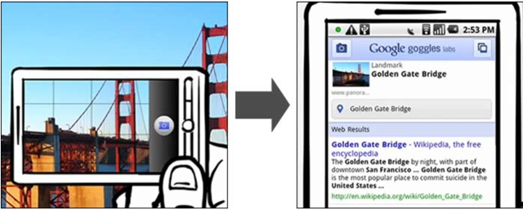
Google Goggle
Only works on certain image categories
Often chooses item which is clearly not the focus of the picture
Unreliable

Slide 5
What is Crowd Search
University of Massachusetts in 2010
Goal
  Exploiting crowds for accurate real-time image search on mobile phones
CrowdSourcing
  Outsource tasks to a group of people
    Via Amazon Mechanical Turk (AMT)
  Leverages that humans are good at recognizing images
  Improves image search precision
  Needs to be optimized for cost and delay

Slide 6

Amazon Mechanical Turk
Outlet for CrowdSourcing
“Workers” do simple tasks for monetary reward
MTurk API for “Requesters”

Slide 7
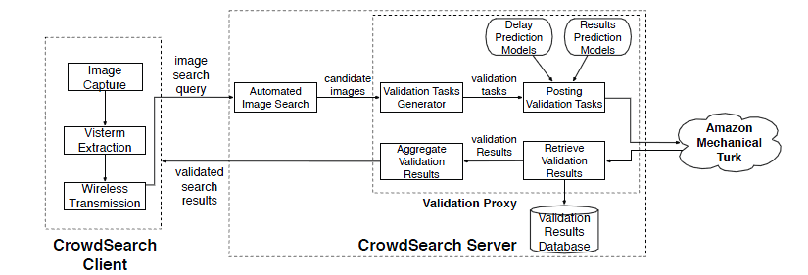
System Architecture
Components
  Mobile Phone
    Queries
    Local Image Processing
    Displays responses
  Remote Server
    Cloud Backend
    Image Search
    Triggers Image Validation
  Crowd Sourcing System
    Validates Results

Slide 8
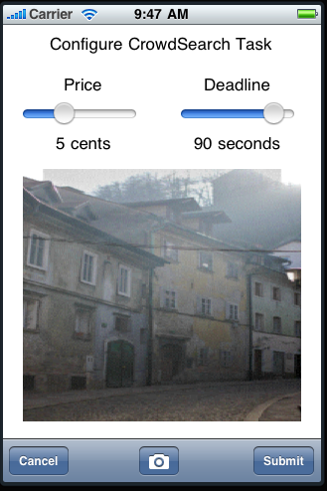
Crowd Search Operation
Crowd Search Query Requires
  Image
  Query deadline
  Payment mechanism
Looks to find multiple verifications

Slide 9
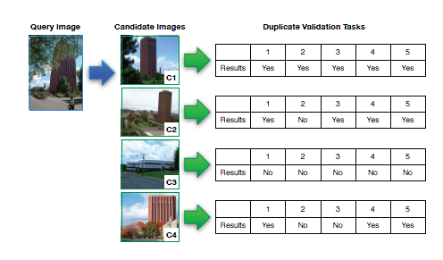
Crowd Search Operation (Cont)

Slide 10
Delay-Cost Tradeoff
Parallel posting
  Immediately posts all candidates
  Pro: Minimizes delay
  Con: Maximum cost guaranteed
Serial Posting
  Posts top ranked candidate first and waits for results then posts next (and continues)
  Pro: Minimizes cost
  Con: Maximizes delay

Slide 11
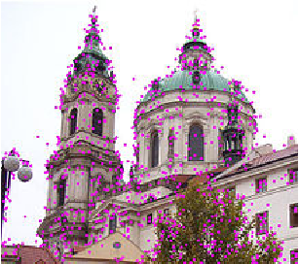
Backend Server
Identifies Ranked Candidate Images
  Scale-invariant feature transformation is used (SIFT)
  Detects and Describes local features in images
  Finds images with closest matching features
Performs Crowd Search Algorithm

Slide 12
Crowd Search Algorithm
Attempts to return at least one correct result within the deadline specified
Uses a balance of the Parallel and Serial Methods to optimize for Delay and Cost
Two Major Components
  Delay Prediction
  Result Prediction

Slide 13
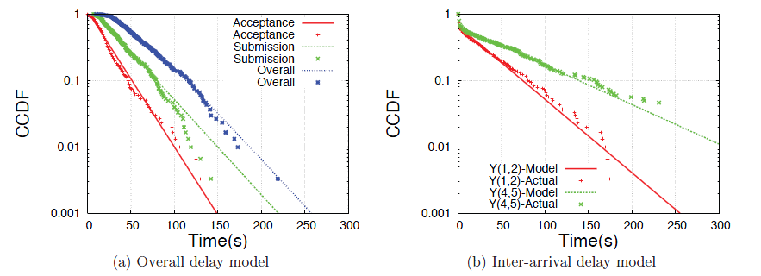
Delay Prediction
Delay consists of
  Acceptance Delay
  Submission Delay
With Crowd Search a model of the delay was developed in order to be able to accurately predict delay times.

Slide 14
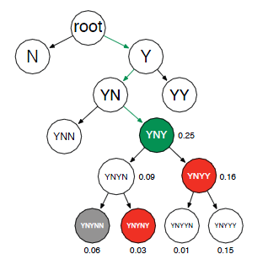
Result Prediction
Probability of 'YNYY' occurring after 'YNY' is 0.16 / 0.25 = 0.64
This result is showing a Majority of 5 case

Slide 15
Crowd Search Experiment
iPhone Application
Considered 4 Image Categories
  Human Faces
  Flowers
  Buildings
  Book Covers
Server was trained on 1000s of images
Tested 500 images to measure for
  Precision - #correct results/#correctly returned to user
  Recall – #correctly retrieved/#correct results
  Cost – in dollars

Slide 16
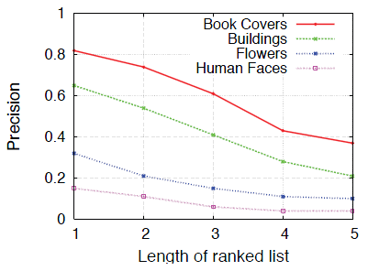
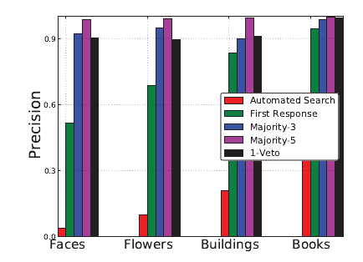
Results – Precision

Slide 17
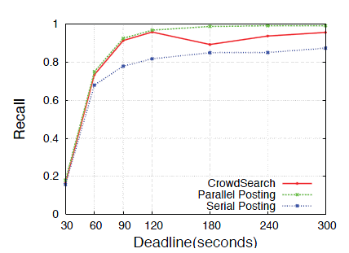
Results - Recall

Slide 18
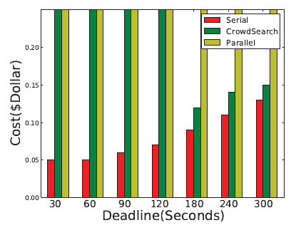
Results - Cost

Slide 19
Other Considerations
Looked to minimize energy consumption
Partitioning Minimal Server Processing to Phone
Using iPhone
  AT&T 3G
    More Power Consumption
    Lower Bandwidth
  WiFi
    Better Power Consumption
    Higher Bandwidth

Slide 20
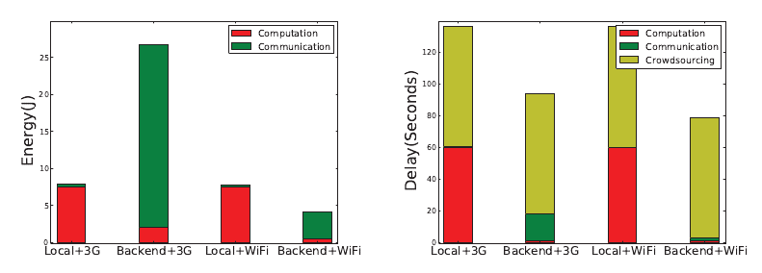
Results
Using the server backend for processing with WiFi communication showed the best results!

Slide 21
Conclusions
Crowd Search was able to reach greater than 95% precision for the image types explored
Compared to other systems Crowd Search provides up to 50% search cost savings
Crowd Search Optimized for Cost and Delay better than a pure serial or parallel method

Slide 22
Possible Improvements
Improve Performance
  Currently takes ~2 minutes
  Initial image processing tuning
Online training of models
  Increasing data sets
Crowd Sourcing for other inputs (video, audio, etc)
Improving payment models

Slide 23
References
[13] J. Philbin, O. Chum, M. Isard, J. Sivic, and A. Zisserman.
Object retrieval with large vocabularies and fast spatial
matching. In CVPR, 2007.
[14] V. S. Sheng, F. Provost, and P. G. Ipeirotis. Get another label?
improving data quality and data mining using multiple, noisy
labelers. In In Proceeding of KDD ’08, pages 614–622, 2008.
[15] A. Sorokin and D. Forsyth. Utility data annotation with
amazon mechanical turk. Computer Vision and Pattern
Recognition Workshops, Jan 2008.
[16] http://images.google.com/imagelabeler/. Google Labeler.
[17] https://www.livework.com/. LiveWork: Outsource Business
Tasks To Teams of On-Demand Workers.
[18] http://www.abiresearch.com/research/1002762-US+Mobile+
Email+and+Mobile+Web+Access+Trends. US Mobile Email and
Mobile Web Access Trends - 2008.
[19] http://www.chacha.com/. ChaCha: Real people answering your
questions.
[20] http://www.crowdspirit.com/. CrowdSpirit: enables businesses
to involve innovators from outside the company directly in the
design of innovative products and services.
[21] http://www.google.com/mobile/products/search.html#p=default.
Goggle: Google image search on mobile phones.
[22] http://www.sensorplanet.org/. Sensor Planet: a mobile
device-centric large-scale Wireless Sensor Networks.
[23] http://www.taskcn.com/. Taskcn: A platform for outsourcing
tasks.
[24] http://www.theextraordinaries.org/crowdsourcing.html. The
Extraordinaries.
[25] http://www.topcoder.com/. www.topcoder.com.
[26] http://www.vlfeat.org/~vedaldi/code/siftpp.html. SIFT++: a
lightweight C++ implementation of SIFT detector and
descriptor.
[27] http://www.wired.com/gadgetlab/2008/12/amazons-iphone/.
Amazon Mobile: Amazon Remember.
[28] L. von Ahn and L. Dabbish. Labeling images with a computer
game. In CHI ’04: Proceedings of the SIGCHI conference on
Human factors in computing systems, pages 319–326, New
York, NY, USA, 2004. ACM Press.
[29] L. von Ahn, B. Maurer, C. Mcmillen, D. Abraham, and
M. Blum. recaptcha: Human-based character recognition via
web security measures. Science, 321(5895):1465–1468, August
2008.
[30] T. Yan, D. Ganesan, and R. Manmatha. Distributed image
search in camera sensor networks. In Proceedings of SenSys
2008, Jan 2008.
[31] C. Zhu, K. Li, Q. Lv, L. Shang, and R. Dick. iscope:
personalized multi-modality image search for mobile devices. In
Proceedings of Mobisys ’09, Jun 2009.
[1] M. Azizyan, I. Constandache, and R. Choudhury.
Surroundsense: mobile phone localization via ambience
fingerprinting. In Proceedings of MobiCom 09, Sep 2009.
[2] R. Baeza-Yates and B. Ribeiro-Neto. Modern Information
Retrieval. ACM Press, 1999.
[3] K. P. Burnham and A. D. R. Model Selection and Multimodel
Inference: A Practical Information-Theoretic Approach,
Second Edition. Springer Science, New York, 2002.
[4] A. T. Campbell, S. B. Eisenman, N. D. Lane, E. Miluzzo, and
R. A. Peterson. People-centric urban sensing. In WICON ’06:
Proceedings of the 2nd annual international workshop on
Wireless internet, page 18, New York, NY, USA, 2006. ACM.
[5] O. Chum, J. Philbin, M. Isard, and A. Zisserman. Scalable near
identical image and shot detection. In Proceedings of CIVR
’07, pages 549–556, New York, NY, USA, 2007.
[6] E. Cuervo, A. Balasubramanian, D. ki Cho, A. Wolman,
S. Saroiu, R. Chandra, and P. Bahl. Maui: Making
smartphones last longer with code offload. In In Proceedings of
ACM MobiSys, 2010.
[7] S. B. Eisenman, N. D. Lane, E. Miluzzo, R. A. Peterson,
G. seop Ahn, and A. T. Campbell. Metrosense project:
People-centric sensing at scale. In In WSW 2006 at Sensys,
2006.
[8] A. Kittur, E. Chi, and B. Suh. Crowdsourcing user studies with
mechanical turk. CHI 2008, Jan 2008. Crowdsourcing applied
to user study.
[9] D. G. Lowe. Distinctive image features from scale-invariant
keypoints, 2003.
[10] H. Lu, W. Pan, N. D. Lane, T. Choudhury, and A. T.
Campbell. Soundsense: scalable sound sensing for
people-centric applications on mobile phones. In MobiSys,
pages 165–178, 2009.
[11] M.-E. Nilsback. An automatic visual Flora - segmentation and
classification of flowers images. PhD thesis, University of
Oxford, 2009.
[12] M.-E. Nilsback and A. Zisserman. Automated flower
classification over a large number of classes. In Proceedings of
the Indian Conference on Computer Vision, Graphics and
Image Processing, Dec 2008.

Slide 24
Questions??

