Slide 1
Diversity in Smartphone Usage
Hossein Falaki, Ratul mahajan, Srikanth kandula, Dimitrios Lymberopoulous, Ramesh Govindan, Deborah Estrin.
UCLA, Microsoft, USC
MobiSys ‘10
Presented by
Vignesh Saravanaperumal

Slide 2
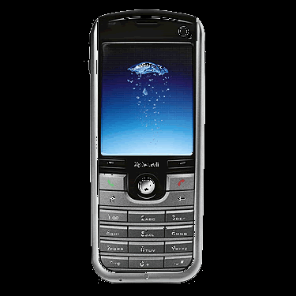
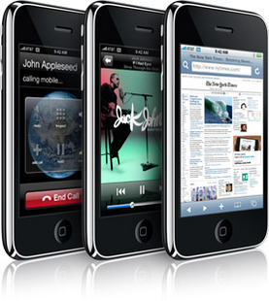
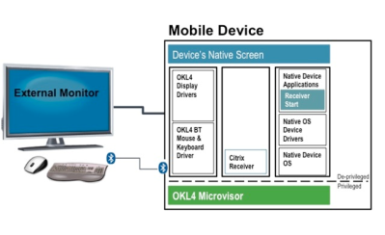
Smart phone - Intro
Mobile phone
Smart phone (Mobile phone + various Sensors )
What if your monitor could be plugged into your phone? What if you really didn't need a laptop, since your phone's CPU could power most applications, and draw data from the cloud?
Nirvana Phones

Slide 3
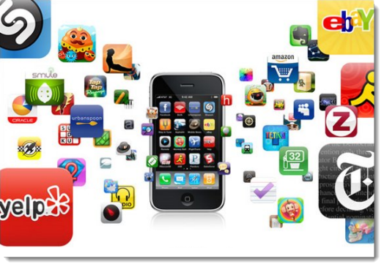
What does this Paper say?
This paper, in short is kind of statistics paper which discusses about the various ways the users interact with the smart phones and its outcome

Slide 4
Why did they do this paper?

Slide 5
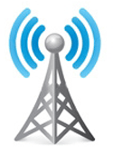
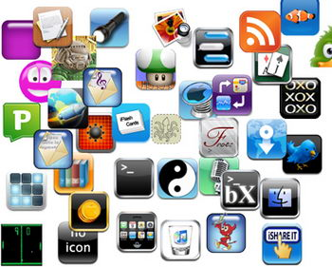
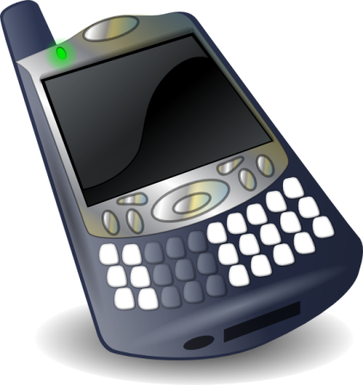

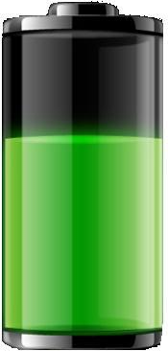
Basic Facts about Smartphone Usage Are Unknown

Slide 6
Why Do We Need to Know These Facts?
How can we improve smart phone performance and usability?
Everyone is different
Identical users
?
Can we improve resource management on smart phones through personalization?

Slide 7








Main Findings
1. Users are quantitatively very diverse in their usage
2. But invariants exist and can be harnessed

Slide 8
Smart phone Usage
Comprehensive
system view
Interaction
Diversity in interaction
Interaction model
Application
Energy
Diversity in application usage
Application usage model
Diversity in battery usage
Energy drain model

Slide 9
Who participated in this survey?
Platform | Demographics
Android | 16 high school students 17 knowledge workers
WinMobile | 16 Social Communicators 56 Life Power Users 59 Business Power Users 37 Organizer Practicals
Platform | Information Logged
Android | Screen state App usage Battery level Net traffic per app Call starts and ends
WinMobile | Screen state Applications used
Platform | # Users | Duration
Android | 33 | 7-21 Weeks/user
WinMobile | 222 | 8-28 Weeks/user

Slide 10
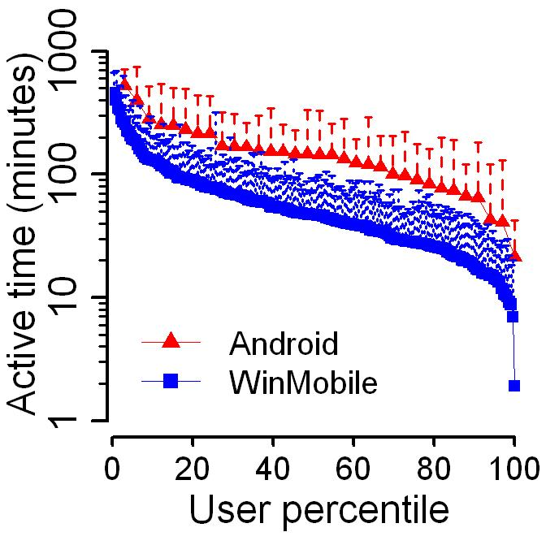
Users have disparate interaction levels
Two orders

Slide 11

Sources of Interaction Diversity
User Demographics
Session count
Session length

Slide 12
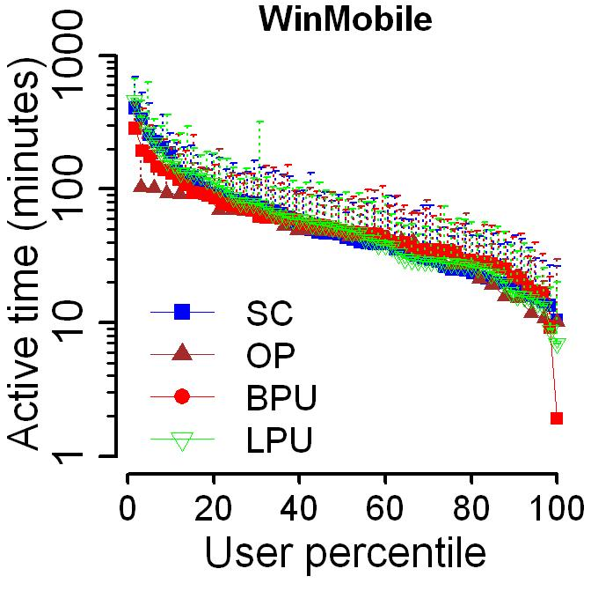
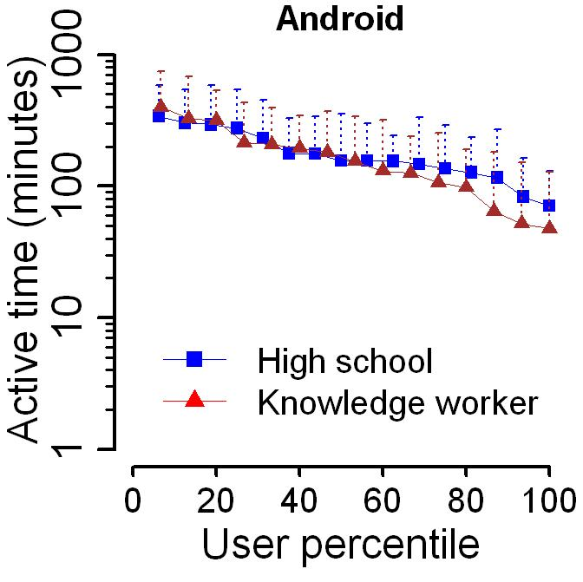
User Demographics Do Not Explain Diversity
Interaction Time:

Slide 13
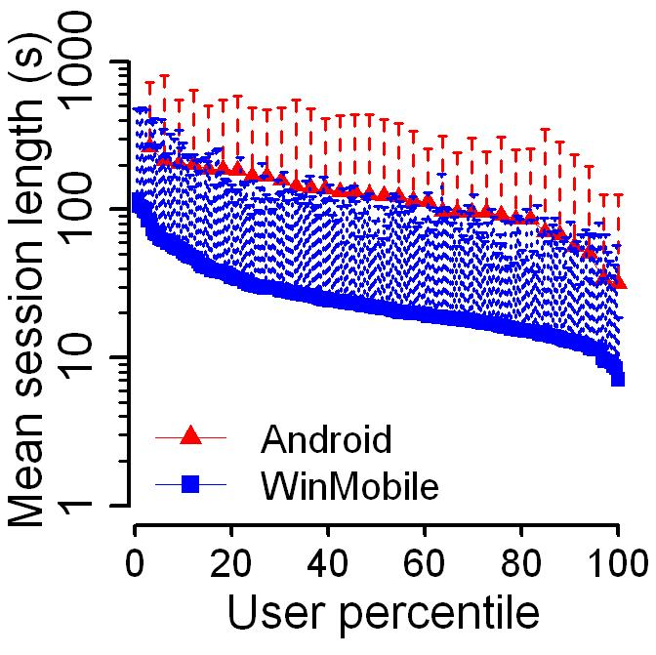
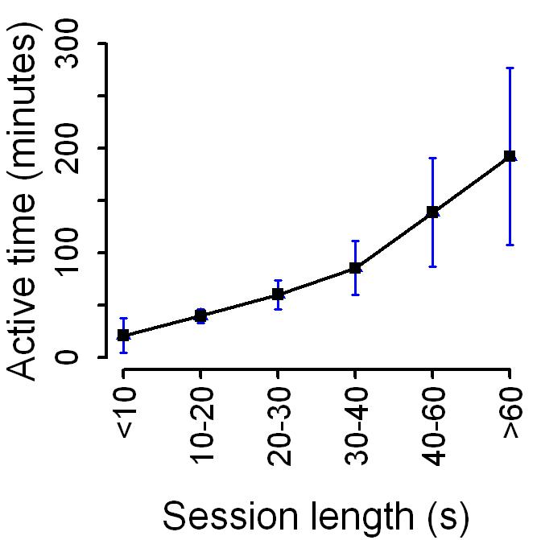
Session Lengths Contribute to Diversity

Slide 14
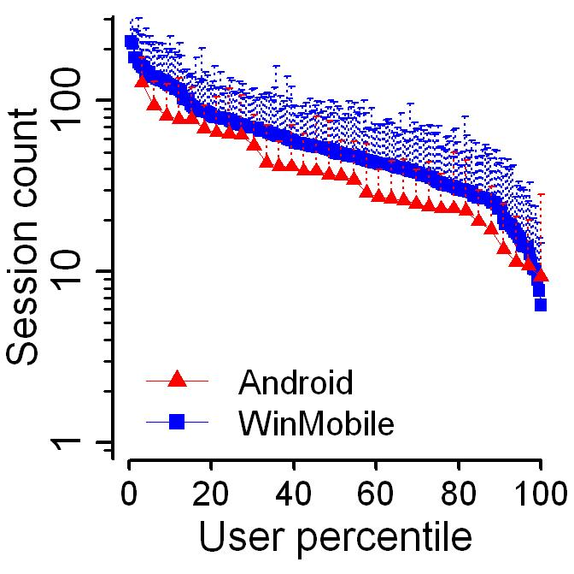
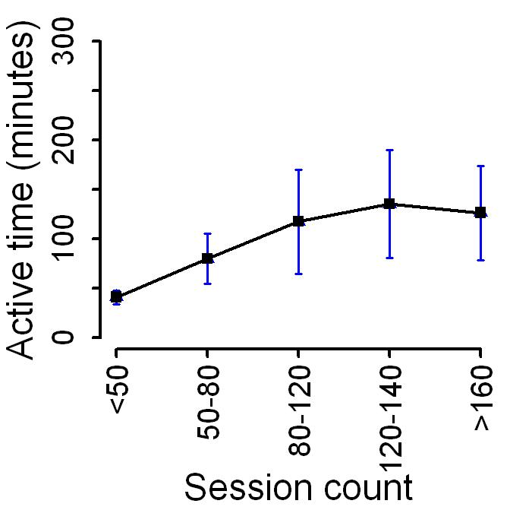
Number of Sessions Contribute to Diversity

Slide 15
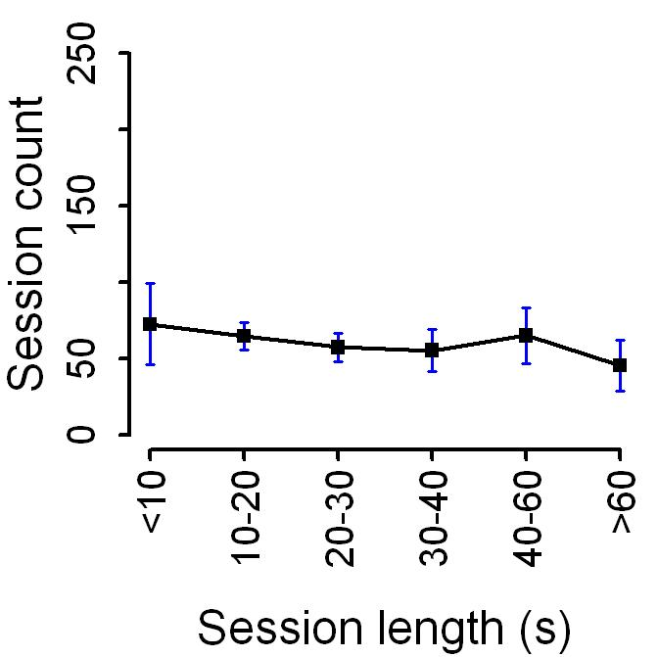
Session Length and Count Are Uncorrelated
Interaction Sessions:

Slide 16
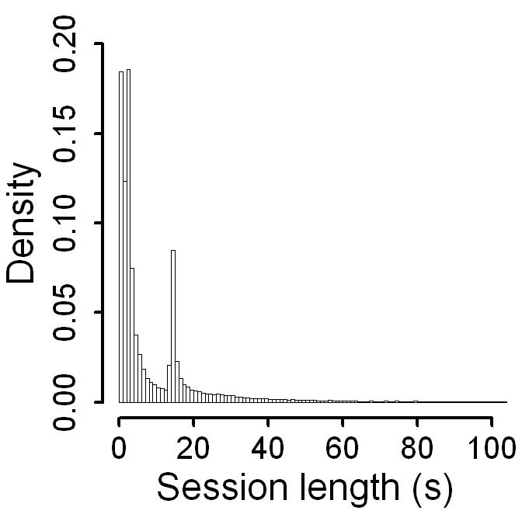
Close Look at Interaction Sessions
Sessions terminated by screen timeout
Exponential distribution
Few very long sessions
Most sessions are short
Shifted Pareto distribution

Slide 17
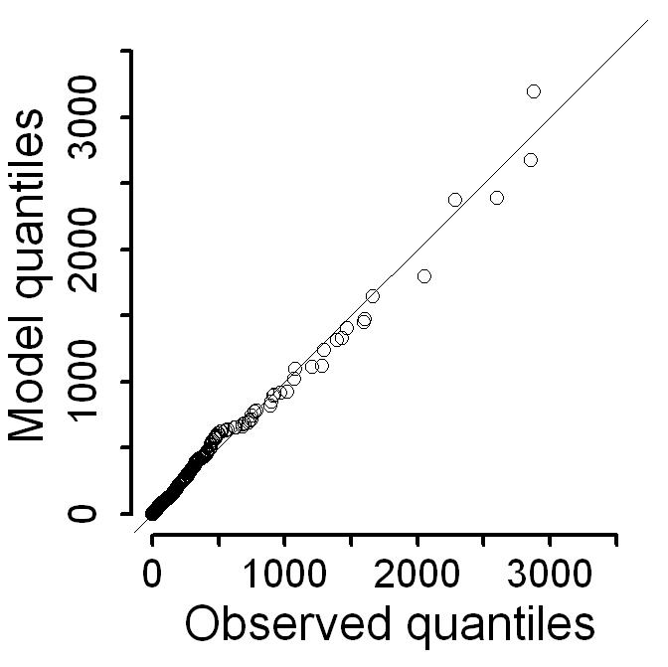
Modeling Interaction Sessions
Extremely long sessions are being modeled well

Slide 18
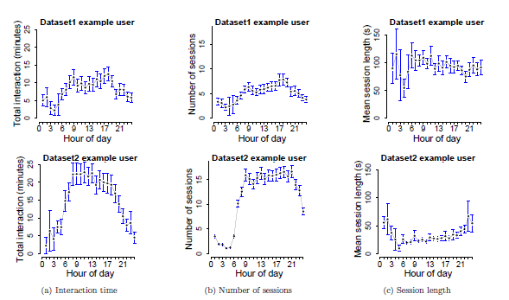
Diurnal Patterns:

Slide 19
Smart phone Usage
Interaction
Diversity in interaction
Interaction model
Application
Diversity in application usage
Application usage model
Energy

Slide 20
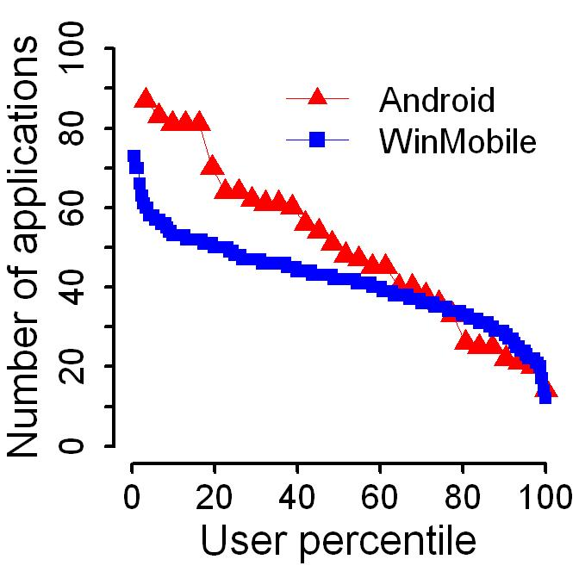
Users Run Disparate Number of Applications
50% of users run more than 40 apps

Slide 21
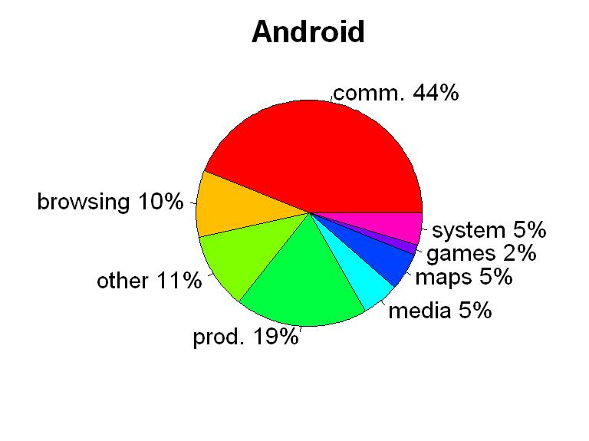
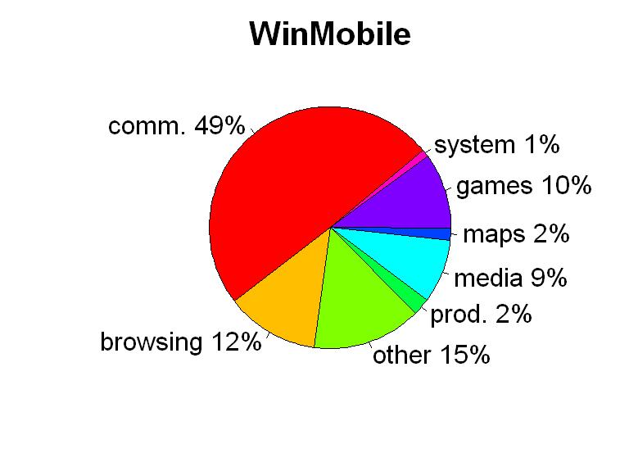
Application Breakdown:

Slide 22
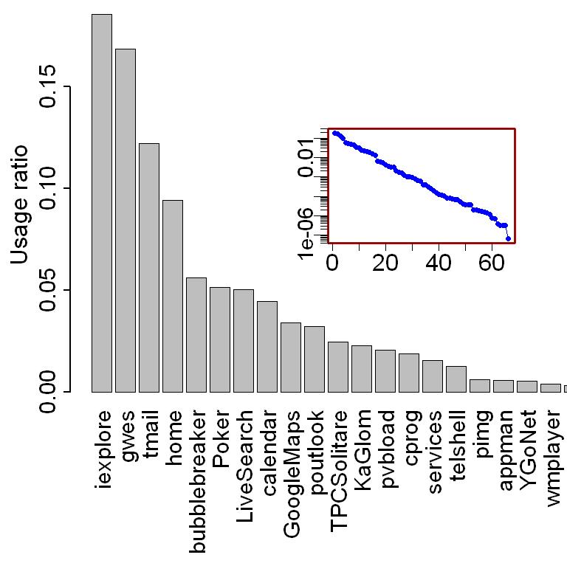
Close Look at Application Popularity
Straight line in semi-log plot appears for all users
Different list for each user

Slide 23
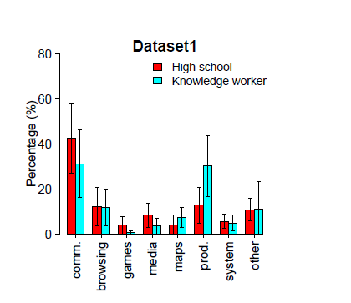
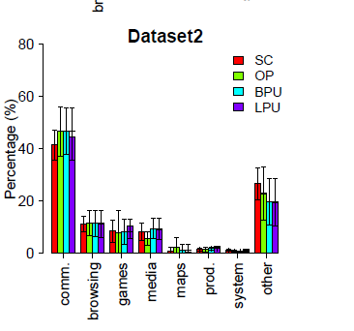
Application Popularity
Relationship to user demographic:
What does this graph signifies?
These graphs cannot reliably predict how a user will use the phone.
While demographic information appears to help in some cases (for e.g., the variation in usage of productivity software in Dataset1), such cases are not the norm, and it is hard to guess when demographic information would be useful.

Slide 24
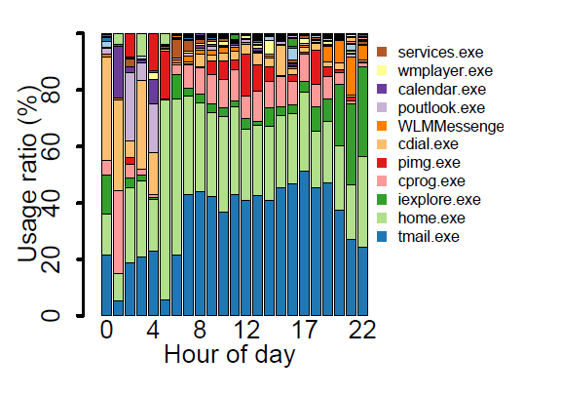
Diurnal patterns:
Time dependent application popularity was recently reported by Trestian based on an analysis of the network traffic logs from a 3G provider and this analysis confirms the effect.

Slide 25
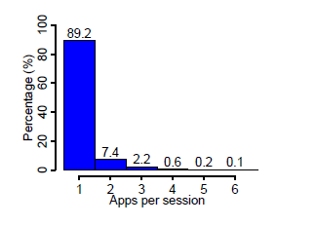
Application Sessions
Applications run per interaction:
90%, of interactions include only one application

Slide 26
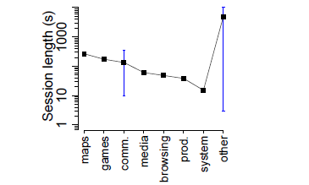
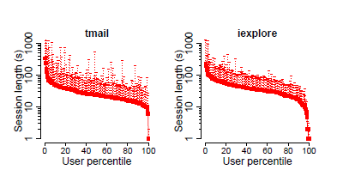
Application session lengths:
what interesting sight do these graphs reveal ?

Slide 27
Smart phone Usage
Interaction
Diversity in interaction
Interaction model
Application
Diversity in application usage
Application usage model
Energy
Diversity in energy drain
Predicting energy drain

Slide 28
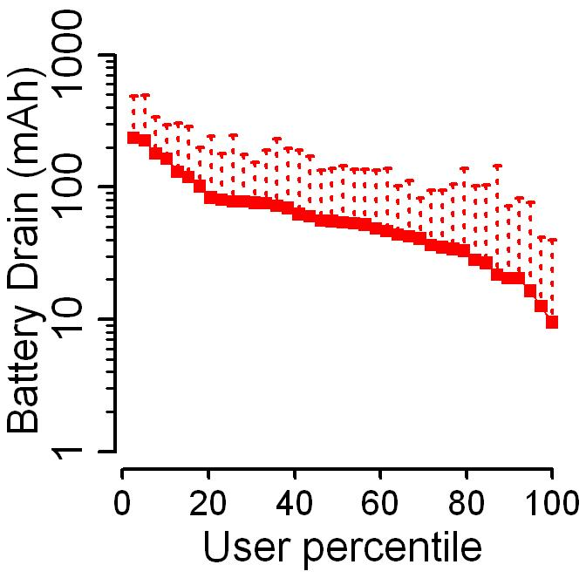
Users Are Diverse in Energy Drain
Two orders

Slide 29
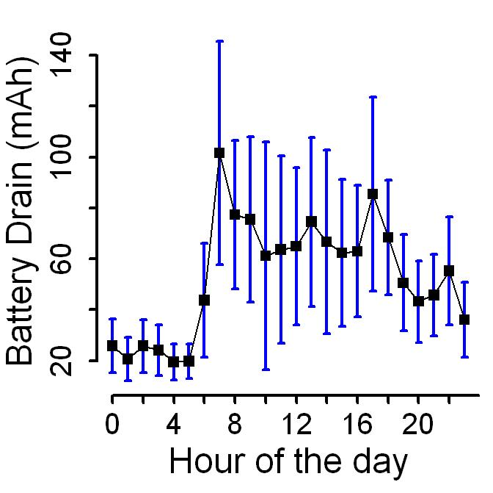
Close Look at Energy Drain
High variation within each hour
Significant variation across time

Slide 30
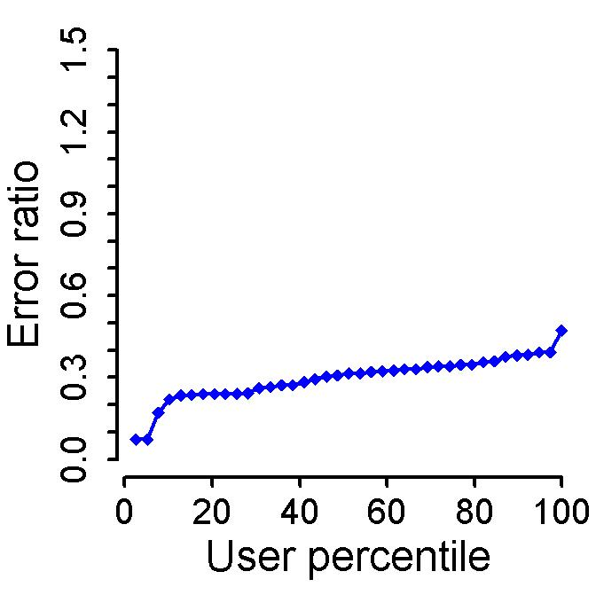
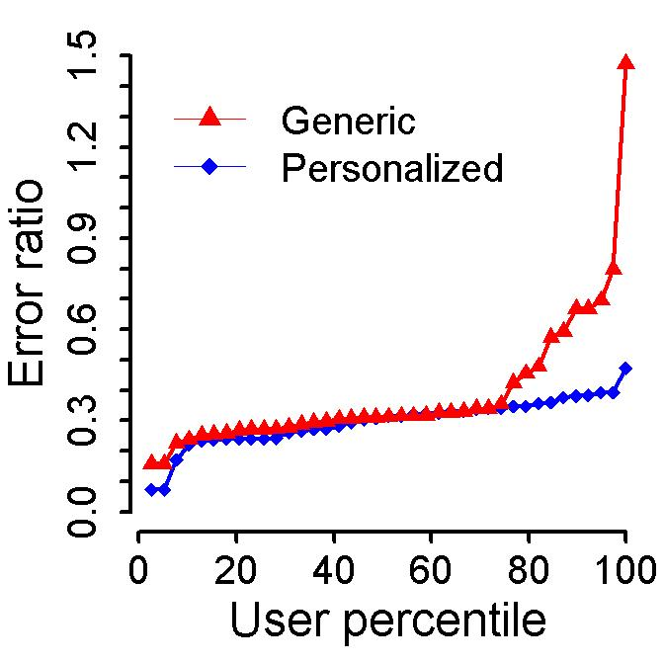
Modeling Energy Drain

Slide 31
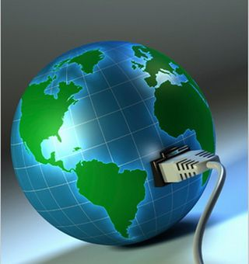
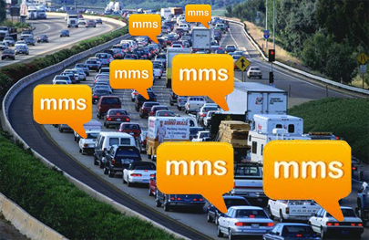
Network Traffic
Traffic per day
Interactive traffic
Diurnal patterns
The Network Analysis was carried out on Dataset 1
The traffic includes
3G radio and the
802.11 wireless link

Slide 32
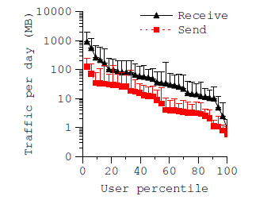
Network Traffic
Traffic per day:
The traffic received - 1 to 1000 MB
The traffic sent - 0.3 to 100 MB.
The median values are 30 MB sent and 5 MB received

Slide 33
Conclusions
Users are quantitatively diverse in their usage
Building effective systems for all users is challenging
Static policies cannot work well for all users
Invariants exist and can be harnessed
Users have similar distributions with different parameters.
This significantly facilitates the adaptation task

Slide 34
Questions Raised?
Based upon these statistics what can be the solution to Resource management in Smart phones?
Customization (Adaptation), but Is it possible?
Analyzing the Qualitative similarities among users
User behavior in the past must also predictive of the future

Slide 35
