Slide 1
Energy-Accuracy Trade-off for Continuous Mobile Device Location, In Proc. of the 8th International Conference on Mobile Systems, Applications, and Services (MobiSys) Lin, K., Kansal, A., Lymberopoulos, D., and Zhao, F., 2010, pp. 285-298
Energy-accuracy Trade-off
Albert Park
EEL 6788: Advanced Topics in Computer Networks

Slide 2
Overview
Mobile Location Service
Purpose
Observation
Design
Case Study

Slide 3
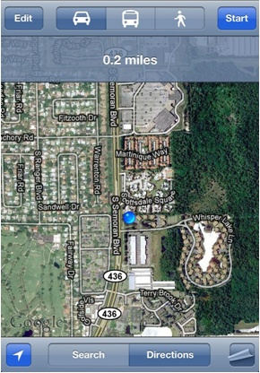
Mobile Location Service
Methods for current mobile device localization
GPS
WiFi
Cell-tower signature based
location service

Slide 4
Purpose
Develop location as a system service that automatically manages location sensor availability, accuracy, and energy.
Allows the system to optimize battery life by intelligently managing the location energy and accuracy trade-offs based on available sensor.
Ensure long battery life for acceptable user experience.

Slide 5
Observation
Two observations
First, location applications do not always need the highest available accuracy provided by GPS.
Second, a phone has multiple modalities to sense location aside from the GPS: WiFi triangulation, cell-tower triangulation, Bluetooth vicinity, and audio or visual sensing.

Slide 6
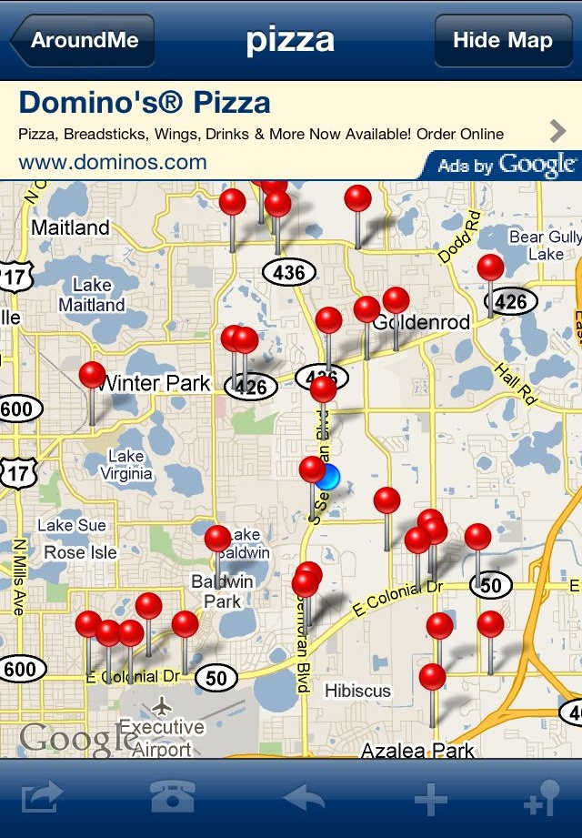
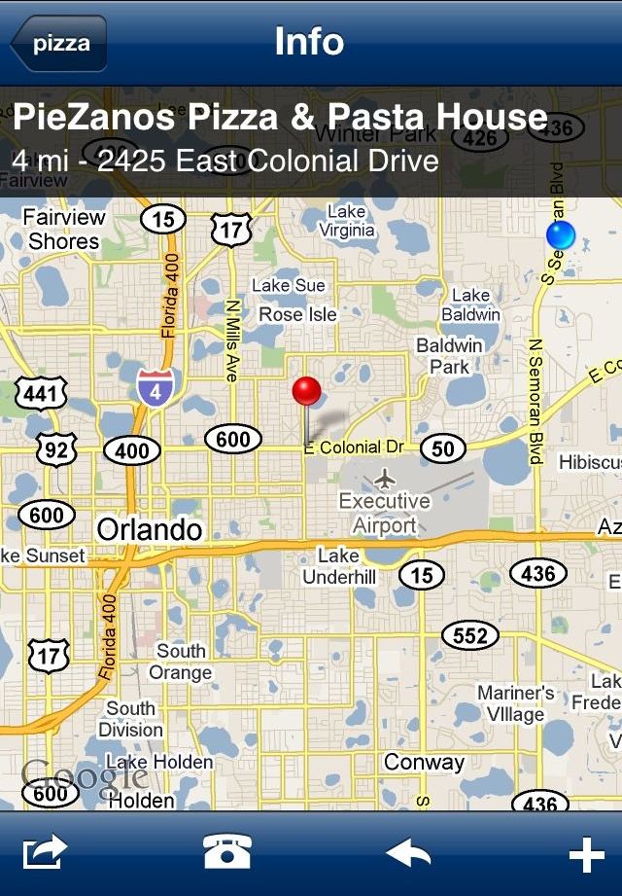
Observation (cont.)
Highest accuracy not always needed

Slide 7
a-Loc
Adaptive location service for mobile device
Automatically determines the dynamic accuracy requirement for mobile search applications
Continually tune the energy expenditure using the available sensor
A Bayesian estimation framework is used to model user location and sensor errors
Android G1 and Nokia N95

Slide 8
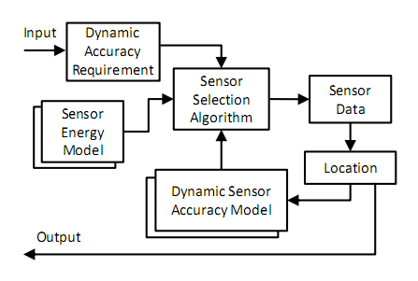
System Overview
Figure 1. System block diagram

Slide 9
Accuracy Models
Dynamic Accuracy Requirement
This block provides the location accuracy needed by the applications.
The dynamic sensor models characterize the accuracy and its variation with location.
GPS
WiFi
Bluetooth
Cell-tower

Slide 10
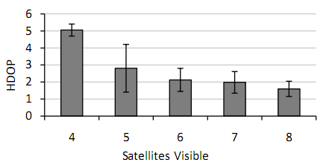
Accuracy Models (cont.)
GPS
A GPS receiver typically reports its estimate of error as horizontal dilution of precision (HDOP).
HDOP 6 or below: translates to less than 12m of location error
Figure 2. Experimentally measured GPS accuracy

Slide 11
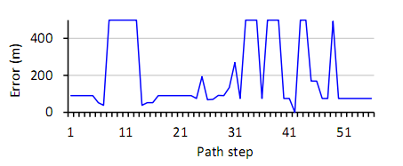
Accuracy Models (cont.)
WiFi
The error is expressed as a function of the number of access points visible over time.
As an alternative, an error estimate for WiFi localization is also provided by Google location service are used on Android.
Figure 3. WiFi location error with Android G1

Slide 12
Accuracy Models (cont.)
Bluetooth
Location based on finding at least one static Bluetooth device within its radio range.
The error is taken to be the Bluetooth range and infinity at other locations.
Cell-Tower
Radio stack in the device maintains cell-towers list.
With only one tower’s identity, the location error is essentially equal to the size of the cell.
Use the cell-size based on typical cell tower density

Slide 13
Energy Models
Sensor Energy Model
These models characterize the energy used by each available location sensor for obtaining location. In some cases, the energy spent depends on the location where the observation is made and experimentally measure this effect.

Slide 14
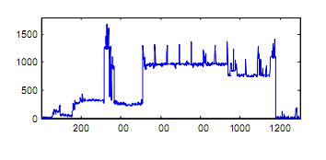
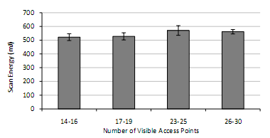
Energy Models (cont.)
WiFi Triangulation
External factor to affect the energy is number of visible APs
Energy cost does not vary significantly with number of APs
Figure 4. Measured power profile for WiFi
Figure 5. Energy usage for WiFi

Slide 15
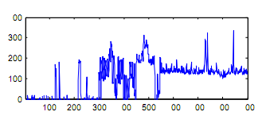
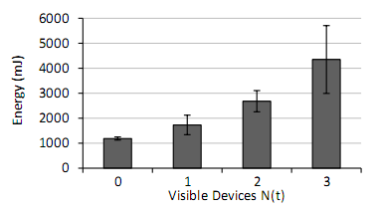
Energy Models (cont.)
Bluetooth Vicinity
Known static device location can determine user’s location
Lower power usage than WiFi, but longer scanning
Energy depends on the number of visible devices
Figure 6. Bluetooth power usage during scan
Figure 7. Bluetooth energy usage variation

Slide 16
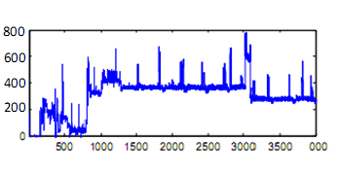
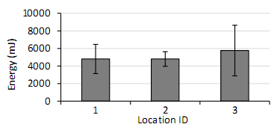
Energy Models (cont.)
GPS
Energy usage depends on location
GPS power drawn measurements
Android:230mW, Nokia:324mW
Warm-start: 1425mJ, Cold-start: 5700mJ
Figure 8. Measured GPS power profile
Figure 9. GPS energy usage (cold start)

Slide 17
Energy Models (cont.)
Cell-Tower Association
Mobile phone maintains a list of cell-towers that are visible to its radio receiver.
Based on this information the phone can determine its location.
The energy consumption is negligible that it only consists as reading data available on the local device which measured less than 20mJ (average) over multiple readings.

Slide 18
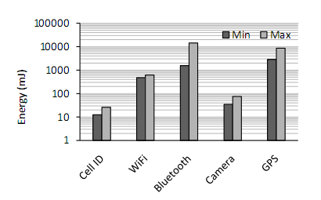
Energy Models (cont.)
Energy spent on various modalities
Figure 10. Relative energy costs of location modalities

Slide 19
Selection Algorithm
Sensor Selection Algorithm
The sensor selection algorithm determines the location sensor to be used at each time step.
The algorithm includes a method to model the user location trajectory and uses the sensor data as available to improve the location estimates.

Slide 20
Selection Algorithm
Determine the most energy efficient sensor to be used
Also maintains an estimate of the user’s location that is based on a prediction of user movements
Helps select the appropriate location for the sensor energy and accuracy model
Help avoid sensing when predicted location has a high confidence

Slide 21
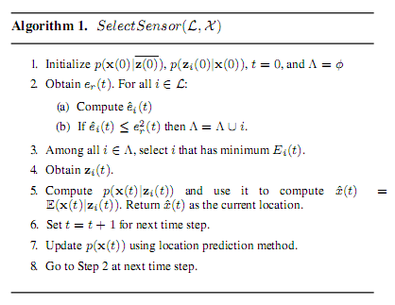
Selection Algorithm (cont.)
Uses Hidden Markov Model (HMM)
Uses the past two observed locations to yield a distribution of predicted locations.
A second order model takes the direction of motion into account, significantly improving prediction performance over a first order of HMM.
Figure 11. Select Sensor Algorithm

Slide 22
System Performance
The sensor accuracy models are assumed to be learned before the performance of the system is measured.
HMM parameters are learned in real-time as the user moves.

Slide 23
System Performance (cont.)
Alternative strategies (for comparison)
Static Model: The parameters used are the typical accuracies expected from different sensors (Bluetooth, WiFi, Cell-Tower, and GPS)
Periodic Model: Use a single location sensor periodically. GPS and WiFi
Perfect Model: As the system is used by more users, more data may be collected to refine a hypothetical perfect accuracy model for all locations

Slide 24
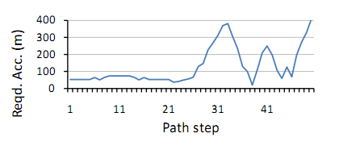
Case Study
Real world scenario (San Diego)
Significant slack in accuracy exists showing sensors other than GPS being used
Figure 12. Accuracy requirement on experimental path

Slide 25
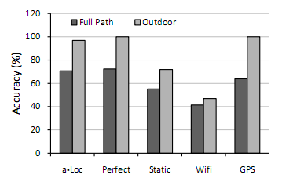
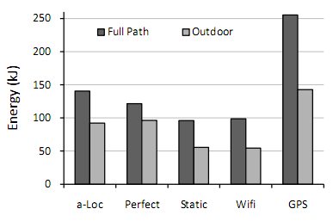
Case Study (cont.)
Real world scenario (San Diego)
a-Loc vs. GPS
Higher accuracy
45% less energy consumption
Figure 13. Fraction of the path for which
the accuracy requirement is satisfied
Figure 14. Energy consumption

Slide 26
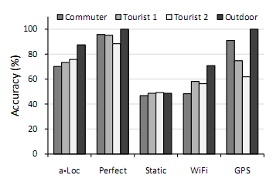
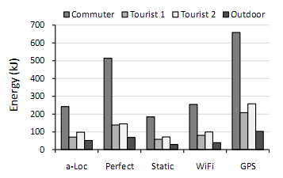
Case Study (cont.)
Real world scenario (Portland)
a-Loc vs. GPS
35% less energy
Figure 15. : Accuracy achieved
Figure 16. Energy consumption

Slide 27
Conclusion
When high accuracy requirements are needed
WiFi is most effective in urban areas
GPS is better in outdoor environments
However, WiFi achieves better accuracy than GPS in indoor environments.
Significant energy saving

Slide 28
Questions

Slide 29
References
Energy-Accuracy Trade-off for Continuous Mobile Device Location, In Proc. of the 8th International Conference on Mobile Systems, Applications, and Services (MobiSys) Lin, K., Kansal, A., Lymberopoulos, D., and Zhao, F., 2010, pp. 285-298

