Slide 1
Energy Efficient Location Sensing
Brent Horine
March 30, 2011

Slide 2
Citation
Jeongyeup Paek, Joongheon Kim, Ramesh Govindan, “Energy-Efficient Rate-Adaptive GPS-based Positioning for Smartphones,” In Proc. Of the 8th International Conference on Mobile Systems, Applications, and Services (MobiSys), 2010, pp. 299-314.
Authors are affiliated with the Embedded Networks Laboratory, Computer Science Department, University of Southern California

Slide 3
Motivation
Many smartphone applications require location services
GPS is very power hungry (0.37 W on Nokia N95)
Not all applications require the accuracy that GPS provides
Nor do they all the most recent position
In urban canyons, GPS is all that accurate anyway
A system which can tradeoff position accuracy with power consumption could improve battery life with no discernable sacrifice in application usability

Slide 4
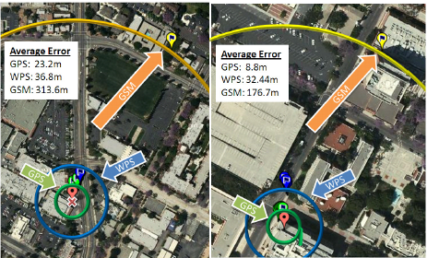
RAPS
Rate Adaptive Positioning System for smartphones

Slide 5
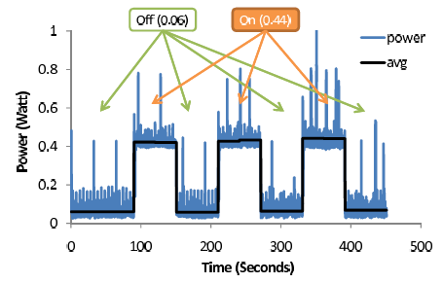
Duty Cycle Impact of GPS
But how do you match up the duty cycle with user mobility and ensure a bounded error?

Slide 6
Significant Contributions
Cheap (computationally) algorithm to infer whether and when GPS activations are necessary
Integrates many previously disclosed techniques in a unified platform

Slide 7
Algorithm Description
Learn user velocities at a given location and time of day
Correlate to accelerometer readings to estimate consistency
Use this information to predict the likelihood of a position update requirement
Senses signal strength and tower ID and queries history for likelihood of successful fix info
Checks local Bluetooth radios for a opportunistic location fix

Slide 8
General Experimental Results
Nokia N95 smartphones deployed on campus
3.8X better lifetime than continuous GPS
1.9X better lifetime than periodic GPS scheme with comparable error rate

Slide 9
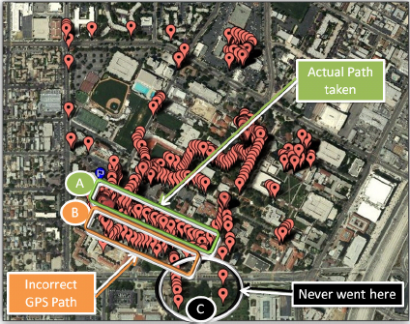
GPS Inaccuracies in Urban Area
1 week data logger at 1 sec interval
Shows ghost traces and errors

Slide 10
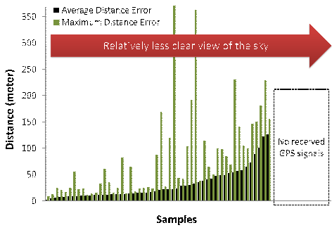
Average and Max Errors

Slide 11
GPS Error Budget
Error Source | Error Budget | Units
Ionospheric effects | +/-5 | meter
Orbit shifts | +/-2.5 | meter
Satellite clock errors | +/-2 | meter
Multipath effects | +/-1 | meter
Tropospheric effects | +/-0.5 | meter
Rounding errors | +/-1 | meter
Assumes 4 satellites in view. Degrades significantly with only 3 in sight.

Slide 12
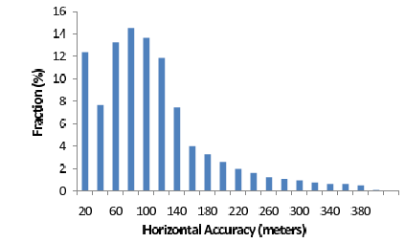
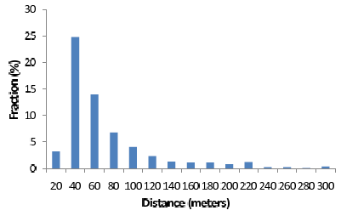
GPS errors
Self reported accuracy estimates
Change in GPS fix every 180 seconds
Mostly measuring mobility

Slide 13
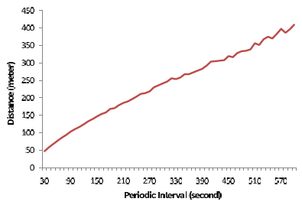
Update Interval vs Delta-fix for periodic updates

Slide 14
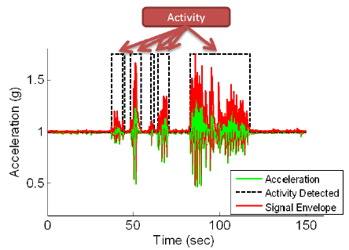
Accelerometer Activity Indicator

Slide 15
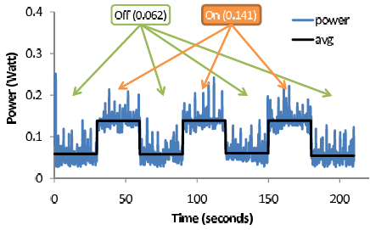
Power Consumption of Accelerometer

Slide 16
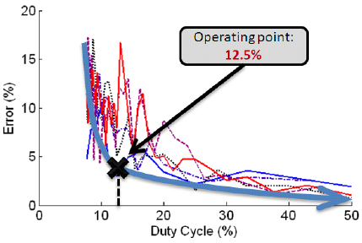
Accelerometer Duty Cycle Analysis
Setting duty cycle at 12.5% reduces power consumption by 8X for 0.01W

Slide 17
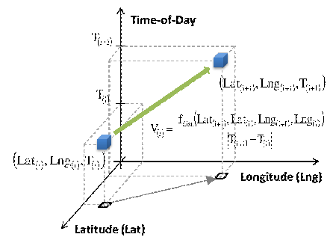
Framework for User Mobility History

Slide 18
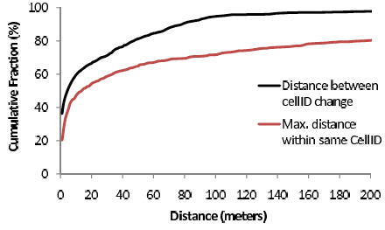
Usefulness of Cell ID?

Slide 19
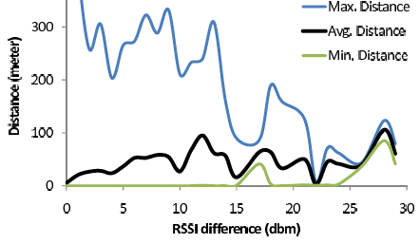
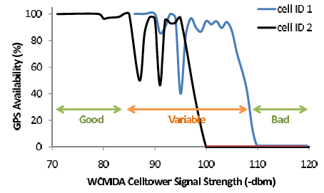
Futility of using RSSI to Estimate Movement

Slide 20
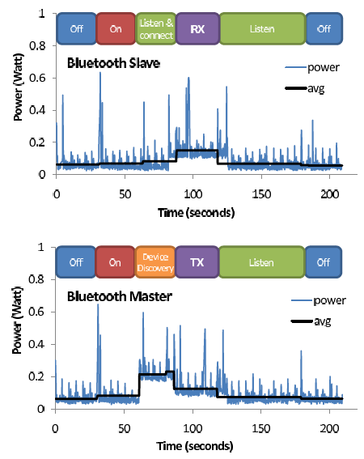

Slide 21
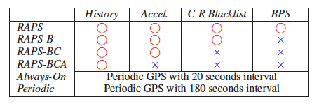
Experiment Matrix

Slide 22
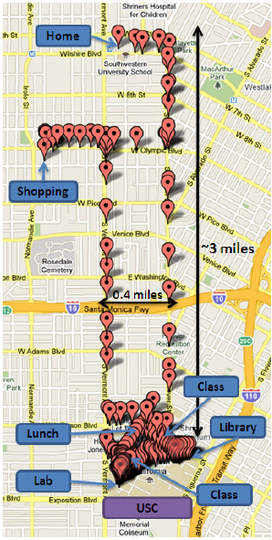
6 phones in one bag, carried by author for almost 2 days
No other apps running on phones
Measure battery life

Slide 23
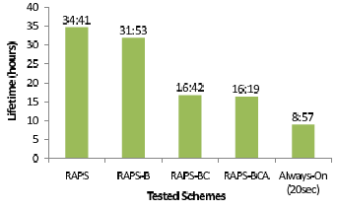
Lifetime

Slide 24
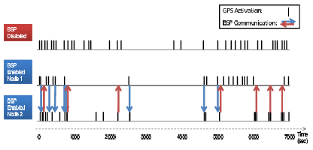
Event Timeline: BPS

Slide 25
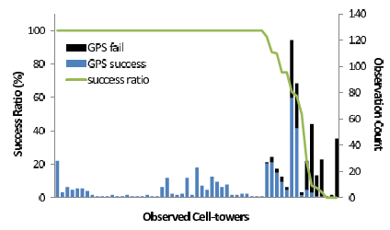
Celltower Blacklist Effectiveness

Slide 26
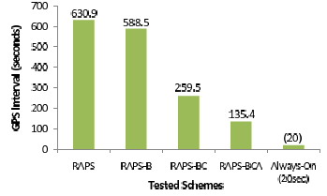
Average GPS Interval

Slide 27
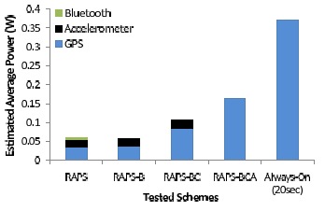
Average Power Consumption

Slide 28
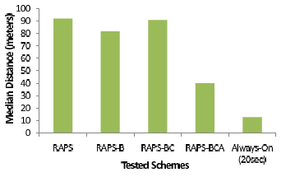
Median delta-GPS-Fix

Slide 29
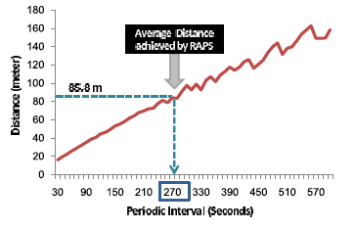
Avg Position Uncertainty vs GPS Duty Cycle

Slide 30
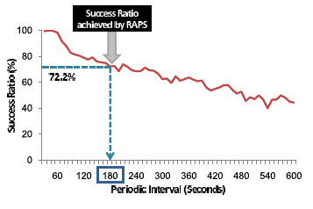
Success Ratio Relative to Periodic GPS vs Duty Cycle

Slide 31
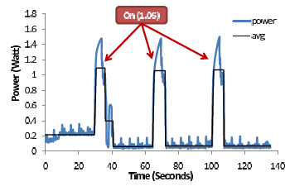
Power Consumption of WPS
WPS – WiFi Positioning Service
Is RAPS compatible?

Slide 32
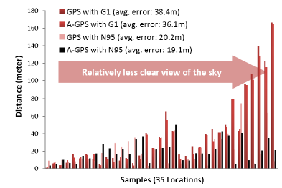
Assisted-GPS Analysis

Slide 33
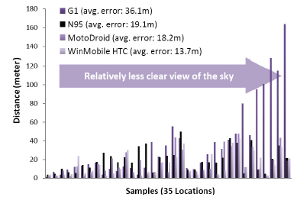
Errors vs Phone Comparison

Slide 34
Reflections
Many of these researchers fail to take advantage of the significant literature on GPS inaccuracies and instead take new measurements
They also consider Google Maps to be ground truth, instead of using survey markers
In my professional work with GPS, I routinely smoothed the data with a moving average filter over e.g. 10 samples. I don’t know what is done in the OS, but this is generally required when dealing directly with the e.g. GPRMC sentences

Slide 35
More Reflections
A statistical approach to design of the experiment (a.k.a. Box & Hunter or Taguichi) would have produced much more confidence in the empirically derived conclusions for the same effort
Industry versus Academic (most of their conclusions are well known to an engineer working in the GPS field)

Slide 36
Questions & Comments

