Slide 1

Improving Energy Efficiency of Location Sensing on Smartphones
Samori Ball
EEL 6788

Slide 2

Smartphone Energy Consumption
Location may be the largest energy hog in sensing applications
Most smartphones have two location sensing mechanisms
  GPS
  Network Based Triangulation (Net)

Slide 3

GPS Energy Consumption Test
Without GPS a cellphone battery level drops to 94% in an hour
With GPS turned on a cellphone battery level drops to 79% in an hour

Slide 4
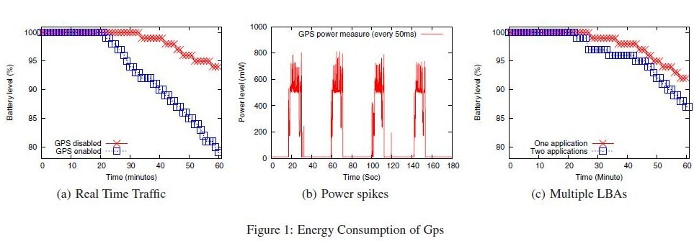
GPS Energy Consumption Test

Slide 5
Network Based Triangulation(NET)
Collects information about reachable cell towers (or WiFi access points) to determine location by retrieving a location database
Uses less energy than GPS
  Causes a cellphone battery level to drop to 93% in 1 hour
Less accurate than GPS

Slide 6
GPS vs Net
GPS can achieve accuracy up to 10m
Net achieves accuracy of about 30m to 100m
Net can be more accurate under certain circumstances
Net or GPS can be unavailable in different areas

Slide 7
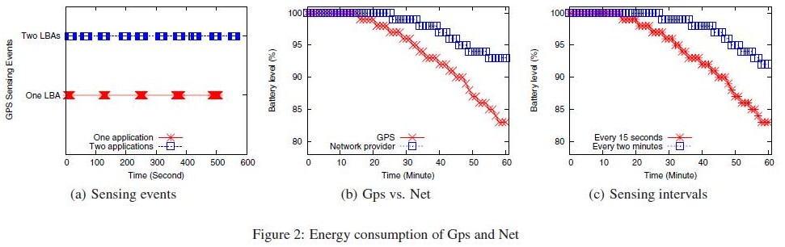
GPS vs Net

Slide 8
GPS vs Net

Slide 9
Reducing Energy Consumption
Test was done on an android phone
For most sensing applications energy management comes down to GPS usage management
Most sensing applications don’t manage their energy usage well
No applications coordinate with other applications to manage GPS usage

Slide 10
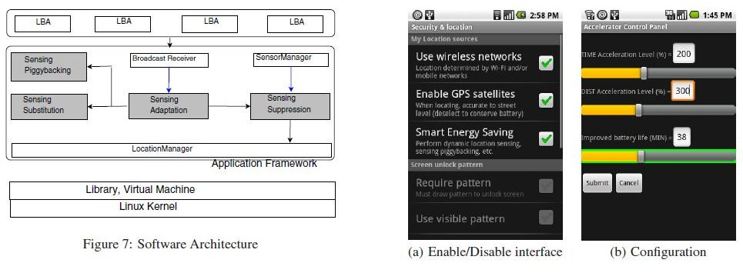
System Architecture

Slide 11
Reducing Energy Consumption
Sensing Substitution (SS)
Sensing Suppression (SR)
Sensing Piggybacking (SP)
Sensing Adaptation (SA)

Slide 12
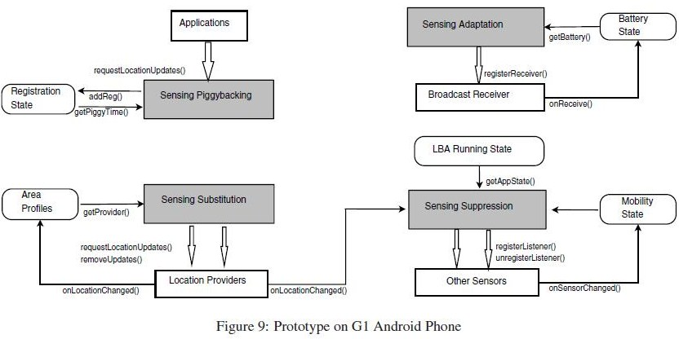
Reducing Energy Consumption

Slide 13
Sensing Substitution
Android phones allow applications to register which location sensing mechanism they want to use when they register their locations
There is no way to swich mechanisms on the fly as conditions change

Slide 14
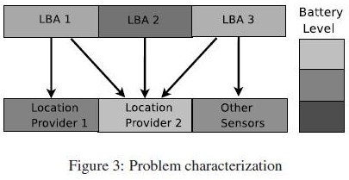
Sensing Substitution

Slide 15
Sensing Substitution
This project uses SS to serve as a middleman to do dynamic selection of mechanisms
It creates a profile of the areas a user travels through and substitutes the optimal mechanism depending on the profile

Slide 16
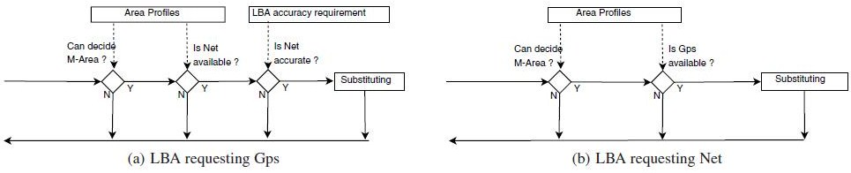
Sensing Substitution

Slide 17
Sensing Substitution
A mechanism is optimal if it meets the accuracy requrements and uses less energy
When GPS is needed but unavailable Net can be sustituted
When only Net accuracy is needed and Net is unavailable GPS will be substituted with reduced update frequency

Slide 18
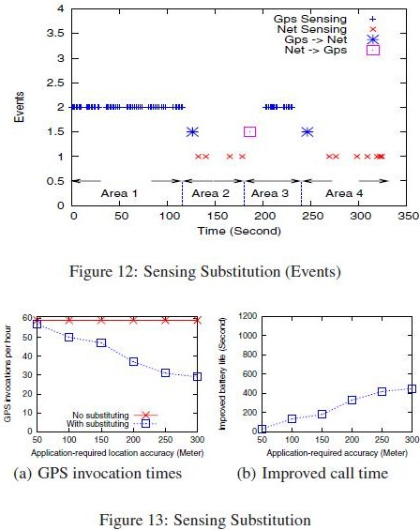
Sensing Substitution

Slide 19
Sensing Suppression
An application calls the location mechanism even when the user stays in one place for an extended period of time
SS uses the lower powered accelerometer and orientation sensors to determine the state of mobility
If the mobility state is determined to be static use of the location sensing is supressed

Slide 20
Sensing Suppression
Supression is dependant on application requirements
  If an application has coarse location needs supression occurs more readily
The location mechanism is called periodically even in suppressed mode to validate the state
Users are allowed to manually adjust the state
States are determined with confidence levels that use profiled route information

Slide 21
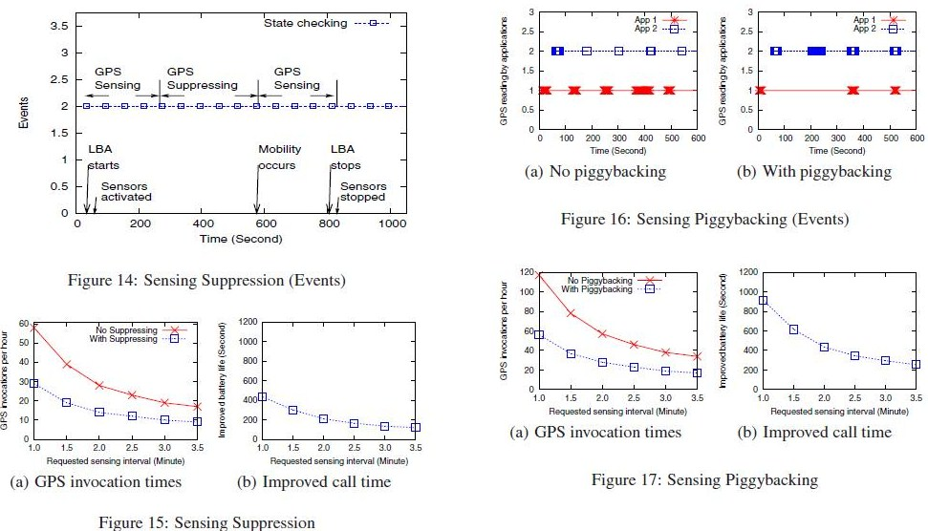
Sensing Suppression

Slide 22
Sensing Piggybacking
Applications don’t syncronize their requests for the location mechanism
Sensing Piggybacking coordinates the requests of multiple applications to make the least amount of calls to the location mechanisms possible

Slide 23
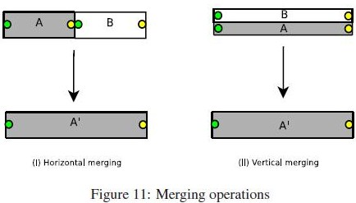
Sensing Piggybacking

Slide 24
Sensing Piggybacking
For example,If there are two applications that register to use a location mechanism 1 with a 1 minute interval and another with a 2 minute interval the use at 1 minute intervals is used to satisfy the 2 minute interval need

Slide 25
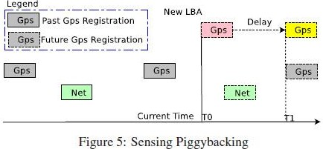
Sensing Piggybacking

Slide 26
Sensing Piggybacking
GPS and Net requests are considered separately, but If there are no other Net requests, a GPS request can be substituted

Slide 27
Sensing Piggybacking

Slide 28
Sensing Adaptation
When the battery is running low users may accept lower accuracy in a trade off for longer phone use time
SA adjusts the intervals of calling the GPS when the battery is low
The user has the ability to manually input the desired application degrees

Slide 29
Sensing Adaptation
A threshold e.g. 20% is set by the user below which SA kicks in
SA adjusts the intervals of calling the GPS when the battery is low
The user has the ability to manually input the desired application degrees

Slide 30
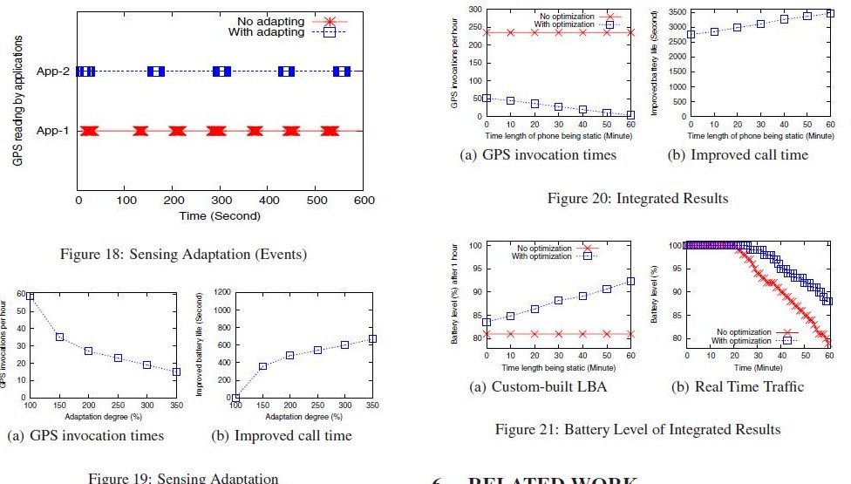
Sensing Adaptation

Slide 31
Integrated Operation
At time T0 user is initially in motion and the battery level is high, SS begins to work
At T1, SP becomes operational
When the user becomes static, SR kicks in
When the battery level becomes low,SA comes into play
As the user starts moving again, SR stops, and SS is invoked if possible

Slide 32
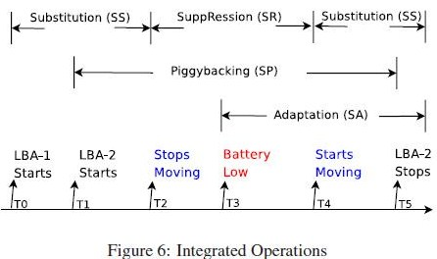
Integrated Operation

Slide 33
Mobility Profiling
Both SR and SS use the M-Area structure
M-Area is an area, generated by profiling, that has a particular characteristic of GPS and Net
Each area is a rectangle with 3 properties:
  Boundary-start, end, width
  Usage-number of visits, last visit time
  Sensing charistics-availability and accuracy of GPS and Net

Slide 34
Mobility Profiling
SR and SS change states as a user moves from one M-Area to another
There is a tradeoff with M-Area Size
  Larger M-Area, higher Supression probability
  Smaller M-Area, less storage space and processing time

Slide 35
Results
SR
  Effectively supresses about half of GPS sensing and improves battery life for calls by 400s
SP
  Improved call-making time by up to 650s per hour

Slide 36
Results
SA
  For every hour of running a location sensing application about 20 minutes of phone-call time can be saved
SS
  With a 300-meter accuracy requirement GPS invocations reduced by 50%

Slide 37
Conclusion
GPS usage reduced by 98%
Improved battery life by up to 75%
Android platform was chosen for it’s open nature and popularity
How much the application can accomplish may depend on OS architecture

Slide 38
Current Work
Energy-Efficient Rate-Adaptive GPS-based Positioning for Smartphones
Uses bluetooth and accelerometer to help with positioning and minimized GPS use
Uses celltower RSS blacklisting to avoid the use of GPS where it is not availabe

Slide 39
Future Work
Application-aware tuning of location-sensing parameters
Indoor location-sensing (e.g. use of WiFi networks)

Slide 40
Questions?

Slide 41

References
Zhenyun Zhuang1∗ Kyu-Han Kim2† Jatinder Pal Singh2, 1Georgia Institute of Technology, Atlanta, GA 30332, U.S.A. 2Deutsche Telekom R&D Laboratories USA, Los Altos, CA 94022, U.S.A., zhenyun@cc.gatech.edu, kyu-han.kim@telekom.com, jatinder.singh@telekom.com, Improving Energy Efficiency of Location Sensing on Smartphones
Android programming tutorial [Chau Ngo]
iPhone programming tutorial [Jonathan Mohlenhoff]
Shane B. Eisenman, Emiliano Miluzzo, Nicholas D. Lane, Ronald A. Peterson, Gahng-Seop Ahn, and Andrew T. Campbell, "BikeNet: A Mobile Sensing System for Cyclist Experience Mapping", ACM Transactions on Sensor Networks (TOSN), vol. 6, no. 1, December 2009, Bikenet

