Slide 1
The JIGsaw continuous Sensing engine for mobile phone Applications
Eric Minner
4/11/2011
Hong Lu,† Jun Yang,! Zhigang Liu,! Nicholas D. Lane,† Tanzeem Choudhury,† Andrew T. Campbell†
†Dartmouth College, {hong,niclane,campbell}@cs.dartmouth.edu, {tanzeem.choudhury}@dartmouth.edu
!Nokia Research Center, {jun.8.yang,zhigang.c.liu}@nokia.com

Slide 2
Outline
Introduction
Design Considerations
Detailed Design
Implementation
Evaluation
Conclusion

Slide 3
Introduction
Paper presents a implementation and analysis for “long term sensing” on mobile devices.
Attempts to balance performance needs to the resources necessary for continuous sensing.
Emphasis on the accomplishing the following tasks :
  Resilient accelerometer data processing
  Intelligent microphone processing throttled by the content of the input data.
  Adaptive Pipeline processing which reduces the frequency of expensive functions based on other sensed data.

Slide 4
Introduction
Compute higher level inferences and representations of human activities and context.
Goals include :
  Function with different phone locations on the body and different orientations.
  Allow data to be collected for a complete charge cycle while sustaining normal phone usage.

Slide 5
Design Considerations –
Accelerometer Pipeline
Accelerometer sampling has a low energy cost.
The main barrier here is the robustness of inferences.
  The effect of the phones location on the body.
  The artifacts induced between times of transition, referred to as extraneous activities.

Slide 6
Design Considerations –
Accelerometer Pipeline
Proposed techniques to overcome issues :
  Use calibration data to model the sensors response from various positions under certain activities.
  Use other phones functions to determine if the phone is under a extraneous activity. (i.e. texting, etc)

Slide 7
Design Considerations –
Microphone Pipeline
Heavy burden on computational resources due to sampling rate of audio.
To overcome this the application allows three small sound processes in parallel.
  regulates how much data enters the pipeline with duty cycle control.
    Short circuits input to pipelines for common but distinctive sounds.
  Also minimizes redundant classification operators when the sound type does not change.

Slide 8
Design Considerations –
GPS Pipeline
Most costly sensor in terms of energy consumption.
Key is optimizing the sampling schedule while minimizing the localization error.
Dynamically learn the sampling schedule by using a Markov Decision Process.
  Use accelerometer readings to trigger GPS sampling.
  Also uses user mobility mode to change the sampling frequency.

Slide 9
Detailed Design –
Accelerometer Pipeline
One-Time calibration phase.
4 Stages of Real Time Pipeline
  Pre-Processing
  Feature Extraction
  Activity Classification
  Smoothing

Slide 10
Detailed Design –
Accelerometer Pipeline
Calibration
  Determines offsets and gains to normalize all sensors to the same output unit.
  Two options for calibration
    User Driven
      User places his/her phone in various positions and orientations.
      Takes a minute or so.
    User Transparent
      SW automatically grabs samples when it deems fit and then uses collected data to perform the same analysis as the user driven calibration.
      Takes 1 to 2 days to collect enough information.

Slide 11
Detailed Design –
Accelerometer Pipeline
Preprocessing
  Normalization
    Takes raw data normalizes it with respect to gravity.
  Admission Control
    Rejects extraneous events.
      Uses absolute difference between previous and current accel. data.
  Projection
    Transforms the normalized vectors into vertical and horizontal components.

Slide 12
Detailed Design –
Accelerometer Pipeline
Feature Extraction
  Computes and tracks :
    Time Domain :
      Mean
      Variance
      Mean Crossing Rate
    Frequency Domain :
      Spectrum Peak
      Sub Band energy
      Spectral Entropy

Slide 13
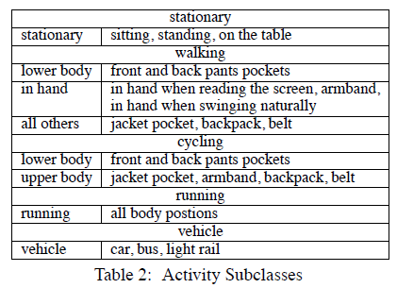
Detailed Design –
Accelerometer Pipeline
Activity Classification
  Uses extracted features to classify into a specific activity

Slide 14
Detailed Design –
Accelerometer Pipeline
Smoothing
  Provides simple sliding smoother to classification output to reduce outliers.

Slide 15
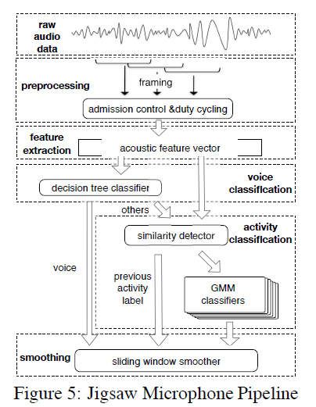
Detailed Design –
Microphone Pipeline
Preprocessing
  Regulates resource usage of the microphone pipeline.
  Uses longer than traditional frames with no overlap. (64ms samples)
  Admission control block throws away packets indicative of silence and reduces duty cycle of sampling/processing.

Slide 16
Detailed Design –
Microphone Pipeline
Feature extraction
  Optimal set of features is extracted from each frame of audio.
  DC component is removed before frequency analysis.

Slide 17
Detailed Design –
Microphone Pipeline
Voice classification
  Inexpensive yet effective classifier.
  Trains decision tree classifier with data set that compromises of almost 1GB of audio.

Slide 18
Detailed Design –
Microphone Pipeline
Activity classification
  Computationally expensive.
  Detects brushing teeth, shower, typing, vacuuming, washing, hands, crowd noise, and street noise.
  Similarity detector is used to curb how often the complex GMM Classifier is used.
    This compares frames of audio to try and detect if they are similar enough to previous frames.

Slide 19
Detailed Design –
Microphone Pipeline
Activity classification (Cont)
  Gaussian Mixture Model (GMM)
  Likelihood model generated for each activity class
  The class with the highest likelihood is compared to a threshold to decide if it is valid or the model returns an “Unknown Sound.”

Slide 20
Detailed Design –
Microphone Pipeline
Smoothing
  Implemented simple classification smoothing window in favor of more complex models.
  Simple and computationally inexpensive.

Slide 21
Detailed Design –
GPS Pipeline
Smoothing
  Duty cycle triggered by accelerometer readings and throttled by the users mobility pattern.
    This allows maximum power savings with minimal latency and maximum performance.
    Duty cycle ranges from constant samples to 20 minute intervals.
  Performs battery budgeting, slowing down duty cycle as battery life becomes critical.

Slide 22
Implementation
Implemented and evaluated on Nokia N95 and Apple iPhone.
~2000 lines of base code.
  Efficient use of semaphores and async processes allows low CPU cycles in processing portions of code.
Uses a 32Hz sampling rate for the accelerometer and streams 8 kHz, 16-bit, mono audio from the microphone.
Allows different applications to use different parts of the engine at any given time.

Slide 23
Implementation

Slide 24
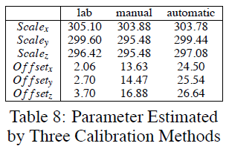
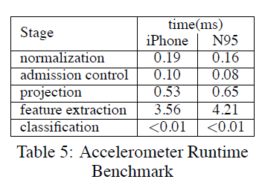
Evaluation
Accelerometer Performance

Slide 25
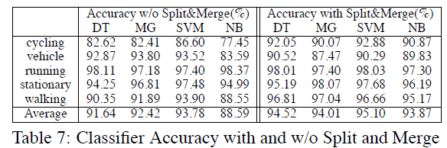
Evaluation
Accelerometer Performance
  Tested with 4 classifiers with and w/o split and merge process.
    Decision Tree (DT)
    Gaussian Model (MG)
    Support Vector Machine (SVM)
    Naive Bayes (NB)
  Decision tree classifier chosen due to its performance to computational cost ratio.

Slide 26
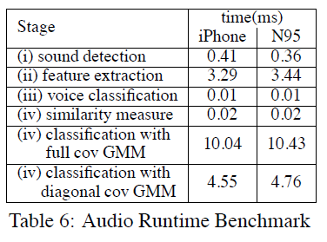
Evaluation
Microphone Performance

Slide 27
Evaluation
GPS Performance
  To evaluate accelerometer inferences are collected along with GPS coordinates on both weekdays and weekends.
  Data is used to optimize the sampling time and derive the best performance to power balance.

Slide 28
Conclusion
All 3 pipelines perform very close to significantly more complex implementations.
Very well optimized in both iPhone and N95 device.
Overall very modular design that can be configured and tailored for many practical applications.

Slide 29
Questions

Slide 30
References

