Slide 1
PEIR, the Personal Environmental Impact Report
A platform for Participatory Sensing Systems Research
Samori Ball
EEL 6788
2/21/2011

Slide 2
What is a PEIR?
Personal Environmental Impact Report
What is an Environmental Impact Report?
An Environmental Impact Report is conducted for a proposed project to determine how the project, if implemented, will affect the environment.
A PEIR is substantially different from an EIR.
In this case a PEIR is a 2 way report to determine what impact each person has on the environment as well as the impact the environment has on each person.

Slide 3
What is PEIR?
Who created PEIR?
The PEIR participatory sensing application is a collaborative project between several professors in the Center for Embedded Networked Sensing at the University of California, Los Angeles and researchers at the Nokia Research Center, Palo Alto.
It is supported by Nokia and the National Science Foundation (NSF)

Slide 4
What is PEIR?
Why was PEIR Created?
To bring specific environmental aspects of our personal lives to light so that its users can make more informed and responsible decisions
Realtime website and Facebook app.
Students compete to achieve the lowest environmental impact.
Help people to avoid environmental risks
Routes are generated showing exposure along the route.
Participants can share route information.(manually)
Demonstrate the broad applicability of the processing model used in PEIR to other geographically organized models.
Fast Food exposure metric
The metrics were selected because of their social relevance, and their ability to be customized for individual participants using time-location traces.

Slide 5
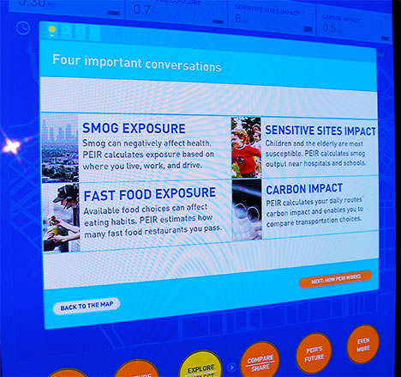
What is PEIR?
What does PEIR Measure?
Smog or particulate exposure(PM2.5)
A user’s transportation-related exposure to particulate matter emissions from other vehicles.
Carbon Impact(CO2)
Measure of transportation-related carbon footprint, a greenhouse gas implicated in climate change
Sensitive Site Impact
A user’s transportation-related airborne particulate matter emissions (PM2.5) near sites with populations sensitive to it, such as hospitals and schools
Fast Food exposure
The time integral of proximity to fast-food eating establishments

Slide 6
Where is PEIR used?
Created in 2008
Up and running since June 2008 with 30 trial users
Currently in closed beta in several California cities between Los Angeles and San Francisco
Used by High School and College students as well as professors

Slide 7
Video about PEIR
http://www.youtube.com/watch?v=YGZ41wH74_s&feature=player_embedded

Slide 8
How does it work?
Participants use one of 3 phone clients,
2 for Symbian S60 3rd edition, and
1 for Windows mobile,
Tested phones included Nokia N80, N95, and E71.
The phone gathers data from the users and sends it to a server every 30 seconds.
Time,
GPS
Accelerometer
The server processes the data to determine which activity the user is performing:
Standing,
Walking,
Driving.

Slide 9
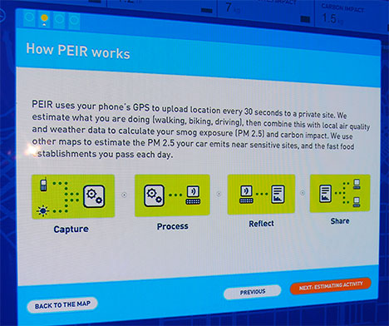
How does it work?
The sever then uses the
Activity,
Location, and
Time data
This data is cross referenced with
MADIS weather information from NOAA
Traffic models and
Vehicle emission estimates from California Air Resources Board(CARB) data model for fine particulate matter(PM 2.5)
Carbon dioxide estimated from California Air Resources Board(CARB) data model to calculate exposure.

Slide 10
How does it work?
When a user is determined to be in the activity, driving,
The speed is calculated
The result is combined with estimated vehicle emissions to determine a users particulate matter and carbon pollution
This result is compared to locations of sensitive sites to determine if the user has come within 200 feet.
The server uses the location information to determine whether a user has come within 1/4 mile of a fast food restaurant.
The sever segments the data into trips.
Trips are defined as traveling from one place to another where the user stays for more than 10 minutes.

Slide 11
How does it work?
The server takes the data and trips and sends the data to:
The web
A facebook application
Once the data is on the web:
The route information can be viewed
Exposures along route are calculated and viewed
Aggregated data is viewable
Trends can be analyzed

Slide 12
How does it work?
Server-side processes are implemented using
Python code,
Shell scripts, and
Native/pre/compiled libraries
Reads from Post GIS and implemented in PHP and Flash
Served by Apache using Wordpress.

Slide 13
How does it work?

Slide 14
How does it work?

Slide 15
Technical Challenges
Activity Classification
Map Matching
Near Real Time Modeling of Exposure and Impact
Privacy

Slide 16
Technical Challenges
Activity Classification
To differentiate walking from being stuck in rush hour traffic freeway annotated GPS data is used
Map matching
Naïve matching
Finds the nearest road segment a correct match
Sensitive to spatial road network and often fails
Intersection-based
Compares the 2 nearest roads and intersections to GPS data point
Intersection w/nearest road and substitution
Uses the Intersection-based approach adding an algorithm for cases when there are not common roads between 2 consecutive intersections

Slide 17
Technical Challenges
Activity Classification
Difficult to differentiate between walking from driving slow on a residential street
Determining walking from standing inside buildings is problematic for some users

Slide 18
Technical Challenges
Near Real Time Modeling of Exposure and Impact
GPS records were sampled every 30 seconds
Reduces power and bandwidth
Lowest sample rate that still resulted in good automatic classification of high speed travel by car.
The Emissions Factors Model(EMFAC) was too slow.
An approximation to the EMFAC was developed via a functional ANOVA model

Slide 19
Technical Challenges
Privacy
PEIR defaults to sharing only aggregate impact and exposure data
Both user profiles and the Facebook application share and compare daily impact and exposure numbers without revealing any location data
Route Sharing not currently implemented, but security issues are discussed.
Route Hiding
Route hiding is considered for partial route sharing
Deleting parts of a route would look suspicious
Route hiding lets a part of a shared route be inconspicuously replaced

Slide 20
Technical Challenges
Privacy
Retention and Deletion
Retained data of a users data could be subject to theft or subpoena
Aggregate data is retained indefinitely
User location data is deleted after 6 months
Users can change retention length
Users can delete specific routes or locations in their trip diaries

Slide 21
Weaknesses
Modeled Data
EMFAC data is an approximation and this system actually uses an approximation of that
EMFAC data is not based on a specific vehicle, but a vehicle type
GPS map data is not completely accurate
Actual exposure window up/down, Dusttrack
Exposure estimate doesn’t compensate for window up/down for exposure
Ambient background PM2.5 exposure is not taken into consideration
Residential PM2.5 is underestimated
High Traffic Area PM2.5 is overestimated

Slide 22
Future planned improvements and extensions
Enable users to share location data with people they trust
Giving users the option to share designated routes with specific people to encourage discovery of new routes
Enhancements to improve scalability
Modular interfaces
Easier integration with local models and data sets relevant to PEIR inferences
Extend the activity classification to accommodate modalities common in other locations
Cycling
Bus
Train
Subway

Slide 23
Questions?

Slide 24
Resources Used
Personal Environmental Impact Report
PM2.5 Exposure Level Validation and Outdoor UCB Particle Monitor Assessment for Personal
Environmental Impact Report – research.cens.uda.edu
Green at WIRED NextFest:GPS-Based Personal Environmental Impact Report(PEIR)- www.treehugger.com
Part 04 Per Personal Environmental Impact Report(PEIR) Validation and Redesign – research.cens.uda.edu/urban/2010/part04.pdf
Personalized estimates of environmental exposure and impact – urban.cens.uda.edu/projects/peir

