Slide 1
Participatory Sensing in Commerce: Using Mobile Camera Phones to Track Market Price Dispersion
Nirupama Bulusu
Portland State University
Chun Tung Chou, Sali Kanhere, Yifei Dong, Shitiz Sehgal, David Sullivan, and Lupco Blazeski
University of South Wales
From UrbanSense 2008
Presented by:
Travis Cossairt
April 4th, 2011
EEL 6788

Slide 2
Overview
Introduction
Related Work
Challenges
Proof of Concept Systems:
  PetroWatch: Automated Fuel Price Collection
  Mobishop: Semi-automated Scanning of Receipts
Conclusion
Discussions

Slide 3
Introduction
“Price Dispersion” – refers to price difference of a homogenous good across different vendors, e.g. gas price, grocery items, etc.
Attributed to several causes including the consumer search cost incurred in collection price information (i.e. takes time to look up and compare prices)
Good reasons to collect this info, notwithstanding empowering consumers to negotiate better prices

Slide 4
Introduction (cont.)
Existing consumer communities already tracking price dispersion (manually):
  Hong Kong housewives divided themselves into teams and manually copied prices of selected staple grocery items and uploaded to a website, led to newspaper to advertise on its website
  Fuel prices are collected manually in several countries by volunteers and uploaded to websites
Manual process however is cumbersome, error-prone, and not up-to-date
Authors propose their vision of using participatory camera phone sensing to solve some of these problems

Slide 5
Related work
Participatory Sensing systems used in several domains including:
  Collecting health info (DietSense [1])
  Intelligent Transportation (Traffic Sense [2])
  Air-Quality Monitoring (“Sensing Atmosphere” [3])
Authors have prepared two proof of concept systems in the domain of commerce
  They suggest that were first to apply to commerce
  Reuters Market Light system provides farmers with up-to-date crop prices [4], but is distinct from this work in that the authors focus on empowering consumers and collecting information from them

Slide 6
Challenges
Data from camera phones not in a consistent format, thus hard to aggregate pricing info across different retailers (vs. well formed web XML)
Larger # of goods/consumers make it difficult to collect information into a single database (thus most apps/system focus on a single good)
Computer vision challenges extracting price info
Having optimal positioning of camera phones for image capture

Slide 7
More Challenges
Inherent challenges in all participatory systems:
  Incentivizing participation
    Need to lower technical and any monetary barrier
      System should be simple and automated
      Take advantage of “free” channels like WiFi
    Offer information reward to contributers
  Security, privacy, and data reliability
    Need to protect not only location for privacy, but also shopping behavior
    Integrity of data needs to be ensured such that no bogus data is contributed (e.g. retailer poisoning data to show competition is higher)
  Authors expect to build upon other solutions being developed in the long term, but not in this paper

Slide 8
Proof of concept Systems
Two proof of concept systems built to show that processing and deliver product pricing info via mobile camera phones can be accomplished:
  PetroWatch
    Automates collection of fuel prices by taking photographs of roadside fuel price boards, processed by computer vision, and mapped to GIS data of stations in the backend
  MobiShop
    Photograph store receipts, processed by OCR, and stored into central database for store/product comparisons

Slide 9
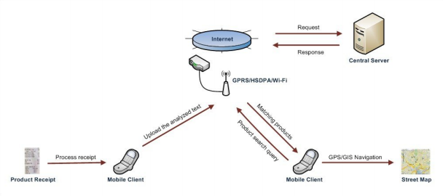
Proof of concept Systems Architecture
Both systems built using similar client-server architectures
Operate in two modes: Price collection, User Query

Slide 10
Proof of concept Detailed PAPERS
The two applications described here are further detailed in their own papers:
  “Automatic Collection of Fuel Prices from a Network of Mobile Cameras” [5]
  “MobiShop: Using Mobile Phones for Sharing Consumer Pricing Information” [6]

Slide 11
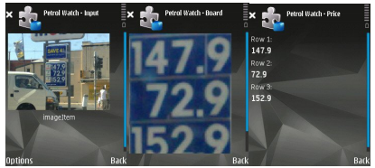
Petrowatch: automated Fuel Price Collection
Automated collection of fuel prices by triggering mobile phones to photograph fuel price boards when users approach service stations

Slide 12
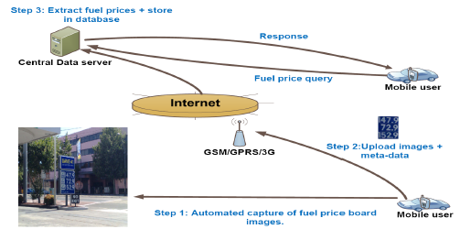
Petrowatch: automated Fuel Price Collection
Central server implements the computer vision algorithms for processing the images and extracting the fuel prices
Relies on GIS database and GPS location to derive what station the user is at
Also relies on unique fact that each brand has a specific color for its fuel price board

Slide 13
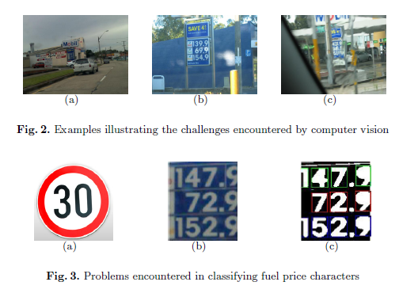
Petrowatch: automated Fuel Price Collection

Slide 14
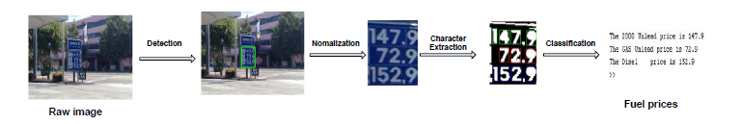
Petrowatch: automated Fuel Price Collection
Post-processing techniques used in some cases to narrow search when other similarly colored objects in photograph (e.g. the sky vs. Mobil fuel price board)
  Color thresholding, color histogram, etc. used to get precise board location
Image cropped to contain only the board, and normalized to standard size/resolution
Feedforward Backpropagation Neural Network algorithm used to classify price numeral characters

Slide 15
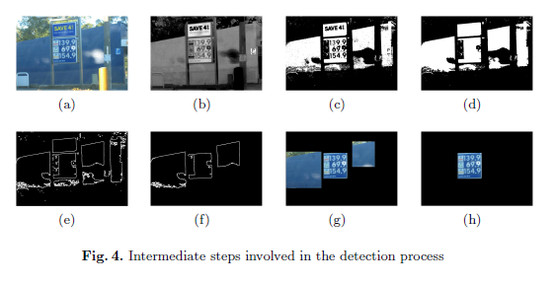
Petrowatch: automated Fuel Price Collection

Slide 16
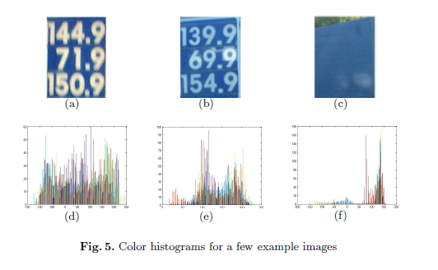
Petrowatch: automated Fuel Price Collection

Slide 17
Petrowatch: automated Fuel Price Collection
Prices stored in a database, and linked to GIS road network database populated with the service station locations
Server updates fuel prices for appropriate station if current image has a new timestamp
History recorded to allow analyzing pricing trends

Slide 18
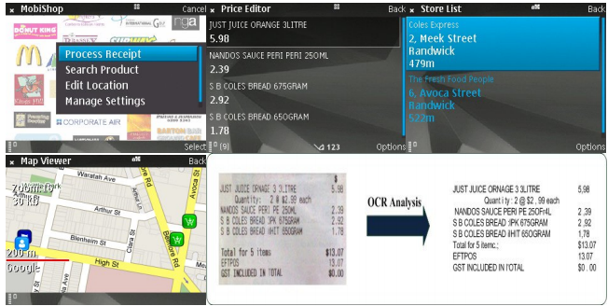
Mobishop: Semi-automated Scanning of Receipts
Users photograph actual store receipts, and OCR technology to extract pricing and product info

Slide 19
Mobishop: Semi-automated Scanning of Receipts
Uploaded along with location/time info, and interfaces with a GIS street map for viewers
Using native Symbian OS 9.2 OCR engine, achieved about 60% accuracy of items
Allows users to manually edit text to fix the rest
Also ability to delete personal info like credit card details

Slide 20
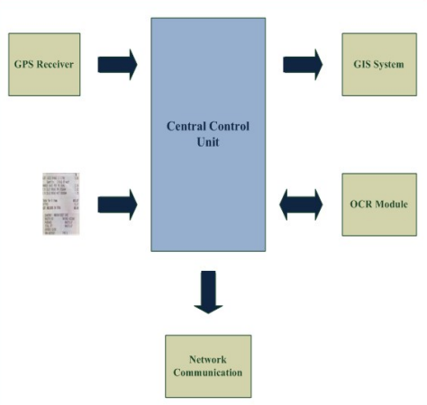
Mobishop: Semi-automated Scanning of Receipts
Implemented in JavaME for portability on a Nokia N95 8GB phone
Interfaces with external GIS library (J2MEMap) to highlight store locations on street map for navigation
Server side also written in Java/Tomcat

Slide 21
Conclusions
Authors explored participatory camera sensing for tracking price dispersion in offline markets (fuel stations, retail product prices)
Claimed to be first to apply participatory sensing in commerce domain
System could be extended to help consumers track spending habits, receive promotions, and other track other homogenous goods

Slide 22
Discussion
Strengths
  Two simple and interesting applications of participatory sensing in the domain of commerce
Weaknesses
  PetroWatch very dependent on assumption that each brand has unique colored fuel price board – these days many are digital with black background!
  Also must assume stations have just Reg,Mid,Premium
  MobiSense depends on items being entered that are purchased, thus no prices tracked for item’s not purchased or popular (or maybe too expensive!)
  60% OCR accuracy still requires a lot of manual entries/editing (authors admit future work here)

Slide 23
Discussion Cont.
Applications seem to be a good start, but never fully explored or made into complete system that’s useful
Fail to describe the usage of the data, e.g. all the fuel prices uploaded to server, what next?
Seems to focus on data collection only in this paper scope

Slide 24
Additional References
[1] S. Reddy, A. Parker, J. Hyman, J. Burke, D. Estrin, and M. Hansen, “Image Browsing, Processing, and Clustering for Participatory Sensing: Lessons From a DietSense Prototype”, in Embedded Networked Sensors, Ireland, June 2007.
[2] P. Mohan, V. Padmanabhan, and R. Ramjee, “TrafficSense: Rich Monitoring of Road and Traffic Conditions using Mobile Smartphones”, Microsoft Research Technical Report, MSR-TR-2008-59, Apr 2008.
[3] E. Paulos, R. Honicky, E. Goodman, “Sensing atmosphere”, In: Workshop on Sensing on Everyday Mobile Phones in Support of Participatory Research, Sydney, Australia, Nov 2007.
[4] D. Grammaticas, “Text messages empower poor farmers”, BBC News, 6 May 2008.
[5] Y.F. Dong, S. Kanhere, C.T. Chou, and N. Bulusu, “Automatic Collection of Fuel Prices from a Network of Mobile Cameras”
[6] Shitiz Sehgal, Salil S. Kanhere, Chun Tung Chou, “MobiShop: Using Mobile Phones for Sharing Consumer Pricing Information”

