Slide 1
An Architecture for Privacy-Sensitive Ubiquitous Computing
By
Jason I-An Hong
In MobiSYS ’04: Proceedings of the 2nd international conference on mobile systems, applications, and services
Presented by
Vignesh Saravanaperumal

Slide 2
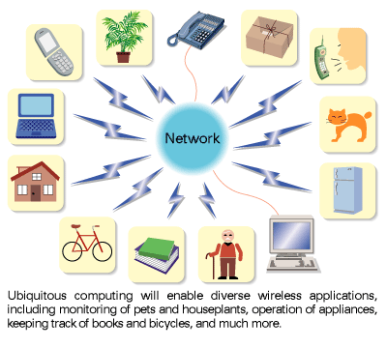
Ubiquitous computing ?
XEROX PARC
1980
Ubiquitous computing is the method of enhancing computer use by making many computers available throughout the physical environment, but making them effectively invisible to the user
– Mark Weiser
Ubiquitous computing, or calm technology, is a paradigm shift where technology becomes virtually invisible in our lives.
-- Marcia Riley

Slide 3
Risk Possessed?
Benefits
everyday ones - Intrusions from overprotective parents and overzealous marketers
extreme ones - Threats to civil liberties by governments as well as dangers to one’s personal safety by stalkers, muggers, and domestic abusers
Helping patients with Alzheimer’s disease
Support for emergency responders
Real-time monitoring of soil conditions

Slide 4

Work done so Far
Security based on
providing anonymity
Secrecy
The missing one was
Personal Privacy

Slide 5
Objective of the paper
The goal of this paper is to empower people with choice and informed consent, so that they can choose to share the right information, with the right people and services, in the right situations
Confab Toolkit

Slide 6
So why was the delay?
Problems
Difficulty in analyzing the privacy needs of end users
Difficulty faced in designing effective user interfaces for Privacy
Difficulty faced in implementing privacy-sensitive systems
Con Fab
A comprehensive set of end-user needs were gathered from a variety of sources.
These include scenario-based interviews that they conducted to understand
the range of privacy concerns with respect to Ubicomp applications.
They described a set of pitfalls in designing user interfaces for Ubicomp privacy,
derived from an analysis of over forty different applications for common
mistakes still being made
Notes:
This paper has implemented a framework called confab which overcomes the first 2 problems. Which we will see in the coming slides. The first 2 problems were addressed through numerous interviews and arrived at a conclusion.
To address this, we present an analysis of interaction design for ubicomp
privacy. Informed by examining over 40 different user interfaces for privacy, we
describe common user interface pitfalls as well as ways of avoiding those pitfalls.
We will see how confab was designed in implementing privacy sensitive systems. The specialty of confab is that it satisfied all the end users and developers need which were got from the numerous interview which was conducted.

Slide 7
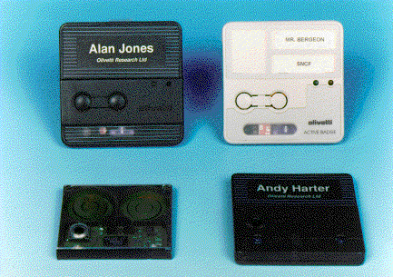
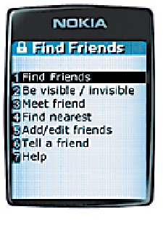
Pitfalls in Designing for Privacy
Obscuring Actual Flow
Users should understand what is being disclosed to whom
  Many Ubicomp systems are “invisible” by default
  Systems should provide appropriate visibility
☒
☑
Who is querying my location?
How often?
“Bob will see this request”
“Alice has requested your location”

Slide 8
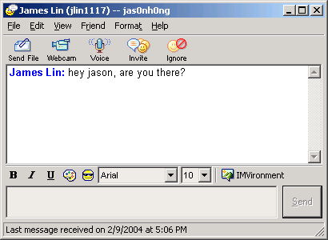
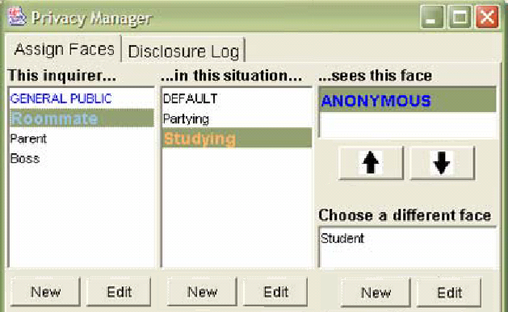
Pitfalls in Designing for Privacy
Configuration over Action
Designs should not require excessive configuration
  Configuration a typical “solution”, but hard to predict right settings
  Manage privacy in the actual context of use
☒
☑

Slide 9
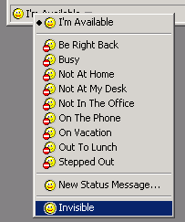
Pitfalls in Designing for Privacy
Fine-grained controls
Did I set it right?
How do I know?
This is a lot of work…
☑
☒

Slide 10
End-User Privacy Needs for
Ubiquitous Computing
clear value proposition
simple and appropriate control and feedback
plausible deniability
limited retention of data
decentralized control
special exceptions for emergencies

Slide 11
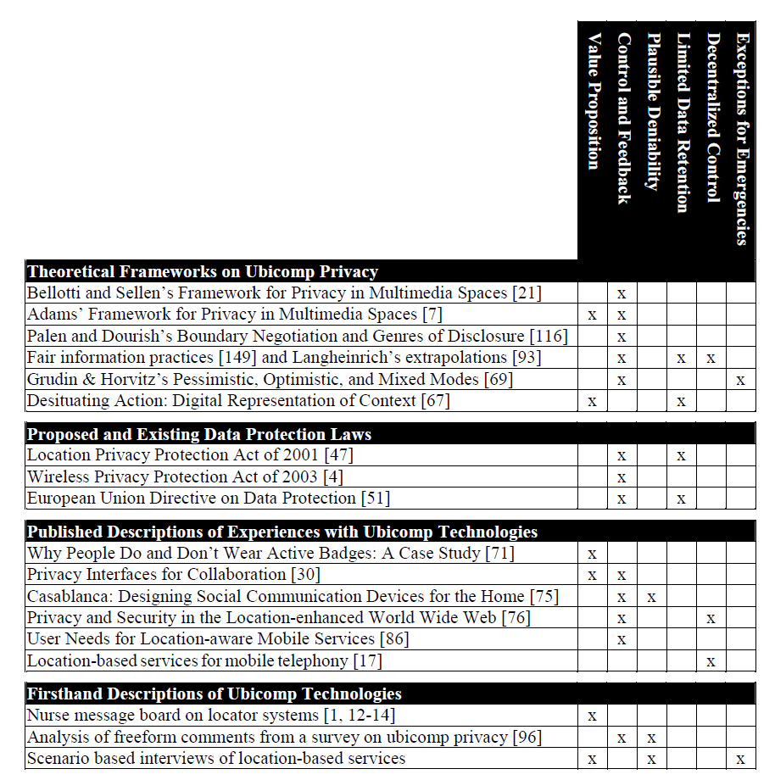
End-User Privacy Needs for
Ubiquitous Computing (work done so far)

Slide 12
Developer Privacy Needs for
Ubiquitous Computing
Support for optimistic, pessimistic, and mixed-mode applications
Tagging of personal information
Mechanisms to control the access, flow, and retention of personal information
Mechanisms to control the precision of personal information disclosed
Logging

Slide 13
Confab Framework
The physical / sensor layer
The infrastructure layer
The presentation layer
This approach gives end-users a greater amount of choice, control, and feedback than previous approaches over what personal information is disclosed to others
A key design decision behind Confab is to place all three of these layers on the end-user’s computer rather than distributing them throughout the network infrastructure

Slide 14
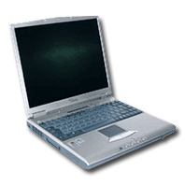
Confab High-Level Architecture
Capture, store, and process personal data on my computer as much as possible (laptops and PDAs)
Provide greater control and feedback over sharing
Name
Loc
My Computer
Personal
Data Store
Source
Sources
In Operators
Out Operators
App
Logging
Check Privacy Tag
Invisible Mode
Enforce Access
User Interface
On Operators
Garbage Collect
Periodic Reports

Slide 15
Confab Architecture
My Computer
Name
Loc
Out Operators
Flow Control
MiniGIS
InfoSpace
Data Store
Location
Messenger
PlaceLab
Source
Request
Tourguide

Slide 16
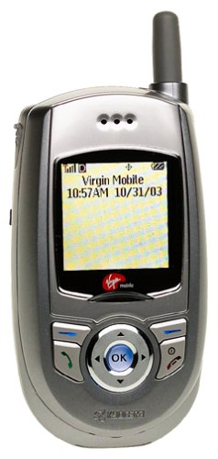
Infrastructure Layer
Confab’s Info Space Data Store
Info Space like a diary that stores your personal info
  Static info (ex. name and phone#)
  Dynamic info (ex. current location and activity)
Runs on your personal device or on a trusted service
  Can choose to expose different parts to people & services

Slide 17
A closer Look
Infrastructure Layer operators - Description
Notify operators:
Invisible mode operator:
Interactive operator:
Garbage Collector operator:
are used to send short messages to give end-users feedback about who is requesting information and when
can be used to block all outgoing tuples and return the value of “UNKNOWN” to all queries
can be used to give end-users control over disclosures.
is run periodically to delete any context tuple that has a privacy tag specifying that it should be deleted

Slide 18
A closer Look
Infrastructure Layer operators - Description
Privacy Tag:
Time To Live
Max Number of Sightings
Notify
Garbage Collect

Slide 19
A closer Look
Infrastructure Layer
Confab’s Built-in MiniGIS Operator
People and apps need semantically useful names - “Meet me at 37.875, -122.257”
Country Name = United States
Region Name = California
City Name = Berkeley
ZIP Code = 94709
Place Name = Soda Hall
Latitude/Longitude = 37.875, -122.257
MiniGIS operator transforms location info locally
  Using network-based services would be privacy hole

Slide 20
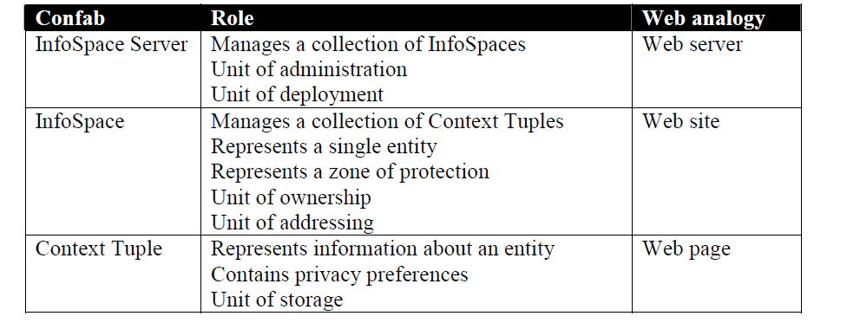
Confab’s Data Model

Slide 21
Implementation
Confab is implemented in Java 2 v1.5
Total Number of Classes = 550 classes
55,000 physical lines of code
Confab uses HTTP for network communication and is built on top of the Tomcat web server, making extensive use of Java servlets
Query Language: Xpath

Slide 22
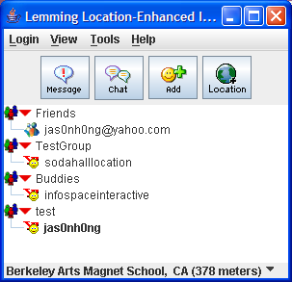
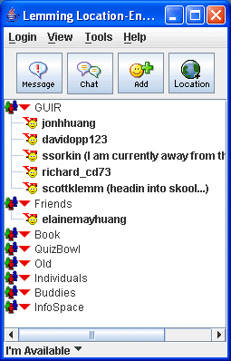
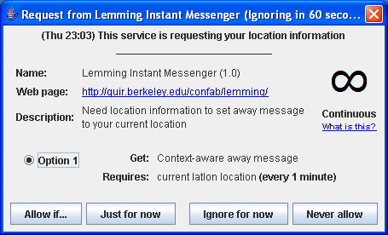
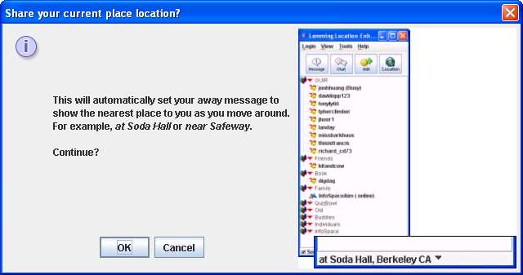
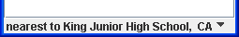
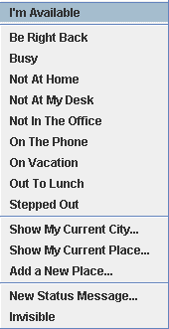
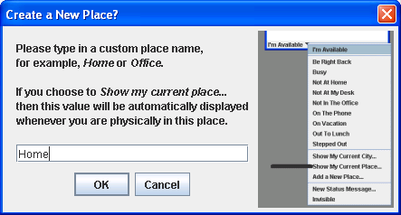
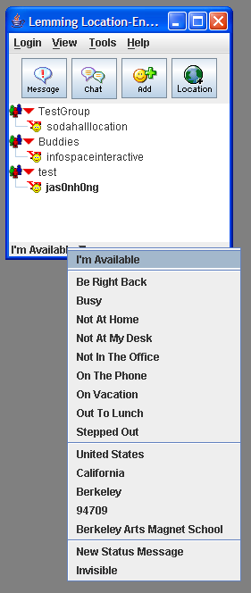
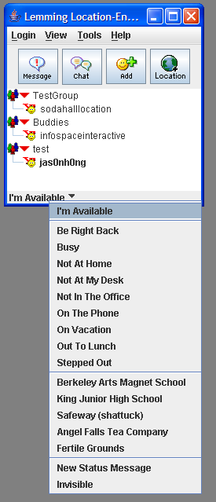
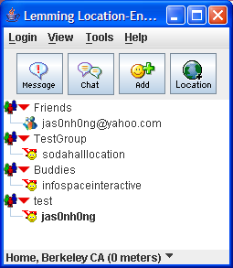
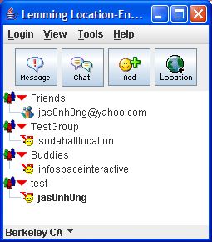
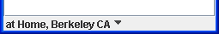
Lemming Location-Enhanced Instant Messenger

Slide 23
Future work
Continued Development and Evaluation of Ubicomp Applications
source code freely available
Deploying real applications to see how people use them
in realistic situations
Better Integration of Access Notifications with Instant Messengers

Slide 24
Related work
The PARCTab system - 1988
Cooltown
The Context Toolkit
Contextors , Limbo
Sentient Computing
Stick-E notes
MUSE
SpeakEasy
Solar
XWeb
GAIA
one.world
iRoom

Slide 25
Conclusion
Clear value proposition
Simple and appropriate control and feedback
  Access notifications.
Plausible deniability
  Default is “unknown”, can’t tell why
Limited retention of data
  Privacy tags, automatic deletion of data
Decentralized control
  PlaceLab source for capturing location info
  MiniGis service for processing location info
Special exceptions for emergencies
“Use technology correctly to enhance life. It is important that people have a choice in how much information can be disclosed. Then the technology is useful.”

Slide 26


