Slide 1

SoundSense: Scalable Sound Sensing for People-Centric Applications on Mobile Phones
-Hong LU, Wei Pan, Nicholas D. Lane, Tanzeem Choudhury and Andrew T. Campbell
-Department of Computer Science Dartmouth College, 2009, number of pages 14
Presented By: Rene Chacon

Slide 2
Sound Sense (Abstract)
Current use of Sound Sensing in mobile phones.
SoundSense, a scalable framework for modeling sounds events on mobile phones.
Implemented on Apple iPhone, supervised and unsupervised learning techniques for classification.
¹Paper: SoundSense: Scalable Sound Sensing for People-Centric Applications on Mobile Phones

Slide 3
Sound Sense (Introduction)
Sounds used to dictate a person’s surrounding environment .
Audio stream degrades more gracefully (phone in pocket) and as such is still useful.
¹Paper: SoundSense: Scalable Sound Sensing for People-Centric Applications on Mobile Phones

Slide 4
Sound Sense (Section 2)
Audio Sensing Scalability Problem
-Voice, Music, Ambient sounds
-hierarchical classification architecture
“Goal of SoundSense is to support robust sound processing and classifications under different phone context conditions.”
¹Paper: SoundSense: Scalable Sound Sensing for People-Centric Applications on Mobile Phones

Slide 5
Sound Sense (Section 2)
Privacy Issues and Resource Limitations
-SoundSense processes all audio data on the phone.
-Consider the accuracy and cost tradeoff.
-Microphone: 4kHz
¹Paper: SoundSense: Scalable Sound Sensing for People-Centric Applications on Mobile Phones

Slide 6
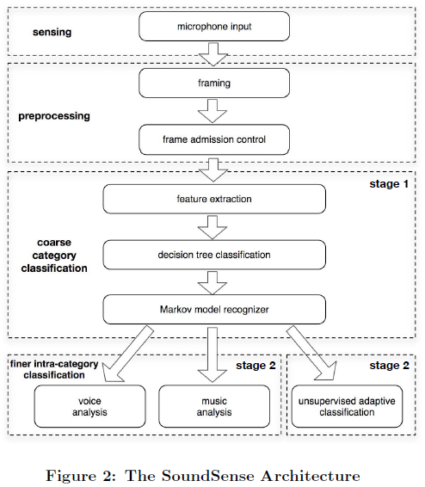
Sound Sense (Section 3)
¹Paper: SoundSense: Scalable Sound Sensing for People-Centric Applications on Mobile Phones

Slide 7

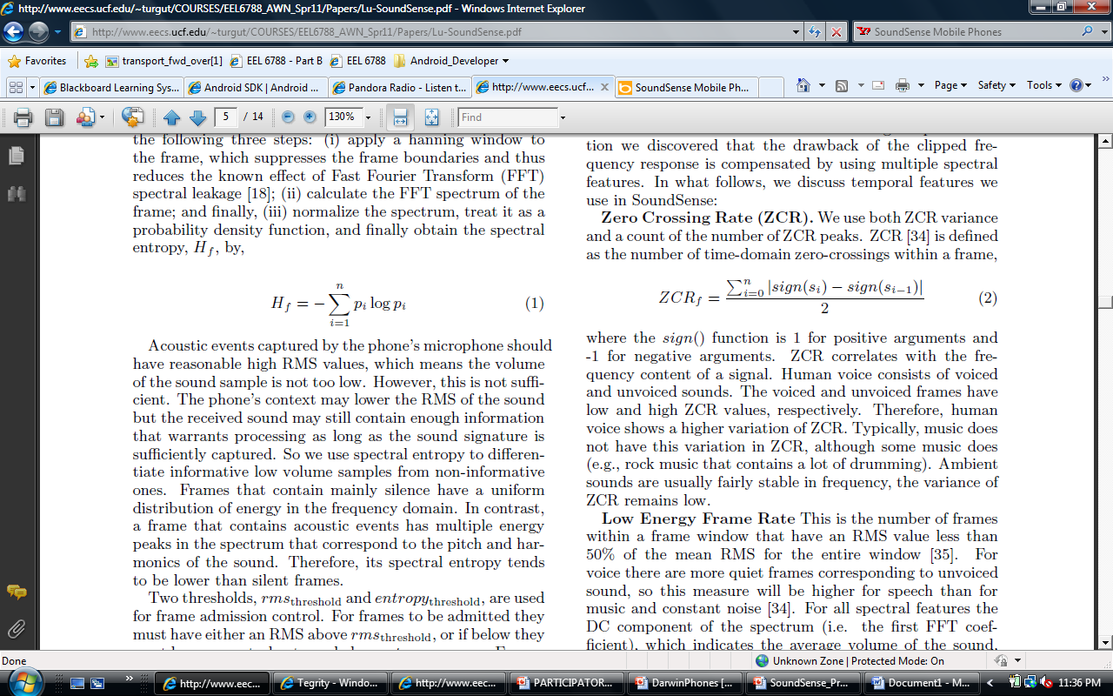
Sound Sense (Section 4)
Preprocessing
Framing (64ms)
Frame Admission Control
rms_{threshold} & entropy_{threshold}
¹Paper: SoundSense: Scalable Sound Sensing for People-Centric Applications on Mobile Phones

Slide 8
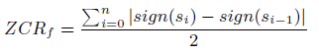
Sound Sense (Section 4)
Coarse Category Classification [voice, music, ambient]
-Zero Crossing Rate, human voice has high variation while music and ambient sounds have low.
-Spectral Flux (SF) measures the changes in the shape of the spectrum.
-Spectral Rolloff (SRF), Spectral Centroid (SC), and more.
¹Paper: SoundSense: Scalable Sound Sensing for People-Centric Applications on Mobile Phones

Slide 9
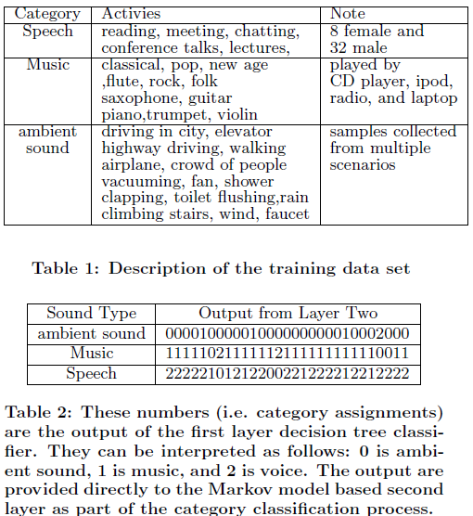
Sound Sense (Section 4)
Multi Level Classification – Use decision tree classifier
-Utilizing algorithms, Gaussian Mixture Models (GMMs), Hidden Markov Models (HMMs) and more.
¹Paper: SoundSense: Scalable Sound Sensing for People-Centric Applications on Mobile Phones

Slide 10
Sound Sense (Section 4)
Finer Intra-Category Classification
Unsupervised Ambient Sound Learning
-utilize Mel Frequency Cepstral Coefficient (MFCC) in depth details of frequency bands sensitive to human ear.
-Sound Rank and Bin Replacement Strategy
-User Annotation of New Sounds
¹Paper: SoundSense: Scalable Sound Sensing for People-Centric Applications on Mobile Phones

Slide 11
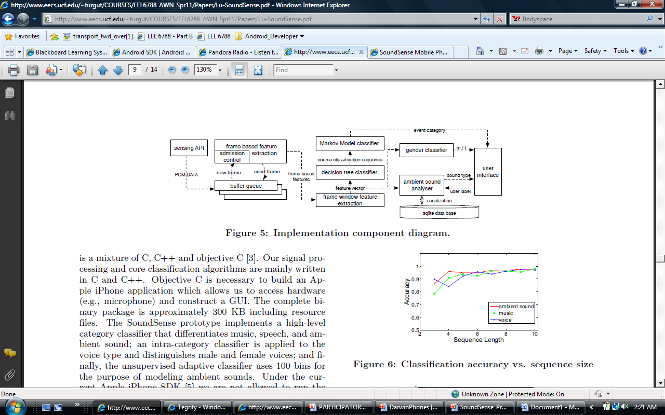
Sound Sense (Section 5)
PCM data: 8kHz, 16 bit
Frame: 512 samples ; lack of acoustic event: long duty cycle state
Either an intra-category classifier or unsupervised adaptive classifier
¹Paper: SoundSense: Scalable Sound Sensing for People-Centric Applications on Mobile Phones

Slide 12
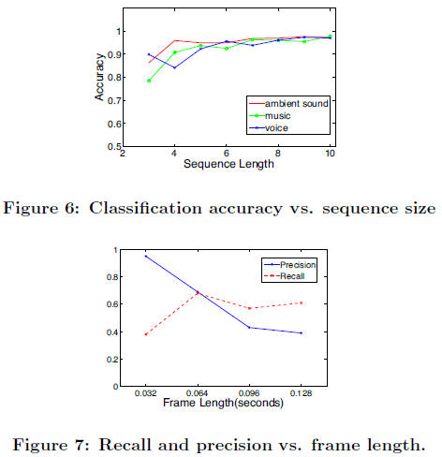
Sound Sense (Section 5)
Determining buffer sizes
-Ex. Output of the decision tree classifier before input to Markov model recognizer.
-Ex. MFCC frame length
¹Paper: SoundSense: Scalable Sound Sensing for People-Centric Applications on Mobile Phones

Slide 13
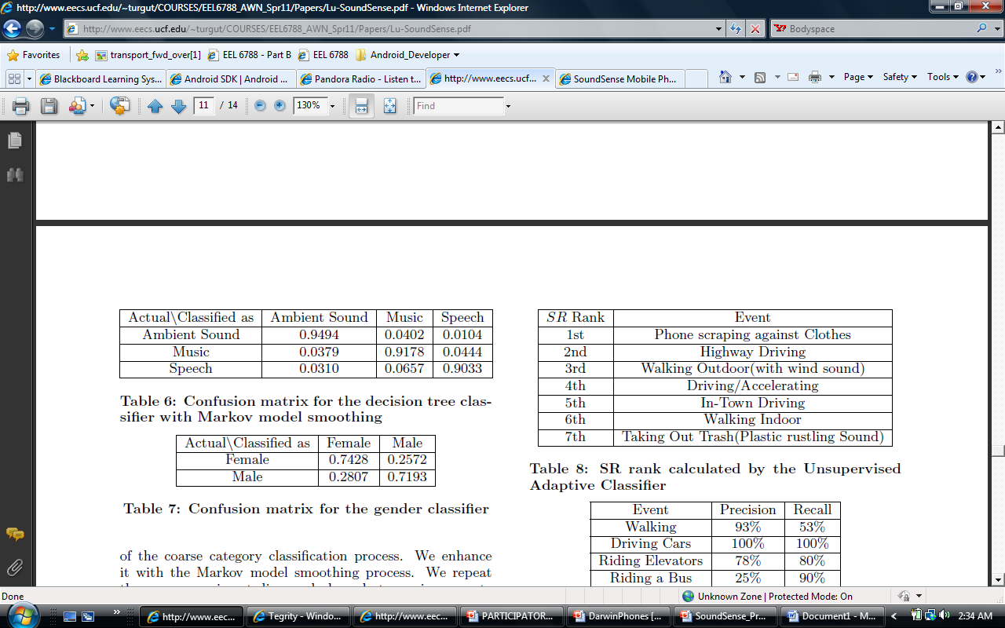
Sound Sense (Section 6)
SoundSense on iPhone. <60% of the CPU utilized
roughly 5MB compare to 30MB
Coarse Category Classifier
Finer Intra-Category
Classifier
¹Paper: SoundSense: Scalable Sound Sensing for People-Centric Applications on Mobile Phones

Slide 14
Sound Sense (Section 6)
Unsupervised Adaptive Ambient Sound Learning
-Future Work, incorporate other types of contextual information such as GPS to further clarify sounds.
¹Paper: SoundSense: Scalable Sound Sensing for People-Centric Applications on Mobile Phones

Slide 15
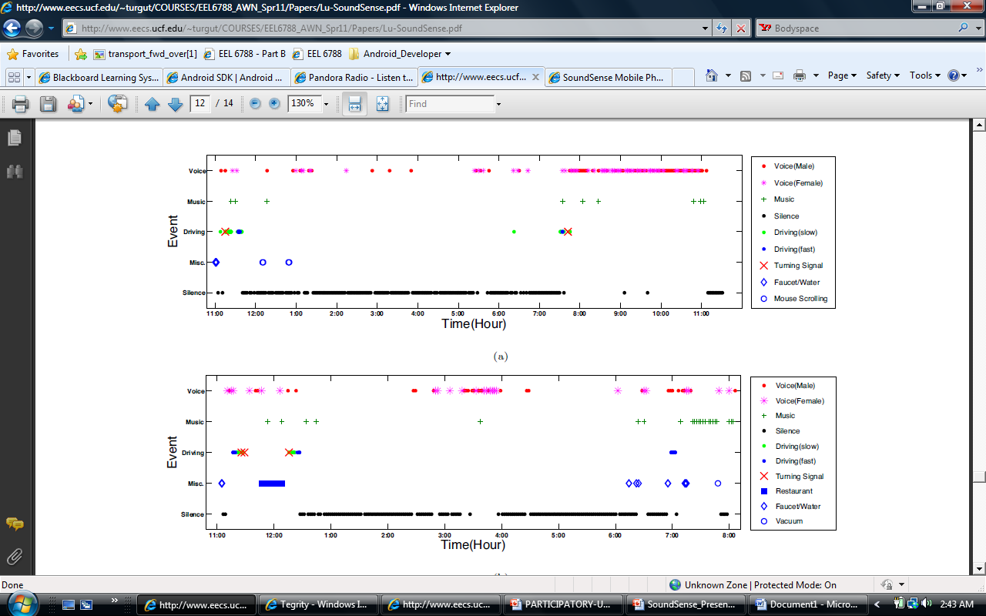
Audio Daily Diary based on Opportunistic Sensing
¹Paper: SoundSense: Scalable Sound Sensing for People-Centric Applications on Mobile Phones

Slide 16
Audio Daily Diary based on Opportunistic Sensing
http://www.youtube.com/watch?v=VK9AE_7dhc4
¹Paper: SoundSense: Scalable Sound Sensing for People-Centric Applications on Mobile Phones

Slide 17
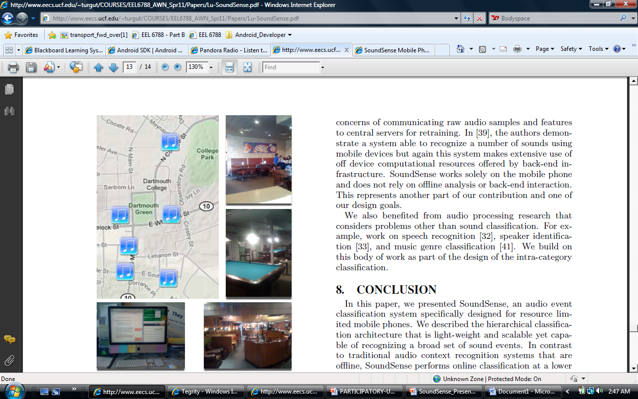
Music Detector based on Participatory Sensing
Discover events with music-like sounds (parties, concerts, music in a room). Camera is used to take picture or location and associate.
¹Paper: SoundSense: Scalable Sound Sensing for People-Centric Applications on Mobile Phones

Slide 18
Significance of Work
Sound Processing and classification is performed real-time as oppose to off-line / external.
SoundSense works solely on the mobile phone.
Tackles Classification issues with Ambient sounds.
¹Paper: SoundSense: Scalable Sound Sensing for People-Centric Applications on Mobile Phones

Slide 19
References
Paper: SoundSense: Scalable Sound Sensing for People-Centric Application on Mobile Phones
Link: http://www.cs.dartmouth.edu/~sensorlab/pubs/s3_mobisys09.pdf
MetroSense Project that explores SoundSense
http://metrosense.cs.dartmouth.edu/projects.html
¹Paper: SoundSense: Scalable Sound Sensing for People-Centric Applications on Mobile Phones

Slide 20
Questions
¹Paper: SoundSense: Scalable Sound Sensing for People-Centric Applications on Mobile Phones

