Slide 1
VTrack
Arvind Thiagarajan, Lenin Ravindranath, Katrina LaCurts, Sivan Toledo, Jakob Eriksson, Hari Balakrishnan, Samuel Madden, "VTrack: Accurate, Energy-Aware Road Traffic Delay Estimation Using Mobile Phones, In Proc. 14th ACM SenSys, November 2009.
Presented By: Lauren Ball
March 2, 2011

Slide 2
Background
Road Traffic Problem
  Results
    Causes inefficiency
    Fuel Waste
    Frustration (not measuring this here ☺)
  Trends
    More cars on road (1B now and projected to double)
    More time wasted in traffic (4.2B Hrs in 2007 and increasing)
Smartphone Capabilities
  Massive Deployment
  GPS , WiFi, and Cellular Triangulation Capabilities

Slide 3
Previous Work
Real-time traffic information can alleviate congestion with information
  Collected Travel Time
  Collected Vehicle Flow Densities
Alleviation Methods
  Informing drivers of “Hotspots” to avoid
  Traffic aware routing
  Combining historic and real-time information
    Update traffic light control
    Plan infrastructure improvements
    Update toll scheme
Dominant Data Source Commercial Fleets
  End user travel times would be more realistic

Slide 4
What is VTrack?
MIT CSAIL, Tel-Aviv Univ, and Univ Illinois Chicago
Goal
  Accurate, Energy-Aware Road Traffic Delay Estimation Using Mobile Phones
    GPS Limitations
      “Urban Canyon” outages
      Pocket outage
      Power Hungry
Key Challenges
  Energy Consumption
    Need to find optimal Sample Rate
  Sensor Unreliability
    GPS Outages
    WiFi and Cellular Triangulation aren’t Precise

Slide 5
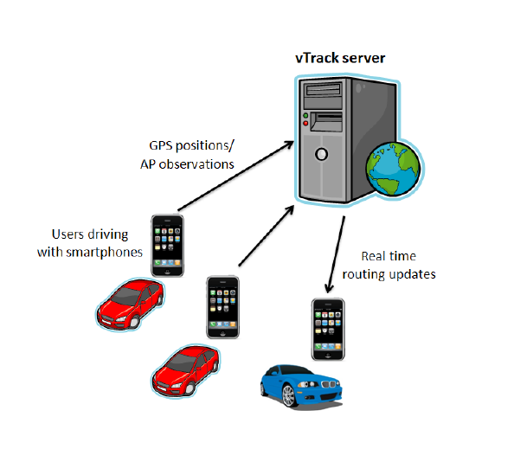
System Architecture
Users with smartphones
  Run VTrack reporting application
  Report position data periodically to the server

Slide 6
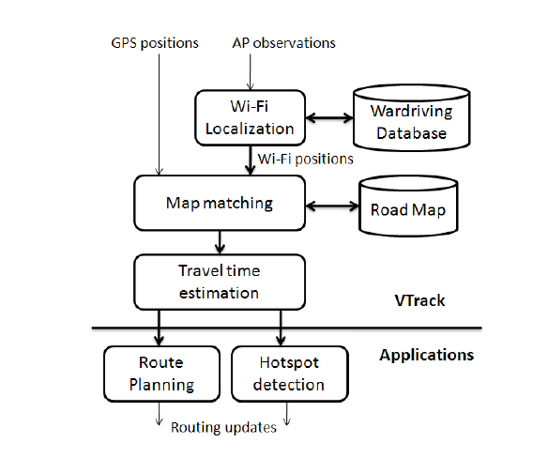
VTrack Server
Server algorithm components
  Map-matcher
  Travel-time estimator
If GPS not available
  Access point (AP) observations are used
    AP observations converted to position estimates
    Done via the wardriving database where APs have been in previous drives

Slide 7
VTrack Application Support
“Hotspot” Reporter
  Senses Traffic Anomalies
  Reports Segments with Rate << Speed Limit
  Optimized for low miss rate
  Optimized for false positive
Route Planner
  Plans Least Time path
  Uses individual segment estimated from VTrack
  Note: Rerouting available real-time

Slide 8
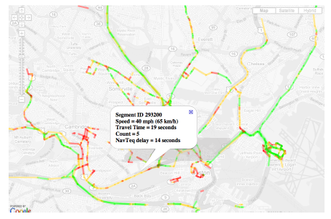
VTrack Website
Users have access
  Users can view current traffic delays
  Users can receive route planning updates

Slide 9
Server Algorithm Constraints
Accurate
  Errors 10% -15% OK
  Correlates to 3-5 minutes on a 30 minute drive
Efficient enough to use real-time data
  Existing map-matching use A*-type
    Prohibitively expensive
    Hard to optimize
Energy Efficient
  Meet accuracy goals
  Maximize battery life

Slide 10
Server Challenges
Map matching with errors
  Not yet characterized with GPS Outages
  Not yet characterized with noisy data
Time estimation is difficult (even with accurate trajectories)
  Source data noisy
    Difficult to determine best route
    Difficult to point a travel time to a segment
Localization accuracy is at odds with energy consumption
  GPS more accurate but more power hungry
  GPS takes up to 20x more power than WiFi
  WiFi only available where Aps available

Slide 11
VTrack Map Matching
Input: A sequence of noisy/sparse position data
Output: A sequence of road segments
Essential for travel time estimation
Steps
  1. Samples are pre-processed to remove outliers.
    Outliers are classified as those > 200mph from last reading.
  2. Outages
    Simple interpolations used
  3. Viterbi decoding over Hidden Markov Model (HMM) to estimate the route driven
  4. Bad zone removal
    low confidence matches

Slide 12
Time Estimation Errors
Main source is inaccuracy of the map-matched output
Two reasons
  Outages during transitions
    Cannot determine if delay is from
      Leaving segment
      Entereing segment
  Noisy positions samples
    Incosistancies when the sample is at the end of a short segment and it’s the only sample in the segment
Note: Though small segment estimates were sometimes inaccurate, the total path results, were accurate!

Slide 13
VTrack Deployment Plan
Extensive Evaluation of Collection Results
  Large Dataset
  ~800 Hrs of Commuter Data
  Deployed on 25 vehicles
Deployment Method
  iPhone 3G
  Embedded in-car computers with GPS and WiFi
Looking for
  Sensor(s) Used
  Sampling Frequency

Slide 14
VTrack Deployment Truth Data
Traditionally a hard problem finding ground truth data, previous approaches
  Additional test drive data
    Costly
  GPS samples as ground truth
    Fails in regions with GPS Errors and dropouts
  Note: Ground truth is impossible

Slide 15
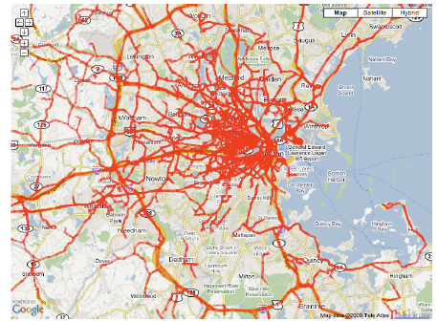
VTrack Deployment Coverage
Initial collection of 2998 drives from the 25 cars with GPS and WiFi sensors
Urban Area
Simultaneous GPS and WiFi location estimates
WiFi locations via centroid calculations of Aps

Slide 16
Findings
HMM-based map matching
  robust to noise
  Error < 10%
    when only WiFi
    With 40m Gaussian noise
Travel Times via only WiFi are accurate even though individual paths are not
Travel Times via only WiFi cannot detect hotspots
  Due to outages
  If WiFi available
    Detection > 80%
    False Alarm < 5%
GPS available and accurate, periodic sampling helps with both

Slide 17
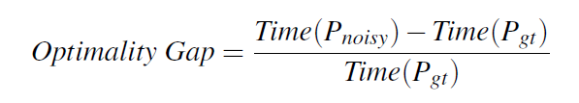
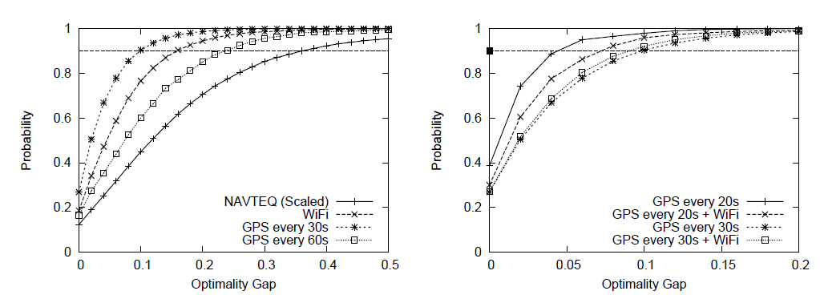
Optimality Gap Metric
GPS vs WiFi vs NAVTEQ GPS vs Hybrid GPS + WiFi

Slide 18
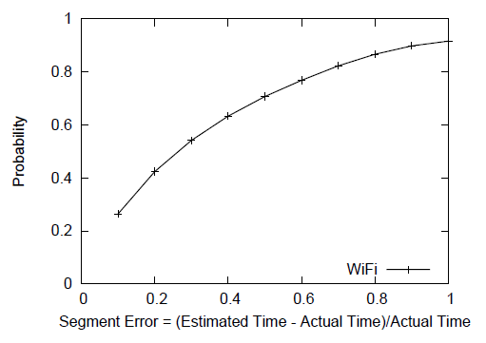
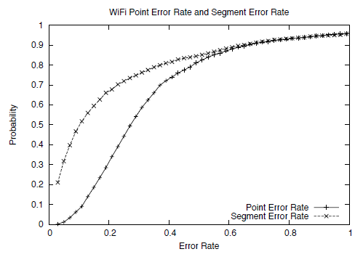
Segment vs Map Matching

Slide 19
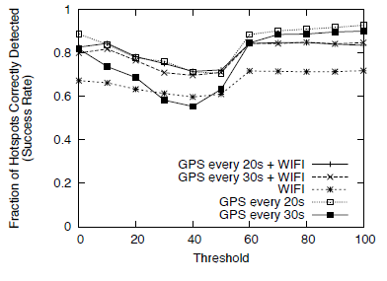
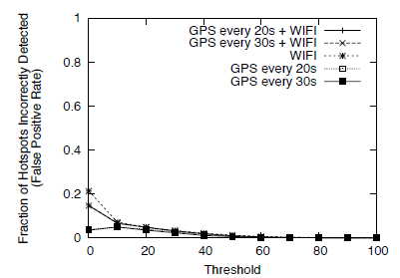
Hotspot Detection Success
Hotspot Detection False Alarms
Threshold = observed segment time - predicted

Slide 20
Out of Scope
Privacy

Slide 21
Conclusions
The approach minimizes energy consumption using inaccurate position sensors
The approach obtains accurate travel time estimates from the inaccurate positions
Significant noise was handled

Slide 22
Future Work
Online, adaptive algorithm
  Dynamically selects the best sensor to sample
    Accounting for available energy, uncertainty of node position, and trajectory
Looking to improve the quality of the algorithms to predict future times on segments
  Using historic times
  Using sparse amounts

Slide 23
References
[1] The mobile millenium project. http://traffic.berkeley.edu.
[2] Navteq. http://navteq.com/about/data.html.
[3] The peir project. http://peir.cens.ucla.edu.
[4] Bureau of Transportation Statistics. http://www.bts.gov.
[5] The CarTel project. http://cartel.csail.mit.edu/.
[6] Y. chung Cheng, Y. Chawathe, A. Lamarca, and J. Krumm. Accuracy
characterization for metropolitan-scale wi-fi localization. In In
Proceedings of Mobisys 2005, pages 233–245, 2005.
[7] C. Claudel and A. Bayen. Guaranteed bounds for traffic flow
parameters estimation using mixed lagrangian-eulerian sensing. In
Allerton Conference on Communication, Control, and Computing,
2008.
[8] C. Claudel, A. Hofleitner, N. Mignerey, and A. Bayen. Guaranteed
bounds on highway travel times using probe and fixed data. In 88th
TRB Annual Meeting Compendium of Papers, 2009.
[9] D. F.V. Gps accuracy: Lies, damn lies, and statistics. 1998.
[10] S. Gaonkar, J. Li, R. R. Choudhury, L. Cox, and A. Schmidt.
Micro-blog: sharing and querying content through mobile phones and
social participation. In MobiSys, pages 174–186, 2008.
[11] M. Gruteser and D. Grunwald. Anonymous usage of location-based
services through spatial and temporal cloaking. In ACM MobiSys, 2003.
[12] M. Gruteser and B. Hoh. On the anonymity of periodic location
samples. In Pervasive, 2005.
[13] B. Hoh, M. Gruteser, R. Herring, J. Ban, D. Work, J.-C. Herrera, A. M.
Bayen, M. Annavaram, and Q. Jacobson. Virtual trip lines for
distributed privacy-preserving traffic monitoring. In MobiSys ’08:
Proceeding of the 6th international conference on Mobile systems,
applications, and services, 2008.
[14] B. Hoh, M. Gruteser, H. Xiong, and A. Alrabady. Enhancing security
and privacy in trafc-monitoring systems. IEEE Pervasive Computing,
5(4):38–46, 2006.
[15] B. Hoh, M. Gruteser, H. Xiong, and A. Alrabady. Preserving privacy in
GPS traces via uncertainty-aware path cloaking. In ACM CCS, 2007.
[16] B. Hull, V. Bychkovsky, Y. Zhang, K. Chen, M. Goraczko, E. Shih,
H. Balakrishnan, and S. Madden. CarTel: A Distributed Mobile Sensor
Computing System. In Proc. ACM SenSys, Nov. 2006.
[17] B. Hummel. Map matching for vehicle guidance. In Dynamic and
Mobile GIS: Investigating Space and Time. CRC Press: Florida, 2006.
[18] Inrix home page. http://www.inrix.com/.
[19] J. Krumm. Inference attacks on location tracks. In Pervasive, 2007.
[20] J. Krumm, J. Letchner, and E. Horvitz. Map matching with travel time
constraints. In SAE World Congress, 2007.
[21] P. Mohan, V. N. Padmanabhan, and R. Ramjee. Nericell: rich
monitoring of road and traffic conditions using mobile smartphones. In
SenSys ’08: Proceedings of the 6th ACM conference on Embedded
network sensor systems, 2008.
[22] D. Sperling and D. Gordon. Two Billion Cars: Driving Toward
Sustainability. Oxford University Press, 2009.
[23] L. Sweeney. k-anonymity: A model for protecting privacy, 2002.
[24] A. J. Viterbi. Error bounds for convolutional codes and an
asymptotically optimum decoding algorithm. In IEEE Transactions on
Information Theory, 1967.
[25] J. Yoon, B. Noble, and M. Liu. Surface Street Traffic Estimation. In
MobiSys, 2007.

Slide 24
My Thoughts
Energy Constraint??
  If in car plugged in phone
  Not true for mass transit if that should be included
  Obviously still have the GPS Outage issue
Mass Transit Buses?
  False Stops

Slide 25
Questions??

