Slide 1
dImpack
By Chau Ngo
EEL 6788 Spring 2011

Slide 2
Outline
Problem Statement/Motivation
Software Overview
Demo
Technical Difficulties
Lessons Learned
Improvements

Slide 3
Motivation/Problem Statement
Shock (G-force) associated with an object is its acceleration relative to freefall.
This acceleration experienced by an object is due to the vector sum of non-gravitational forces acting on an object free to move.
http://en.wikipedia.org/wiki/G-force
How much shock do your body absorb when you walk vs. jog vs. run?
  Shock is transmitted from feet up the legs, through the pelvis, to the lower back.
  It may potentially cause pain in legs, knees, and back

Slide 4
G-force calculation
An astronaut taking off in the shuttle his/her acceleration is 29.4 m/s^2 upward.
This is three times the acceleration of gravity (9.8 m/s^2)
the astronaut will feel an apparent force downward equal to 3 times his/her weight
PLUS the normal force of gravity
Thus the total “g-force” on the person will be “4 g's”.

Slide 5
dImpack
Is an Android application that utilizes the 2 Android phone sensors:
  Accelerometer to measure the amount of shock while a person is walking or running
  Orientation sensor to measure changes in orientation
Compute/Display shock statistics records
Visualize the analyzed data on graphs

Slide 6
Software Overview – Implementation
COTS: Java, Android SDK, sqlite, AndroidPlot, DroidDraw
Configuration
  Turn accelerometer off/on
  Turn orientation sensor off/on:
Control: Start, Pause/Resume, Stop
Record: New, Open, Save, Delete

Slide 7
Data Statistics
Accelerometer
  Start time/date
  Stop time/date
  Total time (seconds)
  Pause time (seconds
  Counts: total number (> 1.2 G) of shocks.
  Biggest shock
  Average of all shocks
  Sum of all shocks
Orientation sensor
  Biggest change for each direction (azimuth, roll, and pitch)
  Average change for each direction

Slide 8
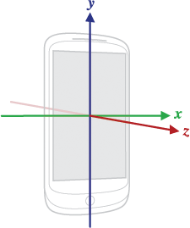
Phone Coordinate System

Slide 9
Orientation Directions
SensorEvent
values[0]: 0 to 359 in degrees
  Azimuth: angle between the magnetic north direction and the y-axis, around the z-axis
values[1]: -180 to 180 in degrees
  Pitch: rotation around x-axis
values[2]: -90 to 90in degrees
  Roll: rotation around y-axis

Slide 10
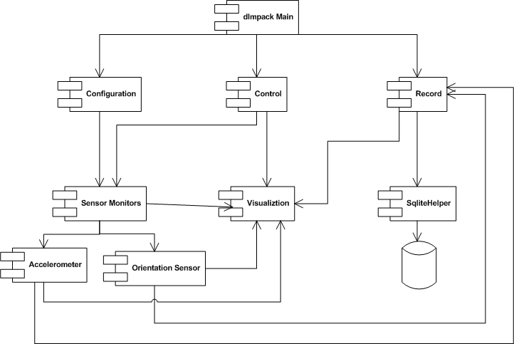
Software Overview – Design

Slide 11
Software Overview – Use Case
Create new record
Start
  If skip 1, will be asked to do so before save (3)
Save record
  Master table: keeps name and statistics
  Accelerometer samples table
  Orientation samples table
Open record
  Statistics tab
  Graphs tab
Delete Record

Slide 12
Demo
Az: 0 vs. 359
Pitch: -180 vs. 180
Roll: -90 vs. 90
Only pick up sensor changes every 10th of a second
Shock < 1.2 will not be recorded
  No shock = 1G

Slide 13
Software Test (not official)
Test at home: 30 minutes, takes 9 minutes to save, size 176KB

Slide 14
Technical Difficulties/Challenges
Change screen orientation causes crash
→ Disable auto-rotate screen
Threads issues
Debug without Android SDK source code
Unfamiliar with Android architecture and components implementation
How to wear/carry phone

Slide 15
Lessons Learned
It’s important to implement “Try/Catch”
Can find online tutorial for almost everything
DroidDraw can be used to design GUI but some color value, e.g. @drawable/green, is not comparable with Android SDK
Clear application data when database is corrupted:
  Settings/Application/Manage Application: select application, then press Clear data
Database:
  Use db.execSQL(“Drop Table …“) command to delete table
  Use db.delete(…) to delete a row
Store record after stop: takes some time
Record name can’t have space, or be a number: sqlite limitation

Slide 16
Improvements
Implemente a service to store sensor data in background
  Persisting large size of data takes a long time
Store data every update/frame.
Change graph domain range
Measure power consumption
Implement a service to listen to sensor data in background
  User might not want look at graphs recording
  Reduce power consumption by not drawing graph.
Change main GUI design to be more Android app-like
Add capability to connect to GPS and record run/walk track.

Slide 17
Question or Suggestion?

Slide 18
Evaluation Plan
Run, walk, jog
  Different surfaces
  Different type of shoes?
Wear phone above knees and by hip

