Slide 1
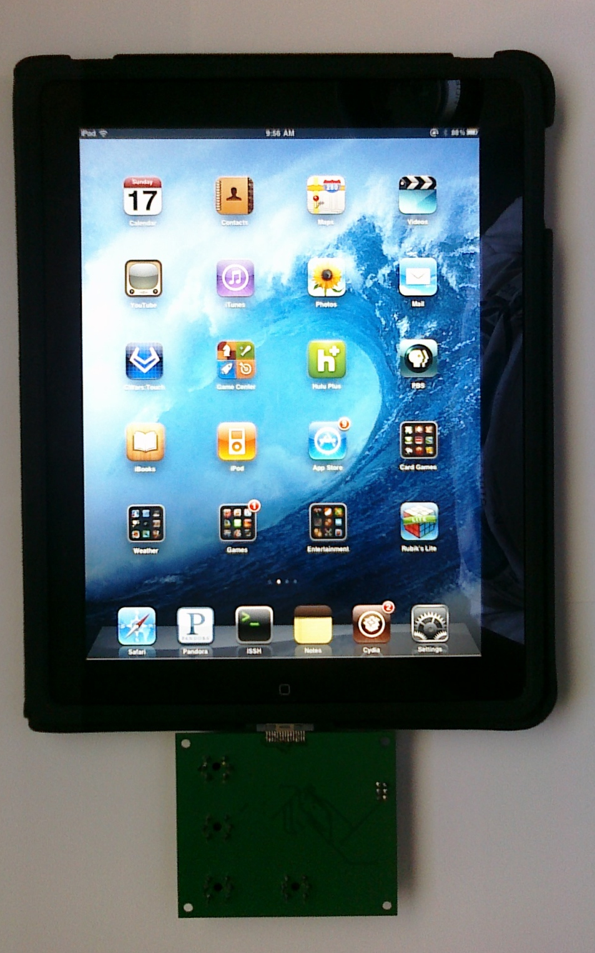
EnviroSense
Jonathan Mohlenhoff
EEL6788 - Team 16
04/20/2011

Slide 2
Introduction
Hardware project focused on interfacing external sensors to mobile devices
Expands variety of sensors available to developers for urban sensing applications
Current sensors available on mobile devices are few, restricted to UI and location functionality:
Multi-touch, accelerometer, compass, GPS, microphone, camera
Adding new sensors allows researchers to expand on experiments

Slide 3
Description
Add environmental sensors to iOS device
Custom designed PCB that interfaces between iOS device and sensors
Ability to sense:
Temperature
Humidity
Barometric Pressure
Carbon Monoxide (CO)
Carbon Dioxide (CO2)
Ozone (O3)
General Air Quality

Slide 4
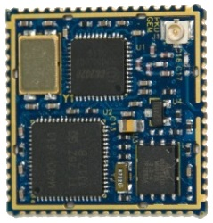
Related Work
Common Sense: Mobile sensing for community action
http://www.communitysensing.org/
Self-contained, built in:
GPRS Modem, GPS, Bluetooth, sensors, battery
Mote Platform
http://www.eecs.berkeley.edu/~prabal/projects/epic/
Large developers community

Slide 5
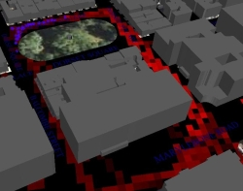
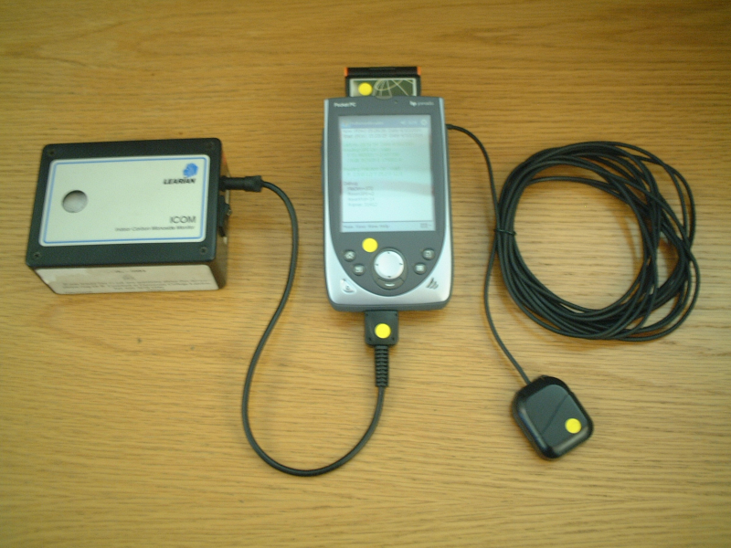
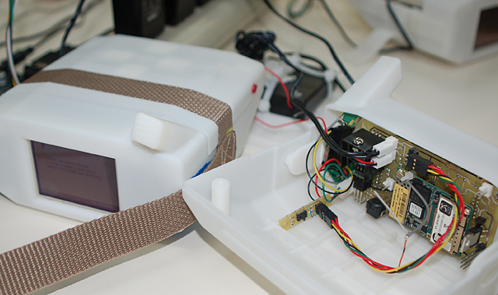
More Related Work
The Urban Pollution Monitoring Project
http://www.equator.ac.uk/index.php/articles/563
Self contained system
Older system
Air: Preemptive Media Project
http://www.pm-air.net/index.php

Slide 6
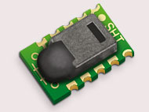
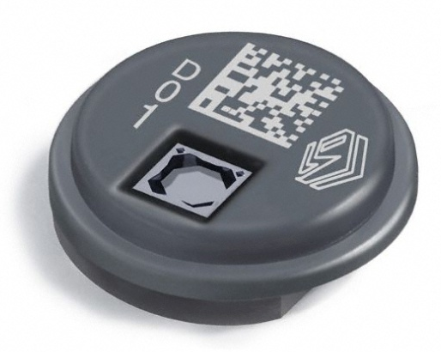
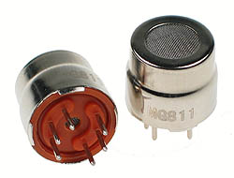
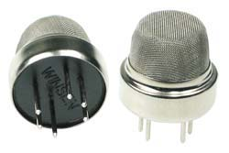
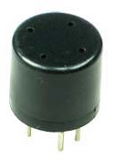
Hardware Design
Sensors
SENSIRION - SHT15
Temperature and Humidity
Two Wire Interface (TWI)
VTI Technologies – SCP1000
Temperature and Barometric Pressure
Serial Peripheral Interface (SPI)
MQ-7 CO Gas Sensor
MG811 CO2 Gas Sensor
MQ135 Air Quality Sensor
MQ131 O3 Gas Sensor

Slide 7
Hardware cont.
Required custom printed circuit board
Microcontroller Atmel Atmega328P to interface to sensors and iPad
Connects to iPad via 30 pin connector
Tx – pin 12, Rx – pin 13
Powers off of 3.3V from iPad

Slide 8
Schematic – Sheet 1

Slide 9
Schematic – Sheet 2

Slide 10
Board Layout

Slide 11
Software Design
Microcontroller programmed in C
Utilizes libraries to interface with sensor
Communicates using serial to iPad with SLIP protocol and Zebulon MCU Message Library
iPad application is programmed in Python
Utilizes built in serial library
Required iPad to be rooted

Slide 12
Results
Board works!
Able to achieve 1 Hz update rate from sensors
Low power consumption
3.3V@30mA
100mW
Does not severely impact battery life, not ran in background

Slide 13
Challenges
Was unable to access serial port through Apple iOS SDK, found different method through Python
Unable to refresh GUI display continuously, receives sensor data once at startup
Gas sensors are not factory calibrated, unable to map the sensor value to a PPM
Hardware required some debugging

Slide 14
Budget
Part | Vendor | Cost
PCB | Gold Phoenix | $50.00
Atmega328P | Mouser | $4.18
CO2 | Futurlec | $19.90
CO | Futurlec | $8.90
O3 | Futurlec | $12.90
Air Quality | Futurlec | $6.90
Barometric Pressure | Sparkfun | $24.95
iPod Connector | Sparkfun | $4.95
Humidity / Temperature | Sparkfun | $28.95
Misc | - | $20.00
Total |  | $181.63

Slide 15
Demo
Show GUI App
Show CLI with continuous updates

Slide 16
Future Work
Incorporate pushing data to central server for sharing with community
Research different available frameworks with built in security and functionality
Log data with timestamp and location information (GPS not available on my iPad)
Add filters for noise on sensors
Graphing capability
Wireless connectivity to sensor board over Bluetooth
More general open source hardware to allow interface to other sensors

Slide 17
Conclusion
Utilizing users’ mobile devices for the UI and network connectivity can make the sensor board cheaper
Opening up hardware from mobile device manufactures would make integrating these technologies simpler
General purpose hardware boards could revolutionize mobile sensing and research
Not restricted to sensor types

Slide 18
Questions

