Slide 1
Survey: The Urban Security and Privacy challenges
Presented By
Vignesh Saravanaperumal
EEL 6788

Slide 2




Introduction
Urban sensing:
Risk Possessed:
Confidentiality and Privacy
Integrity
Availability
Traffic pattern Observed:
Continuous Monitoring – Health care application
Event Driven - Environmental apps
Query Driven - Context aware queries
General Architecture observed
Server Tier
SAP Tier
Sensor Tier

Slide 3


Introduction
Difference between wireless sensor network and urban sensing
Sensor Networks W/O Urban sensing
Sensor Networks with Urban sensing

Slide 4
Solutions available
Virtual Wall
Onion Routing Mechanism
Mist Routing
Hidden credentials method
Hot-Potato-Privacy-Protection Algorithm
Mixed-behavior models in multi-party computation
Multicast Authentication Scheme
Confidentiality and Privacy
Integrity

Slide 5
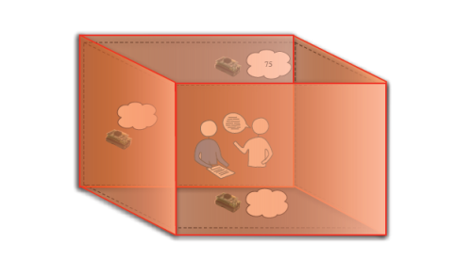
In depth classification
Confidentiality and Privacy
Context Privacy
Anonymous Tasking
Anonymous Data Reporting
Virtual Wall
Q
S
Q
S
Hot-Potato-Privacy-Protection Algorithm
Task specific users without knowing their current location
Mist , Onion Routing
Trust Negotiation
Hidden credential Method

Slide 6
In depth classification
Integrity
Reliable Data reading
Data authenticity
Availability:
Fairness and Participation
Mixed-behavior models in multi-party computation
Multicast Authentication Scheme
Free Rider Problem

Slide 7
Context privacy
Digital footprints
Types of Footprints:
Personal
General
Empty
Information about users derived from sensors
Transparent wall
Translucent wall
Opaque wall

Slide 8
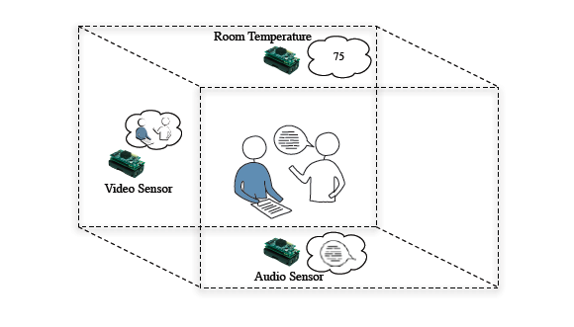
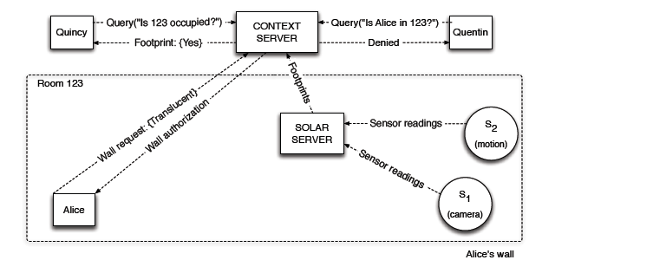
Context privacy
Virtual Wall

Slide 9
Anonymous Tasking
Mist Routing
Objective:
Location privacy
Anonymous connections
Confidentiality
This privacy protocol prevents insiders, system administrators and even the system itself from tracking users and detecting their physical location
They do this by conceal the identity and location of communicating parties by rerouting packets among themselves using hop-to-hop handle-based routing.

Slide 10
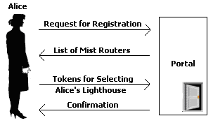
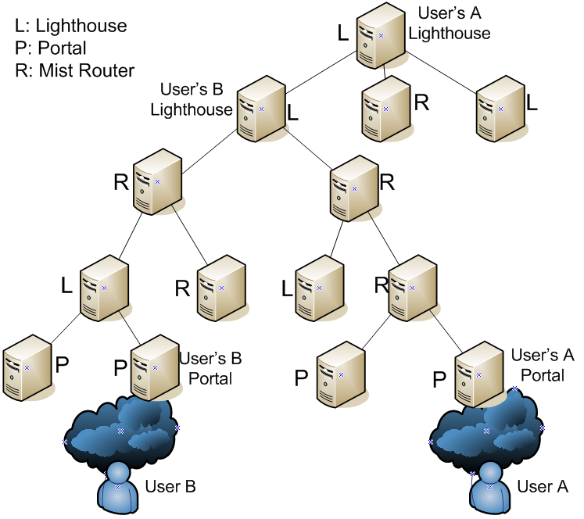
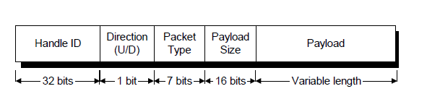
Anonymous Tasking
Mist Routing
Mist:
Mist Routers are Hierarchical Structure based
Portal:
  Mist Router – leaf node
  Knowledge of user’s positions but not user’s ID
Lighthouse:
  Mist Router – Portal’s ancestor
  Knowledge of user’s ID but not user’s physical position

Slide 11

Anonymous Tasking
Mist Routing
Mist Circuit establishment
Locating Users
Web Servers

Slide 12
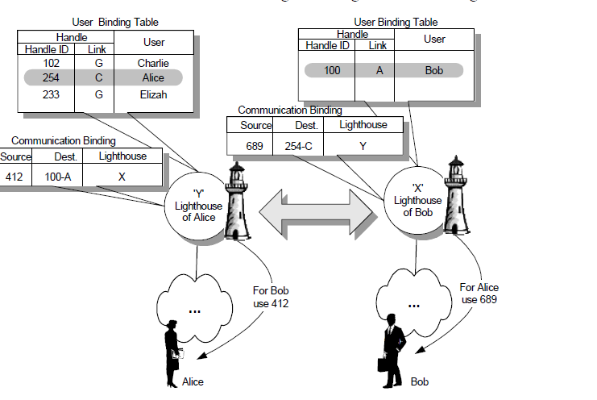





Anonymous Tasking
Mist Routing
Mist communication setup

Slide 13
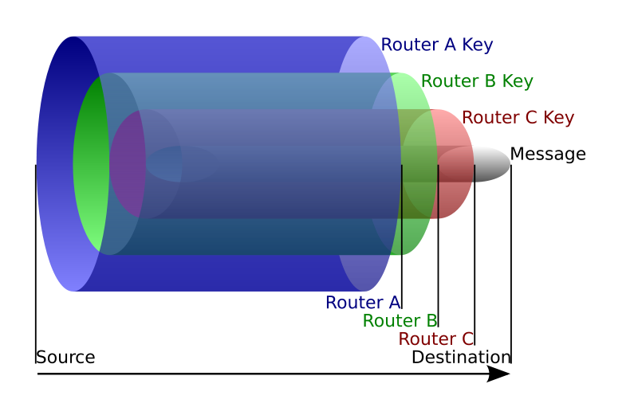
Anonymous Tasking
Onion Router mechanism
  Messages are constantly encrypted and then sent through several network nodes called onion routers which creates a circuit of nodes.
  Each onion router removes a layer of encryption with its symmetric key to reveal routing instructions, and sends the message to the next router where this is process is repeated.
  “onion router” - It prevents these intermediary nodes from knowing the origin, destination, and contents of the message. It knows only know the successor or predecessor but not any other Onion Router.
  Tor is a distributed overlay network which anonymizes TCP-based applications (e.g. web browsing, secure shell, instant messaging applications.)
  Message are put in cells and unwrapped at each node or onion router with a symmetric key.

Slide 14
Anonymous Tasking
Onion Router mechanism
The sender picks nodes from a list provided by a special node called the directory . The chosen nodes are ordered to provide a path through which the message may be transmitted; this ordering of the nodes is called a chain or a circuit.
Using a symmetric key cryptography, the sender uses the public key of each chosen node to wrap the plaintext message in the necessary layers of encryption: The public keys are retrieved from an advertised list or by on-the-spot negotiation for temporary use, and the layers are applied in reverse order of the message's path from sender to receiver; with each layer, the client includes information for the corresponding node regarding the next node to which the onion should be transmitted.
As the onion passes to each node in the chain, a layer of encryption is peeled away by the receiving node (using the private key that corresponds to the public key with which the layer was encrypted), and then the newly diminished onion is transmitted to then next node in the chain.
The last node in the chain peels off the last layer and transmits the original message to the intended recipient.

Slide 15
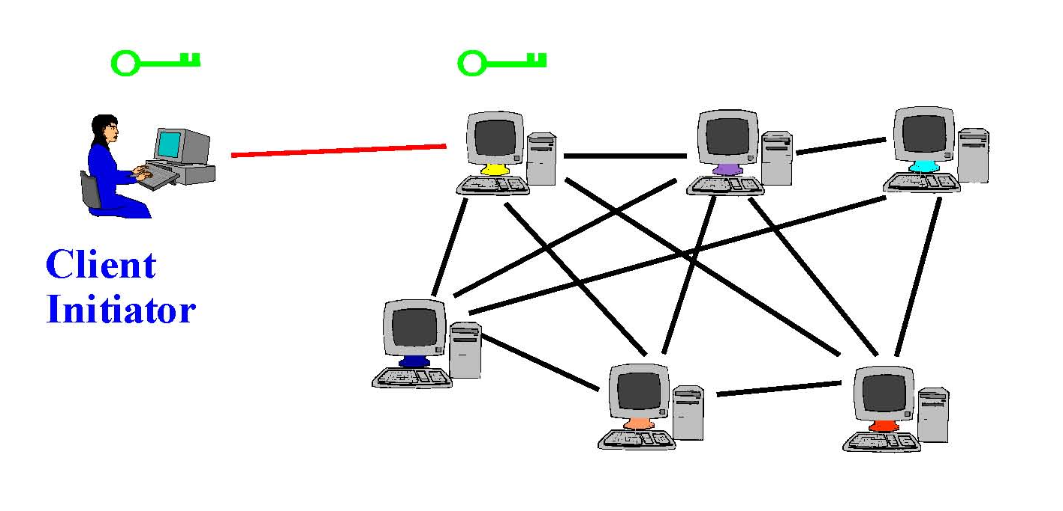
Anonymous Tasking
Onion Router mechanism
Client proxy establish a symmetric session key and circuit with Onion Router #1

Slide 16
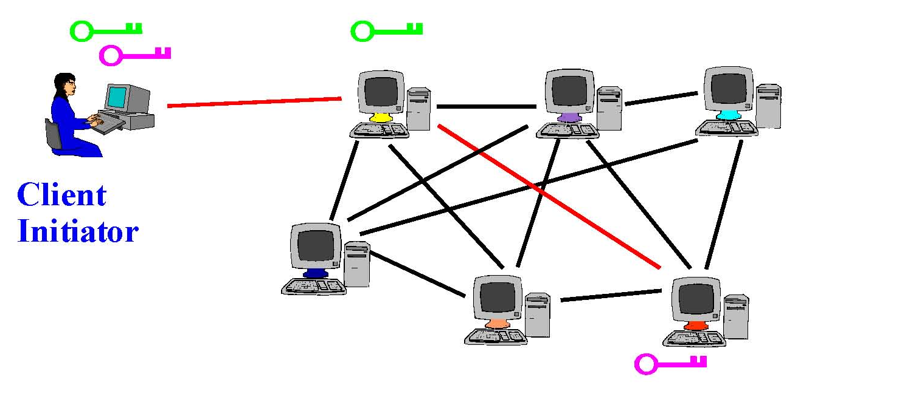
Anonymous Tasking
Onion Router mechanism
Client proxy extends the circuit by establishing a symmetric session key with Onion Router #2
  Tunnel through Onion Router #1

Slide 17

Anonymous Tasking
Onion Router mechanism
Client proxy extends the circuit by establishing a symmetric session key with Onion Router #3
  Tunnel through Onion Routers #1 and #2

Slide 18
Anonymous Tasking
Hidden credentials method
A complex policy is an expression of one or more simple policies which must be satisfied
to decrypt a resource.
A simple policy is the pair (attr; Pub) where attr is a set of one or more attributes (not
including identity) and Pub is the public key of the credential authority (CA) needed to verify those attributes.
Credential is a tuple (nym; attr; Pub; sig) where nym is the (pseudo-)identity of the credential holder. (attr; Pub) form a simple policy, and sig is the signature on both attr and nym made with the secret key corresponding to the public key Pub.
Based on Identity Based Encryption
IBE is a public-key encryption system in which
an arbitrary string can be used as the public key

Slide 19
Anonymous Tasking
Hidden credentials method
email encrypted using public key:
“alice@hotmail.com”
I am
“alice@hotmail.com”
Private key
CA/PKG
master-key
Identity Based Encryption
Hidden Credentials let Bob encrypt a message in such a
way that Alice can only decrypt if he has the right credentials.
That is, her credentials are the decryption key.

Slide 20
Anonymous Tasking
Hidden credentials Method
Create CA
To create a Credential Authority, generate a private key and publish the corresponding public key. CAs can be created at any time.
Issue( nym, attr )
Create a credential certifying that the user identified by nym possesses the attribute(s) designated in attr.
Encrypt( m, nym, P )
Encrypt a message guarded by a policy P with a specific intended recipient identified by nym, and return the cipher text
Decrypt( cipher text, nym, credentials)
Attempts decryption of a cipher text, returning the plaintext if and only if the set of available credentials issued with respect to nym is sufficient to satisfy P

Slide 21
Anonymous Tasking
Hidden credentials Method
How useful is it in urban sensing?
Provides location privacy but not identity privacy
Can be used to task only specific users
Provides anonymity to the person who queries and the user.
Notes:
A website which has many sub websites which offers queries.

Slide 22


Anonymous Data Reporting
Bouncing data from access-point to access-point several times before the data goes to the database
Fuzzing the location and time of the
sensed information
Single organization maintains all the access points

Slide 23
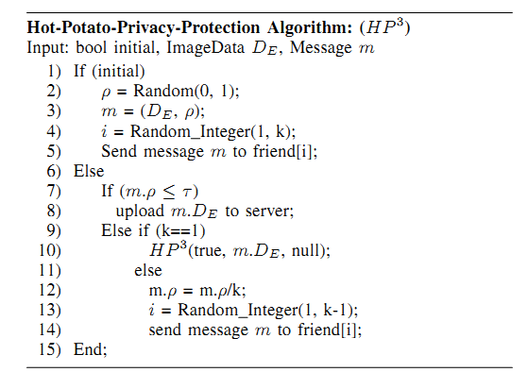
Anonymous Data Reporting
Hot-Potato-Privacy-Protection Algorithm
Each node on the network can initiate a process of transmitting data to the server
The data is encrypted using the server’s public key and the encrypted data is DE.
The exact path taken by each image is non-deterministic
The first node generates a random number p in the range (0,1)
After passing through a node with ki edges, p decreases by 1 /ki
The user sends the data to the server when the value of P reaches the hopping threshold T
Communications between friends (k) are secured by some pre-negotiated shared secret between each pair of them.
In this system, a mobile user does not send its data directly to the server to avoid disclosing its privacy information. Instead, it sends data to one of its friends chosen randomly
and independently

Slide 24
Anonymous Data Reporting
Hot-Potato-Privacy-Protection Algorithm
There are two levels of authentication
Each user needs to subscribe to the server
The two parties need to verify each other before becoming friends
What happens when node corruption happens?
Fragmenting original data into several segments with some redundancy and
transporting each segment using the HP3 algorithm independently

Slide 25
Data Integrity
Reliable Data Readings
Redundancy
Game Theory Approach
But what happens when incorrect data readings are reported due to erroneous configurations of the sensor devices
provide multiple sensor nodes with the same task
Mixed-behavior models in multi-party computation

Slide 26
Data Integrity
Reliable Data Readings
Mixed-behavior models in multi-party computation
Users can be either
Honest or
Adversarial
There comes a third type
Rational or selfish users

Slide 27
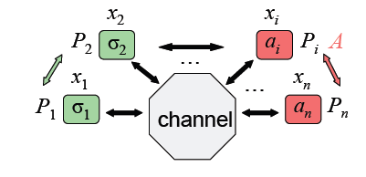
Data Integrity
Reliable Data Readings
Mixed-behavior models in multi-party computation
Mixed Behavioral Model:
More general setting
no party is honest in executing a suggested protocol
Every party can deviate
Rational parties each behaves selfishly towards more utility
adversary controls t parties
Stronger security requirements
Best-of-two-worlds: secure preferred protocols
Correct protocols that tolerate adversarial behavior and that rational
Parties will follow Conflicting goals, stronger assumptions
computationally bounded rational parties and adversary
Approximate solution concepts: ε-preferred Nash
New definitional framework

Slide 28
Data Integrity
Reliable Data Readings
Mixed-behavior models in multi-party computation
Multiparty secure computation allows N parties to share a computation, each learning only what can be inferred from their own inputs and the output of the computation
The problem of secure multi-party function computation is as follows: n players, P₁,P₂,…P_{n}, wish to evaluate a function , F(x₁,x₂,…x_{n}), where x_{i} is a secret value provided by P_{i}. The goal is to preserve the privacy of the player's inputs and guarantee the correctness of the computation

Slide 29
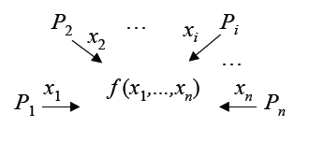
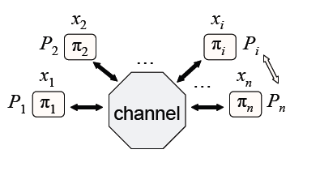
Data Integrity
Reliable Data Readings
Mixed-behavior models in multi-party computation
Multi-party computation:
Joint computations between n parties
Party Pi submits input xi
Common output y = f (x1,…, xn)
f : polynomial-time function
Protocol Π= (π1,…, πn) for computing f
Series of computation & message exchanges
Correctness
Computation model, set up & communication assumptions

Slide 30
Data Integrity
Reliable Data Readings
Mixed-behavior models in multi-party computation
The protocol proposed allows the rational parties to emulate the mediator and jointly compute the function such that
(1) assuming that each rational party prefers that it
learns the output while others do not, no rational party has an incentive
to deviate from the protocol; and
(2) the rational parties are protected from a malicious adversary controlling n
/2 − 2 of the participants:
Result:
The adversary can only either cause all rational participants to abort (so no
one learns the function they are trying to compute), or can only learn
whatever information is implied by the output of the function

Slide 31
Data Integrity
Data Authenticity
Leap
LEAP: Localized Encryption and Authentication Protocol
Support in-network processing, while at the same time restricting the security impact of a compromised node.
A KEY management protocol for sensor networks
Four types of keys for each sensor node
The establishing and updating part of the protocol is communication and energy-efficient and minimizes the involvement of the BS (base station)
The authentication part of the protocol supports source authentication without precluding in-network processing

Slide 32
Data Integrity
Data Authenticity
Leap
Individual key: shared with BS, used for secure communications
Group Key: Each node will also have a copy of the group key, which is shared by all the nodes on the system. It is used by BS for encryption of broadcast
Cluster Key: shared by a node and all its neighbors, used for securing locally broadcast messages
Pair wise Shared Key: shared with its immediate neighbors

Slide 33
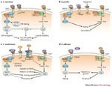
Data Availability
Fairness
Free Riders:
Nodes which attempts to benefit from the resources of others without offering their own resources in exchange.
Solutions:
Reciprocity-Based Schemes
Direct reciprocity
In-direct reciprocity
Query node
A
B
C

Slide 34
Data Availability
Fairness
Suggestion:
Solves to an extent
Anonymous tasking and
Fairness Issue
Query node
A
B
C

Slide 35
Data Availability participation
How to provide incentives to users to make them participate in urban sensing application?
One solution is to incorporate the sensors into a device they
want to carry and provide incentives that are compatible
with users’ needs and interests

Slide 36
Conclusion
I have reviewed to an extent, effective solutions existing and how it can be applied in the urban sensing environment.
An effective complete framework solution for security in urban sensing is yet to come
In urban sensing, it is hard to find solutions for participatory privacy issues
The main challenge is how to solve the participation of adversaries who are unlike in other types of networks are legally involved in participation.

Slide 37
Mistakes done so far
During first few weeks
Got confused between Ubiquitous computing and urban sensing.
(so, For few weeks, was concentrating on security issues related to ubiquitous computing instead of urban sensing)
Was concentrating on other layer of attacks related to general wireless sensor networking to like DOS, Sybil attack, Wormhole attack, until I realized that urban sensing security issues deals with application layer mode.

Slide 38
References
A. Kapadia, T. Henderson, J. Fielding, and D. Kotz. Virtual walls: Protecting digital privacy in pervasive environments. In Proceedings of the Fifth International Conference on Pervasive Computing (Pervasive), Lecture Notes in Computer Science. Springer- Verlag, May 2007
I. Dinur and K. Nissim. Revealing information while preserving privacy. In PODS ’03: Proceedings of the twenty-second ACM SIGMOD-SIGACT-SIGART symposium on Principles of database systems, pages 202–210, New York, NY, USA, 2003. ACM Press.
Ling Hu; Shahabi, C.; , "Privacy assurance in mobile sensing networks: Go beyond trusted servers," Pervasive Computing and Communications Workshops (PERCOM Workshops), 2010 8th IEEE International Conference on , vol., no., pp.613-619, March 29 2010-April 2 2010
J. Al-Muhtadi, R. H. Campbell, A. Kapadia, D. Mickunas, and S. Yi. Routing Through the Mist: Privacy Preserving Communication in Ubiquitous Computing Environments In Proceedings of The 22nd IEEE International Conference on Distributed Computing Systems (ICDCS), pages 74–83, 2002.
R. Dingledine, N. Mathewson, and P. Syverson. Tor: The Second-Generation Onion Router. In Usenix Security Symposium, pages 303–320, Aug. 2004.
R. W. Bradshaw, J. E. Holt, and K. E. Seamons. Concealing complex policies with hidden credentials. In Eleventh ACM Conference on Computer and Communications Security, Washington, DC, pages 146–157, Oct. 2004
E. R. Verheul. Self-Blindable Credential Certificates from the Weil Pairing. In Proceedings of the 7th International Conference on the Theory and Application of Cryptology and Information Security, pages 533–551. Springer-Verlag, 2001.

Slide 39
References
A. Lysyanskaya, R. Tamassia, and N. Triandopoulos. Multicast authentication in fully adversarial networks. In Proceedings of IEEE Symposium on Security and Privacy (SSP), pages 241–255, May 2004
A. Lysyanskaya and N. Triandopoulos. Rationality and adversarial behavior in multiparty computation. In Proceedings of Advances in Cryptology — CRYPTO ’06, pages 180–197, 2006.
Alcaraz, C.; Lopez, J.; , "A Security Analysis for Wireless Sensor Mesh Networks in Highly Critical Systems," Systems, Man, and Cybernetics, Part C: Applications and Reviews, IEEE Transactions on , vol.40, no.4, pp.419-428, July 2010 doi: 10.1109/TSMCC.2010.2045373
Andrew T. Campbell, Shane B. Eisenman, Nicholas D. Lane, Emiliano Miluzzo, and Ronald A. Peterson. 2006. People-centric urban sensing. In Proceedings of the 2nd annual international workshop on Wireless internet (WICON '06). ACM, New York, NY, USA, , Article 18 . DOI=10.1145/1234161.1234179 http://doi.acm.org/10.1145/1234161.1234179
Nicholas D. Lane, Shane B. Eisenman, Emiliano Miluzzo, Mirco Musolesi, Andrew T. Campbell, "Urban Sensing: Opportunistic or Participatory?", Presented at First Workshop Sensing on Everyday Mobile Phones in Support of Participatory Research, Sydney, Australia, November 6, 2007
Peter Johnson, Apu Kapadia, David Kotz, Nikos Triandopoulos, "People-Centric Urban Sensing: Security Challenges for the New Paradigm", Dartmouth Technical Report TR2007-586, February 2007
M. Feldman and J. Chuang. Overcoming free-riding behavior in peer-to-peer systems. SIGecom Exch., 5(4):41–50, 2005

