Slide 1
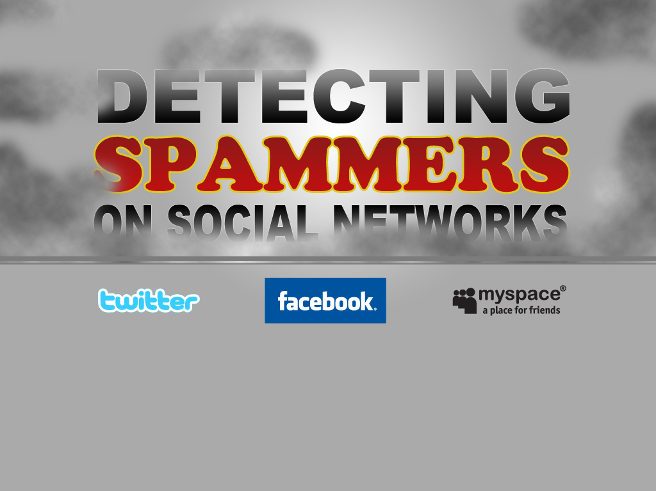
Authors:
Gianluca Stringhini
Christopher Kruegel
Giovanni Vigna
University of California, Santa Barbara
Presenter:
Justin Rhodes

Slide 2
Presentation
Detecting Spammers on Social Networks
Presented at: Annual Computer Security Applications Conference 2010
  Austin, Texas
  December 6-10, 2010
Presentation by Justin Rhodes
  UCF MS Digital Forensics

Slide 3
Overview of paper
Introduction
Social Networks
Related Work
Data Collection
Data Analysis
Spam Profile Detection
Conclusions

Slide 4



Introduction
Users spend more time on social networking sites than any other site.
Collect HUGE amounts of personal information from users.
  Their friends and habits as well
In 2008, 83% of these users of social networks have received at least one unwanted friend request or message.
  SPAM

Slide 5
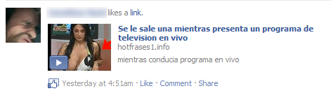
Introduction
“Network of Trust”
  Easy to get into someone’s network
Most people know about phishing, email spam, and viruses…
…But 45% of social network users will readily click on links posted by their “friends”.

Slide 6
What’s going to be done
Honey-profiles set up on social networking sites
Logged all activity
Investigate how spammers are using social networks
Characteristics to detect spammers
Build a tool to detect spammers
1 year
11 months

Slide 7
Background and Related Work
Taking a closer look into the ways that social networks manage the network of trust and what is visible between users.
Overview of the three most popular social networks

Slide 8

400 million active users all over the world
  2 billion media items shared every week
  Since has grown to 500 million and 30 billion pieces each month
Facebook users accept friend requests from people they barely know.
  Would be different in real life.
Most user profiles are not public
Geographic networks
  Security forces a valid email address to join now

Slide 9



First social network to gain significant popularity
MySpace pages are public by default
  Easier for malicious user to obtain information
Used to be the biggest social network on the internet
  Since then it has pretty much died.
This is why

Slide 10

A much simpler social network
  Microblogging platform
No personal information shown on pages by default
Users follow each other instead of friending each other
Twitter is the fastest growing social network on the internet.
  During last year, it reported a 660% increase in visits

Slide 11
Background and Related Work
Sophos Experiement in 2008
  41% of Facebook users who were contacted reported a friend request from a random person.
Phishing attacks are more likely to succeed if the attacker uses personal information.
  Friends info, age, family, hobbies, etc.
Botnets such as Koobface
  Infects systems and grabs login information
  Delivered through Facebook messages
  Adobe Flash Player download

Slide 12
Data Collection
900 profiles created
300 profiles
300 profiles
300 profiles

Slide 13
Honey-Profiles
Crawled social networks to collect common data
  Networks:
    North America
    Europe
    Asia
    Africa
    South America
  2,000 accounts per Network on Facebook
  4,000 accounts on MySpace
  Names, ages, gender, etc.
Mixed this data and created fake accounts
  Wanted to create “average” profiles
  Is a manual process for some sites

Slide 14
Collection of Data
Scripts would connect to accounts and check activity
  Acted passively
  Accepted all friend requests
Logged all email notifications, messages, and other requests.
  Facebook: Wall Posts, App invites, Group invites, etc.
  MySpace: Mood changes, messages, etc.
  Twitter: Tweets and DM’s
Ran for 12 Months for Facebook (6/6/2009 – 6/6/2010)
Ran for 11 Months for others (6/24/2009 – 6/6/2010)

Slide 15
Analysis of Data
Tracked friend requests and follows
  Received total of 4,250 friend requests.
Surprising…not all of these were spam bots
  People just want the popularity
  Or people with the same name
Overall recorded 85,569 messages
  Most come from Twitter
Network | Overall | Spam | %
Facebook | 3,831 | 173 | 5
MySpace | 22 | 8 | 36
Twitter | 397 | 361 | 91
Network | Overall | Spam | %
Facebook | 72,431 | 3,882 | 5
MySpace | 25 | 0 | 0
Twitter | 13,113 | 11,338 | 86
Requests
Messages

Slide 16
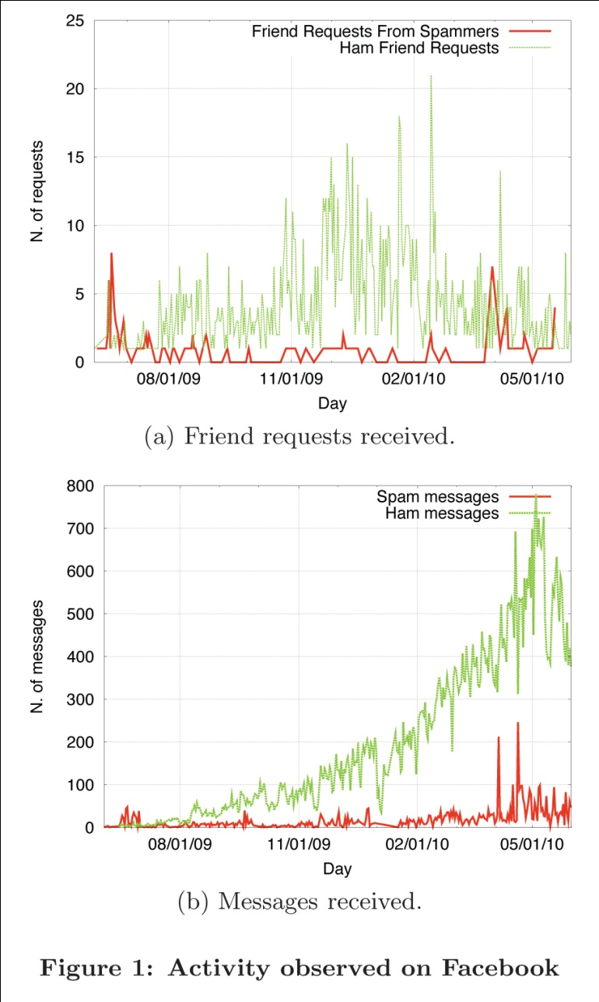
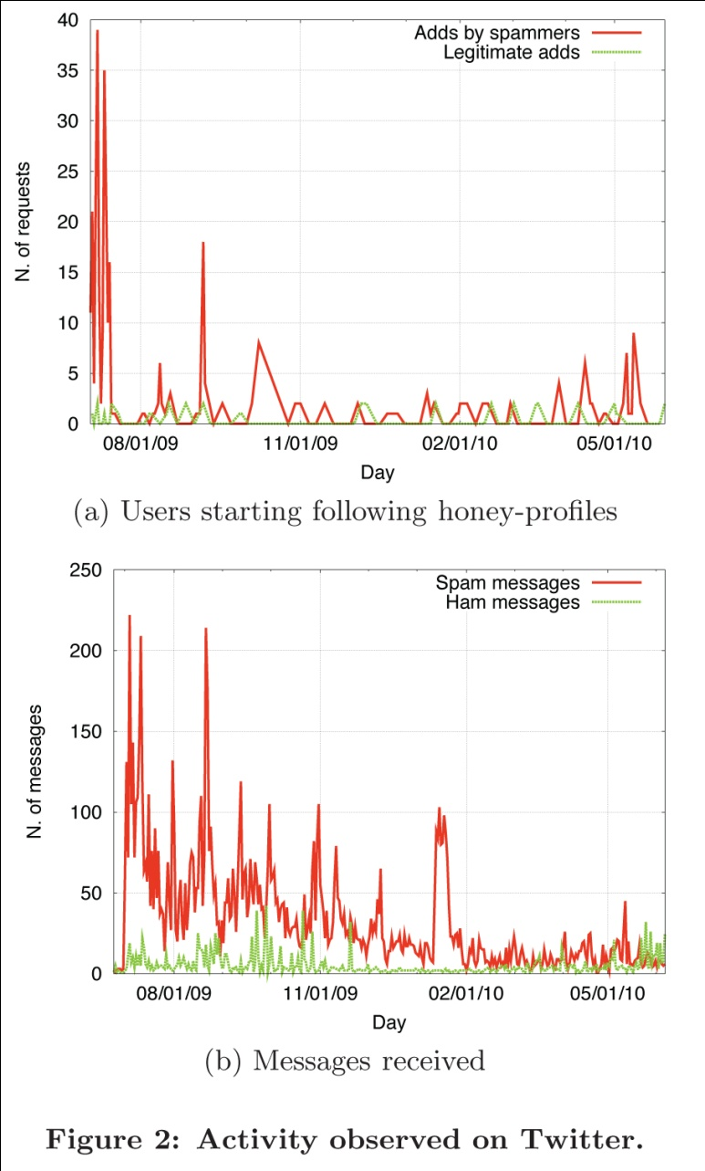
Analysis of Data

Slide 17
Identifying Spam Accounts
People looking for “legitimate” friends
  Maybe from the same area
Distinguish between spammers and benign users
  Started by manually checking all profiles that contacted us
  From that study created an automated process
Honey-Profiles appear as “friend suggestions”

Slide 18
Spam Bot Analysis
Different levels of activity and strategies can be sorted into 4 categories:
  Displayer
  Bragger
  Poster
  Whisperer
So what does each one do?

Slide 19
Spam Bot Analysis
Displayer
  Bots that do not post spam messages, but
  only display some spam content on their own profile
  pages. In order to view spam content, a victim has to
  manually visit the profile page of the bot. This kind of
  bots is likely to be the least effective in terms of people
  reached. All the detected MySpace bots belonged to
  this category, as well as two Facebook bots.

Slide 20
Spam Bot Analysis
Bragger
  Bots that post messages to their own feed.
  These messages vary according to the networks: on
  Facebook, these messages are usually status updates,
  while on Twitter these are the tweets. The result of
  this action is that the spam message is distributed and
  shown on all the victims’ feeds. However, the spam
  is not shown on the victim’s profile when the page is
  visited by someone else (i.e., a victim’s friends). Therefore,
  the spam campaign reaches only victims who are
  directly connected with the spam bot. 163 bots on
  Facebook belonged to this category, as well as 341 bots
  on Twitter.

Slide 21
Spam Bot Analysis
Poster
  Bots that send a direct message to each victim.
  This can be achieved in different ways, depending
  on the social network. On Facebook, for example, the
  message might be a post on a victim’s wall. The spam
  is shown on the victims feed, but, unlike the case of a
  “bragger”, can be viewed also by victim’s friends visiting
  her profile page. This is the most effective way
  of spamming, because it reaches a greater number of
  users compared to the previous two. Eight bots from
  this category have been detected, all of them on the
  Facebook network. Koobface-related messages also belong
  to this category

Slide 22
Spam Bot Analysis
Whisperer
  Bots that send private messages to their
  victims. As for “poster” bots, these messages have to
  be addressed to a specific user. The difference, however,
  is that this time the victim is the only one seeing
  the spam message. This type of bots is fairly common
  on Twitter, where spam bots send direct messages to
  their victim. We observed 20 bots of this kind on this
  network, but none on Facebook and MySpace.

Slide 23
Spam Bot Analysis
Observed average number of messages per day
  Facebook: 11 /day
  Twitter: 34 /day
  MySpace: None because of being displayers
Average life of a spam account
  Facebook: 4 days
  Twitter: 31 days
  MySpace: None have been deactivated
Higher activity during midnight hours

Slide 24
Spam Bot Analysis
Stealthy and Greedy Bots
  Greedy: All spam all the time
  Stealthy: Legitmate looking and malicious
Of the 534 bots found:
  416 Greedy
  98 Stealthy
Most victims were male…or females with male last names

Slide 25
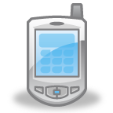

Mobile Interface
No Javascript and no CAPTCHAs
  Can easily send malicious messages
80% of bots detected on Facebook were sending spam messages with a mobile interface
SPAM

Slide 26
Spam Profile Detection
Six features to detect a spammer or not:
  FF ratio (R)
  URL ratio (U)
  Message Similarity (S)
  Friend Choice (F)
  Message Sent (M)
  Friend Number (FN)

Slide 27
Spam Profile Detection
FF Ratio (R)
  Compares how many requests were sent to how many friends they have.
  Only used Twitter’s public info.
  R = following / followers
URL Ratio (U)
  Detects URL’s in messages (only to outside sources)
  U = messages with URLs / total messages

Slide 28
Spam Profile Detection
Message Similarity (S)
  P: the set of possible message-to-message combinations among any two messages logged for a certain account
  p: is a single pair
  c(p): calculates number of words each share
  la: average length
  lp: number of message combinations
Low value of S means more similar messages

Slide 29
Spam Profile Detection
Friend Choice (F)
  Tn: total number of names among the profiles’ friend
  Dn: number of distinct first names
Legitimate accounts have values closer to 1
Spammers have values of 2 or more

Slide 30
Spam Profile Detection
Messages Sent (M)
  Most spam bots sent less then 20 messages
Friend Number (FN)
  Number of friends the profile has

Slide 31
Spam Detection
Could not apply R because of privacy
Trained with 1,000 profiles
False positive ratio of 2%
False negative ratio of 1%
Tested against 790,951 in NY & LA networks
  130 spammers detected
  7 were false positives

Slide 32
Spam Detection
Much easier than Facebook
Trained with 500 spam accounts and 500 real
Eliminated F feature
  Twitter spam bots don’t chose based on name
False positive ratio of 2.5%
False negative ratio of 3%

Slide 33
Spam Detection
Every time they detected spam they reported it to Twitter.
Crawled 135,834 profiles in 3 months
  15,932 were detected as spam
  Twitter reported only 75 to be false positives
  All others were deleted by Twitter

Slide 34
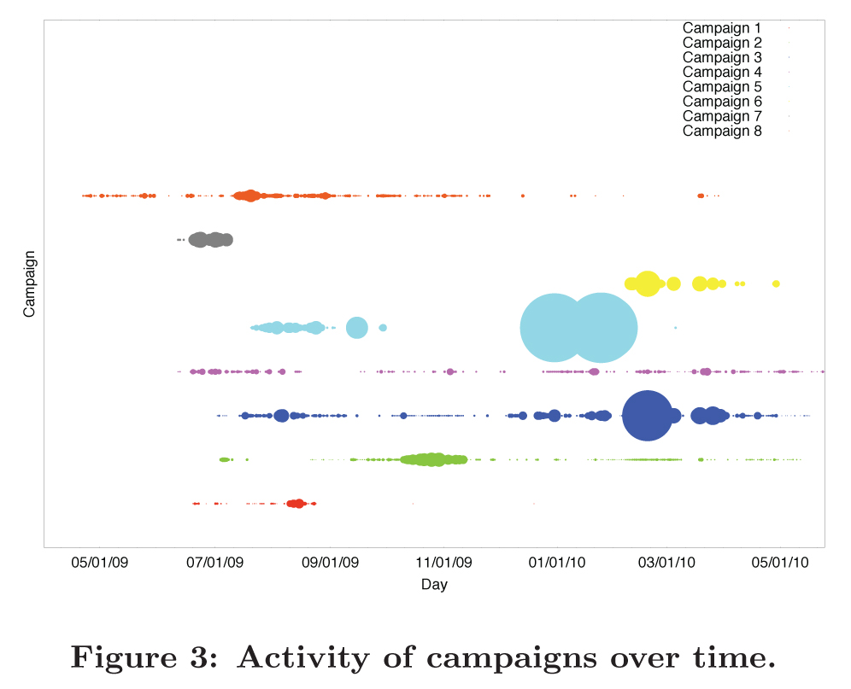
Spam Campaigns
Multiple spam profiles that act under a single spammer
  Two bots posting the same URLs are the same campaign

Slide 35
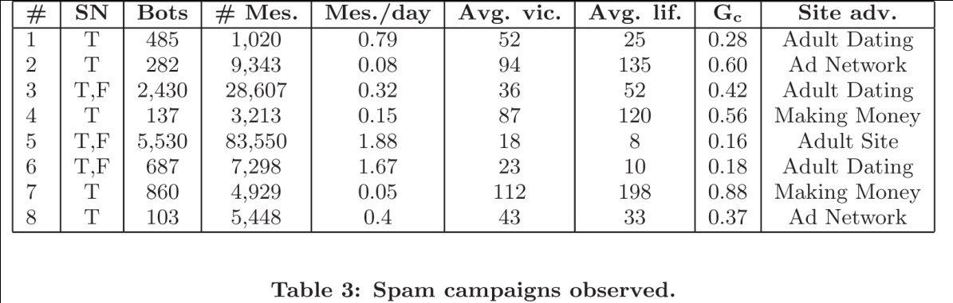
Spam Campaigns
Bots with long campaigns were considered successful
  Greedy bots are detected faster
  Stealthy bots are more effective

Slide 36
Conclusions
Spam on social networks is a problem
Created 900 honey-profiles and logged all data
Techniques to identify spam bots
  Also detect campaigns
Tools to detect spam on social networks
  Twitter used their collected data to shut down 15,857

Slide 37
Contribution
Supported by the ONR under grant N000140911042
National Science Foundation (NSF) under grants CNS-0845559 and CNS-0905537

Slide 38
Weakness
Doesn’t really explain why they stopped detecting spam on MySpace
No explanation of what the main type of malicious attacks happen due to spam.
  Viruses, Advertisements, Malware, etc.
Was Facebook contacted about their tools to detect spam?

Slide 39
Improvement
Follow the links provided in Spam
  Track the changes on virtual machines
Contact Facebook and offer them a tool to detect and delete spam accounts.

Slide 40
ANY QUESTIONS?

