Slide 1
Section 3.1: Operating Systems Concepts

Slide 2
A Computer Model
An operating system has to deal with the fact that a computer is made up of a CPU, random access memory (RAM), input/output (I/O) devices, and long-term storage.
RAM
0
1
2
3
4
5
6
7
8
9
.
.
.
Disk Drive
I/O
CPU

Slide 3
OS Concepts
An operating system (OS) provides the interface between the users of a computer and that computer’s hardware.
An operating system manages the ways applications access the resources in a computer, including its disk drives, CPU, main memory, input devices, output devices, and network interfaces.
An operating system manages multiple users.
An operating system manages multiple programs.

Slide 4
Multitasking
Give each running program a “slice” of the CPU’s time.
The CPU is running so fast that to any user it appears that the computer is running all the programs simultaneously.
Public domain image from http://commons.wikimedia.org/wiki/File:Chapters_meeting_2009_Liam_juggling.JPG

Slide 5
The Kernel
The kernel is the core component of the operating system. It handles the management of low-level hardware resources, including memory, processors, and input/output (I/O) devices, such as a keyboard, mouse, or video display.
User Applications
Userland
Non-essential OS Applications
Operating System
The OS Kernel
CPU, Memory, Input/Output
Hardware

Slide 6
Input/Output (I/O)
input/output devices
Essential devices:
keyboard, mouse, video display card, and network card
optional devices:
scanner, Wi-Fi interface, video camera, USB ports, audio card, etc.
device driver: encapsulates the details of how interaction with that device should be done.
application programmer interface (API), which the device drivers present to application programs
allows application programs to interact with devices at a fairly high level, while the operating system does the “heavy lifting” of performing the low-level interactions that make such devices actually work.

Slide 7
System Calls
User applications don’t communicate directly with low-level hardware components, and instead delegate such tasks to the kernel via system calls.
System calls usually have root privilege that user codes do not have
Thus user codes have to call system calls to access I/O or others
Examples: file I/O (open, close, read, write) and running application programs (exec).

Slide 8
Difference between API and System Call?
System calls are provided by OS Kernels.
System calls are usually implemented via software interrupt
System calls are the bridge between user code and OS kernel code
User code can only use system calls to access privileged services or OS kernel data
API are available code blocks that users can use directly
Facilitate programming, not essential

Slide 9
Processes
A process is an instance of a program that is currently executing.
The actual contents of all programs are initially stored in persistent storage, such as a hard drive.
In order to be executed, a program must be loaded into random-access memory (RAM) and uniquely identified as a process.
In this way, multiple copies of the same program can be run as different processes.
For example, we can have multiple copies of MS Powerpoint open at the same time.

Slide 10
Process IDs
Each process running on a given computer is identified by a unique nonnegative integer, called the process ID (PID).
Given the PID for a process, we can then associate its CPU time, memory usage, user ID (UID), program name, etc.

Slide 11
Checking Process in Unix Machine
PS command: listing processes running
“ps –aux” : list all users processes
May reveal private information of other users
TOP command: display top CPU processes
“top a”: list top processes from all users
PSTREE command:
shows running processes as a tree.

Slide 12
Process Privileges
User ID (uid): identify the user associated with a process
Group ID (gid): identify a group of users associated with a process
Effective user ID (euid): determines the current privilege of the running process
Can set to be higher than uid in order to have permission to access OS kernel data or services

Slide 13
File Systems
A filesystem is an abstraction of how the external, nonvolatile memory of the computer is organized.
Operating systems typically organize files hierarchically into folders, also called directories.
Each folder may contain files and/or subfolders.
Thus, a volume, or drive, consists of a collection of nested folders that form a tree.
The topmost folder is the root of this tree and is also called the root folder.

Slide 14
File System Example

Slide 15
File Permissions
File permissions are checked by the operating system to determine if a file is readable, writable, or executable by a user or group of users.
In Unix-like OS’s, a file permission matrix shows who is allowed to do what to the file.
Files have owner permissions, which show what the owner can do, and group permissions, which show what some group id can do, and world permissions, which give default access rights.
group
others
user

Slide 16
File Permissions
Read bit: ‘r’
Write bit: ‘w’
Execute bit: ‘x’
Folder permission:
‘r’: list folder’s contents (such as ‘dir’, ‘ls’)
‘w’: allow creation of new files in that folder
‘x’ (search bit): allows you to enter the directory (e.g., cd command). However, you're not allowed to list its contents, unless you also have the read permissions to that directory.

Slide 17
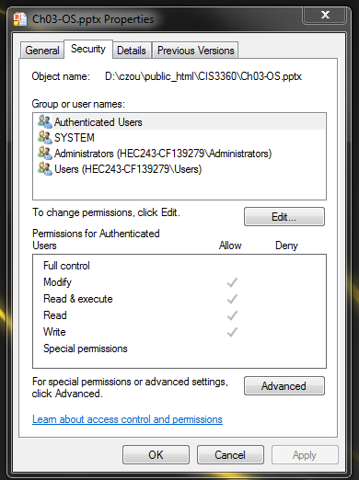
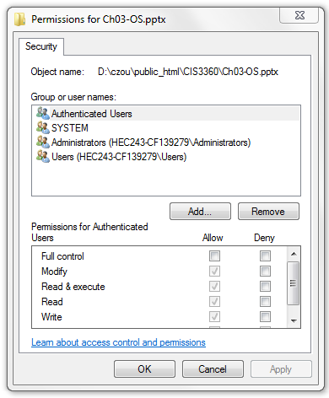
File Permissions in Windows
You can edit permissions of a file/folder

Slide 18
Memory Management
The RAM memory of a computer is its address space.
It contains both the code for the running program, its input data, and its working memory.
For any running process, it is organized into different segments, which keep the different parts of the address space separate.
As we will discuss, security concerns require that we never mix up these different segments.

Slide 19
Memory Organization
Text. This segment contains the actual (binary) machine code of the program.
Data. This segment contains static program variables that have been initialized in the program code.
BSS. This segment, which is named for an antiquated acronym for block started by symbol, contains static variables that are uninitialized.
Heap. This segment, which is also known as the dynamic segment, stores data generated during the execution of a process.
Stack. This segment houses a stack data structure that grows downwards and is used for keeping track of the call structure of subroutines (e.g., methods in Java and functions in C) and their arguments.

Slide 20
Memory Layout

Slide 21
Virtual Memory
There is generally not enough computer memory for the address spaces of all running processes.
Nevertheless, the OS gives each running process the illusion that it has access to its complete (contiguous) address space.
In reality, this view is virtual, in that the OS supports this view, but it is not really how the memory is organized.
Instead, memory is divided into pages, and the OS keeps track of which ones are in memory and which ones are stored out to disk.
ATM

Slide 22
Page Faults
1. Process requests virtual address not in memory,
causing a page fault.
2. Paging supervisor pages out
an old block of RAM memory.
“read 0110101”
“Page fault,
let me fix that.”
Process
Paging supervisor
old
Blocks in
RAM memory:
new
External disk
3. Paging supervisor locates requested block
on the disk and brings it into RAM memory.

Slide 23
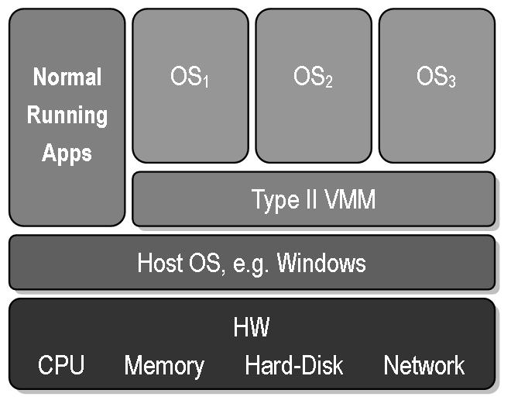
Virtual Machines
Virtual machine: A view that an OS presents that a process is running on a specific architecture and OS, when really it is something else. E.g., a windows emulator on a Mac.
Benefits:
Hardware Efficiency
Portability
Security
Management
Public domain image from http://commons.wikimedia.org/wiki/File:VMM-Type2.JPG

Slide 24
Two Types of Virtual Machine
System Virtual Machine
Also called “hardware virtual machine’,
multiple OS environments can co-exist on the same computer
software that controls virtualization: "hypervisor" or "virtual machine monitor (VMM)"
Process Virtual Machine
Also called ‘application virtual machine’
runs as a normal application inside a host OS
Its purpose is to provide a platform-independent physical machine emulation
Content is mainly from wiki: http://en.wikipedia.org/wiki/Virtual_machine

Slide 25
Examples of VM
Process VM
Java VM
.NET framework
Early version of Vmware
running as a normal program in Win/Linux to create a virtual machine that can be installed with any OSes.
System VM
VMWare
Xen

