Slide 1




User-Side Wi-Fi Evil Twin Attack Detection Using SSL/TCP Protocols
Omar Nakhila, Erich Dondyk, Muhammad F. Amjad and Cliff Zou
University of Central Florida
12th Consumer Communications and Networking Conference
Las Vegas, Nevada
10 January 2015

Slide 2
Contents
What is evil twin attack (ETA)?
ETA detection background.
Our Proposed ETA detection.
  Design assumption.
  Proposed Detection Design
  Implementation.
  Evaluation.
  Discussion And Limitations.
  Conclusion.
Questions!

Slide 3
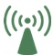





What is evil twin attack?
SSID = FreeNet
AP1
Classical ETA
SSID = FreeNet
AP2
Customer
Attacker

Slide 4
ETA detection background
Administrator side detection
  Administrators are the one responsible for ensuring wireless client protection from ETA.
  Administrators scan the airwaves and match between APs found transmitting nearby with an authenticated APs list.
  Adds more cost to the total wireless network construction price.
  Detections are limited.
  Not available in many cases.
User side detection
  This type of detection is more preferable than the administrator side detection since the wireless clients will ensure their protection against ETA.

Slide 5
Our Proposed ETA detection
ETA detection technique is proposed to detect ETA using different gateway(such as using 4G LTE).
The detection technique is lightweight and is a client-side approach.
No authorized AP-list will be used.

Slide 6
Design assumption.
APs belonging to the same hotspot will always use a single gateway for Internet access.
Administrators in these wireless networks assign private IP addresses to their wireless customers.
Private IP addresses will be eventually translated into the public IP of the gateway using network address translator (NAT) or port address translator (PAT)

Slide 7
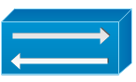

Proposed Detection Design
SSID = FreeNet
AP1
NAT
Private IP
Coffee shop Public IP
SSL/TCP 3-way handshake to www.google.com
SSID = FreeNet
AP2
Google.com
Attacker
SSL/TCP socket created
Get a webpage
Attacker Public IP
Request rejected
Customer

Slide 8
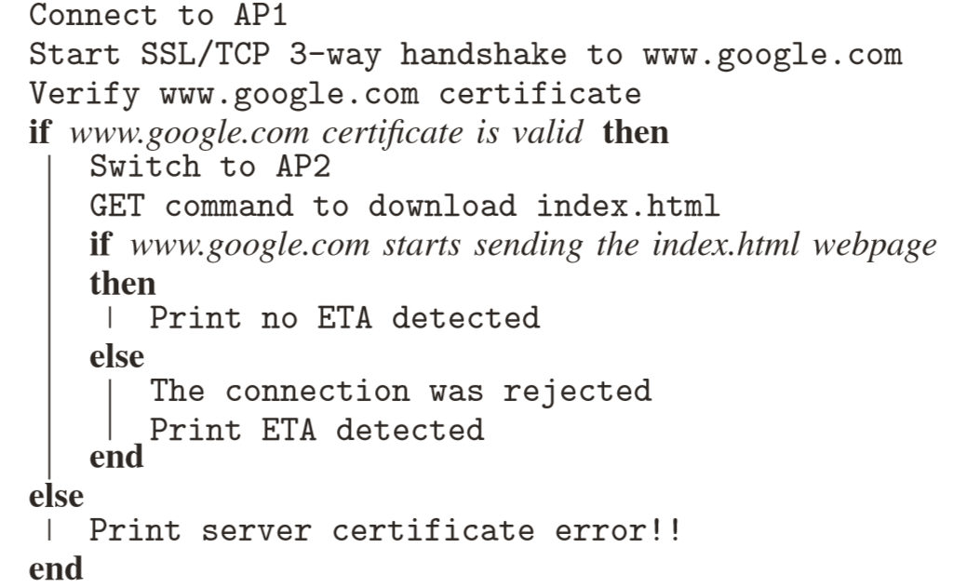
Proposed Detection Design (Pseudo Code)

Slide 9
Implementation
Prototype was implemented using C language and run on Linux machine.
The webserver implemented in our prototype was www.google.com
  More reliable
  Has a long time-to-live SSL/TCP connection (240 seconds based on our measurements).

Slide 10
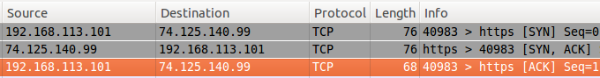
Evaluation (Wireshark Software)
SSID = FreeNet
AP1
NAT
Private IP
Coffee shop Public IP
SSID = FreeNet
AP2
Google.com
Attacker
SSL/TCP socket created
Get a webpage
Attacker Public IP
Request rejected
Customer

Slide 11


Evaluation (Wireshark Software)
SSID = FreeNet
AP1
NAT
Private IP
Coffee shop Public IP
SSID = FreeNet
AP2
Google.com
Get a webpage
Customer

Slide 12
Evaluation (Detection Time Delay Analysis)
The wireless APs used in the test bed were :
  NETGEAR FWG114P
  D-LINK DIR-601.
APs also operated as :
  DHCP servers .
  DNS servers.
  Gateway.
The wireless client is Ubuntu Linux based OS.
WLAN card client Intel(R) Centrino(R) WiMAX 6150.

Slide 13
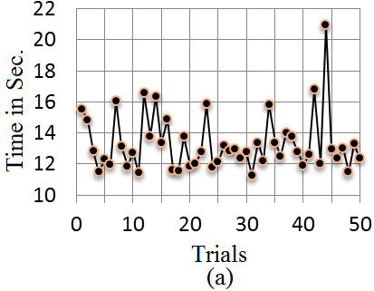
Evaluation (Detection Time Delay Analysis)
The time to connect to AP1 and obtain a valid IP address from the DHCP server.
Avg. time =13.3 sec.

Slide 14
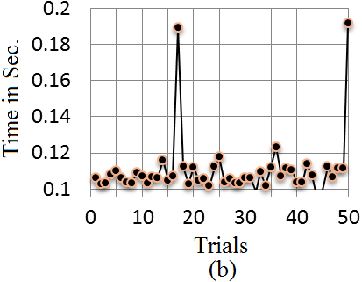
Evaluation (Detection Time Delay Analysis)
The time to finish the 3-way SSL/TCP handshake.
Avg. time = 0.1 sec.

Slide 15
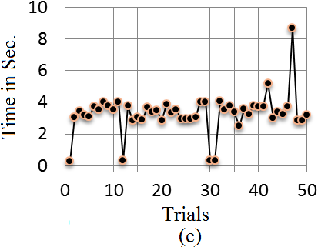
Evaluation (Detection Time Delay Analysis)
The time spent to switch from AP1 to AP2 and obtain/reuse a valid IP from the DHCP server
Avg. time = 3.3 sec.

Slide 16
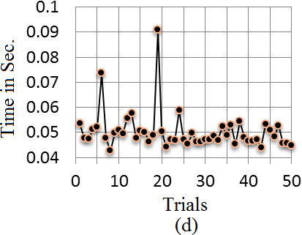
Evaluation (Detection Time Delay Analysis)
The time to receive response from the webserver.
Avg. time = 0.05 sec.

Slide 17
Discussion And Limitations
If the attacker uses the same legitimate gateway to pass client data, our detection method will not work.
Our detection method will not be able to identify which AP is rogue and which one is legitimate.
If the client receives only rogue AP(s) signals without any legitimate AP, our detection method will not work.

Slide 18
Conclusion
A novel ETA detection technique is proposed to detect ETA using a different gateway.
The detection technique is lightweight and is a client-side approach.
The detection method was prototyped and evaluated using real-world scenarios.
Detection time delay is generally short and time delay variance does not affect the detection effectiveness
Our proposed ETA detection can be combined with other type of ETA detections to provide a comprehensive ETA detection.

Slide 19
Q & A

