Slide 1
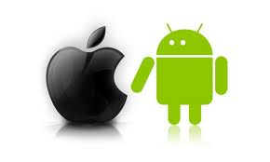
"Smart phones are getting popular quickly. Compare the Apple’s I-phone platform (which is a closed system) with Google’s Droid platform (which is open) in terms of pros and cons. Which platform is winning and why?"
iPhone
Closed System
VS
Andriod
Open Source
Monali Vora
Zohaib Malik
Muhammad Muneel Karrar
ECE-645 Wireless Networks
Prof. Byron Chen

Slide 2
Outline
Introduction to Smart Phones
What is “Open” and “Closed System”? Who is supporting?
History of iPhone
Timeline of I Phone OS
History of Android
Timeline of Android OS
I Phone Architecture
Android Architecture
Power Management
Memory Management
Development Environment
Network Choices
Hardware Choices
Game Choices
Application Choices
A Quick Glance
Market Share
Income Factor
Recent Acquirers
Winner is… ?
References

Slide 3
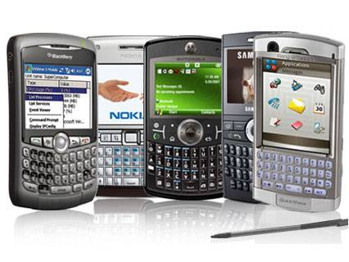
Introduction to Smart Phones
A handheld computer that also acts as a phone.
A device designed to access internet services – e-mail, web, etc. anywhere you are.
A device that runs an identifiable operating system (just as your home computer runs Windows, MacOS, or Linux).

Slide 4
What is “Open” and “Closed System”? Who is supporting?
Closed System refers to software/operating system whose source code is kept secret.
Open System refers to software/operating system whose source code is available for understanding and possible modification and improvement.
Apple’s a closed system and a Walled Garden.
Andriod an open system supported by “ Open Handset Alliance”.
The Open Handset Alliance (OHA) is a business alliance of 78 firms for developing open standards for mobile devices.[1]
Google
HTC
Motorola
Samsung
LG and many more

Slide 5
History of Iphone
iPhone operating system is a mobile operating system developed and marketed by Apple Inc.
The iPhone OS was derived from Mac OX X.
iPhone OS had no official name until the first beta version of the iPhone SDK (Software Development Kit) released on March 6, 2008.[2]
The initial version of iPhone was released on June 29, 2007.
The version 1.0.2 was initially released on iPod Touch on September 14.
The version 2.0 was available with the release of the iPhone 3G on July 11, 2008.
On June 17, 2009, Apple Inc. released the version 3.0 with the iPhone 3GS.
On June 21, 2010, Apple Inc. released the version 4.0.

Slide 6
Timeline of iPhone OS

Slide 7
History of Android
In 2005, July Google bought Android, Inc. which initially developed the Android OS.
Android is not only a mobile operating system that uses a modified version of the Linux kernel.[3]
On the November 5th in 2007, Open Handset Alliance Android.
Android, a mobile device platform built on the Linux Kernel version 2.6.[4]
Android has been available as an open-source software since October 2008.
Cupcake (the official 1.5 update),which based on Linux kernel 2.6.27 was released on 30 April 2009.
On 15 September 2009, Donut (the 1.6 SDK) was released.

Slide 8
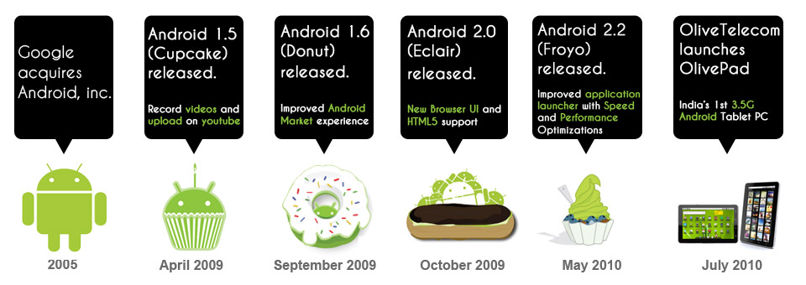
Timeline of Android OS
[9]

Slide 9
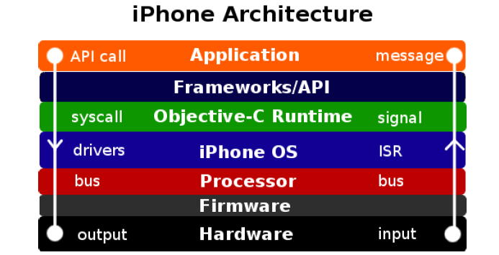
iPhone Architecture
Hardware
Firmware
Processor
iPhone OS
Objective-C Runtime
Objective-C dynamically
-linked runtime libraries
Frameworks/API
Application

Slide 10
Android Architecture
Kernel Linux
Android relies on Linux version 2.6 for core system services
Libraries
Android has a set of C/C++ libraries used by various components of the Android system
These libraries are exposed to developers

Slide 11
Android Architecture
Runtime
Core libraries
Dalvik virtual machine
Application framework
All Android applications are written with Java programming language
Offer developers with the ability to build applications

Slide 12
Power Management
Android supports its own Power Management (on top of the standard Linux Power Management)
CPU shouldn't consume power if no applications or services require power.
Android requires “wake locks” for CPU services request.
iPhone do not have the power management toolkit as Mac OS does.
Embedded into the core layer
Support Sleep mode/ Airline mode

Slide 13
Memory Management
Android
Handles memory management automatically
Garbage collector destroys the application without active
May cause performance issues(too many allocations; too large allocations)
iPhone
Has no garbage collection
Developer maintain the count number for each object
When count number become 0, destroy the object

Slide 14
Development Environment
Language
Android, Java
iPhone, Objective C
Programming Model
Android, XML, UI components can be integrated.
iPhone, XML, UI for customize preferences need to be build from scratch.
IDE
Java Development Tools, rich model of source code.
iPhone, Xcode IDE, iPhone simulators.
UI Builder
Android, Android UI builder can’t display UIs how they’ll actually appear.
iPhone, iPhone app developers are given a good UI builder;

Slide 15
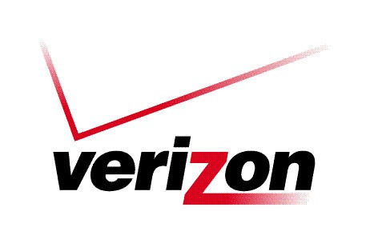
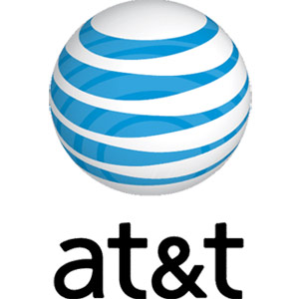
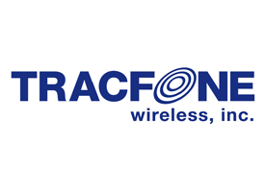
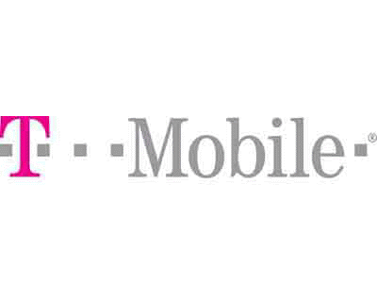
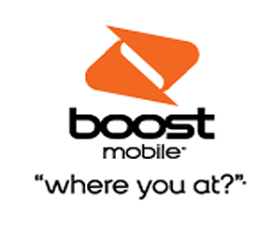
Network Choices

Slide 16
Hardware Choices
iPhone
Stuck with one vendor
Tablet only iPad
Android
More than 40 choices.[3]
From Nexus One to simple call + text mobile.
Tablet choices more than 15.[3]

Slide 17
Games Choices
Android a Java Platform
More games
Android doesn’t even have a language that enables the rich games that iPhone OS allows.
Although, it has NDK for 3D games
No hardware support
iPhone support rich games
Hardware support

Slide 18
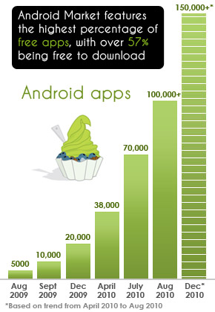
Application Choices
Apple
Apple takes 30% of the profit and you keep 70%.[11]
250,000+ , Applications available for iPhone.
Android
100,000+ , Applications available.
Free to develop any kind of application.
[9]

Slide 19
A Quick Glance
Ease of Use
iPhone wins, It's got one main button, and everything you do consists of tapping app icons from the home screen.
Android, several buttons on the front of the device that perform a variety you're confronted with many different possible home screens and ways of doing things from those home screens. of functions.[6]
Openness
Android wins, being open source platform and having no restrictions on which application to run.
iPhone, runs only applications purchased from Apple App Store.

Slide 20
A Quick Glance(cont)
Multitasking
Android wins, fully customizable multitasking.
iPhone, controlled by Apple.
Software Keyboard
Tie, iPhone has got better software keyboard, but Android can install alternate keyboards like “Swype”.
System-Wide Search
Tie, iPhone and Android both does the search with some difference
Notification System
Android wins, pull-down window shade notification tray, iPhone one notification at a time.

Slide 21
A Quick Glance(cont)
Voice-to-Text
Android wins, every text field can be filled with voice to text, iPhone has 3rd party apps for replying to mails but not efficient.
Syncing
Android Wins, wireless sync with google accounts, iPhone has to be plugged in to get sync
Apps
Android wins, again open source, more apps and customizable
Gaming
iPhone wins, better options and better graphics available.

Slide 22
A Quick Glance(cont)
Music Player
iPhone wins, built in ipod App
Video Chat
Android wins, Available only through add-on apps
iPhone, Native support (only on iPhone 4 hardware)`
Google Turn-by-Turn Navigation
Android wins, free navigation system with google maps, iPhone have many but paid

Slide 23
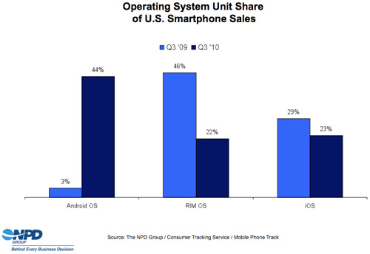
Market Share
US Market Share
NPD
[6]

Slide 24
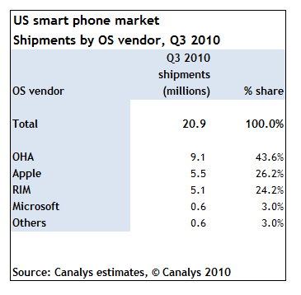
Market Share
US Market Share
Canalys
[6]

Slide 25
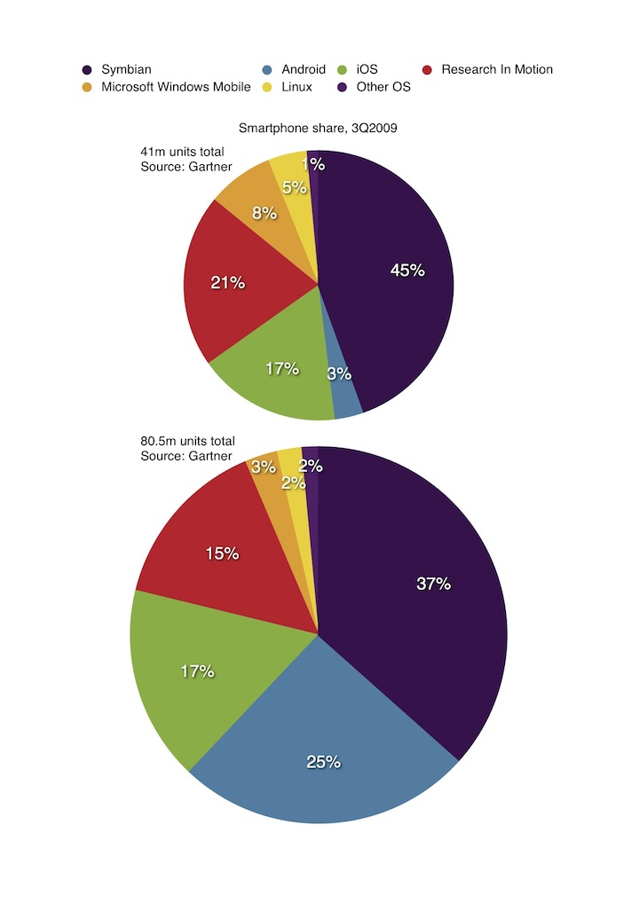
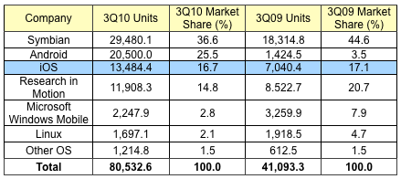
Market Share
Global Market Share
Gartner
[5]
[5]

Slide 26
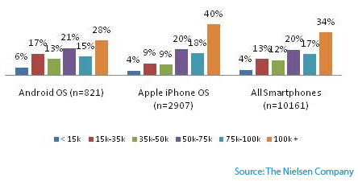
Income Factor
US Market
Nielsen
[7]

Slide 27
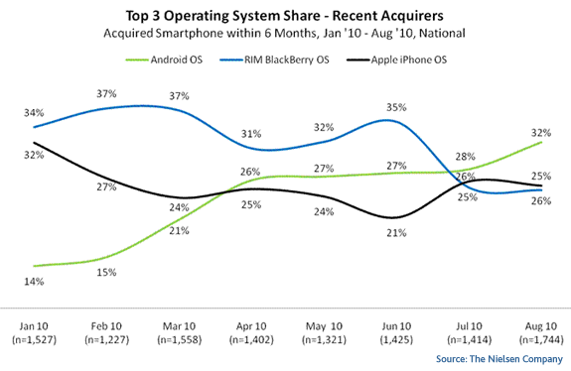
Recent Acquirers
US Market
Nielsen
[8]

Slide 28
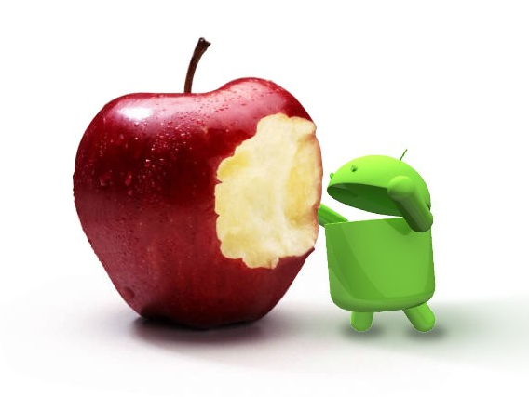
Winner is…?

Slide 29
References
[1] Open Handset Alliance.
http://en.wikipedia.org/wiki/Open_Handset_Alliance
[2] Honan, Matthew. "Apple unveils iPhone".Macworld.
http://www.macworld.com/article/54769/2007/01/iphone.html
[3] Lu Cheng Analysis and Comparison with Android and iPhone Operating System”
http://www.cs.ucf.edu/~dc m/Teaching/COP5611Spring2010/Project/AmberChang-Project.pdf
[4]Open Handset Alliance. "Industry Leaders Announce Open Platform for Mobile Devices".
http://www.openhandsetalliance.com/press_110507.html
[5] Aaron . “Android On Top For Q3 Global Smartphone Market Share, iOS Places Third”
http://www.razorianfly.com/2010/11/10/android-on-top-for-q3-global-smartphone-market-share-ios-places-third/
[6] Jason Hiner . “Q3 stats show Android and iPhone surging past BlackBerry”
http://blogs.techrepublic.com.com/hiner/?p=5772
[7] Don Kellogg, Senior Manager. “iPhone vs. Android”
http://blog.nielsen.com/nielsenwire/online_mobile/iphone-vs-android/
[8] Nielsen Wiire. ” Android Most Popular Operating System in U.S. Among Recent Smartphone Buyers”
http://blog.nielsen.com/nielsenwire/online_mobile/android-most-popular-operating-system-in-u-s-among-recent-smartphone-buyers/
[9] http://notebooks.com/2010/04/08/timeline-of-the-iphone/
[10] Olive Telecom, “Android Market”
http://www.olivetelecom.in/laptop/olivepad/
[11] Ultimate Application
http://ulapp.us/iphone-app-qa-if-i-sell-an-iphone-app-how-much-will-apple-take-out-of-the-profit/

