Slide 1
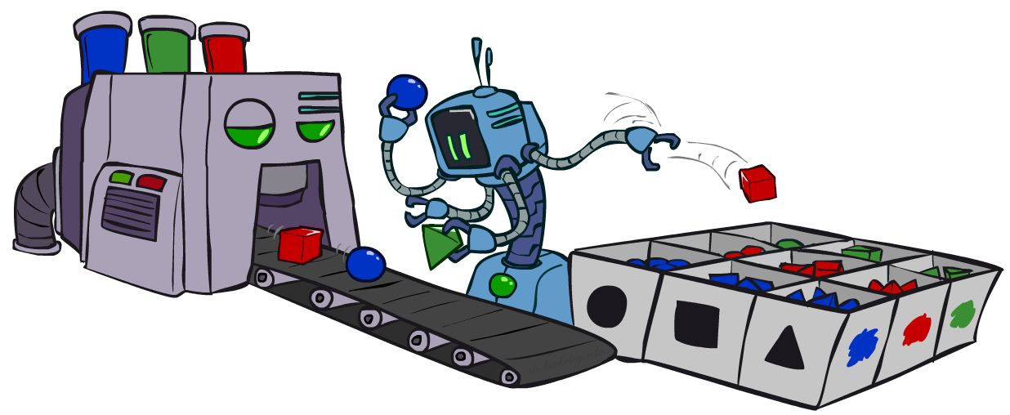
CAP 5636 – Advanced Artificial Intelligence
Bayes’ Nets: Sampling
Instructor: Lotzi Bölöni
  [These slides were adapted from the ones created by Dan Klein and Pieter Abbeel for CS188 Intro to AI at UC Berkeley, available at http://ai.berkeley.edu.]
Notes:
Please retain proper attribution, including the reference to ai.berkeley.edu. Thanks!

Slide 2
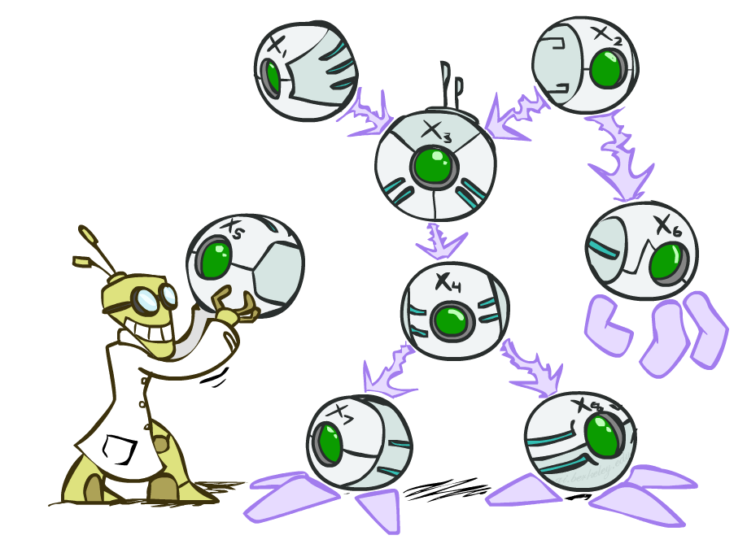

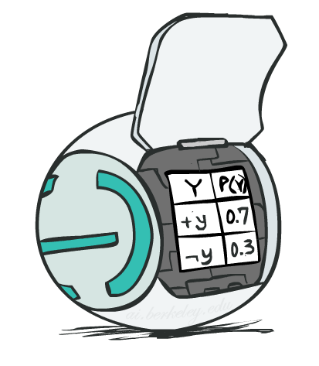
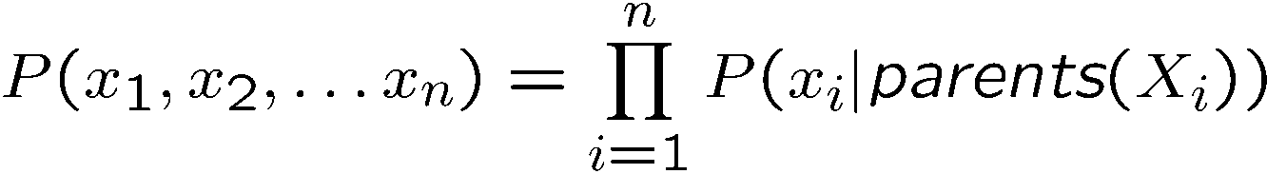
Bayes’ Net Representation
A directed, acyclic graph, one node per random variable
A conditional probability table (CPT) for each node
  A collection of distributions over X, one for each combination of parents’ values
Bayes’ nets implicitly encode joint distributions
  As a product of local conditional distributions
  To see what probability a BN gives to a full assignment, multiply all the relevant conditionals together:

Slide 3
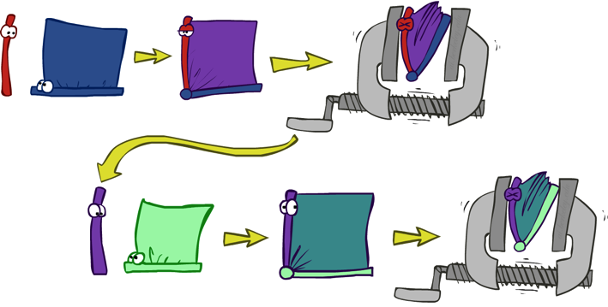











Variable Elimination
Interleave joining and marginalizing
d^{k} entries computed for a factor over k variables with domain sizes d
Ordering of elimination of hidden variables can affect size of factors generated
Worst case: running time exponential in the size of the Bayes’ net
…
…

Slide 4
















Worst Case Complexity?
CSP:
If we can answer P(z) equal to zero or not, we answered whether the 3-SAT problem has a solution.
Hence inference in Bayes’ nets is NP-hard. No known efficient probabilistic inference in general.
…
…

Slide 5

Approximate Inference: Sampling

Slide 6

Sampling
Sampling is a lot like repeated simulation
  Predicting the weather, basketball games, …
Basic idea
  Draw N samples from a sampling distribution S
  Compute an approximate posterior probability
  Show this converges to the true probability P
Why sample?
  Learning: get samples from a distribution you don’t know
  Inference: getting a sample is faster than computing the right answer (e.g. with variable elimination)

Slide 7
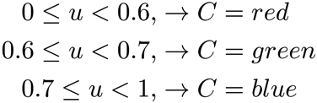

Sampling
Sampling from given distribution
  Step 1: Get sample u from uniform distribution over [0, 1)
    E.g. random() in python
  Step 2: Convert this sample u into an outcome for the given distribution by having each outcome associated with a sub-interval of [0,1) with sub-interval size equal to probability of the outcome
Example
  If random() returns u = 0.83, then our sample is C = blue
  E.g, after sampling 8 times:
C | P(C)
red | 0.6
green | 0.1
blue | 0.3

Slide 8
Sampling in Bayes’ Nets
Prior Sampling
Rejection Sampling
Likelihood Weighting
Gibbs Sampling

Slide 9
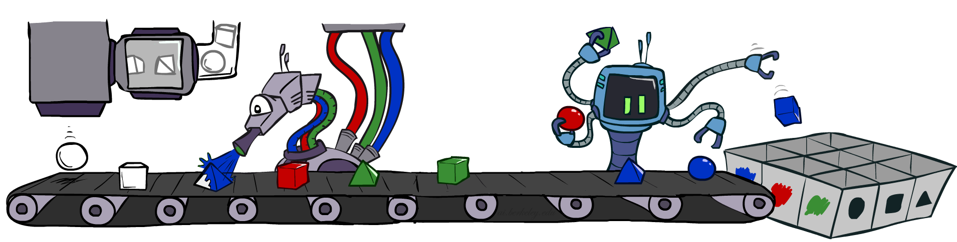
Prior Sampling

Slide 10




Prior Sampling
+c | 0.5
-c | 0.5
Cloudy
Cloudy
+c | +s | 0.1
 | -s | 0.9
-c | +s | 0.5
 | -s | 0.5
+c | +r | 0.8
 | -r | 0.2
-c | +r | 0.2
 | -r | 0.8
Sprinkler
Sprinkler
Rain
Rain
WetGrass
WetGrass
Samples:
+s | +r | +w | 0.99
 |  | -w | 0.01
 | -r | +w | 0.90
 |  | -w | 0.10
-s | +r | +w | 0.90
 |  | -w | 0.10
 | -r | +w | 0.01
 |  | -w | 0.99
+c, -s, +r, +w
-c, +s, -r, +w
…

Slide 11
Prior Sampling
For i=1, 2, …, n
  Sample x_{i} from P(X_{i} | Parents(X_{i}))
Return (x₁, x₂, …, x_{n})

Slide 12
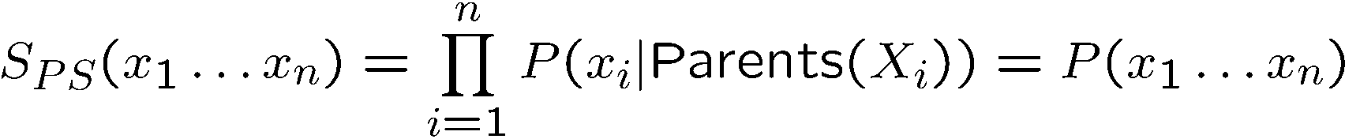

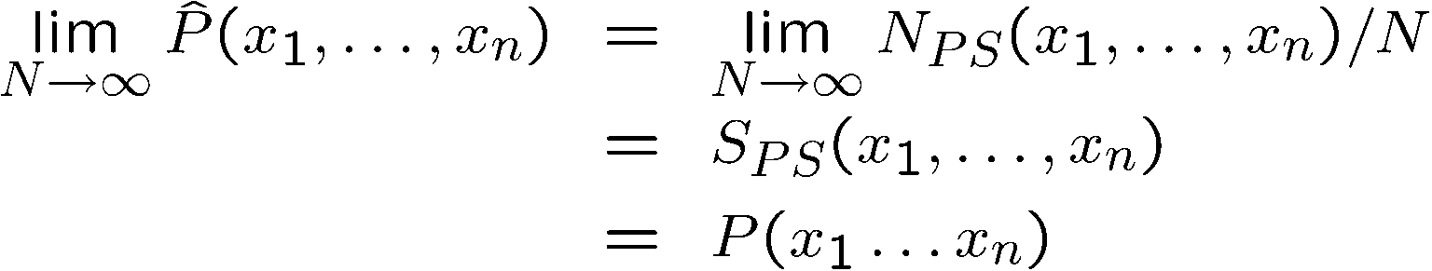
Prior Sampling
This process generates samples with probability:
…i.e. the BN’s joint probability
Let the number of samples of an event be
Then
I.e., the sampling procedure is consistent

Slide 13
Example
We’ll get a bunch of samples from the BN:
  +c, -s, +r, +w
  +c, +s, +r, +w
  -c, +s, +r, -w
  +c, -s, +r, +w
  -c, -s, -r, +w
If we want to know P(W)
  We have counts <+w:4, -w:1>
  Normalize to get P(W) = <+w:0.8, -w:0.2>
  This will get closer to the true distribution with more samples
  Can estimate anything else, too
  What about P(C| +w)? P(C| +r, +w)? P(C| -r, -w)?
  Fast: can use fewer samples if less time (what’s the drawback?)
C
S
R
W

Slide 14
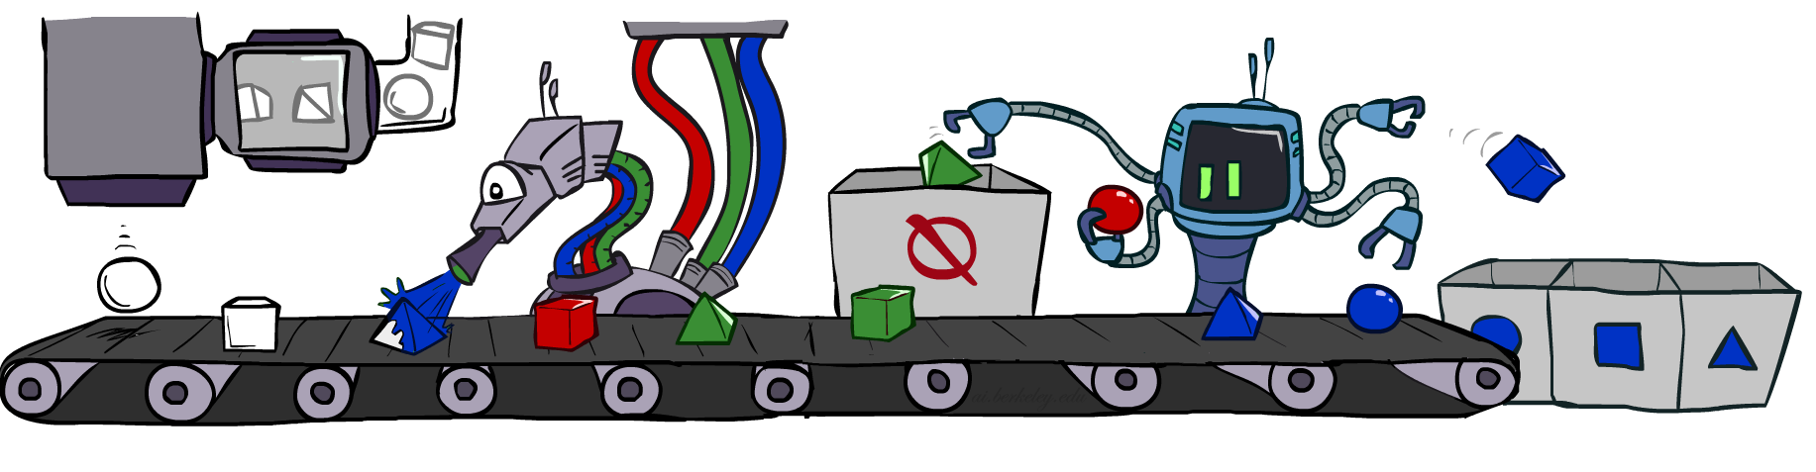
Rejection Sampling

Slide 15
Rejection Sampling
Let’s say we want P(C)
  No point keeping all samples around
  Just tally counts of C as we go
Let’s say we want P(C| +s)
  Same thing: tally C outcomes, but ignore (reject) samples which don’t have S=+s
  This is called rejection sampling
  It is also consistent for conditional probabilities (i.e., correct in the limit)
C
S
R
W
  +c, -s, +r, +w
  +c, +s, +r, +w
  -c, +s, +r, -w
  +c, -s, +r, +w
  -c, -s, -r, +w

Slide 16
Rejection Sampling
IN: evidence instantiation
For i=1, 2, …, n
  Sample x_{i} from P(X_{i} | Parents(X_{i}))
  If x_{i} not consistent with evidence
    Reject: Return, and no sample is generated in this cycle
Return (x₁, x₂, …, x_{n})

Slide 17
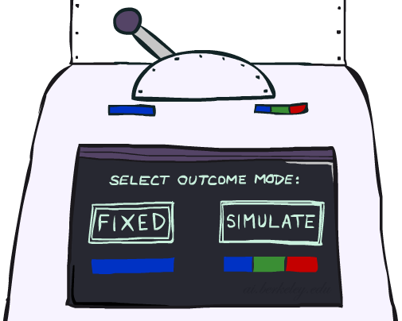
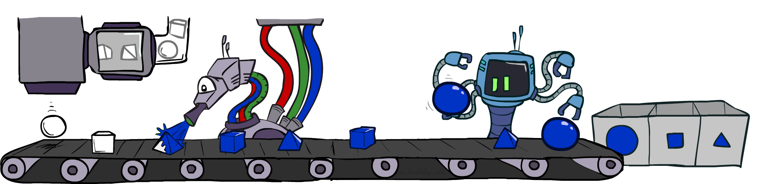
Likelihood Weighting

Slide 18
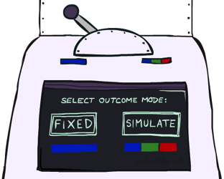


Likelihood Weighting
Problem with rejection sampling:
  If evidence is unlikely, rejects lots of samples
  Evidence not exploited as you sample
  Consider P(Shape|blue)
Idea: fix evidence variables and sample the rest
  Problem: sample distribution not consistent!
  Solution: weight by probability of evidence given parents
  pyramid, green
  pyramid, red
  sphere, blue
  cube, red
  sphere, green
  pyramid, blue
  pyramid, blue
  sphere, blue
  cube, blue
  sphere, blue
Shape
Color
Shape
Color

Slide 19



Likelihood Weighting
+c | 0.5
-c | 0.5
Cloudy
Cloudy
+c | +s | 0.1
 | -s | 0.9
-c | +s | 0.5
 | -s | 0.5
+c | +r | 0.8
 | -r | 0.2
-c | +r | 0.2
 | -r | 0.8
Sprinkler
Sprinkler
Rain
Rain
WetGrass
Samples:
WetGrass
+s | +r | +w | 0.99
 |  | -w | 0.01
 | -r | +w | 0.90
 |  | -w | 0.10
-s | +r | +w | 0.90
 |  | -w | 0.10
 | -r | +w | 0.01
 |  | -w | 0.99
+c, +s, +r, +w
…

Slide 20
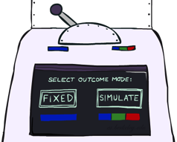
Likelihood Weighting
IN: evidence instantiation
w = 1.0
for i=1, 2, …, n
  if X_{i} is an evidence variable
    X_{i} = observation x_{i} for X_{i}
    Set w = w * P(x_{i} | Parents(X_{i}))
  else
    Sample x_{i} from P(X_{i} | Parents(X_{i}))
return (x₁, x₂, …, x_{n}), w

Slide 21
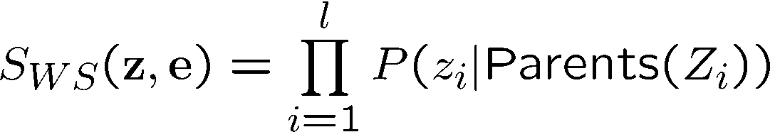
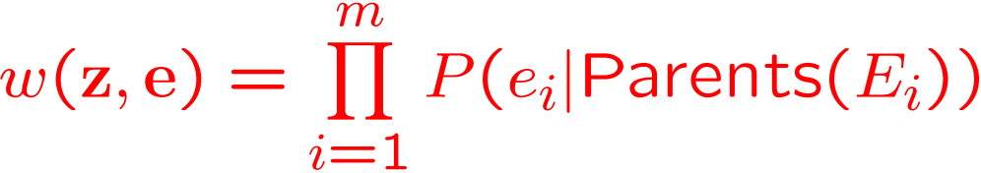
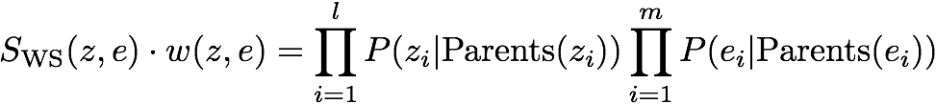

Likelihood Weighting
Sampling distribution if z sampled and e fixed evidence
Now, samples have weights
Together, weighted sampling distribution is consistent
Cloudy
C
S
R
W

Slide 22
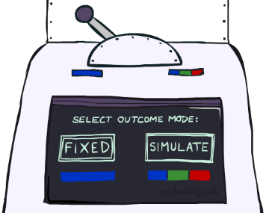
Likelihood Weighting
Likelihood weighting is good
  We have taken evidence into account as we generate the sample
  E.g. here, W’s value will get picked based on the evidence values of S, R
  More of our samples will reflect the state of the world suggested by the evidence
Likelihood weighting doesn’t solve all our problems
  Evidence influences the choice of downstream variables, but not upstream ones (C isn’t more likely to get a value matching the evidence)
We would like to consider evidence when we sample every variable
→ Gibbs sampling

Slide 23
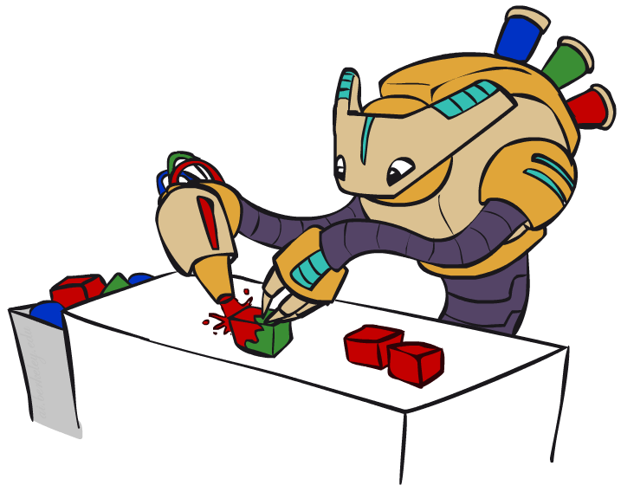
Gibbs Sampling

Slide 24
Gibbs Sampling
Procedure: keep track of a full instantiation x₁, x₂, …, x_{n}. Start with an arbitrary instantiation consistent with the evidence. Sample one variable at a time, conditioned on all the rest, but keep evidence fixed. Keep repeating this for a long time.
Property: in the limit of repeating this infinitely many times the resulting sample is coming from the correct distribution
Rationale: both upstream and downstream variables condition on evidence.
In contrast: likelihood weighting only conditions on upstream evidence, and hence weights obtained in likelihood weighting can sometimes be very small. Sum of weights over all samples is indicative of how many “effective” samples were obtained, so want high weight.

Slide 25
Gibbs Sampling Example: P( S | +r)
Step 1: Fix evidence
  R = +r
Steps 3: Repeat
  Choose a non-evidence variable X
  Resample X from P( X | all other variables)
Step 2: Initialize other variables
  Randomly
C
C
S
+r
S
+r
W
W
C
C
C
C
C
C
S
+r
S
+r
S
+r
S
+r
S
+r
S
+r
W
W
W
W
W
W

Slide 26
Gibbs Sampling
How is this better than sampling from the full joint?
  In a Bayes’ Net, sampling a variable given all the other variables (e.g. P(R|S,C,W)) is usually much easier than sampling from the full joint distribution
    Only requires a join on the variable to be sampled (in this case, a join on R)
    The resulting factor only depends on the variable’s parents, its children, and its children’s parents (this is often referred to as its Markov blanket)

Slide 27
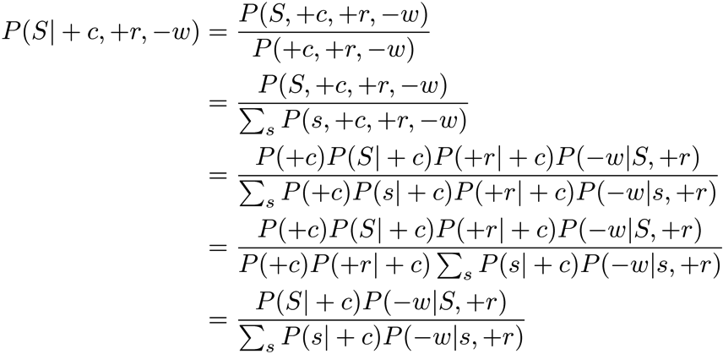
Efficient Resampling of One Variable
C
Sample from P(S | +c, +r, -w)
Many things cancel out – only CPTs with S remain!
More generally: only CPTs that have resampled variable need to be considered, and joined together
S
+r
W

Slide 28



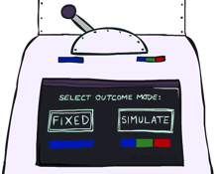

Bayes’ Net Sampling Summary
Prior Sampling P
Likelihood Weighting P( Q | e)
Rejection Sampling P( Q | e )
Gibbs Sampling P( Q | e )

Slide 29
Further Reading on Gibbs Sampling*
Gibbs sampling produces sample from the query distribution P( Q | e ) in limit of re-sampling infinitely often
Gibbs sampling is a special case of more general methods called Markov chain Monte Carlo (MCMC) methods
  Metropolis-Hastings is one of the more famous MCMC methods (in fact, Gibbs sampling is a special case of Metropolis-Hastings)
You may read about Monte Carlo methods – they’re just sampling

Slide 30
How About Particle Filtering?
X₁
X₂
X₂
= likelihood weighting
E₂
Elapse
Weight
Resample
Particles:
(3,3)
(2,3)
(3,3)
(3,2)
(3,3)
(3,2)
(1,2)
(3,3)
(3,3)
(2,3)
Particles:
(3,2)
(2,3)
(3,2)
(3,1)
(3,3)
(3,2)
(1,3)
(2,3)
(3,2)
(2,2)
Particles:
(3,2) w=.9
(2,3) w=.2
(3,2) w=.9
(3,1) w=.4
(3,3) w=.4
(3,2) w=.9
(1,3) w=.1
(2,3) w=.2
(3,2) w=.9
(2,2) w=.4
(New) Particles:
(3,2)
(2,2)
(3,2)
(2,3)
(3,3)
(3,2)
(1,3)
(2,3)
(3,2)
(3,2)

Slide 31
Particle Filtering
Particle filtering operates on ensemble of samples
  Performs likelihood weighting for each individual sample to elapse time and incorporate evidence
  Resamples from the weighted ensemble of samples to focus computation for the next time step where most of the probability mass is estimated to be

Slide 32
Markov Chain Monte Carlo*
Idea: instead of sampling from scratch, create samples that are each like the last one.
Procedure: resample one variable at a time, conditioned on all the rest, but keep evidence fixed. E.g., for P(b|c):
Properties: Now samples are not independent (in fact they’re nearly identical), but sample averages are still consistent estimators!
What’s the point: both upstream and downstream variables condition on evidence.
+b
+a
+c
-b
+a
+c
-b
-a
+c

