Slide 1
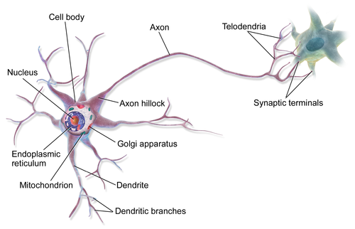
Activation Functions: Biological Inspiration

Slide 2
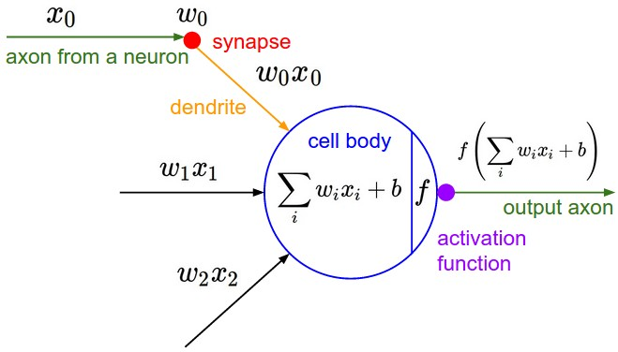
Activation Functions

Slide 3
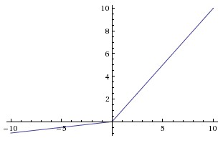
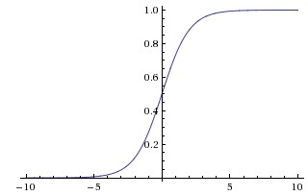

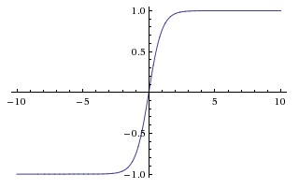


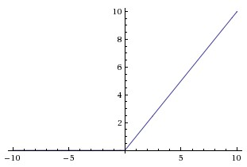
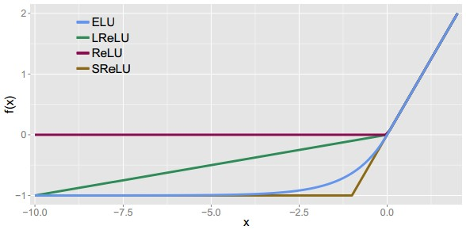
Activation Functions
Sigmoid
Leaky ReLU
max(0.1x, x)
Maxout
tanh tanh(x)
ELU
ReLU max(0,x)

Slide 4
Activation Functions
Squashes numbers to range [0,1] – can kill gradients.
A key element in LSTM networks – “control signals”
Good for learning “logical” functions, – good for non-linear control (robots)
Not as good for image networks (replaced by RELU)
Not zero-centered
Sigmoid (logistic function)

Slide 5
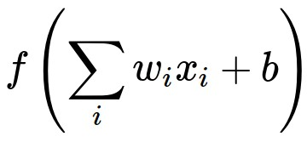

Consider what happens when the input to a neuron (x) is always positive:
What can we say about the gradients on $w$?

Slide 6
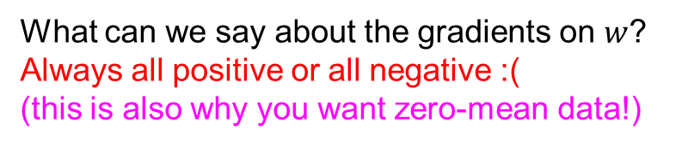
Consider what happens when the input to a neuron is always positive...
allowed gradient update directions
zig zag path
allowed gradient update directions
hypothetical optimal w vector
What can we say about the gradients on $w$?
Always all positive or all negative :(
(this is also why you want zero-mean data!)

Slide 7
Activation Functions
Squashes numbers to range [-1,1]
Zero centered (nice)
Still kills gradients when saturated :(
Also used in LSTMs for bounded, signed values.
Not as good for binary functions
tanh(x)
[LeCun et al., 1991]

Slide 8
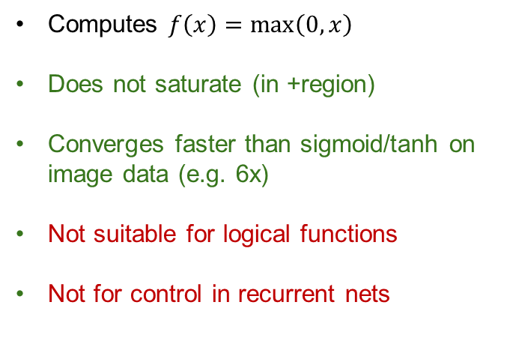
Activation Functions
Computes $f\left(x\right)=max\left(0,x\right)$
Does not saturate (in +region)
Converges faster than sigmoid/tanh on image data (e.g. 6x)
Not suitable for logical functions
Not for control in recurrent nets
ReLU
(Rectified Linear Unit)
[Krizhevsky et al., 2012]

Slide 9
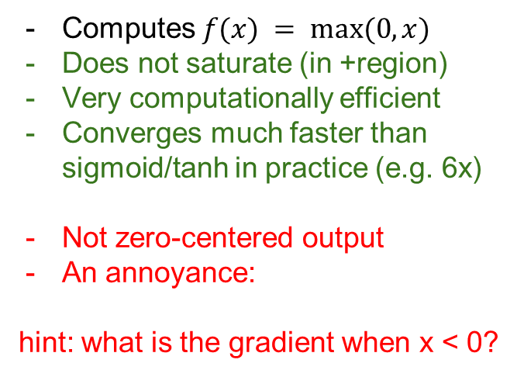
Activation Functions
Computes $f(x) = max⁡(0,x)$
Does not saturate (in +region)
Very computationally efficient
Converges much faster than sigmoid/tanh in practice (e.g. 6x)
Not zero-centered output
An annoyance:
hint: what is the gradient when x < 0?
ReLU
(Rectified Linear Unit)

Slide 10


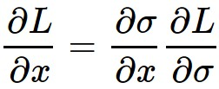

ReLU
gate
x
What happens when x = -10?
What happens when x = 0?
What happens when x = 10?

Slide 11
DATA CLOUD
active ReLU
=> Need to take care that no RELU unit is outside the data envelope – it will never learn.
dead ReLU
will never activate
=> never update

Slide 12

Activation Functions
[Mass et al., 2013]
[He et al., 2015]
Does not saturate
Converges faster than sigmoid/tanh on image data(e.g. 6x)
will not “die”.
Leaky ReLU

Slide 13


Activation Functions
[Mass et al., 2013]
[He et al., 2015]
Does not saturate
Converges faster than sigmoid/tanh on image data (e.g. 6x)
will not “die”.
Parametric Rectifier (PReLU)
Leaky ReLU
backprop into $α$ (parameter)

Slide 14
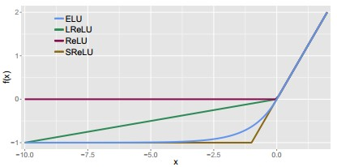

Activation Functions
[Clevert et al., 2015]
Exponential Linear Units (ELU)
All benefits of ReLU
Does not die
Closer to zero mean outputs

Slide 15
Maxout “Neuron”
Does not have the basic form of dot product -> nonlinearity
Generalizes ReLU and Leaky ReLU
Linear Regime! Does not saturate! Does not die!
can learn:
[Goodfellow et al., 2013]
Problem: doubles the number of parameters/neuron :(

Slide 16
TLDR: In practice:
Try everything. Usually:
Use ReLU on early image layers.
Try out Leaky ReLU / Maxout / ELU.
Use sigmoids for smooth functions, e.g. robot control.
Sigmoids are also good for logical functions AND/OR.

Slide 17
Weight Initialization

Slide 18
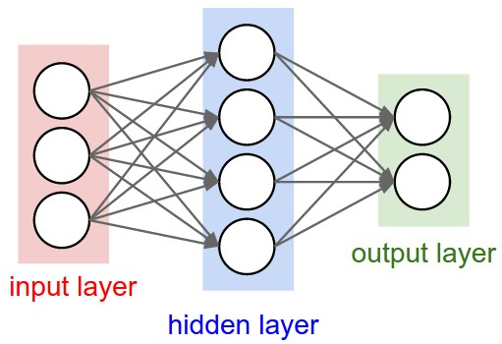
Weight Initialization
Q: what happens when W=0 init is used?
Notes:
Zero activation in conv/relu or fc/relu layers. No activations on output. No gradients.

Slide 19
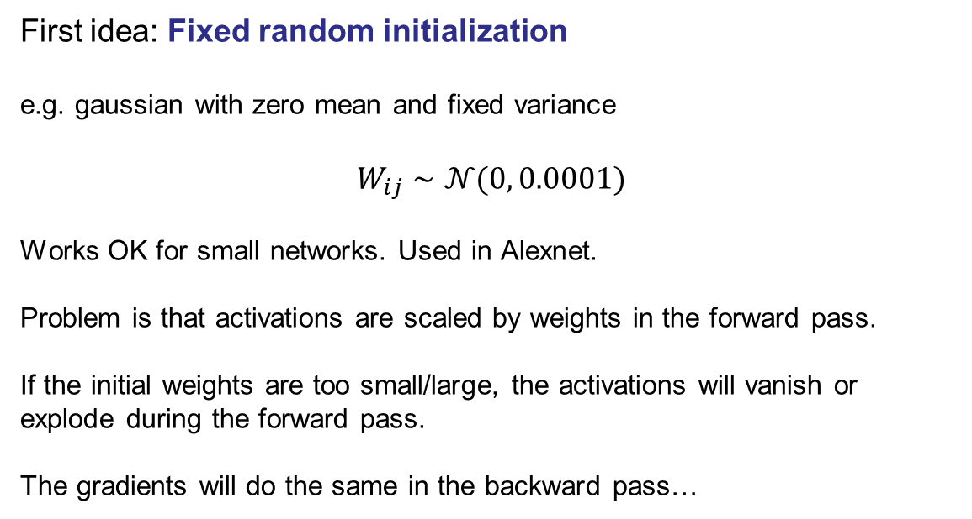
Weight Initialization
First idea: Fixed random initialization
e.g. gaussian with zero mean and fixed variance
$$W_{ij}∼𝒩(0, 0.0001)$$
Works OK for small networks. Used in Alexnet.
Problem is that activations are scaled by weights in the forward pass.
If the initial weights are too small/large, the activations will vanish or explode during the forward pass.
The gradients will do the same in the backward pass…

Slide 20
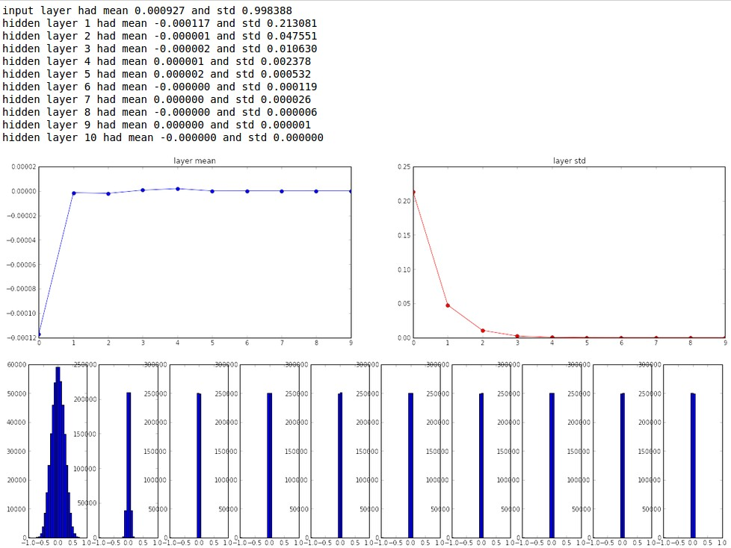
Activations with Random Weight init

Slide 21
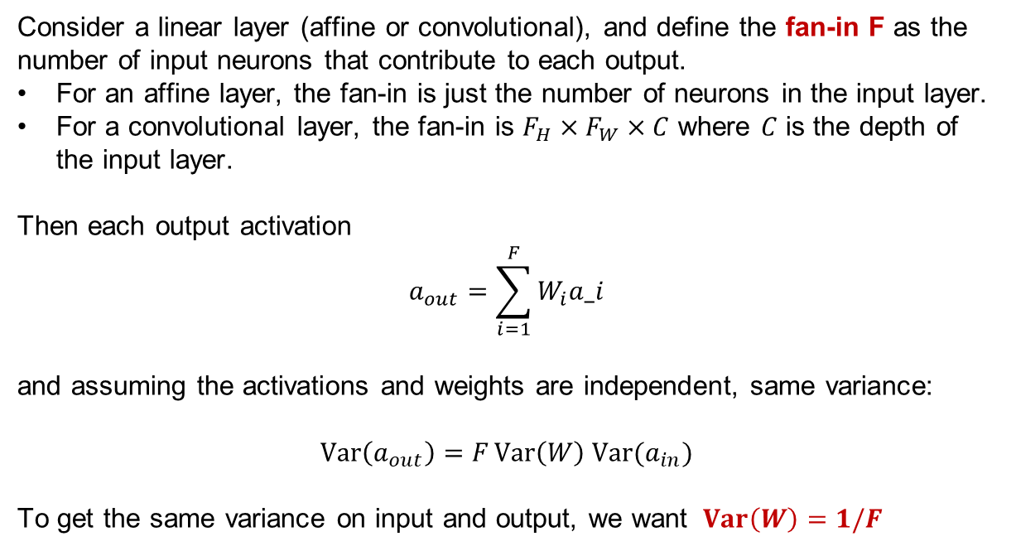
Analysis of activation growth
Consider a linear layer (affine or convolutional), and define the fan-in F as the number of input neurons that contribute to each output.
For an affine layer, the fan-in is just the number of neurons in the input layer.
For a convolutional layer, the fan-in is $F_{H}×F_{W}×C$ where $C$ is the depth of the input layer.
Then each output activation
$$a_{out}=\sum_{i=1}^{F}{W_{i}a_i}$$
and assuming the activations and weights are independent, same variance:
$$Var\left(a_{out}\right)=F Var\left(W\right) Var(a_{in})$$
To get the same variance on input and output, we want $Var\left(W\right)=1/F$

Slide 22
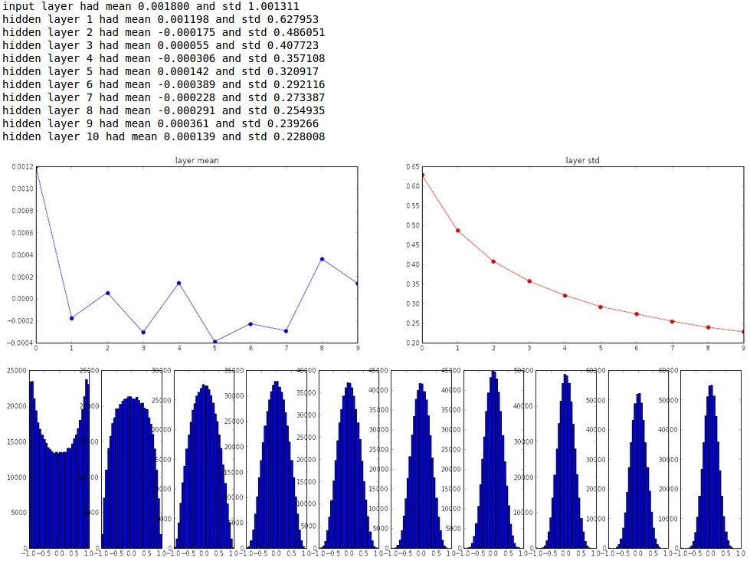
Xavier Initialization
“Xavier initialization” [Glorot et al., 2010]

Slide 23
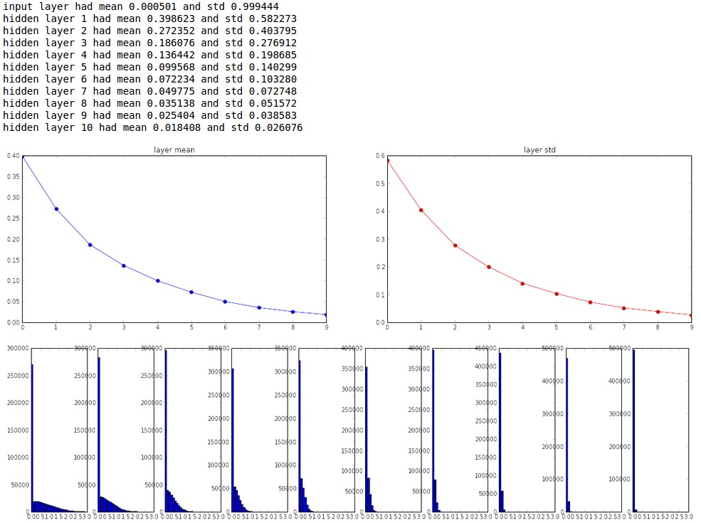
Accounting for ReLUs
Our analysis assumed that layers were linear.
Not accurate with ReLU layers.

Slide 24
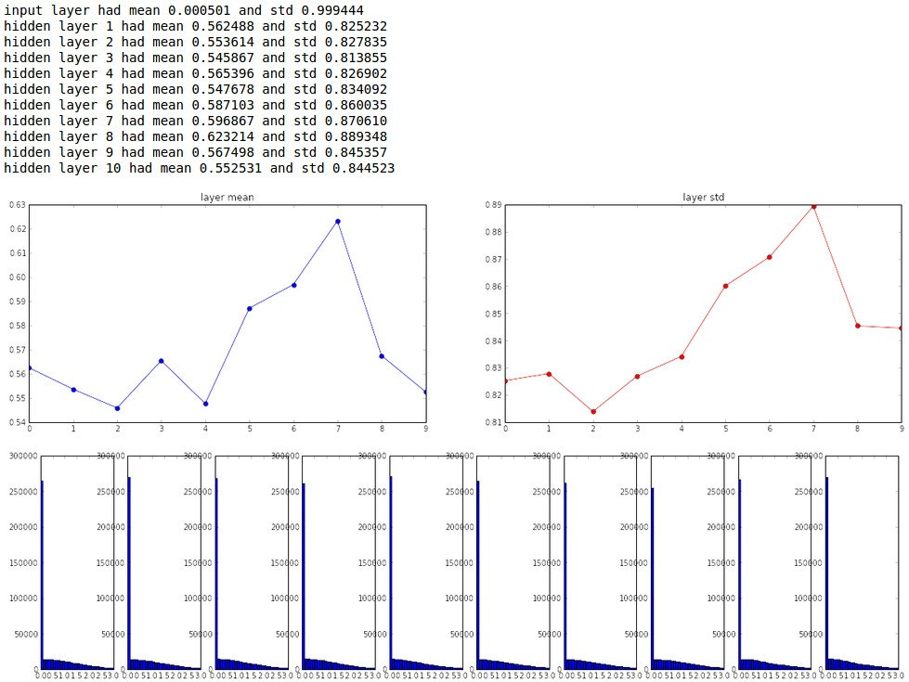
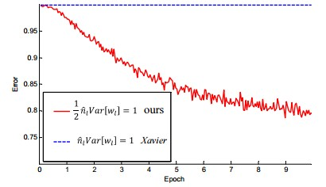
ReLU adjustment to Xavier
He et al., 2015 (note additional /2)
factor of 2 doesn’t seem like much, but it applies multiplicatively 150 times in a large ResNet.

Slide 25
Proper initialization is an active area of research…
Understanding the difficulty of training deep feedforward neural networks
by Glorot and Bengio, 2010
Exact solutions to the nonlinear dynamics of learning in deep linear neural networks by Saxe et al, 2013
Random walk initialization for training very deep feedforward networks by Sussillo and Abbott, 2014
Delving deep into rectifiers: Surpassing human-level performance on ImageNet classification by He et al., 2015
Data-dependent Initializations of Convolutional Neural Networks by Krähenbühl et al., 2015
All you need is a good init, Mishkin and Matas, 2015
…

Slide 26

Batch Normalization
[Ioffe and Szegedy, 2015]
“you want unit gaussian activations? just make them so.”
Consider a batch of activations at some layer. To make each dimension unit gaussian, apply:
this is a vanilla differentiable function...

Slide 27
Batch Norm: Per-Activation (default) or Spatial
activation map
32x32x3 image
5x5x3 filter
32
28
Normal: average one neuron activation across a minibatch
32
28
3
1

Slide 28
Batch Norm: Spatial
activation map
32x32x3 image
5x5x3 filter
32
28
Spatial: average a plane of neurons across the plane, and across a minibatch
32
28
3
1

Slide 29
Batch Normalization
[Ioffe and Szegedy, 2015]
“you want unit gaussian activations?
just make them so.”
1. compute the empirical mean and variance independently for each dimension.
X
N
2. Normalize
D

Slide 30



Batch Normalization
[Ioffe and Szegedy, 2015]
Normalize:
Note, the network can learn:
And then allow the network to squash
the range if it wants to:
to recover the identity mapping.

Slide 31
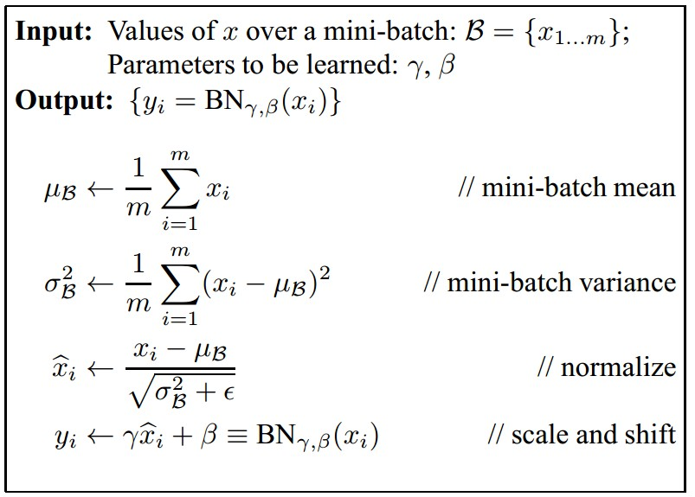
Batch Normalization
[Ioffe and Szegedy, 2015]
Improves gradient flow through the network
Allows higher learning rates
Reduces the strong dependence on initialization
Acts as a form of regularization in a funny way, and slightly reduces the need for dropout, maybe

Slide 32
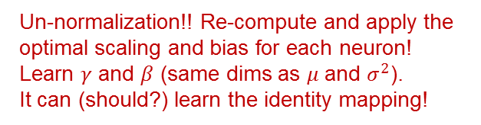
This Time: Batch Normalization
[Ioffe and Szegedy, 2015]
Improves gradient flow through the network
Allows higher learning rates
Reduces the strong dependence on initialization
Reduces need for dropout
Un-normalization!! Re-compute and apply the optimal scaling and bias for each neuron!
Learn $γ$ and $β$ (same dims as $μ$ and $σ^{2}$).
It can (should?) learn the identity mapping!

Slide 33
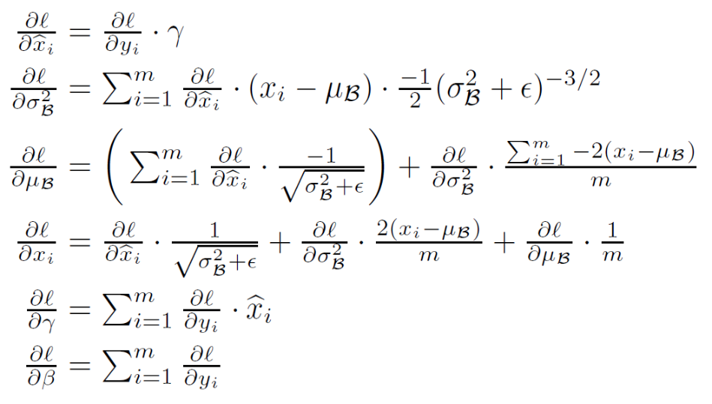
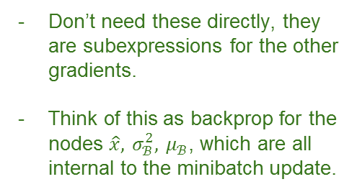
Batch Normalization Gradients
[Ioffe and Szegedy, 2015]
Don’t need these directly, they are subexpressions for the other gradients.
Think of this as backprop for the nodes $\hat{x}, σ_{ℬ}^{2}, μ_{ℬ}$, which are all internal to the minibatch update.

Slide 34
Batch Normalization Gradients
[Ioffe and Szegedy, 2015]
Gradient to propagate to
the input layer

Slide 35

Batch Normalization Gradients
[Ioffe and Szegedy, 2015]
Gradients for the learnable parameters $γ$ and $β$.

Slide 36





Where to do BatchNorm ?
BatchNorm is just a linear scale/bias layer in the limit of large batch sizes ($μ$, $σ^{2}$).
Batch
Norm
Linear
weight
$$W_{1}x$$
ReLU
Linear
Weight
$$W_{2}h_{2}$$
$$h_{1}$$
$$h_{2}$$

Slide 37

Where to do BatchNorm ?
BatchNorm is just a linear scale/bias layer in the limit of large batch sizes ($μ$, $σ^{2}$).
Linear
weight
$$W_{1}x$$
Batch
Norm
ReLU
Linear
Weight
$$W_{2}h_{2}$$
$$h_{1}$$
$$h_{2}$$
?? Linear weight layer should
already have optimal scale/bias
in its output

Slide 38

Where to do BatchNorm ?
BatchNorm is just a linear scale/bias layer in the limit of large batch sizes ($μ$, $σ^{2}$).
Linear
weight
$$W_{1}x$$
ReLU
Batch
Norm
Linear
Weight
$$W_{2}h_{2}$$
$$h_{1}$$
$$h_{2}$$
?? Any bias/scaling by the batch
norm layer should be over-ruled
by the second linear weight layer.

Slide 39
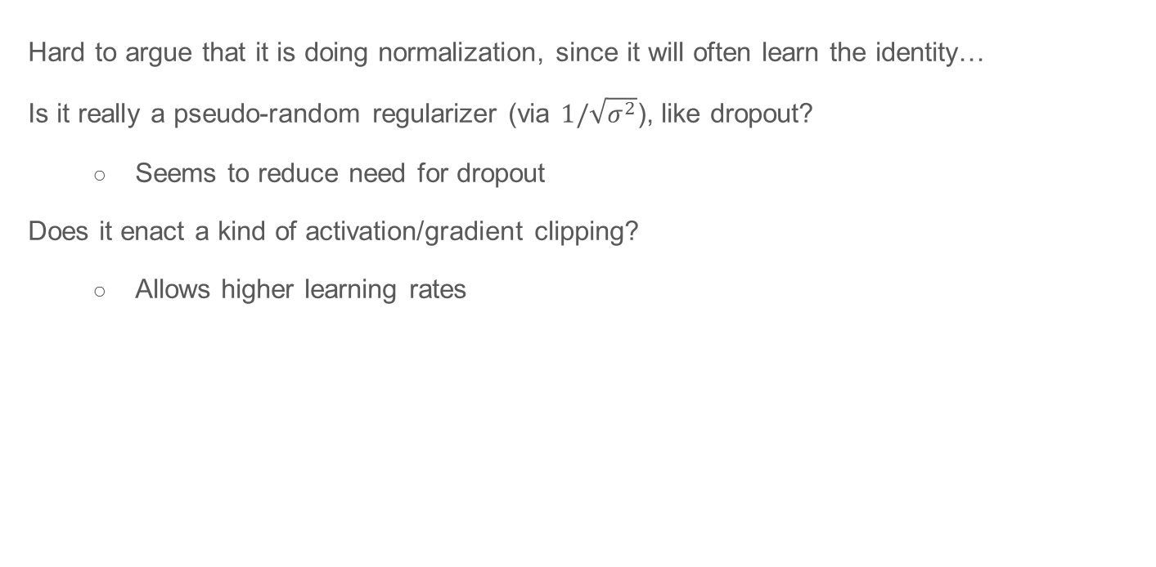



Where to do BatchNorm ?
Hard to argue that it is doing normalization, since it will often learn the identity…
Is it really a pseudo-random regularizer (via $1/\sqrt{σ^{2}}$), like dropout?
  Seems to reduce need for dropout
Does it enact a kind of activation/gradient clipping?
  Allows higher learning rates
Batch
Norm
Linear
weight
$$W_{1}x$$
ReLU
Linear
Weight
$$W_{2}h_{2}$$
$$h_{1}$$
$$h_{2}$$

Slide 40
Gradient Magnitudes:
Occasional “monster” gradients
Gradient magnitudes far from gaussian, long-tailed distributions
Gradients much larger for mis-classified instances
Some minibatches may contain several huge gradients

Slide 41
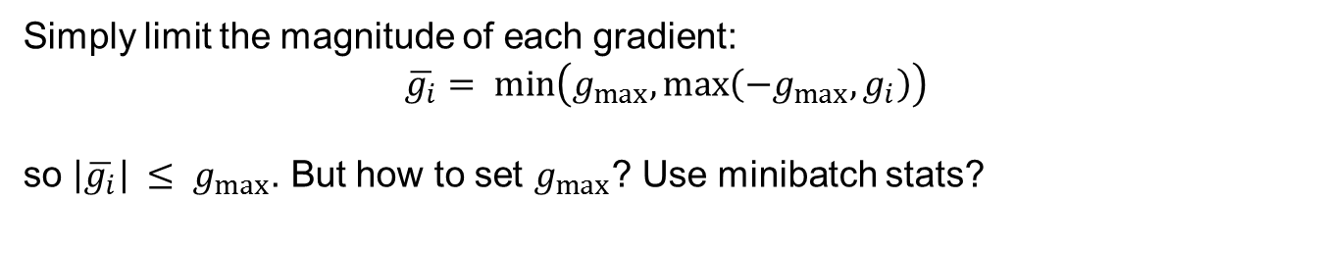
Gradient Clipping by Value:
Simply limit the magnitude of each gradient:
$$\overline{g_{i}}= min⁡\left(g_{max⁡},max⁡\left(−g_{max⁡}, g_{i}\right)\right)$$
so $\left|\overline{g_{i}}\right| ≤ g_{max⁡}$. But how to set $g_{max⁡}$? Use minibatch stats?

Slide 42
Gradient Clipping by Norm:
Clip to limit the norm of the gradient:
clipped_grad[i] = grad[i] * clip_norm / max(norm(grad), clip_norm)
Still need to set clip_norm, use a multiple of median norm(grad) ?

Slide 43
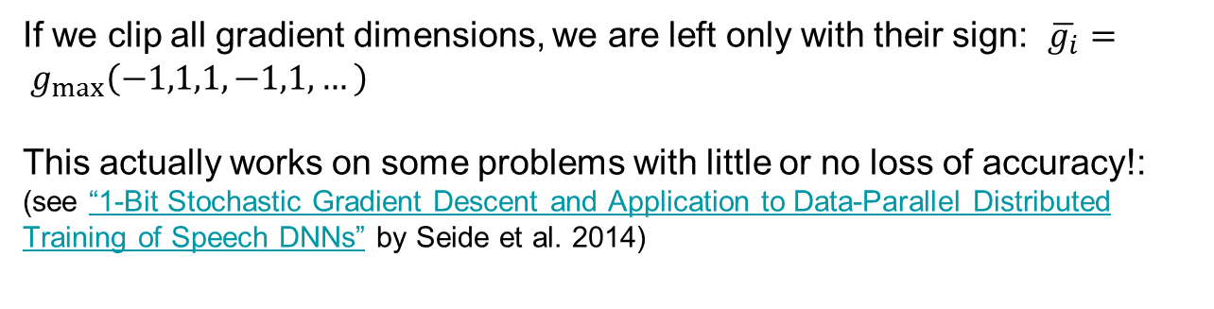
One-bit Gradients!
Standard gradient
One-bit gradient
If we clip all gradient dimensions, we are left only with their sign: $\overline{g_{i}}= g_{max⁡}\left(−1,1,1,−1,1,…\right)$
This actually works on some problems with little or no loss of accuracy!: (see “1-Bit Stochastic Gradient Descent and Application to Data-Parallel Distributed Training of Speech DNNs” by Seide et al. 2014)

Slide 44
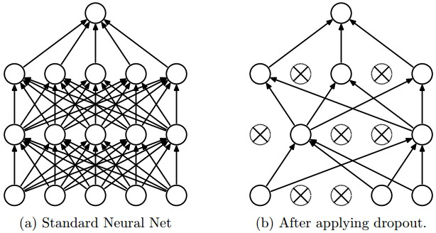
Dropout
“randomly set some neurons to zero in the forward pass”
i.e. multiply by random bernoulli variables with parameter p.
Note, p is the probability of
keeping a neuron (note,
incorrect in assignment 1)
[Srivastava et al., 2014]

Slide 45
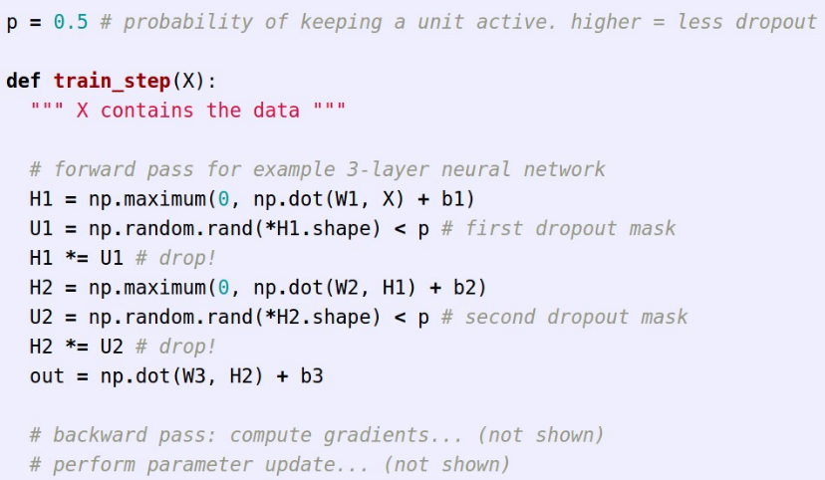
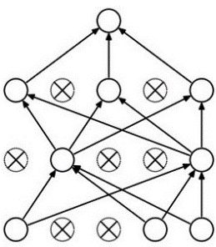
Example forward pass with a 3-layer network using dropout

Slide 46

Waaaait a second…
How could this possibly be a good idea?

Slide 47
Waaaait a second…
How could this possibly be a good idea?
Forces the network to have a redundant representation.
has an ear
X
has a tail
is furry
X
cat score
has claws
mischievous
look
X

Slide 48
Waaaait a second…
How could this possibly be a good idea?
Another interpretation:
Dropout is training a large ensemble of models (that share parameters).
Each binary mask is one model, gets trained on only ~one datapoint.

Slide 49
At test time….
Can in fact do this with a single forward pass! (approximately)
Leave all input neurons turned on (no dropout).
(this can be shown to be an approximation to evaluating the whole ensemble)

Slide 50
At test time….
Can in fact do this with a single forward pass! (approximately)
Leave all input neurons turned on (no dropout).
Q: Suppose that with all inputs present at test time the output of this neuron is x.
What would its output be during training time, in expectation? (e.g. if p = 0.5)

Slide 51
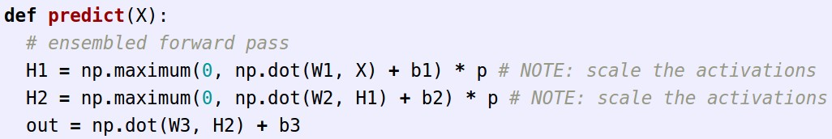
We can do something approximate analytically
At test time all neurons are active always
=> We must scale the activations so that for each neuron:
output at test time = expected output at training time

Slide 52
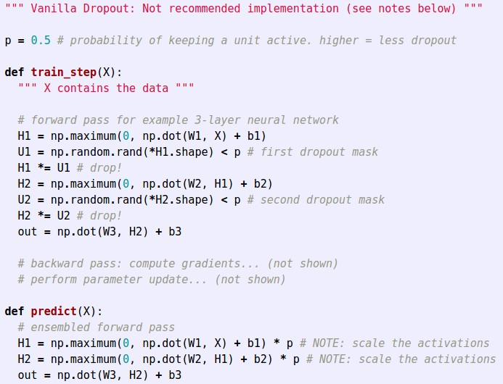
Dropout Summary
drop in forward pass
scale at test time

Slide 53
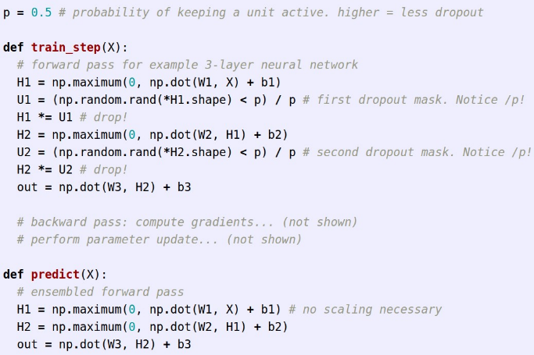
More common: “Inverted dropout”
test time is unchanged!

