Slide 1
This Time: Case Study: LeNet-5
[LeCun et al., 1998]
Conv filters were 5x5, applied at stride 1
Subsampling (Pooling) layers were 2x2 applied at stride 2
i.e. architecture is [CONV-POOL-CONV-POOL-CONV-FC]

Slide 2
Handwritten digit classification
[Courtesy of Yann LeCun]

Slide 3
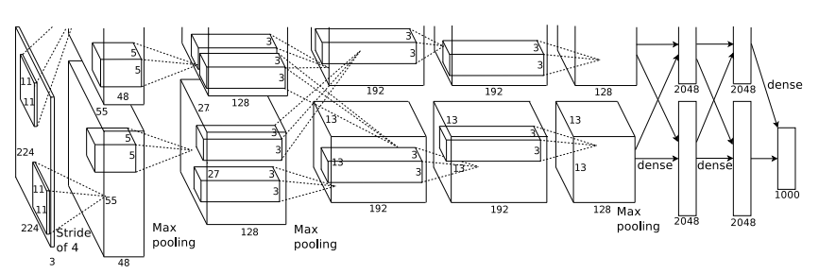
Case Study: AlexNet
[Krizhevsky et al. 2012]
Input: 227x227x3 images
First layer (CONV1): 96 11x11 filters applied at stride 4
=>
Q: what is the output volume size? Hint: (227-11)/4+1 = 55

Slide 4
Case Study: AlexNet
[Krizhevsky et al. 2012]
Input: 227x227x3 images
First layer (CONV1): 96 11x11 filters applied at stride 4
=>
Output volume [55x55x96]
Q: What is the total number of parameters in this layer?

Slide 5
Case Study: AlexNet
[Krizhevsky et al. 2012]
Input: 227x227x3 images
First layer (CONV1): 96 11x11 filters applied at stride 4
=>
Output volume [55x55x96]
Parameters: (11*11*3)*96 = 35K

Slide 6
Case Study: AlexNet
[Krizhevsky et al. 2012]
Input: 227x227x3 images
After CONV1: 55x55x96
Second layer (POOL1): 3x3 filters applied at stride 2
Q: what is the output volume size? Hint: (55-3)/2+1 = 27

Slide 7
Case Study: AlexNet
[Krizhevsky et al. 2012]
Input: 227x227x3 images
After CONV1: 55x55x96
Second layer (POOL1): 3x3 filters applied at stride 2
Output volume: 27x27x96
Q: what is the number of parameters in this layer?

Slide 8
Case Study: AlexNet
[Krizhevsky et al. 2012]
Input: 227x227x3 images
After CONV1: 55x55x96
Second layer (POOL1): 3x3 filters applied at stride 2
Output volume: 27x27x96
Parameters: 0!

Slide 9
Case Study: AlexNet
[Krizhevsky et al. 2012]
Input: 227x227x3 images
After CONV1: 55x55x96
After POOL1: 27x27x96
...

Slide 10
Case Study: AlexNet
[Krizhevsky et al. 2012]
Full (simplified) AlexNet architecture:
[227x227x3] INPUT
[55x55x96] CONV1: 96 11x11 filters at stride 4, pad 0
[27x27x96] MAX POOL1: 3x3 filters at stride 2
[27x27x96] NORM1: Normalization layer
[27x27x256] CONV2: 256 5x5 filters at stride 1, pad 2
[13x13x256] MAX POOL2: 3x3 filters at stride 2
[13x13x256] NORM2: Normalization layer
[13x13x384] CONV3: 384 3x3 filters at stride 1, pad 1
[13x13x384] CONV4: 384 3x3 filters at stride 1, pad 1
[13x13x256] CONV5: 256 3x3 filters at stride 1, pad 1
[6x6x256] MAX POOL3: 3x3 filters at stride 2
[4096] FC6: 4096 neurons
[4096] FC7: 4096 neurons
[1000] FC8: 1000 neurons (class scores)

Slide 11
Case Study: AlexNet
[Krizhevsky et al. 2012]
Full (simplified) AlexNet architecture:
[227x227x3] INPUT
[55x55x96] CONV1: 96 11x11 filters at stride 4, pad 0
[27x27x96] MAX POOL1: 3x3 filters at stride 2
[27x27x96] NORM1: Normalization layer
[27x27x256] CONV2: 256 5x5 filters at stride 1, pad 2
[13x13x256] MAX POOL2: 3x3 filters at stride 2
[13x13x256] NORM2: Normalization layer
[13x13x384] CONV3: 384 3x3 filters at stride 1, pad 1
[13x13x384] CONV4: 384 3x3 filters at stride 1, pad 1
[13x13x256] CONV5: 256 3x3 filters at stride 1, pad 1
[6x6x256] MAX POOL3: 3x3 filters at stride 2
[4096] FC6: 4096 neurons
[4096] FC7: 4096 neurons
[1000] FC8: 1000 neurons (class scores)
Details/Retrospectives:
- first use of ReLU
- used LRNorm layers (not common anymore)
- heavy data augmentation
- dropout 0.5
- batch size 128
- SGD Momentum 0.9
- Learning rate 1e-2, reduced by 10
manually when val accuracy plateaus
- L2 weight decay 5e-4
- 7 CNN ensemble: 18.2% -> 15.4%

Slide 12
“You need a lot of a data if you want to train/use CNNs”

Slide 13
Transfer Learning
“You need a lot of a data if you want to train/use CNNs”
NOT ALWAYS

Slide 14
Transfer Learning with CNNs
1. Train on
Imagenet

Slide 15
Transfer Learning with CNNs
1. Train on
Imagenet
2. If small dataset: fix all weights (treat CNN as fixed feature extractor), retrain only the classifier
i.e. swap the Softmax layer at the end

Slide 16
Transfer Learning with CNNs
1. Train on
Imagenet
2. If small dataset: fix all weights (treat CNN as fixed feature extractor), retrain only the classifier
i.e. swap the Softmax layer at the end
3. If you have medium sized dataset, “finetune” instead: use the old weights as initialization, train the full network or only some of the higher layers
retrain bigger portion of the network, or even all of it.

Slide 17
Transfer Learning with CNNs
1. Train on
Imagenet
2. If small dataset: fix all weights (treat CNN as fixed feature extractor), retrain only the classifier
i.e. swap the Softmax layer at the end
3. If you have medium sized dataset, “finetune” instead: use the old weights as initialization, train the full network or only some of the higher layers
retrain bigger portion of the network, or even all of it.
tip: use only ~1/10th of the original learning rate in finetuning to player, and ~1/100th on intermediate layers

Slide 18
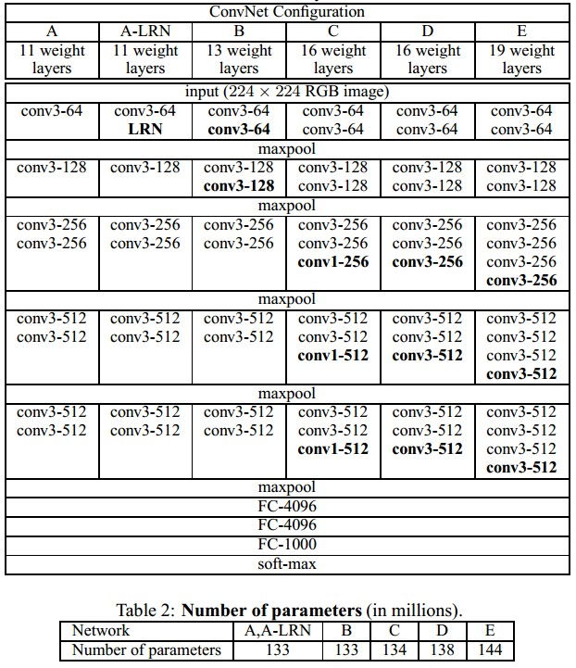
Case Study: VGGNet
[Simonyan and Zisserman, 2014]
Only 3x3 CONV stride 1, pad 1
and 2x2 MAX POOL stride 2
best model
11.2% top 5 error in ILSVRC 2013
->
7.3% top 5 error

Slide 19
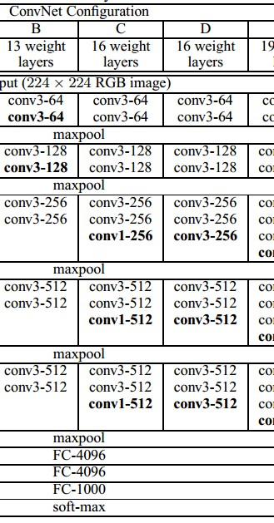
INPUT: [224x224x3] memory: 224*224*3=150K params: 0
CONV3-64: [224x224x64] memory: 224*224*64=3.2M params: (3*3*3)*64 = 1,728
CONV3-64: [224x224x64] memory: 224*224*64=3.2M params: (3*3*64)*64 = 36,864
POOL2: [112x112x64] memory: 112*112*64=800K params: 0
CONV3-128: [112x112x128] memory: 112*112*128=1.6M params: (3*3*64)*128 = 73,728
CONV3-128: [112x112x128] memory: 112*112*128=1.6M params: (3*3*128)*128 = 147,456
POOL2: [56x56x128] memory: 56*56*128=400K params: 0
CONV3-256: [56x56x256] memory: 56*56*256=800K params: (3*3*128)*256 = 294,912
CONV3-256: [56x56x256] memory: 56*56*256=800K params: (3*3*256)*256 = 589,824
CONV3-256: [56x56x256] memory: 56*56*256=800K params: (3*3*256)*256 = 589,824
POOL2: [28x28x256] memory: 28*28*256=200K params: 0
CONV3-512: [28x28x512] memory: 28*28*512=400K params: (3*3*256)*512 = 1,179,648
CONV3-512: [28x28x512] memory: 28*28*512=400K params: (3*3*512)*512 = 2,359,296
CONV3-512: [28x28x512] memory: 28*28*512=400K params: (3*3*512)*512 = 2,359,296
POOL2: [14x14x512] memory: 14*14*512=100K params: 0
CONV3-512: [14x14x512] memory: 14*14*512=100K params: (3*3*512)*512 = 2,359,296
CONV3-512: [14x14x512] memory: 14*14*512=100K params: (3*3*512)*512 = 2,359,296
CONV3-512: [14x14x512] memory: 14*14*512=100K params: (3*3*512)*512 = 2,359,296
POOL2: [7x7x512] memory: 7*7*512=25K params: 0
FC: [1x1x4096] memory: 4096 params: 7*7*512*4096 = 102,760,448
FC: [1x1x4096] memory: 4096 params: 4096*4096 = 16,777,216
FC: [1x1x1000] memory: 1000 params: 4096*1000 = 4,096,000
(not counting biases)

Slide 20
INPUT: [224x224x3] memory: 224*224*3=150K params: 0
CONV3-64: [224x224x64] memory: 224*224*64=3.2M params: (3*3*3)*64 = 1,728
CONV3-64: [224x224x64] memory: 224*224*64=3.2M params: (3*3*64)*64 = 36,864
POOL2: [112x112x64] memory: 112*112*64=800K params: 0
CONV3-128: [112x112x128] memory: 112*112*128=1.6M params: (3*3*64)*128 = 73,728
CONV3-128: [112x112x128] memory: 112*112*128=1.6M params: (3*3*128)*128 = 147,456
POOL2: [56x56x128] memory: 56*56*128=400K params: 0
CONV3-256: [56x56x256] memory: 56*56*256=800K params: (3*3*128)*256 = 294,912
CONV3-256: [56x56x256] memory: 56*56*256=800K params: (3*3*256)*256 = 589,824
CONV3-256: [56x56x256] memory: 56*56*256=800K params: (3*3*256)*256 = 589,824
POOL2: [28x28x256] memory: 28*28*256=200K params: 0
CONV3-512: [28x28x512] memory: 28*28*512=400K params: (3*3*256)*512 = 1,179,648
CONV3-512: [28x28x512] memory: 28*28*512=400K params: (3*3*512)*512 = 2,359,296
CONV3-512: [28x28x512] memory: 28*28*512=400K params: (3*3*512)*512 = 2,359,296
POOL2: [14x14x512] memory: 14*14*512=100K params: 0
CONV3-512: [14x14x512] memory: 14*14*512=100K params: (3*3*512)*512 = 2,359,296
CONV3-512: [14x14x512] memory: 14*14*512=100K params: (3*3*512)*512 = 2,359,296
CONV3-512: [14x14x512] memory: 14*14*512=100K params: (3*3*512)*512 = 2,359,296
POOL2: [7x7x512] memory: 7*7*512=25K params: 0
FC: [1x1x4096] memory: 4096 params: 7*7*512*4096 = 102,760,448
FC: [1x1x4096] memory: 4096 params: 4096*4096 = 16,777,216
FC: [1x1x1000] memory: 1000 params: 4096*1000 = 4,096,000
(not counting biases)
TOTAL memory: 24M * 4 bytes ~= 93MB / image (only forward! ~*2 for bwd)
TOTAL params: 138M parameters

Slide 21
INPUT: [224x224x3] memory: 224*224*3=150K params: 0
CONV3-64: [224x224x64] memory: 224*224*64=3.2M params: (3*3*3)*64 = 1,728
CONV3-64: [224x224x64] memory: 224*224*64=3.2M params: (3*3*64)*64 = 36,864
POOL2: [112x112x64] memory: 112*112*64=800K params: 0
CONV3-128: [112x112x128] memory: 112*112*128=1.6M params: (3*3*64)*128 = 73,728
CONV3-128: [112x112x128] memory: 112*112*128=1.6M params: (3*3*128)*128 = 147,456
POOL2: [56x56x128] memory: 56*56*128=400K params: 0
CONV3-256: [56x56x256] memory: 56*56*256=800K params: (3*3*128)*256 = 294,912
CONV3-256: [56x56x256] memory: 56*56*256=800K params: (3*3*256)*256 = 589,824
CONV3-256: [56x56x256] memory: 56*56*256=800K params: (3*3*256)*256 = 589,824
POOL2: [28x28x256] memory: 28*28*256=200K params: 0
CONV3-512: [28x28x512] memory: 28*28*512=400K params: (3*3*256)*512 = 1,179,648
CONV3-512: [28x28x512] memory: 28*28*512=400K params: (3*3*512)*512 = 2,359,296
CONV3-512: [28x28x512] memory: 28*28*512=400K params: (3*3*512)*512 = 2,359,296
POOL2: [14x14x512] memory: 14*14*512=100K params: 0
CONV3-512: [14x14x512] memory: 14*14*512=100K params: (3*3*512)*512 = 2,359,296
CONV3-512: [14x14x512] memory: 14*14*512=100K params: (3*3*512)*512 = 2,359,296
CONV3-512: [14x14x512] memory: 14*14*512=100K params: (3*3*512)*512 = 2,359,296
POOL2: [7x7x512] memory: 7*7*512=25K params: 0
FC: [1x1x4096] memory: 4096 params: 7*7*512*4096 = 102,760,448
FC: [1x1x4096] memory: 4096 params: 4096*4096 = 16,777,216
FC: [1x1x1000] memory: 1000 params: 4096*1000 = 4,096,000
(not counting biases)
Note:
Most memory is in early CONV
Most params are
in late FC
TOTAL memory: 24M * 4 bytes ~= 93MB / image (only forward! ~*2 for bwd)
TOTAL params: 138M parameters

Slide 22
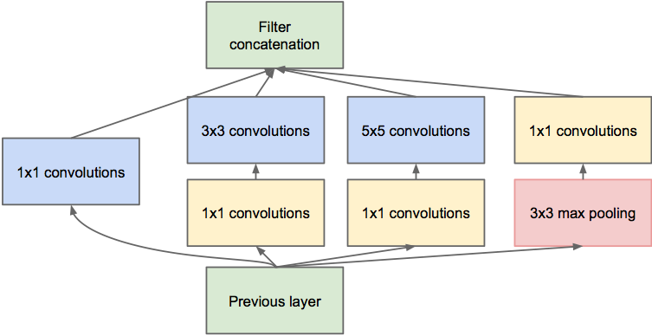
Case Study: GoogLeNet
[Szegedy et al., 2014]
Inception module
ILSVRC 2014 winner (6.7% top 5 error)

Slide 23
Case Study: GoogLeNet
[Szegedy et al., 2014]
1x1 dimension reduction layers (reduce compute bottlenecks)
Inception module

Slide 24
Case Study: GoogLeNet
[Szegedy et al., 2014]
Helper loss (during training only)
Inception module

Slide 25
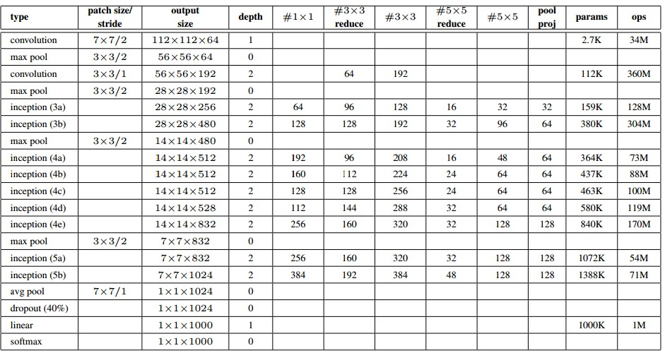
Case Study: GoogLeNet
Fun features:
- Only 5 million params!
(Removes FC layers completely)
Compared to AlexNet:
- 12X less params
- 2x more compute
- 6.67% (vs. 16.4%)

Slide 26
Case Study: ResNet
[He et al., 2015]
ILSVRC 2015 winner (3.6% top 5 error)
Slide from Kaiming He’s recent presentation https://www.youtube.com/watch?v=1PGLj-uKT1w

Slide 27
(slide from Kaiming He’s recent presentation)

Slide 28
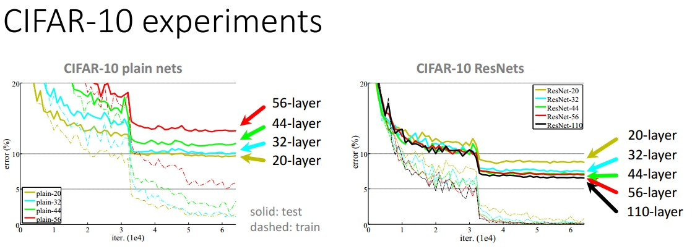

Slide 29
Case Study: ResNet
[He et al., 2015]
ILSVRC 2015 winner (3.6% top 5 error)
2-3 weeks of training on 8 GPU machine
at runtime: faster than a VGGNet! (even though it has 8x more layers)
(slide from Kaiming He’s recent presentation)

Slide 30
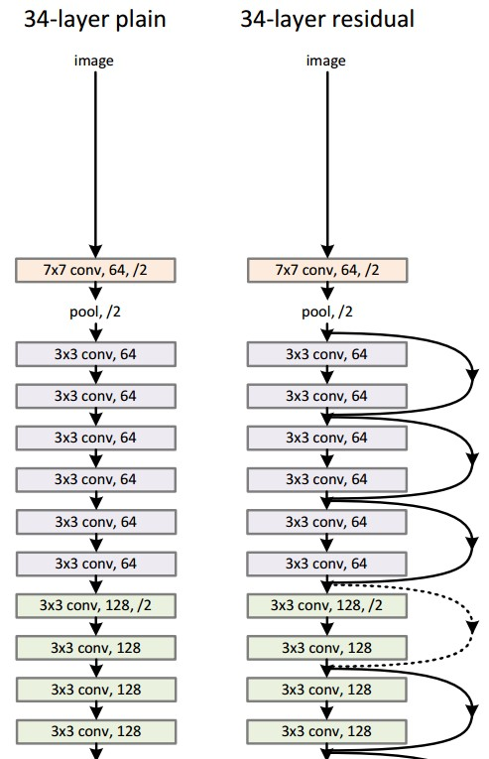
Case Study:
ResNet
224x224x3
spatial dimension only 56x56!
[He et al., 2015]

Slide 31
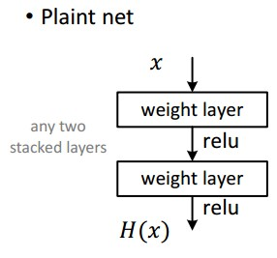
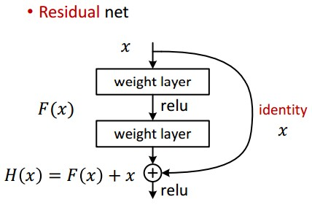
Case Study: ResNet
[He et al., 2015]

Slide 32
Case Study: ResNet
[He et al., 2015]
Batch Normalization after every CONV layer
Xavier/2 initialization from He et al.
SGD + Momentum (0.9)
Learning rate: 0.1, divided by 10 when validation error plateaus
Mini-batch size 256
Weight decay of 1e-5
No dropout used

Slide 33
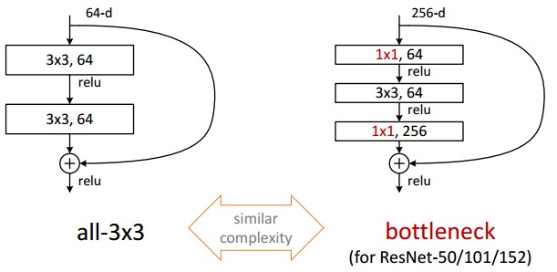
Case Study: ResNet
[He et al., 2015]

Slide 34
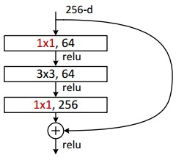
Case Study: ResNet
[He et al., 2015]
(this trick is also used in GoogLeNet)

Slide 35
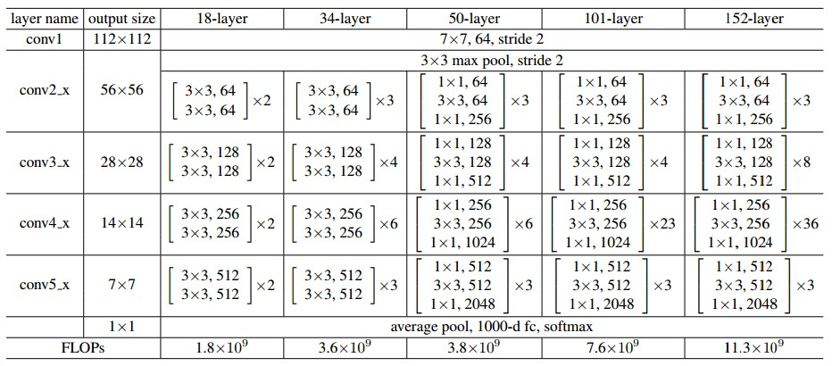
Case Study: ResNet
[He et al., 2015]

Slide 36
Summary
ConvNets stack CONV,ReLU,POOL,FC layers
Trend towards smaller filters and deeper architectures
Trend towards getting rid of POOL/FC layers (just CONV)
Early architectures look like
[(CONV-RELU)*N-POOL?]*M-(FC-RELU)*K,SOFTMAX
but recent advances such as ResNet/GoogLeNet use only Conv-ReLU, 1x1 convolutions, global max pooling and Softmax

