Slide 1
Neural Network structure
Standard Neural Networks are DAGs (Directed Acyclic Graphs). That means they have a topological ordering.
The topological ordering is used for activation propagation, and for gradient back-propagation.
These networks process one input minibatch at a time.
Conv 3x3
ReLU
Conv 3x3
+

Slide 2
Recurrent Neural Networks (RNNs)
Recurrent networks introduce cycles and a notion of time.
They are designed to process sequences of data $x_{1},…,x_{n}$ and can produce sequences of outputs $y_{1},…,y_{m}$.
$$x_{t}$$
$$y_{t}$$
$$h_{t−1}$$
$$h_{t}$$
One-step delay

Slide 3
Unrolling RNNs
RNNs can be unrolled across multiple time steps.
This produces a DAG which supports backpropagation.
But its size depends on the input sequence length.
$$x_{t}$$
$$y_{t}$$
$$y_{0}$$
$$x_{0}$$
$$h_{t−1}$$
$$h_{t}$$
$$h_{0}$$
$$y_{1}$$
One-step delay
$$x_{1}$$
$$h_{1}$$
$$y_{2}$$
$$x_{2}$$
$$h_{2}$$

Slide 4
Unrolling RNNs
Usually drawn as:
$$y_{0}$$
$$x_{0}$$
$$h_{0}$$
$$y_{0}$$
$$y_{1}$$
$$y_{2}$$
$$y_{1}$$
$$x_{1}$$
$$h_{0}$$
$$h_{1}$$
$$h_{2}$$
$$h_{1}$$
$$y_{2}$$
$$x_{0}$$
$$x_{1}$$
$$x_{2}$$
$$x_{2}$$
$$h_{2}$$

Slide 5
RNN structure
Often layers are stacked vertically (deep RNNs):
$$y_{10}$$
$$y_{11}$$
$$y_{12}$$
$$h_{10}$$
$$h_{11}$$
$$h_{12}$$
Same parameters at this level
$$x_{00}$$
$$x_{01}$$
$$x_{02}$$
≠
=
or
Abstraction
Higher level features
$$y_{00}$$
$$y_{01}$$
$$y_{02}$$
$$h_{00}$$
$$h_{01}$$
$$h_{02}$$
Same parameters at this level
$$x_{0}$$
$$x_{1}$$
$$x_{2}$$
Time

Slide 6
RNN structure
Backprop still works:
$$y_{10}$$
$$y_{11}$$
$$y_{12}$$
$$h_{10}$$
$$h_{11}$$
$$h_{12}$$
$$x_{00}$$
$$x_{01}$$
$$x_{02}$$
Activations (forward computation)
Abstraction
Higher level features
$$y_{00}$$
$$y_{01}$$
$$y_{02}$$
$$h_{00}$$
$$h_{01}$$
$$h_{02}$$
$$x_{0}$$
$$x_{1}$$
$$x_{2}$$
Time

Slide 7
RNN structure
Backprop still works:
$$y_{10}$$
$$y_{11}$$
$$y_{12}$$
$$h_{10}$$
$$h_{11}$$
$$h_{12}$$
$$x_{00}$$
$$x_{01}$$
$$x_{02}$$
Activations
Abstraction
Higher level features
$$y_{00}$$
$$y_{01}$$
$$y_{02}$$
$$h_{00}$$
$$h_{01}$$
$$h_{02}$$
$$x_{0}$$
$$x_{1}$$
$$x_{2}$$
Time

Slide 8
RNN structure
Backprop still works:
$$y_{10}$$
$$y_{11}$$
$$y_{12}$$
$$h_{10}$$
$$h_{11}$$
$$h_{12}$$
$$x_{00}$$
$$x_{01}$$
$$x_{02}$$
Activations
Abstraction
Higher level features
$$y_{00}$$
$$y_{01}$$
$$y_{02}$$
$$h_{00}$$
$$h_{01}$$
$$h_{02}$$
$$x_{0}$$
$$x_{1}$$
$$x_{2}$$
Time

Slide 9
RNN structure
Backprop still works:
$$y_{10}$$
$$y_{11}$$
$$y_{12}$$
$$h_{10}$$
$$h_{11}$$
$$h_{12}$$
$$x_{00}$$
$$x_{01}$$
$$x_{02}$$
Activations
Abstraction
Higher level features
$$y_{00}$$
$$y_{01}$$
$$y_{02}$$
$$h_{00}$$
$$h_{01}$$
$$h_{02}$$
$$x_{0}$$
$$x_{1}$$
$$x_{2}$$
Time

Slide 10
RNN structure
Backprop still works:
$$y_{10}$$
$$y_{11}$$
$$y_{12}$$
$$h_{10}$$
$$h_{11}$$
$$h_{12}$$
$$x_{00}$$
$$x_{01}$$
$$x_{02}$$
Activations
Abstraction
Higher level features
$$y_{00}$$
$$y_{01}$$
$$y_{02}$$
$$h_{00}$$
$$h_{01}$$
$$h_{02}$$
$$x_{0}$$
$$x_{1}$$
$$x_{2}$$
Time

Slide 11
RNN structure
Backprop still works:
$$y_{10}$$
$$y_{11}$$
$$y_{12}$$
$$h_{10}$$
$$h_{11}$$
$$h_{12}$$
$$x_{00}$$
$$x_{01}$$
$$x_{02}$$
Activations
Abstraction
Higher level features
$$y_{00}$$
$$y_{01}$$
$$y_{02}$$
$$h_{00}$$
$$h_{01}$$
$$h_{02}$$
$$x_{0}$$
$$x_{1}$$
$$x_{2}$$
Time

Slide 12
RNN structure
Backprop still works:
$$y_{10}$$
$$y_{11}$$
$$y_{12}$$
$$h_{10}$$
$$h_{11}$$
$$h_{12}$$
$$x_{00}$$
$$x_{01}$$
$$x_{02}$$
Activations
Abstraction
Higher level features
$$y_{00}$$
$$y_{01}$$
$$y_{02}$$
$$h_{00}$$
$$h_{01}$$
$$h_{02}$$
$$x_{0}$$
$$x_{1}$$
$$x_{2}$$
Time

Slide 13
RNN structure
Backprop still works:
$$y_{10}$$
$$y_{11}$$
$$y_{12}$$
$$h_{10}$$
$$h_{11}$$
$$h_{12}$$
$$x_{00}$$
$$x_{01}$$
$$x_{02}$$
Gradients (backward computation)
Abstraction
Higher level features
$$y_{00}$$
$$y_{01}$$
$$y_{02}$$
$$h_{00}$$
$$h_{01}$$
$$h_{02}$$
$$x_{0}$$
$$x_{1}$$
$$x_{2}$$
Time

Slide 14
RNN structure
Backprop still works:
$$y_{10}$$
$$y_{11}$$
$$y_{12}$$
$$h_{10}$$
$$h_{11}$$
$$h_{12}$$
$$x_{00}$$
$$x_{01}$$
$$x_{02}$$
Gradients
Abstraction
Higher level features
$$y_{00}$$
$$y_{01}$$
$$y_{02}$$
$$h_{00}$$
$$h_{01}$$
$$h_{02}$$
$$x_{0}$$
$$x_{1}$$
$$x_{2}$$
Time

Slide 15
RNN structure
Backprop still works:
$$y_{10}$$
$$y_{11}$$
$$y_{12}$$
$$h_{10}$$
$$h_{11}$$
$$h_{12}$$
$$x_{00}$$
$$x_{01}$$
$$x_{02}$$
Gradients
Abstraction
Higher level features
$$y_{00}$$
$$y_{01}$$
$$y_{02}$$
$$h_{00}$$
$$h_{01}$$
$$h_{02}$$
$$x_{0}$$
$$x_{1}$$
$$x_{2}$$
Time

Slide 16
RNN structure
Backprop still works:
$$y_{10}$$
$$y_{11}$$
$$y_{12}$$
$$h_{10}$$
$$h_{11}$$
$$h_{12}$$
$$x_{00}$$
$$x_{01}$$
$$x_{02}$$
Gradients
Abstraction
Higher level features
$$y_{00}$$
$$y_{01}$$
$$y_{02}$$
$$h_{00}$$
$$h_{01}$$
$$h_{02}$$
$$x_{0}$$
$$x_{1}$$
$$x_{2}$$
Time

Slide 17
RNN structure
Backprop still works:
$$y_{10}$$
$$y_{11}$$
$$y_{12}$$
$$h_{10}$$
$$h_{11}$$
$$h_{12}$$
$$x_{00}$$
$$x_{01}$$
$$x_{02}$$
Gradients
Abstraction
Higher level features
$$y_{00}$$
$$y_{01}$$
$$y_{02}$$
$$h_{00}$$
$$h_{01}$$
$$h_{02}$$
$$x_{0}$$
$$x_{1}$$
$$x_{2}$$
Time

Slide 18
RNN structure
Backprop still works:
$$y_{10}$$
$$y_{11}$$
$$y_{12}$$
$$h_{10}$$
$$h_{11}$$
$$h_{12}$$
$$x_{00}$$
$$x_{01}$$
$$x_{02}$$
Gradients
Abstraction
Higher level features
$$y_{00}$$
$$y_{01}$$
$$y_{02}$$
$$h_{00}$$
$$h_{01}$$
$$h_{02}$$
$$x_{0}$$
$$x_{1}$$
$$x_{2}$$
Time

Slide 19
RNN structure
Backprop still works:
$$y_{10}$$
$$y_{11}$$
$$y_{12}$$
$$h_{10}$$
$$h_{11}$$
$$h_{12}$$
$$x_{00}$$
$$x_{01}$$
$$x_{02}$$
Gradients
Abstraction
Higher level features
$$y_{00}$$
$$y_{01}$$
$$y_{02}$$
$$h_{00}$$
$$h_{01}$$
$$h_{02}$$
$$x_{0}$$
$$x_{1}$$
$$x_{2}$$
Time

Slide 20
RNN unrolling
Question: Can you run forward/backward inference on an unrolled RNN, i.e. keeping only one copy of its state?
$$x_{t}$$
$$y_{t}$$
$$h_{t−1}$$
$$h_{t}$$
One-step delay
Notes:
No:
You *can* do forward inference
But you cant do backward inference without the activations at each time step.

Slide 21
RNN unrolling
Question: Can you run forward/backward inference on an unrolled RNN, i.e. keeping only one copy of its state?
Forward: Yes
Backward: No
$$x_{t}$$
$$y_{t}$$
$$h_{t−1}$$
$$h_{t}$$
One-step delay
Notes:
No:
You *can* do forward inference
But you cant do backward inference without the activations at each time step.

Slide 22
Recurrent Networks offer a lot of flexibility:
Vanilla Neural Networks

Slide 23
Recurrent Networks offer a lot of flexibility:
e.g. Image Captioning
image -> sequence of words

Slide 24
Recurrent Networks offer a lot of flexibility:
e.g. Sentiment Classification
sequence of words -> sentiment

Slide 25
Recurrent Networks offer a lot of flexibility:
e.g. Machine Translation
seq of words -> seq of words

Slide 26
Recurrent Networks offer a lot of flexibility:
e.g. Video classification on frame level

Slide 27
Recurrent Neural Network
RNN
h
x

Slide 28
Recurrent Neural Network
y
usually want to predict a vector at some time steps
RNN
h
x

Slide 29
Recurrent Neural Network
We can process a sequence of vectors x by applying a recurrence formula at every time step:
y
RNN
h
new state
old state
input vector at some time step
some function
with parameters W
x

Slide 30
Recurrent Neural Network
We can process a sequence of vectors x by applying a recurrence formula at every time step:
y
RNN
h
Notice: the same function and the same set of parameters are used at every time step.
x

Slide 31
(Vanilla) Recurrent Neural Network
The state consists of a single “hidden” vector h:
y
RNN
h
x

Slide 32
Character-level language model example
Vocabulary:
[h,e,l,o]
Example training
sequence:
“hello”
y
h
RNN
x

Slide 33
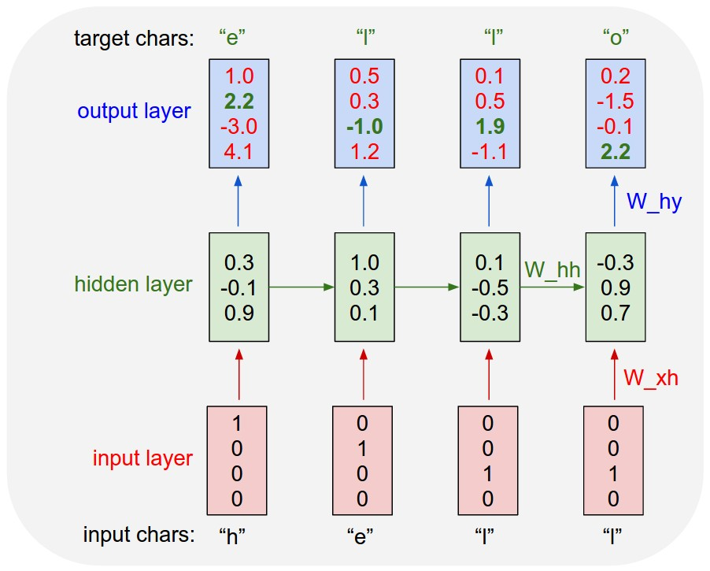
Character-level language model example
Vocabulary:
[h,e,l,o]
Example training
sequence:
“hello”

Slide 34
Character-level anguage model example
Vocabulary:
[h,e,l,o]
Example training
sequence:
“hello”

Slide 35
Character-level language model example
Vocabulary:
[h,e,l,o]
Example training
sequence:
“hello”

Slide 36
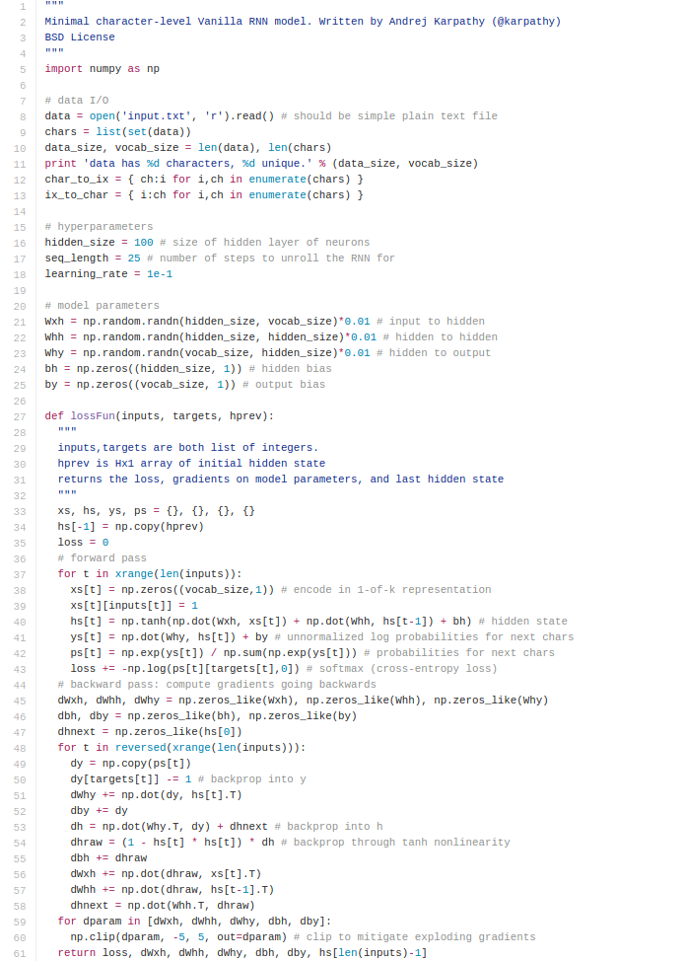
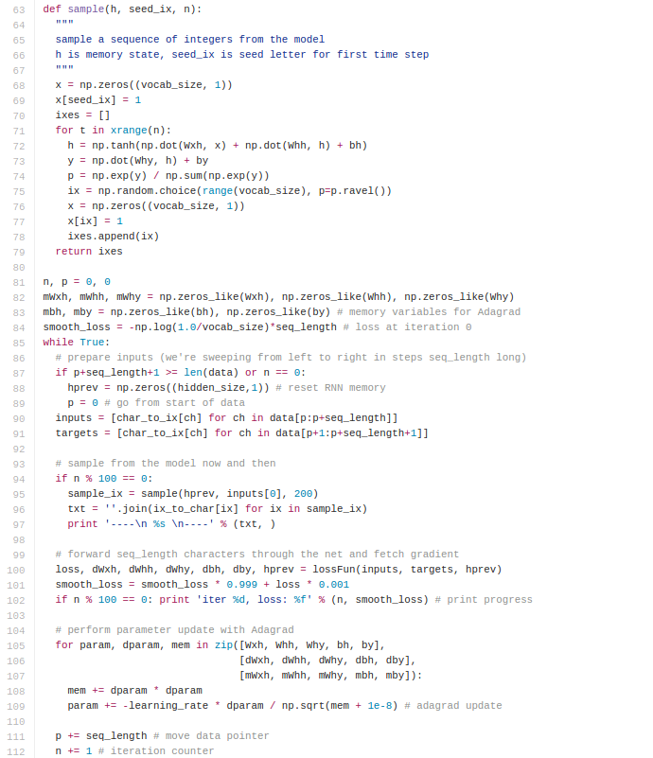
min-char-rnn.py gist: 112 lines of Python
(https://gist.github.com/karpathy/d4dee566867f8291f086)

Slide 37
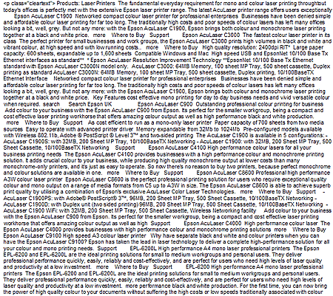
Applications - Poetry
y
RNN
h
x
http://karpathy.github.io/2015/05/21/rnn-effectiveness/

Slide 38
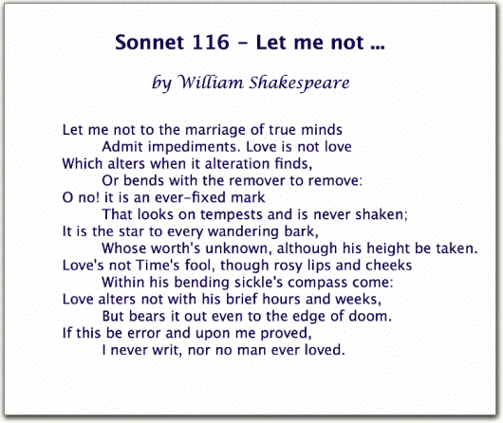
Character-Level Recurrent Neural Network
http://karpathy.github.io/2015/05/21/rnn-effectiveness/

Slide 39
At first:
train more
train more
train more

Slide 40
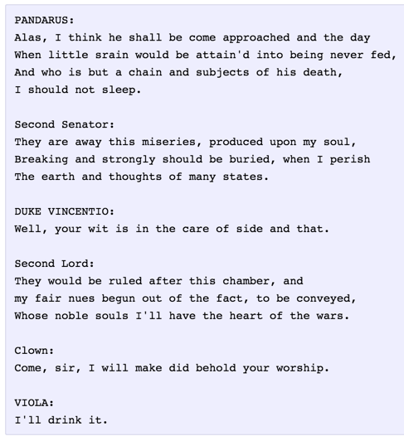
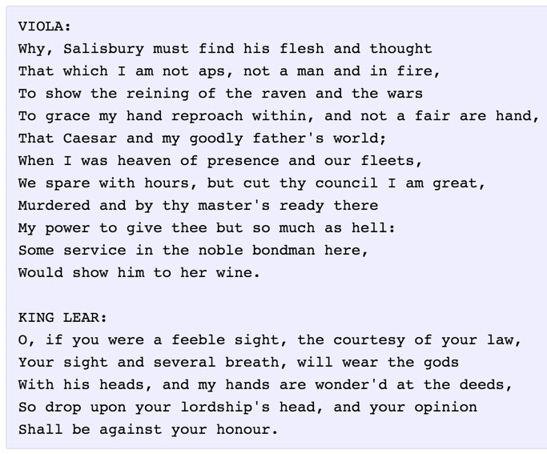
And later:

Slide 41
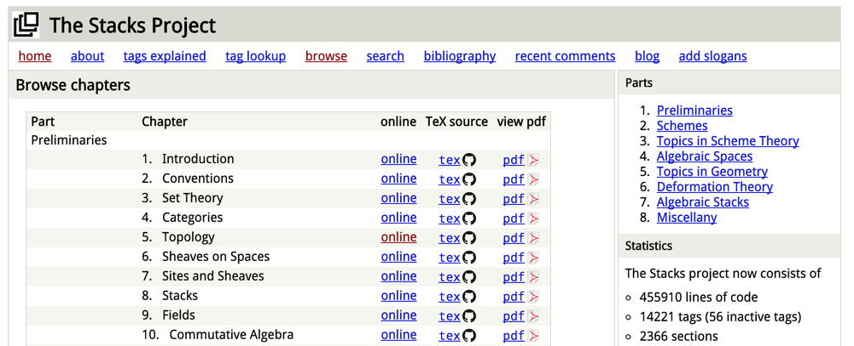
Open source textbook on algebraic geometry
Latex source
http://karpathy.github.io/2015/05/21/rnn-effectiveness/

Slide 42
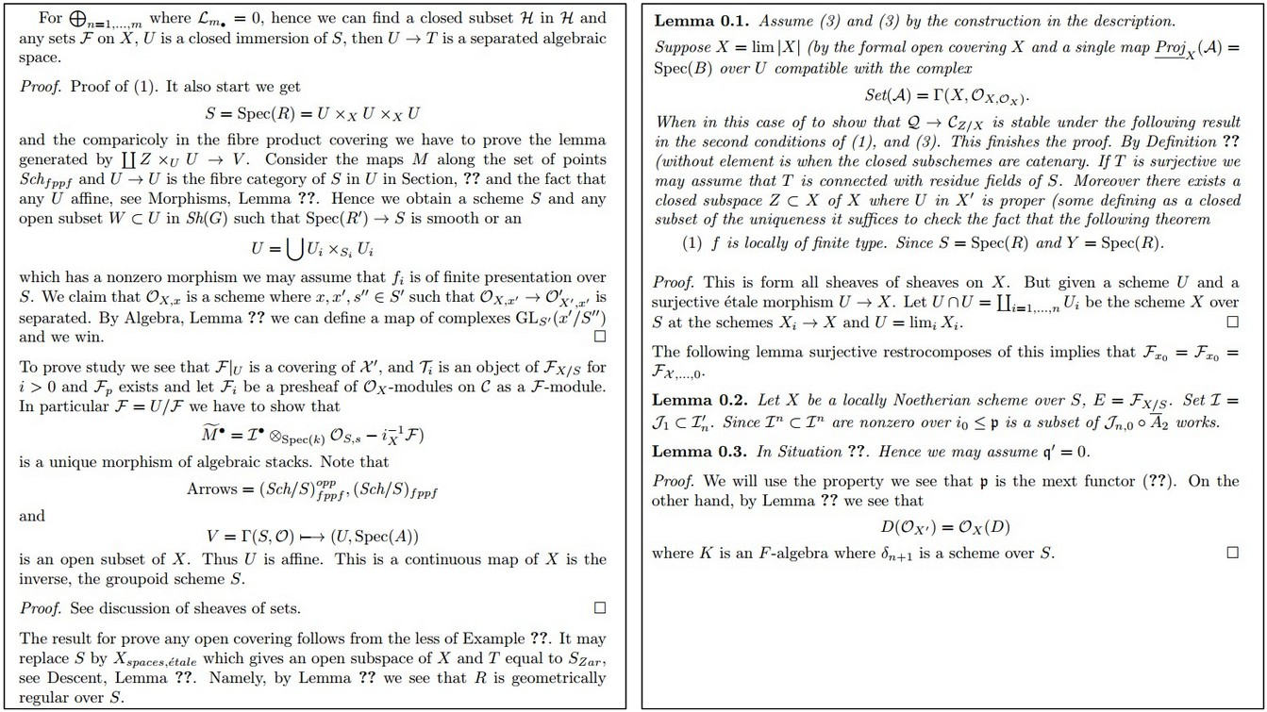
Generated math
http://karpathy.github.io/2015/05/21/rnn-effectiveness/

Slide 43
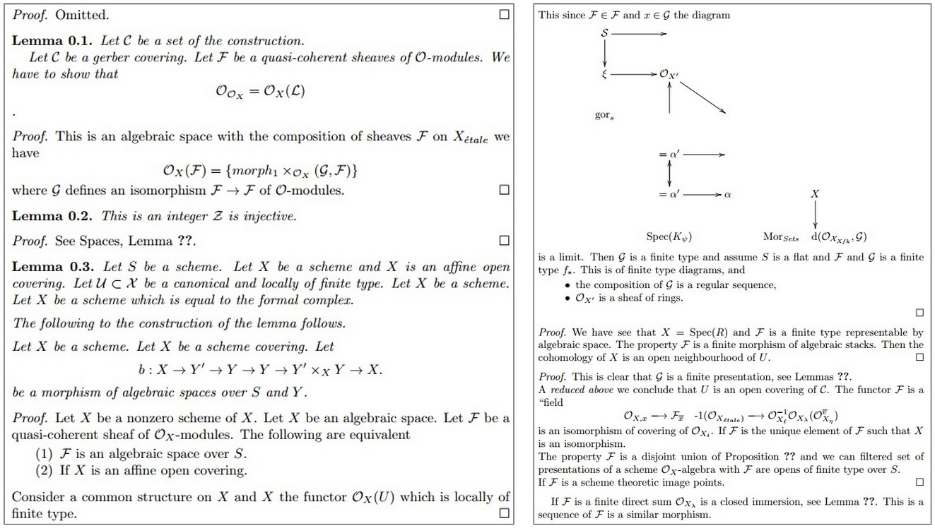
Generated math
http://karpathy.github.io/2015/05/21/rnn-effectiveness/

Slide 44
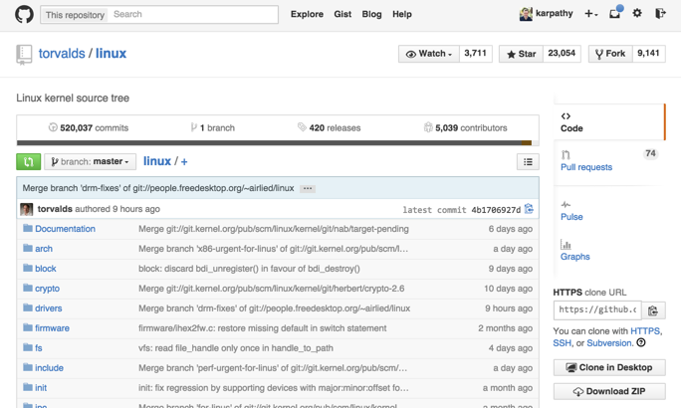
Train on Linux code
http://karpathy.github.io/2015/05/21/rnn-effectiveness/

Slide 45
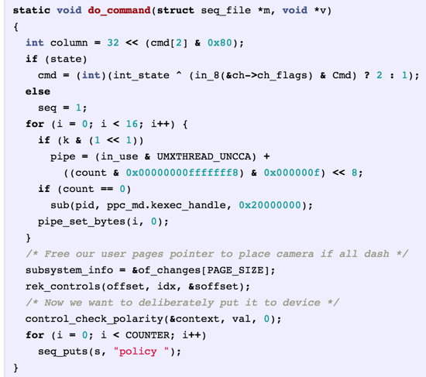
Generated C code

Slide 46
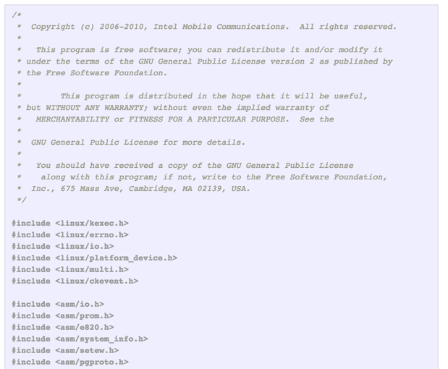
Generated C code

Slide 47
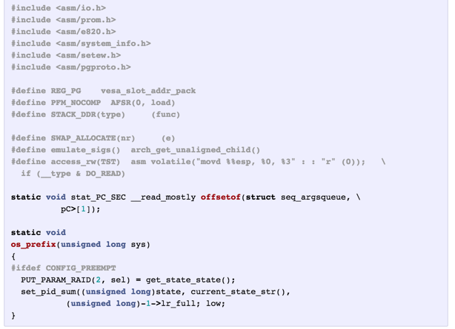
Generated C code

Slide 48
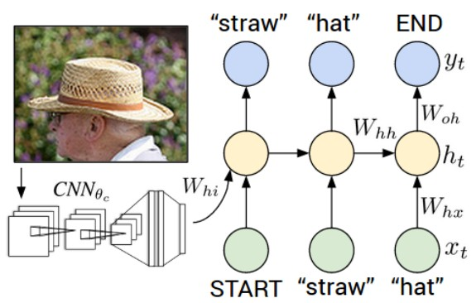
Image Captioning
“Explain Images with Multimodal Recurrent Neural Networks,” Mao et al.
“Deep Visual-Semantic Alignments for Generating Image Descriptions,” Karpathy and Fei-Fei
“Show and Tell: A Neural Image Caption Generator,” Vinyals et al.
“Long-term Recurrent Convolutional Networks for Visual Recognition and Description,” Donahue et al.
“Learning a Recurrent Visual Representation for Image Caption Generation,” Chen and Zitnick

Slide 49
Recurrent Neural Network
Convolutional Neural Network

Slide 50
test image

Slide 51
test image

Slide 52
test image
X

Slide 53
test image
x0
<START>
<START>

Slide 54
test image
y0
before:
h = tanh(Wxh * x + Whh * h)
now:
h = tanh(Wxh * x + Whh * h + Wih * v)
h0
Wih
x0
<START>
v
<START>

Slide 55
test image
y0
sample!
h0
x0
<START>
straw
<START>

Slide 56
test image
y0
y1
h0
h1
x0
<START>
straw
<START>

Slide 57
test image
y0
y1
h0
h1
sample!
x0
<START>
straw
hat
<START>

Slide 58
test image
y0
y1
y2
h0
h1
h2
x0
<START>
straw
hat
<START>

Slide 59
test image
y0
y1
y2
sample
<END> token
=> finish.
h0
h1
h2
x0
<START>
straw
hat
<START>

Slide 60
RNN sequence generation
Greedy (most likely) symbol generation is not very effective.
Typically, the top-k sequences generated so far are remembered and the top-k of their one-symbol continuations are kept for the next step (beam search)
However, k does not have to be very large (7 was used in Karpathy and Fei-Fei 2015).

Slide 61
Beam search with k = 2
Top-k most likely words
straw
0.2
man
0.1
…
h0
<start>
<START>

Slide 62
Beam search with k = 2
Top-k most likely words
straw
0.2
hat
0.3
0.3
with
Need Top-k most likely words
Because they might be part of the top-K most likely subsequences
Top sequences so far are:
straw hat (p = 0.06)
man with (p = 0.03)
man
0.1
roof
0.03
0.1
sitting
…
…
…
h0
h1
h1
<start>
straw
man
<START>

Slide 63
Beam search with k = 2
Top-k most likely words
straw
0.2
hat
0.3
0.3
with
<end>
0.1
0.3
straw
Best 2 words this pos’n
Top sequences so far:
straw hat <end> (0.006)
man with straw (0.009)
man
0.1
roof
0.03
0.1
sitting
0.01
0.1
hat
…
…
…
…
…
h0
h1
h1
h2
h2
<start>
straw
man
hat
with
2 best Subsequence words
(0.06)
(0.03)
<START>

Slide 64
Beam search with k = 2
Top-k most likely words
straw
0.2
hat
0.3
0.3
with
<end>
0.1
0.3
straw
0.4
hat
0.4
<end>
man
0.1
roof
0.03
0.1
sitting
0.01
0.1
hat
0.1
0.1
…
…
…
…
…
…
…
h0
h1
h1
h2
h2
h3
h4
<start>
straw
man
hat
with
straw
hat
2 best Subsequence words
(0.06)
(0.03)
(0.009)
(0.00036)
<START>

Slide 65
Image Sentence Datasets
Microsoft COCO
[Tsung-Yi Lin et al. 2014]
mscoco.org
currently:
~120K images
~5 sentences each

Slide 68
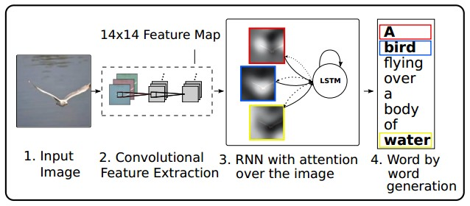
RNN attention networks
RNN attends spatially to different parts of images while generating each word of the sentence:
Show Attend and Tell, Xu et al., 2015

Slide 69
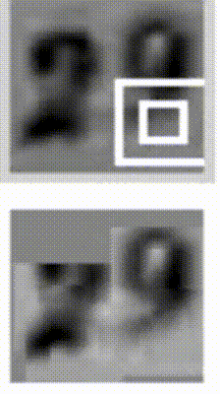
Sequential Processing of fixed inputs
Multiple Object Recognition with Visual Attention, Ba et al. 2015

Slide 70
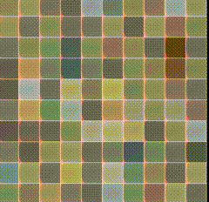
Recurrent Image Generation
DRAW: A Recurrent Neural Network For Image Generation, Gregor et al.

Slide 71
Vanilla RNN: Exploding/Vanishing Gradients
y
$$\hat{h}$$
Using Jacobians:
$$J_{L}\left(h_{t−1}\right)=J_{L}\left(h_{t}\right) J_{h_{t}}(h_{t−1})$$
$$J_{h_{t}}\left(h_{t−1}\right)=\frac{1}{\cosh^{2}{\hat{h}}}W_{hh}$$
RNN
h
x

Slide 72
Vanilla RNN: Exploding/Vanishing Gradients
Using Jacobians:
$$J_{L}\left(h_{t−1}\right)=J_{L}\left(h_{t}\right) J_{h_{t}}(h_{t−1})$$
$$J_{h_{t}}\left(h_{t−1}\right)=\frac{1}{\cosh^{2}{\hat{h}}}W_{hh}$$
Now $\frac{1}{\cosh^{2}{\hat{h}}}$ is $≤1$, and $W_{hh}$ can be arbitrarily large/small.
$W_{hh}$ is multiplied by the gradient at the next step, so the gradient across time steps is roughly a power of $W_{hh}$
If the largest eigenvalue of $W_{hh}>1$, the gradients will grow exponentially with time (exploding).
If the largest eigenvalue of $W_{hh}<1$, the gradients will shrink exponentially with time (vanishing).
y
RNN
h
x

Slide 73
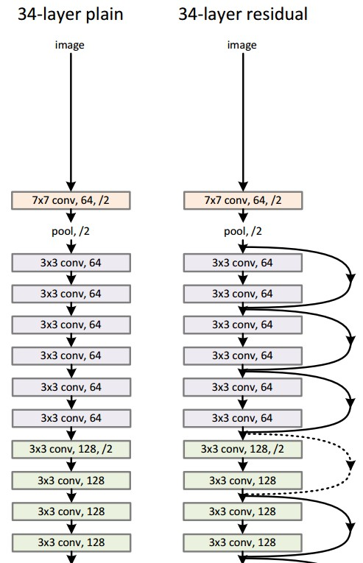
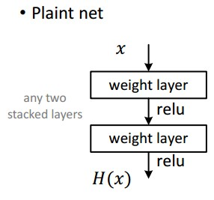
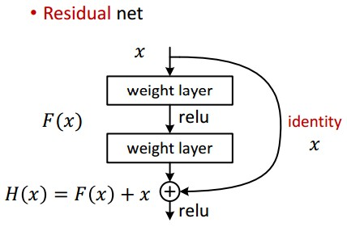
Better RNN Memory: LSTMs
Recall: “PlainNets” vs. ResNets
ResNet are very deep networks. They use residual connections as “hints” to approximate the identity fn.

Slide 74
Better RNN Memory: LSTMs
LSTMs (Long Short-Term Memory) units have a memory cell $c_{i}$ which is gated element-wise (no linear transform) from one time step to the next.

Slide 75
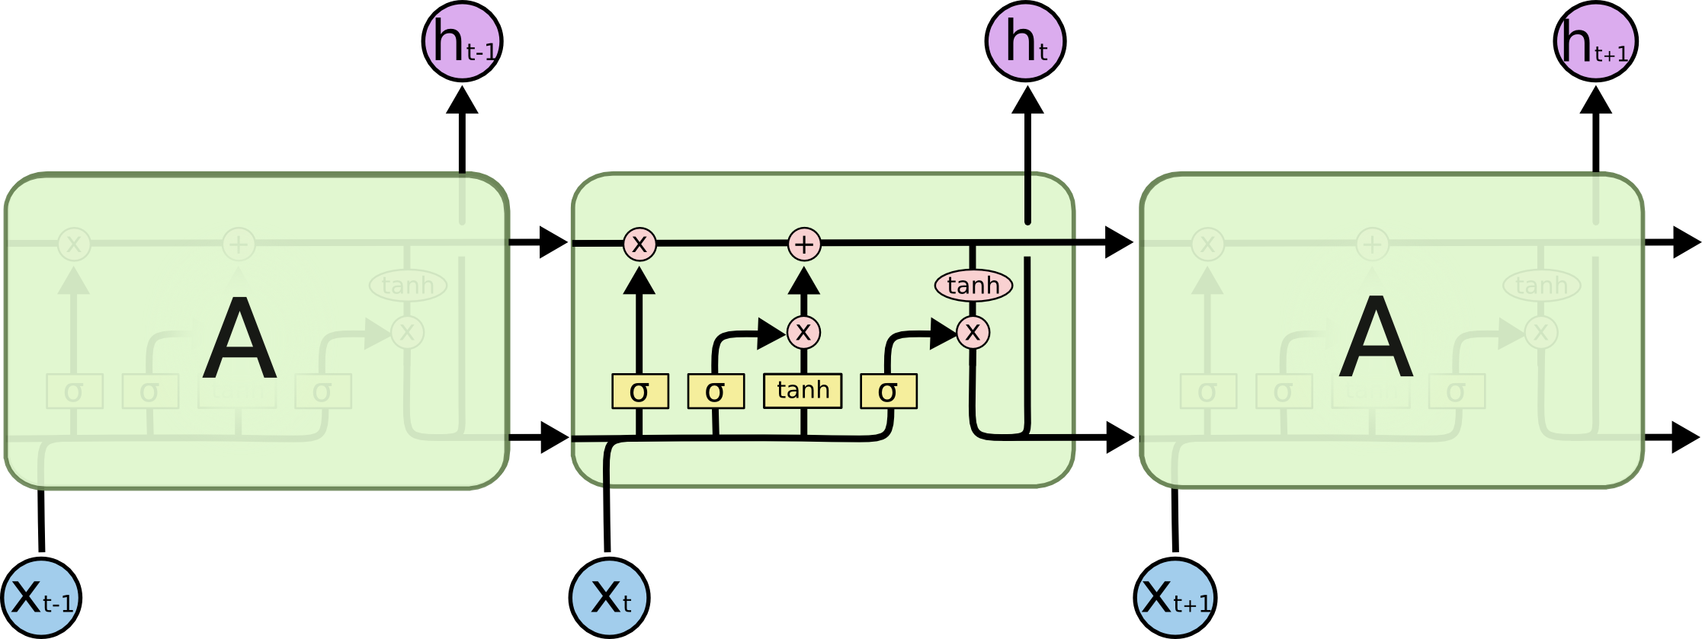
Better RNN Memory: LSTMs
They also have non-linear, linearly transformed hidden states like a standard RNN.
No Transformation
$$c_{t−1}$$
$$c_{t}$$
$$h_{t−1}$$
$$h_{t}$$
W
General Linear Transformation

Slide 76
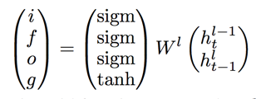
LSTM: Long Short-Term Memory
Vanilla RNN:
Input from below Input from left
LSTM: (much more widely used)
Input from below Input from left

Slide 77
LSTM: Anything you can do…
Vanilla RNN:
Input from below Input from left
LSTM: (much more widely used)
Input from below Input from left
An LSTM can emulate a simple RNN by remembering with i and o

Slide 78
LSTM: Anything you can do…
Vanilla RNN:
Input from below Input from left
LSTM: (much more widely used)
Input from below Input from left
0
1
An LSTM can emulate a simple RNN by remembering with i and o
1

Slide 79
LSTM: Anything you can do…
Vanilla RNN:
Input from below Input from left
LSTM: (much more widely used)
Input from below Input from left
0
1
An LSTM can emulate a simple RNN by remembering with i and o,
almost
1

Slide 80
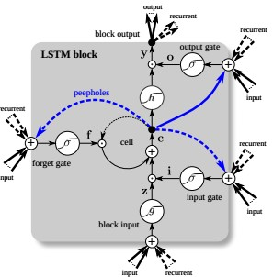
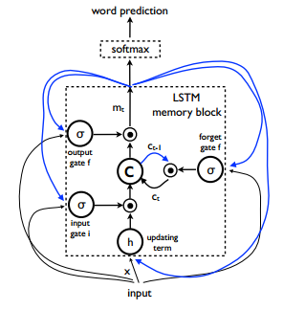
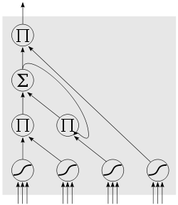
LSTM
= “gain” nodes [0,1]
Input from below Input from left
= “data” nodes [-1,1]
cell Input (left)
h
tanh
g
tanh
“peepholes” exist in some variations

Slide 81
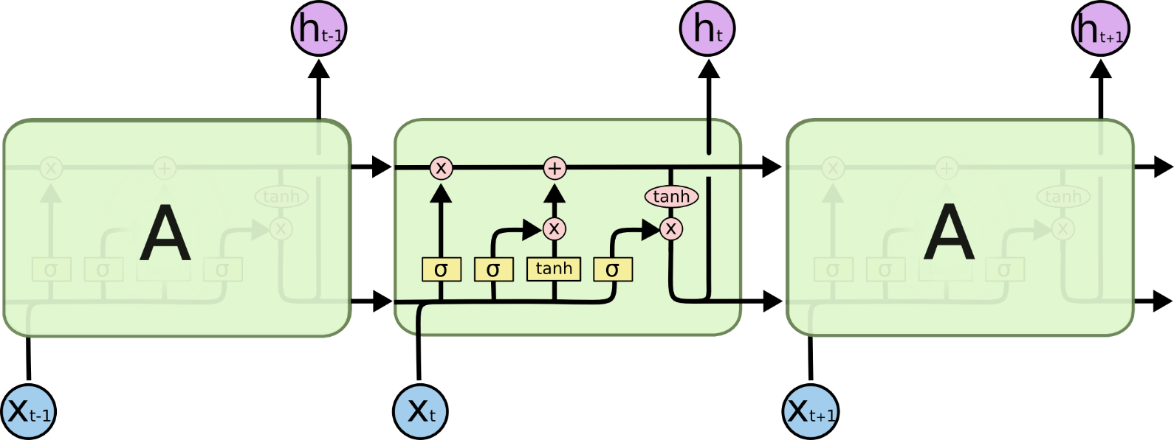
LSTM Arrays
We now have two recurrent nodes, $c_{i}$ and $h_{i}$.
$h_{i}$ plays the role of the output in the simple RNN, and is recurrent.
The the cell state $c_{i}$ is the cell’s memory, it undergoes no transform.
When we compose LSTMs into arrays, they look like this:
For stacked arrays, the hidden layers ($h_{i}$’s) become the inputs ($x_{i}$’s) for the layer above.
Figure courtesy Chris Olah http://colah.github.io/posts/2015-08-Understanding-LSTMs/
$$c_{i}$$
W

Slide 82
Long Short Term Memory (LSTM)
[Hochreiter et al., 1997]
vector from
below (x)
W
x
sigmoid
i
h
sigmoid
f
vector from
before (h)
sigmoid
o
tanh
g
4n x 2n
4n
4*n

Slide 83
Long Short Term Memory (LSTM)
[Hochreiter et al., 1997]
cell
state c
x
f

Slide 84
Long Short Term Memory (LSTM)
[Hochreiter et al., 1997]
cell
state c
x
+
x
f
i
g

Slide 85
Long Short Term Memory (LSTM)
[Hochreiter et al., 1997]
cell
state c
x
+
c
x
tanh
f
i
g
o
x
h

Slide 86
Long Short Term Memory (LSTM)
[Hochreiter et al., 1997]
higher layer, or prediction
cell
state c
x
+
c
x
tanh
f
i
g
o
x
h

Slide 87
LSTM
one timestep
one timestep
cell
state c
x
+
x
+
tanh
tanh
x
x
f
x
f
x
i
g
i
g
o
o
h
h
h
x
x

Slide 88
LSTM Summary
Decide what to forget
Decide what new things to remember
Decide what to output
Notes:
A: linearly
B: linearly

Slide 89
Searching for interpretable cells
[Visualizing and Understanding Recurrent Networks, Andrej Karpathy*, Justin Johnson*, Li Fei-Fei]

Slide 90
Searching for interpretable cells
quote detection cell
(LSTM, tanh(c), red = -1, blue = +1)

Slide 91
Searching for interpretable cells
line length tracking cell

Slide 92
Searching for interpretable cells
if statement cell

Slide 93
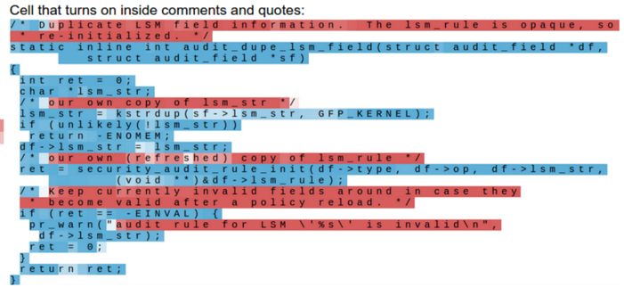
Searching for interpretable cells
quote/comment cell

Slide 94
Searching for interpretable cells
code depth cell

Slide 95
LSTM stability
How fast can the cell value c grow with time?
How fast can the backpropagated gradient of c grow with time?
Notes:
A: linearly
B: linearly

Slide 96
LSTM stability
How fast can the cell value c grow with time?
Linear
How fast can the backpropagated gradient of c grow with time?
Linear
Notes:
A: linearly
B: linearly

Slide 97
Better RNN Memory: LSTMs
Remember that the $h$ path has a linear transform $W_{hh}$ at each node.
No Transformation
$$c_{t−1}$$
$$c_{t}$$
$$h_{t−1}$$
$$h_{t}$$
W
General Linear Transformation

Slide 98
Better RNN Memory: LSTMs
Gradients are well-behaved along the $c$ path but not the $h$ path. Luckily LSTMs learn to rely mostly on $c$ for long-term memory.
Linear gradient growth
$$c_{t−1}$$
$$c_{t}$$
$$h_{t−1}$$
$$h_{t}$$
W
Exponential gradient grow/shrink

Slide 99
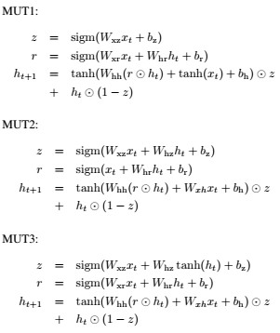
LSTM variants and friends
[An Empirical Exploration of Recurrent Network Architectures, Jozefowicz et al., 2015]
[LSTM: A Search Space Odyssey,
Greff et al., 2015]
GRU [Learning phrase representations using rnn encoder-decoder for statistical machine translation, Cho et al. 2014]

Slide 100
LSTM variants and friends
These designs combine the function of $c$ and $h$, and (similar to ResNet) always include an identity path to the previous h (memory path).
GRU:

Slide 101
LSTM variants and friends
They also combine the functions of $f$ (forgetting gate) and $i$ (input) in a single $z$ gate.
The more you add from the current state (large $z$) the less $\left(1−z\right)$ you remember from previous $h$, and vice versa.
GRU:

Slide 102
Summary
RNNs are a widely used model for sequential data, including text
RNNs are trainable with backprop when unrolled over time
RNNs learn complex and varied patterns in sequential data
Vanilla RNNs are simple but don’t work very well
Backward flow of gradients in RNN can explode or vanish
Common to use LSTM or GRU. Memory path makes them stably learn long-distance interactions.
Better/simpler architectures are a hot topic of current research

