Slide 1
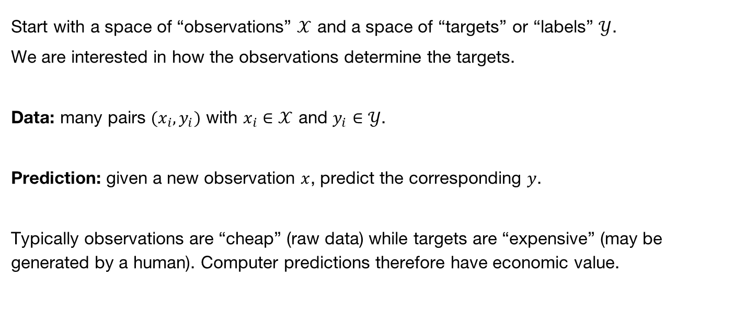
Machine Learning Background
Start with a space of “observations” $𝒳$ and a space of “targets” or “labels” $𝒴$.
We are interested in how the observations determine the targets.
Data: many pairs $(x_{i},y_{i})$ with $x_{i}∈𝒳$ and $y_{i}∈𝒴$.
Prediction: given a new observation $x$, predict the corresponding $y$.
Typically observations are “cheap” (raw data) while targets are “expensive” (may be generated by a human). Computer predictions therefore have economic value.

Slide 2
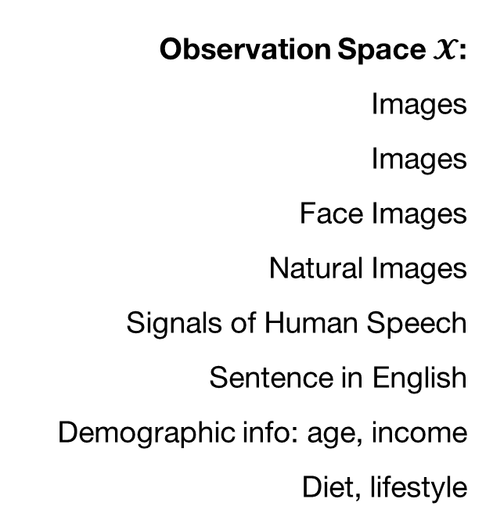
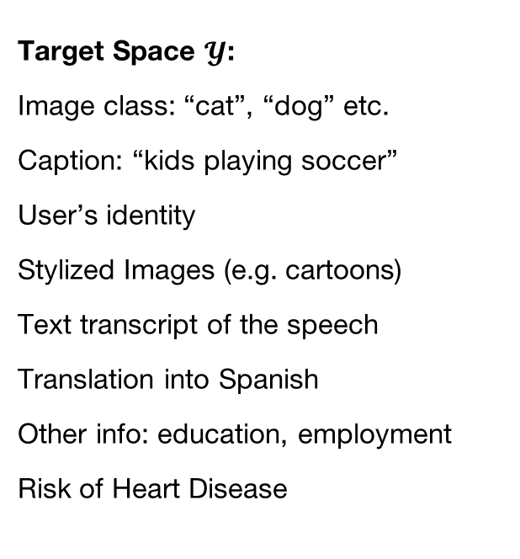
Prediction Problems
Observation Space $𝓧$:
Images
Images
Face Images
Natural Images
Signals of Human Speech
Sentence in English
Demographic info: age, income
Diet, lifestyle
Target Space $𝓨$:
Image class: “cat”, “dog” etc.
Caption: “kids playing soccer”
User’s identity
Stylized Images (e.g. cartoons)
Text transcript of the speech
Translation into Spanish
Other info: education, employment
Risk of Heart Disease

Slide 3
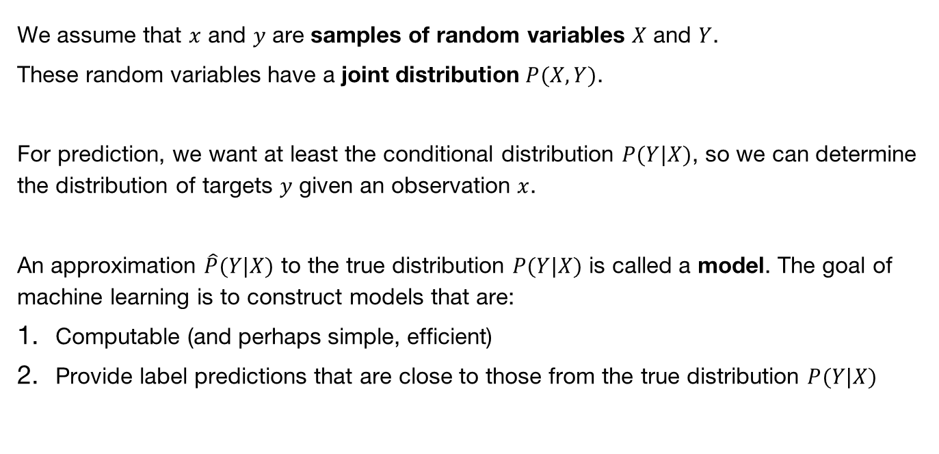
Probabilistic Framing
We assume that $x$ and $y$ are samples of random variables $X$ and $Y$.
These random variables have a joint distribution $P(X,Y)$.
For prediction, we want at least the conditional distribution $P(Y|X)$, so we can determine the distribution of targets $y$ given an observation $x$.
An approximation $\hat{P}(Y|X)$ to the true distribution $P(Y|X)$ is called a model. The goal of machine learning is to construct models that are:
Computable (and perhaps simple, efficient)
Provide label predictions that are close to those from the true distribution $P(Y|X)$

Slide 4
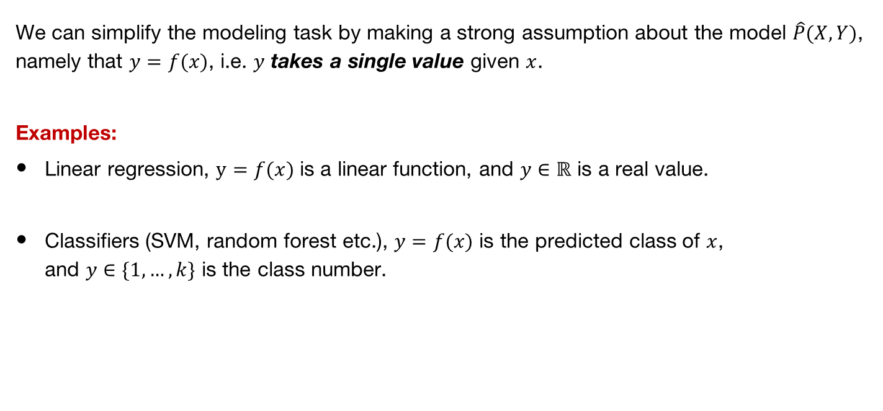
Prediction Functions
We can simplify the modeling task by making a strong assumption about the model $\hat{P}(X,Y)$, namely that $y=f(x)$, i.e. $y$ takes a single value given $x$.
Examples:
Linear regression, $y=f(x)$ is a linear function, and $y∈ℝ$ is a real value.
Classifiers (SVM, random forest etc.), $y=f(x)$ is the predicted class of $x$,
and $y∈\{1,…,k\}$ is the class number.

Slide 5
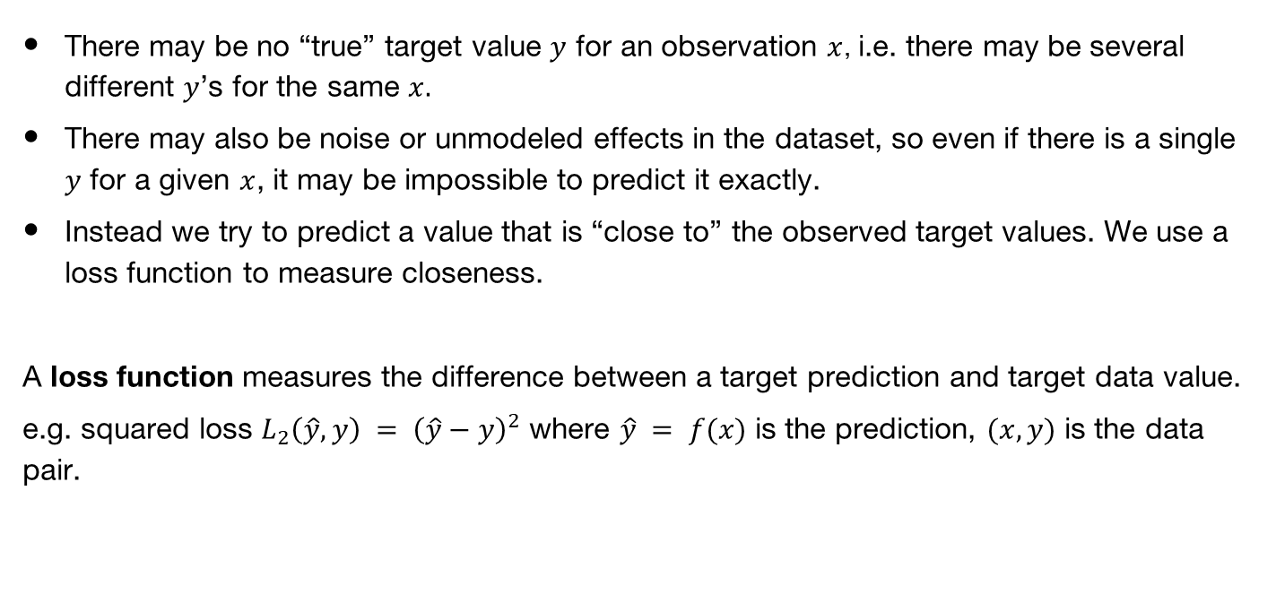
Loss Functions
There may be no “true” target value $y$ for an observation $x$, i.e. there may be several different $y$’s for the same $x.$
There may also be noise or unmodeled effects in the dataset, so even if there is a single $y$ for a given $x$, it may be impossible to predict it exactly.
Instead we try to predict a value that is “close to” the observed target values. We use a loss function to measure closeness.
A loss function measures the difference between a target prediction and target data value.
e.g. squared loss $L_{2}\left(\hat{y},y\right) = {\left(\hat{y}−y\right)}^{2}$ where $\hat{y} = f(x)$ is the prediction, $(x,y)$ is the data pair.

Slide 6
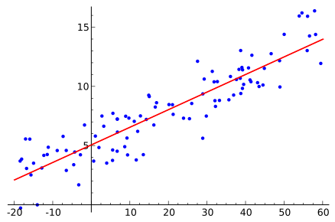


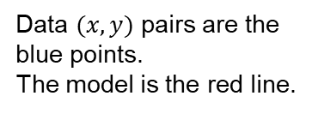



Linear Regression
Simplest case, $\hat{y}=f\left(x\right)=ax+b$ with $x$ a real value, and real constants $a$ and $b$.
The loss is the squared loss $L_{2}\left(\hat{y},y\right) = {\left(\hat{y}−y\right)}^{2}$
$$y$$
$$y$$
Data $(x,y)$ pairs are the
blue points.
The model is the red line.
$$\hat{y}$$
$$x$$

Slide 7

Linear Regression
The total loss across all points is
$$L=\sum_{i=1}^{n}{{\left({\hat{y}}_{i}−y_{i}\right)}^{2}}$$
$$= \sum_{i=1}^{n}{{\left(ax_{i}+b−y_{i}\right)}^{2}}$$
We want the optimum values of $a$ and $b$, and since the loss is differentiable, we set
$\frac{dL}{da}=0$ and $\frac{dL}{db}=0$

Slide 8
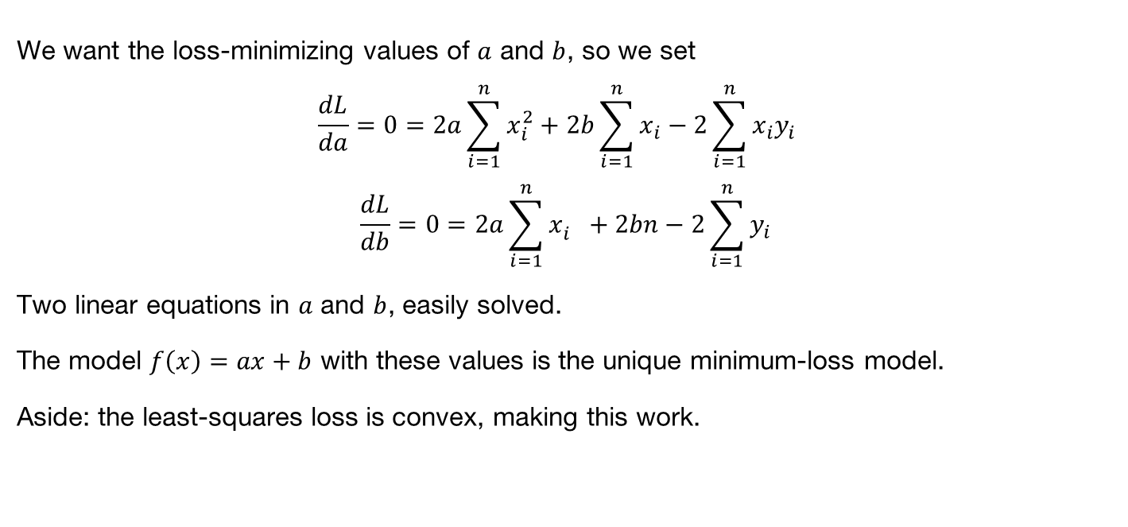
Linear Regression
We want the loss-minimizing values of $a$ and $b$, so we set
$$\frac{dL}{da}=0=2a\sum_{i=1}^{n}{x_{i}^{2}}+2b\sum_{i=1}^{n}{x_{i}}−2\sum_{i=1}^{n}{x_{i}y_{i}}$$
$$\frac{dL}{db}=0=2a\sum_{i=1}^{n}{x_{i}^{}}+2bn−2\sum_{i=1}^{n}{y_{i}}$$
Two linear equations in $a$ and $b$, easily solved.
The model $f\left(x\right)=ax+b$ with these values is the unique minimum-loss model.
Aside: the least-squares loss is convex, making this work.

Slide 9
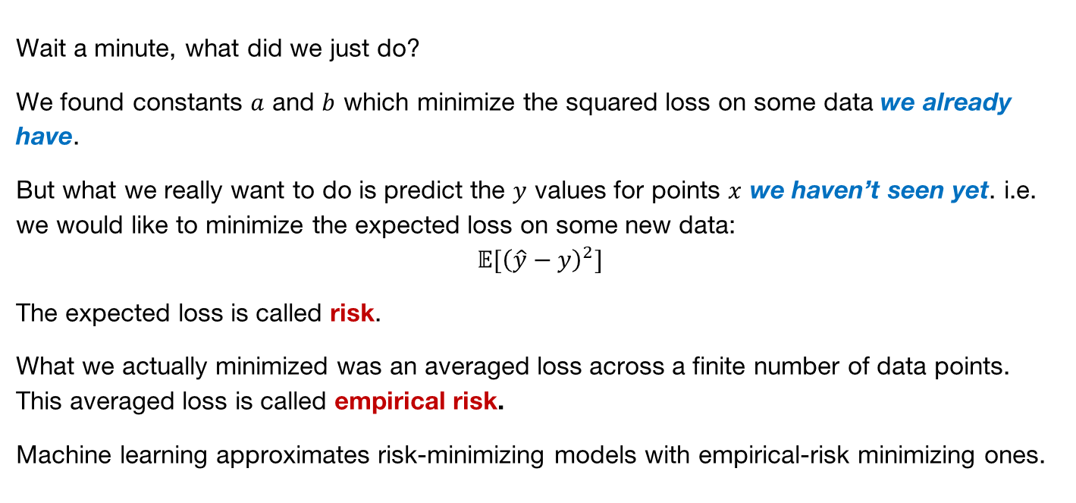
Risk Minimization
Wait a minute, what did we just do?
We found constants $a$ and $b$ which minimize the squared loss on some data we already have.
But what we really want to do is predict the $y$ values for points $x$ we haven’t seen yet. i.e. we would like to minimize the expected loss on some new data:
$$𝔼{[\left(\hat{y}−y\right)}^{2}]$$
The expected loss is called risk.
What we actually minimized was an averaged loss across a finite number of data points. This averaged loss is called empirical risk.
Machine learning approximates risk-minimizing models with empirical-risk minimizing ones.

Slide 10
Risk Minimization
Generally minimizing empirical risk (loss on the data) instead of true risk works fine, but it can fail if:
The data sample is biased. e.g. you cant build a (good) classifier with observations of only one class.
There is not enough data to accurately estimate the parameters of the model. Depends on the complexity (number of parameters, variation in gradients, complexity of the loss function, generative vs. discriminative etc.).

Slide 11
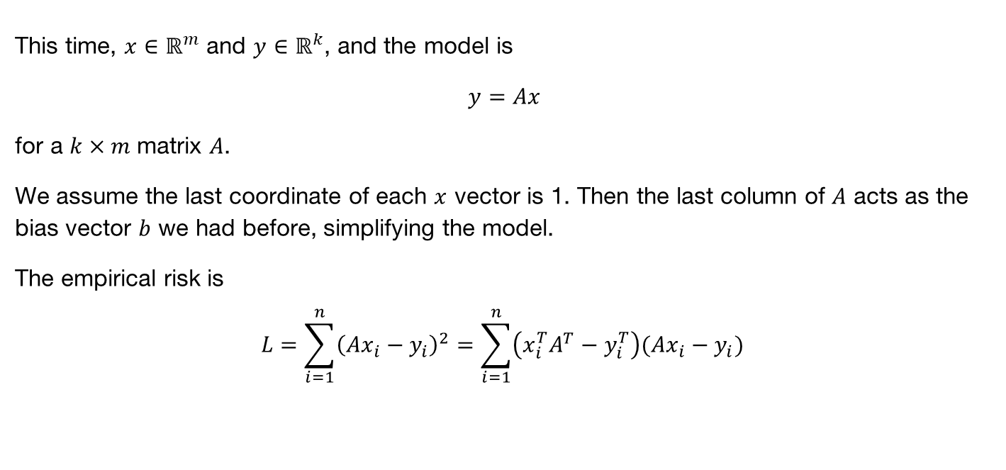
Multivariate Linear Regression
This time, $x∈ℝ^{m}$ and $y∈ℝ^{k}$, and the model is
$y=Ax$
for a $k×m$ matrix $A$.
We assume the last coordinate of each $x$ vector is 1. Then the last column of $A$ acts as the bias vector $b$ we had before, simplifying the model.
The empirical risk is
$$L=\sum_{i=1}^{n}{{\left(Ax_{i}−y_{i}\right)}^{2}}=\sum_{i=1}^{n}{\left(x_{i}^{T}A^{T}−y_{i}^{T}\right)(Ax_{i}−y_{i})}$$

Slide 12

Multivariate Linear Regression
We want to optimize $L$ with respect to the model matrix $A$, so this time we need a gradient:
$$∇_{A}L=0$$
- we are treating the loss as a function $L(A)$ of the matrix $A.$

Slide 13
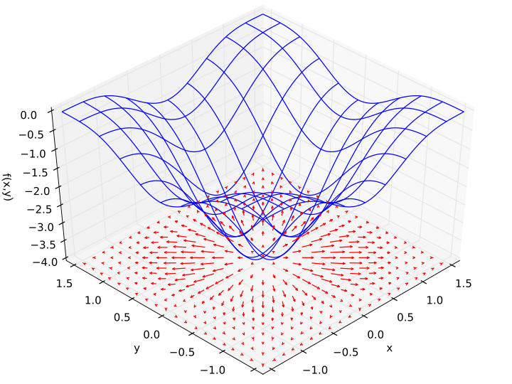
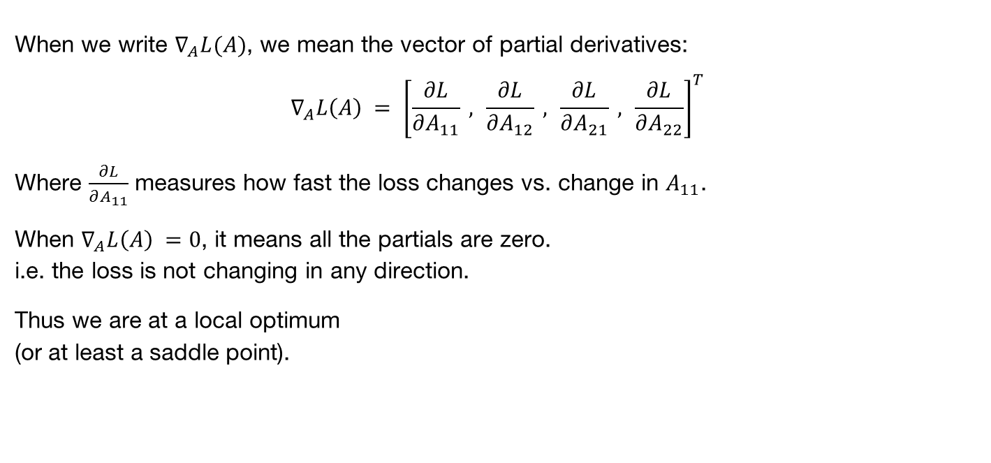
Aside: Gradients
When we write $∇_{A}L(A)$, we mean the vector of partial derivatives:
$$∇_{A}L\left(A\right) = {\left[\frac{∂L}{∂A_{11}} , \frac{∂L}{∂A_{12}} , \frac{∂L}{∂A_{21}} , \frac{∂L}{∂A_{22}}\right]}^{T}$$
Where $\frac{∂L}{∂A_{11}}$ measures how fast the loss changes vs. change in $A_{11}$.
When $∇_{A}L\left(A\right) =0$, it means all the partials are zero.
i.e. the loss is not changing in any direction.
Thus we are at a local optimum
(or at least a saddle point).
Notes:
Loss surface is blue. Gradients are shown below as red arrows. Gradient is zero at the minimum.

Slide 14
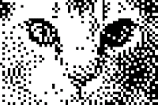
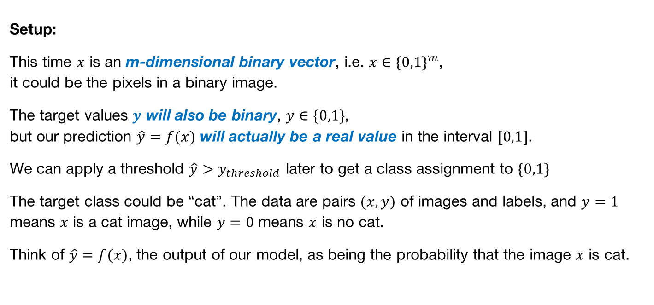
Logistic Regression
Setup:
This time $x$ is an m-dimensional binary vector, i.e. $x∈\{0,1\}^{m}$,
it could be the pixels in a binary image.
The target values $y$ will also be binary, $y∈\{0,1\}$,
but our prediction $\hat{y}=f(x)$ will actually be a real value in the interval $[0,1]$.
We can apply a threshold $\hat{y}>y_{threshold}$ later to get a class assignment to $\{0,1\}$
The target class could be “cat”. The data are pairs $(x,y)$ of images and labels, and $y=1$ means $x$ is a cat image, while $y=0$ means $x$ is no cat.
Think of $\hat{y}=f(x)$, the output of our model, as being the probability that the image $x$ is cat.

Slide 15
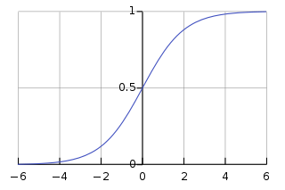



Logistic Regression
Let $w∈ℝ^{m}$ be a weight vector (the logistic model). Then
$$f\left(x\right)=\frac{1}{1+\exp\left(−w^{T}x\right)}$$
Is the probability that the output should be “cat”.
We can write this as $f\left(x\right)=g(w^{T}x)$ where $g\left(u\right)=1/\left(1+\exp\left(−u\right)\right)$ is the logistic function:
$$g\left(u\right)$$
$$u$$

Slide 16
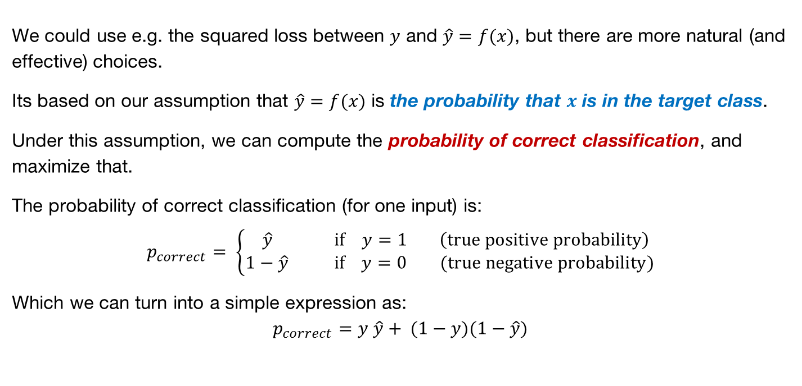
Loss for Logistic Regression
We could use e.g. the squared loss between $y$ and $\hat{y}=f(x)$, but there are more natural (and effective) choices.
Its based on our assumption that $\hat{y}=f(x)$ is the probability that $x$ is in the target class.
Under this assumption, we can compute the probability of correct classification, and maximize that.
The probability of correct classification (for one input) is:
$$p_{correct}= \left\{\begin{matrix} \hat{y} if y=1 \left(true positive probability\right) \\ 1−\hat{y} if y=0 (true negative probability)\end{matrix}\right.$$
Which we can turn into a simple expression as:
$$p_{correct}=y \hat{y}+ (1−y)(1−\hat{y})$$

Slide 17
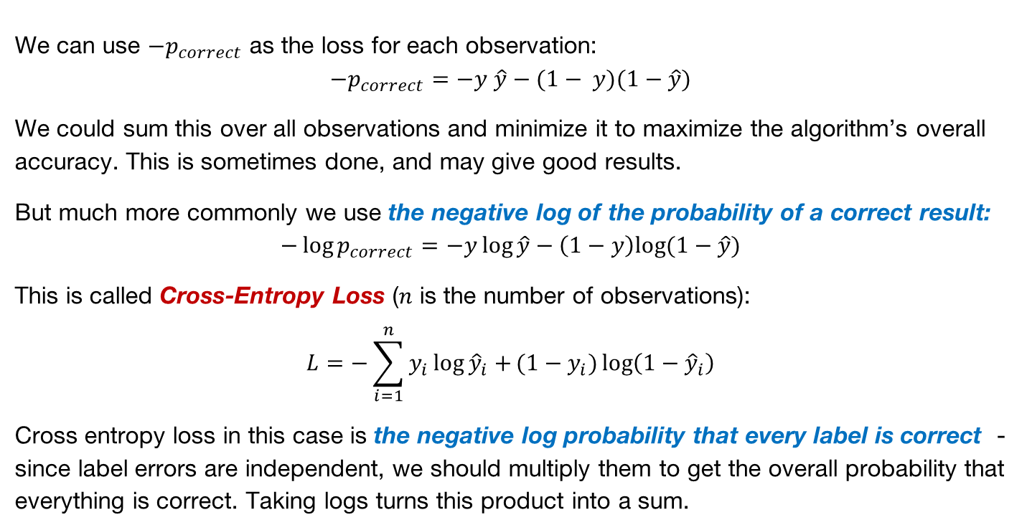
Cross-Entropy Loss
We can use $−p_{correct}$ as the loss for each observation:
$$−p_{correct}=−y \hat{y}−(1− y)(1−\hat{y})$$
We could sum this over all observations and minimize it to maximize the algorithm’s overall accuracy. This is sometimes done, and may give good results.
But much more commonly we use the negative log of the probability of a correct result:
$$−\log{p_{correct}}=−y\log{\hat{y}}−\left(1−y\right)log⁡(1−\hat{y})$$
This is called Cross-Entropy Loss ($n$ is the number of observations):
$$L=−\sum_{i=1}^{n}{y_{i}\log{{\hat{y}}_{i}}+}(1−y_{i})\log\left(1−{\hat{y}}_{i}\right)$$
Cross entropy loss in this case is the negative log probability that every label is correct - since label errors are independent, we should multiply them to get the overall probability that everything is correct. Taking logs turns this product into a sum.

Slide 18
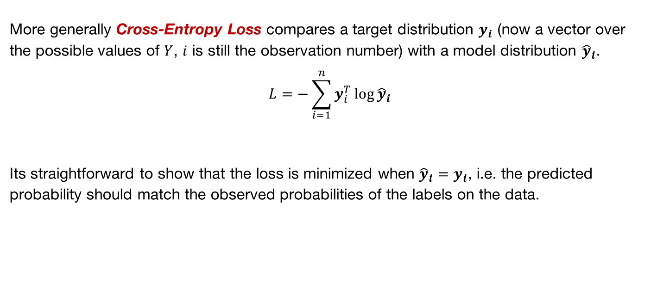
Cross-Entropy Loss
More generally Cross-Entropy Loss compares a target distribution $y_{i}$ (now a vector over the possible values of $Y$, $i$ is still the observation number) with a model distribution ${\hat{y}}_{i}$.
$$L=−\sum_{i=1}^{n}{y_{i}^{T}\log{{\hat{y}}_{i}}}$$
Its straightforward to show that the loss is minimized when ${\hat{y}}_{i}=y_{i}$, i.e. the predicted probability should match the observed probabilities of the labels on the data.

Slide 19

Logistic Regression
Is there something special about the logistic function
$$f\left(x\right)=\frac{1}{1+\exp\left(−w^{T}x\right)}$$
or would any other “sigmoid” function work?

Slide 20
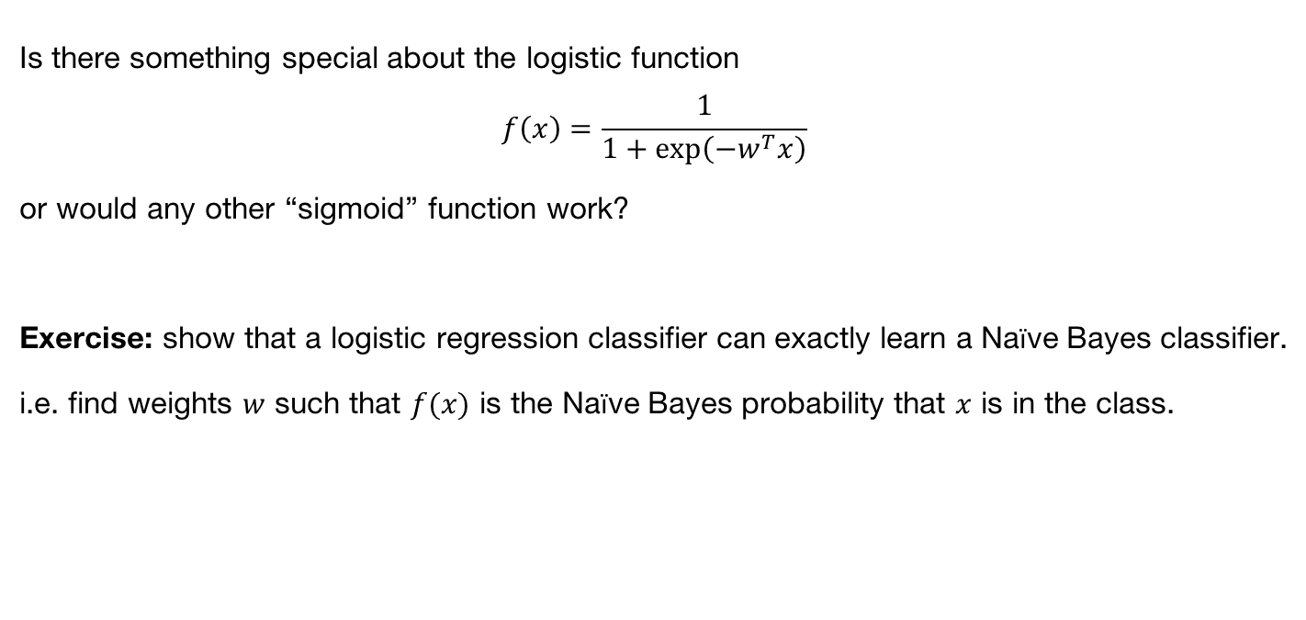
Logistic Regression
Is there something special about the logistic function
$$f\left(x\right)=\frac{1}{1+\exp\left(−w^{T}x\right)}$$
or would any other “sigmoid” function work?
Exercise: show that a logistic regression classifier can exactly learn a Naïve Bayes classifier.
i.e. find weights $w$ such that $f(x)$ is the Naïve Bayes probability that $x$ is in the class.

Slide 21
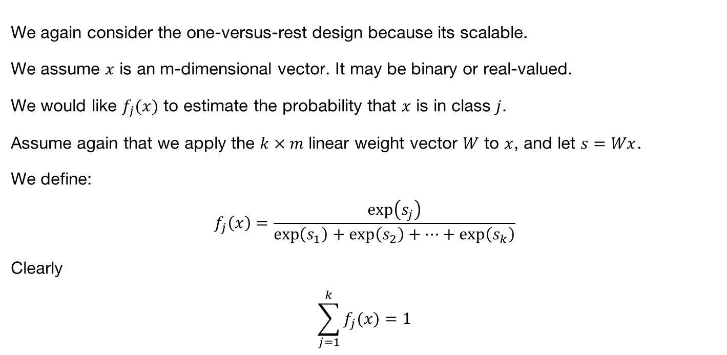
Multi-Class Logistic Regression
We again consider the one-versus-rest design because its scalable.
We assume $x$ is an m-dimensional vector. It may be binary or real-valued.
We would like $f_{j}(x)$ to estimate the probability that $x$ is in class $j$.
Assume again that we apply the $k×m$ linear weight vector $W$ to $x$, and let $s=Wx$.
We define:
$$f_{j}\left(x\right)=\frac{\exp\left(s_{j}\right)}{\exp\left(s_{1}\right)+\exp\left(s_{2}\right)+⋯+\exp\left(s_{k}\right)}$$
Clearly
$$\sum_{j=1}^{k}{f_{j}(x)}=1$$
So it acts as a probability

Slide 22
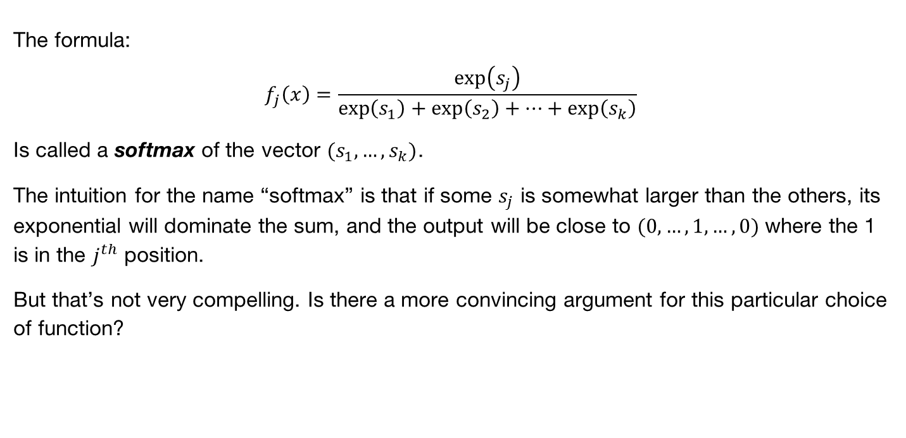
Multiclass Logistic Regression (Softmax)
The formula:
$$f_{j}\left(x\right)=\frac{\exp\left(s_{j}\right)}{\exp\left(s_{1}\right)+\exp\left(s_{2}\right)+⋯+\exp\left(s_{k}\right)}$$
Is called a softmax of the vector $(s_{1},…,s_{k})$.
The intuition for the name “softmax” is that if some $s_{j}$ is somewhat larger than the others, its exponential will dominate the sum, and the output will be close to $(0,…,1,…,0)$ where the 1 is in the $j^{th}$ position.
But that’s not very compelling. Is there a more convincing argument for this particular choice of function?

