Slide 1
This Time: Optimization
General story: how do we minimize the loss?

Slide 2
Method 1: Search
Take several random steps and measure the altitude (loss). Then go to the lowest one.
Not totally crazy. This is one kind of “gradient-free” optimization. It makes sense if you can’t compute gradients for some reason (e.g. loss is not continuous or differentiable).
A slightly smarter version takes an average of the random points weighted by altitude (deeper points get higher weight). This in fact approximates the gradient.
See:
Salimans, Ho, Chen, Sidor and Sutskever “Evolution Strategies as a Scalable Alternative to Reinforcement Learning” arXiv 1703.03864, 2017.
But it’s less efficient than gradient descent when gradients are available.

Slide 3
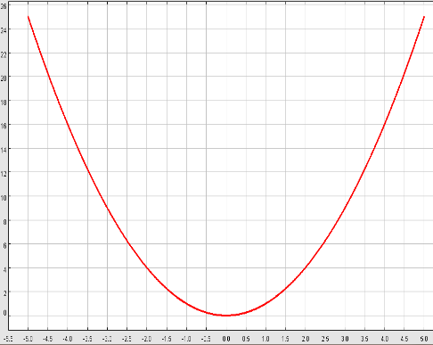
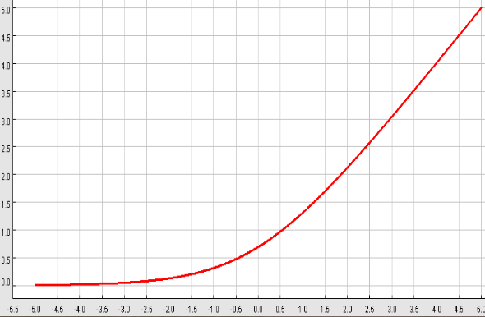
Losses we have seen so far
Squared Loss
$L={\left(y_{i}−f\left(x_{i}\right)\right)}^{2}$
Hinge Loss, $y_{i}∈\{−1,1\}$
$$L= max⁡(0,1−y_{i}f\left(x_{i}\right))$$
Cross-entropy loss on logistic function, $y_{i}∈\{−1,1\}$
$$L=\log\left(1+\exp\left(−y_{i}f(x_{i})\right)\right)$$
All three have “well behaved” derivatives. $f\left(x\right)=w^{T}x$ is a linear function of the weights $W$, so we can differentiate loss with respect to weights.
Notes:
The hinge loss “corner” doesn’t have a well-defined derivative, but this isn’t normally a problem.

Slide 4
loss
params

Slide 5
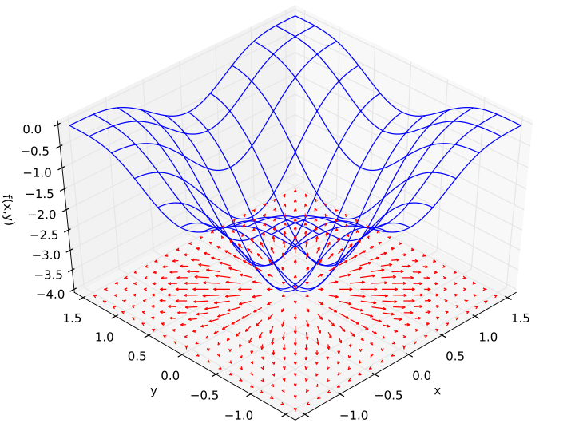
Gradients Again
When we write $∇_{W}L(W)$, we mean the vector of partial derivatives wrt all coordinates of $W$:
$$∇_{W}L\left(W\right) = {\left[\frac{∂L}{∂W_{1}} , \frac{∂L}{∂W_{2}} , … , \frac{∂L}{∂W_{m}}\right]}^{T}$$
Where $\frac{∂L}{∂W_{i}}$ measures how fast the loss changes vs. change in $W_{i}$.
In figure: loss surface is blue, gradient vectors are red:
When $∇_{W}L\left(W\right) =0$, it means all the partials are zero. i.e. the loss is not changing in any direction.
Thus we are at a local optimum (or at least a saddle point).
Note: arrows point out from a minimum, in toward a maximum.

Slide 6
Gradient Descent
So to reach a minimum of loss, we should follow the negative gradient.
i.e. we should take small steps in direction
$$−∇_{W}L(W)$$
To be more concrete, let $W^{t}$ denote the weights at step $t$ of gradient descent. Then
$W^{t+1}=W^{t}−α ∇_{W}L(W)$
Where $α$ is called the learning rate.

Slide 7
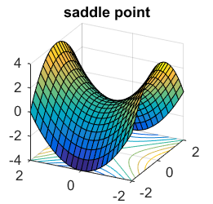
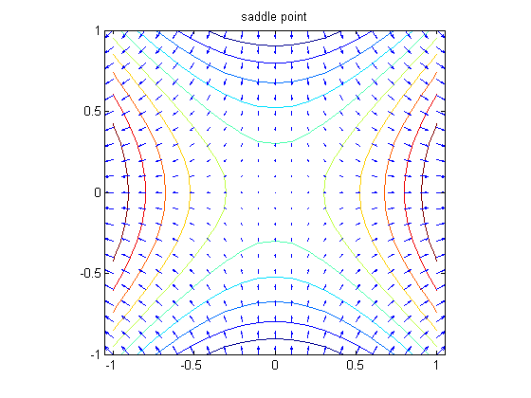
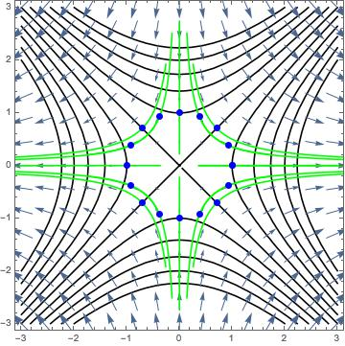
Caveat: Saddle Points
Following the negative gradient should eventually get you to a loss minimum. But it may take a long time. One reason is the presence of saddle points, where the gradient also vanishes:
Gradient vectors
Gradient flows (green)

Slide 8
Caveat: Saddle Points
Following the negative gradient should eventually get you to a loss minimum. But it may take a long time. One reason is the presence of saddle points:
Gradient vectors
Gradient flows (green)
Gradients very small in here – slow progress

Slide 9
Caveat: Saddle Points
There is a lot of evidence that most zeros of the loss gradient $∇_{W}L$ for neural networks are in fact saddles.
See e.g.
Dauphin et al. “Identifying and attacking the saddle point problem in high-dimensional non-convex optimization” arXiv 1406.2572, 2014.

Slide 10
Caveat: Efficiency
The loss $L$ is a sum of the losses for all the data items:
$$L=\sum_{i=1}^{N}{L(x_{i},y_{i},W)}$$
and
$$\frac{dL}{dW}=\sum_{i=1}^{N}{\frac{dL}{dW}(x_{i},y_{i},W)}$$
so computing the gradient wrt $W$ requires a full pass through the dataset. Getting to the loss minimum may require millions of gradient steps, so this is very expensive.

Slide 11
Minibatches
Instead of computing a gradient across the entire dataset, we can compute it using a fixed-size subset of data samples called a minibatch. The minibatch size m is typically 32, 64, 128, 256,…
The minibatch is ideally a random sample of size m from the full dataset. In practice it may just be m consecutive samples.
So we compute this gradient ($N$ is our dataset size, $m$ is our minibatch size):
$$g^{(t)}=\frac{1}{m}\sum_{j= i_{1},…,i_{m} ∈ \{1,…,N\}}{∇_{W}L\left(x_{j},y_{j},W\right)}$$
And then (superscripts are iteration numbers):
$$W^{(t+1)}=W^{(t)}−α g^{(t)}$$
In this way, we perform N/m updates to the weights for one pass over the dataset.

Slide 12
Stochastic Gradient Descent
This approach is called Stochastic Gradient Descent or SGD. SGD and its variants are used almost universally in deep network training.
SGD uses $g^{\left(t\right)}$, the gradient of a minibatch instead of the true average gradient (call it $g$) on the full dataset. It should be clear that:
$$g=𝔼[g^{\left(t\right)}]$$
where expectation is over minibatches sampled from the full dataset.
So that $g^{\left(t\right)}$ is an unbiased estimate of $g$. But $g^{\left(t\right)}$ will typically have a lot of variance (is noisy) compared to $g$ (if we considered the full dataset as a sample of an infinite dataset…).
SGD is “stochastic” because it uses $g^{\left(t\right)}$, the gradient of a minibatch instead of the true gradient (call it $g$) on the full dataset.

Slide 13
Other optimization algorithms
Simple Gradient Methods like SGD can make adequate progress to an optimum when used on minibatches of data.
Second-order methods (quasi-Newton) make much better progress toward a gradient zero, but are more expensive and unstable. They also can’t distinguish optima from saddle points, and get trapped in the latter.
Momentum: is another method to produce better effective gradients.
ADAGRAD, RMSprop: diagonally scale the gradient. ADAM diagonally scales and applies momentum.
Nesterov Momentum: can improve over vanilla SGD by gradient “look-ahead”

Slide 14
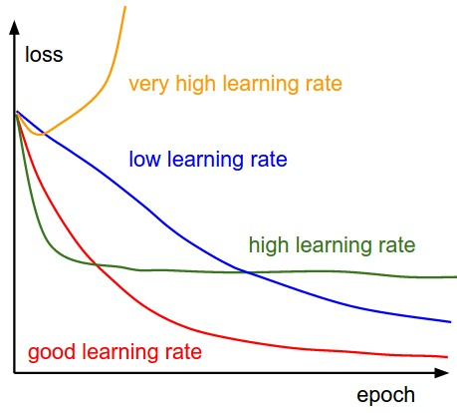
SGD, SGD+Momentum, Adagrad, RMSProp, Adam all have learning rate as a hyperparameter.
=> Learning rate decay over time!
step decay: e.g. decay learning rate by half every few epochs.
exponential decay:
1/t decay:
$1/\sqrt{t}$ decay (ADAGRAD): $α=α_{0}/\sqrt{1+kt}$

Slide 15
“Tensors” (not really)
Deep networks are often applied to structured data like images or time series or texts.
Activations are also grouped into minibatches of some dimension N.
Its useful to organize layer activations and model weights to represent this structure. They are therefore most naturally represented as multi-dimensional arrays (incorrectly called “tensors”).
e.g. the activations in layers of most 2D image processing networks have dimensions:
N x C x H x W or N x H x W x C
N = minibatch dimension C = number of channels or filters H = image height W = image width

Slide 16
“Tensors” (not really)
Alexnet (simplified): The 3D blocks show activations with C, H, W dimensions. N, the minibatch dimension, is not shown.
H
W
C

Slide 17
Next Topic: Backpropagation
So far we have been using gradient methods to minimize a loss over some parameters.
Our loss is of the form $L(f\left(x,W\right),y)$.
where $x$ is an input, $y$ is a target, and $W$ are the parameters.
To compute the gradient of $L$ wrt $W$, we need the chain rule. If $f$ is single-valued, $W$ a single parameter the chain rule is just:
$$\frac{dL}{dW}=\frac{dL}{df}\frac{df}{dW}$$
If $W$ is a vector of parameters, then we have:
$$∇_{W}L=\frac{dL}{df}∇_{W}f$$
Which is really just the first rule applied to all the partial derivatives wrt elements of $W$.

Slide 18
The Chain Rule
If $f$ is also vector-valued with $k$ values and $W$ is a vector of $m$ parameters, then we can apply the chain rule parameter-wise and then sum over the contributions:
$$\frac{∂L}{∂W_{j}}=\sum_{i=1}^{k}{\frac{∂L}{∂f_{i}}\frac{∂f_{i}}{∂W_{j}}}$$
For $j=1,…,m$. This can be written as a matrix multiply
$$J_{L}\left(W\right)=J_{L}\left(f\right) J_{f}(W)$$
Where $J_{f}(W)$ is a Jacobian matrix.
$$J_{f}{\left(W\right)}_{ij}=\frac{∂f_{i}}{∂W_{j}}$$

Slide 19
Jacobians
The Jacobian generalizes the gradient of a scalar-valued function $f$ to a $k$-valued function. Here we think of the function as a neural layer with $m$ inputs and $k$ outputs.
$$J_{f}\left(W\right)=\left[\begin{matrix}\frac{∂f_{1}}{∂W_{1}} & \frac{∂f_{1}}{∂W_{2}} & ⋯ & \frac{∂f_{1}}{∂W_{m}} \\ \frac{∂f_{2}}{∂W_{1}} & \frac{∂f_{2}}{∂W_{2}} & ⋯ & \frac{∂f_{2}}{∂W_{m}} \\ ⋮ & ⋮ & ⋱ & ⋮ \\ \frac{∂f_{k}}{∂W_{1}} & \frac{∂f_{k}}{∂W_{2}} & ⋯ & \frac{∂f_{k}}{∂W_{m}}\end{matrix}\right]$$
The Jacobian has dimensions $k×m$ which is $n_{outputs}×n_{inputs}$.

Slide 20
N-step Chain Rule
Now suppose we have several vector-valued functions $A\left(.\right), B\left(.\right), C\left(.\right),…$ composed in a chain (e.g. a deep network):
$$W→A→B→C→⋯L$$
Algebraically, that looks like:
$$L(W)=L(⋯C\left(B\left(A\left(W\right)\right)\right)⋯)$$
Then we just multiply Jacobians (matrix multiply $∗$) to get the gradient:
$$J_{L}\left(W\right)=J_{L}\left(K\right)∗⋯J_{C}\left(B\right)∗J_{B}\left(A\right)∗J_{A}(W)$$
And $J_{L}\left(W\right)={\left(∇_{W}L\right)}^{T}$ which is the gradient we need to minimize loss over $W$.

Slide 21
Backpropagation
Now all the Jacobians are matrices, and matrix multiply is associative.
$$J_{L}\left(W\right)=J_{L}\left(K\right)∗⋯J_{C}\left(B\right)∗J_{B}\left(A\right)∗J_{A}(W)$$
So we could actually evaluate the product of Jacobians in any order, including left-to-right and right-to-left.
Backpropagation: evaluate the Jacobian product (loss gradient wrt params) left-to-right, i.e. from the output of the neural network toward its input.
Why not some other order?

Slide 22
Backpropagation
Reason 1: Efficiency
Output Jacobian is always a row vector (because loss is a scalar). Matrix-vector multiply is much less expensive than matrix-matrix multiply.
$$J_{D}\left(W\right)=J_{D}\left(C\right) ∗ J_{C}\left(B\right) ∗ J_{B}\left(A\right) ∗ J_{A}(W)$$
Do first (output layer)
Jacobians (matrix shape)
Back (output) of network
Front (input) of network

Slide 23
Backpropagation
Reason 1: Efficiency
Output Jacobian is always a row vector. Matrix-vector multiply is much less expensive than matrix-matrix multiply.
$$J_{D}\left(W\right)=J_{D}\left(C\right) ∗ J_{C}\left(B\right) ∗ J_{B}\left(A\right) ∗ J_{A}(W)$$
Do next
Product of matrices to my left
Back (output) of network
Front (input) of network

Slide 24
Backpropagation
Reason 1: Efficiency
Output Jacobian is always a row vector. Matrix-vector multiply is much less expensive than matrix-matrix multiply.
$$J_{D}\left(W\right)=J_{D}\left(C\right) ∗ J_{C}\left(B\right) ∗ J_{B}\left(A\right) ∗ J_{A}(W)$$
Do next
Product of matrices to my left
Back (output) of network
Front (input) of network

Slide 25
Backpropagation
Reason 1: Efficiency
Output Jacobian is always a row vector. Matrix-vector multiply is much less expensive than matrix-matrix multiply.
$$J_{D}\left(W\right)=J_{D}\left(C\right) ∗ J_{C}\left(B\right) ∗ J_{B}\left(A\right) ∗ J_{A}(W)$$
Final result, without any matrix-matrix multiplies
Product of all matrices
Back (output) of network
Front (input) of network

Slide 26
For-propagation
Reason 1: Efficiency
By comparison, we could invent “for-propagation”:
$$J_{D}\left(W\right)=J_{D}\left(C\right) ∗ J_{C}\left(B\right) ∗ J_{B}\left(A\right) ∗ J_{A}(W)$$
Do first
Back (output) of network
Front (input) of network

Slide 27
For-propagation
Reason 1: Efficiency
We could invent “for-propagation”: Oops, cost $O(n^{3})$ instead of $O\left(n^{2}\right)$ for the first multiply and we still have another matrix-matrix multiply to do.
A good invention for the wastebasket…
$$J_{D}\left(W\right)=J_{D}\left(C\right) ∗ J_{C}\left(B\right) ∗ J_{B}\left(A\right) ∗ J_{A}(W)$$
Do first
Product of matrices to my right
Back (output) of network
Front (input) of network

Slide 28
Backpropagation
Reason 2 to use backpropagation: Common subexpressions.
Let’s build a real neural network (Tensorflow style):
$$W_{1}$$
$$W_{2}$$
$$x$$
$$h_{1}$$
$$h_{2}$$
$$\hat{y}$$
Matrix multiply $$W_{1}x$$
ReLU
Matrix multiply $$W_{2}h_{2}$$
$$L(x,y,W_{1},W_{2})$$
loss
$$y$$
Notes:
x and y are input and target respectively.
W_1 and W_2 are learnable weight matrices.
Input, output and hidden layers are column vectors.

Slide 29
Backpropagation
Reason 2 to use backpropagation: Common subexpressions.
Let’s build a real neural network (Tensorflow style):
$$W_{1}$$
$$W_{2}$$
$$x$$
$$h_{1}$$
$$h_{2}$$
$$J_{L}{\left(\hat{y}\right)}^{}$$
$$\hat{y}$$
Matrix multiply $$W_{1}x$$
ReLU
Matrix multiply $$W_{2}h_{2}$$
$$L(x,y,W_{1},W_{2})$$
loss
1
$$y$$
Note: the Jacobians are actually row vectors, transposes left out for readability.
Notes:
x and y are input and target respectively.
W_1 and W_2 are learnable weight matrices.
Input, output and hidden layers are column vectors.

Slide 30
Backpropagation
Reason 2 to use backpropagation: Common subexpressions.
Let’s build a real neural network (Tensorflow style):
$$W_{1}$$
$$W_{2}$$
$$J_{L}\left(W_{2}\right)=J_{L}\left(\hat{y}\right) ∗ J_{\hat{y}}\left(W_{2}\right)$$
$$x$$
$$h_{1}$$
$$h_{2}$$
Common
subexpression
$$\hat{y}$$
$$J_{L}(\hat{y})$$
Matrix multiply $$W_{1}x$$
ReLU
Matrix multiply $$W_{2}h_{2}$$
$$L(x,y,W_{1},W_{2})$$
loss
1
$$y$$
$$J_{L}\left(h_{2}\right)=J_{L}\left(\hat{y}\right) ∗ J_{\hat{y}}\left(h_{2}\right)$$
Notes:
x and y are input and target respectively.
W_1 and W_2 are learnable weight matrices.
Input, output and hidden layers are column vectors.

Slide 31
Backpropagation
Reason 2 to use backpropagation: Common subexpressions.
Let’s build a real neural network (Tensorflow style):
$$W_{1}$$
$$W_{2}$$
$$J_{L}\left(W_{1}\right)=J_{L}\left(h_{1}\right)∗J_{h_{1}}\left(W_{1}\right)$$
$$x$$
$$h_{1}$$
$$h_{2}$$
$$\hat{y}$$
Matrix multiply $$W_{1}x$$
ReLU
Matrix multiply $$W_{2}h_{2}$$
$$L(x,y,W_{1},W_{2})$$
loss
1
$$y$$
$$J_{L}\left(h_{1}\right)=J_{L}\left(h_{2}\right) ∗ J_{h_{2}}\left(h_{1}\right)$$
Notes:
The Jacobian for a weight layer is the product of matrices on the path from the weight layer to the output.
Backprop shares the products along common paths to the output layer.

Slide 32
Backpropagation
Compute function values (activations) from the first layer to the last.
Compute derivatives of the loss wrt other layers from the last layer to the first (backpropagation).
This only requires matrix-vector multiplies.
Paths from the loss layer to inner layers are re-used.

