Slide 1
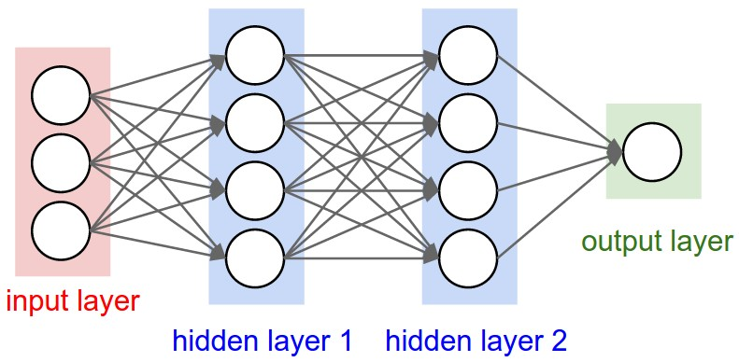
This time: Neural Networks for Visual Data

Slide 2
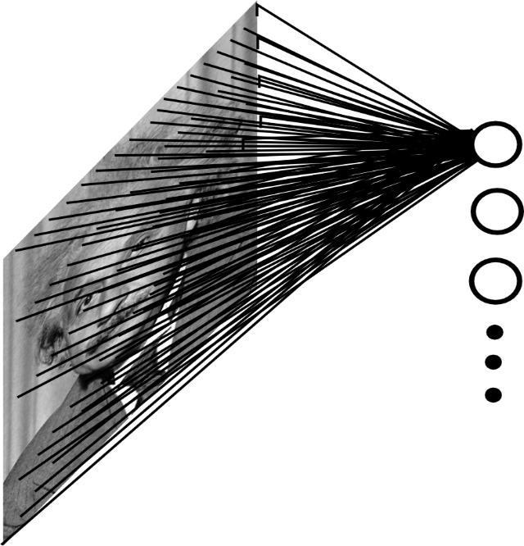

Fully Connected Layer for Visual Data
Example: An affine (FC) layer from
200x200 images to 40K hidden units
~2B parameters!!!
- Spatial correlation is local
Waste of resources + we have not enough
training samples anyway..
Ranzato

Slide 3
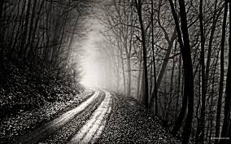
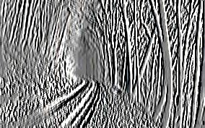
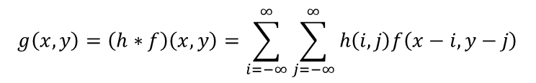
Convolutional of Two Signals
Note: to implement convolution with a sliding mask,
you must flip it in x and y because of the negated i,j indices
-1 0 1
-1 0 1
-1 0 1
*
=
$$g\left(x,y\right)=\left(h∗f\right)\left(x,y\right)=\sum_{i=−∞}^{∞}{\sum_{j=−∞}^{∞}{h\left(i,j\right)f\left(x−i,y−j\right)}}$$
elementwise multiplication and sum of a filter and the signal (image)
Ranzato
Notes:
Convolution is closely related to correlation. For correlation, the indices n1, n2 are added instead of subtracted

Slide 4
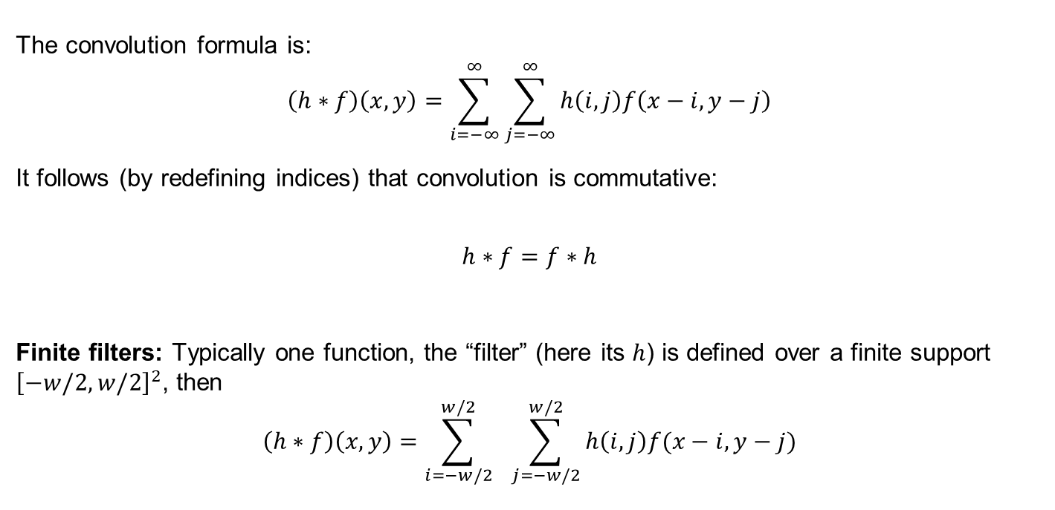
Convolutional of Two Signals
The convolution formula is:
$$\left(h∗f\right)\left(x,y\right)=\sum_{i=−∞}^{∞}{\sum_{j=−∞}^{∞}{h\left(i,j\right)f\left(x−i,y−j\right)}}$$
It follows (by redefining indices) that convolution is commutative:
$$h∗f=f∗h$$
Finite filters: Typically one function, the “filter” (here its $h$) is defined over a finite support ${\left[−w/2,w/2\right]}^{2}$, then
$$\left(h∗f\right)\left(x,y\right)=\sum_{i=−w/2}^{w/2}{ \sum_{j=−w/2}^{w/2}{h\left(i,j\right)f(x−i,y−j)}}$$
Ranzato
Notes:
Convolution is closely related to correlation. For correlation, the indices n1, n2 are added instead of subtracted

Slide 5

Image filtering
$$g=h∗f$$
1
1
1
1
1
1
1
1
1
0 | 0 | 0 | 0 | 0 | 0 | 0 | 0 | 0 | 0
0 | 0 | 0 | 0 | 0 | 0 | 0 | 0 | 0 | 0
0 | 0 | 0 | 90 | 90 | 90 | 90 | 90 | 0 | 0
0 | 0 | 0 | 90 | 90 | 90 | 90 | 90 | 0 | 0
0 | 0 | 0 | 90 | 90 | 90 | 90 | 90 | 0 | 0
0 | 0 | 0 | 90 | 0 | 90 | 90 | 90 | 0 | 0
0 | 0 | 0 | 90 | 90 | 90 | 90 | 90 | 0 | 0
0 | 0 | 0 | 0 | 0 | 0 | 0 | 0 | 0 | 0
0 | 0 | 90 | 0 | 0 | 0 | 0 | 0 | 0 | 0
0 | 0 | 0 | 0 | 0 | 0 | 0 | 0 | 0 | 0
 | 0
0 | 0 | 0 | 0 | 0 | 0 | 0 | 0 | 0 | 0
0 | 0 | 0 | 0 | 0 | 0 | 0 | 0 | 0 | 0
0 | 0 | 0 | 90 | 90 | 90 | 90 | 90 | 0 | 0
0 | 0 | 0 | 90 | 90 | 90 | 90 | 90 | 0 | 0
0 | 0 | 0 | 90 | 90 | 90 | 90 | 90 | 0 | 0
0 | 0 | 0 | 90 | 0 | 90 | 90 | 90 | 0 | 0
0 | 0 | 0 | 90 | 90 | 90 | 90 | 90 | 0 | 0
0 | 0 | 0 | 0 | 0 | 0 | 0 | 0 | 0 | 0
0 | 0 | 90 | 0 | 0 | 0 | 0 | 0 | 0 | 0
0 | 0 | 0 | 0 | 0 | 0 | 0 | 0 | 0 | 0
Credit: S. Seitz
Notes:
ones, divide by 9

Slide 6
Image filtering
$$g=h∗f$$
1
1
1
1
1
1
1
1
1
0 | 0 | 0 | 0 | 0 | 0 | 0 | 0 | 0 | 0
0 | 0 | 0 | 0 | 0 | 0 | 0 | 0 | 0 | 0
0 | 0 | 0 | 90 | 90 | 90 | 90 | 90 | 0 | 0
0 | 0 | 0 | 90 | 90 | 90 | 90 | 90 | 0 | 0
0 | 0 | 0 | 90 | 90 | 90 | 90 | 90 | 0 | 0
0 | 0 | 0 | 90 | 0 | 90 | 90 | 90 | 0 | 0
0 | 0 | 0 | 90 | 90 | 90 | 90 | 90 | 0 | 0
0 | 0 | 0 | 0 | 0 | 0 | 0 | 0 | 0 | 0
0 | 0 | 90 | 0 | 0 | 0 | 0 | 0 | 0 | 0
0 | 0 | 0 | 0 | 0 | 0 | 0 | 0 | 0 | 0
 | 0 | 10
0 | 0 | 0 | 0 | 0 | 0 | 0 | 0 | 0 | 0
0 | 0 | 0 | 0 | 0 | 0 | 0 | 0 | 0 | 0
0 | 0 | 0 | 90 | 90 | 90 | 90 | 90 | 0 | 0
0 | 0 | 0 | 90 | 90 | 90 | 90 | 90 | 0 | 0
0 | 0 | 0 | 90 | 90 | 90 | 90 | 90 | 0 | 0
0 | 0 | 0 | 90 | 0 | 90 | 90 | 90 | 0 | 0
0 | 0 | 0 | 90 | 90 | 90 | 90 | 90 | 0 | 0
0 | 0 | 0 | 0 | 0 | 0 | 0 | 0 | 0 | 0
0 | 0 | 90 | 0 | 0 | 0 | 0 | 0 | 0 | 0
0 | 0 | 0 | 0 | 0 | 0 | 0 | 0 | 0 | 0
Credit: S. Seitz
Notes:
ones, divide by 9

Slide 7
Image filtering
$$g=h∗f$$
1
1
1
1
1
1
1
1
1
0 | 0 | 0 | 0 | 0 | 0 | 0 | 0 | 0 | 0
0 | 0 | 0 | 0 | 0 | 0 | 0 | 0 | 0 | 0
0 | 0 | 0 | 90 | 90 | 90 | 90 | 90 | 0 | 0
0 | 0 | 0 | 90 | 90 | 90 | 90 | 90 | 0 | 0
0 | 0 | 0 | 90 | 90 | 90 | 90 | 90 | 0 | 0
0 | 0 | 0 | 90 | 0 | 90 | 90 | 90 | 0 | 0
0 | 0 | 0 | 90 | 90 | 90 | 90 | 90 | 0 | 0
0 | 0 | 0 | 0 | 0 | 0 | 0 | 0 | 0 | 0
0 | 0 | 90 | 0 | 0 | 0 | 0 | 0 | 0 | 0
0 | 0 | 0 | 0 | 0 | 0 | 0 | 0 | 0 | 0
 | 0 | 10 | 20
0 | 0 | 0 | 0 | 0 | 0 | 0 | 0 | 0 | 0
0 | 0 | 0 | 0 | 0 | 0 | 0 | 0 | 0 | 0
0 | 0 | 0 | 90 | 90 | 90 | 90 | 90 | 0 | 0
0 | 0 | 0 | 90 | 90 | 90 | 90 | 90 | 0 | 0
0 | 0 | 0 | 90 | 90 | 90 | 90 | 90 | 0 | 0
0 | 0 | 0 | 90 | 0 | 90 | 90 | 90 | 0 | 0
0 | 0 | 0 | 90 | 90 | 90 | 90 | 90 | 0 | 0
0 | 0 | 0 | 0 | 0 | 0 | 0 | 0 | 0 | 0
0 | 0 | 90 | 0 | 0 | 0 | 0 | 0 | 0 | 0
0 | 0 | 0 | 0 | 0 | 0 | 0 | 0 | 0 | 0
Credit: S. Seitz
Notes:
ones, divide by 9

Slide 8
Image filtering
$$g=h∗f$$
1
1
1
1
1
1
1
1
1
0 | 0 | 0 | 0 | 0 | 0 | 0 | 0 | 0 | 0
0 | 0 | 0 | 0 | 0 | 0 | 0 | 0 | 0 | 0
0 | 0 | 0 | 90 | 90 | 90 | 90 | 90 | 0 | 0
0 | 0 | 0 | 90 | 90 | 90 | 90 | 90 | 0 | 0
0 | 0 | 0 | 90 | 90 | 90 | 90 | 90 | 0 | 0
0 | 0 | 0 | 90 | 0 | 90 | 90 | 90 | 0 | 0
0 | 0 | 0 | 90 | 90 | 90 | 90 | 90 | 0 | 0
0 | 0 | 0 | 0 | 0 | 0 | 0 | 0 | 0 | 0
0 | 0 | 90 | 0 | 0 | 0 | 0 | 0 | 0 | 0
0 | 0 | 0 | 0 | 0 | 0 | 0 | 0 | 0 | 0
 | 0 | 10 | 20 | 30
0 | 0 | 0 | 0 | 0 | 0 | 0 | 0 | 0 | 0
0 | 0 | 0 | 0 | 0 | 0 | 0 | 0 | 0 | 0
0 | 0 | 0 | 90 | 90 | 90 | 90 | 90 | 0 | 0
0 | 0 | 0 | 90 | 90 | 90 | 90 | 90 | 0 | 0
0 | 0 | 0 | 90 | 90 | 90 | 90 | 90 | 0 | 0
0 | 0 | 0 | 90 | 0 | 90 | 90 | 90 | 0 | 0
0 | 0 | 0 | 90 | 90 | 90 | 90 | 90 | 0 | 0
0 | 0 | 0 | 0 | 0 | 0 | 0 | 0 | 0 | 0
0 | 0 | 90 | 0 | 0 | 0 | 0 | 0 | 0 | 0
0 | 0 | 0 | 0 | 0 | 0 | 0 | 0 | 0 | 0
Credit: S. Seitz
Notes:
ones, divide by 9

Slide 9
Image filtering
$$g=h∗f$$
1
1
1
1
1
1
1
1
1
0 | 0 | 0 | 0 | 0 | 0 | 0 | 0 | 0 | 0
0 | 0 | 0 | 0 | 0 | 0 | 0 | 0 | 0 | 0
0 | 0 | 0 | 90 | 90 | 90 | 90 | 90 | 0 | 0
0 | 0 | 0 | 90 | 90 | 90 | 90 | 90 | 0 | 0
0 | 0 | 0 | 90 | 90 | 90 | 90 | 90 | 0 | 0
0 | 0 | 0 | 90 | 0 | 90 | 90 | 90 | 0 | 0
0 | 0 | 0 | 90 | 90 | 90 | 90 | 90 | 0 | 0
0 | 0 | 0 | 0 | 0 | 0 | 0 | 0 | 0 | 0
0 | 0 | 90 | 0 | 0 | 0 | 0 | 0 | 0 | 0
0 | 0 | 0 | 0 | 0 | 0 | 0 | 0 | 0 | 0
 | 0 | 10 | 20 | 30 | 30
Credit: S. Seitz
Notes:
ones, divide by 9

Slide 10
Image filtering
$$g=h∗f$$
1
1
1
1
1
1
1
1
1
0 | 0 | 0 | 0 | 0 | 0 | 0 | 0 | 0 | 0
0 | 0 | 0 | 0 | 0 | 0 | 0 | 0 | 0 | 0
0 | 0 | 0 | 90 | 90 | 90 | 90 | 90 | 0 | 0
0 | 0 | 0 | 90 | 90 | 90 | 90 | 90 | 0 | 0
0 | 0 | 0 | 90 | 90 | 90 | 90 | 90 | 0 | 0
0 | 0 | 0 | 90 | 0 | 90 | 90 | 90 | 0 | 0
0 | 0 | 0 | 90 | 90 | 90 | 90 | 90 | 0 | 0
0 | 0 | 0 | 0 | 0 | 0 | 0 | 0 | 0 | 0
0 | 0 | 90 | 0 | 0 | 0 | 0 | 0 | 0 | 0
0 | 0 | 0 | 0 | 0 | 0 | 0 | 0 | 0 | 0
 | 0 | 10 | 20 | 30 | 30
?
Credit: S. Seitz
Notes:
ones, divide by 9

Slide 11
Image filtering
$$g=h∗f$$
1
1
1
1
1
1
1
1
1
0 | 0 | 0 | 0 | 0 | 0 | 0 | 0 | 0 | 0
0 | 0 | 0 | 0 | 0 | 0 | 0 | 0 | 0 | 0
0 | 0 | 0 | 90 | 90 | 90 | 90 | 90 | 0 | 0
0 | 0 | 0 | 90 | 90 | 90 | 90 | 90 | 0 | 0
0 | 0 | 0 | 90 | 90 | 90 | 90 | 90 | 0 | 0
0 | 0 | 0 | 90 | 0 | 90 | 90 | 90 | 0 | 0
0 | 0 | 0 | 90 | 90 | 90 | 90 | 90 | 0 | 0
0 | 0 | 0 | 0 | 0 | 0 | 0 | 0 | 0 | 0
0 | 0 | 90 | 0 | 0 | 0 | 0 | 0 | 0 | 0
0 | 0 | 0 | 0 | 0 | 0 | 0 | 0 | 0 | 0
 | 0 | 10 | 20 | 30 | 30
 |  |  |  | 50
?
Credit: S. Seitz
Notes:
90

Slide 12
Image filtering
$$g=h∗f$$
1
1
1
1
1
1
1
1
1
0 | 0 | 0 | 0 | 0 | 0 | 0 | 0 | 0 | 0
0 | 0 | 0 | 0 | 0 | 0 | 0 | 0 | 0 | 0
0 | 0 | 0 | 90 | 90 | 90 | 90 | 90 | 0 | 0
0 | 0 | 0 | 90 | 90 | 90 | 90 | 90 | 0 | 0
0 | 0 | 0 | 90 | 90 | 90 | 90 | 90 | 0 | 0
0 | 0 | 0 | 90 | 0 | 90 | 90 | 90 | 0 | 0
0 | 0 | 0 | 90 | 90 | 90 | 90 | 90 | 0 | 0
0 | 0 | 0 | 0 | 0 | 0 | 0 | 0 | 0 | 0
0 | 0 | 90 | 0 | 0 | 0 | 0 | 0 | 0 | 0
0 | 0 | 0 | 0 | 0 | 0 | 0 | 0 | 0 | 0
 | 0 | 10 | 20 | 30 | 30 | 30 | 20 | 10
 | 0 | 20 | 40 | 60 | 60 | 60 | 40 | 20
 | 0 | 30 | 60 | 90 | 90 | 90 | 60 | 30
 | 0 | 30 | 50 | 80 | 80 | 90 | 60 | 30
 | 0 | 30 | 50 | 80 | 80 | 90 | 60 | 30
 | 0 | 20 | 30 | 50 | 50 | 60 | 40 | 20
 | 10 | 20 | 30 | 30 | 30 | 30 | 20 | 10
 | 10 | 10 | 10 | 0 | 0 | 0 | 0 | 0
Credit: S. Seitz

Slide 13
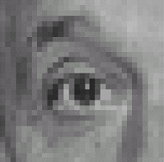
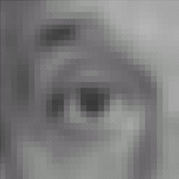

Linear filters: examples
1
1
1
=
1
1
1
1
1
1
Original
Blur (with a mean filter)
Source: D. Lowe

Slide 14
Practice with linear filters
0
0
0
?
0
1
0
0
0
0
Original
Source: D. Lowe

Slide 15
Practice with linear filters
0
0
0
0
1
0
0
0
0
Original
Filtered
(no change)
Source: D. Lowe

Slide 16
Practice with linear filters
0
0
0
?
0
0
1
0
0
0
Original
Source: D. Lowe

Slide 17
Practice with linear filters
0
0
0
0
0
1
Convolutional Filter Weights
0
0
0
0
0
0
Original
0
0
1
Shifted right
By 1 pixel
0
0
0
Sliding Mask (Correlation) Weights
Source: D. Lowe

Slide 18
Impulse response
Image
0 | 0 | 0 | 0 | 0 | 0 | 0
0 | 0 | 0 | 0 | 0 | 0 | 0
0 | 0 | 0 | 0 | 0 | 0 | 0
0 | 0 | 0 | 1 | 0 | 0 | 0
0 | 0 | 0 | 0 | 0 | 0 | 0
0 | 0 | 0 | 0 | 0 | 0 | 0
0 | 0 | 0 | 0 | 0 | 0 | 0
0 | 0 | 0 | 0 | 0
0 | 1 | 2 | 3 | 0
0 | 4 | 5 | 6 | 0
0 | 7 | 8 | 9 | 0
0 | 0 | 0 | 0 | 0
1 | 2 | 3
4 | 5 | 6
7 | 8 | 9
*
=
Convolutional
Filter
Output
The impulse response (response to a single “1” pixel at the center of an image)
should be a copy of the filter weights. True for convolution, not for correlation

Slide 19
Impulse response
Image
Convolutional
Filter
0 | 0 | 0 | 0 | 0 | 0 | 0
0 | 0 | 0 | 0 | 0 | 0 | 0
0 | 0 | 0 | 0 | 0 | 0 | 0
0 | 0 | 0 | 1 | 0 | 0 | 0
0 | 0 | 0 | 0 | 0 | 0 | 0
0 | 0 | 0 | 0 | 0 | 0 | 0
0 | 0 | 0 | 0 | 0 | 0 | 0
1 | 2 | 3
4 | 5 | 6
7 | 8 | 9
*
0 | 0 | 0 | 0 | 0
0 | 1 | 2 | 3 | 0
0 | 4 | 5 | 6 | 0
0 | 7 | 8 | 9 | 0
0 | 0 | 0 | 0 | 0
=
9 | 8 | 7
6 | 5 | 4
3 | 2 | 1
Output
Sliding (Correlation) Mask

Slide 20
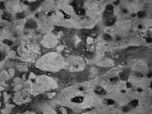
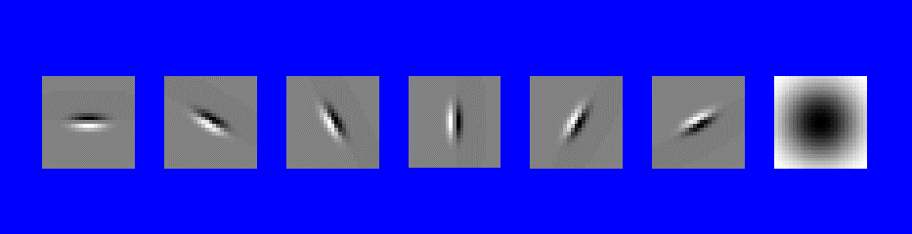
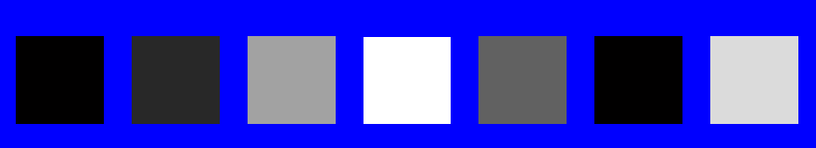
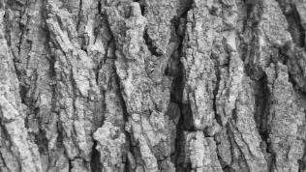

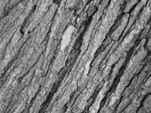

Can you match the texture to the response?
Filters
A
B
1
2
C
3
Mean abs responses
Notes:
1-B
2-C
3-A

Slide 21
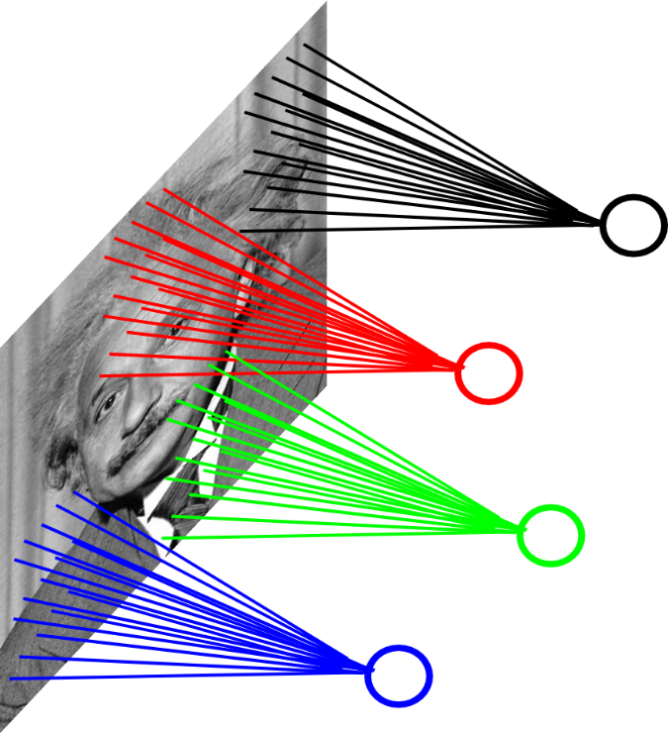
Locally Connected Layers
Example: 200x200 image
40K hidden units
Filter size: 10x10
→ 4M parameters
Note: This parameterization is good when
input image is registered (e.g., face recognition).
Ranzato

Slide 22
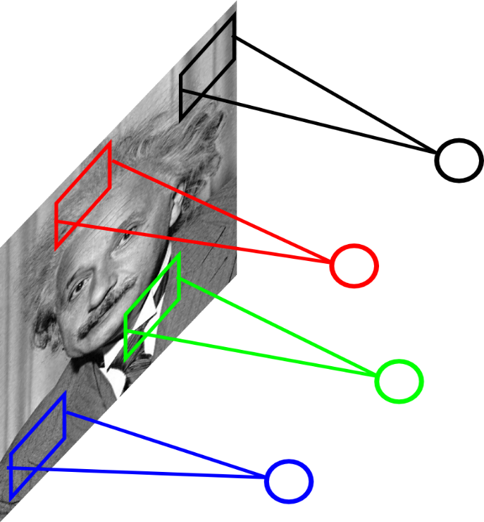
Locally Connected Layers
STATIONARITY? Statistics is similar at
different locations
Example: 200x200 image
40K hidden units
Filter size: 10x10
→ 4M parameters
Ranzato

Slide 23
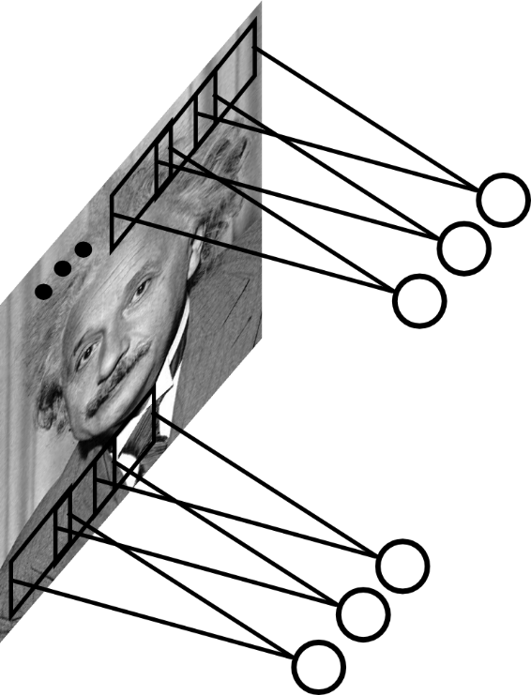
Convolutional Layer
Share the same parameters across different
locations (assuming input is stationary):
Convolutions with learned kernels
Ranzato

Slide 24
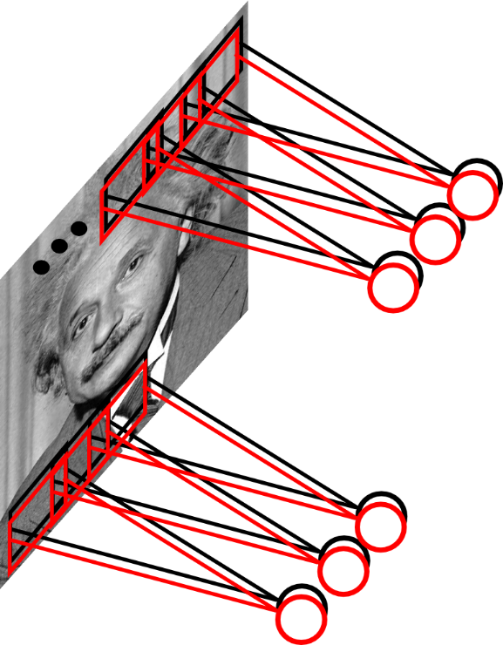
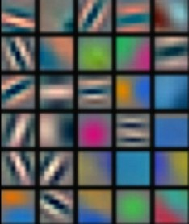
Convolutional Layer
Learn multiple filters.
E.g.: 200x200 image
100 Filters
Filter size: 10x10
10K parameters
Ranzato

Slide 25
Convolution Layer
32x32x3 image
32
height
32
width
3
Depth (color)

Slide 26
Convolution Layer
32x32x3 image
5x5x3 filter
32
Convolve the filter with the image
i.e. “slide over the image spatially, computing dot products”
32
3

Slide 27
Convolution Layer
Filters always extend to the full depth of the input volume
32x32x3 image
5x5x3 filter
32
Convolve the filter with the image
i.e. “slide over the image spatially, computing dot products”
32
3

Slide 28


Convolution Layer
32x32x3 image
5x5x3 filter
32
1 number:
the result of taking a dot product between the filter and a small 5x5x3 chunk of the image
(i.e. 5*5*3 = 75-dimensional dot product + bias)
32
3

Slide 29
Convolution Layer
activation map
32x32x3 image
5x5x3 filter
32
28
convolve (slide) over all spatial locations
32
28
3
1

Slide 30
consider a second, green filter
Convolution Layer
32x32x3 image
5x5x3 filter
activation maps
32
28
convolve (slide) over all spatial locations
32
28
3
1

Slide 31
For example, if we had 6 5x5 filters, we’ll get 6 separate activation maps:
activation maps
32
28
Convolution Layer
32
28
3
6
We stack these up to get a “new image” of size 28x28x6!

Slide 32
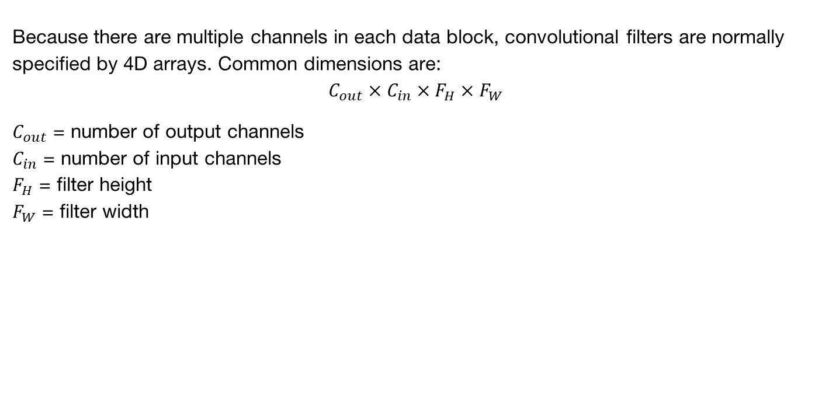
“Tensors” again
Because there are multiple channels in each data block, convolutional filters are normally specified by 4D arrays. Common dimensions are:
$$C_{out}×C_{in}×F_{H}×F_{W}$$
$C_{out}$ = number of output channels
$C_{in}$ = number of input channels
$F_{H}$ = filter height
$F_{W}$ = filter width

Slide 33
Preview: ConvNet is a sequence of Convolution Layers, interspersed with non-linear activation functions
32
28
CONV,
ReLU
e.g. 6 5x5x3 filters
32
28
3
6

Slide 34
Preview: ConvNet is a sequence of Convolution Layers, interspersed with non-linear activation functions
32
28
24
….
CONV,
ReLU
e.g. 6 5x5x3 filters
CONV,
ReLU
e.g. 10 5x5x6 filters
CONV,
ReLU
32
28
24
3
6
10

Slide 35
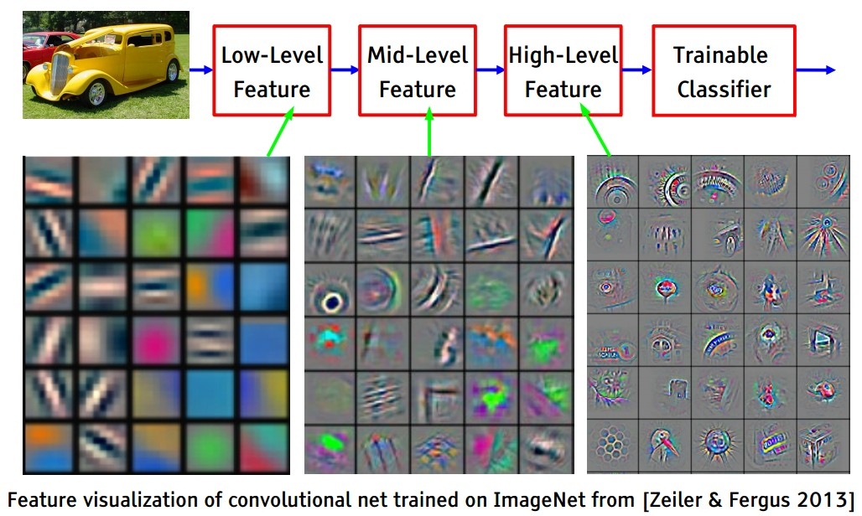
Recall

Slide 36
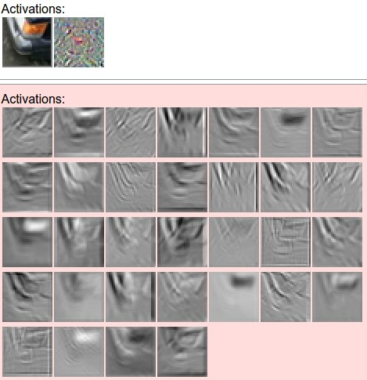
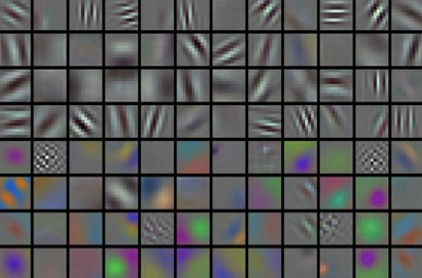
convolving the first filter in the input gives the first slice of depth in output volume

Slide 37
A closer look at spatial dimensions:
activation map
32x32x3 image
5x5x3 filter
32
28
convolve (slide) over all spatial locations
32
28
3
1

Slide 38
A closer look at spatial dimensions:
7
7x7 input (spatially)
assume 3x3 filter
7

Slide 39
A closer look at spatial dimensions:
7
7x7 input (spatially)
assume 3x3 filter
7

Slide 40
A closer look at spatial dimensions:
7
7x7 input (spatially)
assume 3x3 filter
7

Slide 41
A closer look at spatial dimensions:
7
7x7 input (spatially)
assume 3x3 filter
7

Slide 42
A closer look at spatial dimensions:
7
7x7 input (spatially)
assume 3x3 filter
=> 5x5 output
7

Slide 43
A closer look at spatial dimensions:
7
7x7 input (spatially)
assume 3x3 filter
applied with stride 2
7

Slide 44
A closer look at spatial dimensions:
7
7x7 input (spatially)
assume 3x3 filter
applied with stride 2
7

Slide 45
A closer look at spatial dimensions:
7
7x7 input (spatially)
assume 3x3 filter
applied with stride 2
=> 3x3 output!
7

Slide 46
A closer look at spatial dimensions:
7
7x7 input (spatially)
assume 3x3 filter
applied with stride 3?
7

Slide 47
A closer look at spatial dimensions:
7
7x7 input (spatially)
assume 3x3 filter
applied with stride 3?
7
doesn’t fit!
Wastes some input pixels.

Slide 48
N
Output size:
(N - F) / stride + 1
e.g. N = 7, F = 3:
stride 1 => (7 - 3)/1 + 1 = 5
stride 2 => (7 - 3)/2 + 1 = 3
stride 3 => (7 - 3)/3 + 1 = 2.33 :\
F
N
F

Slide 49
In practice: Common to zero pad the border
0 | 0 | 0 | 0 | 0 | 0
0
0
0
0
Aside: remove image mean first!
e.g. input 7x7
3x3 filter, applied with stride 1
pad with 1 pixel border => what is the output?
(recall:)
(N - F) / stride + 1

Slide 50
In practice: Common to zero pad the border
0 | 0 | 0 | 0 | 0 | 0
0
0
0
0
e.g. input 7x7
3x3 filter, applied with stride 1
pad with 1 pixel border => what is the output?
7x7 output!

Slide 51
In practice: Common to zero pad the border
0 | 0 | 0 | 0 | 0 | 0
0
0
0
0
e.g. input 7x7
3x3 filter, applied with stride 1
pad with 1 pixel border => what is the output?
7x7 output!
in general, common to see CONV layers with stride 1, filters of size FxF, and zero-padding with (F-1)/2. (will preserve size spatially)
e.g. F = 3 => zero pad with 1
F = 5 => zero pad with 2
F = 7 => zero pad with 3

Slide 52
Remember back to…
E.g. 32x32 input convolved repeatedly with 5x5 filters shrinks volumes spatially!
(32 -> 28 -> 24 ...). Shrinking too fast is not good, doesn’t work well.
32
28
24
….
CONV,
ReLU
e.g. 6 5x5x3 filters
CONV,
ReLU
e.g. 10 5x5x6 filters
CONV,
ReLU
32
28
24
3
6
10

Slide 53
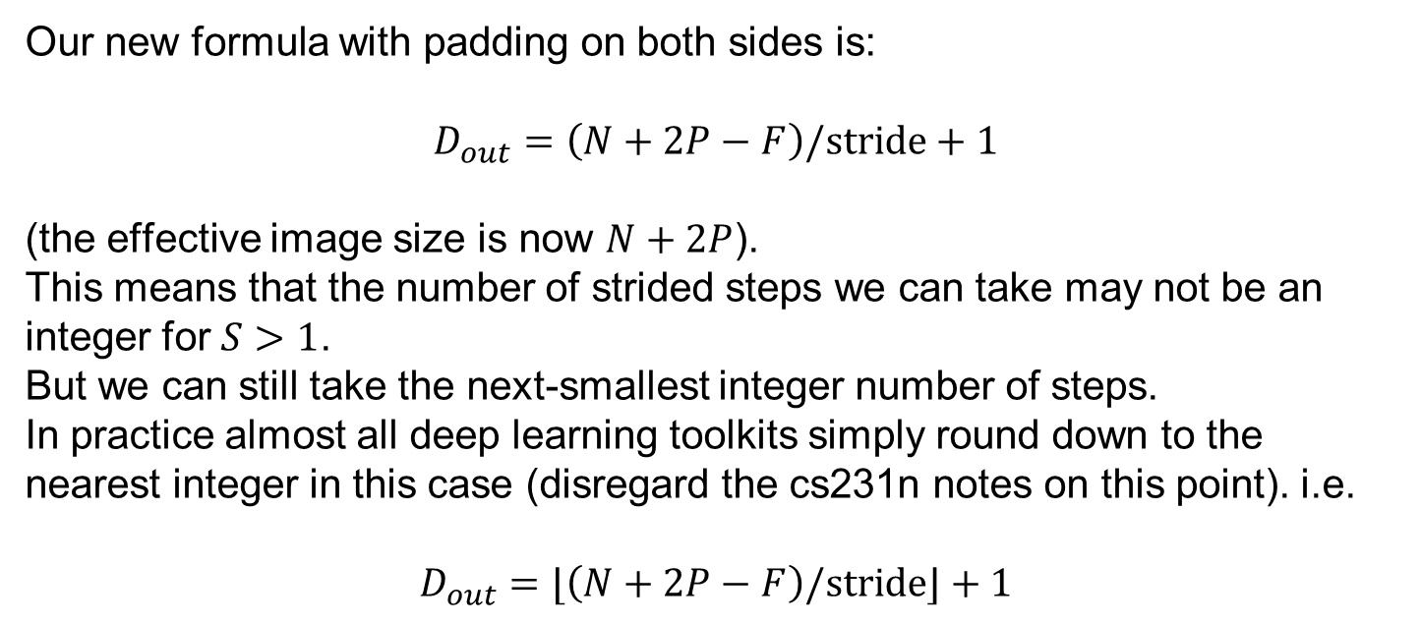
When the Filter doesn’t fit:
Our new formula with padding on both sides is:
$$D_{out}=\left(N+2P−F\right)/stride+1$$
(the effective image size is now $N+2P$).
This means that the number of strided steps we can take may not be an integer for $S>1$.
But we can still take the next-smallest integer number of steps.
In practice almost all deep learning toolkits simply round down to the nearest integer in this case (disregard the cs231n notes on this point). i.e.
$$D_{out}=⌊\left(N+2P−F\right)/stride⌋+1$$

Slide 54
Examples time:
Input volume: 32x32x3
10 5x5 filters with stride 1, pad 2
Output volume size: ?

Slide 55
Examples time:
Input volume: 32x32x3
10 5x5 filters with stride 1, pad 2
Output volume size:
(32+2*2-5)/1+1 = 32 spatially, so
32x32x10

Slide 56
Examples time:
Input volume: 32x32x3
10 5x5 filters with stride 1, pad 2
Number of parameters in this layer?

Slide 57
Examples time:
Input volume: 32x32x3
10 5x5 filters with stride 1, pad 2
Number of parameters in this layer?
each filter has 5*5*3 + 1 = 76 params (+1 for bias)
=> 76*10 = 760

Slide 58
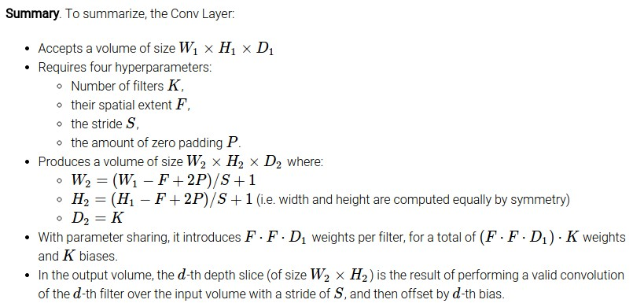

Slide 59
Common settings:
K = (powers of 2, e.g. 32, 64, 128, 512)
F = 3, S = 1, P = 1
F = 5, S = 1, P = 2
F = 5, S = 2, P = ? (whatever fits)
F = 1, S = 1, P = 0

Slide 60
(btw, 1x1 convolution layers make perfect sense)
1x1 CONV
with 32 filters
56
56
(each filter has size 1x1x64, and performs a 64-dimensional dot product)
56
56
64
32

Slide 61



(btw, 1x1 convolution layers make perfect sense)
1x1 CONV
with 32 filters
56
56
Input “fiber” $f_{in}$
Output “fiber” $f_{out}$
$f_{out}=Mf_{in}$ where $M$
is a $32×64$ matrix
56
56
64
32

Slide 62
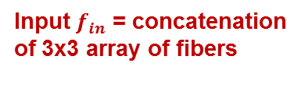

Aside: convolution via matrix multiply: im2col
1x1 CONV
with 32 filters
56
56
Output “fiber” $f_{out}$
$f_{out}=Mf_{in}$ where $M$
is a $32×(64×9)$ matrix
Input $f_{in}$ = concatenation
of 3x3 array of fibers
56
56
64
32

Slide 63
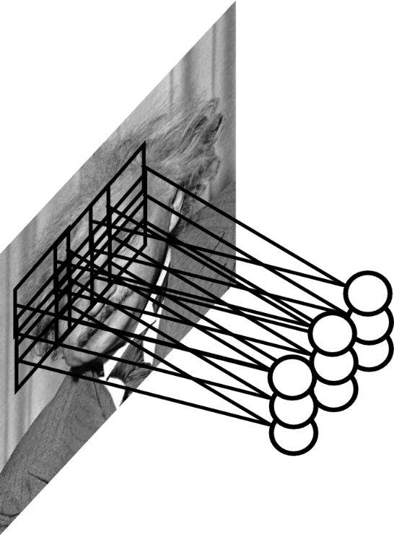
Pooling Layer
Let us assume filter is an “eye” detector.
Q.: how can we make the detection robust to the
exact location of the eye?
Ranzato

Slide 64
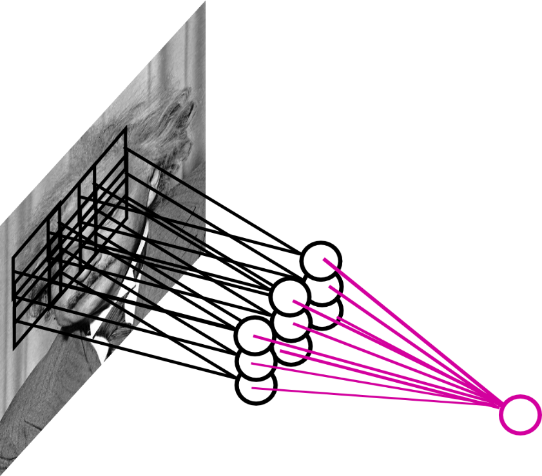
Pooling Layer
By “pooling” (e.g., taking max) filter
responses at different locations we gain
robustness to the exact spatial location
of features.
Ranzato

Slide 65
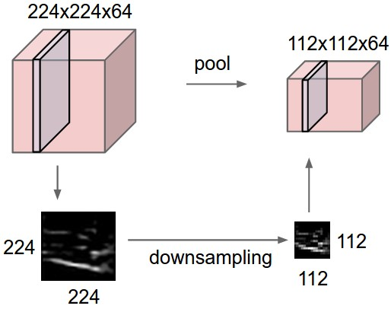
Pooling layer
makes the representations smaller and more manageable
operates over each activation map independently:

Slide 66
MAX POOLING
Single depth slice
1 | 1 | 2 | 4
5 | 6 | 7 | 8
3 | 2 | 1 | 0
1 | 2 | 3 | 4
x
max pool with 2x2 filters and stride 2
6 | 8
3 | 4
y

Slide 67
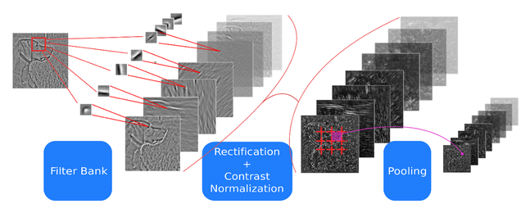
ConvNets: Typical Stage
One stage (zoom)
Convol.
Pooling
courtesy of
K. Kavukcuoglu
Ranzato

Slide 68
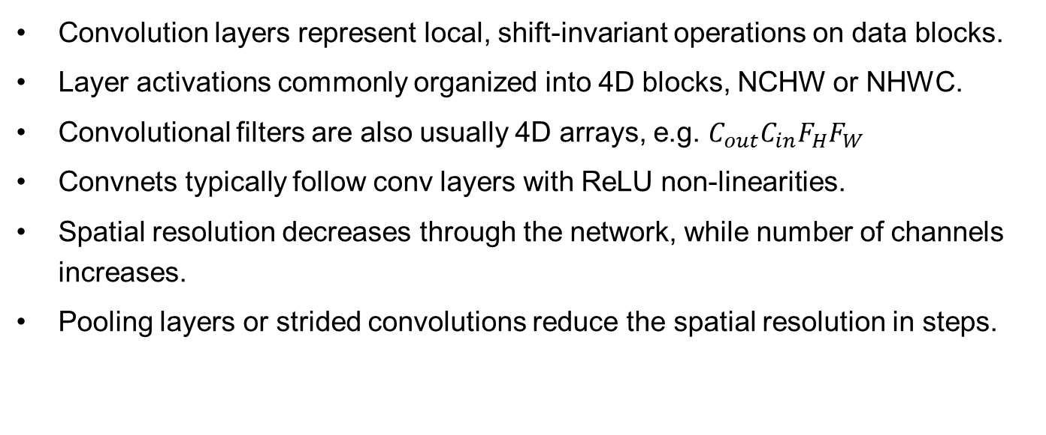
Convnets Summary
Convolution layers represent local, shift-invariant operations on data blocks.
Layer activations commonly organized into 4D blocks, NCHW or NHWC.
Convolutional filters are also usually 4D arrays, e.g. $C_{out}C_{in}F_{H}F_{W}$
Convnets typically follow conv layers with ReLU non-linearities.
Spatial resolution decreases through the network, while number of channels increases.
Pooling layers or strided convolutions reduce the spatial resolution in steps.

