Slide 1
Cloud computing

Slide 2
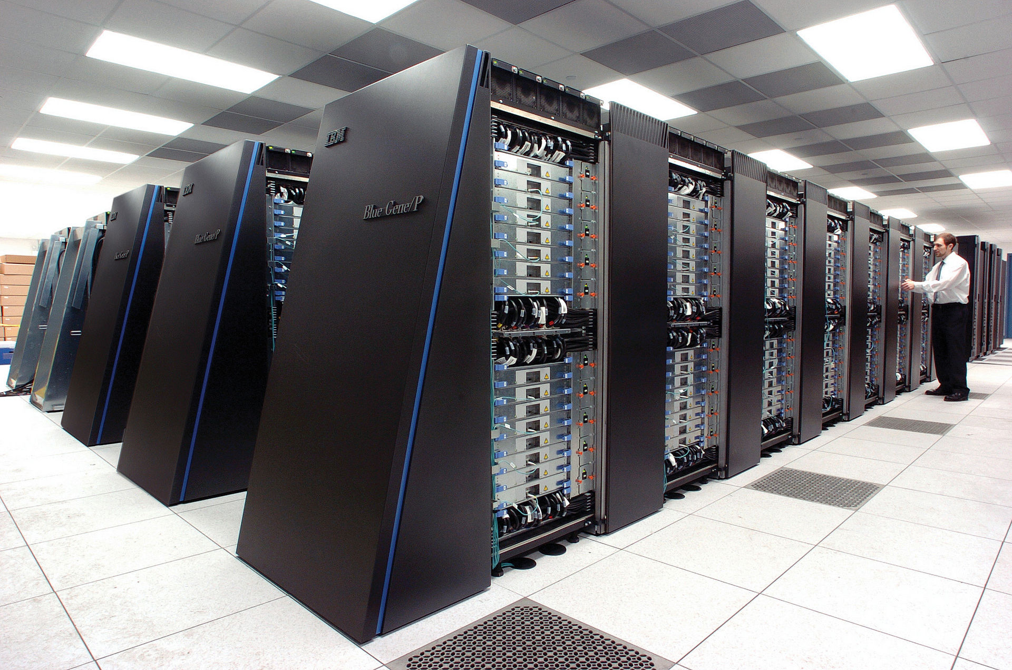
Supercomputers
Supercomputers are tightly integrated computer systems, dedicated to running a specialized task
  Quantum mechanics
  Weather forecasting / climate research
  Oil / gas exploration
  Physical simulations etc.
Modern supercomputers are massively parallel
  Eg. IBM BlueGene/P at Argonne National Lab: 250,000 processors, interconnected by high speed optical networks
  Custom interconnects, specialized network, specialized processors
TOP 500 https://en.wikipedia.org/wiki/TOP500
  Performance measured by PetaFLOPS (10^15) floating point operations per second

Slide 3
Computing outside the scientific computing field – Enterprise computing
Most companies don’t need supercomputers, because they don’t solve single tasks with high computational needs
Instead, they need to solve many individual computing problems
  Interactions happen at the level of shared storage (eg. shared databases) not at the level of shared memory.
The challenge of IT managers at companies is:
  How do we satisfy the computing needs of various parts of the business?
    Computational power
    Storage requirements
    Networking requirements

Slide 4
Enterprise computing requirements
How reliable is the infrastructure?
  Downtime?
  Loss of data?
Cost of the infrastructure?
  How much it costs to build?
  How much it costs to maintain?
How quickly it can adapt to changing requirements?

Slide 5
Reliability
Downtime
  Downtime is usually not catastrophic, but it can provide major problems
    E-commerce systems
    Air traffic control
    Medical systems
    Defense
Data loss
  Almost always catastrophic…
Example: Amazon S3 data service
  S3 guarantees 99.9% monthly uptime service-level agreement (SLA),that is, not more than 43 minutes of downtime per month.
  S3 is designed to provide 99.999999999% durability and 99.99% availability of objects over a given year, though there is no service-level agreement for durability.
It is not easy to achieve these numbers!

Slide 6
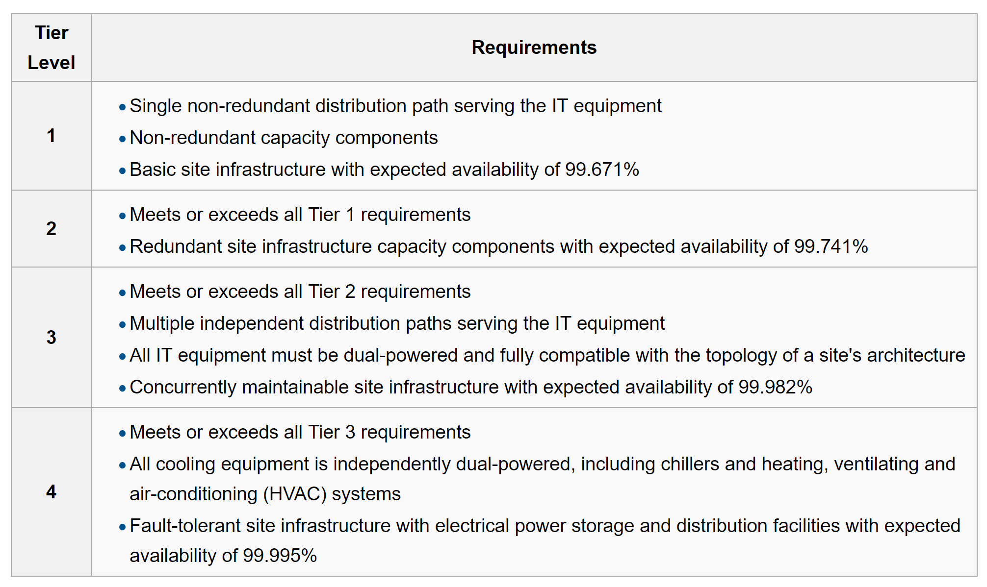
Reliability tiers
Telecommunication Industry Association levels

Slide 7
Components of a data center, from bottom up

Slide 8
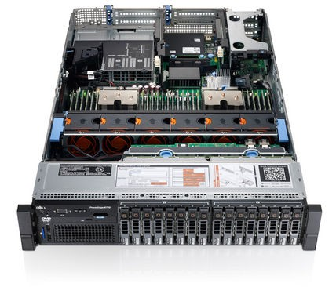
Server computer
Server computers: architecturally similar to a desktop computer
Strip away the unnecessary parts
  No graphics card, keyboard etc.
Individual computers normally managed by logging in using ssh
Standardized size in Rack Units
  Rack unit 1.752 inches
  Can be 1U, 2U, 3U high etc. (the one on the left is 2U)
    Many modern systems are 1U..
  Standard width: 19 inches
Blade servers: computers smaller than 1U, can achieve higher computing densities per rack

Slide 9
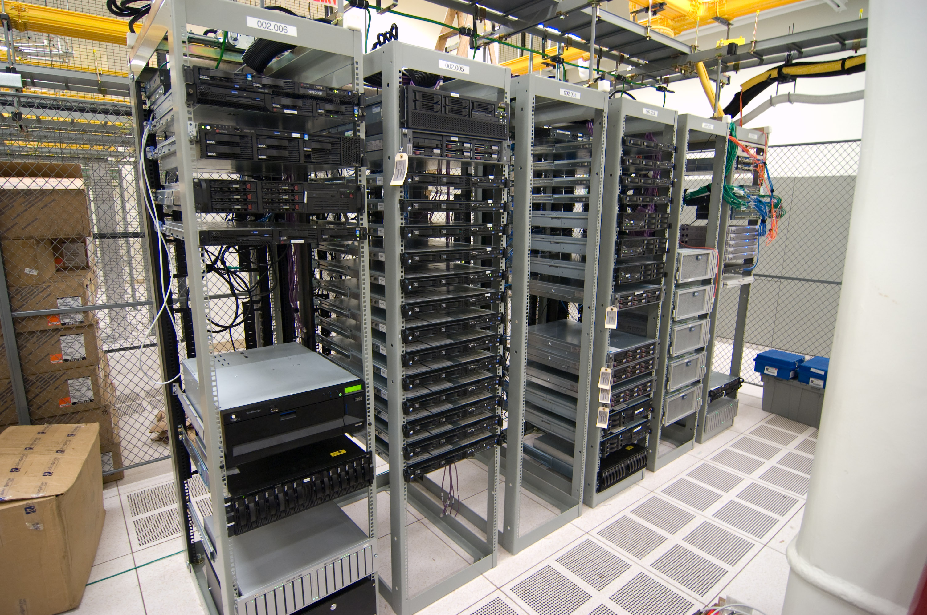
Server rack
Standard height 42U
Cables run in the back
As long as you are just running several individual servers on the rack, ad hoc arrangements are possible.
What if you need to run 2 million servers?

Slide 10
Google data center video
https://www.youtube.com/watch?v=XZmGGAbHqa0

Slide 11
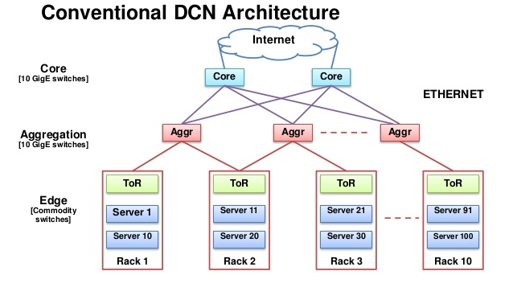
How do you wire it together? Data center network architecture

Slide 12
How quickly you can scale up and down?
How to satisfy the need for new compute capacity
  Identify the needs (CPU, memory, storage, bandwidth)
  Order server / software / etc.
  Install server in appropriate rack
  Set up networking hardware
  Configure the system
  Install operating system and software packages
  Set up backup
It can take weeks!
Several problems (from the many):
  What if I don’t have empty slots on racks, network capacity?
  What if I over-estimated the needs? (computer mostly empty)
  What if I under-estimated the needs?
  Maintenance down the line just as bad…

Slide 13
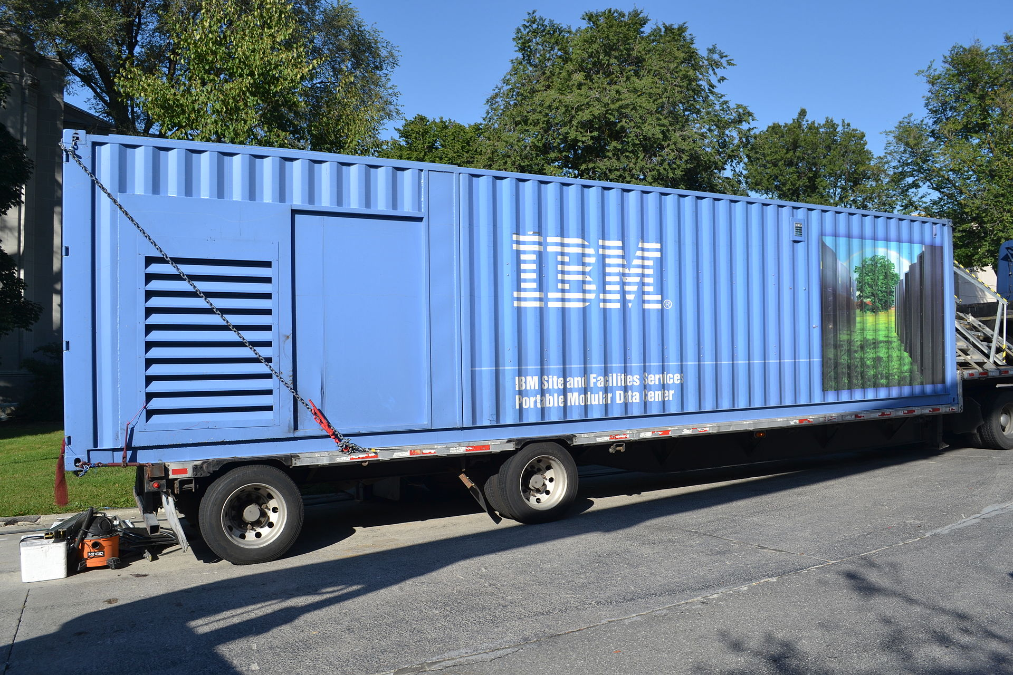
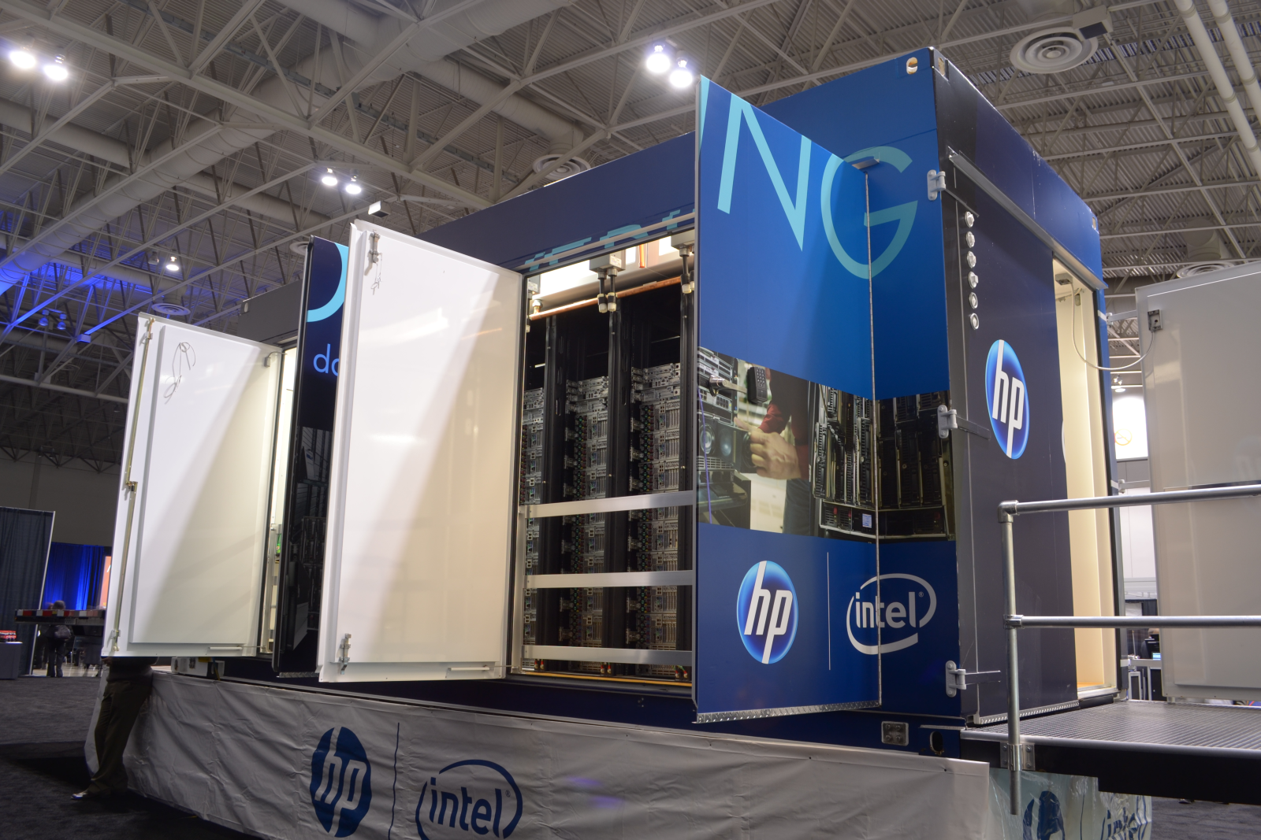
Portable modular data centers
Installing, configuring individual servers one by one is a major maintenance problem.
One solution: buy entire data centers pre-configured
Example: containerized data centers
  Fits data center equipment (servers, storage and networking equipment) into a standard shipping container, which is then transported to a desired location
  Come outfitted with their own cooling systems
  You only need to provide electricity and network pipe.
  They can come with preinstalled software, preconfigured networks etc.

Slide 14
Challenges in enterprise computing
Dynamical need to scale up
Dynamical need to scale down
Difficulty to estimate the needs going forward
  How much computing capacity we need?
  Depends on success and fads
Extreme requirements of
  Uptime
  Data safety
Very high cost of computer technicians who can maintain systems of such complexity
  Mistakes can be very expensive
Cloud computing promises solutions to all these.

Slide 15
What is Cloud Computing
Cloud Computing is a general term used to describe a new class of network based computing that takes place over the Internet,
  a collection/group of integrated and networked hardware, software and Internet infrastructure (called a platform).
  using the Internet for communication and transport provides hardware, software and networking services to clients
These platforms hide the complexity and details of the underlying infrastructure from users and applications by providing very simple graphical interface or API (Applications Programming Interface).

Slide 16
What is cloud computing, cont’d
In addition, the platform provides on demand services, that are always on, anywhere, anytime and any place.
Pay for use and as needed, elastic
  scale up and down in capacity and functionalities
The hardware and software services are available to
  general public, enterprises, corporations and businesses markets

Slide 17
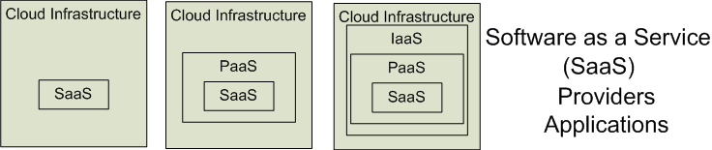

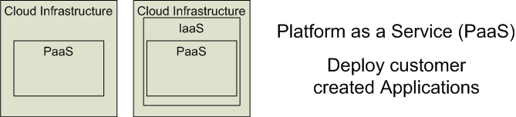

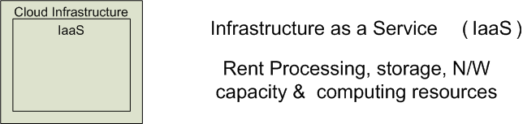


Cloud Service Models
Software as a Service (SaaS)
Platform as a Service (PaaS)
Infrastructure as a Service (IaaS)
SalesForce CRM
LotusLive
Google App Engine
Adopted from: Effectively and Securely Using the Cloud Computing Paradigm by peter Mell, Tim Grance
Notes:
IaaSdelivers computer infrastructure, typically a platform virtualization environment, as a service. Rather than purchasing servers, software, data center space or network equipment, clients instead buy those resources as a fully outsourced service.
PaaSdeliver a computing platform where the developers can develop their own applications.
SaaSis a model of software deployment where the software applications are provided to the customers as a service.

Slide 18
Public cloud / private cloud / hybrid cloud
Public cloud:
  A company owning the resources provide cloud services to external companies or individuals
  Normally, metered and paid by the hour
  Examples: Amazon AWS, Google Cloud Platform, Microsoft Azure
Private cloud
  A company that owns a datacenter, provides cloud-type access to its employees or subdivisions
Hybrid cloud
  Mixed use of private and public cloud resources
  For instance, spill over of computational resources from the local datacenter to the public cloud

Slide 19
Basic Cloud Characteristics
The “no-need-to-know” in terms of the underlying details of infrastructure, applications interface with the infrastructure via the APIs.
The “flexibility and elasticity” allows these systems to scale up and down at will
  utilising the resources of all kinds
    CPU, storage, server capacity, load balancing, and databases
The “pay as much as used and needed” type of utility computing and the “always on!, anywhere and any place” type of network-based computing.

Slide 20
Basic Cloud Characteristics
Cloud are transparent to users and applications, they can be built in multiple ways
  branded products, proprietary open source, hardware or software, or just off-the-shelf PCs.
In general, they are built on clusters of PC servers and off-the-shelf components plus Open Source software combined with in-house applications and/or system software.

Slide 21
Software as a Service (SaaS)
SaaS is a model of software deployment where an application is hosted as a service provided to customers across the Internet.
Saas alleviates the burden of software maintenance/support
  but users relinquish control over software versions and requirements.
Terms that are used in this sphere include
  Platform as a Service (PaaS) and
  Infrastructure as a Service (IaaS)

Slide 22
Virtualization
Virtual workspaces:
  An abstraction of an execution environment that can be made dynamically available to authorized clients by using well-defined protocols,
  Resource quota (e.g. CPU, memory share),
  Software configuration (e.g. O/S, provided services).
Implement on Virtual Machines (VMs):
  Abstraction of a physical host machine,
  Hypervisor intercepts and emulates instructions from VMs, and allows management of VMs,
  VMWare, Xen, etc.
Provide infrastructure API:
  Plug-ins to hardware/support structures
App
App
App
OS
OS
OS
Hypervisor
Hardware
Virtualized Stack

Slide 23
Virtual Machines
VM technology allows multiple virtual machines to run on a single physical machine.
App
App
App
App
App
Xen
Guest OS
(Linux)
Guest OS
(NetBSD)
Guest OS
(Windows)
VMWare
VM
VM
VM
Virtual Machine Monitor (VMM) / Hypervisor
UML
Denali
Hardware
etc.
Performance: Para-virtualization (e.g. Xen) is very close to raw physical performance!

Slide 24
Virtualization in General
Advantages of virtual machines:
  Run operating systems where the physical hardware is unavailable,
  Easier to create new machines, backup machines, etc.,
  Software testing using “clean” installs of operating systems and software,
  Emulate more machines than are physically available,
  Timeshare lightly loaded systems on one host,
  Debug problems (suspend and resume the problem machine),
  Easy migration of virtual machines (shutdown needed or not).
  Run legacy systems!

Slide 25
What is the purpose and benefits?
Cloud computing enables companies and applications, which are system infrastructure dependent, to be infrastructure-less.
By using the Cloud infrastructure on “pay as used and on demand”, all of us can save in capital and operational investment!
Clients can:
  Put their data on the platform instead of on their own desktop PCs and/or on their own servers.
  They can put their applications on the cloud and use the servers within the cloud to do processing and data manipulations etc.

Slide 26
Cloud-Sourcing
Why is it becoming a Big Deal:
  Using high-scale/low-cost providers,
  Any time/place access via web browser,
  Rapid scalability; incremental cost and load sharing,
  Can forget need to focus on local IT.
Concerns:
  Performance, reliability, and SLAs,
  Control of data, and service parameters,
  Application features and choices,
  Interaction between Cloud providers,
  No standard API – mix of SOAP and REST!
  Privacy, security, compliance, trust…

Slide 27
Cloud Storage
Several large Web companies are now exploiting the fact that they have data storage capacity that can be hired out to others.
  allows data stored remotely to be temporarily cached on desktop computers, mobile phones or other Internet-linked devices.
Amazon’s Elastic Compute Cloud (EC2) and Simple Storage Solution (S3) are well known examples
  Mechanical Turk

Slide 28
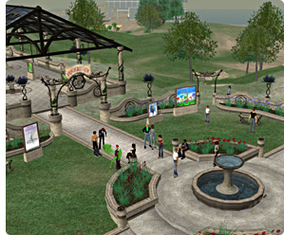
Amazon Simple Storage Service (S3)
Unlimited Storage.
Pay for what you use:
  $0.20 per GByte of data transferred,
  $0.15 per GByte-Month for storage used,
  Second Life Update:
    1TBytes, 40,000 downloads in 24 hours - $200,

Slide 29
Utility Computing – EC2
Amazon Elastic Compute Cloud (EC2):
  Elastic, marshal 1 to 100+ PCs via WS,
  Machine Specs…,
  Fairly cheap!
Powered by Xen – a Virtual Machine:
  Different from Vmware and VPC as uses “para-virtualization” where the guest OS is modified to use special hyper-calls:
  Hardware contributions by Intel (VT-x/Vanderpool) and AMD (AMD-V).
  Supports “Live Migration” of a virtual machine between hosts.
Linux, Windows, OpenSolaris
Management Console/AP

Slide 30
EC2 – The Basics
Load your image onto S3 and register it.
Boot your image from the Web Service.
Open up required ports for your image.
Connect to your image through SSH.
Execute you application…

Slide 31
Opportunities and Challenges
The use of the cloud provides a number of opportunities:
  It enables services to be used without any understanding of their infrastructure.
  Cloud computing works using economies of scale:
    It potentially lowers the outlay expense for start up companies, as they would no longer need to buy their own software or servers.
    Cost would be by on-demand pricing.
    Vendors and Service providers claim costs by establishing an ongoing revenue stream.
  Data and services are stored remotely but accessible from “anywhere”.

Slide 32
Opportunities and Challenges
In parallel there has been backlash against cloud computing:
  Use of cloud computing means dependence on others and that could possibly limit flexibility and innovation:
    The others are likely become the bigger Internet companies like Google and IBM, who may monopolise the market.
    Some argue that this use of supercomputers is a return to the time of mainframe computing that the PC was a reaction against.
  Security could prove to be a big issue:
    It is still unclear how safe out-sourced data is and when using these services ownership of data is not always clear.
  There are also issues relating to policy and access:
    If your data is stored abroad whose policy do you adhere to?
    What happens if the remote server goes down?
    How will you then access files?
    There have been cases of users being locked out of accounts and losing access to data.
Notes:
Freedom of Information == FOI

Slide 33
Advantages of Cloud Computing
Lower computer costs:
  You do not need a high-powered and high-priced computer to run cloud computing's web-based applications.
  Since applications run in the cloud, not on the desktop PC, your desktop PC does not need the processing power or hard disk space demanded by traditional desktop software.
  When you are using web-based applications, your PC can be less expensive, with a smaller hard disk, less memory, more efficient processor...
  In fact, your PC in this scenario does not even need a CD or DVD drive, as no software programs have to be loaded and no document files need to be saved.

Slide 34
Advantages of Cloud Computing
Improved performance:
  With few large programs hogging your computer's memory, you will see better performance from your PC.
  Computers in a cloud computing system boot and run faster because they have fewer programs and processes loaded into memory…
Reduced software costs:
  Instead of purchasing expensive software applications, you can get most of what you need for free-ish!
    most cloud computing applications today, such as the Google Docs suite.
  better than paying for similar commercial software
    which alone may be justification for switching to cloud applications.

Slide 35
Advantages of Cloud Computing
Instant software updates:
  Another advantage to cloud computing is that you are no longer faced with choosing between obsolete software and high upgrade costs.
  When the application is web-based, updates happen automatically
    available the next time you log into the cloud.
  When you access a web-based application, you get the latest version
    without needing to pay for or download an upgrade.
Improved document format compatibility.
  You do not have to worry about the documents you create on your machine being compatible with other users' applications or OSes
  There are potentially no format incompatibilities when everyone is sharing documents and applications in the cloud.

Slide 36
Advantages of Cloud Computing
Unlimited storage capacity:
  Cloud computing offers virtually limitless storage.
  Your computer's current 1 Tbyte hard drive is small compared to the hundreds of Pbytes available in the cloud.
Increased data reliability:
  Unlike desktop computing, in which if a hard disk crashes and destroy all your valuable data, a computer crashing in the cloud should not affect the storage of your data.
    if your personal computer crashes, all your data is still out there in the cloud, still accessible
  In a world where few individual desktop PC users back up their data on a regular basis, cloud computing is a data-safe computing platform!

Slide 37
Advantages of Cloud Computing
Universal document access:
  That is not a problem with cloud computing, because you do not take your documents with you.
  Instead, they stay in the cloud, and you can access them whenever you have a computer and an Internet connection
  Documents are instantly available from wherever you are
Latest version availability:
  When you edit a document at home, that edited version is what you see when you access the document at work.
  The cloud always hosts the latest version of your documents
    as long as you are connected, you are not in danger of having an outdated version

Slide 38
Advantages of Cloud Computing
Easier group collaboration:
  Sharing documents leads directly to better collaboration.
  Many users do this as it is an important advantages of cloud computing
    multiple users can collaborate easily on documents and projects
Device independence.
  You are no longer tethered to a single computer or network.
  Changes to computers, applications and documents follow you through the cloud.
  Move to a portable device, and your applications and documents are still available.

Slide 39
Disadvantages of Cloud Computing
Requires a constant Internet connection:
  Cloud computing is impossible if you cannot connect to the Internet.
  Since you use the Internet to connect to both your applications and documents, if you do not have an Internet connection you cannot access anything, even your own documents.
  A dead Internet connection means no work and in areas where Internet connections are few or inherently unreliable, this could be a deal-breaker.

Slide 40
Disadvantages of Cloud Computing
Does not work well with low-speed connections:
  Similarly, a low-speed Internet connection, such as that found with dial-up services, makes cloud computing painful at best and often impossible.
  Web-based applications require a lot of bandwidth to download, as do large documents.
Features might be limited:
  This situation is bound to change, but today many web-based applications simply are not as full-featured as their desktop-based applications.
    For example, you can do a lot more with Microsoft PowerPoint than with Google Presentation's web-based offering

Slide 41
Disadvantages of Cloud Computing
Can be slow:
  Even with a fast connection, web-based applications can sometimes be slower than accessing a similar software program on your desktop PC.
  Everything about the program, from the interface to the current document, has to be sent back and forth from your computer to the computers in the cloud.
  If the cloud servers happen to be backed up at that moment, or if the Internet is having a slow day, you would not get the instantaneous access you might expect from desktop applications.

Slide 42
Disadvantages of Cloud Computing
Stored data might not be secure:
  With cloud computing, all your data is stored on the cloud.
    The questions is How secure is the cloud?
  Can unauthorised users gain access to your confidential data?
Stored data can be lost:
  Theoretically, data stored in the cloud is safe, replicated across multiple machines.
  But on the off chance that your data goes missing, you have no physical or local backup.
    Put simply, relying on the cloud puts you at risk if the cloud lets you down.

Slide 43
Disadvantages of Cloud Computing
HPC Systems:
  Not clear that you can run compute-intensive HPC applications that use MPI/OpenMP!
  Scheduling is important with this type of application
    as you want all the VM to be co-located to minimize communication latency!
General Concerns:
  Each cloud systems uses different protocols and different APIs
    may not be possible to run applications between cloud based systems
  Amazon has created its own DB system (not SQL 92), and workflow system (many popular workflow systems out there)
    so your normal applications will have to be adapted to execute on these platforms.

