Slide 1
Computer Architecture
A Quantitative Approach, Fifth Edition
Chapter 4
Data-Level Parallelism in Vector, SIMD, and GPU Architectures

Slide 2
Introduction
Introduction
SIMD: single instruction multiple data
MIMD: multiple instruction multiple data
SIMD architectures can exploit significant data-level parallelism for:
  matrix-oriented scientific computing
  media-oriented image and sound processors
SIMD is more energy efficient than MIMD
  Only needs to fetch one instruction per data operation
  Makes SIMD attractive for personal mobile devices
SIMD allows programmer to continue to think sequentially

Slide 3
SIMD Parallelism
Introduction
Vector architectures
SIMD extensions
Graphics Processor Units (GPUs)
For x86 processors:
  Expect two additional cores per chip per year
  SIMD width to double every four years
  Potential speedup from SIMD to be twice that from MIMD!

Slide 4
VECTOR ARCHITECTURES

Slide 5
Vector Architectures
Vector Architectures
Basic idea:
  Read sets of data elements into “vector registers”
  Operate on those registers
  Disperse the results back into memory
Registers are controlled by compiler
  Used to hide memory latency
  Leverage memory bandwidth

Slide 6
VMIPS
Vector Architectures
Example (fictional) architecture: VMIPS
  Loosely based on Cray-1
  Vector registers
    Each register holds a 64-element, 64 bits/element vector
    Register file has 16 read ports and 8 write ports
  Vector functional units
    Fully pipelined
    Data and control hazards are detected
  Vector load-store unit
    Fully pipelined
    One word per clock cycle after initial latency
  Scalar registers
    32 general-purpose registers
    32 floating-point registers

Slide 7
VMIPS Instructions
Vector Architectures
ADDVV.D: add two vectors
ADDVS.D: add vector to a scalar
LV/SV: vector load and vector store from address
Example: DAXPY (Y = a * X + Y)
  L.D F0,a ; load scalar a
  LV V1,Rx ; load vector X
  MULVS.D V2,V1,F0 ; vector-scalar multiply
  LV V3,Ry ; load vector Y
  ADDVV V4,V2,V3 ; add
  SV Ry,V4 ; store the result
Requires 6 instructions vs. almost 600 for MIPS

Slide 8
Vector Execution Time
Vector Architectures
Execution time depends on three factors:
  Length of operand vectors
  Structural hazards
  Data dependencies
VMIPS functional units consume one element per clock cycle
  Execution time is approximately the vector length

Slide 9
Challenges
Vector Architectures
Start up time
  Latency of vector functional unit
  Assume the same as Cray-1
    Floating-point add => 6 clock cycles
    Floating-point multiply => 7 clock cycles
    Floating-point divide => 20 clock cycles
    Vector load => 12 clock cycles
Improvements:
  > 1 element per clock cycle
  Non-64 wide vectors
  IF statements in vector code
  Memory system optimizations to support vector processors
  Multiple dimensional matrices
  Sparse matrices
  Programming a vector computer

Slide 10
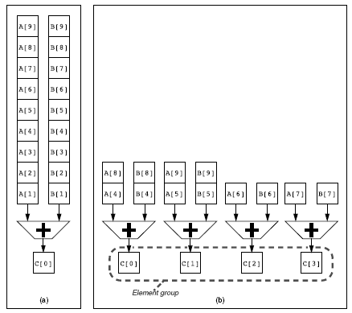
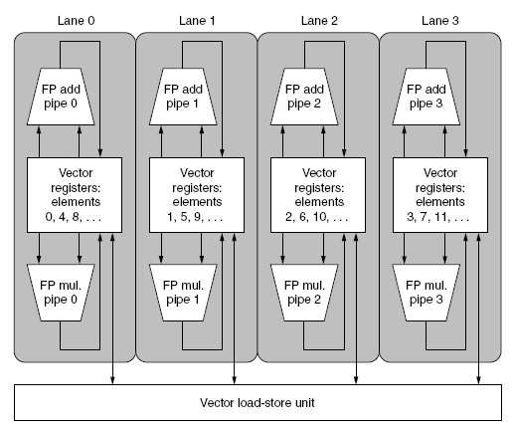
Multiple Lanes
Vector Architectures
Element n of vector register A is “hardwired” to element n of vector register B
  Allows for multiple hardware lanes

Slide 11
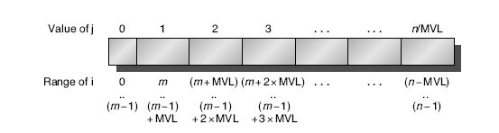
Vector Length Register
Vector Architectures
Vector length not known at compile time?
Use Vector Length Register (VLR)
Use strip mining for vectors over the maximum length:
  low = 0;
  VL = (n % MVL); /*find odd-size piece using modulo op % */
  for (j = 0; j <= (n/MVL); j=j+1) { /*outer loop*/
  for (i = low; i < (low+VL); i=i+1) /*runs for length VL*/
  Y[i] = a * X[i] + Y[i] ; /*main operation*/
  low = low + VL; /*start of next vector*/
  VL = MVL; /*reset the length to maximum vector length*/
  }

Slide 12
Vector Mask Registers
Vector Architectures
Consider:
for (i = 0; i < 64; i=i+1)
if (X[i] != 0)
X[i] = X[i] – Y[i];
Use vector mask register to “disable” elements:
LV V1,Rx ;load vector X into V1
LV V2,Ry ;load vector Y
L.D F0,#0 ;load FP zero into F0
SNEVS.D V1,F0 ;sets VM(i) to 1 if V1(i)!=F0
SUBVV.D V1,V1,V2 ;subtract under vector mask
SV Rx,V1 ;store the result in X
GFLOPS rate decreases!

Slide 13
Memory Banks
Vector Architectures
Memory system must be designed to support high bandwidth for vector loads and stores
Spread accesses across multiple banks
  Control bank addresses independently
  Load or store non sequential words
  Support multiple vector processors sharing the same memory
Example:
  32 processors, each generating 4 loads and 2 stores/cycle
  Processor cycle time is 2.167 ns, SRAM cycle time is 15 ns
  How many memory banks needed?

Slide 14
Stride: handling multidimensional arrays
Vector Architectures
Consider:
for (i = 0; i < 100; i=i+1)
for (j = 0; j < 100; j=j+1) {
A[i][j] = 0.0;
for (k = 0; k < 100; k=k+1)
A[i][j] = A[i][j] + B[i][k] * D[k][j];
}
Must vectorize multiplication of rows of B with columns of D
Use non-unit stride
  Loading: load non-consecutive memory locations in consecutive vector register locations
  Saving…
  Complicates the memory system

Slide 15
Scatter-Gather: handling sparse matrices
Vector Architectures
In sparse matrices, the elements of the vector are stored in some compacted form and accessed indirectly.
Consider:
for (i = 0; i < n; i=i+1)
A[K[i]] = A[K[i]] + C[M[i]];
Use index vector which indicates the non-zero elements of the vector, and allows to load them
LV Vk, Rk ;load K
LVI Va, (Ra+Vk) ;load A[K[]]
LV Vm, Rm ;load M
LVI Vc, (Rc+Vm) ;load C[M[]]
ADDVV.D Va, Va, Vc ;add them
SVI (Ra+Vk), Va ;store A[K[]]

Slide 16
sIMD EXTENSIONS

Slide 17
SIMD Extensions
Media applications operate on data types narrower than the native word size
  Example: disconnect carry chains to “partition” adder
Limitations, compared to vector instructions:
  Number of data operands encoded into op code
  No sophisticated addressing modes (strided, scatter-gather)
  No mask registers
SIMD Instruction Set Extensions for Multimedia

Slide 18
SIMD Implementations
Implementations:
  Intel MMX (1996)
    Eight 8-bit integer ops or four 16-bit integer ops
  Streaming SIMD Extensions (SSE) (1999)
    Eight 16-bit integer ops
    Four 32-bit integer/fp ops or two 64-bit integer/fp ops
  Advanced Vector Extensions (2010)
    Four 64-bit integer/fp ops
  Operands must be consecutive and aligned memory locations
SIMD Instruction Set Extensions for Multimedia

Slide 19
Example SIMD Code
Example DXPY:
L.D F0,a ;load scalar a
MOV F1, F0 ;copy a into F1 for SIMD MUL
MOV F2, F0 ;copy a into F2 for SIMD MUL
MOV F3, F0 ;copy a into F3 for SIMD MUL
DADDIU R4,Rx,#512 ;last address to load
Loop: L.4D F4,0[Rx] ;load X[i], X[i+1], X[i+2], X[i+3]
MUL.4D F4,F4,F0 ;a×X[i],a×X[i+1],a×X[i+2],a×X[i+3]
L.4D F8,0[Ry] ;load Y[i], Y[i+1], Y[i+2], Y[i+3]
ADD.4D F8,F8,F4 ;a×X[i]+Y[i], ..., a×X[i+3]+Y[i+3]
S.4D 0[Ry],F8 ;store into Y[i], Y[i+1], Y[i+2], Y[i+3]
DADDIU Rx,Rx,#32 ;increment index to X
DADDIU Ry,Ry,#32 ;increment index to Y
DSUBU R20,R4,Rx ;compute bound
BNEZ R20,Loop ;check if done
SIMD Instruction Set Extensions for Multimedia

Slide 20
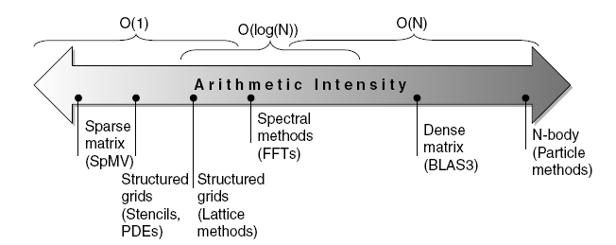
Roofline Performance Model
Basic idea:
  Plot peak floating-point throughput as a function of arithmetic intensity
  Ties together floating-point performance and memory performance for a target machine
Arithmetic intensity
  Floating-point operations per byte read
SIMD Instruction Set Extensions for Multimedia

Slide 21
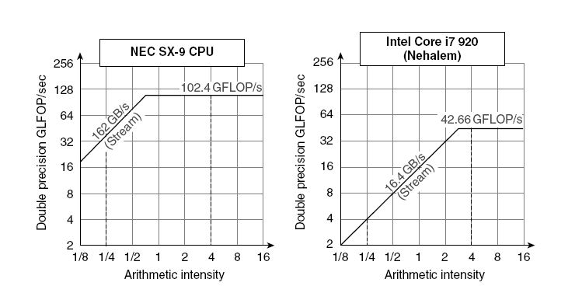
Examples
Attainable GFLOPs/sec Min = (Peak Memory BW × Arithmetic Intensity, Peak Floating Point Perf.)
  The vector computer NEC SX-9 (millions of dollars) can achieve a higher performance even for “low arithmetic intensity” problems.
SIMD Instruction Set Extensions for Multimedia

Slide 22
GPUs

Slide 23
Graphical Processing Units
Given the hardware invested to do graphics well, how can be supplement it to improve performance of a wider range of applications?
Graphical Processing Units

Slide 24
Vendors and frameworks
CUDA architecture (proprietary for NVidia)
  Compute Unified Device Architecture
OpenCL (AMD, Intel, ARM)

Slide 25
From the user’s perspective (on CUDA)
Drop in a GPU-accelerated library to replace or augment CPU-only libraries such as MKL BLAS, IPP, FFTW and other widely-used libraries
Automatically parallelize loops in Fortran or C code using OpenACC directives for accelerators
Develop custom parallel algorithms and libraries using a familiar programming language such as C, C++, C#, Fortran, Java, Python, etc.

Slide 26
Parallelism in CUDA
Host: the main computer
  __host__ functions
Device: the GPU
  __device__ or __global__ functions
CUDA Thread
  Unifies multiple forms of parallelism (multi-threading, MIMD, SIMD, instruction-level parallelism)
Writing C functions that run on the GPU:
  Name<<<dimGrid, dimBlock>>>(…parameter list…)

Slide 27
Example in C (CUDA)
#define N (2048*2048)
#define THREADS_PER_BLOCK 512
int main()
{
int *a, *b, *c;
int *d_a, *d_b, *d_c;
int size = N * sizeof( int );
/* allocate space for device copies of a, b, c */
cudaMalloc( (void **) &d_a, size );
cudaMalloc( (void **) &d_b, size );
cudaMalloc( (void **) &d_c, size );
/* allocate space for host copies of a, b, c and setup input values */
a = (int *)malloc( size );
b = (int *)malloc( size );
c = (int *)malloc( size );

Slide 28
CUDA
for( int i = 0; i < N; i++ ) {
a[i] = b[i] = i; c[i] = 0;
}
/* copy inputs to device */
/* fix the parameters needed to copy data to the device */
cudaMemcpy( d_a, a, size, cudaMemcpyHostToDevice );
cudaMemcpy( d_b, b, size, cudaMemcpyHostToDevice );
/* launch the kernel on the GPU */
/* insert the launch parameters to launch the kernel properly using blocks and threads */
add<<< (N + (THREADS_PER_BLOCK-1)) / THREADS_PER_BLOCK, THREADS_PER_BLOCK >>>( d_a, d_b, d_c );
/* copy result back to host */
/* fix the parameters needed to copy data back to the host */
cudaMemcpy( c, d_c, size, cudaMemcpyDeviceToHost );
printf( "c[0] = %d\n",0,c[0] );
printf( "c[%d] = %d\n",N-1, c[N-1] );
/* clean up */
free(a); free(b); free(c);
cudaFree( d_a ); cudaFree( d_b ); cudaFree( d_c );
return 0; } /* end main */

Slide 29
NVIDIA GPU Architecture
CUDA hides a lot of the internal details of the GPU
  In order to write the most efficient code, you need to know more
Similarities to vector machines:
  Works well with data-level parallel problems
  Scatter-gather transfers
  Mask registers
  Large register files
Differences:
  No scalar processor
  Uses multithreading to hide memory latency
  Has many functional units, as opposed to a few deeply pipelined units like a vector processor
Graphical Processing Units

Slide 30
Terminology
Threads of SIMD instructions
  Each has its own PC
  Thread scheduler uses scoreboard to dispatch
  No data dependencies between threads!
  Keeps track of up to 48 threads of SIMD instructions
    Hides memory latency
Thread block scheduler schedules blocks to SIMD processors
Within each SIMD processor:
  32 SIMD lanes
  Wide and shallow compared to vector processors
Graphical Processing Units

Slide 31
Example
NVIDIA GPU has 32,768 registers
  Divided into lanes
  Each SIMD thread is limited to 64 registers
  SIMD thread has up to:
    64 vector registers of 32 32-bit elements
    32 vector registers of 32 64-bit elements
  Fermi has 16 physical SIMD lanes, each containing 2048 registers
Graphical Processing Units

Slide 32
NVIDIA Instruction Set Arch.
ISA is an abstraction of the hardware instruction set
  “Parallel Thread Execution (PTX)”
  Uses virtual registers
  Translation to machine code is performed in software
  Example:
  shl.s32 R8, blockIdx, 9 ; Thread Block ID * Block size (512 or 29)
  add.s32 R8, R8, threadIdx ; R8 = i = my CUDA thread ID
  ld.global.f64 RD0, [X+R8] ; RD0 = X[i]
  ld.global.f64 RD2, [Y+R8] ; RD2 = Y[i]
  mul.f64 R0D, RD0, RD4 ; Product in RD0 = RD0 * RD4 (scalar a)
  add.f64 R0D, RD0, RD2 ; Sum in RD0 = RD0 + RD2 (Y[i])
  st.global.f64 [Y+R8], RD0 ; Y[i] = sum (X[i]*a + Y[i])
Graphical Processing Units

Slide 33
Conditional Branching
Like vector architectures, GPU branch hardware uses internal masks
Also uses
  Branch synchronization stack
    Entries consist of masks for each SIMD lane
    I.e. which threads commit their results (all threads execute)
  Instruction markers to manage when a branch diverges into multiple execution paths
    Push on divergent branch
  …and when paths converge
    Act as barriers
    Pops stack
Per-thread-lane 1-bit predicate register, specified by programmer
Graphical Processing Units

Slide 34
Example
if (X[i] != 0)
X[i] = X[i] – Y[i];
else X[i] = Z[i];
ld.global.f64 RD0, [X+R8] ; RD0 = X[i]
setp.neq.s32 P1, RD0, #0 ; P1 is predicate register 1
@!P1, bra ELSE1, *Push ; Push old mask, set new mask bits
; if P1 false, go to ELSE1
ld.global.f64 RD2, [Y+R8] ; RD2 = Y[i]
sub.f64 RD0, RD0, RD2 ; Difference in RD0
st.global.f64 [X+R8], RD0 ; X[i] = RD0
@P1, bra ENDIF1, *Comp ; complement mask bits
; if P1 true, go to ENDIF1
ELSE1: ld.global.f64 RD0, [Z+R8] ; RD0 = Z[i]
st.global.f64 [X+R8], RD0 ; X[i] = RD0
ENDIF1: <next instruction>, *Pop ; pop to restore old mask
Graphical Processing Units

Slide 35
NVIDIA GPU Memory Structures
Each SIMD Lane has private section of off-chip DRAM
  “Private memory”
  Contains stack frame, spilling registers, and private variables
Each multithreaded SIMD processor also has local memory
  Shared by SIMD lanes / threads within a block
Memory shared by SIMD processors is GPU Memory
  Host can read and write GPU memory
Graphical Processing Units

Slide 36
Fermi Architecture Innovations
Each SIMD processor has
  Two SIMD thread schedulers, two instruction dispatch units
  16 SIMD lanes (SIMD width=32, chime=2 cycles), 16 load-store units, 4 special function units
  Thus, two threads of SIMD instructions are scheduled every two clock cycles
Fast double precision
Caches for GPU memory
64-bit addressing and unified address space
Error correcting codes
Faster context switching
Faster atomic instructions
Graphical Processing Units

Slide 37
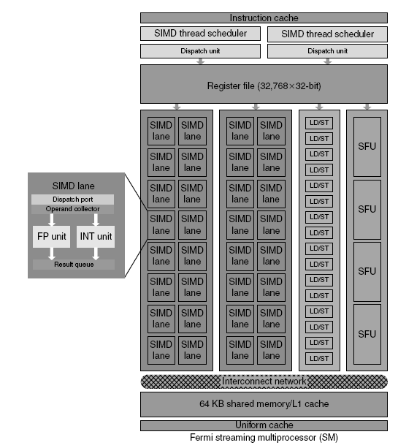
Fermi Multithreaded SIMD Proc.
Graphical Processing Units

Slide 38
Loop-Level Parallelism
Focuses on determining whether data accesses in later iterations are dependent on data values produced in earlier iterations
  Loop-carried dependence
Example 1:
for (i=999; i>=0; i=i-1)
x[i] = x[i] + s;
No loop-carried dependence
Detecting and Enhancing Loop-Level Parallelism

Slide 39
Loop-Level Parallelism
Example 2:
for (i=0; i<100; i=i+1) {
A[i+1] = A[i] + C[i]; /* S1 */
B[i+1] = B[i] + A[i+1]; /* S2 */
}
S1 and S2 use values computed by S1 in previous iteration
S2 uses value computed by S1 in same iteration
Detecting and Enhancing Loop-Level Parallelism

Slide 40
Loop-Level Parallelism
Example 3:
for (i=0; i<100; i=i+1) {
A[i] = A[i] + B[i]; /* S1 */
B[i+1] = C[i] + D[i]; /* S2 */
}
S1 uses value computed by S2 in previous iteration but dependence is not circular so loop is parallel
Transform to:
A[0] = A[0] + B[0];
for (i=0; i<99; i=i+1) {
B[i+1] = C[i] + D[i];
A[i+1] = A[i+1] + B[i+1];
}
B[100] = C[99] + D[99];
Detecting and Enhancing Loop-Level Parallelism

Slide 41
Loop-Level Parallelism
Example 4:
for (i=0;i<100;i=i+1) {
A[i] = B[i] + C[i];
D[i] = A[i] * E[i];
}
Example 5:
for (i=1;i<100;i=i+1) {
Y[i] = Y[i-1] + Y[i];
}
Detecting and Enhancing Loop-Level Parallelism

Slide 42
Finding dependencies
Assume indices are affine:
  a x i + b (i is loop index)
Assume:
  Store to a x i + b, then
  Load from c x i + d
  i runs from m to n
  Dependence exists if:
    Given j, k such that m ≤ j ≤ n, m ≤ k ≤ n
    Store to a x j + b, load from a x k + d, and a x j + b = c x k + d
Detecting and Enhancing Loop-Level Parallelism

Slide 43
Finding dependencies
Generally cannot determine at compile time
Test for absence of a dependence:
  GCD test:
    If a dependency exists, GCD(c,a) must evenly divide (d-b)
Example:
  for (i=0; i<100; i=i+1) {
  X[2*i+3] = X[2*i] * 5.0;
  }
Detecting and Enhancing Loop-Level Parallelism

Slide 44
Finding dependencies
Example 2:
  for (i=0; i<100; i=i+1) {
  Y[i] = X[i] / c; /* S1 */
  X[i] = X[i] + c; /* S2 */
  Z[i] = Y[i] + c; /* S3 */
  Y[i] = c - Y[i]; /* S4 */
  }
Watch for antidependencies and output dependencies
Detecting and Enhancing Loop-Level Parallelism

Slide 45
Finding dependencies
Example 2:
  for (i=0; i<100; i=i+1) {
  Y[i] = X[i] / c; /* S1 */
  X[i] = X[i] + c; /* S2 */
  Z[i] = Y[i] + c; /* S3 */
  Y[i] = c - Y[i]; /* S4 */
  }
Watch for antidependencies and output dependencies
Detecting and Enhancing Loop-Level Parallelism

Slide 46
Reductions
Reduction Operation:
for (i=9999; i>=0; i=i-1)
sum = sum + x[i] * y[i];
Transform to…
for (i=9999; i>=0; i=i-1)
sum [i] = x[i] * y[i];
for (i=9999; i>=0; i=i-1)
finalsum = finalsum + sum[i];
Do on p processors:
for (i=999; i>=0; i=i-1)
finalsum[p] = finalsum[p] + sum[i+1000*p];
Note: assumes associativity!
Detecting and Enhancing Loop-Level Parallelism

