Slide 1
Computer Architecture
A Quantitative Approach, Fifth Edition
Chapter 3
Instruction-Level Parallelism and Its Exploitation

Slide 2
Introduction
Introduction
Pipelining become universal technique in 1985
  Overlaps execution of instructions
  Exploits “Instruction Level Parallelism”
Beyond this, there are two main approaches:
  Hardware-based dynamic approaches
    Used in server and desktop processors
    Not used as extensively in mobile processors
  Compiler-based static approaches
    Not as successful outside of scientific applications

Slide 3
Instruction-Level Parallelism
Introduction
When exploiting instruction-level parallelism, goal is to maximize CPI
  Pipeline CPI =
    Ideal pipeline CPI +
    Structural stalls +
    Data hazard stalls +
    Control stalls
Parallelism with basic block is limited
  Typical size of basic block = 3-6 instructions
  Must optimize across branches

Slide 4
Data Dependence
Introduction
Loop-Level Parallelism
  Unroll loop statically or dynamically
  Use SIMD (vector processors and GPUs)
Challenges:
  Data dependency
    Instruction j is data dependent on instruction i if
      Instruction i produces a result that may be used by instruction j
      Instruction j is data dependent on instruction k and instruction k is data dependent on instruction i
Dependent instructions cannot be executed simultaneously

Slide 5
Data Dependence
Introduction
Dependencies are a property of programs
Pipeline organization determines if dependence is detected and if it causes a stall
Data dependence conveys:
  Possibility of a hazard
  Order in which results must be calculated
  Upper bound on exploitable instruction level parallelism
Dependencies that flow through memory locations are difficult to detect

Slide 6
Name Dependence
Introduction
Two instructions use the same name but no flow of information
  Not a true data dependence, but is a problem when reordering instructions
  Antidependence: instruction j writes a register or memory location that instruction i reads
    Initial ordering (i before j) must be preserved
  Output dependence: instruction i and instruction j write the same register or memory location
    Ordering must be preserved
To resolve, use renaming techniques

Slide 7
Other Factors
Introduction
Data Hazards
  Read after write (RAW)
  Write after write (WAW)
  Write after read (WAR)
Control Dependence
  Ordering of instruction i with respect to a branch instruction
    Instruction control dependent on a branch cannot be moved before the branch so that its execution is no longer controlled by the branch
    An instruction not control dependent on a branch cannot be moved after the branch so that its execution is controlled by the branch

Slide 8
Examples
Introduction
Example 1:
DADDU R1,R2,R3
BEQZ R4,L
DSUBU R1,R1,R6
L: …
OR R7,R1,R8
Example 2:
DADDU R1,R2,R3
BEQZ R12,skip
DSUBU R4,R5,R6
DADDU R5,R4,R9
skip:
OR R7,R8,R9
OR instruction dependent on DADDU and DSUBU
Assume R4 isn’t used after skip
  Possible to move DSUBU before the branch

Slide 9
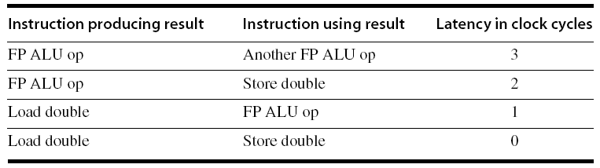
Compiler Techniques for Exposing ILP
Compiler Techniques
Pipeline scheduling
  Separate dependent instruction from the source instruction by the pipeline latency of the source instruction
Example:
  for (i=999; i>=0; i=i-1)
  x[i] = x[i] + s;

Slide 10
Pipeline Stalls
Compiler Techniques
Loop: L.D F0,0(R1)
stall
ADD.D F4,F0,F2
stall
stall
S.D F4,0(R1)
DADDUI R1,R1,#-8
stall (assume integer load latency is 1)
BNE R1,R2,Loop

Slide 11
Pipeline Scheduling
Compiler Techniques
Scheduled code:
Loop: L.D F0,0(R1)
DADDUI R1,R1,#-8
ADD.D F4,F0,F2
stall
stall
S.D F4,8(R1)
BNE R1,R2,Loop

Slide 12
Loop Unrolling
Compiler Techniques
Loop unrolling
  Unroll by a factor of 4 (assume # elements is divisible by 4)
  Eliminate unnecessary instructions
Loop: L.D F0,0(R1)
ADD.D F4,F0,F2
S.D F4,0(R1) ;drop DADDUI & BNE
L.D F6,-8(R1)
ADD.D F8,F6,F2
S.D F8,-8(R1) ;drop DADDUI & BNE
L.D F10,-16(R1)
ADD.D F12,F10,F2
S.D F12,-16(R1) ;drop DADDUI & BNE
L.D F14,-24(R1)
ADD.D F16,F14,F2
S.D F16,-24(R1)
DADDUI R1,R1,#-32
BNE R1,R2,Loop
note: number of live registers vs. original loop

Slide 13
Loop Unrolling/Pipeline Scheduling
Compiler Techniques
Pipeline schedule the unrolled loop:
Loop: L.D F0,0(R1)
L.D F6,-8(R1)
L.D F10,-16(R1)
L.D F14,-24(R1)
ADD.D F4,F0,F2
ADD.D F8,F6,F2
ADD.D F12,F10,F2
ADD.D F16,F14,F2
S.D F4,0(R1)
S.D F8,-8(R1)
DADDUI R1,R1,#-32
S.D F12,16(R1)
S.D F16,8(R1)
BNE R1,R2,Loop

Slide 14
Strip Mining
Compiler Techniques
Unknown number of loop iterations?
  Number of iterations = n
  Goal: make k copies of the loop body
  Generate pair of loops:
    First executes n mod k times
    Second executes n / k times
    “Strip mining”

Slide 15
Branch Prediction
Branch Prediction
Basic 2-bit predictor:
  For each branch:
    Predict taken or not taken
    If the prediction is wrong two consecutive times, change prediction
Correlating predictor:
  Multiple 2-bit predictors for each branch
  One for each possible combination of outcomes of preceding n branches
Local predictor:
  Multiple 2-bit predictors for each branch
  One for each possible combination of outcomes for the last n occurrences of this branch
Tournament predictor:
  Combine correlating predictor with local predictor

Slide 16
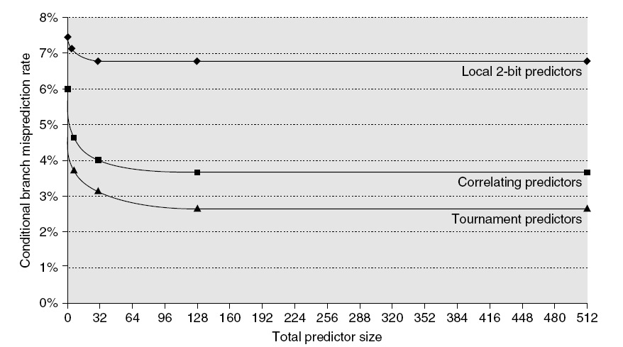
Branch Prediction Performance
Branch Prediction
Branch predictor performance

Slide 17
Dynamic Scheduling
Branch Prediction
Rearrange order of instructions to reduce stalls while maintaining data flow
Advantages:
  Compiler doesn’t need to have knowledge of microarchitecture
  Handles cases where dependencies are unknown at compile time
Disadvantage:
  Substantial increase in hardware complexity
  Complicates exceptions

Slide 18
Dynamic Scheduling
Branch Prediction
Dynamic scheduling implies:
  Out-of-order execution
  Out-of-order completion
Creates the possibility for WAR and WAW hazards
Tomasulo’s Approach
  Tracks when operands are available
  Introduces register renaming in hardware
    Minimizes WAW and WAR hazards

Slide 19
Register Renaming
Branch Prediction
Example:
DIV.D F0,F2,F4
ADD.D F6,F0,F8
S.D F6,0(R1)
SUB.D F8,F10,F14
MUL.D F6,F10,F8
+ name dependence with F6
antidependence
antidependence

Slide 20
Register Renaming
Branch Prediction
Example:
DIV.D F0,F2,F4
ADD.D S,F0,F8
S.D S,0(R1)
SUB.D T,F10,F14
MUL.D F6,F10,T
Now only RAW hazards remain, which can be strictly ordered

Slide 21
Register Renaming
Branch Prediction
Register renaming is provided by reservation stations (RS)
  A reservation station contains:
    The instruction
    Buffered operand values (when available)
    Reservation station number of instruction providing the operand values
  RS fetches and buffers an operand as soon as it becomes available (not necessarily involving register file)
  Pending instructions designate the RS to which they will send their output
    Result values broadcast on a result bus, called the common data bus (CDB)
  Only the last output updates the register file
  As instructions are issued, the register specifiers are renamed with the reservation station
  May be more reservation stations than registers

Slide 22
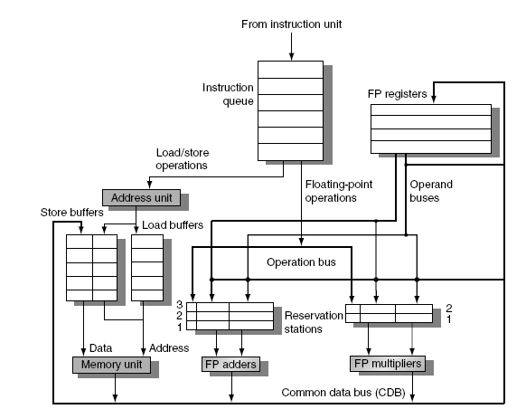
Tomasulo’s Algorithm
Branch Prediction
Load and store buffers
  Contain data and addresses, act like reservation stations
Top-level design:

Slide 23
Tomasulo’s Algorithm
Branch Prediction
Three Steps:
  Issue
    Get next instruction from FIFO queue
    If available RS, issue the instruction to the RS with operand values if available
    If operand values not available, stall the instruction
  Execute
    When operand becomes available, store it in any reservation stations waiting for it
    When all operands are ready, execute the instruction
    Loads and store maintained in program order through effective address
    No instruction allowed to initiate execution until all branches that proceed it in program order have completed
  Write result
    Write result on CDB into reservation stations and store buffers
      (Stores must wait until address and value are received)

Slide 24
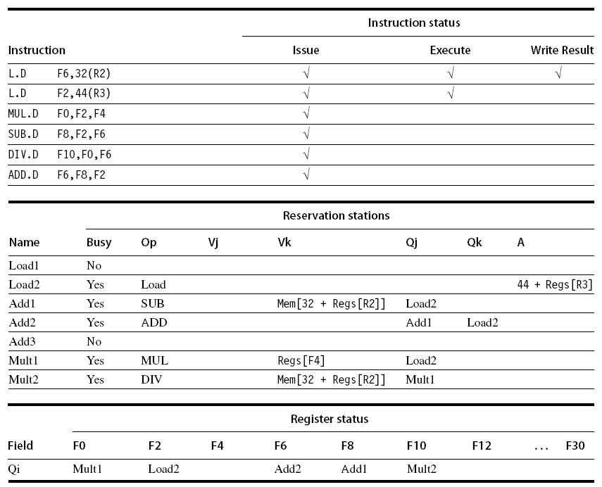
Example
Branch Prediction

Slide 25
Hardware-Based Speculation
Branch Prediction
Execute instructions along predicted execution paths but only commit the results if prediction was correct
Instruction commit: allowing an instruction to update the register file when instruction is no longer speculative
Need an additional piece of hardware to prevent any irrevocable action until an instruction commits
  I.e. updating state or taking an execution

Slide 26
Reorder Buffer
Branch Prediction
Reorder buffer – holds the result of instruction between completion and commit
Four fields:
  Instruction type: branch/store/register
  Destination field: register number
  Value field: output value
  Ready field: completed execution?
Modify reservation stations:
  Operand source is now reorder buffer instead of functional unit

Slide 27
Reorder Buffer
Branch Prediction
Register values and memory values are not written until an instruction commits
On misprediction:
  Speculated entries in ROB are cleared
Exceptions:
  Not recognized until it is ready to commit

Slide 28
Multiple issue and static scheduling

Slide 29
Multiple Issue and Static Scheduling
To achieve CPI < 1, need to complete multiple instructions per clock
Solutions:
  Statically scheduled superscalar processors
  VLIW (very long instruction word) processors
  dynamically scheduled superscalar processors
Multiple Issue and Static Scheduling

Slide 30
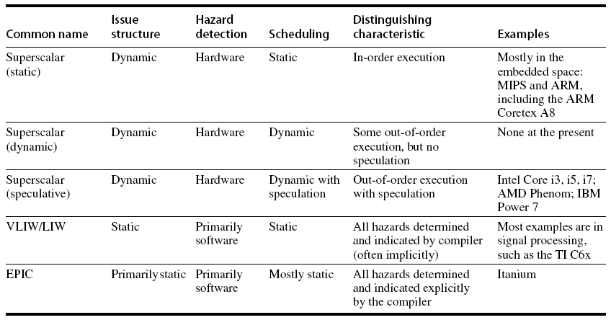
Multiple Issue
Multiple Issue and Static Scheduling

Slide 31
VLIW Processors
Package multiple operations into one instruction
Example VLIW processor:
  One integer instruction (or branch)
  Two independent floating-point operations
  Two independent memory references
Must be enough parallelism in code to fill the available slots
Multiple Issue and Static Scheduling

Slide 32
VLIW Processors
Disadvantages:
  Statically finding parallelism
  Code size
  No hazard detection hardware
  Binary code compatibility
Multiple Issue and Static Scheduling

Slide 33
Dynamic Scheduling, Multiple Issue, and Speculation
Modern microarchitectures:
  Dynamic scheduling + multiple issue + speculation
Two approaches:
  Assign reservation stations and update pipeline control table in half clock cycles
    Only supports 2 instructions/clock
  Design logic to handle any possible dependencies between the instructions
  Hybrid approaches
Issue logic can become bottleneck
Dynamic Scheduling, Multiple Issue, and Speculation

Slide 34
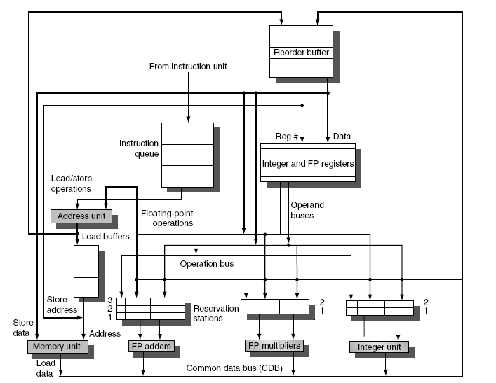
Overview of Design
Dynamic Scheduling, Multiple Issue, and Speculation

Slide 35
Multiple Issue
Limit the number of instructions of a given class that can be issued in a “bundle”
  I.e. on FP, one integer, one load, one store
Examine all the dependencies amoung the instructions in the bundle
If dependencies exist in bundle, encode them in reservation stations
Also need multiple completion/commit
Dynamic Scheduling, Multiple Issue, and Speculation

Slide 36
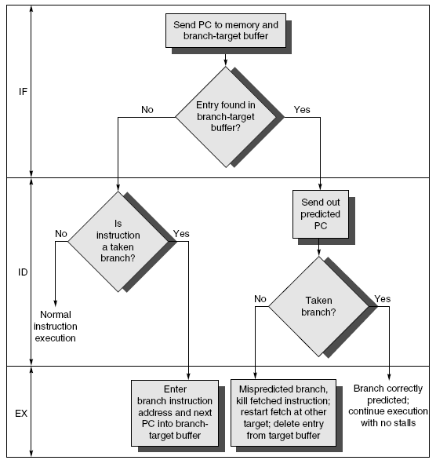
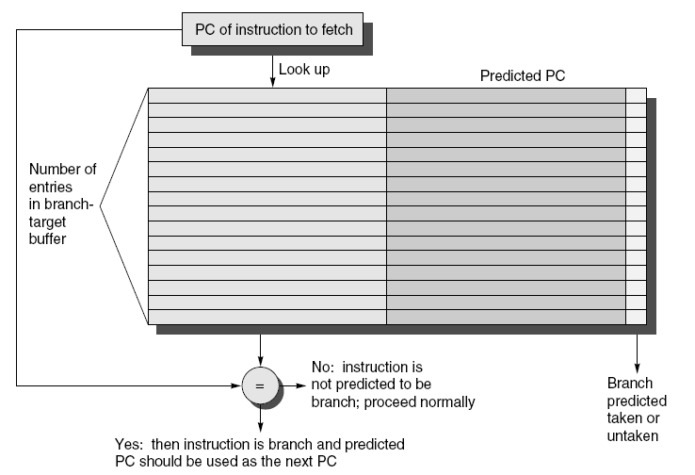
Branch-Target Buffer
Need high instruction bandwidth!
  Branch-Target buffers
    Next PC prediction buffer, indexed by current PC
Adv. Techniques for Instruction Delivery and Speculation

Slide 37
Branch Folding
Optimization:
  Larger branch-target buffer
  Add target instruction into buffer to deal with longer decoding time required by larger buffer
  “Branch folding”
Adv. Techniques for Instruction Delivery and Speculation

Slide 38
Return Address Predictor
Most unconditional branches come from function returns
The same procedure can be called from multiple sites
  Causes the buffer to potentially forget about the return address from previous calls
Create return address buffer organized as a stack
Adv. Techniques for Instruction Delivery and Speculation

Slide 39
Integrated Instruction Fetch Unit
Design monolithic unit that performs:
  Branch prediction
  Instruction prefetch
    Fetch ahead
  Instruction memory access and buffering
    Deal with crossing cache lines
Adv. Techniques for Instruction Delivery and Speculation

Slide 40
Register Renaming
Register renaming vs. reorder buffers
  Instead of virtual registers from reservation stations and reorder buffer, create a single register pool
    Contains visible registers and virtual registers
  Use hardware-based map to rename registers during issue
  WAW and WAR hazards are avoided
  Speculation recovery occurs by copying during commit
  Still need a ROB-like queue to update table in order
  Simplifies commit:
    Record that mapping between architectural register and physical register is no longer speculative
    Free up physical register used to hold older value
    In other words: SWAP physical registers on commit
  Physical register de-allocation is more difficult
Adv. Techniques for Instruction Delivery and Speculation

Slide 41
Integrated Issue and Renaming
Combining instruction issue with register renaming:
  Issue logic pre-reserves enough physical registers for the bundle (fixed number?)
  Issue logic finds dependencies within bundle, maps registers as necessary
  Issue logic finds dependencies between current bundle and already in-flight bundles, maps registers as necessary
Adv. Techniques for Instruction Delivery and Speculation

Slide 42
How Much?
How much to speculate
  Mis-speculation degrades performance and power relative to no speculation
    May cause additional misses (cache, TLB)
  Prevent speculative code from causing higher costing misses (e.g. L2)
Speculating through multiple branches
  Complicates speculation recovery
  No processor can resolve multiple branches per cycle
Adv. Techniques for Instruction Delivery and Speculation

Slide 43
Energy Efficiency
Speculation and energy efficiency
  Note: speculation is only energy efficient when it significantly improves performance
Value prediction
  Uses:
    Loads that load from a constant pool
    Instruction that produces a value from a small set of values
  Not been incorporated into modern processors
  Similar idea--address aliasing prediction--is used on some processors
Adv. Techniques for Instruction Delivery and Speculation

